Slide 2
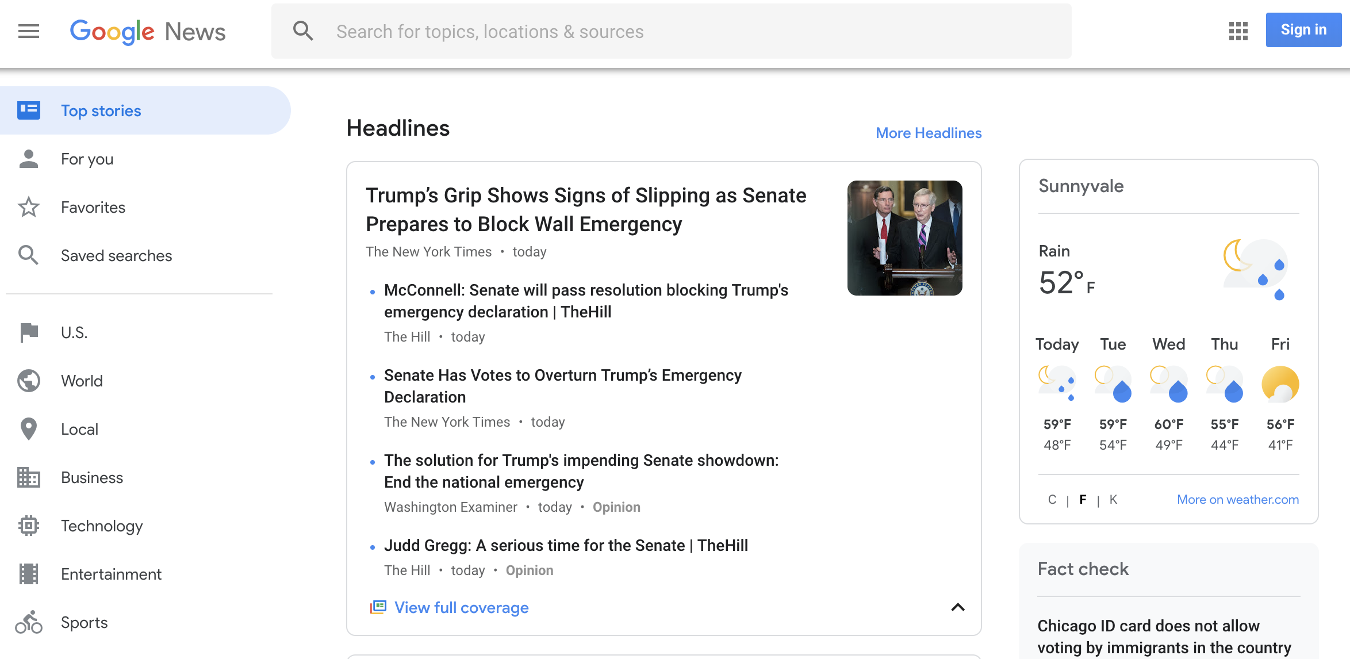


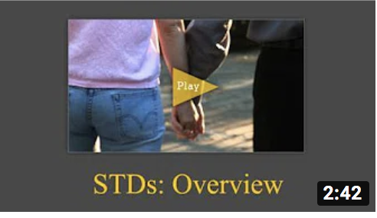
STDs Information
STDs information
What’s New
Google news feeds
CDC Videos
Disease Test
Book Appointment
More links
News feeds from CDC

Slide 3


Disease Test
STDs information
Answer a few questions to find out your disease
Questions
What’s your gender?
…
CDC Videos
Disease Test
Book Appointment
Next
Results
Bacterial Vaginosis (link to treatment page)
Book an appointment
More links
News feeds from CDC

Slide 4

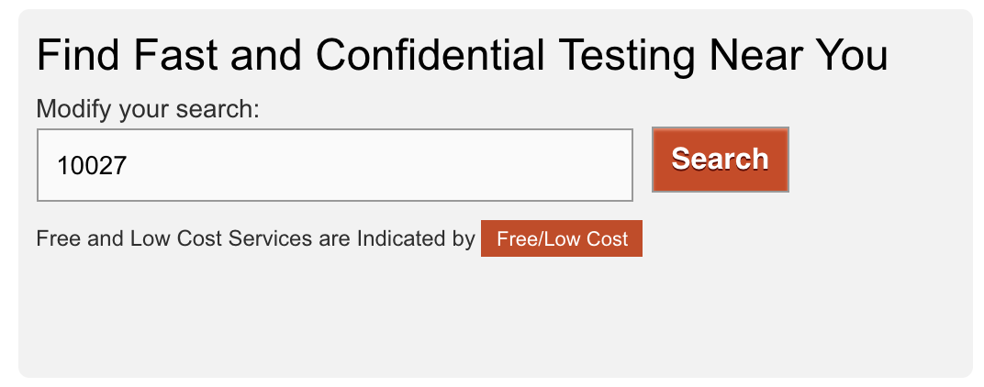
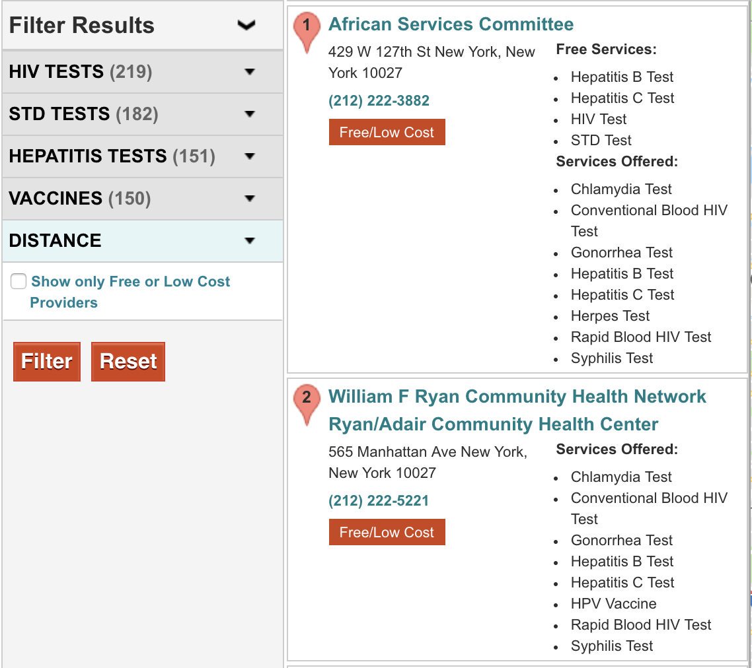

Book Appointment
STDs information
What’s New
Google news feeds
CDC Videos
Disease Test
Book Appointment
Change list to
Doctor info
Book Appointment
More links
Find test centers
Book Appointment

Slide 5
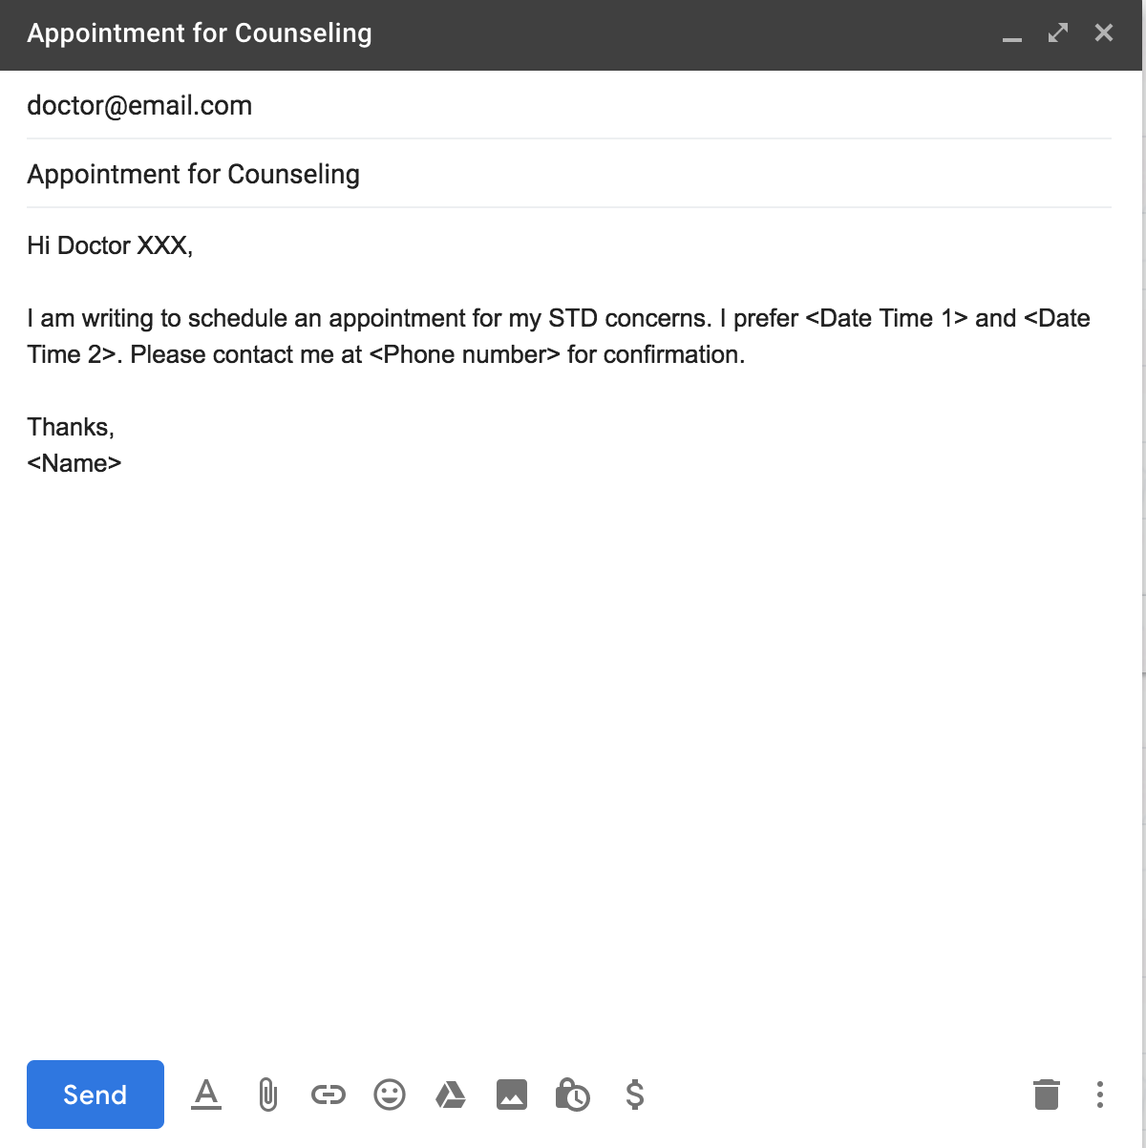
Book Appointment
STDs information
What’s New
Google news feeds
CDC Videos
Disease Test
Book Appointment
Change list to
Doctor info
Book Appointment
More links
Find test centers
Book Appointment

Slide 6
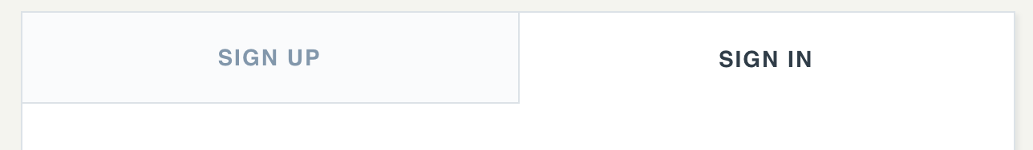
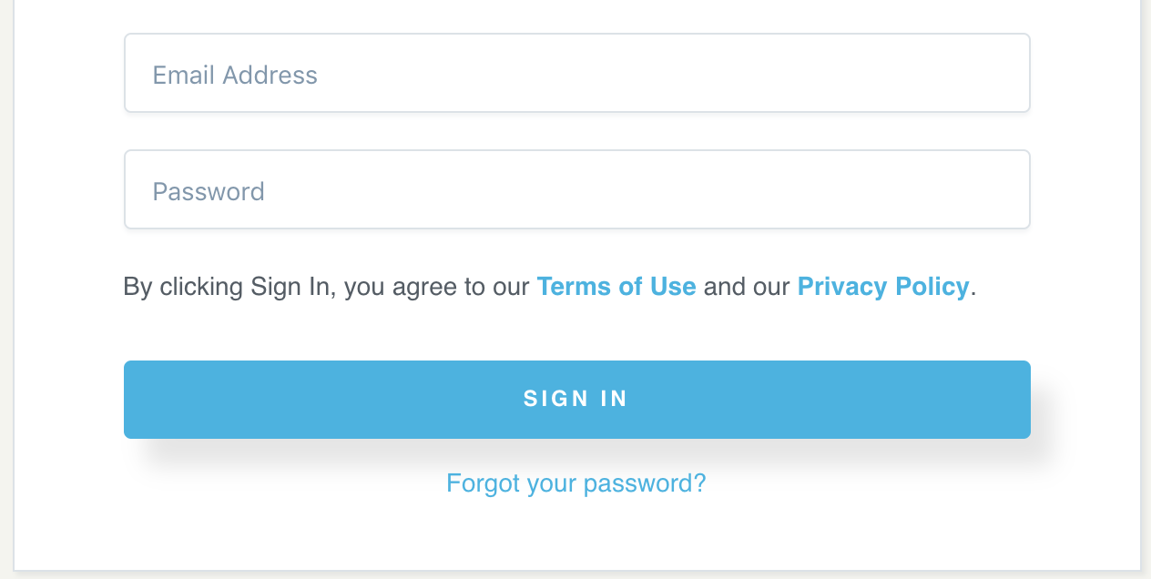
Homepage

Slide 7
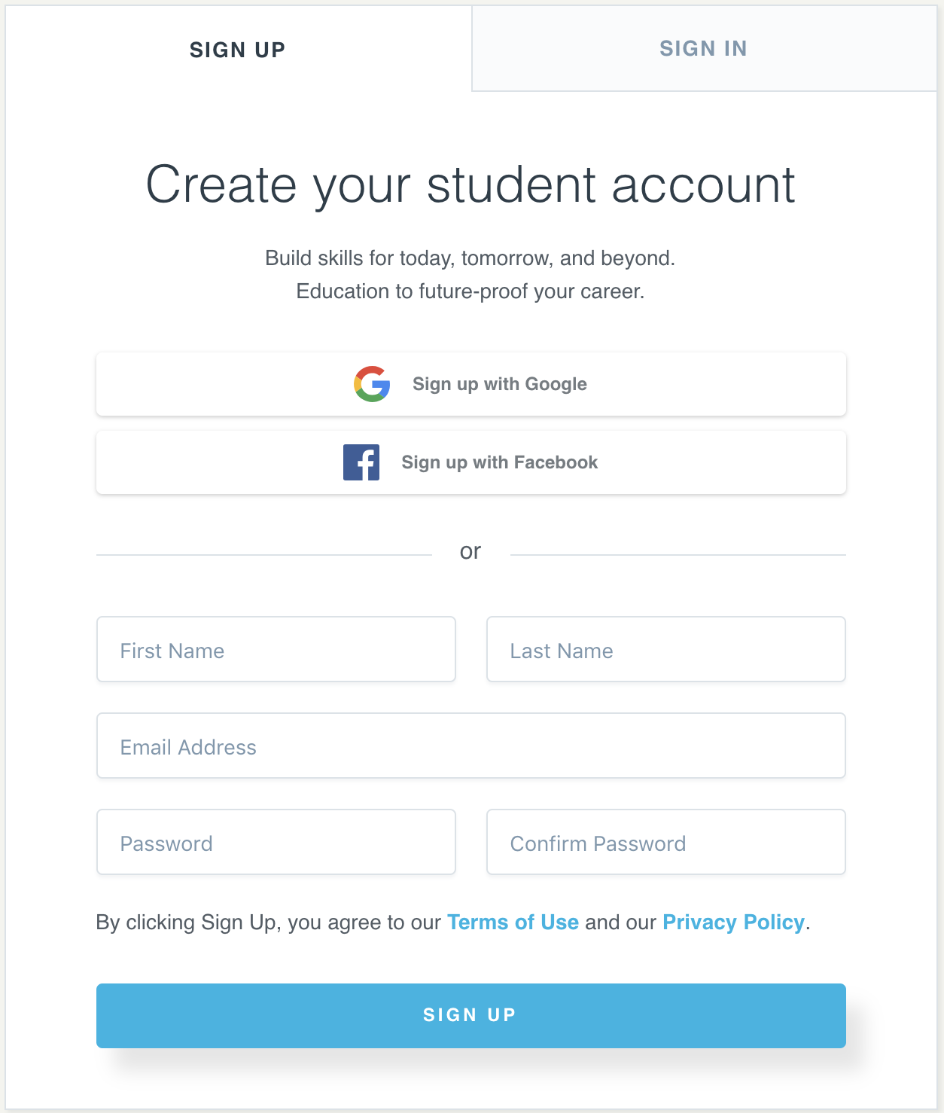
Homepage
First Name
Last Name
Email Address
Phone Number
Gender
Date of Birth
Zip Code
Password
Confirm Password

