Slide 1

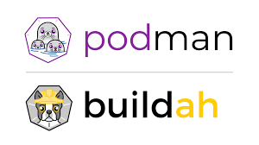
Introduction to Linux Containers on RHEL 8
Er. VIKAS NEHRA
(B. tech, M. Tech)

Slide 2
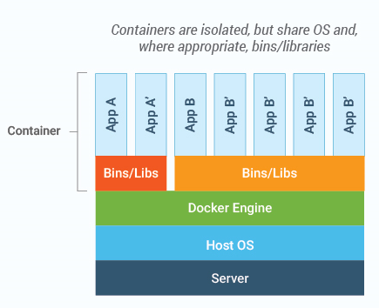
Managing Containers on RHEL 8:
Introduction to Linux Containers on RHEL 8:
Linux containers can be thought of as a lightweight alternative to virtualization. Containers work by using a concept referred to as kernel sharing which takes advantage of the architectural design of Linux and UNIX-based operating systems.
In order to understand how kernel sharing and containers work it helps to first understand the two main components of Linux or UNIX operating systems. At the core of the operating system is the kernel. The kernel, in simple terms, handles all the interactions between the operating system and the physical hardware. The second key component is the root file system which contains all the libraries, files and utilities necessary for the operating system to function. Taking advantage of this structure, containers each have their own root file system but share the kernel of the host operating system.

Slide 3
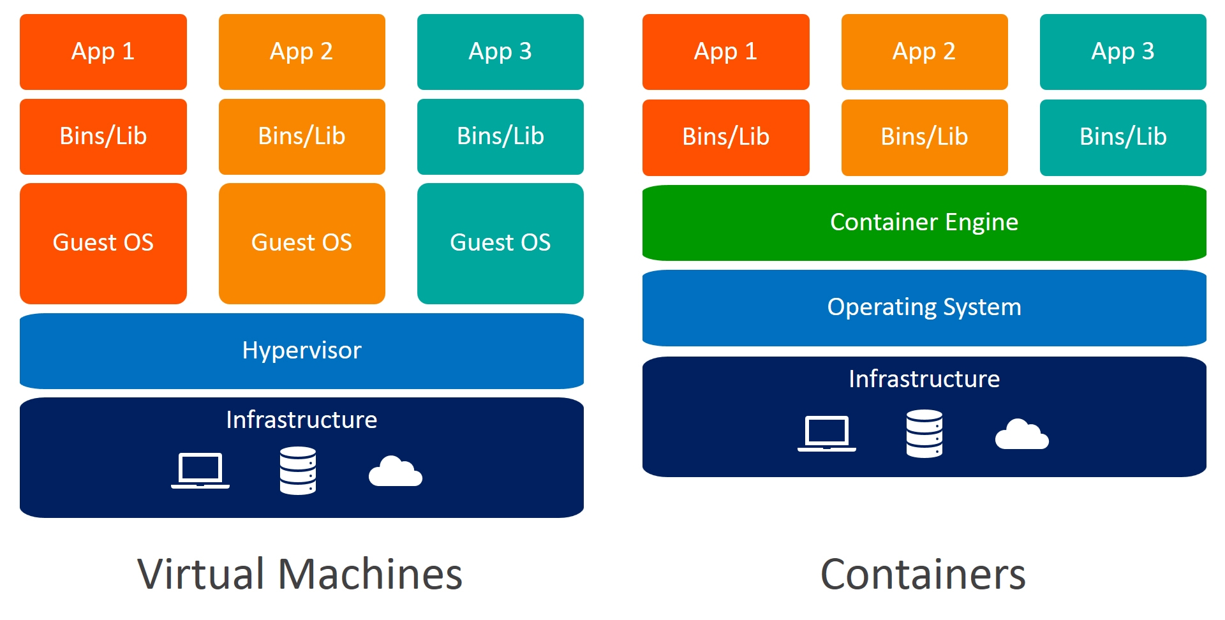
Managing Containers on RHEL 8:
Difference Between Container & Virtual Machine:
Virtual Machine:
It runs on top of an emulating software called the hypervisor which sits between the hardware and the virtual machine. The hypervisor is the key to enable virtualization. It manages the sharing of physical resources into virtual machines. Each virtual machine runs its own guest operating system. They are less agile and have low portability than containers.

Slide 4
Managing Containers on RHEL 8:
Difference Between Container & Virtual Machine:
Container:
It sits on the top of a physical server and its host operating system. They share a common operating system that requires care and feeding for bug fixes and patches. They are more agile and have high portability than virtual machines.

Slide 5
Managing Containers on RHEL 8:
Difference Between Container & Virtual Machine:
S. No. | Virtual Machines (VMs) | Containers
1. | VM is piece of software that allows you to install other software inside of it so you basically control it virtually as opposed to installing the software directly on the computer. | While a container is a software that allows different functionalities of an application independently.
2. | Applications running on VM system can run different OS. | While applications running in a container environment share a single OS.
3. | VM virtualizes the computer system. | While containers virtualize the operating system only.
4. | VMs are generally very large in size. | While the size of containers are very light, generally in few Megabytes.
5. | VM takes minutes to run, due to large size. | While containers take a few seconds to run.
6. | VM uses a lot of system memory. | While containers require very less memory.
7. | VMs are much more secured as compared to containers. | While containers are less secured as compared to VMs.
8. | VMs are useful when we require all of OS resources to run various applications. | While containers are useful when we are required to maximize the running applications using minimal servers.
9. | Examples of VMs are: KVM, Xen, VMware. | While examples of containers are: Podman & Docker.

Slide 6
Managing Containers on RHEL 8:
RHEL 8 Container Tools:
RHEL 8 provides a number of tools for creating, inspecting and managing containers. The main tools are as follows:
buildah – A command-line tool for building container images.
podman – A command-line based container runtime and management tool. Performs tasks such as downloading container images from remote registries and inspecting, starting and stopping images.
skopeo – A command-line utility used to convert container images, copy images between registries and inspect images stored in registries without the need to download them.
runc – A lightweight container runtime for launching and running containers from the command-line.
OpenShift – An enterprise level container application management platform consisting of command-line and web-based tools.
All of the above tools are compliant with the Open Container Initiative (OCI), a set of specifications designed to ensure that containers conform to the same standards between competing tools and platforms.

Slide 7
Managing Containers on RHEL 8:
Container Catalogues, Repositories and Registries:
The Red Hat Container Catalog (RHCC) provides a set of pre-built images that have been tested by Red Hat and can be downloaded and used as the basis for your own container images. The RHCC can be accessed at the following URL and allows searches to be performed for specific images:
https://access.redhat.com/containers/
After a search has completed, the catalog will display a list of matching repositories. A repository in this context is a collection of associated images.
In addition to downloading (referred to as “pulling” in container terminology) container images from Red Hat and other third party hosts registries, you can also use registries to store your own images. This can be achieved either by hosting your own registry, or by making use of existing services such as those provided by Amazon AWS, Google Cloud and IBM Cloud to name a few of the many options.

Slide 8
Managing Containers on RHEL 8:
Container Networking:
By default, containers are connected to a network using a Container Networking Interface (CNI) bridged network stack. In the bridged configuration, all the containers running on a server belong to the same subnet (10.88.0.0/16 by default) and, as such, are able to communicate with each other.
The containers are also connected to the external network by bridging the host system’s network connection. Similarly, the host is able to access the containers via a virtual network interface (usually named cni0) which will have been created as part of the container tool installation.

Slide 9
Managing Containers on RHEL 8:
Install and Use Podman on CentOS 8 / RHEL 8:
RHEL 8 / CentOS 8 has dropped official support for Docker as container runtime. Instead, Red Hat has been working on libpod (Podman’s container management library) which provides a library for applications to use the Container Pod concept available in the world of Kubernetes. One of the tools provided as part of libpod project is podman – Used for managing Pods, Containers, and Container Images.
Podman can be defined as a tool designed for managing containers and pods without requiring a container daemon. All the containers and Pods are created as child processes of the Podman tool. The Podman’s CLI is based on the Docker CLI.
It is easy to install Podman on CentOS 8 or RHEL 8 Linux machine. Most container related tools on CentOS 8 are available on the module called container-tools.
# dnf install -y @container-tools
# podman version

