Slide 1
Exploring the chemical space boundaries of potential candidates in liquid chromatography using molecular descriptors
Alex Nikolopoulos
1st examiner: Saer Samanipour
2nd examiner: Bob Pirok
Daily Supervisor: Denice Van Herwerden

Slide 2
Present the issue and the necessity of the study
NTA-> possible candidates-> large number -> Cumbersome identification

Slide 3
Introduction to descriptors and retention indices

Slide 4
Training datasets used

Slide 5
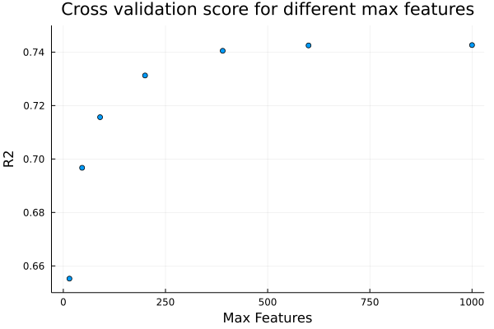
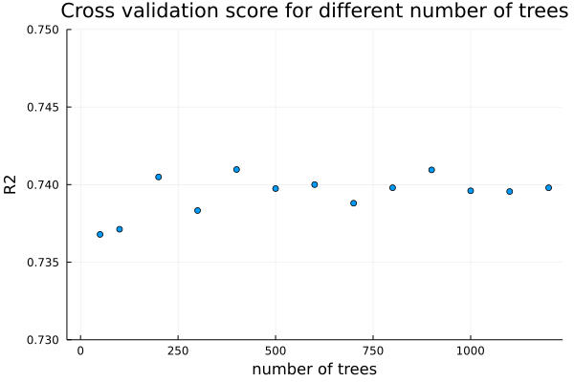
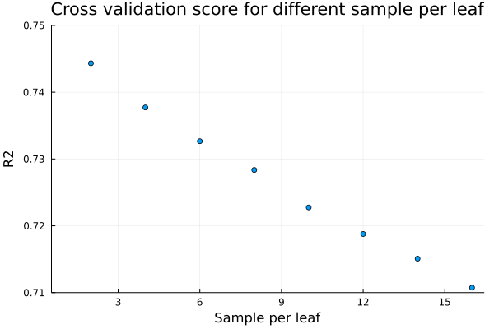
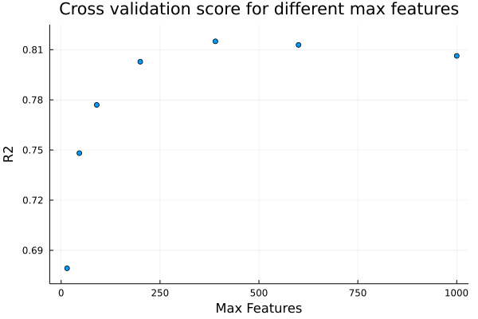
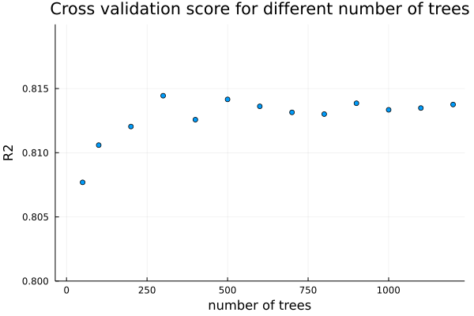
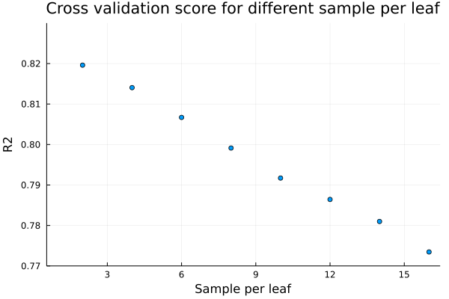
Hyperparameter optimization
n-alkylamide dataset
UoA dataset

Slide 6
Partial models
Most important descriptors based on average variance reduction

Slide 7
How does random forest regression work?
Decision trees are the core of a random forest regressor
Every decision tree “asks questions” to the set of variables of every compound
Multiple decision trees are randomly created using different set of variables
The result of the random forest is equal to the average result of all the decision trees
Var1 > a
YES
NO
Var2 > b
Var3 < c
YES
NO
YES
NO
751
819
215
Var2 < d
YES
NO
355
378

