Slide 1

School of Electronics Engineering (SENSE)
Project-I (2026)
Design of a Temperature-Compensated PLL Frequency Synthesiser
Student Name(s):
Aaryan Dogra (23BEC1032) · Yugeshwaran (23BEC1404) · Viju Sanjai (23BEC1306)
Guide's Signature with Date
Guide:
Dr. B. Bindu, School of Electronics Engineering (SENSE)
Signature: _____________________
Programme / School:
B.Tech — SENSE, VIT Chennai
Date: _________________________
Review & Date:
Final Review (Review-III) · 28.10.2026
1

Slide 2
Problem & Objectives
Problem
A ring-VCO drifts with temperature: threshold voltage, mobility and capacitance all shift, so the same control voltage gives a different frequency hot vs cold. Process corners change the size of the drift.
Objectives
Integer-N charge-pump PLL in sky130B, open-source and headless (ngspice 47): REF 28.275 MHz -> PFD -> charge pump -> loop filter -> 5-stage current-starved ring VCO -> /8.
Measure the uncompensated drift on every process corner, design a temperature-compensation, and validate it with Monte Carlo and hypothesis tests.
Close the loop and check lock time across corners and temperature.
226.2 MHz
target at V_ctrl = 0.9 V (tt, 27 C) = 8 x 28.275 MHz
+/-0.3 %
frequency-drift target over -40 to 85 C
< 2 us
lock-time target
Takeaway: we need a drift figure measured on the real topology and process, then a correction that is proven, not assumed.
2

Slide 3
Detailed Literature Review
No. | Author(s) & Year | Title / Source | Method / Approach | Findings & Research Gap
1 | G. Souliotis et al., 2022 | Temperature compensated ring oscillator based VCO, AEU Int. J. Electron. Commun. | PTAT current compensation of a ring VCO inside a PLL; 180nm, 480MHz, fabricated | Closest topology benchmark: -1.5%/+0.4% over -40->120C, measured. First-order only; different node
2 | C. Stancu et al., 2023 | Temp. and power-supply compensated CMOS clock circuit based on ring osc., Electronics | Temp + supply compensated 50MHz ring-oscillator clock; simulation only | 1.6% temperature error pre-layout. A clock circuit, never closed into a PLL
3 | Z. Geng et al., 2018 | Low power fast locking PLL freq. synthesizer with temp. compensation, EAME | Freq. presetting + dynamic loop BW + static/dynamic temp. comp.; 180nm, 2.1-2.6GHz | Lock <2us over 0-80C, -117dBc/Hz@1MHz, 9mW. Stability claim is the locked output, set by the crystal
4 | Y. You et al., 2014 | 12GHz 67% tuning, 0.37ps RJrms PLL, LC-VCO temp. comp., 0.13um CMOS, IEEE RFIC | LC-VCO PLL for serial links; comp. scheme preserves tuning range; 5.6-13.4GHz | Stays locked -40->85C. Needs inductor models our process supports poorly; not portable to a ring VCO
5 | S. Sinha, 2002 | Design of an integrated CMOS PLL frequency synthesizer, IEEE MELECON | Dual-loop CP-PLL, 0.35um, 2.4-2.5GHz, 1MHz steps | -82dBc/Hz@10kHz. Architectural reference for our loop; no temperature compensation
6 | E. M. V. Freitas et al., 2025 | Using open source EDA tools in ASICs for HEP: a mixed comparison, JINST | Open-source vs commercial flows on IHP 130nm blocks incl. a current-starved ring VCO | Digital QoR quantified (+53% area, +118% power); analog VCO comparison qualitative, open-loop, no MC
7 | M. Thiriloganathan et al., 2026 | 2.4GHz LC-VCO fractional-N PLL, open-source, 130nm BiCMOS, SMACD | Fully open-source flow (Xschem/ngspice/KLayout/OpenEMS), EM-modelled inductor | -100.8dBc/Hz@1MHz. Closes a loop open-source, but no temp. compensation, no PVT/Monte Carlo
8 | R. N. S. Raphael et al., 2019 | PLL-based frequency synthesizer for digital systems driving, BTSym'18 (Springer) | 3rd-order CP-PLL for clock generation, integer-N (N=8-16), VCO input-cap-aware LF model | Settling <2us. Same loop class as ours; no temperature compensation
3

Slide 4
Detailed Literature Review (contd.)
No. | Author(s) & Year | Title / Source | Method / Approach | Findings & Research Gap
9 | Y. Li, K. Du, J. Zhang, 2022 | Design of ring oscillator with temperature compensation effect, Int. J. RF Microw. CAE | Positive-TC supply voltage on a 31-stage ring, 0.18um; 33kHz sleep timer | 120 ppm/C (1.6%) over -40->80C. Single linear coefficient; kHz timer, not a PLL
10 | H. H. Hammam et al., 2022 | An ultra-low-power process-and-temperature compensated ring oscillator, IEEE ICEEE | 3-stage current-starved ring, 130nm, process + temperature compensation | Up to 90% less variation vs. plain current-starved ring, 346nW. Standalone oscillator
11 | S. Zhang et al., 2016 | Temperature compensation technique for ring oscillators with tail current, Electron. Lett. | Tail current = constant source + PTAT current, first-order | Foundational first-order technique; no numbers reported in abstract; not closed-loop
12 | M. Ortner, M. Punzenberger, 2017 | Oscillators using quadratic temperature compensation, US Pat. 9,748,962 B2 | Linear + quadratic temperature term for a VCO, -40->85C | Generic 2nd-order compensation is patented -- narrows our claim to ring-VCO + closed PLL + open PDK + stats
13 | D. Patrinos, G. Souliotis, 2025 | Low-voltage, low-power 2.5GHz ring oscillator with process & temp. comp., JLPEA | PTAT current + process-corner detection/tuning; 22nm, 0.8V; post-layout sim | Drift 23.9%->5.4% (tt) and 47.3%->7.2% (PVT). Corner-aware like our C(corner); not in a PLL
14 | M. Sivasakthi, P. Radhika, 2024 | PVT tolerant hybrid current starved ring VCO, bulk-driven keeper, 45nm, AEU | Two current-starved ring VCOs; Cadence GPDK45; corner + Monte Carlo | 6.97GHz, -121.5dBc/Hz@1MHz. PVT tolerance of the VCO itself, no compensation network or loop
15 | S. Madheswaran, R. Panneerselvam, 2024 | 7-stage MCML power-gated current starved VCO for PLL, IJECE | MOS current-mode logic delay cells with power gating, 45nm, simulation | 3.06GHz, -125.9dBc/Hz. Same device class as ours; no closed-loop temperature characterisation
Research gap (from all 15): no reported work combines a compensated ring VCO inside a closed loop, characterised across process corners with Monte Carlo rigor -- that gap is what this project fills.
4

Slide 5
Novelty, Patent and Research Gap
What is NOT novel
Generic quadratic (2nd-order) temperature compensation of an oscillator is patented: US 9,748,962 B2 (Ortner and Punzenberger, Infineon, 2017) [12]. We do not claim it.
Current-starved ring VCOs and the charge-pump PLL topology are textbook.
What this project adds
A closed-loop, per-corner, statistically validated study of a compensated ring-VCO PLL on an open PDK (sky130B), with the failures and corrections documented.
Research gap (from 15 IEEE-level references)
No reported work combines a compensated ring VCO inside a closed loop, characterised across process corners with Monte Carlo rigour.
15 refs
read; closest: Souliotis 2022 [1], Stancu 2023 [2], Geng 2018 [3]
1 patent
narrowed the claim to ring-VCO + closed PLL + open PDK + statistics
Open PDK
everything reproducible: ngspice + sky130B, no licensed tools yet
Takeaway: our contribution is the validated closed-loop study, not the idea of 2nd-order compensation.
5

Slide 6
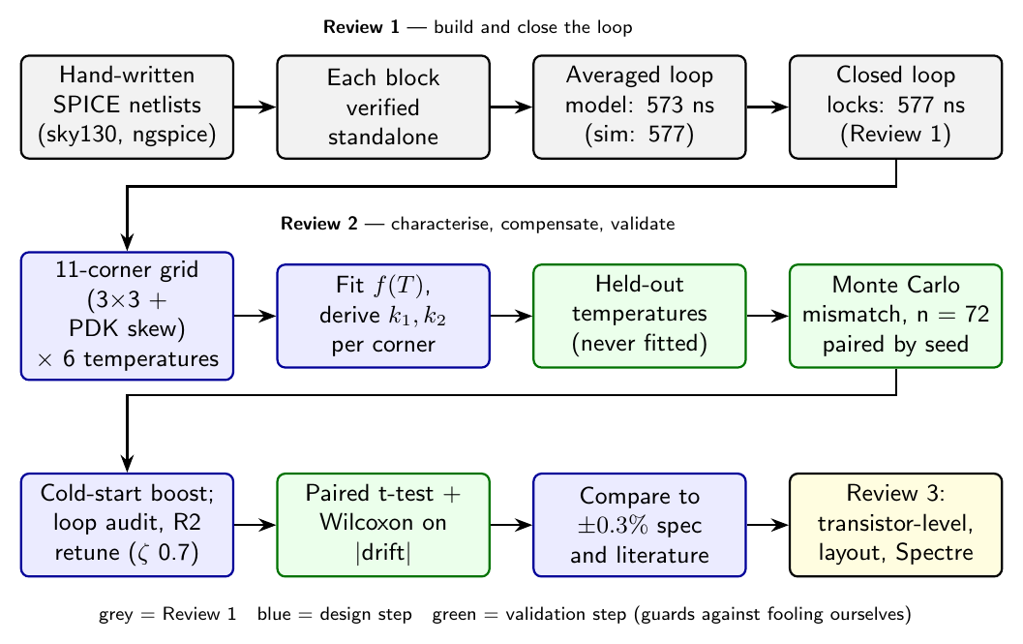
Methodology: Review 1 -> Review 2 -> Review 3
Takeaway: characterise, compensate, close the loop, then validate statistically.
6

Slide 7
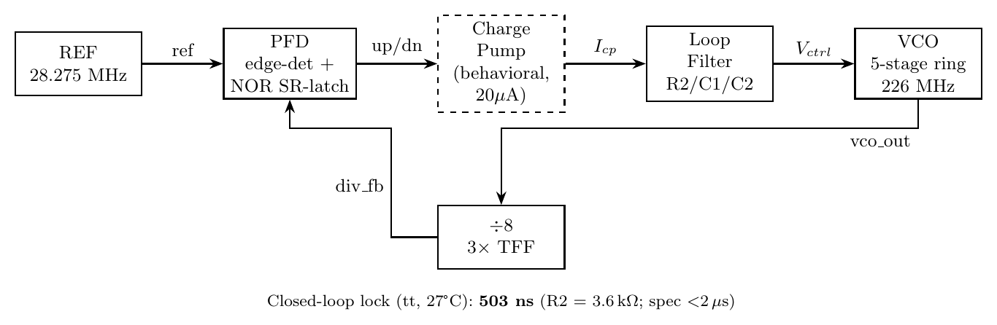
System Architecture
20 uA
charge pump (behavioural), 5x until first divider edge
3.6 kOhm
R2 (retuned from 1.7 k); C1 68 pF, C2 6.8 pF
5 stages
current-starved ring VCO, tunes 18 -> 358 MHz
/ 8
divider (3 T flip-flops)
Takeaway: a standard integer-N loop, so every difference we see comes from the VCO and its compensation.
7

Slide 8
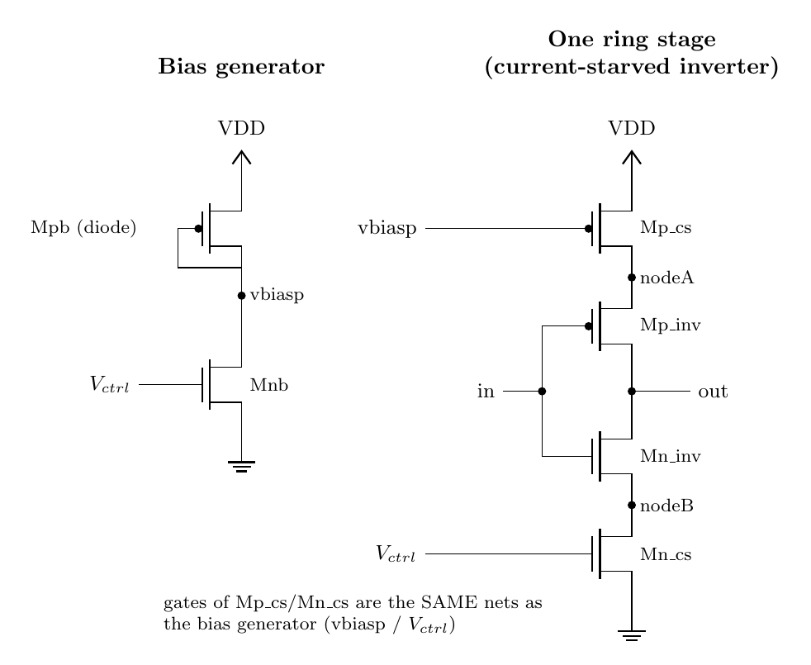
VCO: Schematic & Tuning Curve
~890 MHz/V
local K_VCO at 0.9 V (tt)
18 -> 358 MHz
over 0.65 -> 1.40 V (tt)
Takeaway: V_ctrl sets the starving current; 0.9 V gives the 226 MHz target. K_VCO is ~890 MHz/V (an earlier 669 was wrong).
8

Slide 9
Uncompensated Drift: PDK Corners
12.5x
tempco spread, sf 112 to fs 1399 ppm/C
8.51 %
tt frequency span, -40 to 85 C
112 - 1399
ppm/C across the 5 PDK corners
Takeaway: every corner is far outside +/-0.3 % without compensation, and the corners disagree by a factor of 12.
9

Slide 10
Why the Corner Numbers Looked Out of Range
In review, ff / tt / fs / sf values were not in the ranges they are meant to be. We audited it (ngspice 47, same PDK).
Verdict: the simulations were fine. Three things were wrong in how we expected and described the corners.
1. Labels
In this PDK sf = fast-NMOS / slow-PMOS and fs = slow-NMOS / fast-PMOS (measured). Earlier labels were reversed.
2. Expectation
'Skew corners lie between ss and ff' is false in sky130: its skew corners shift each device further than ss/ff do. At the VCO's low bias this is amplified to about 9 %.
3. Tempco is not bounded by ff and ss
Even in a clean textbook NMOS x PMOS set the tempco extremes sit at the skew corners.
Takeaway: nothing was broken; our expectation of the corner envelope was wrong.
10

Slide 11
Audit 1: PDK Skew Corners Are Wider Than ss / ff
Threshold shift vs tt (mV) | ss | ff | PDK sf | PDK fs
NMOS Vth | +25 | -25 | -36 | +36
PMOS |Vth| | +15 | -23 | +32 | -43
~9 %
skew corners fall outside the ss-ff envelope at 0.9 V
The extracted device thresholds of the skew corners move further than ss/ff.
At the VCO bias (0.9 V, overdrive only ~0.2 V) an extra ~11 mV of Vth is ~9 % of drive current.
At 1.8 V the same corners agree within 1 %.
< 1 %
outside the envelope at 1.8 V
11 corners
9 textbook + PDK sf + PDK fs
Takeaway: the PDK defines its skew corners more aggressively than ss/ff, so they can fall outside them.
11

Slide 12
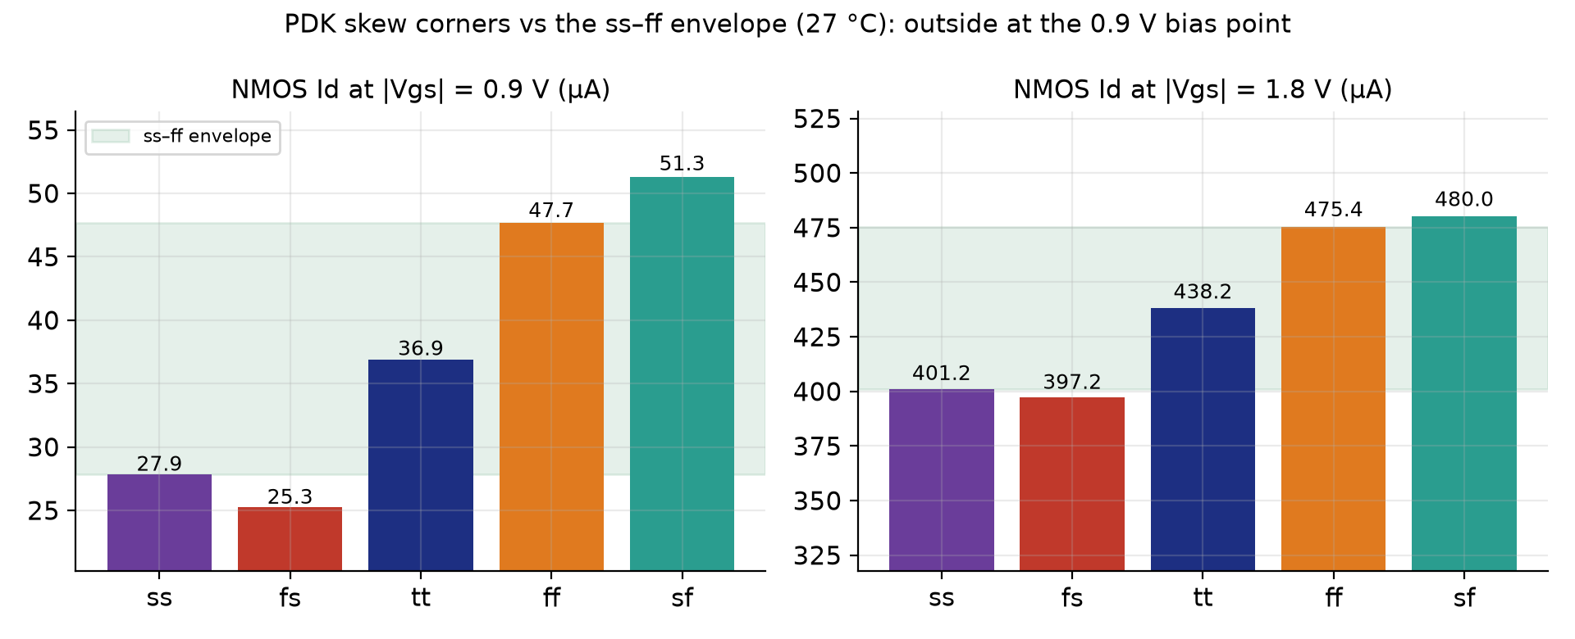
Audit 2: Device Current vs the ss-ff Envelope
25.3 - 51.3 uA
NMOS Id at 0.9 V: fs 25.3, ss 27.9, tt 36.9, ff 47.7, sf 51.3
397 - 480 uA
NMOS Id at 1.8 V: skews within 1 % of ss/ff
8 - 9 %
skews outside the ss-ff envelope at 0.9 V
Takeaway: at the low VCO bias, skew corners step outside ss/ff; at full gate drive they do not.
12

Slide 13
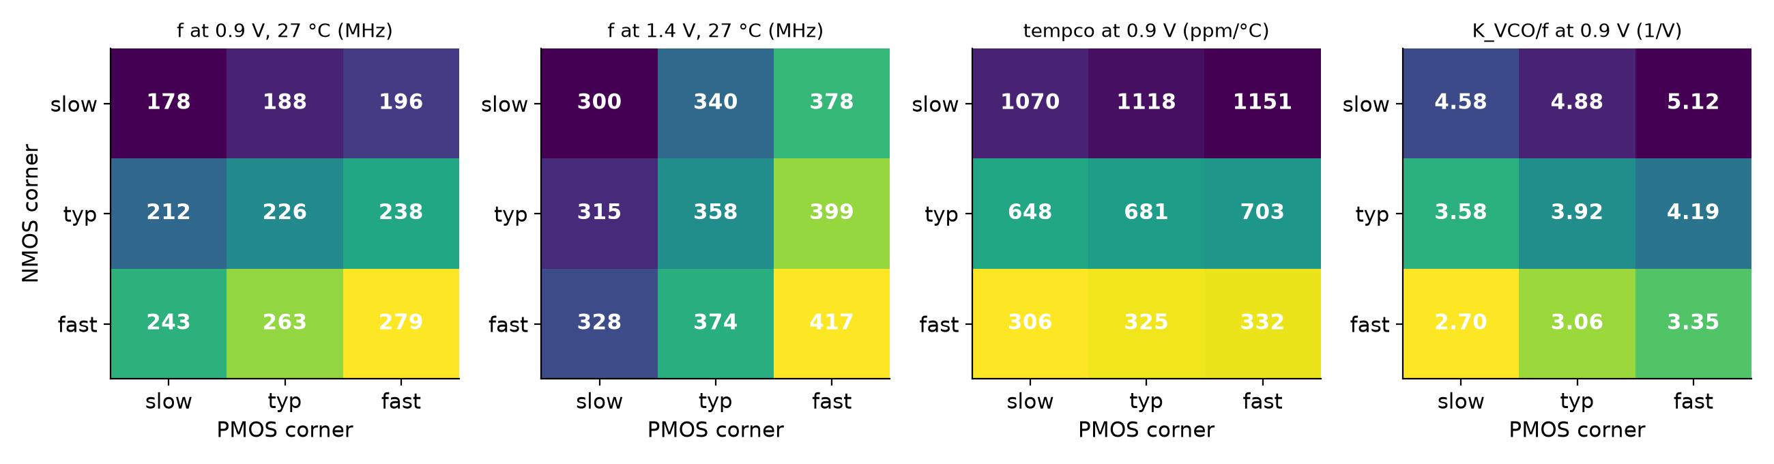
Audit 3: A Textbook 3 x 3 Corner Set
8 / 8
ordering checks pass (f rises with N and P strength at 0.9 and 1.4 V; tempco falls with N strength)
178.0 - 279.2 MHz
f at 0.9 V across the 9 textbook corners
306 - 1151
textbook tempco range ppm/C (3.8x) vs PDK 5-corner 112 - 1399 (12.5x)
Takeaway: with N and P varied independently the ordering is textbook-clean; only the PDK skews break the tempco range.
13

Slide 14
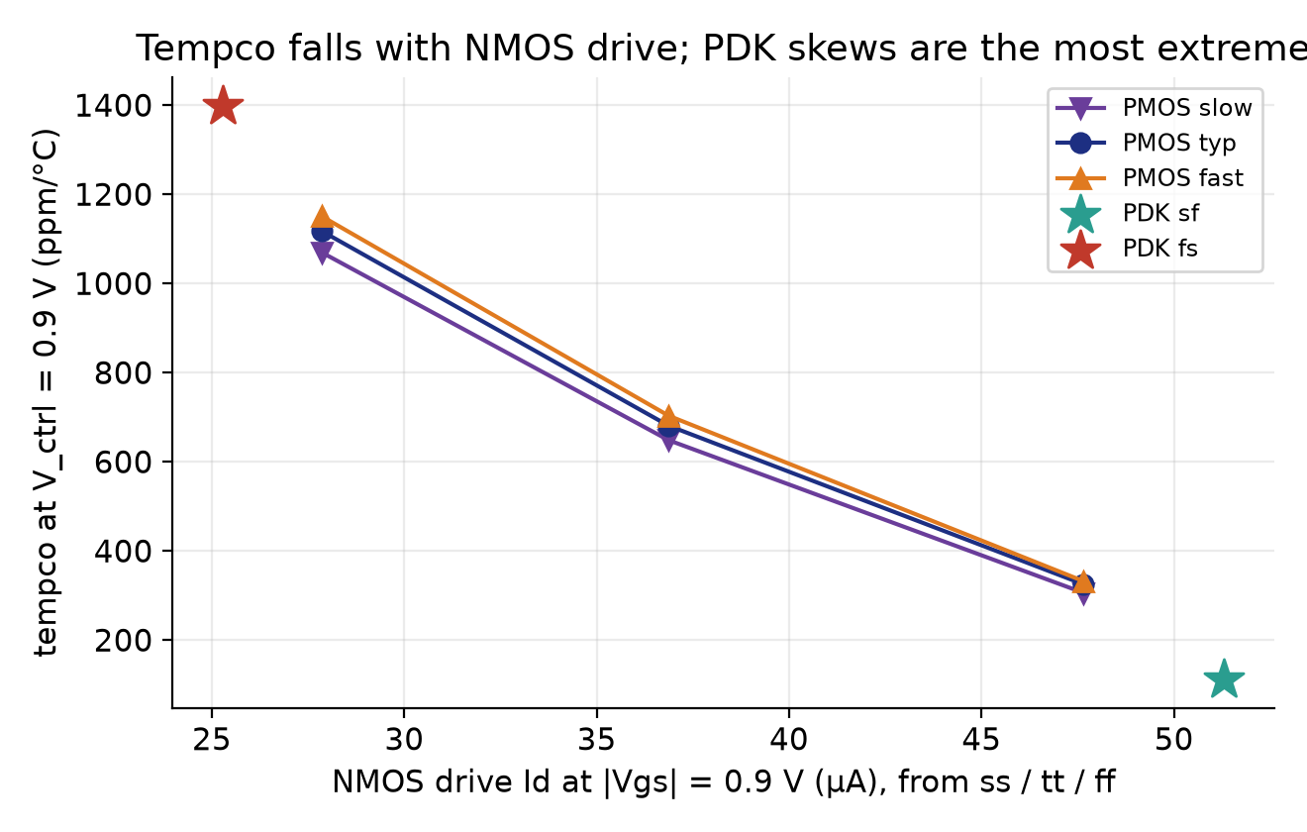
Audit 4: Tempco Follows NMOS Drive
-0.78 / -1.1
Vth tempco mV/C, NMOS / PMOS (textbook -0.5 to -3)
-30 % / +14 %
NMOS Id over 125 C at 1.8 V / 0.9 V
-816 ppm/C
tt tempco at V_ctrl = 1.4 V (sign flips from +681 at 0.9 V)
Takeaway: weaker NMOS drive means larger positive tempco; the bias sits below the zero-tempco point.
14

Slide 15
Tempco Mechanism and Physics Checks
Why the frequency rises with temperature at 0.9 V
Vth falls with temperature (about -0.8 mV/C NMOS). With only ~0.2 V overdrive, that gain wins over the mobility loss, so drive current rises.
Which device limits the ring depends on V_ctrl
At 0.9 V the NMOS dominates (36 % spread slow to fast N vs 10 % across P). At 1.4 V the PMOS dominates (26 % vs 9 %).
Other checks that pass
Supply current is proportional to f in every corner (C ~ 27-30 fF per node). Closed-loop lock voltage equals the open-loop value for 226.2 MHz within 0.2 mV at all 11 corners.
36 % vs 10 %
0.9 V: NMOS vs PMOS spread
26 % vs 9 %
1.4 V: PMOS vs NMOS spread
0.2 mV
lock V vs open-loop V, 11 corners
Takeaway: the tempco mechanism is overdrive, not N/P balance; every physics check agrees with theory.
15

Slide 16
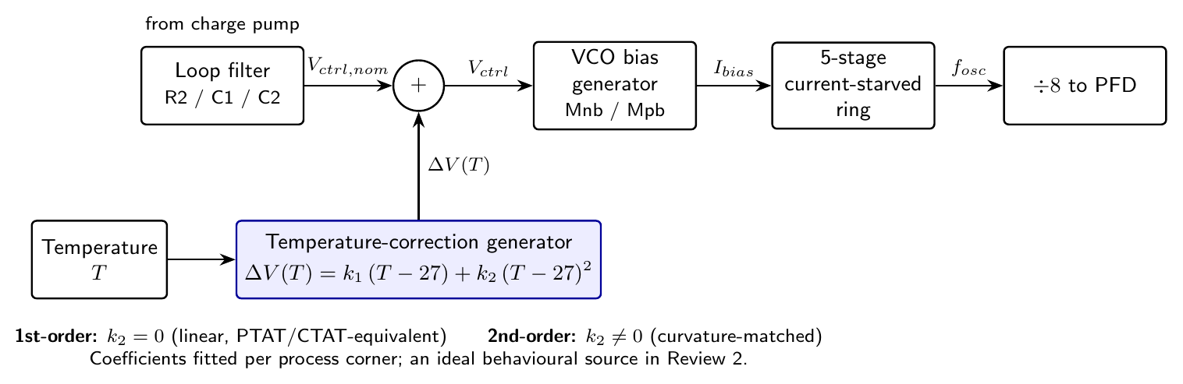
Compensation Architecture
dV(T)
correction added to V_ctrl before the VCO bias generator
1st order
k1 (T - 27): PTAT/CTAT equivalent
2nd order
adds k2 (T - 27)^2 for the curvature
Ideal
behavioural source; transistor-level network is future work
Takeaway: the correction is a voltage added to V_ctrl: v_eff = v + k1 (T-27) + k2 (T-27)^2.
16

Slide 17
Compensation Method: Fit, Then Verify
scripts/comp_factorial.py, applied per corner
1. Measure f(T, V) at V = 0.85 / 0.9 / 0.95 V for 6 temperatures.
2. Solve the exact voltage shift dV*(T) that restores f(27 C).
3. Least-squares fit k1 (1st order) and k1, k2 (2nd order).
4. Verify by simulating the compensated VCO at the 6 fit temperatures and at 4 held-out temperatures (-30, 10, 40, 70 C).
Why Review 2's numbers changed
Review 2 used a wrong K_VCO (669 instead of ~890 MHz/V) and an analytic first-order guess. The measured fit replaces it: tt span 1.12 % -> 0.20 %.
-1.543e-4
k1 at tt (V/C)
4.18e-7
k2 at tt (V/C^2)
4 held-out
temperatures never used in the fit
Takeaway: coefficients come from measured data and are checked at temperatures the fit never saw.
17

Slide 18
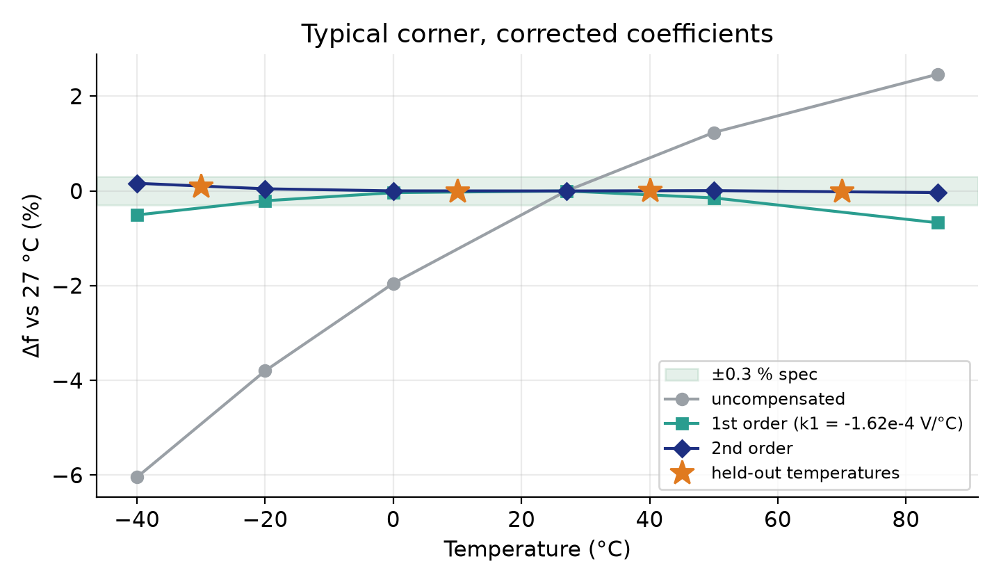
Compensation at the Typical (tt) Corner
8.51 -> 0.20 %
span: baseline -> 2nd order (1st order 0.67 %)
0.16 %
max deviation; +/-0.3 % spec MET
0.09 %
max deviation at held-out temperatures
Takeaway: at tt the compensated VCO stays within +/-0.16 % over -40 to 85 C.
18

Slide 19
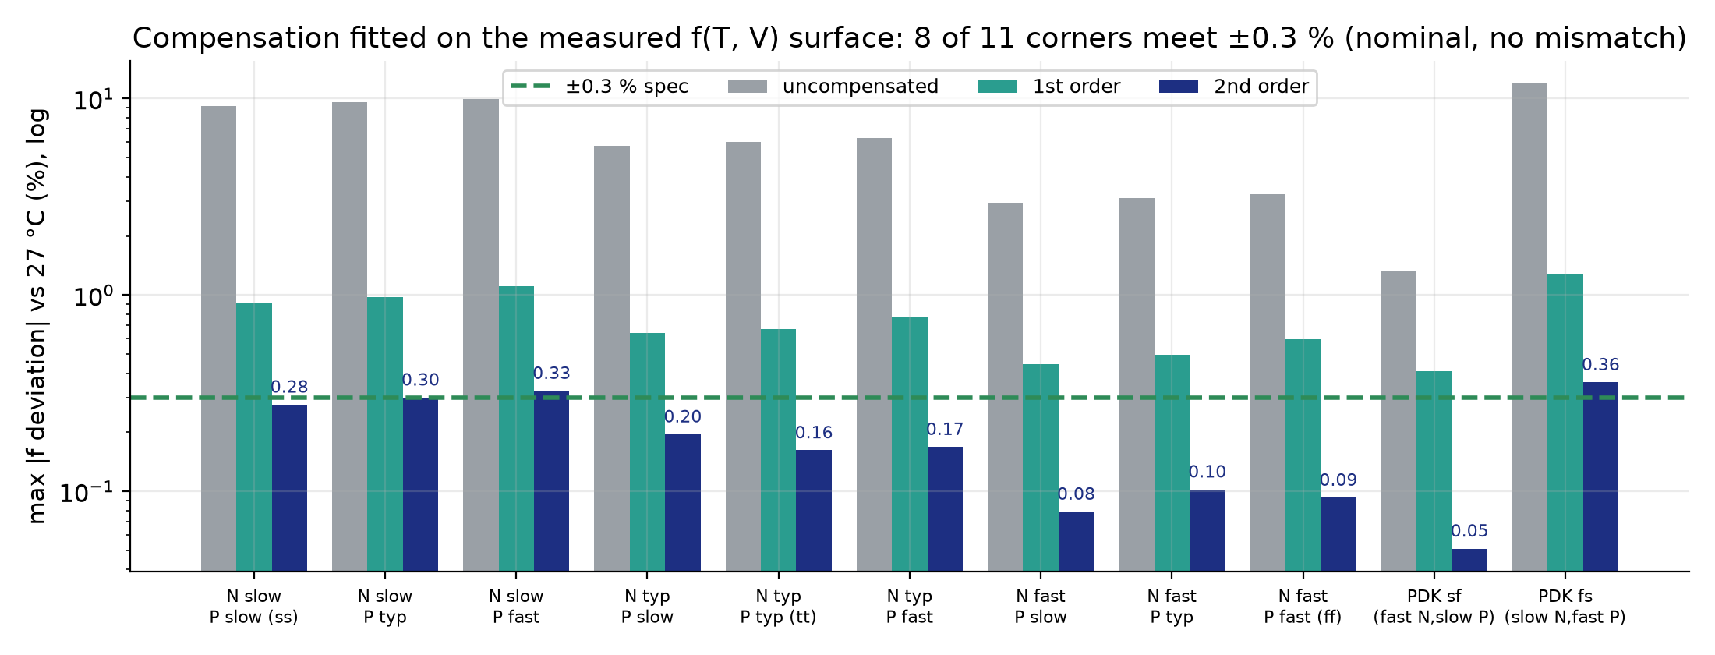
Compensation on 11 Corners
8 / 11
corners meet +/-0.3 % (7 of 9 textbook)
31 - 44x
compensation ratio (PDK sf 15.9x)
0.03 - 0.25 %
held-out max deviation
Takeaway: 8 of 11 corners meet the spec; the slow-NMOS corners are the hardest.
19

Slide 20
Compensation Results: All 11 Corners
Corner | f 0.9 V (MHz) | Base span % | 1st % | 2nd % | Max dev % | Held-out % | Ratio C | +/-0.3 %
N slow / P slow (ss) | 178.0 | 13.37 | 0.91 | 0.35 | 0.277 | 0.175 | 38.4 | yes
N slow / P typ | 188.0 | 13.97 | 0.98 | 0.38 | 0.301 | 0.201 | 37.2 | NO
N slow / P fast | 195.9 | 14.38 | 1.10 | 0.42 | 0.325 | 0.223 | 34.3 | NO
N typ / P slow | 211.8 | 8.10 | 0.64 | 0.24 | 0.195 | 0.109 | 33.6 | yes
N typ / P typ (tt) | 226.2 | 8.51 | 0.67 | 0.20 | 0.162 | 0.091 | 43.2 | yes
N typ / P fast | 238.1 | 8.79 | 0.77 | 0.20 | 0.168 | 0.097 | 43.7 | yes
N fast / P slow | 242.8 | 3.82 | 0.45 | 0.12 | 0.079 | 0.034 | 31.0 | yes
N fast / P typ | 262.7 | 4.06 | 0.50 | 0.12 | 0.102 | 0.041 | 33.3 | yes
N fast / P fast (ff) | 279.2 | 4.15 | 0.59 | 0.11 | 0.093 | 0.035 | 37.0 | yes
PDK sf (N fast / P slow) | 246.2 | 1.49 | 0.41 | 0.09 | 0.051 | 0.036 | 15.9 | yes
PDK fs (N slow / P fast) | 183.7 | 17.49 | 1.29 | 0.49 | 0.360 | 0.251 | 35.8 | NO
Takeaway: NOT met: N slow / P typ 0.301 (borderline), N slow / P fast 0.325, PDK fs 0.360. Nominal, ideal source.
20

Slide 21
Monte Carlo (n = 72 chips, tt): Mean |Drift|
-17.35 MHz
baseline -> 2nd order, CI [16.37, 18.34], 72/72 chips
-16.86 MHz
baseline -> 1st order, CI [15.57, 18.16], 71/72 chips
0.49 MHz
1st vs 2nd order: CI [-0.26, 1.24], NOT significant (2nd smaller in 40/72)
Takeaway: compensation cuts drift ~7x (72/72 chips), but the 2nd-order term adds no detectable benefit under mismatch.
21

Slide 22
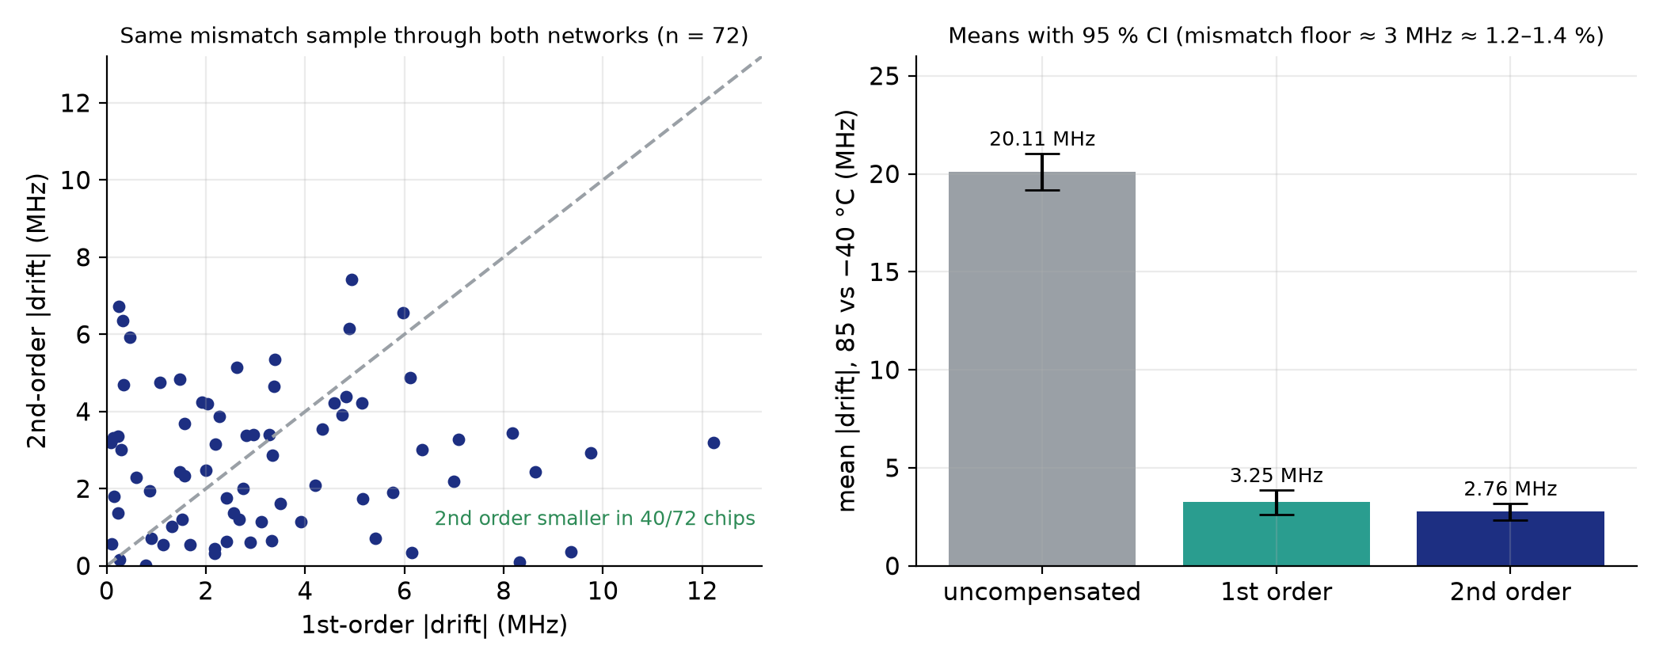
Monte Carlo: The Mismatch Floor
~3 MHz
residual drift (~1.2-1.4 % of 226 MHz)
0.2 - 0.7 %
nominal residual without mismatch
Per-chip trim
needed to reach +/-0.3 % across chips (future work)
Takeaway: transistor mismatch makes each chip drift differently, and one global correction cannot remove it.
22

Slide 23
Loop Dynamics: Found, Fixed, Verified
Found
The Review-1 loop design dropped a 1/(2 pi) factor in omega_n^2, so damping was zeta ~0.33, not the 0.72 claimed. The original loop had not settled at ss/ff/sf/fs within 2 us.
Fixed
R2 retuned 1.7 k -> 3.6 kOhm: zeta ~0.70, phase margin ~65-70 deg (100 x zeta rule, not a Bode plot).
Cost
Cold start is slower (tt 839 -> 1351 ns) but in spec; coarse start faster (577 -> 503 ns).
zeta 0.33 -> 0.70
damping
8.6 -> 0.35 mV
V_ctrl ripple at lock
0.78 -> 0.008 %
final frequency error
Takeaway: we caught a design-equation error ourselves; the retuned loop is well damped and quiet.
23

Slide 24
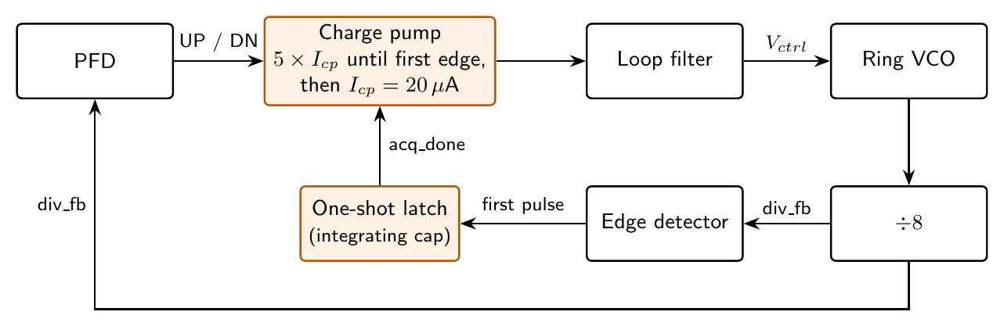
Cold-Start Fix: Boosted Charge Pump
Problem
From 0 V the VCO is in deep subthreshold (0.6 MHz at 0.5 V, 6.5 MHz at 0.6 V vs 226 MHz target), so the divider clock is effectively absent and the pump-up is slow.
Fix
Charge pump runs at 5 x I_cp until the divider's first edge, then drops to 20 uA.
1351 ns
tt lock from 0 V
503 ns
tt lock from 0.85 V
Takeaway: the boosted pump removes the dead zone at start-up; lock is inside 2 us.
24

Slide 25
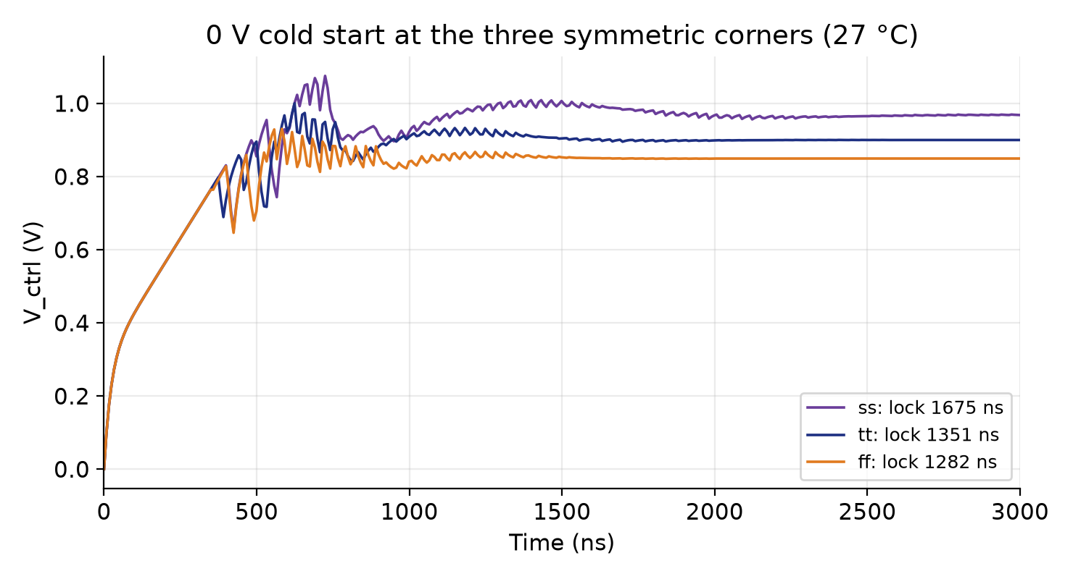
Cold-Start Traces
1283 - 1675 ns
cold-start lock, 11 corners, 27 C
<= 0.8 mV
V_ctrl ripple in every run
226.17 MHz
= 8 x f_ref (-0.01 %) in every run
Takeaway: from 0 V the control voltage climbs and settles to its corner-specific value.
25

Slide 26
Lock Time Across 11 Corners (27 C)
177 - 967 ns
coarse start
1283 - 1675 ns
cold start
22 / 22
runs inside 2 us at 27 C
Takeaway: all 11 corners lock inside 2 us at 27 C; slow-NMOS corners take longest. (Ns = N slow, Pf = P fast, etc.)
26

Slide 27
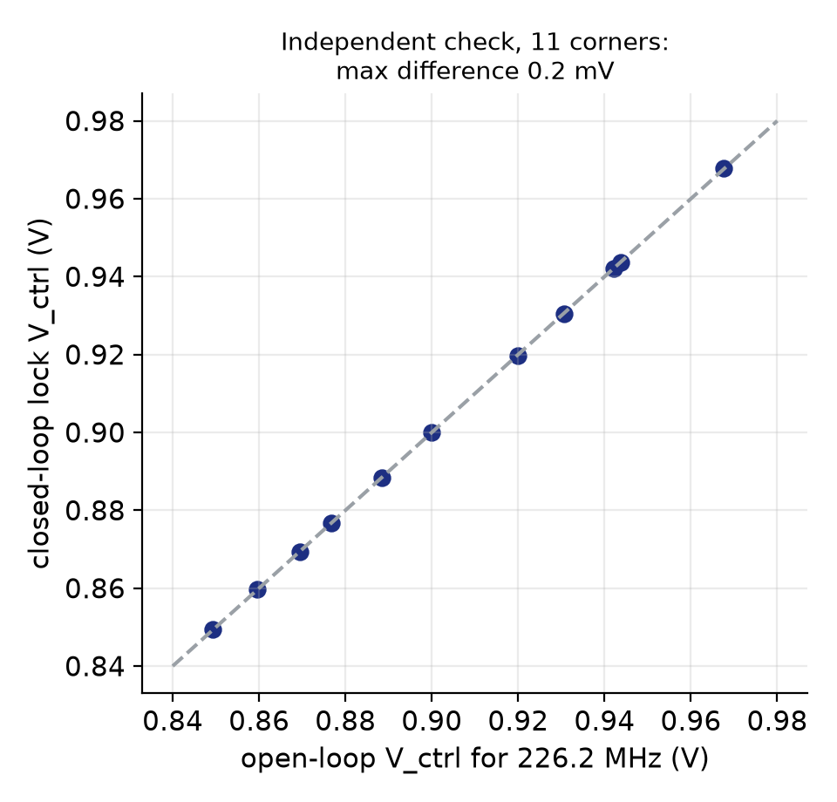
Does the Loop Lock at the Right Voltage?
< 0.2 mV
lock V vs open-loop V for 226.2 MHz, 11 corners
0.849 - 0.968 V
lock V_ctrl range, ff to ss at 27 C
+11.9 / -7.5 mV
tt lock-V shift at -40 / 85 C = fitted compensation (+12.2 / -7.5)
Takeaway: the PLL absorbs the VCO tempco; at tt this independently confirms the compensation fit.
27

Slide 28
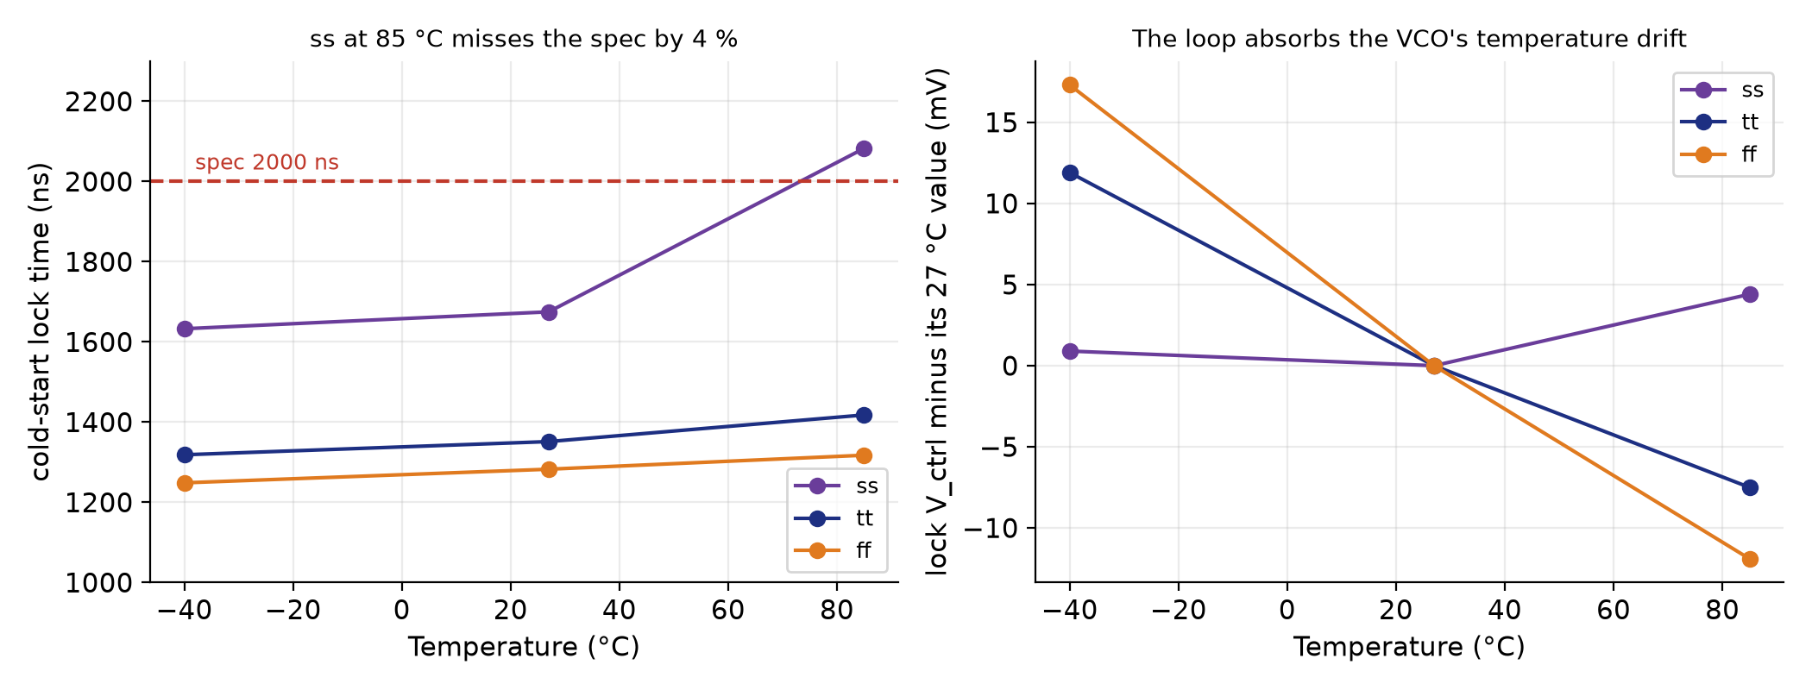
Temperature: Cold-Start Lock at -40, 27, 85 C
2083 ns
ss at 85 C: MISSES the 2 us spec by 4 %
1319 / 1418 ns
tt at -40 / 85 C
1249 / 1317 ns
ff at -40 / 85 C
Takeaway: worst case ss / 85 C misses the lock spec slightly; every other case is inside it.
28

Slide 29
Benchmark vs Literature (Honest)
Design | Process / basis | Residual drift | Lock time
This work, 2nd order (tt, nominal) | sky130, simulation, ideal source | +/-0.16 % max dev (0.20 % span), -40 to 85 C | 1351 ns (0 V cold start)
This work, 2nd order (MC n = 72) | sky130, simulation, mismatch on | ~2.76 MHz = ~1.2 % |drift|, 85 vs -40 C | n/a
Souliotis 2022 [1] | 180 nm, measured silicon | -1.5 % / +0.4 %, -40 to 120 C | not reported
Stancu 2023 [2] | simulation, 50 MHz clock | 1.6 % temperature error | n/a
Geng 2018 [3] | 180 nm, measured silicon | not reported as drift | < 2 us
Nominal simulation of an ideal network is competitive, but it is not like-for-like with measured silicon or with a transistor-level circuit. With chip-to-chip mismatch our residual (~1.2 %) is the same order as the published numbers.
No jitter or phase-noise number yet (no PSS/Pnoise in open tools), so [3]'s -117 dBc/Hz cannot be compared.
Takeaway: in the right ballpark, not proof of parity with fabricated designs.
29

Slide 30
What We Found and Corrected
# | Earlier claim | Corrected
1 | sf / fs labels (sf = slow N) | reversed: PDK sf = fast N / slow P (measured)
2 | Tempco set by N/P balance | set by NMOS overdrive; sign flips at 1.4 V
3 | K_VCO = 669 MHz/V | ~890 MHz/V (887 local slope at 0.9 V)
4 | Hard oscillation floor at 0.63 V | none: 0.63 MHz at 0.5 V, 6.5 MHz at 0.6 V (window artefact)
5 | Loop zeta 0.72 (1/(2 pi) dropped) | zeta 0.33 -> retuned R2 = 3.6 k gives ~0.70
6 | Compensation coefficients (wrong K_VCO) | refit: tt 0.16 % max dev, 8 / 11 corners meet spec
7 | 2nd order significantly better (n = 30) | n = 72, corrected fit: not significant; mismatch floor ~1.2-1.4 %
8 | PDK skew corners lie inside ss-ff | wider than ss/ff; textbook 3 x 3 set added
9 | Closed loop fine in all cases | ss / 85 C cold start 2083 ns misses 2 us by 4 %
Takeaway: each fix came from our own audit and each is traceable to a re-run.
30

Slide 31
Known Limitations
Compensation network and charge pump are behavioural (ideal) models; no transistor-level versions yet.
No layout, DRC, LVS or post-layout simulation yet.
No jitter or phase-noise number (no PSS/Pnoise in open tools).
Phase margin is the 100 x zeta rule, not a Bode plot.
Only R2 = 1.7 / 3.0 / 3.6 kOhm simulated at transistor level; 3.6 k is not claimed optimal.
Cold start simulated on 11 corners at 27 C and at 3 corners for +/-temperature, not all 11 x all T.
Compensation is fitted nominally at V_ctrl = 0.9 V; each corner actually locks at 0.85 - 0.97 V.
Mismatch limits compensated drift to ~1.2-1.4 %; the H1 test and Spectre arm are pending.
Takeaway: we state plainly what is ideal, nominal, or still missing.
31

Slide 32
Remaining Work / Next Phase
Circuit
Transistor-level charge pump and compensation network (PTAT/CTAT + squarer), then re-run the loop.
Define the compensation at each corner's own lock voltage; per-chip trim to beat the mismatch floor.
Physical design
Layout in Magic, DRC, LVS (netgen, built), post-layout simulation.
Validation and release
Virtuoso/Spectre cross-check arm, PSS/Pnoise, H1 regression (needs department Virtuoso access - to confirm with Dr. Bindu).
Spec sign-offs (V_ctrl floor revision, +/-0.15 ppm restatement); paper and artifact release.
Takeaway: the behavioural result is solid; the next phase makes it real hardware-shaped.
32

Slide 33
Final Review at a Glance
8 / 11
corners meet +/-0.3 % (tt 0.16 % max dev)
8.51 -> 0.20 %
tt span, baseline -> 2nd order
31 - 44x
compensation ratio (PDK sf 15.9x)
20.1 -> 2.8 MHz
Monte Carlo |drift|, n = 72
1.2 - 1.4 %
mismatch floor (per-chip trim needed)
177 - 967 ns
coarse-start lock, 11 corners, 27 C
1283 - 1675 ns
cold-start lock, 11 corners, 27 C
2083 ns
ss / 85 C cold start: misses 2 us by 4 %
zeta ~0.70 (R2 = 3.6 k); 15 references; 1 patent narrowed the claim; 9 corrections found by our own audit.
Takeaway: a verified, honest closed-loop study with its limits stated.
33

Slide 34
References
[1] G. Souliotis, E. Keramida, F. Plessas, R. Malatesta, and S. Vlassis, “Temperature compensated ring oscillator based VCO,” AEU – Int. J. Electron. Commun., vol. 149, Art. no. 154195, May 2022.
[2] C. Stancu, A. Neacsu, O. Profirescu, D. Dobrescu, and L. Dobrescu, “Temperature and power supply compensated CMOS clock circuit based on ring oscillator,” Electronics, vol. 12, no. 3, Art. no. 507, Jan. 2023.
[3] Z. Geng, X. Ma, and Z. Li, “A low power fast locking PLL frequency synthesizer with temperature compensation,” in Proc. 3rd Int. Conf. EAME, Atlantis Press, Jun. 2018, pp. 281–285.
[4] Y. You, D. Huang, J. Chen, and S. Chakraborty, “A 12GHz 67% tuning range 0.37ps RJrms PLL with LC-VCO temperature compensation scheme in 0.13µm CMOS,” in Proc. IEEE RFIC, Tampa, FL, USA, Jun. 2014, pp. 101–104.
[5] S. Sinha, “Design of an integrated CMOS PLL frequency synthesizer,” in Proc. 11th IEEE MELECON, Cairo, Egypt, 2002, pp. 220–224.
[6] É. M. V. Freitas et al., “Using open source EDA tools in ASICs for HEP: A mixed comparison,” J. Instrum., vol. 20, no. 12, Art. no. P12022, Dec. 2025.
[7] M. Thiriloganathan et al., “A 2.4 GHz LC-VCO fractional-N phase locked loop open-source design in 130-nm BiCMOS,” in Proc. 22nd Int. Conf. SMACD, 2026, arXiv:2607.08852.
[8] R. N. S. Raphael, A. M. Pinto, L. T. Manera, and S. Finco, “Phase-locked loop (PLL)-based frequency synthesizer for digital systems driving,” in Proc. BTSym’18, SIST vol. 140, Springer, 2019, pp. 395–406.
[9] Y. Li, K. Du, and J. Zhang, “Design of ring oscillator with temperature compensation effect,” Int. J. RF Microw. Comput.-Aided Eng., vol. 32, no. 11, Art. no. e23374, Nov. 2022.
[10] H. H. Hammam, K. M. Hassan, and S. A. Ibrahim, “An ultra-low-power process-and-temperature compensated ring oscillator,” in Proc. 9th Int. Conf. ICEEE, Alanya, Turkey, Mar. 2022.
[11] S. Zhang, A. Li, Y. Han, L. Jie, X. Han, and R. C. C. Cheung, “Temperature compensation technique for ring oscillators with tail current,” Electron. Lett., vol. 52, no. 13, pp. 1108–1110, Jun. 2016.
[12] M. Ortner and M. Punzenberger, “Systems and methods for oscillators using quadratic temperature compensation,” U.S. Patent 9 748 962 B2, Aug. 29, 2017.
[13] D. Patrinos and G. Souliotis, “A low-voltage, low-power 2.5 GHz ring oscillator with process and temperature compensation,” J. Low Power Electron. Appl., vol. 15, no. 3, Art. no. 52, Sep. 2025.
[14] M. Sivasakthi and P. Radhika, “Design and analysis of PVT tolerant hybrid current starved ring VCO with bulk driven keeper technique at 45 nm CMOS technology for the PLL application,” AEU – Int. J. Electron. Commun., vol. 173, Art. no. 154987, Jan. 2024.
[15] S. Madheswaran and R. Panneerselvam, “Design and analysis of 7-stage MOS current mode logic power gated MOSFETs in current starved VCO for the PLL application,” Int. J. Electr. Comput. Eng., vol. 14, no. 2, pp. 1398–1405, Apr. 2024.
34

Slide 35
Thank You
Project-I (2026) · SENSE · VIT Chennai · github.com/pocopepe/visualizer
35

