Slide 1
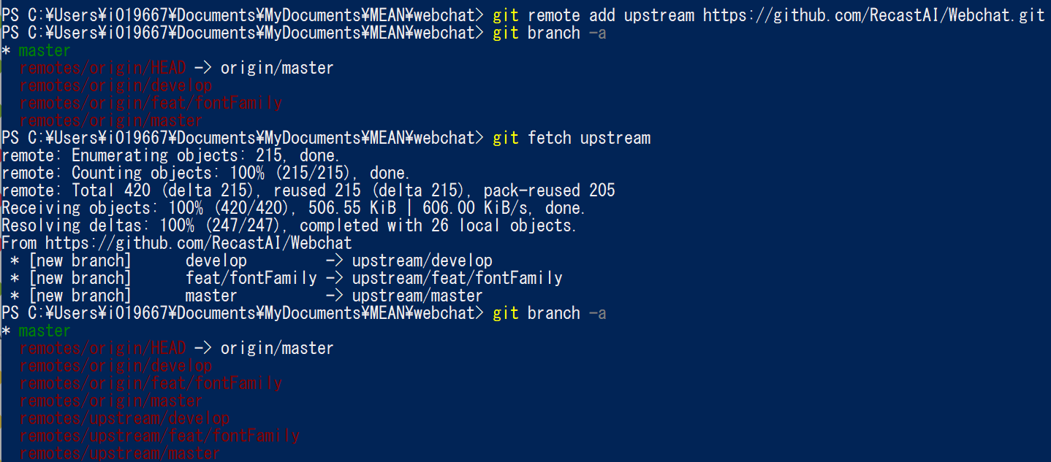
Reference: https://qiita.com/xtetsuji/items/555a1ef19ed21ee42873
本家のリポジトリを “upstream” として登録後、Fetchして、Branchの確認。

Slide 2
Reference: https://qiita.com/xtetsuji/items/555a1ef19ed21ee42873
本家のリポジトリを “upstream” として登録後、Fetchして、Branchの確認。
<Your local folder path that holds your local repository>
<Parent Github Repository>.git
<Your local folder path that holds your local repository>
<Your local folder path that holds your local repository>
<Parent Github Repository>.git
<Your local folder path that holds your local repository>

Slide 3
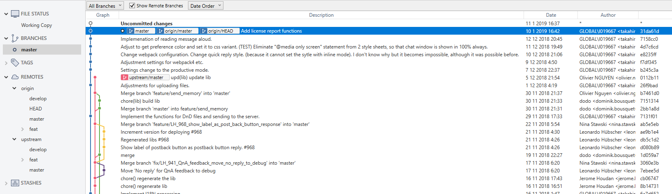
Before “git merge upstream/master”.

Slide 4
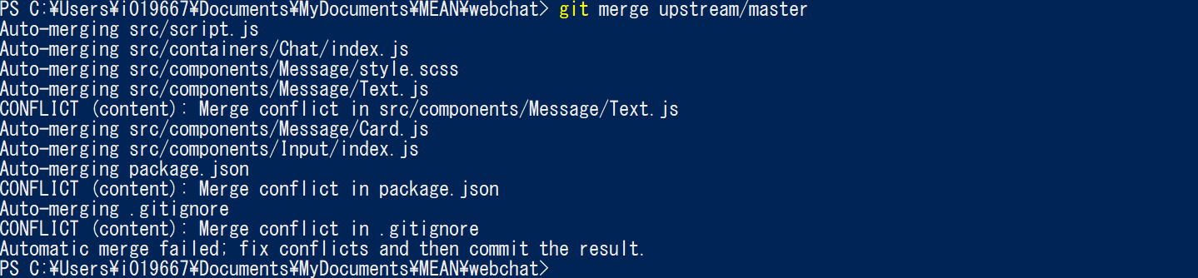
Execute “git merge upstream/master”.
Several conflicts were happened.
It is necessary to adjust manually.

Slide 5
Execute “git merge upstream/master”.
<Your local folder path that holds your local repository>
Several conflicts were happened.
It is necessary to adjust manually.

Slide 6
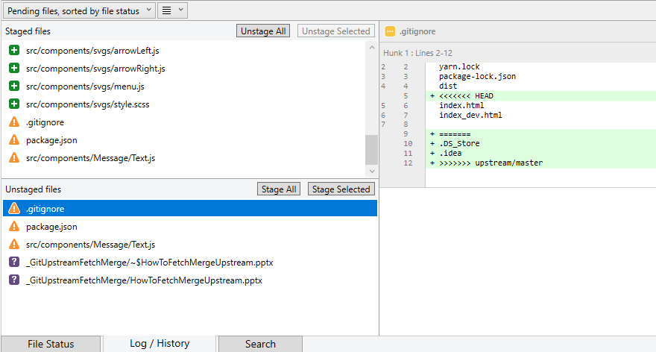
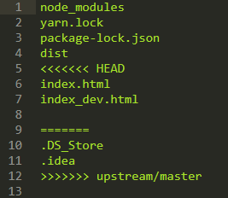
Conflicts in the sourcetree and the exact file contents.

Slide 7
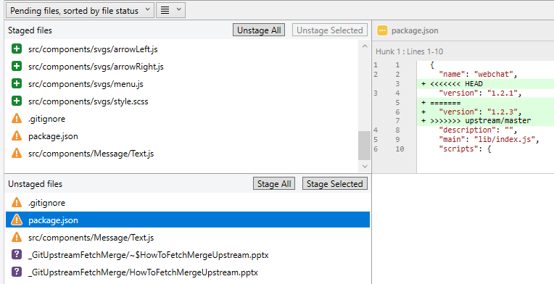
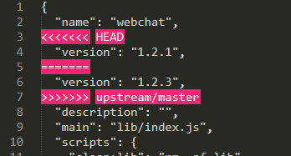
Conflicts in the sourcetree and the exact file contents.

Slide 8
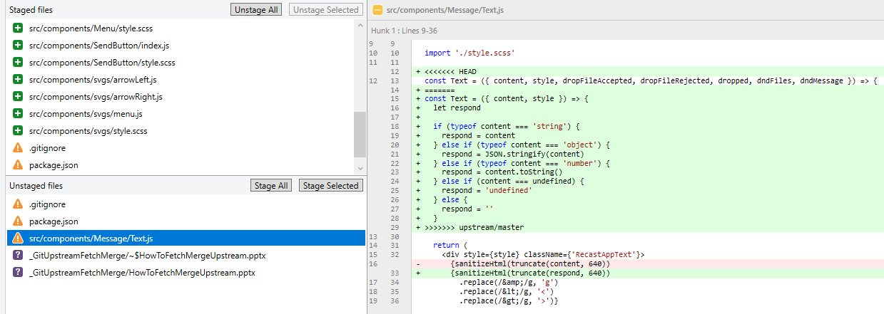
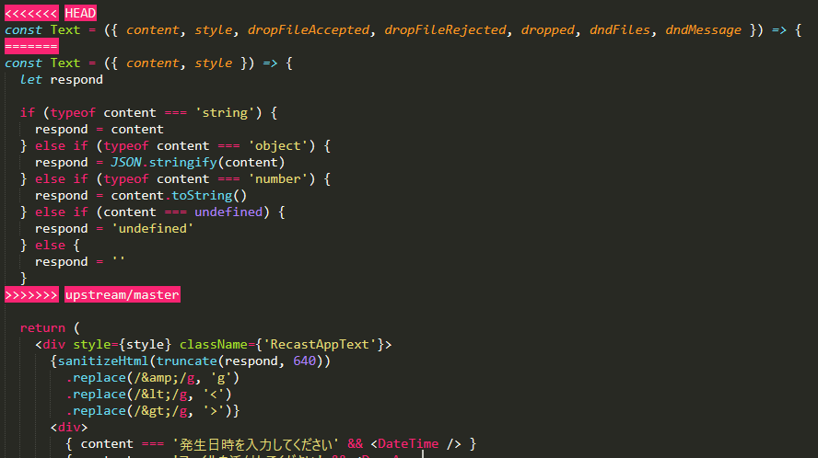
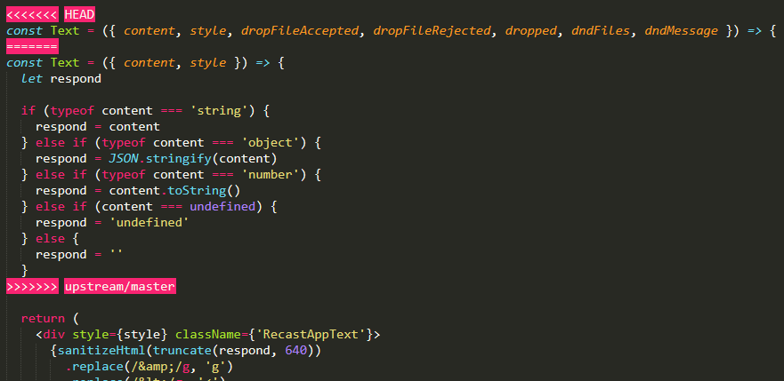
Conflicts in the sourcetree and the exact file contents.
ScreenShot for the video

Slide 9
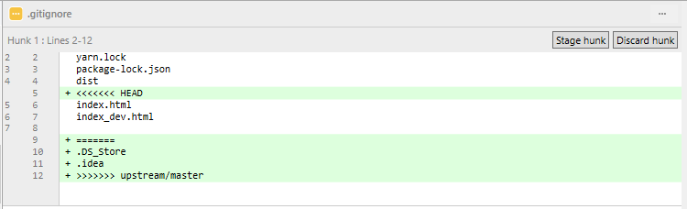
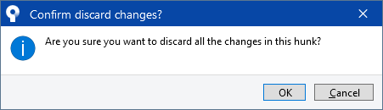
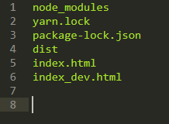
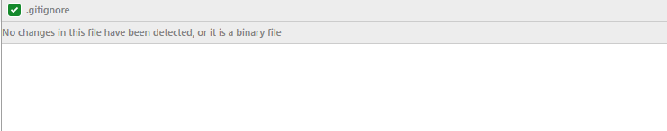
Adjustments
About gitignore I don’t need the changes because “.DS_Store” and “.idea” are not existing in my folder, so discard these changes.
File after discarding.

Slide 10
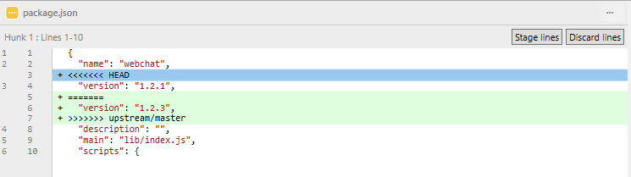
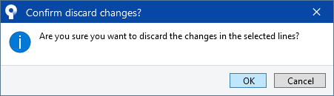
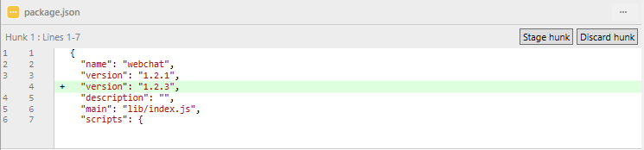
Regarding, package.json, delete unnecessary lines and change the version to 1.2.3 as in the upstream version.
I could not delete the line “version”: “1.2.1”, so deleted it in the editor.

Slide 11
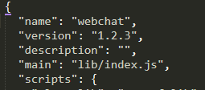
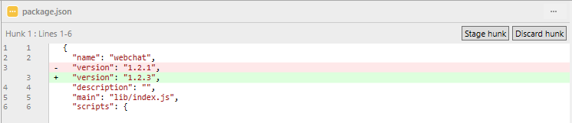

Slide 12
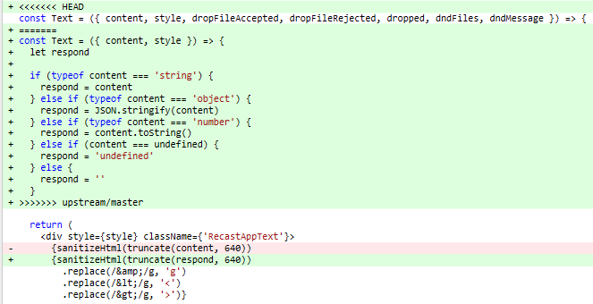
Regarding “Text.js”, it is necessary to merge my own changes (surrounded by the red square) to the change of upstream.
This part is already implemented automatically by git.

Slide 13
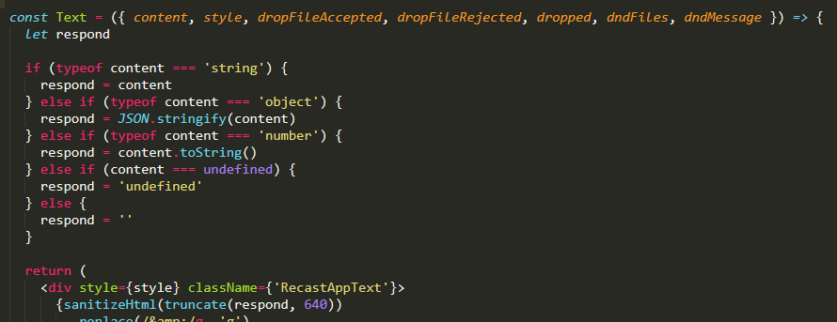
So I edited the code in the editor and the result is as follow.
This part is pasted.

Slide 14
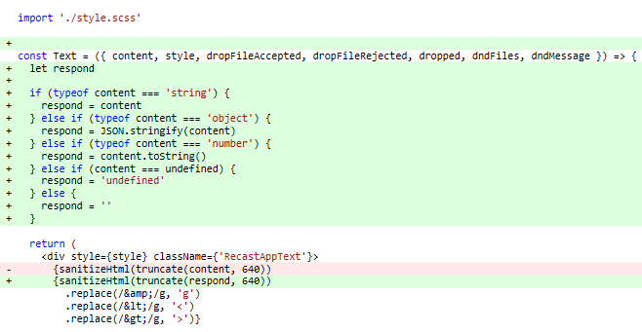
Here is the result of screen in the source tree.

Slide 15
Stage all changes and push&commit.

Slide 16
2回目以降

Slide 17
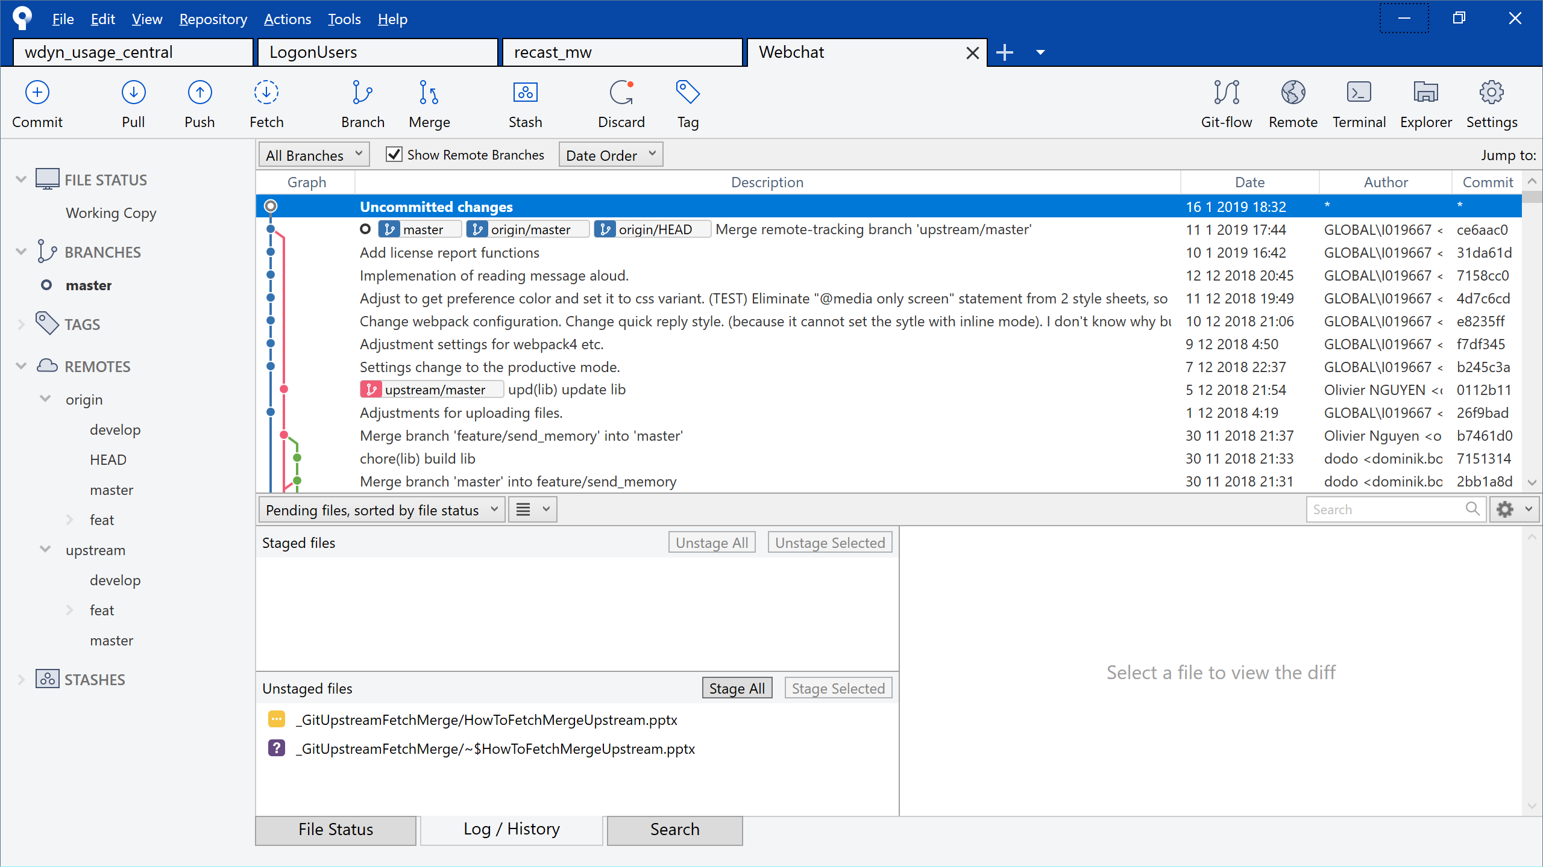
Before “git fetch upstream”

Slide 18
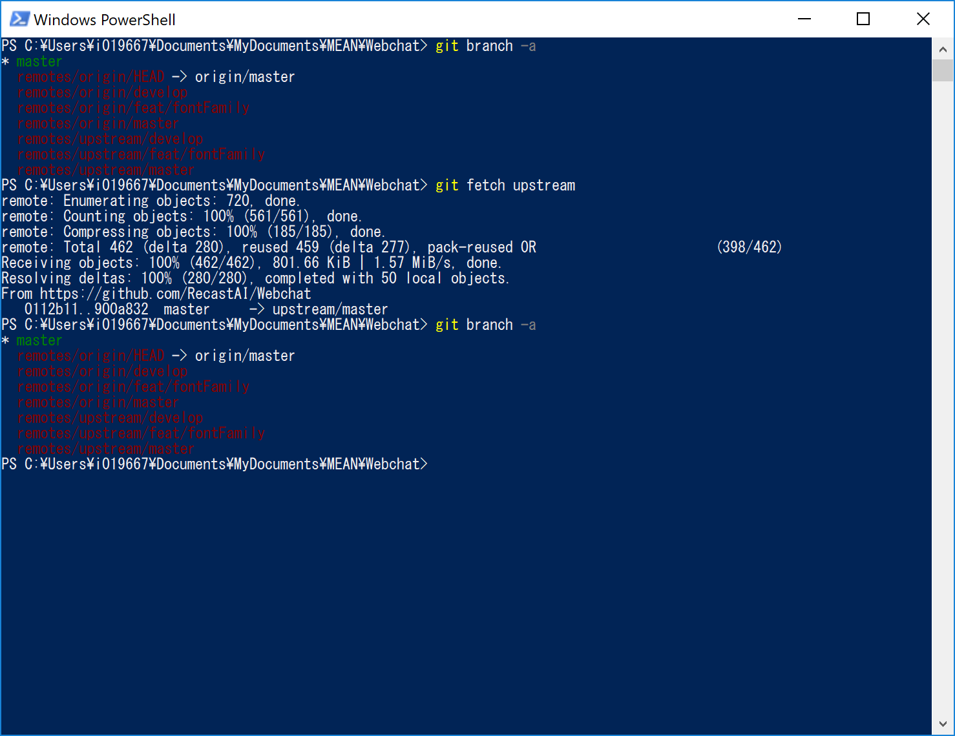
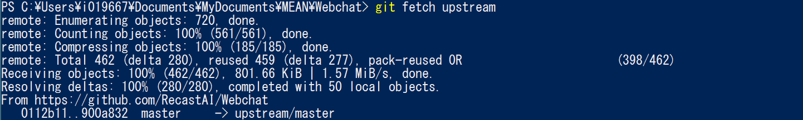

Slide 19
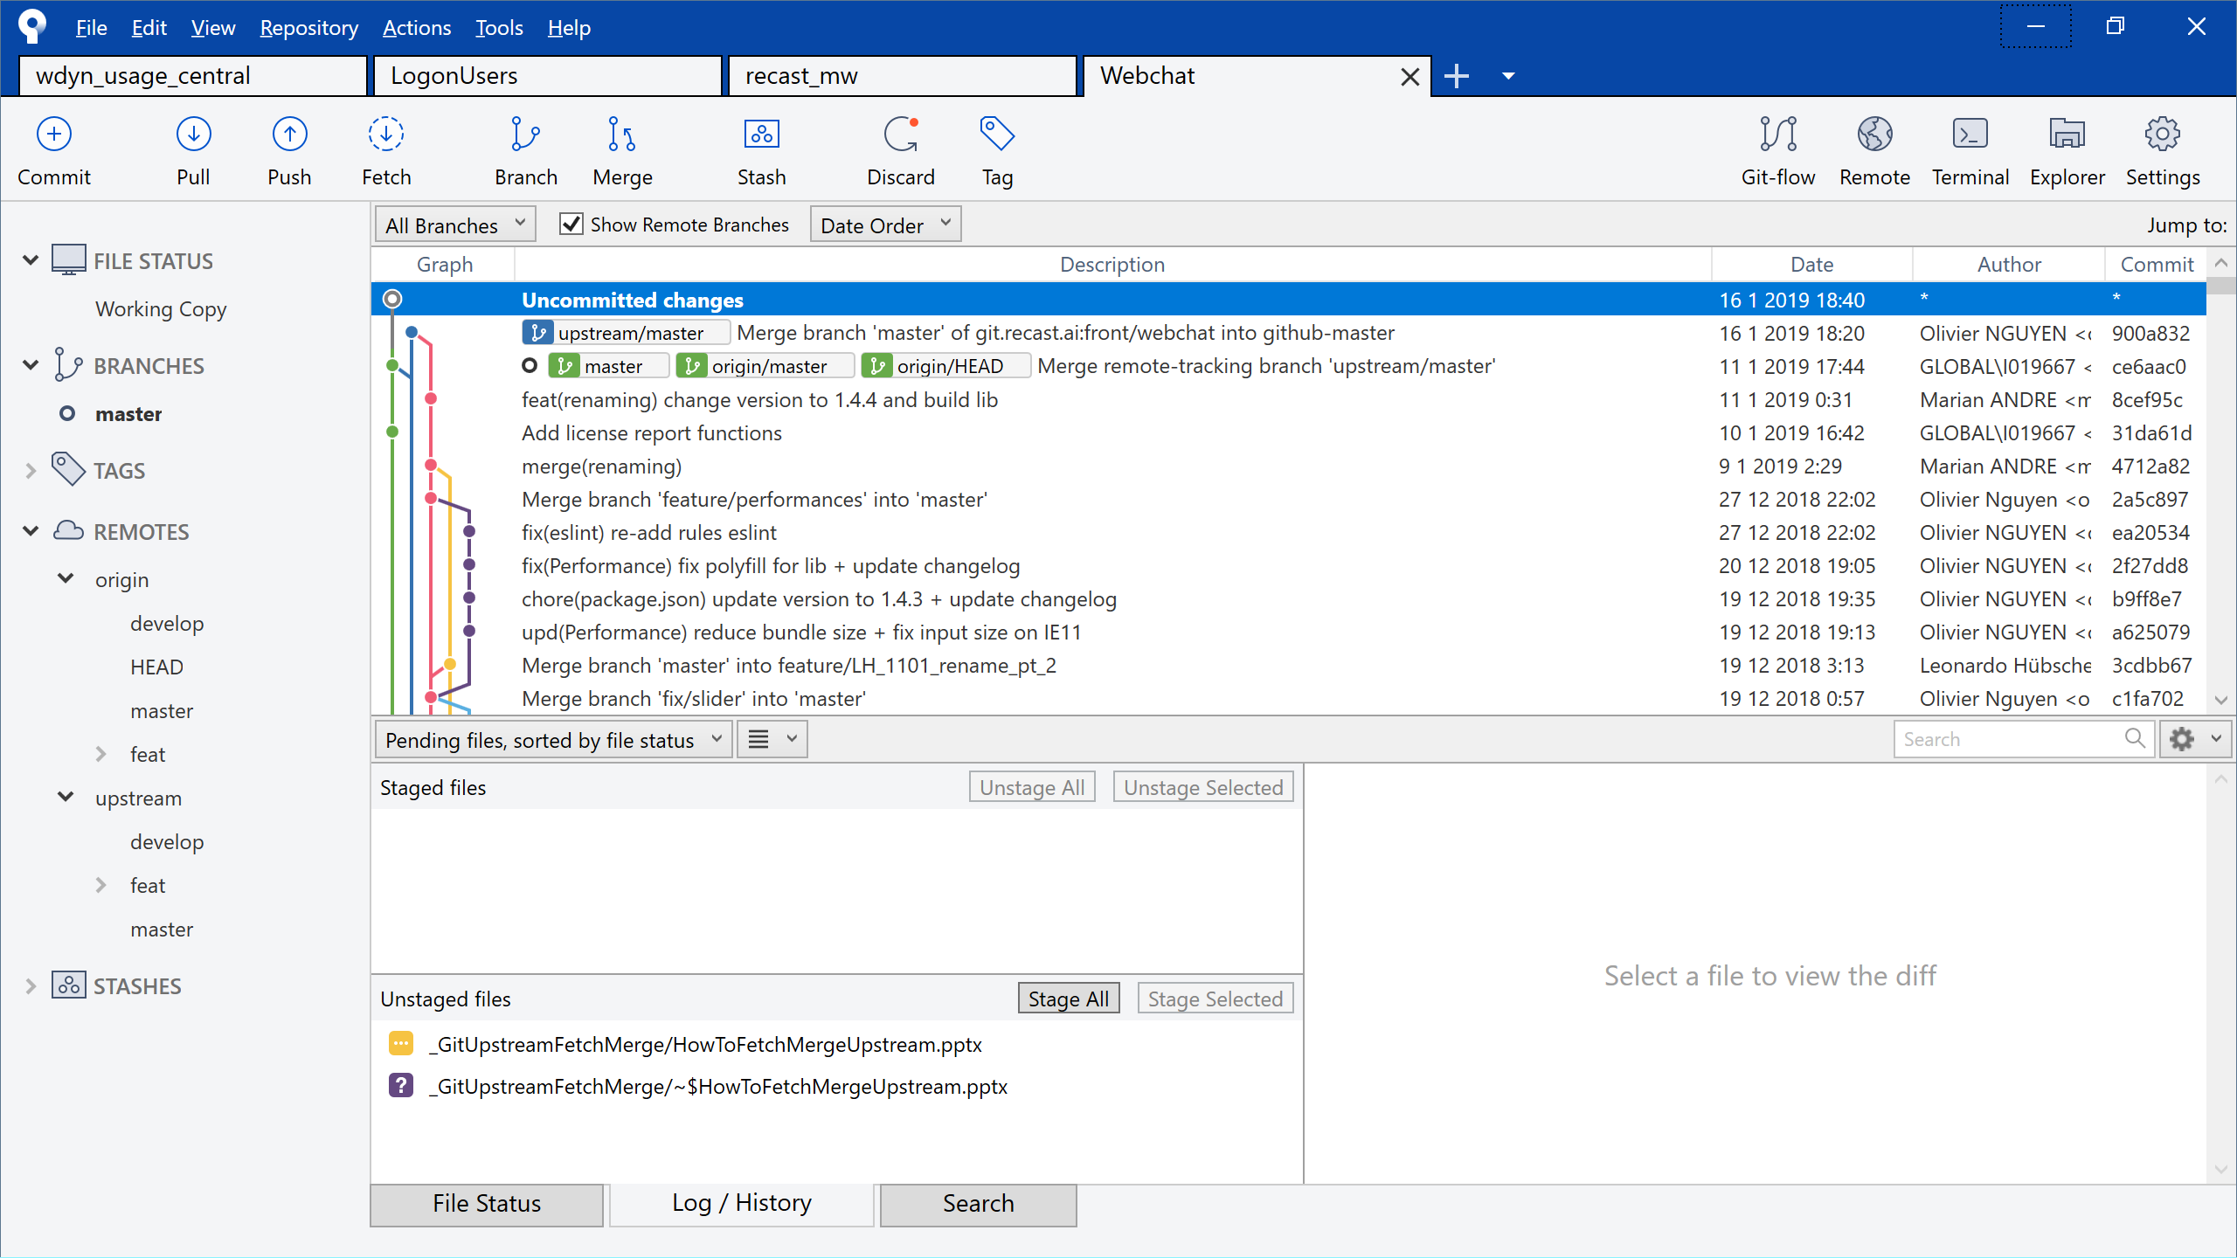

Slide 20
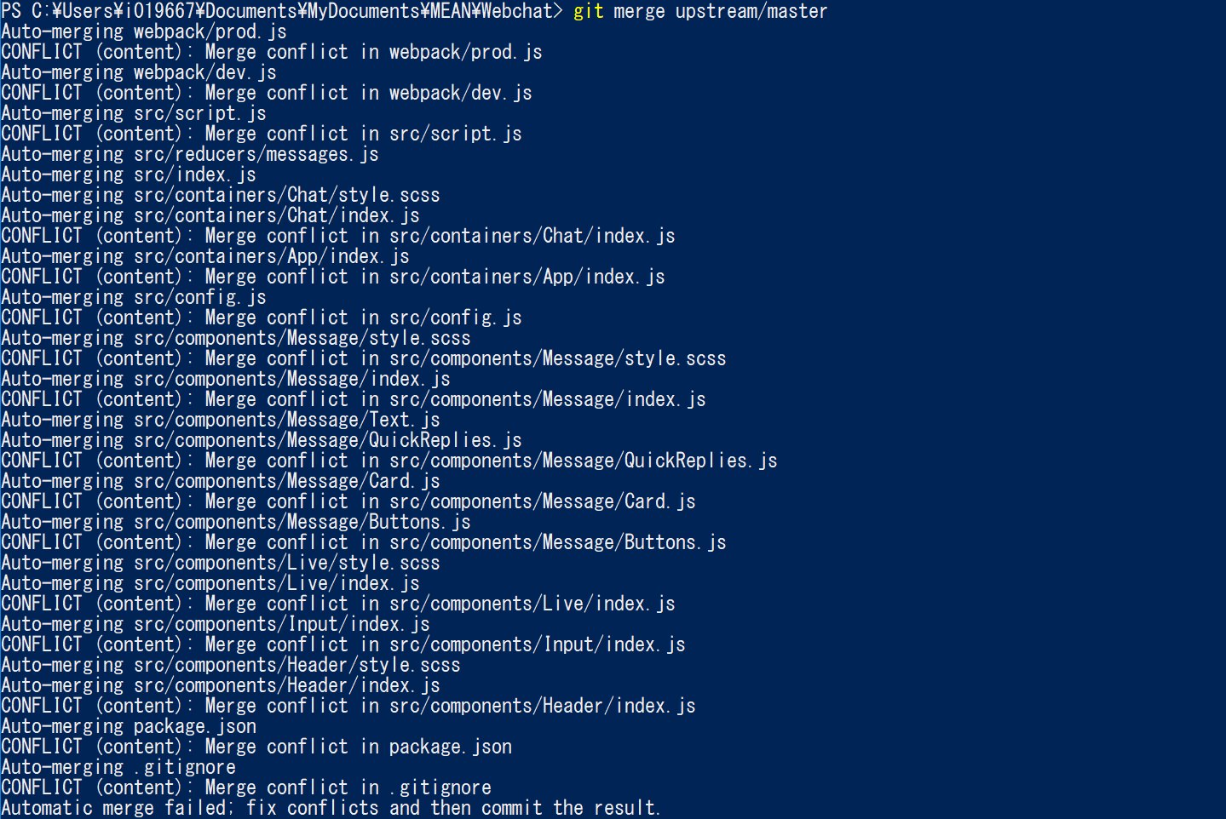
Execute “git merge upstream/master”

Slide 21
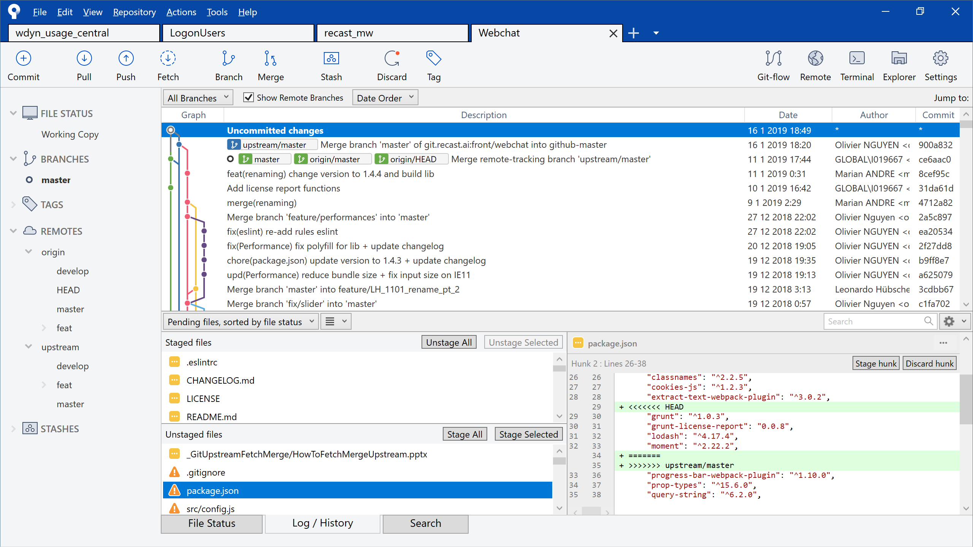
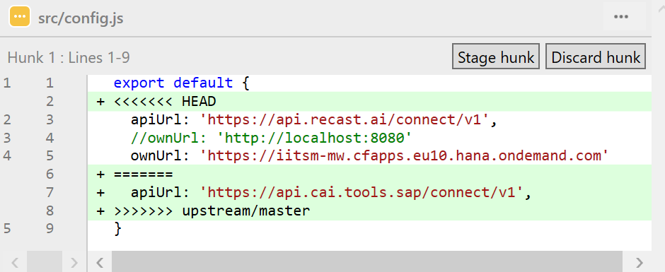
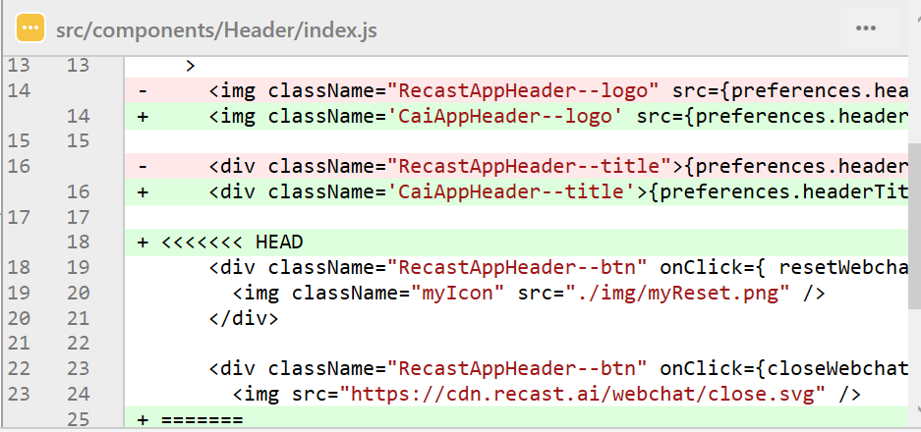
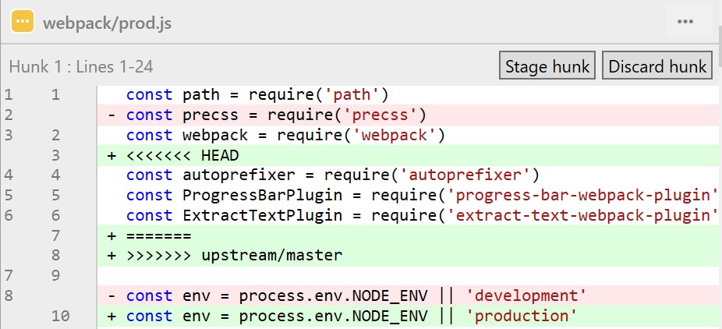
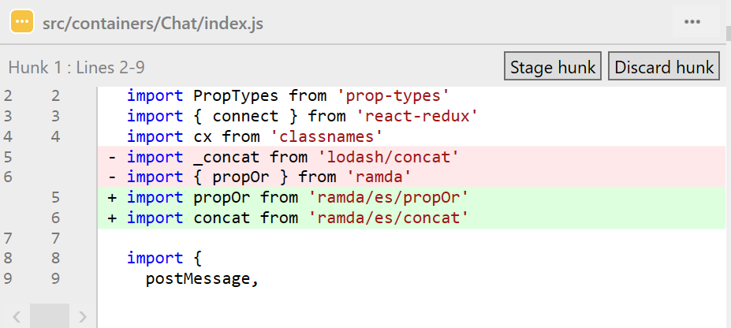
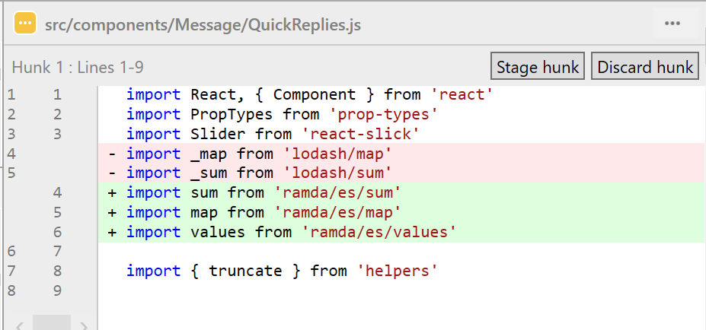

Slide 22
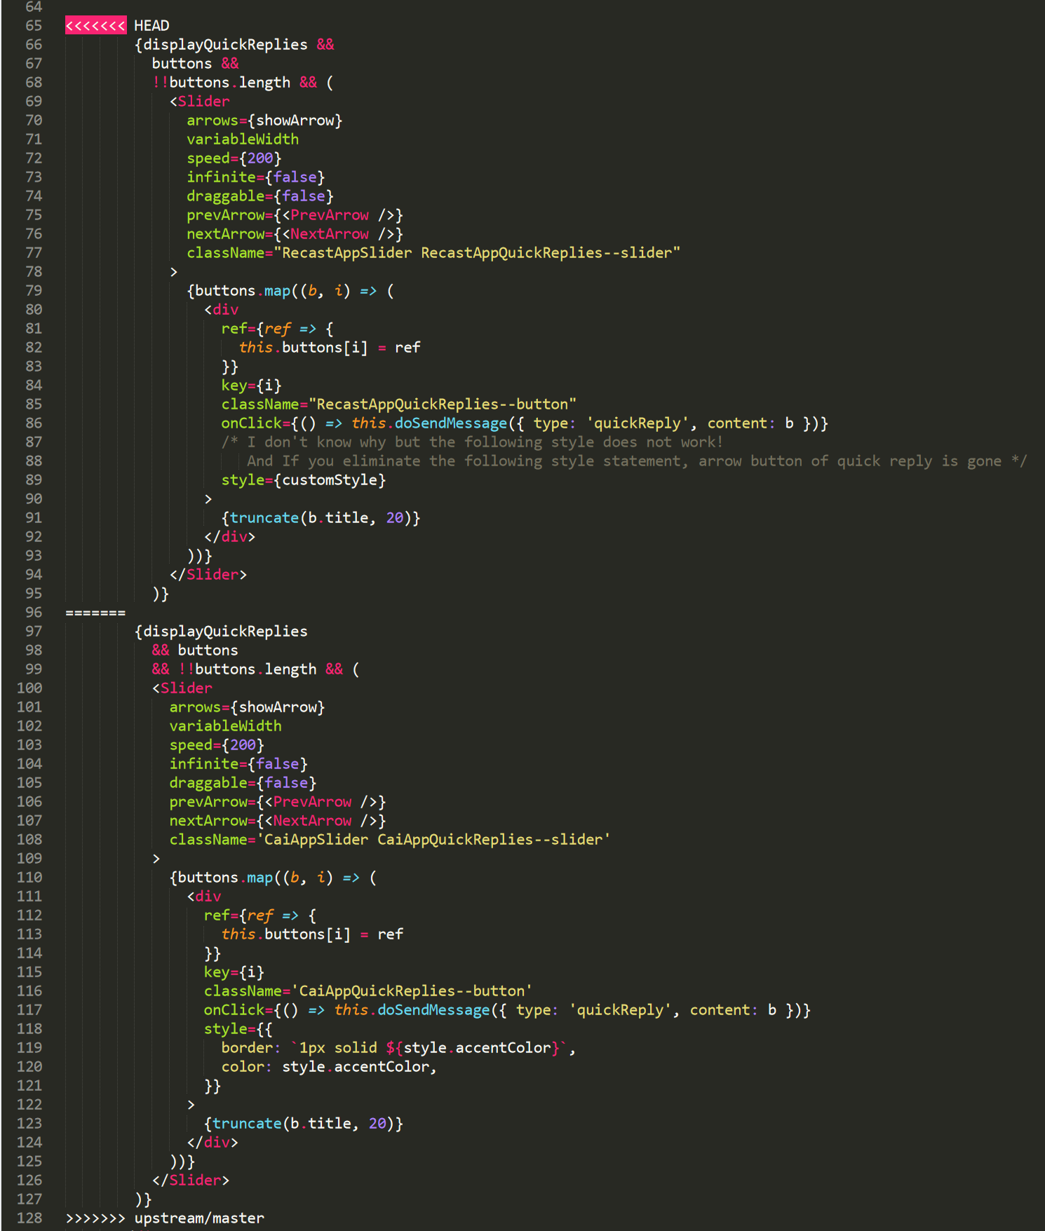
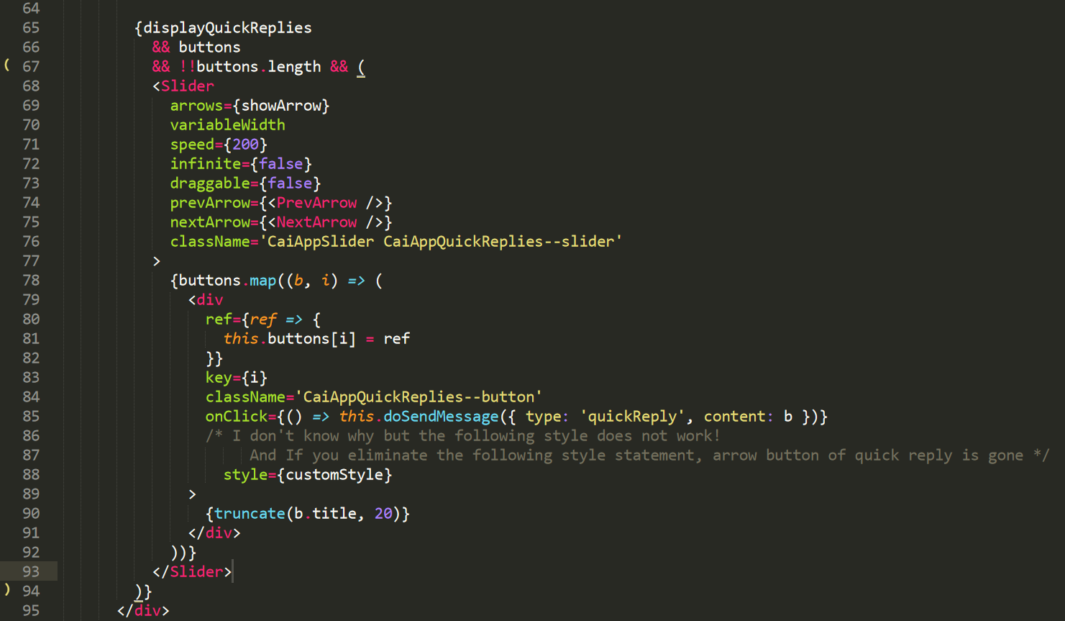
Src/components/Message/QuickReplies.js
① Replace
② Keep this part because several class names are new

Slide 23
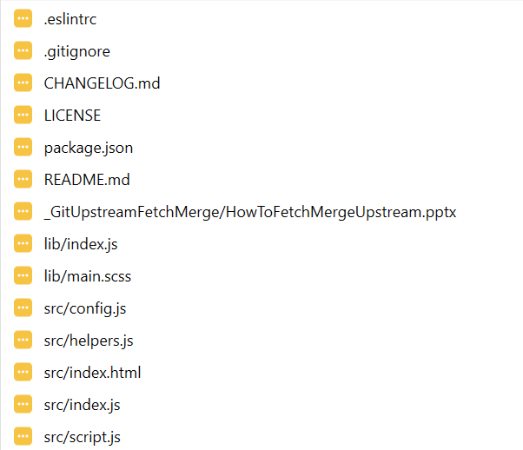
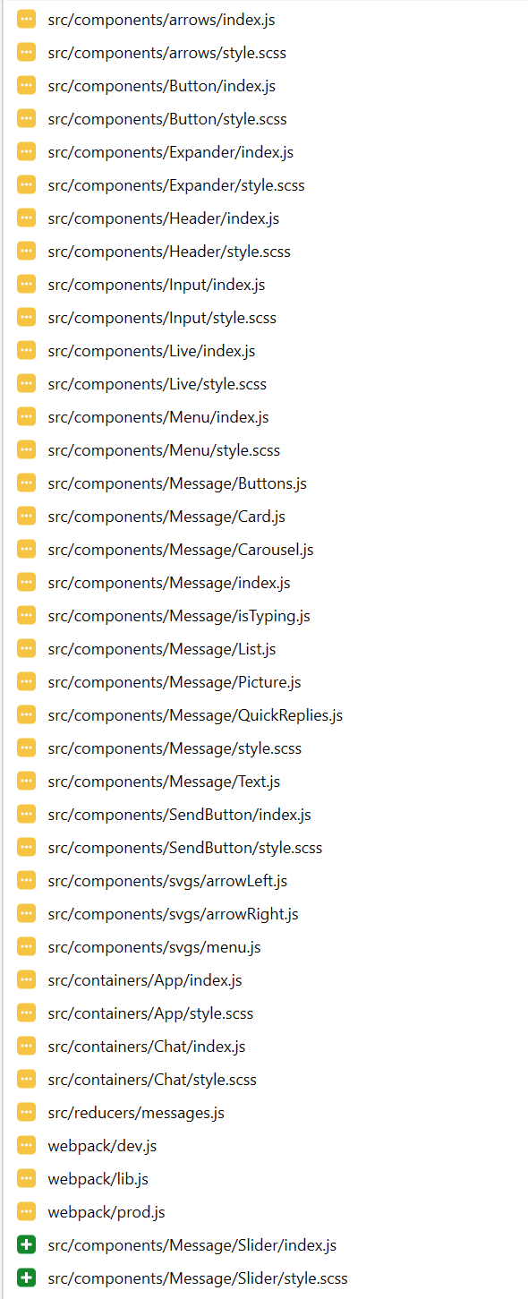
All changed files.

Slide 24
Additional info
Checking upstream

Slide 25
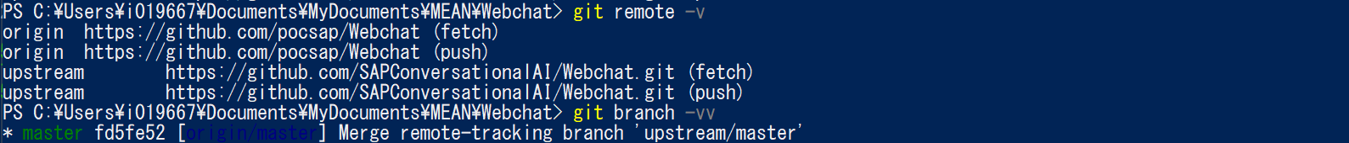
Change upstream

Slide 26
