Slide 1
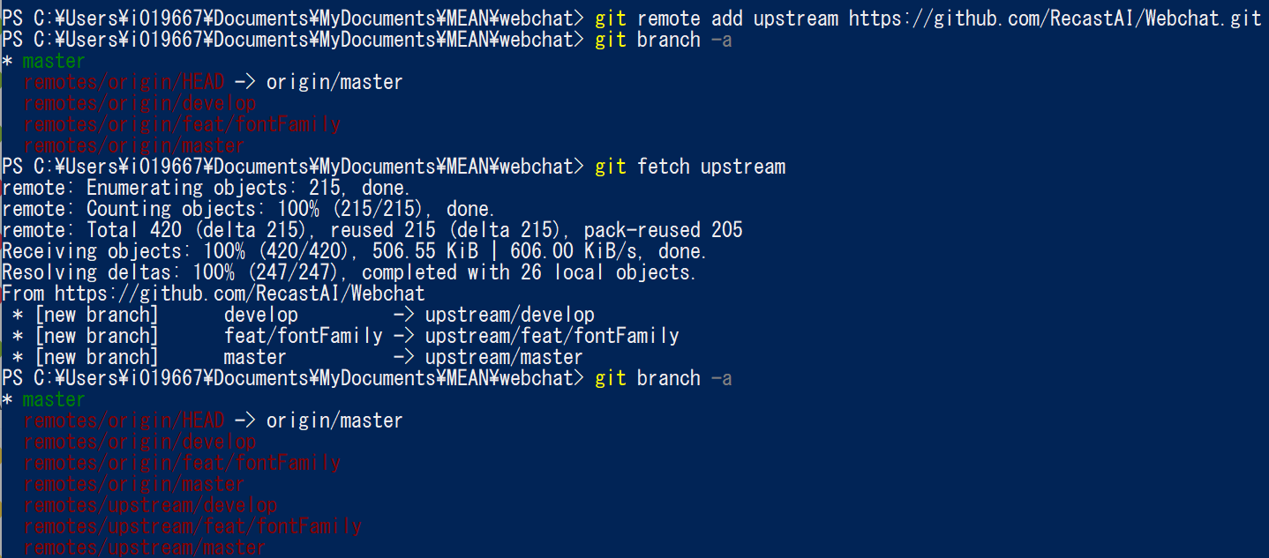
Reference: https://qiita.com/xtetsuji/items/555a1ef19ed21ee42873
本家のリポジトリを “upstream” として登録後、Fetchして、Branchの確認。

Slide 2
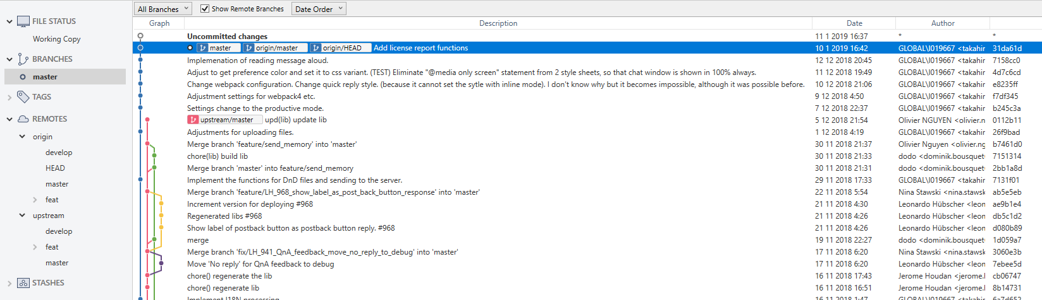
Before “git merge upstream/master”.

Slide 3
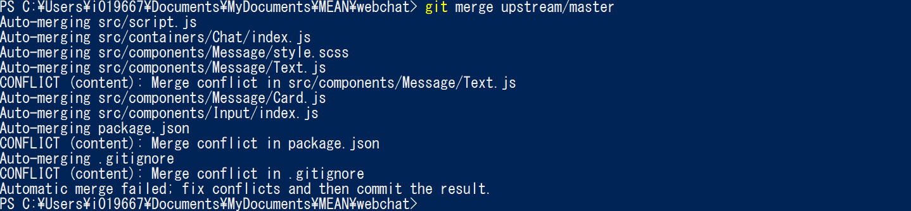
Execute “git merge upstream/master”.
Several conflicts were happened.
It is necessary to adjust manually.

Slide 4
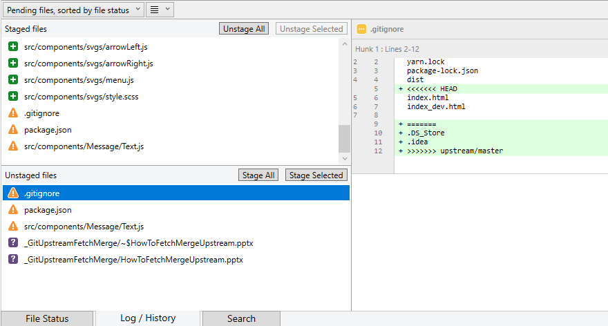
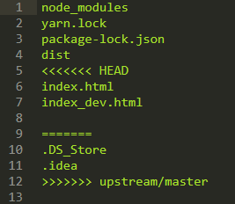
Conflicts in the sourcetree and the exact file contents.

Slide 5
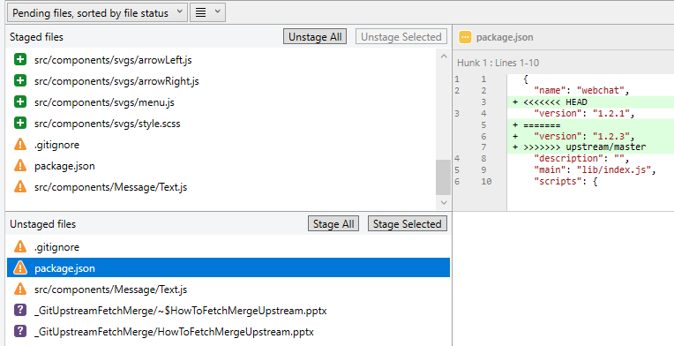
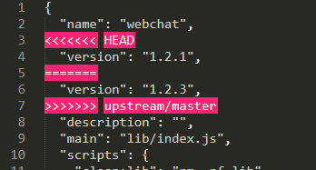
Conflicts in the sourcetree and the exact file contents.

Slide 6
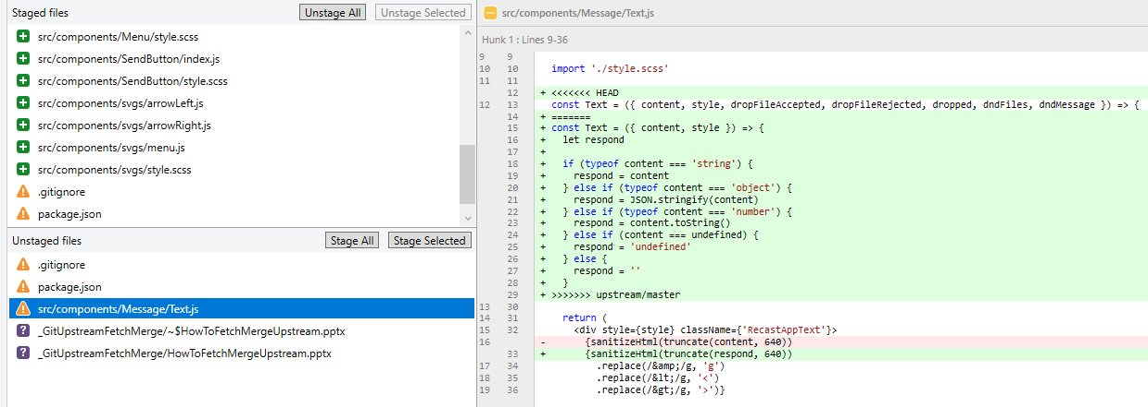
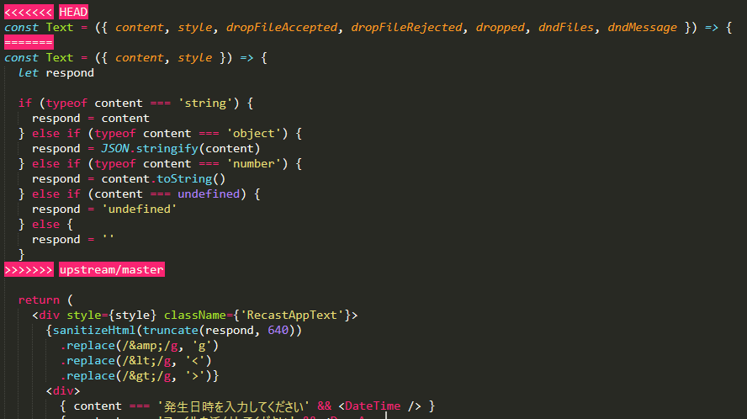
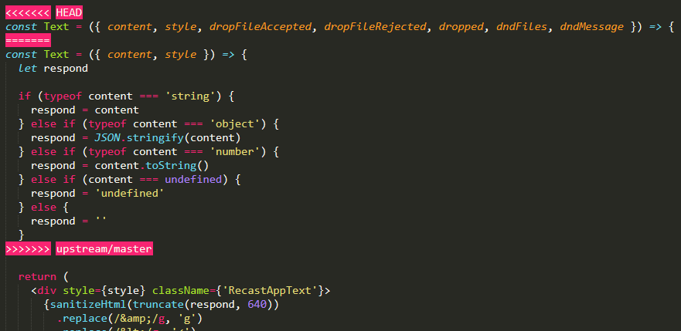
Conflicts in the sourcetree and the exact file contents.
ScreenShot for the video

Slide 7
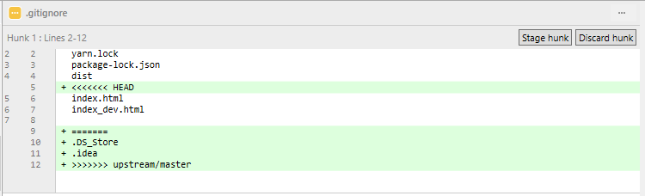
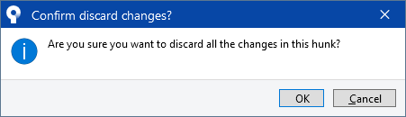
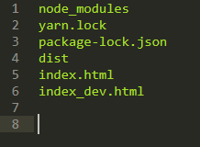
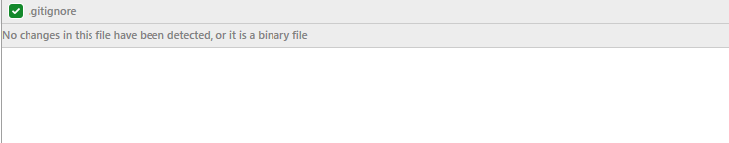
Adjustments
About gitignore I don’t need the changes because “.DS_Store” and “.idea” are not existing in my folder, so discard these changes.
File after discarding.

Slide 8
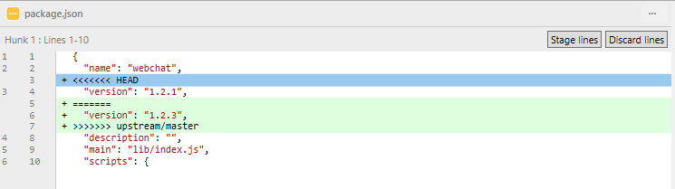
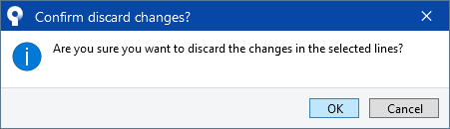
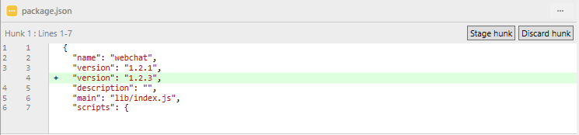
Regarding, package.json, delete unnecessary lines and change the version to 1.2.3 as in the upstream version.
I could not delete the line “version”: “1.2.1”, so deleted it in the editor.

Slide 9
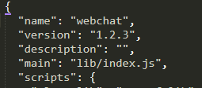
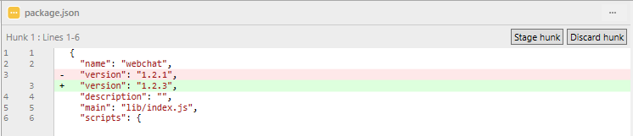

Slide 10
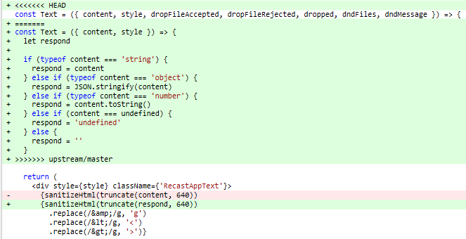
Regarding “Text.js”, it is necessary to merge my own changes (surrounded by the red square) to the change of upstream.
This part is already implemented automatically by git.

Slide 11
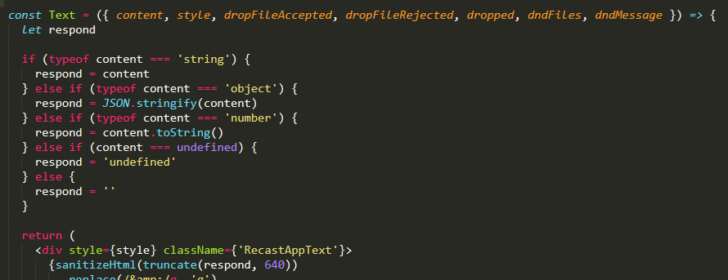
So I edited the code in the editor and the result is as follow.
This part is pasted.

Slide 12
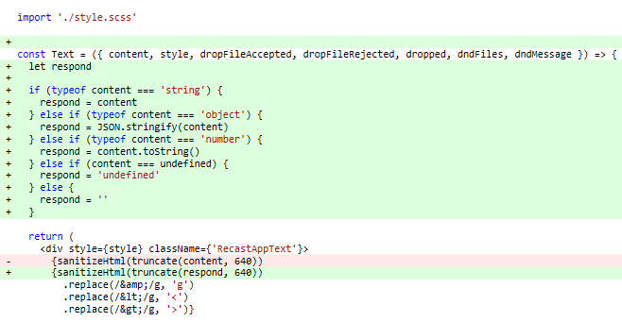
Here is the result of screen in the source tree.

Slide 13
Stage all changes and push&commit.

Slide 14
2回目以降

Slide 15
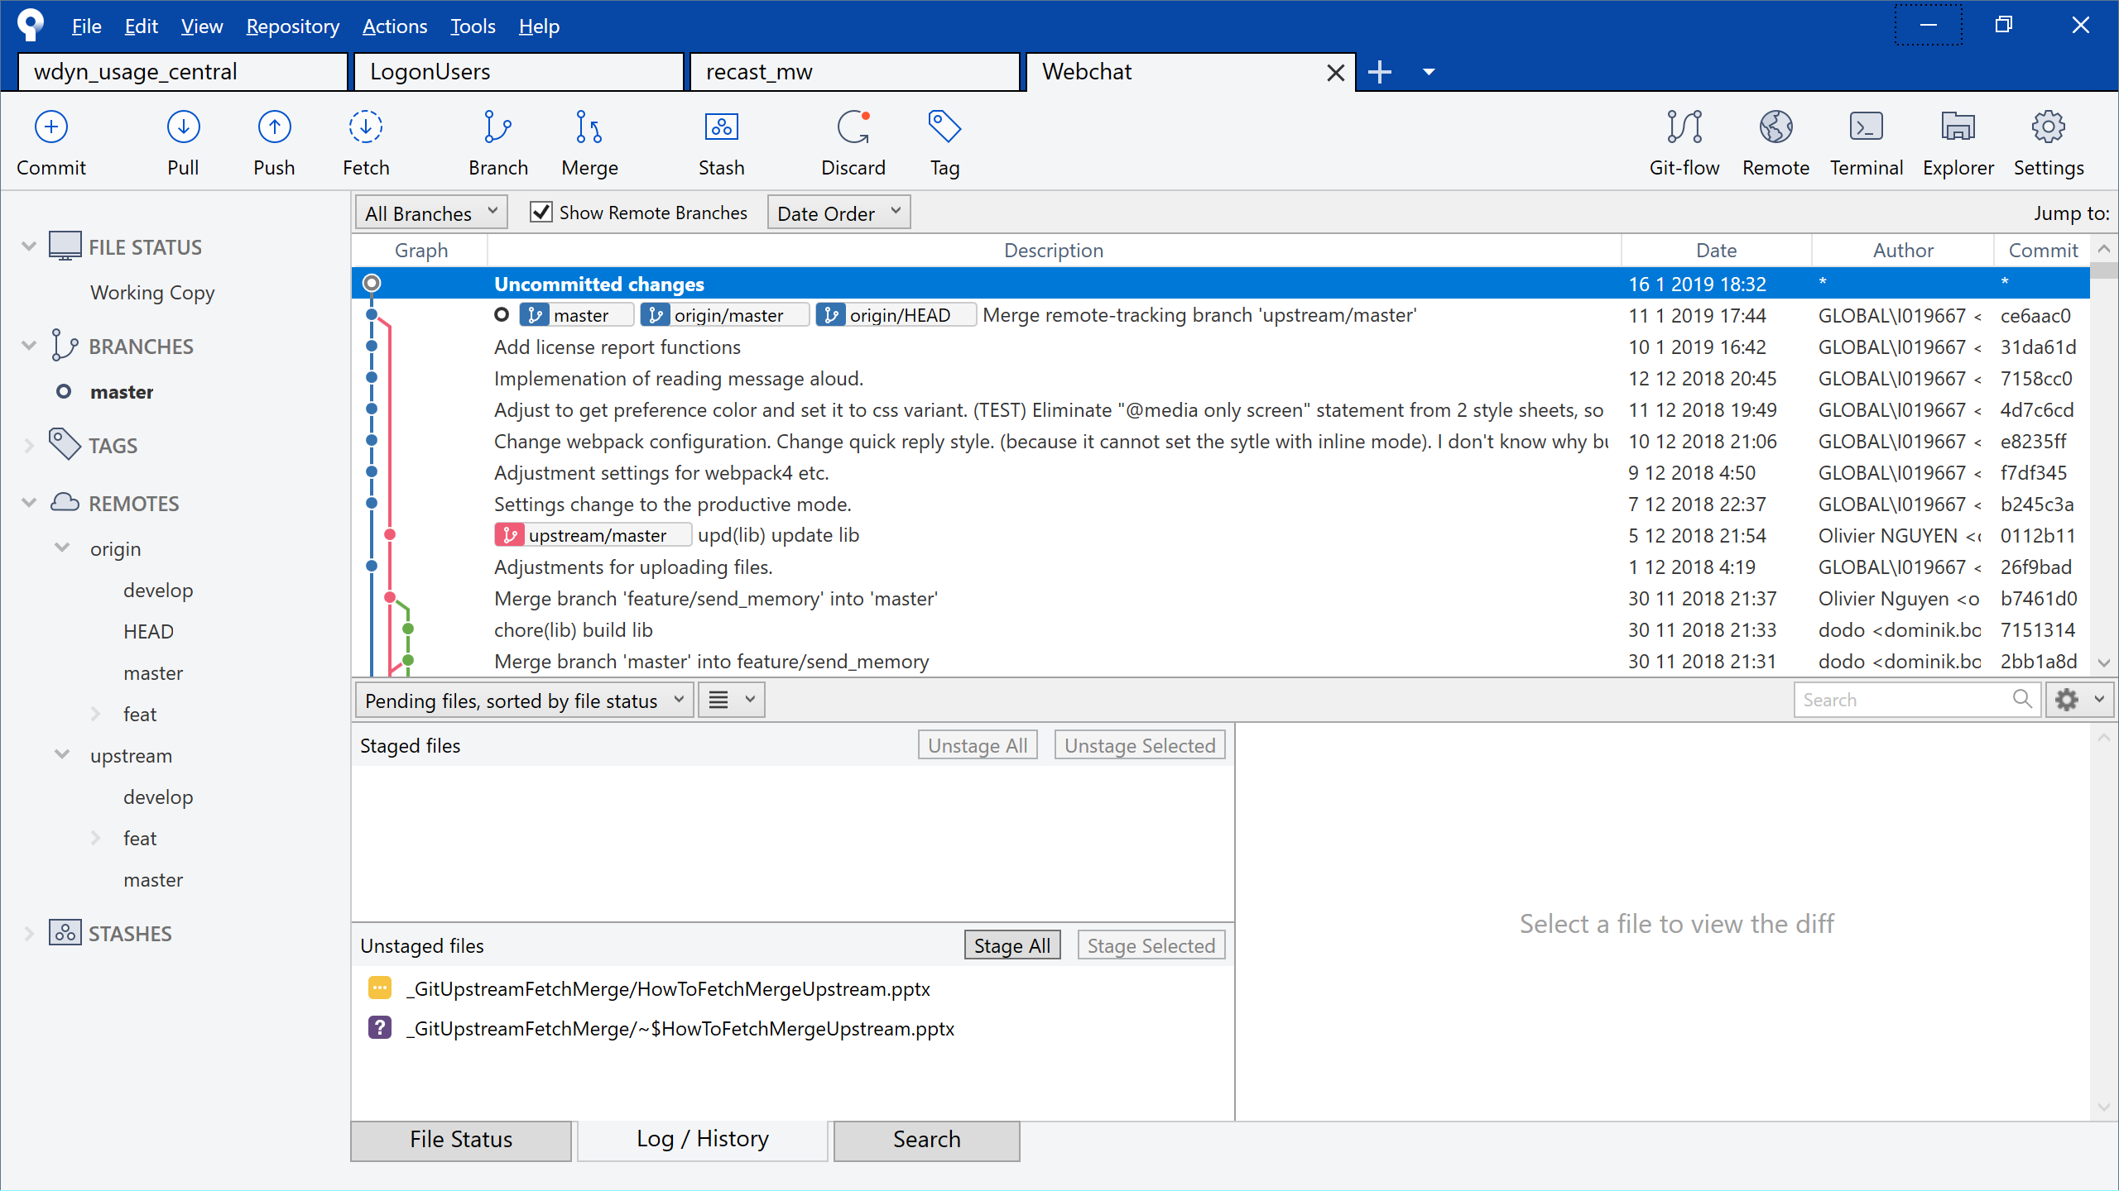
Before “git fetch upstream”

Slide 16
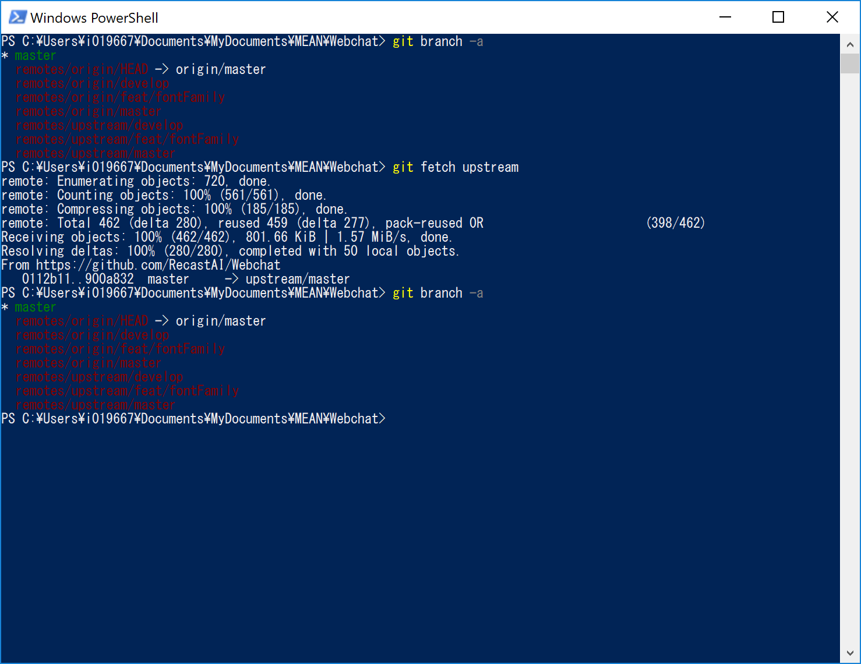
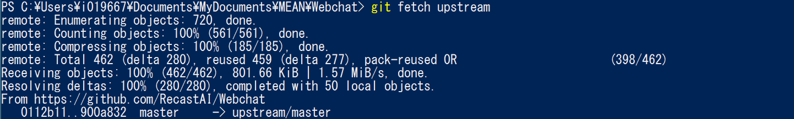

Slide 17
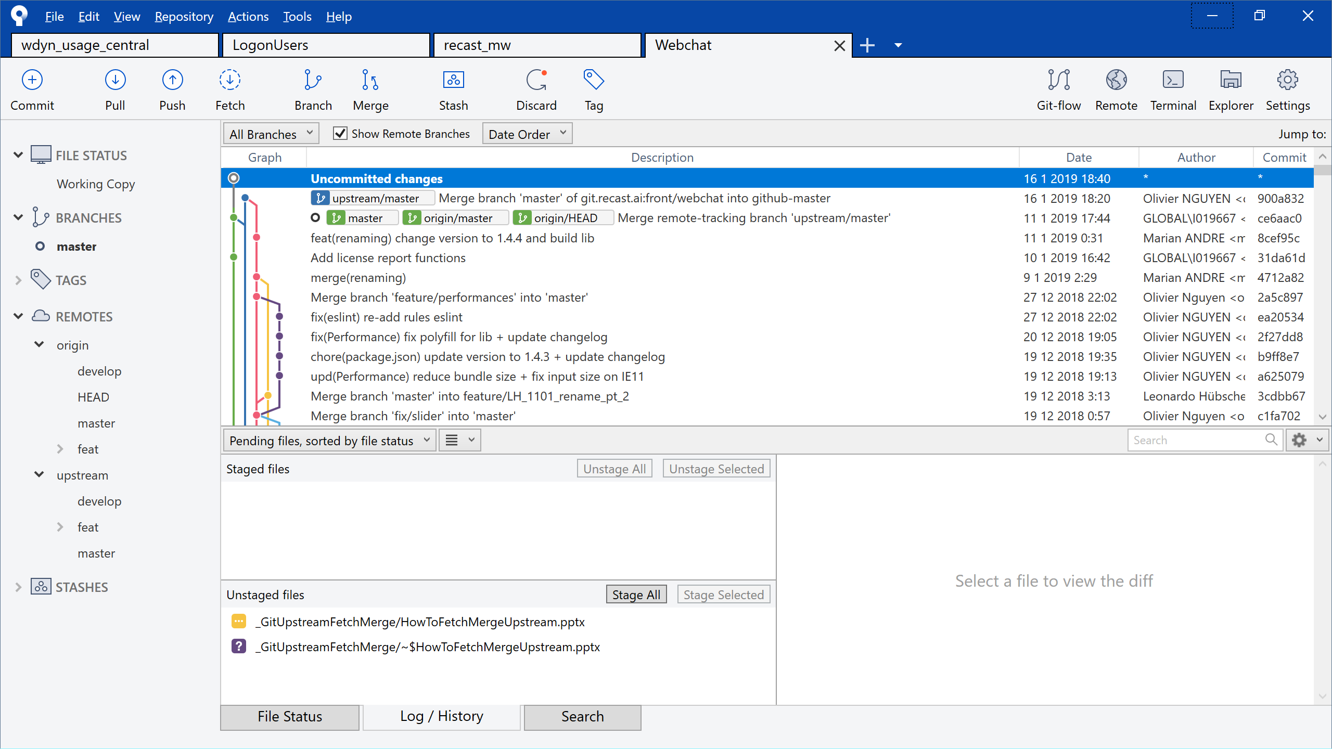

Slide 18
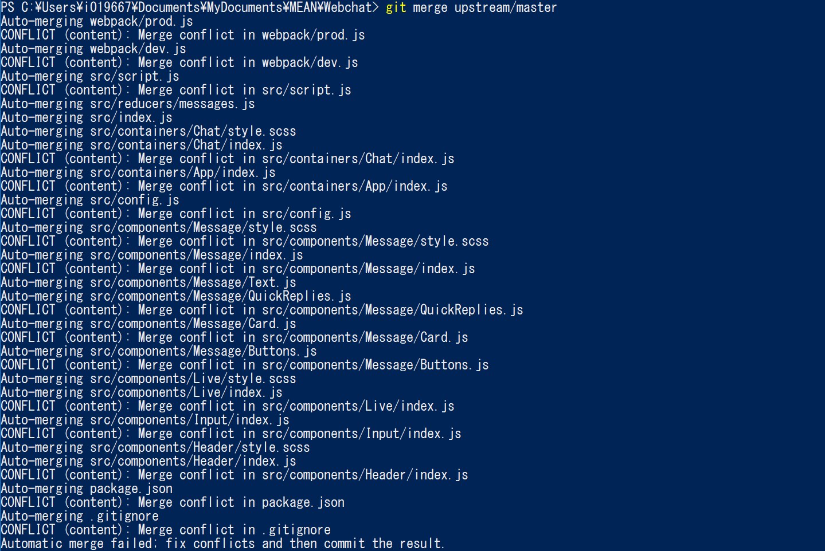
Execute “git merge upstream/master”

Slide 19
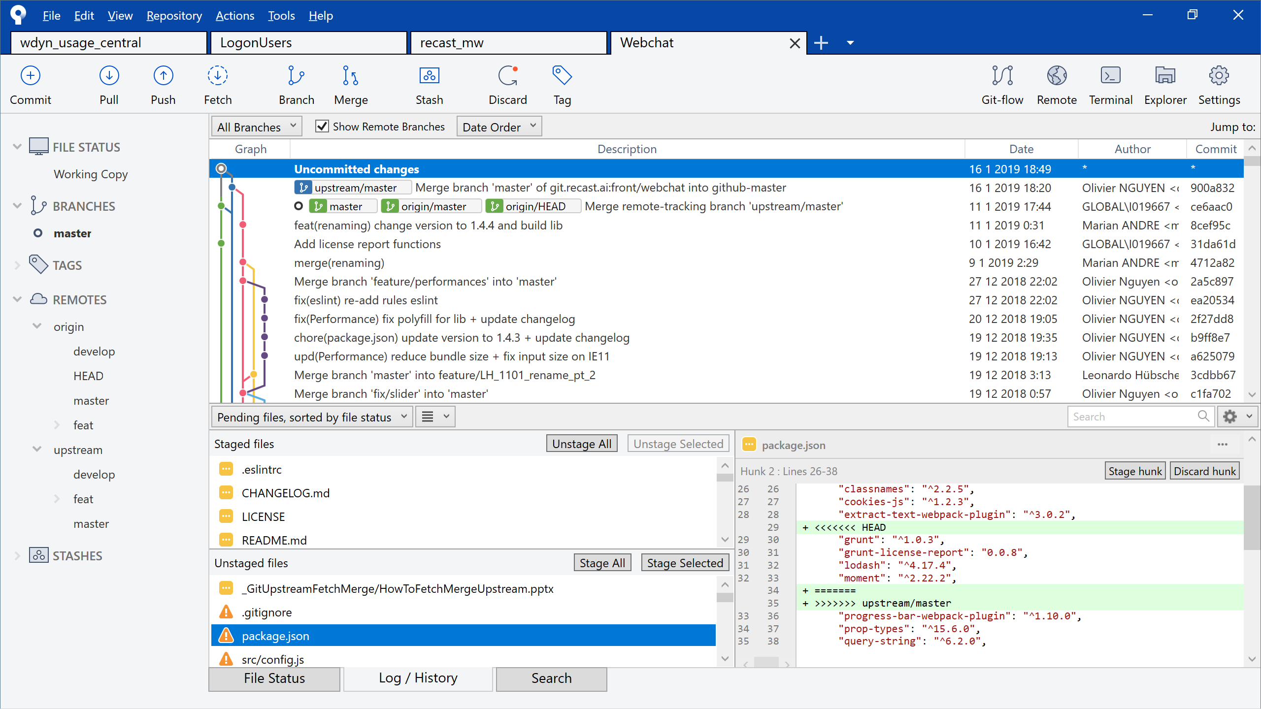
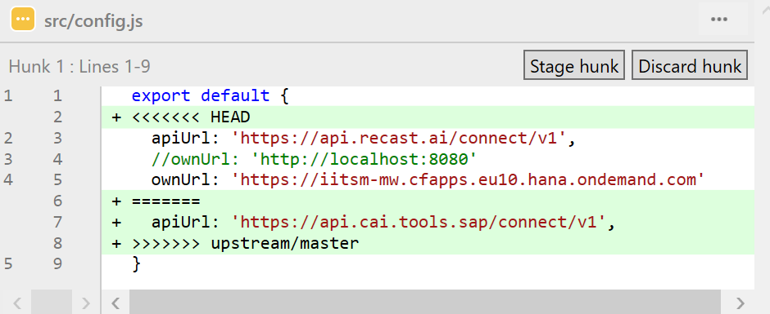
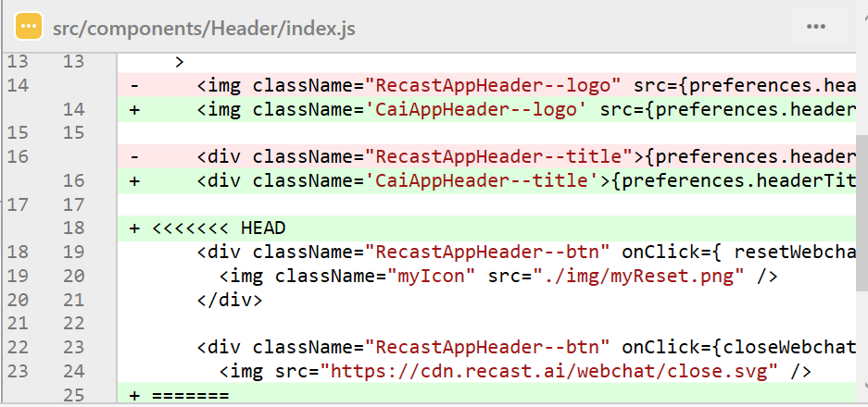
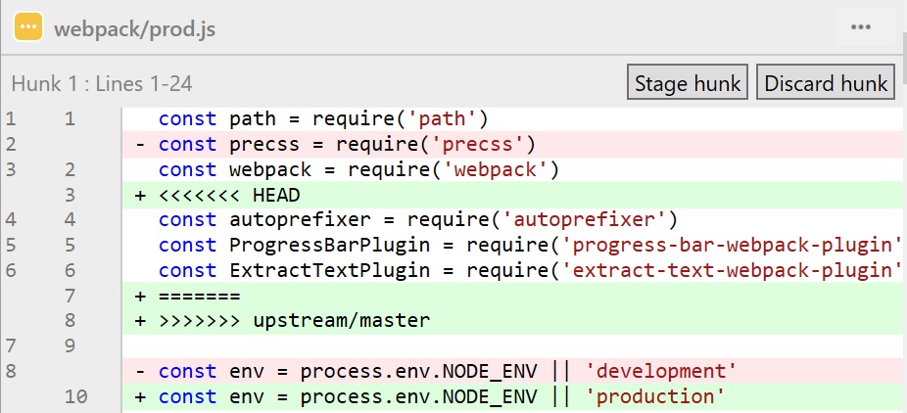
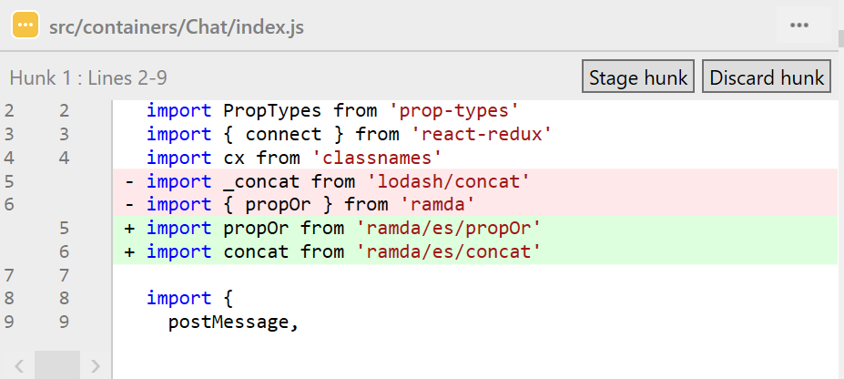
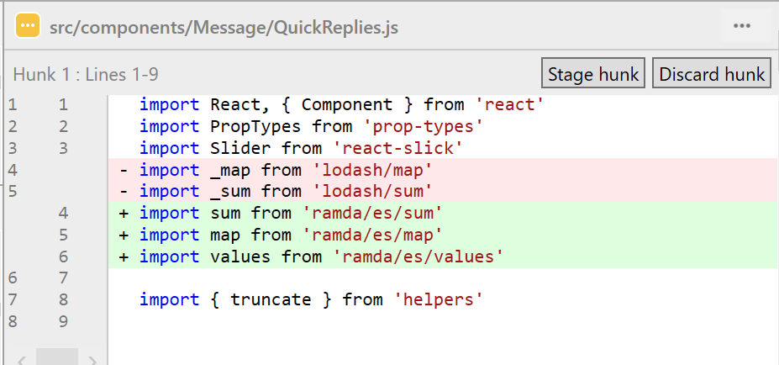

Slide 20
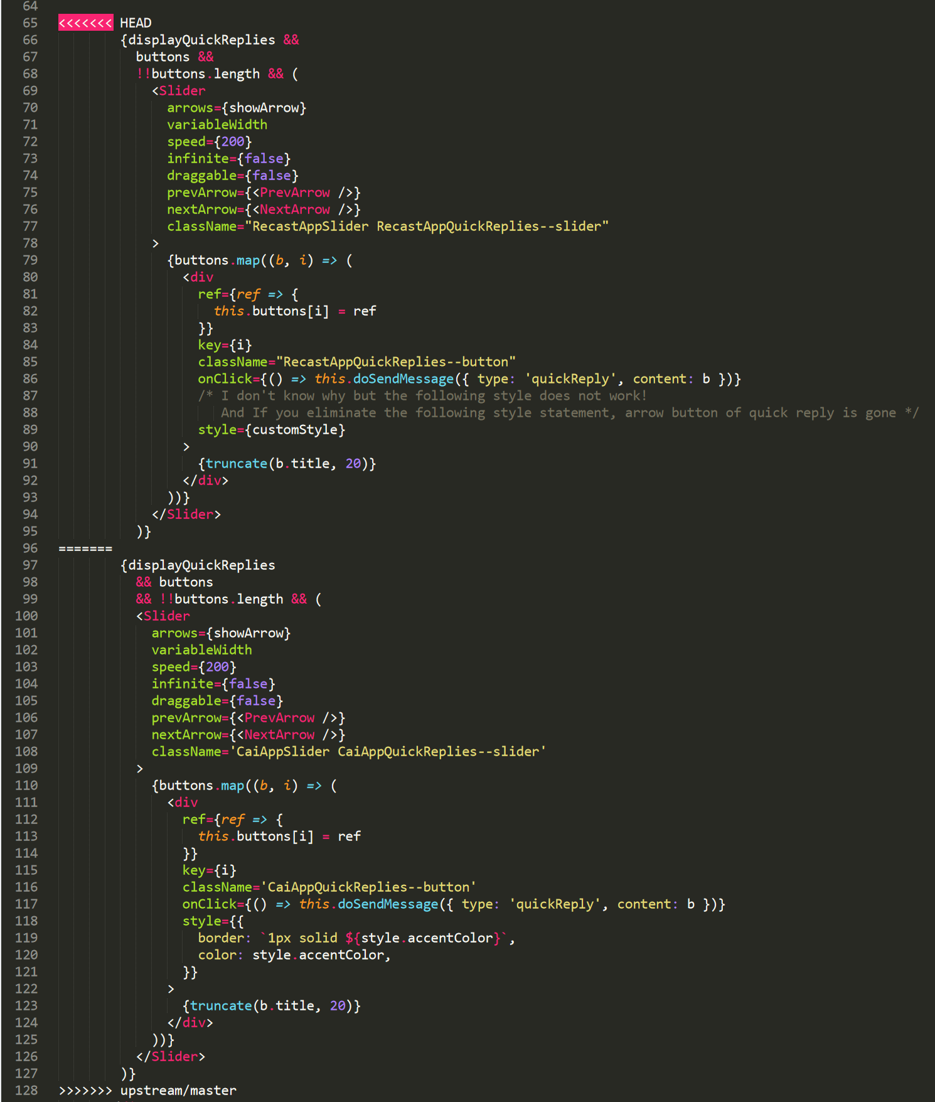
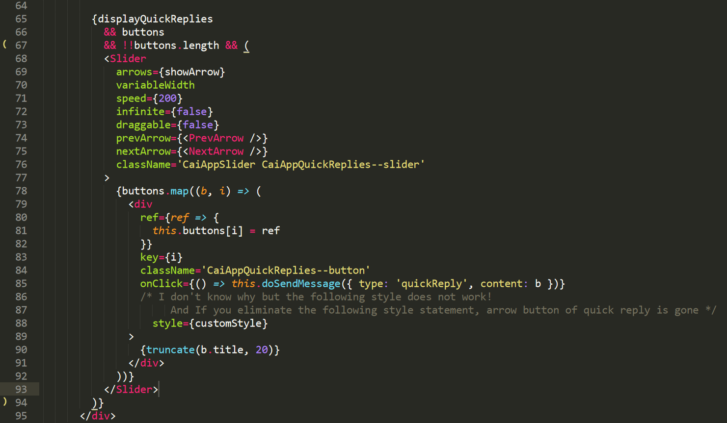
Src/components/Message/QuickReplies.js
① Replace
② Keep this part because several class names are new

