Slide 1
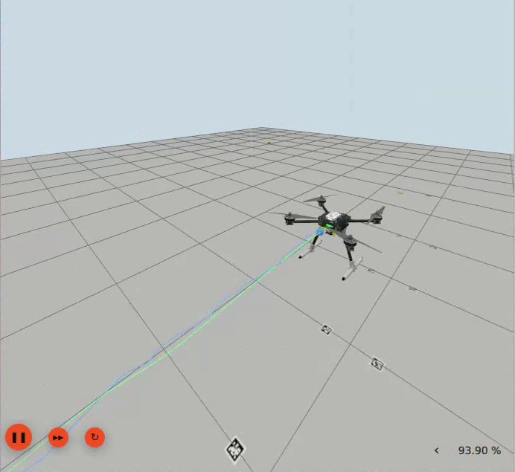
Indoor positioning with an IMU at the core
Embien Technologies · Problem 4 · Transfinitte'26, NIT Tiruchirappalli
MAJoRS
Phone IMU → measured noise model → 15-state ESKF, aided by AprilTags on real hardware and by UWB in simulation and on a public dataset
3.9 cm
13.8 cm
13.5 cm
RMSE · Gazebo drone + UWB
RMSE · i-ASL UWB dataset
end error · 33.8 m real walk
Gazebo: PX4 drone over the tag track, live ESKF path (blue) on top of ground truth (green)
Notes:
MAJoRS: Michelle, Aditya, Joshua, Rahul, Saiprakash. Problem 4. One sentence: we measured our phone's IMU properly, built one 15-state ESKF tuned from that measurement, and showed it on a simulated drone, a public UWB dataset and real hardware.

Slide 2
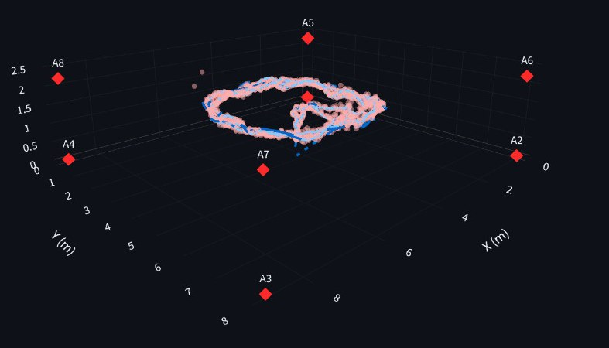
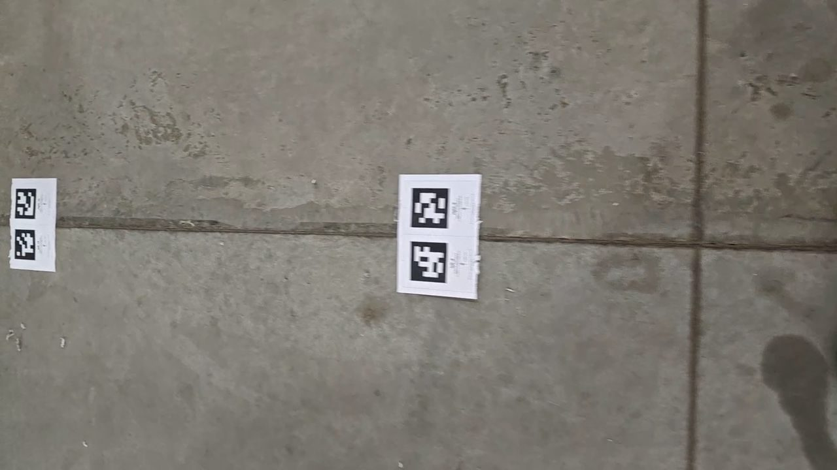
One ESKF, three test beds
Overview
Phone IMU
ADB streaming
Calibrate + model
15-state ESKF
Position + GUI
Bosch BMI26x in a CPH2661, accel + gyro at 395 Hz
SensorServer app: every sample, hardware timestamps
bias, then Allan noise N · B · K per axis
predict at IMU rate, correct with an aid
3D trajectory, live plots, automatic reports
Absolute aid AprilTag pose (real) · UWB ranges (sim, i-ASL) · gravity for tilt
SIMULATION
PUBLIC DATASET
REAL HARDWARE
Gazebo drone + 8 UWB anchors
i-ASL flight, 8 real UWB anchors
Handheld phone on an AprilTag track
3.9 cm
13.8 cm
13.5 cm
live RMSE vs ground truth, 1514 samples
3D RMSE over a 100 s flight
end-point error after 33.8 m
Notes:
Read left to right. Raw phone IMU over ADB, every sample kept with its hardware timestamp. Bias and noise measured from a 1-hour static run. Those numbers set the ESKF's process noise. The ESKF predicts at IMU rate and is corrected by an absolute aid: AprilTag pose on real hardware, UWB ranges in Gazebo and on i-ASL. Then the three test beds and their headline numbers.

Slide 3
Where we stand against the brief
Problem 4 tiers
Tier | Target | What we measured | Status
1 · Core | Calibration, orientation filter, under 1 m over the first 30 s | Bias and a full Allan noise model from 1 h static. Attitude ESKF 0.4–1.3° RMSE on synthetic motion with the phone's noise. The bare IMU is 7.46 m off at 30 s, so we aid it: the aided ESKF stays under 1 m for the first 30 s of the real walk. | Met with an aid
2 · Main | ≤ 3 % of distance on a marked 50 m path, return-to-start reported | Real walk of 33.8 m: end point 13.5 cm from the AprilTag fix (0.4 % of distance). Return-to-start: ESKF 0.95 m, camera 0.90 m (the walk ended 0.9 m from its start). | 33.8 m done · 50 m run next
3 · Bonus | Low-cost aid keeps error under 0.3 m (or fixed-point on an MCU) | AprilTags: median 2.4 cm while tags are in view, 10.5 cm with the camera blanked half the time. UWB: 3.9 cm in Gazebo, 13.8 cm on i-ASL. | Met with tags / UWB · no MCU port
Aids we used, stated exactly Real walk: AprilTag fiducials + gravity. Gazebo: 8 UWB anchor ranges + gravity. i-ASL: 8 UWB anchors + magnetometer. No ZUPT, no wheel odometry, no map constraints.
Notes:
Be upfront: the bare IMU fails Tier 1 on this phone (7.5 m at 30 s), which is exactly why the brief allows aiding. With an aid we are well inside Tier 1 and Tier 3 numbers. Tier 2 asks for a 50 m path; our recorded real walk is 33.8 m, so that run is the first next step.

Slide 4
How the five of us got here
Team MAJoRS
1
Whole team
2
Aditya Ganta
3
Joshua John
4
Saiprakash
Surveyed filters, from complementary and Mahony / Madgwick to EKF and ESKF, then split the work
Calibration procedure for the IMU and the bias calculations
Raw phone IMU on the laptop via Developer options, ADB and the SensorServer app
Live orientation GUI; fixed Android signal issues; static runs on all 6 channels → noise model and drift analysis
5
Rahul → Michelle
6
Michelle & Rahul
7
Joshua → Rahul
8
Whole team
Kalman filter on synthetic Gaussian signals, then re-run with the measured Allan noise model
UWB as the correction sensor: ESKF positioning on the i-ASL dataset Michelle found
Gazebo drone carrying UWB; Rahul's live ground truth vs IMU + UWB ESKF
No UWB hardware, so the same filter went onto a real phone with AprilTags as the aid
Orange: real phone and hardware · teal: filter and dataset · blue: simulation
Notes:
Credit each person by name while walking the eight cards in order. The thread: measure the sensor, model its noise, build the filter on synthetic data, prove it with UWB on a dataset and in simulation, then take it to hardware with the aid we could actually build.

Slide 5
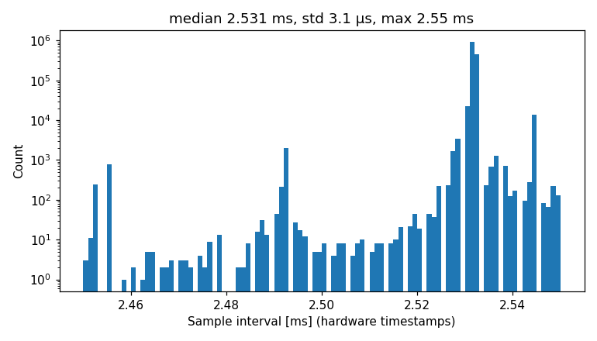
Step 1: get every IMU sample out of the phone
Real phone data
Joshua John · Saiprakash
Polling the latest value lost about half the samples
395.0 Hz
3.0 µs
0 lost
Fix Keep every SensorEvent with its hardware timestamp
accel and gyro, same clock
timing jitter (std)
of 1,422,283 samples in 1 h
Android's calibrated streams hide the bias we want to measure
Fix Record the uncalibrated accelerometer and gyroscope
Sensors throttle in the background or with the screen off
Fix The console checks USB, Stay awake and SensorServer in front before every run
The phone does not expose the IMU temperature
Fix Log battery temperature over ADB every 10 s as a proxy
Sample intervals over the 1 h static run, from hardware timestamps
A fixed-interval assumption would add only 0.16° of heading error in that hour, so timing is not where drift comes from.
Notes:
Four Android problems we hit and how each was fixed. The proof is on the right: a full hour at 395 Hz with 3 microseconds of timing jitter and not one lost sample out of 1.42 million per sensor.

Slide 6
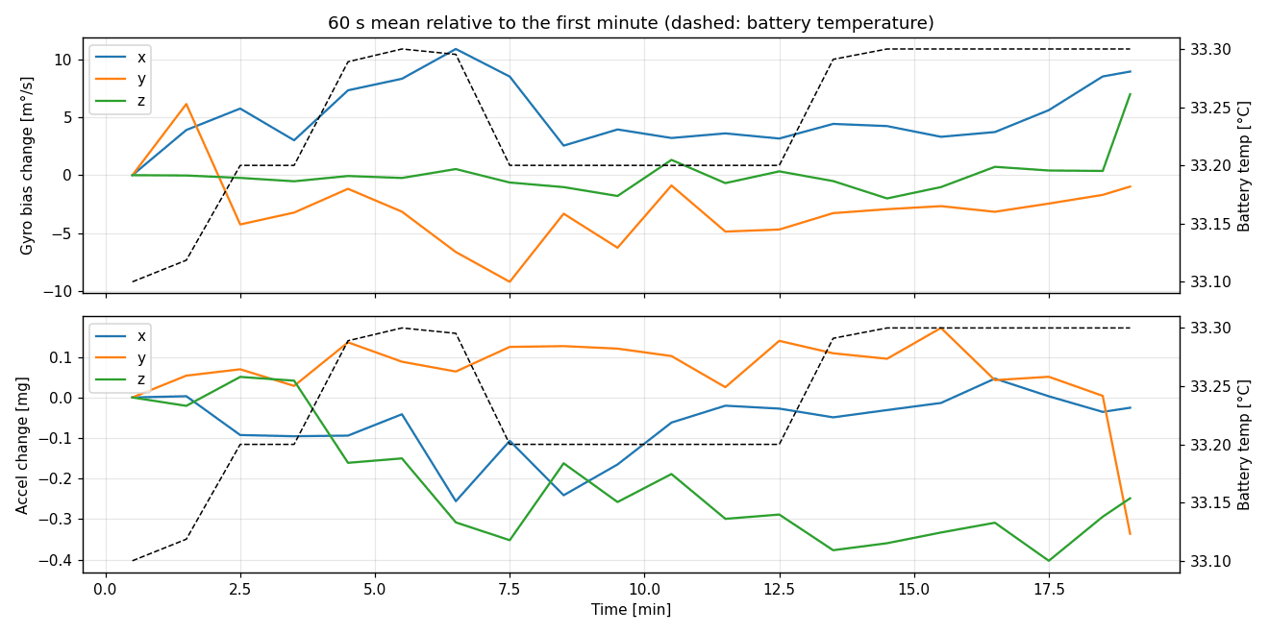
Step 2: calibrate the bias first
Real phone data
Aditya Ganta
Error model (Tedaldi, Pretto, Menegatti, ICRA 2014)
0.21 · −0.34 · 0.11
9.839 vs 9.78 m/s²
a = T_{a} K_{a} (a_{S} + b_{a})
ω = T_{g} K_{g} (ω_{S} + b_{g})
T misalignment · K scale · b bias · S raw sensor reading
°/s gyro turn-on bias, x · y · z
|a| at rest vs local g: 0.06 m/s² of scale/bias
1
Hold still, average
Mean gyro over a still period gives the turn-on bias; the gravity direction gives initial roll and pitch.
2
Multi-position fit
Detect static intervals, then least squares for T, K and b; the six-position method is the baseline.
3
Align longer
What averaging leaves behind is N / √t_align, the largest static drift term, so a longer still start cuts drift.
60 s mean bias over 20 min: gyro wanders ±10 m°/s and tracks the battery temperature (dashed)
The multi-position fit is coded (nav/calib.py) and checked on synthetic data with known errors; a multi-pose run on the phone is next.
Notes:
Aditya's procedure. The error model is the standard multi-position one from Tedaldi et al. The numbers that matter on this phone are the gyro turn-on bias, about a third of a degree per second, and the accel magnitude 0.06 m/s^2 above local g. The plot shows the bias is not constant: it follows temperature, which is why the filter keeps estimating bias online.

Slide 7
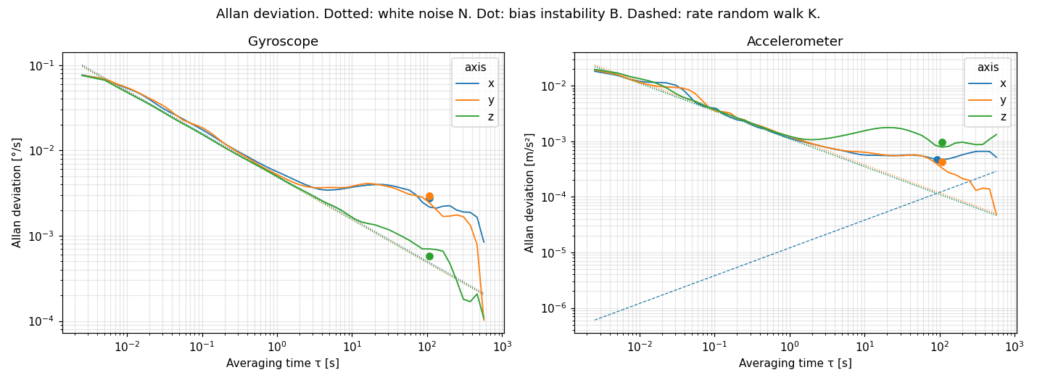
One hour on a table: the phone's noise fingerprint
Real phone data · 1 h static
Saiprakash
 | Gyro | Accel
White noise N | 4.8–5.1 m°/s/√Hz | 112–121 µg/√Hz
Random walk | 0.30 °/√h | 0.07 m/s/√h
Bias instability B | 15 °/h x, y · 3 °/h z | 65–146 µg
At τ | ≈ 107 s | 93–107 s
1,422,283
−½ slope white noise: averaging helps until about 100 s
samples per sensor in the hour
Flat bottom bias instability, the floor on how well a bias can be known
0.69 %
Rising tail temperature drift as the phone warmed from 33.1 to 35.6 °C
of the hour disturbed (people walking past), found and cut out automatically
Notes:
Saiprakash's 1-hour static recording, all six channels. Allan deviation: the minus one-half slope is white noise, the flat bottom is bias instability. These N, B and K values are exactly what goes into the filter's Q matrix and into the simulator's noisy IMU.

Slide 8
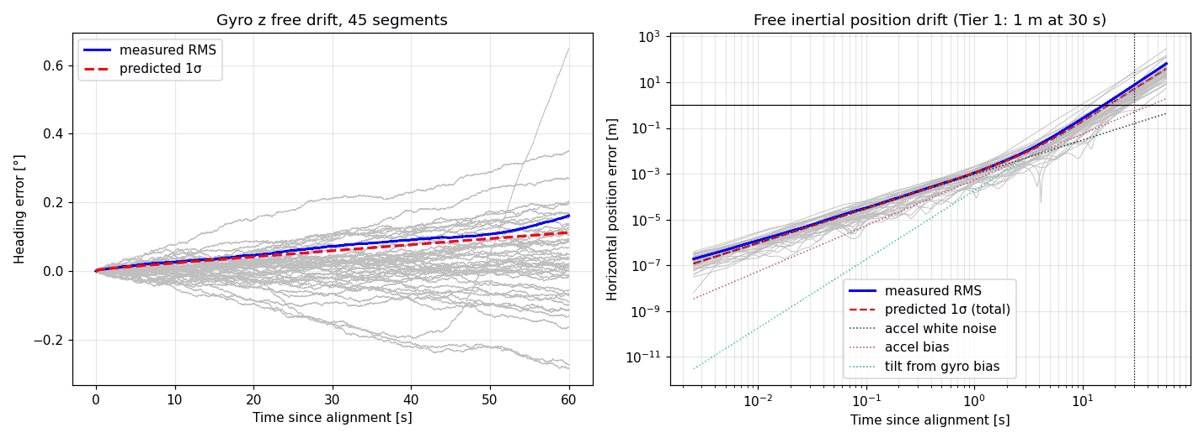
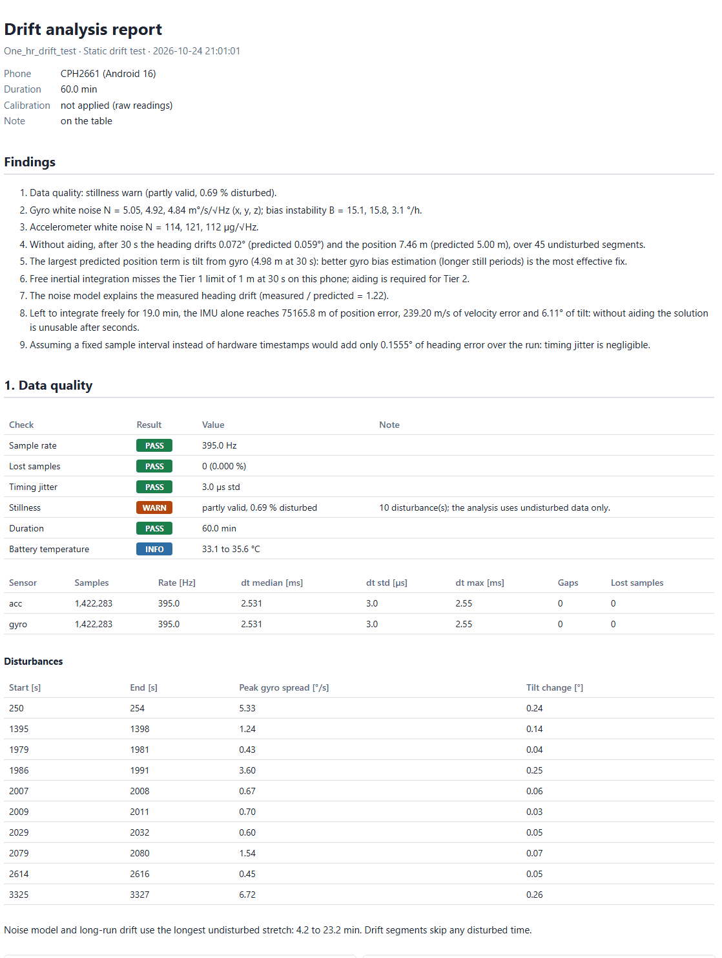
Unaided, the IMU is 7.5 m off after 30 s
Real phone data · 45 segments of 60 s
Saiprakash
0.072°
7.46 m
4.98 m
75 km
heading at 30 s (model 0.059°)
position at 30 s (model 5.00 m)
of that from tilt by gyro bias
after 19 min free, 6.1° tilt
The model explains the drift (measured / predicted = 1.22) and names the culprit, so every test bed carries an absolute aid.
Saiprakash's console writes this report after every recording: findings, data-quality checks, noise model, drift
Notes:
45 back-to-back 60 s segments of the static hour, integrated freely. Heading drift matches the noise model (measured over predicted is 1.22). Position blows up because a tiny gyro bias tilts the frame and gravity leaks into acceleration. That single term is 4.98 of the predicted 5 m at 30 s. Hence: every test bed uses an absolute aid.

Slide 9
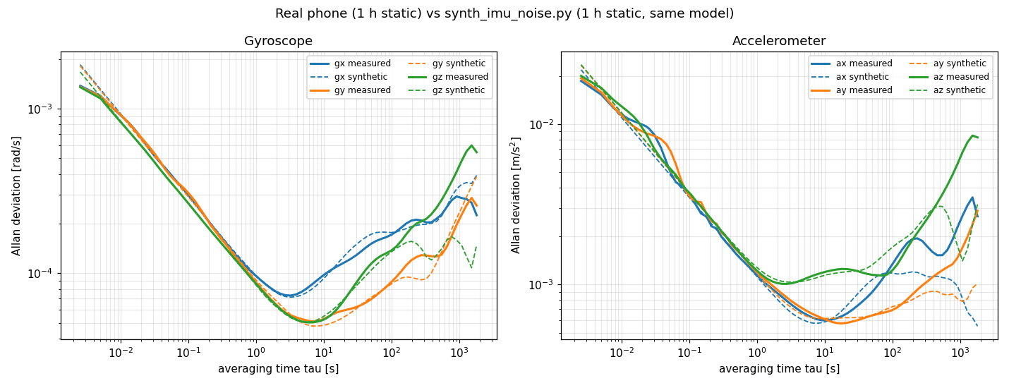
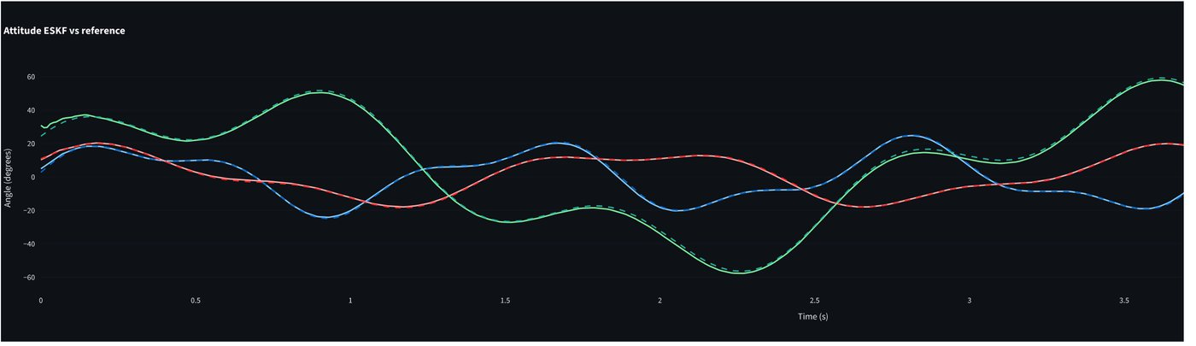
From Gaussian test noise to the phone's real noise
Synthetic motion + measured noise
Rahul → Michelle
Attitude ESKF (solid) vs truth (dashed): roll, pitch, yaw on a synthetic 5 s manoeuvre
RMSE | Attitude EKF (4 states) | 15-state ESKF
Roll | 0.38° | 0.51°
Pitch | 0.35° | 0.40°
Yaw | 1.12° | 1.34°
Real phone (solid) vs our generator (dashed), 1 h each: within 2–4 % (gyro) and 5–9 % (accel) up to τ = 600 s
One noise model, three users
Rahul's filter tests on synthetic trajectories
Gazebo /imu/noisy at 200 Hz: gyro σ 1.25e-3 rad/s, accel σ 0.017 m/s²
The ESKF's Q matrix: N² · dt, bias walk max(K², 2σ²/τ)
Auto-tune 20 Q / R pairs searched against truth; best Q = 0.001, R = 1 gives 0.70° overall. The ESKF trades a little attitude for position, velocity and bias states.
Notes:
Rahul first ran the Kalman filter on synthetic signals with plain Gaussian noise. Michelle then swapped in the measured noise model: white noise, Gauss-Markov bias, bias random walk and turn-on bias. The generator reproduces the real Allan curves. Attitude results on a synthetic manoeuvre, EKF vs ESKF, and a Q/R grid search.

Slide 10
The filter: a 15-state error-state Kalman filter
Same filter in every test bed
Rahul · Michelle · Saiprakash
next IMU sample
Why error-state
IMU
Predict
Update
Inject
The error stays small, so the linearisation holds through turns
Attitude error is a 3-vector; the quaternion stays unit-norm
Biases are states, learnt online as temperature moves them
ω, a at 200–395 Hz
strapdown p, v, q
P ← F P Fᵀ + Q
K = P Hᵀ S⁻¹
χ² gate on every fix
x ← x ⊕ δx
reset δx = 0
UWB ranges
AprilTag pose
Gravity
one scalar update per anchor, NIS gate
position + yaw, χ² gate, restart after 5 rejects
roll + pitch from the accelerometer
734 / 196
Gazebo · i-ASL
real walk
all test beds
AprilTag fixes used / gated out on the real walk; 13 restarts from the camera after 5 rejected fixes in a row
Error state δp, δv, δθ, δb_{a}, δb_{g} (15 states). Q from the Allan fit white noise N² · dt; bias random walk max(K², 2σ²/τ), so the filter is never more sure of the bias than the sensor allows.
Notes:
Same structure in all three test beds. Predict is plain strapdown integration at IMU rate, which is where drift comes from. Each aid is a measurement model into the same update, with a chi-square gate. Inject the error into the nominal state and reset. Q comes from the Allan fit, not from guessing.

Slide 11
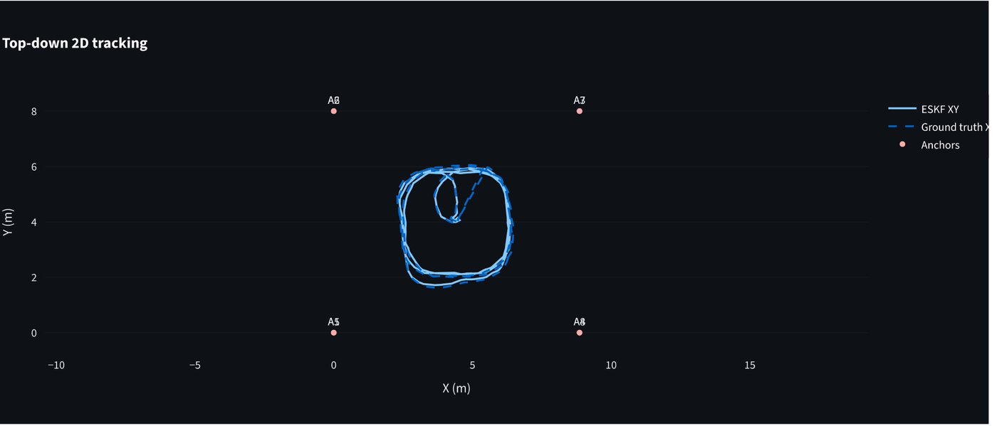
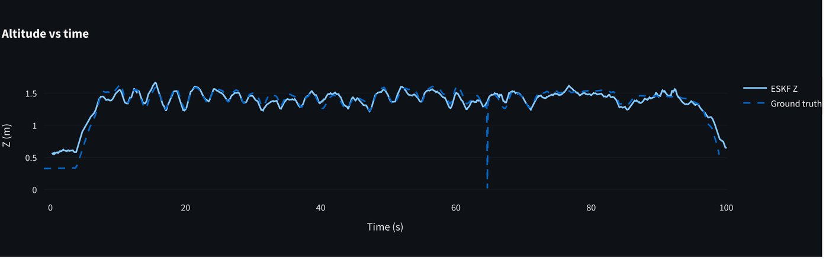
Real UWB data: 13.8 cm RMSE on the i-ASL dataset
Public dataset: i-ASL (GitHub)
Michelle · Rahul
13.8 cm
9.5 cm
39,917
99.8 s
Top: ESKF (solid) on ground truth (dashed), top-down. Bottom: altitude vs time. Every anchor range is a separate scalar update; outliers are rejected by NIS, so there is no fixed 3-anchor limit.
3D position RMSE
worst axis (z); x 5.6, y 8.4 cm
UWB ranges fused
flight, 8 anchors
Notes:
Michelle found the i-ASL dataset: IMU, eight UWB anchors and ground truth from a real flight. IMU and magnetometer predict; each anchor range is its own scalar update, so the filter uses every anchor it can see and drops outliers by normalised innovation. 13.8 cm 3D RMSE over 100 s.

Slide 12
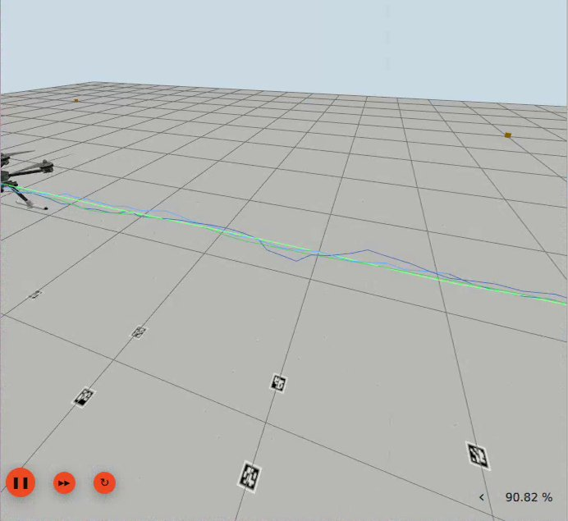
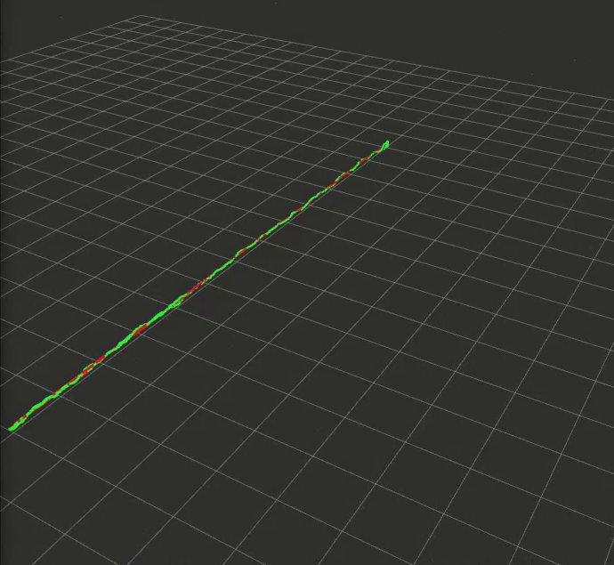
Gazebo drone: live ESKF within 3.9 cm of truth
Simulation: PX4 SITL + Gazebo Harmonic + ROS 2 Jazzy
Joshua John → Rahul
3.9 cm
live position RMSE vs ground truth, 1514 matched samples
PX4 x500 flying the 11.5 m track at 0.3 m/s, 1.1 m up
8 UWB anchors on a 12 m cube, 10 Hz, σ = 5 cm
/imu/noisy at 200 Hz with the phone's measured noise
22 AprilTags, same layout as our printed track
All in Docker: Ubuntu 24.04, PX4 v1.16
Left: Gazebo overlay, ESKF in blue on ground truth in green. Middle: the same run in RViz. Bottom: the node's own log; ground truth is used only for scoring.
Notes:
Joshua built the PX4 drone simulation over our tag track with eight UWB anchors on a 12 m cube. The noisy IMU carries our phone's measured noise. Rahul's live ESKF node fuses IMU and UWB ranges; ground truth is only used to score it. The node's own log reads 3.9 cm RMSE over 1514 matched samples.

Slide 13
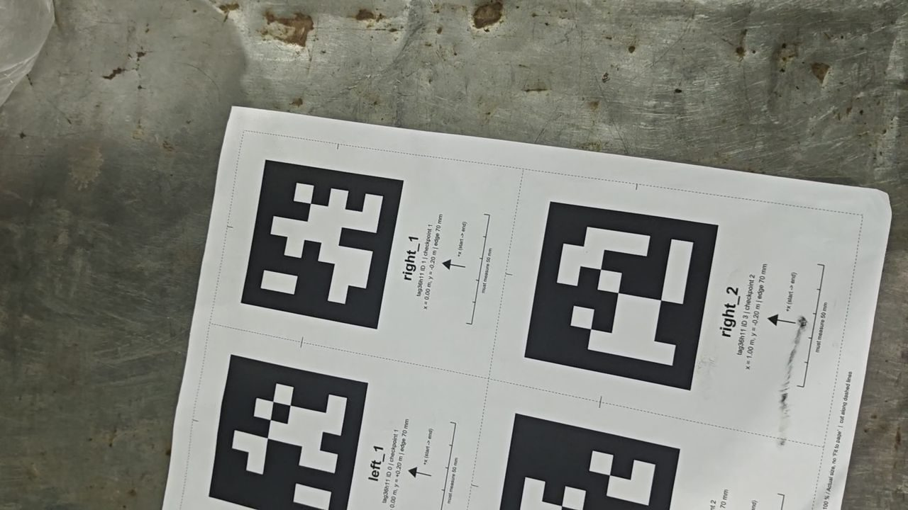
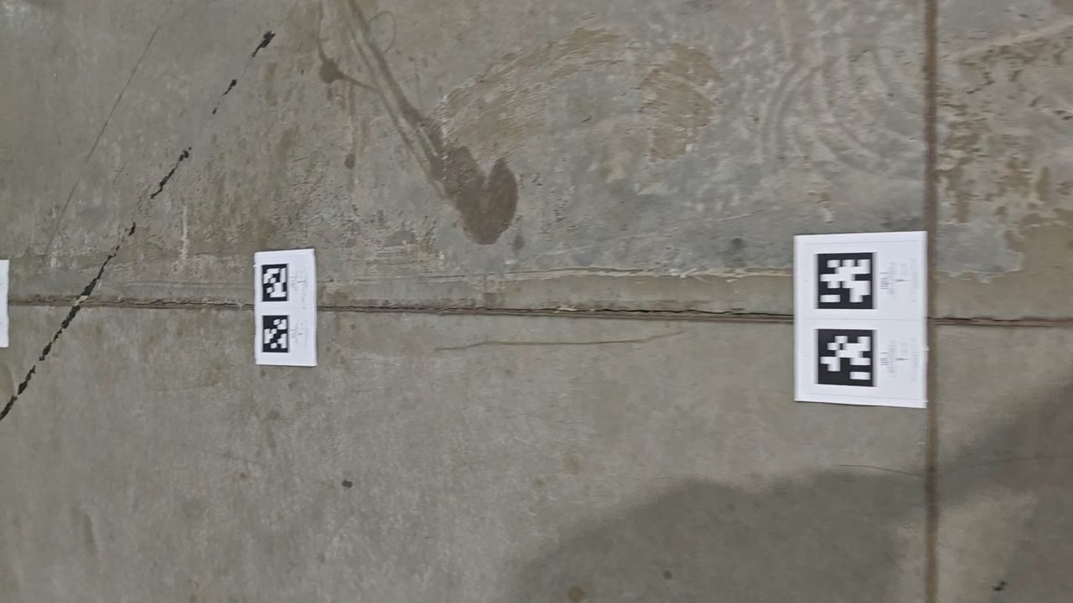
No UWB hardware, so AprilTags became our anchors
Real hardware
Whole team
1
Track
11 checkpoints 1 m apart, a pair of 70 mm tag36h11 tags at each
2
Rig
Phone in hand at about 1.0 m, back camera about 67° down; IMU at 395 Hz and 1080p30 video over one USB cable (record_walk.py)
3
Camera pose
OpenCV IPPE + Levenberg–Marquardt on the tag corners; fixes worse than 2 mm reprojection are dropped
4
Sync
0.3 s windows of camera rotation matched to the integrated gyro: video offset −9 ms; camera-to-IMU rotation is an axis swap
5
Why tags
An allowed low-cost aid that gives position and yaw, and doubles as ground truth
Frames from the phone's own camera: a checkpoint mid-walk (top), the first A4 test page and the start of the walk
Notes:
Fiducial tags are on the brief's list of allowed low-cost aids, and they also give ground truth. Printed track on the floor, phone in hand with the back camera looking down, one command records IMU and video together. Camera pose from the tags, time-aligned to the IMU by matching rotations.

Slide 14
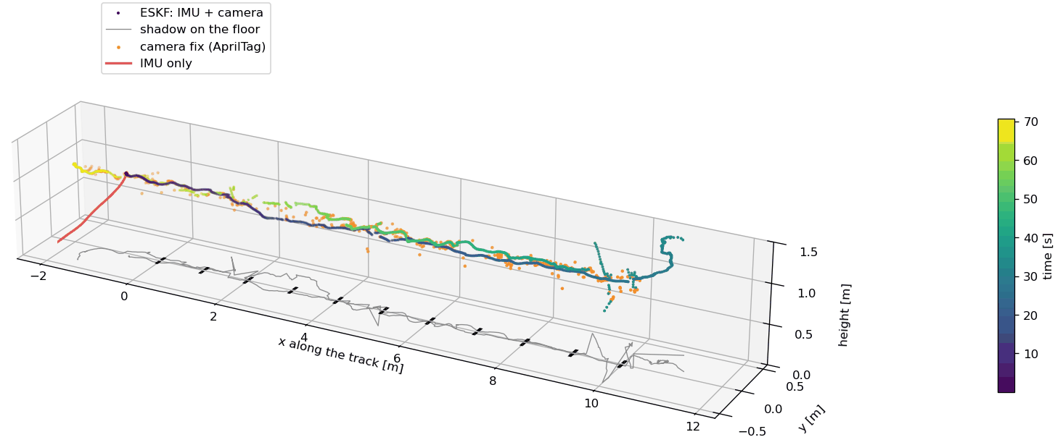
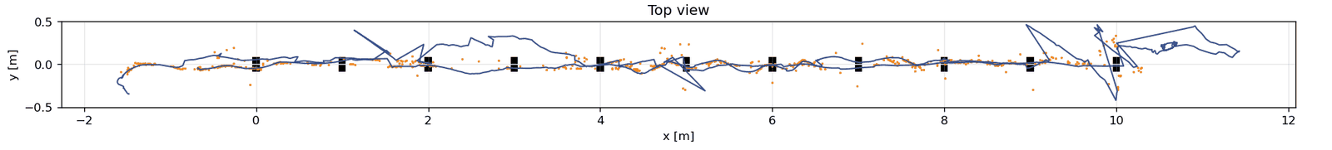
Real walk: 33.8 m, end point 13.5 cm off
Real hardware · walk_01
Saiprakash · whole team
33.8 m
walked in 70.8 s
44 %
of video frames see a tag
734 / 196
tag fixes used / gated out
13.5 cm
end point vs the last AprilTag fix
2.9 s
Top view: ESKF (blue line), AprilTag fixes (orange), checkpoints (black)
until the bare IMU is 1 m off
Notes:
walk_01: 70 s, down the 10 m track and back. Orange dots are AprilTag fixes, the coloured line is the ESKF over time, red is the bare IMU from the same start: it leaves the track within 3 s. Tags are visible in only 44 percent of frames; the IMU carries the estimate through the rest. The weak spot is the turnaround at the far end, 7 s without a tag.

Slide 15
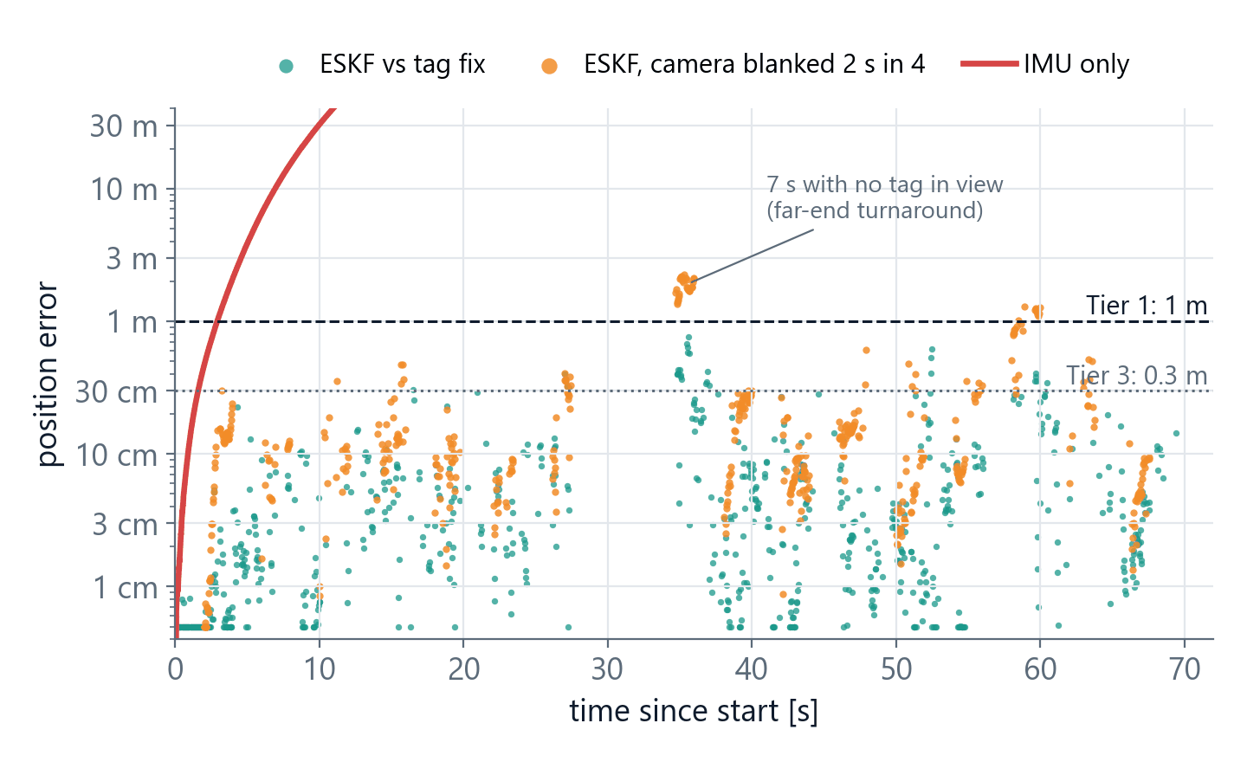
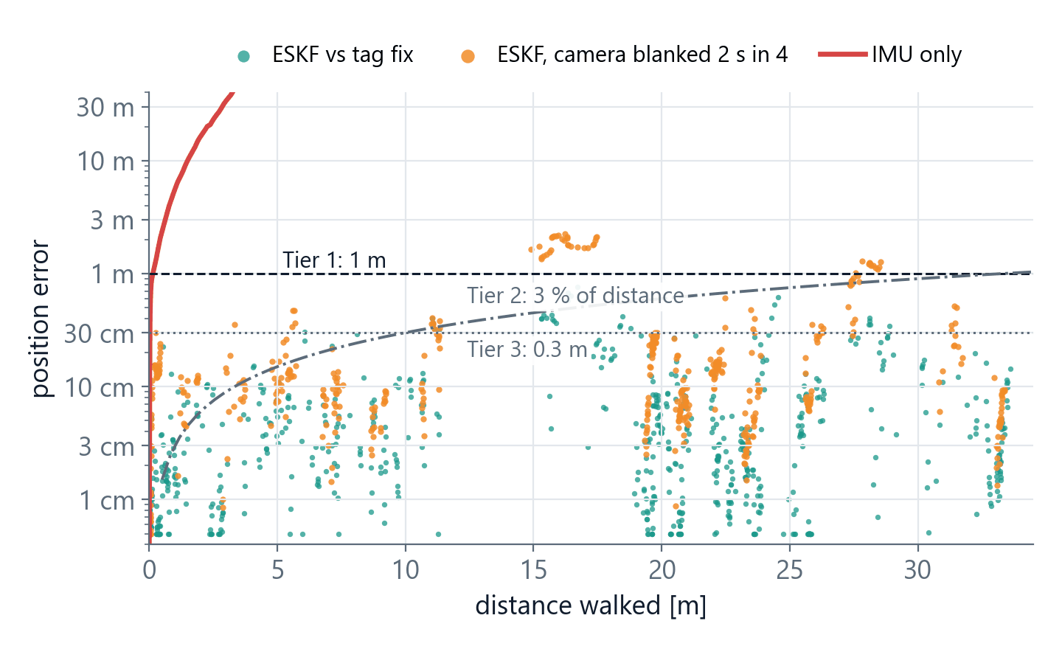
Error vs time and distance on the real walk
Real hardware · error analysis
Computed from walk_01
2.4 cm
10.5 cm
6 → 16 cm
≈ 2 m
median ESKF vs tag fix; 90 % under 15 cm (737 fixes)
median on held-out fixes, camera blanked 2 s in every 4 s
median bridging error, 0.5 s → 2 s after the camera drops
worst case: 7 s with no tag at the far-end turnaround
Notes:
The deliverable plots. Teal: ESKF against each AprilTag fix it saw. Orange: an honest test, the camera switched off 2 s out of every 4 s, error measured on the fixes the filter never saw. Red: bare IMU. The dashed lines are the tier limits; the dash-dot line is 3 percent of distance. The only excursion above 1 m is the 7 s turnaround with no tag in view.

Slide 16
Scorecard and what comes next
35
Accuracy
Next
cm-level with an aid on all three test beds: 3.9 cm sim, 13.8 cm i-ASL, 2.4 cm median on the real walk
50 m walk (5 × 10 m lengths) for Tier 2
More tags at the turnaround to close the 7 s gap
Checkerboard intrinsics for the phone camera
Multi-position calibration run on the phone
Fixed-point ESKF predict on a microcontroller
20
Filter and fusion
one 15-state ESKF: per-anchor UWB, tag pose, gravity, χ² gating, restarts
15
Calibration and drift
1 h Allan noise model, drift predicted vs measured (1.22), bias procedure
15
Real-time
live ROS 2 ESKF on the 200 Hz sim IMU; live phone console at 395 Hz; no MCU port yet
15
Docs and demo
repo with README, automatic drift reports, videos, interactive 3D trajectory page
Tools Python (NumPy, SciPy, OpenCV, PyAV, Matplotlib, Plotly, Streamlit), ADB + SensorServer, scrcpy, PX4 v1.16 SITL, Gazebo Harmonic, ROS 2 Jazzy, apriltag_ros, Docker. Data our own phone recordings and the public i-ASL dataset.
Notes:
Map to the rubric, then the next steps in priority order. The 50 m walk is the single most valuable next run for Tier 2.

