Slide 2
Data acquisition and management
Dr Peter Ansell
Data Scientist, BSc/BBus, BIT (Hons), PhD

Slide 3
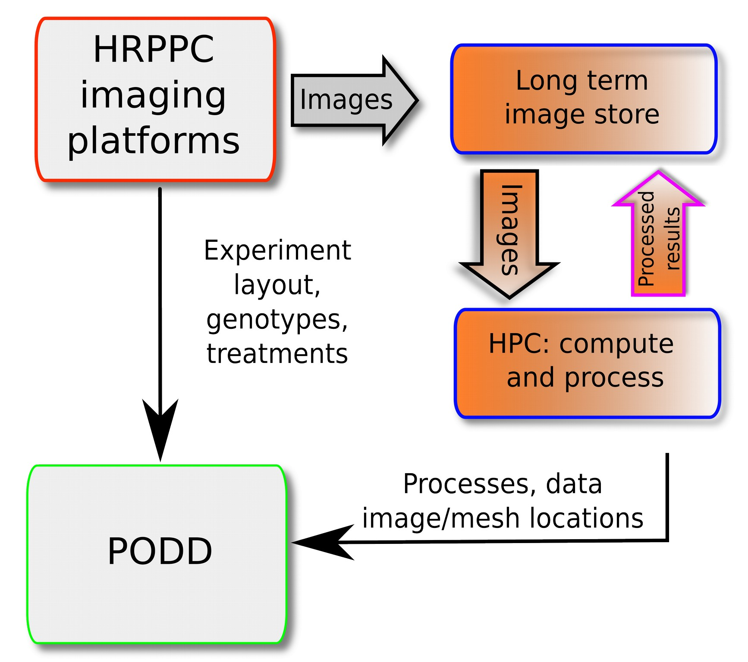
Overview

Slide 4
Data acquisition
Experimental layouts agreed on and encoded before experiment begins
Layout uploaded to machine databases and PODD
PODD is our metadata store to enable systematic integration of all of our platforms
Images and other measurements collected regularly using PlantScan, TrayScan, CabScan, Cropatron, etc.
Images stored on disks, specific to each platform, and acquisition metadata initially stored in SQL databases for each platform

Slide 5
Data management and processing
Images are batched up and sent to the CSIRO Datastore
CSIRO Datastore is backed up to a long term tape library
Images are processed on the CSIRO Pearcey cluster and in the near future on the NCI node of the Nectar Research Cloud
Results are sent to the CSIRO Datastore and backed up on tape

Slide 6
Data analysis
Results are aggregated based on the experimental layout that is found in PODD
Categories include:
  Genotype
  Pot
  Treatment
  Replicate
For each category, the average, maximum, minimum, standard deviation and count are computed for each day where data was acquired

Slide 7
Discussion
CSIRO Datastore capacity and a very large allocation to the HRPPC makes it possible to permanently store our very large datasets
Experimenting with new technologies and new species
Experimental layouts submitted to PODD and machine databases must be accurate for analysis to be useful
All species need to be tested in each of the desired platforms before data and image analysts can say whether analysis is likely to be useful

Slide 8
Future work
Further visualisation of data and results using Sapphire, including aggregation based on the experimental layout in PODD
Integration with genomics through the experimental layout and PODD
Acquire experimental layouts in a common form from experiments run on all platforms and store them in PODD
Expand the number of platforms that use the CSIRO Datastore for permanent archival of data
Expand the number of platforms that use fully automated cluster processing
Define data standards to enable other scientists to send us their images and experimental layouts for us to attempt to process them, in particular, for Mini PlantScan replicas
Reuse relevant specifications for dataset metadata, such as the W3C HCLS Dataset Description
Have an integrated approach to data management and processing

