Slide 1
Flexible scientific data management for plant phenomics research
Dr Xavier Sirault
CSIRO Plant Industry

Slide 2
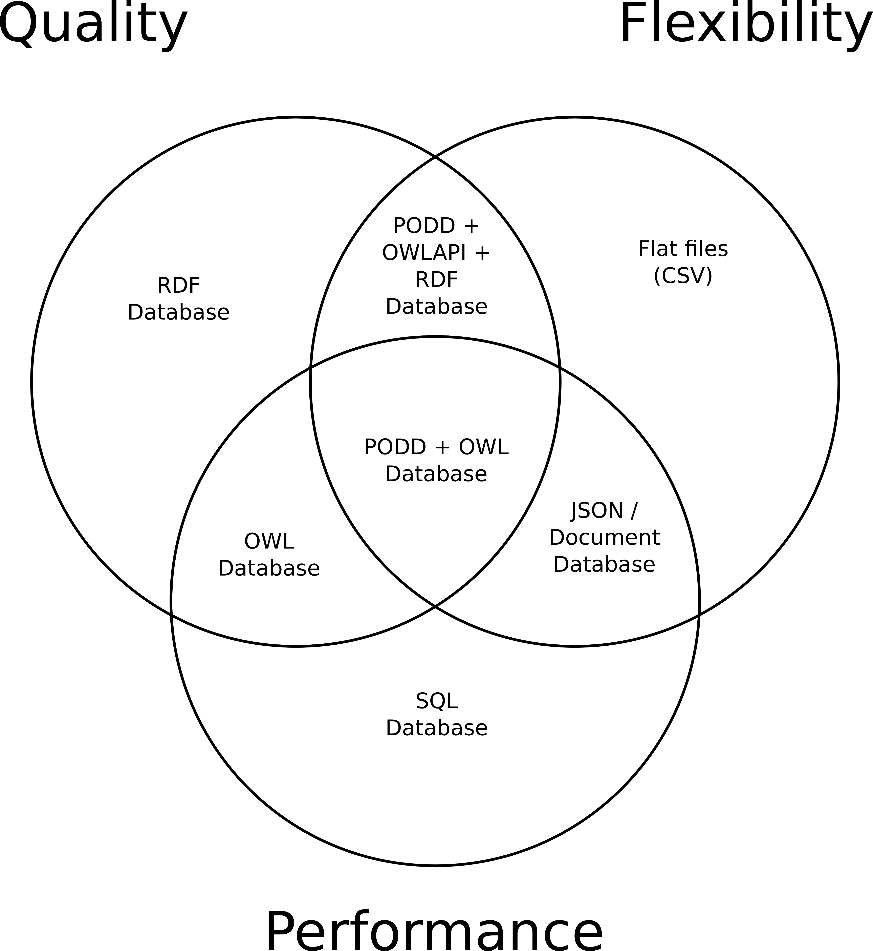
Database Management Tradeoffs

Slide 3
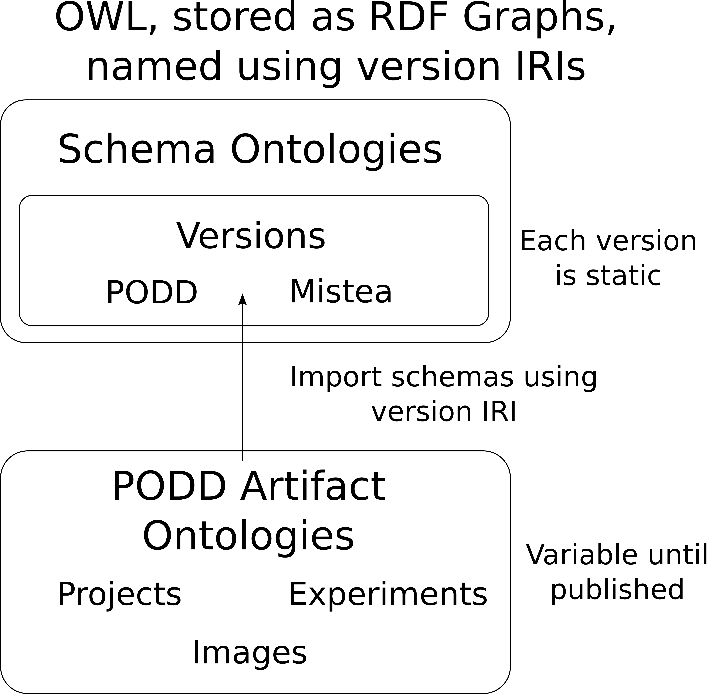
PODD Object Model

Slide 4
PODD Data Management
Quality
  Semantic and structural
  Both correct and complete
Flexibility
  Controlled, optional migration of data
  Based on OWL Version IRIs and OWL Imports
Performance
  Scales by OWL performance for updating
  Scales by SPARQL performance for querying

Slide 5
PODD Workflow

Slide 6
PODD Events
Event created in PODD for each set of images from a platform
Pots linked to images using events
Pots currently linked to:
  Genus, species, and wild type
  Planting date
Pots will be linked to more events in future:
  Watering
  Client reviews

Slide 7
Conclusion
Overall goal to allow for federated SPARQL queries across PODD instances to reuse existing plant phenomics data whereever possible
  Already implemented, but datasets are small so far
Flexible integration of all project management data for a research group in a single PODD instance using the most relevant schema ontologies in each project
Similar SPARQL queries across all artifacts, regardless of the schema ontologies they are currently using
  Results would be limited of course by the practicality of the query for the particular schema ontologies in use

