Slide 1




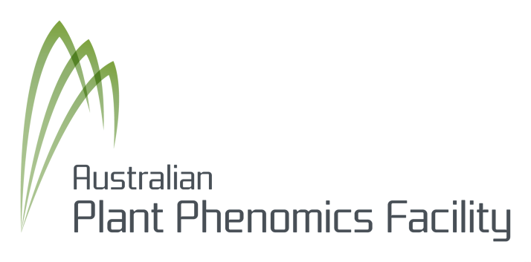
PODD
Phenomics Data: An Ontological Approach
Yuan-Fang Li, Faith Davies, Gavin Kennedy
eResearch Lab, School of ITEE, The University of Queensland {uqyli4,f.davies,g.kennedy1}@uq.edu.au
What is PODD?
Phenomics Ontology Driven Data Repository
NeAT (National eResearch Architecture Taskforce) project
Goals:
satisfy the data management needs of phenomics researchers in Australia
develop an online persistent data repository
support data capture, storage, annotation and publication
provide an integrated approach to the study of phenotypes
ontology-based integration and reasoning
Key stakeholders:
The Australian Phenomics Network (APN)
The Australian Plant Phenomics Facility (APPF)
Challenges & Proposed Solutions
The PODD Ontology
Data scalability
The management of very large amounts of data
iRODS as the data storage layer
Data perpetuity
Data should be retained indefinitely
Fedora Commons as the persistent repository
Extensibility & Interoperability
The repository should be extensible to accommodate new domain models & concepts
The PODD ontology will define essential domain concepts and allow for future extension
Data analysis
Providing ontology-based “context” around raw data to facilitate analysis
A conceptual model for phenomics research
Reuse & integrate components from well-known ontologies and datasets
The PODD Ontology
System Architecture
Major Features
Domain objects are typed
Rather than hard-wiring types (concepts), the PODD ontology is extensible
Defines domain concepts
Through OWL & RDF(S) language constructs
Enables the integration with other domain ontologies
Facilitates information reuse, integration & publishing
Leverages existing efforts in ontology development
Ensures extensibility
New concepts can be easily added by extending current ones
Requires Services to support the ingestion of new concepts & validation of objects against concepts
Data Acquisition
Organization of research activities in hierarchies – projects, experiments, etc.
Capture & management of experimental data – raw images, analysis files
Metadata capture
Annotation of domain data with free text or ontological terms
Data & Metadata Dissemination
Through publishing of objects on PODD web site
Through OAI-ORE for automated harvesting
Information Search
Free-text & faceted search
Semantic query through RDF & SPARQL

