Slide 1
MILESTONE 4 SQL FOR DATA SCIENCE CAPSTONE PROJECT

Slide 2
Milestone Week 04
Review Criteria:
Your presentation will be a culmination of the other milestones you completed in this project-based course. You will create your presentation using any media you choose and use the Rich Text Editor feature to submit your presentation.
For presentation ideas:
Look at DataBricks and markdown (notebooks)
Visualizations … raw data Infographics
Presentation Styles / Audiences
Reference SQL output vs. Visualizations

Slide 3
Milestone Week 04
Build on Project Proposal
Build on your project proposal (from Milestone 1) that described the client or dataset you chose, the approach you were going to take, your initial hypotheses, and your initial approach. Include descriptive stats and any visualizations from your data exploration. You want to highlight key learnings from your data exploration and any aha's or changes to your plan as a results of your findings:
Include Client/Hypotheses/Approach
Include artifacts from previous modules
Include results (good and bad paths); Correlations / regressions
Graphics / Visualizations
Discuss Insights Discovered
Discuss insights discovered (results from your diving deeper / going broader analysis). This is where you put your spin on what you’ve discovered
Discuss your hypotheses and any direct outcomes from whether you were right or wrong. Did you change your hypotheses? Or create new ones?
Discuss any metrics you created and why?
Discuss discoveries about relationships in the data / themes discovered.
Recommendations and Actions
Summarize the insights you found and make recommendations on what your client should do. What is the next steps or the action that should be taken as a result of your analysis?

Slide 4
TABLE OF CONTENTS
01
02
03
BUILD ON PROJECT PROPOSAL
DISCUSS INSIGHTS DISCOVERED
RECOMMENDATIONS AND ACTIONS

Slide 5
BUILD ON PROJECT PROPOSAL
01

Slide 6
BUILD ON PROJECT PROPOSAL
Question to answer
How has the participation of men and women changed over time?
Is there any relationship between age and medal obtained by athletes?
Does the performance of countries vary by season of game?
Initial Hypotheses
Yes, I think it has been changing as a function of time
It is likely that they do, having participants with an age range between 20 and 30 years.
Probably yes.

Slide 7
Number 1
Number 3
Data Analysis Approach
Number 2
Display a histogram plot
Calculate the standard deviation in the progress of the country over time.
Calculate Pearson's correlation coefficient.

Slide 8
Technical Chanllenges
Number 1
Number 2
There have been some difficulties in getting the starting year of the Summer Olympic Games to be different from that of the Winter Olympic Games.
Some queries at the pandas sql level were complicated by the existing limitations.

Slide 9
ERD (Proposal)

Slide 10
DISCUSS INSIGHTS DISCOVERED
02

Slide 11
Initial Findings
Among the main discoveries when looking at the more ordered data, it was that although the diversity in the participants increased over time, the difference is very marked between seasons. Likewise, the medals obtained as a function of time have been obtaining a more stable line, that is, it is normalized.
There are significant differences between male and female participants not only in expected height and weight, but also in age. The first two differences can be attributed to biology. Although the last one may require more than that: social factors are worth considering at the same time.
Although the ratio between summer and winter Olympics is indeed different, it turns out that men dominate. My first assumption is that the ratio of women to men has increased over time. I started digging into it.

Slide 12
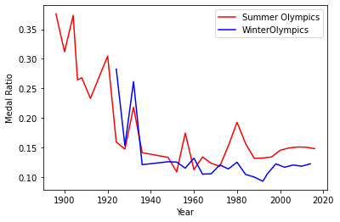
Initial finding
Over time, the proportion of medals fluctuated greatly in the competition seasons, but eventually stabilized. This can be interpreted as the establishment of standards on these issues.

Slide 13
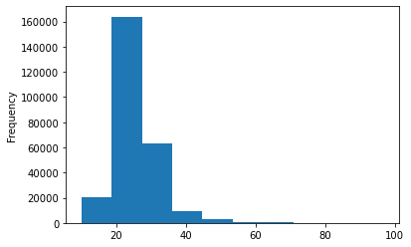
Initial finding
We can see that the age range of the athletes who won medals in the Olympics is mostly in the range of 20-30 years of age, in contrast to the number of participants.

Slide 14
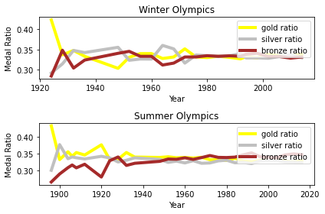
Initial finding
The different gold, silver and bronze medals have obtained relative percentages; however, they also have more stability, and this may be due to the reasons.

Slide 15
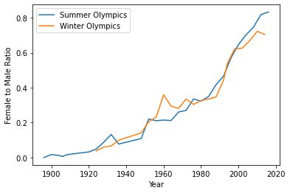
Initial finding
This assumption seems to be correct. Over time, the ratio of women to men has indeed increased. This is reflected in a more detailed analysis of the whole, by filters such as sports, city and year of competition.

Slide 16

Deeper Analysis
The length of the array of the number of medal count in the winter Olympics and summer Olympics are different because Winter Olympics started in 1924, but Summer Olympics started in 1896. Therefore, I must create a new shortened table of the summer Olympics started in 1924 to match the length of the winter Olympics.

Slide 17
Deeper Analysis
The Pearson correlation coefficient between the total number of medals in the winter and summer Olympics from 1924 to 2016, is 0.94, which is highly positive.
Therefore, the performance of a country in winter Olympics is highly correlated to that in summer Olympics.

Slide 18
Deeper Analysis
I will then calculate the standard deviation in country performance through years. A Comparison between average std of Winter and that of Summer Olympics will help.

Slide 19
475
Count summer olympics

Slide 20
153
Count winter olympics

Slide 21
Final
Number 1
Number 2
Number 3
Yes, a country's performance at the Winter Olympics is closely related to that of the Summer Olympics, i.e., with its seasonal variation
Yes, the age of the participants influences their medal haul
Women's participation has increased from 1896 to 2016

Slide 22
RECOMMENDATIONS AND ACTIONS
03

Slide 23

The information analyzed from this dataset can be quite useful for many groups, including sports sales managers, as they can invest in comfortable accessories for sports. Also, the sports equipment to be feasible to adapt to all ages, ease of movement, location, among others. Finally, if the data were better treated, the information could be exploited much more to make predictions based on the performance of athletes and increase the dissemination of sport to continue encouraging women to take part in these sports.

