Slide 1
Elsevier streaming AMs to U Florida
27 March 2017
Robert Phillips, U Florida

Slide 2
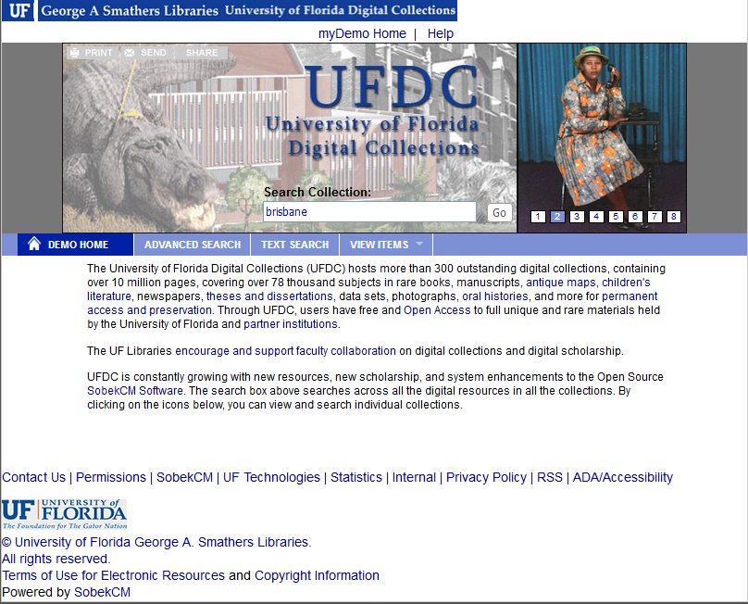
Main U Florida
Digital
Collections
web page
“brisbane”
entered into
search box

Slide 3
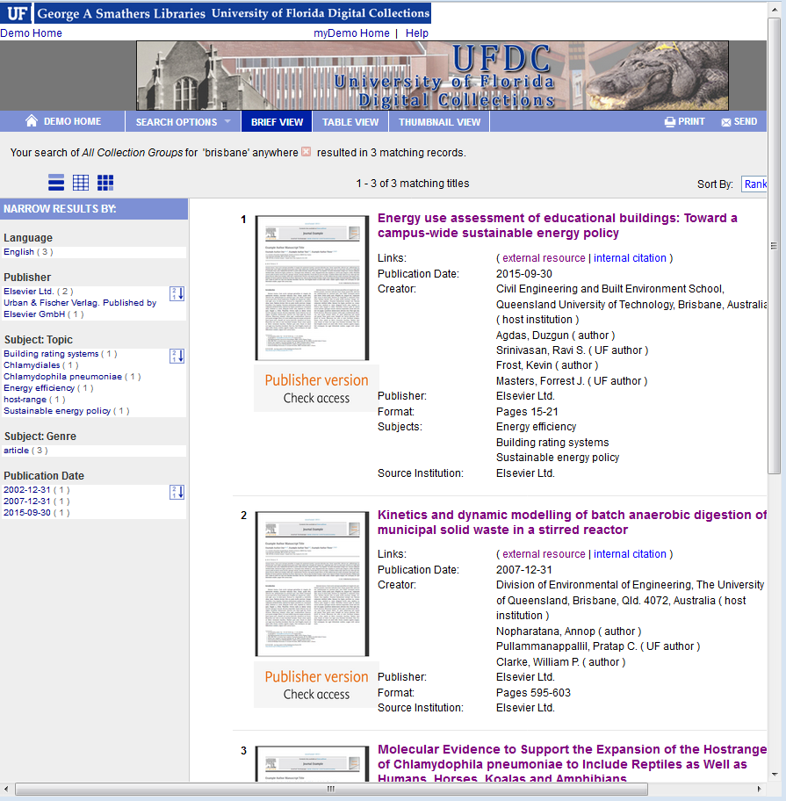
Results page for
search on brisbane
click

Slide 4
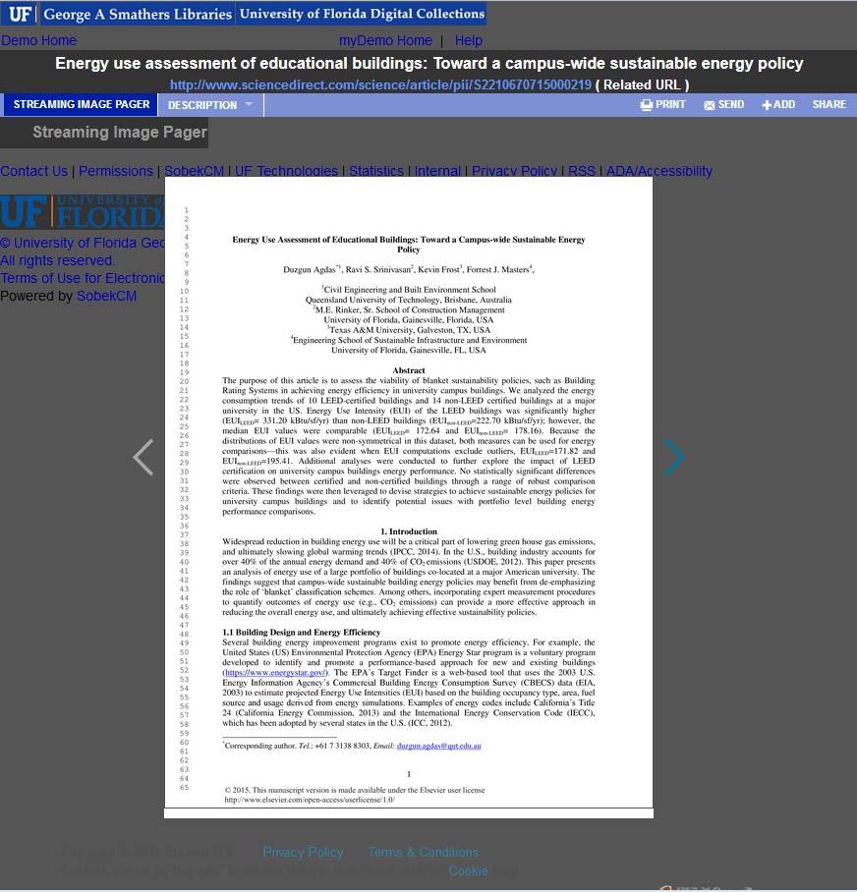
Page 1 of manuscript
that appears after
clicking first title link
in results
Author manuscript
is streamed from
Elsevier
click arrow for next page
Download PDF Text Version

Slide 5
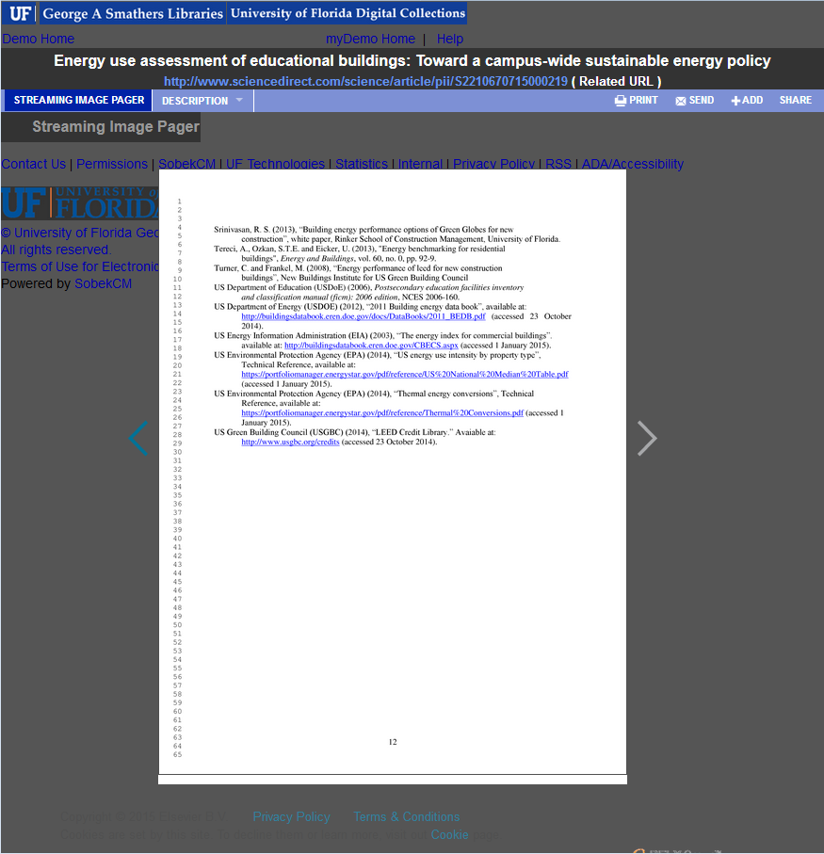
Final manuscript page
that would appear
after repeatedly hitting
right arrow of manuscript
until final page appears
Download PDF Text Version

