Slide 1
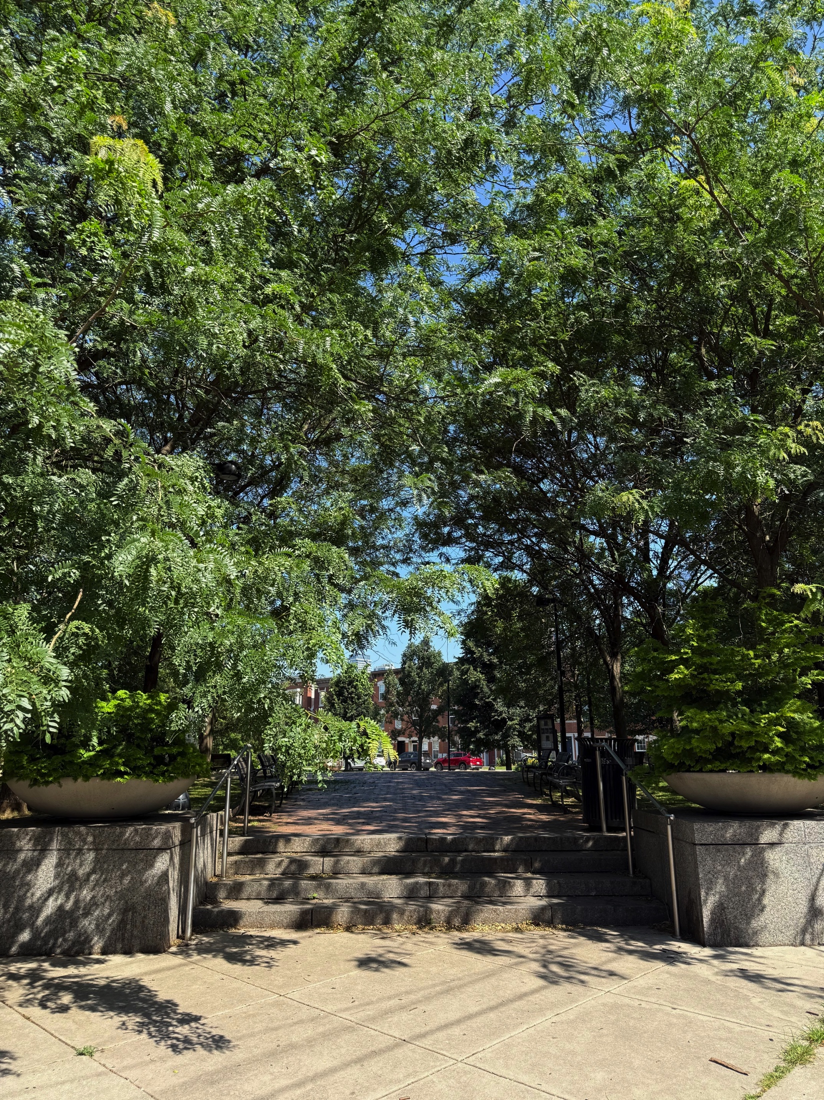
Hawthorne Empowerment Coalition
Community Meeting
6/26/2025

Slide 2
Interim Board
Co-Presidents: Daphne Watkins and Greg LaBier
Co-Vice Presidents: Gwendolyn Toler and Judith Thomas
Treasurer: Ann Lastuvka
Recording Secretary: Valerie King
Correspondence Secretary: Jacob Goldfischer
Communications Chair: John Kehayias
Arts Committee Chair: Kelly Korzun
Education Committee Chair: Gabby Thomas
Zoning Committee Chair: Ann Lastuvka

Slide 3
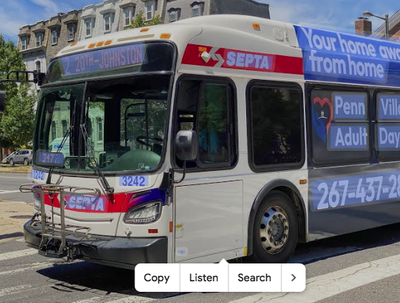
Agenda
Financial Report
Bylaws
Hawthorne Tree Cover Initiative
Arts Committee Update
Upcoming Events
Zoning Committee Update
Guest Speaker: Aaron Davis from
Representative Waxman’s Office will
give update on SEPTA Funding Situation

Slide 4
Financial Report
We have now gained access to HEC’s Bank Account from previous board president as of 6/20/2025.
Cash Position as of 6/25/2025
Checking: $10,283.34
Escrow: $63,256.30
Recent Expenses in Last Month:
1. Renewed HEC’s contract with ACAM (street cleaning services). $1230 Weekly. Paid $6,150 on 5/29/2025.
2. $10,000 (?) recently paid to recreation center for Ridgeway Park Improvements (paid out previously on 5/27/2025 by prior board president)
3. Community Organizer: Stan Horowitz.

Slide 5
Financial Report
Income YTD
No income has been brought in this year so far, but we are owed $65,000 from Post Brothers and Benchmark, with new bank access and Quickbooks, will send invoices shortly.
Expenses YTD: $38,278.16
Charitable Disbursements: $31,200
Academic Scholarships: $3,000
Sidewalk Sweeping: $6,200
Jazz in the Park: $7,000
Fanny Jackson Auditorium Improvements: $5,000
Ridgeway Park Improvements: $10,000
Community Organizer: $2,500
Directors and Officers Liability Insurance: $655
Community Meeting Mailings: $4,000

Slide 6
Other Updates
RCO Registration with Philadelphia City Planning Commission: June 1st – June 30th. To be done this week.
P.O. Box has now been set up.
Completed annual report to the state.
In process of renewing our RCO status
Daphne Watkins and Ann Lastuvka attended Crosstown Coalition’s Annual Meeting.

Slide 7
Bylaws
We need updated bylaws. This should be a priority for our RCO.
Should be a collaborative effort between interim board and community members.
Previous Bylaws are from 2002.
Previous Bylaws had two voting members ->
1. An attending member is a voting member who has attended at least 5 general meetings within a year and is eligible to vote on all community issues, in the annual election and on financial matters of HEC.
2. A general member is a voting member eligible to vote on all community issues.
3. Also had 5 different membership classes (Individual, Seniors/Disabled, Individual Patron, Small Business, Medium Business, Large Business
Notes:
Each voting member shall be entitled to one vote on any question brought before the membership of HEC. Business members shall be entitled to one vote per business and must assign a disignee to represent said business. The treasure of HEC shall certify that the voting member is an attending member or general member before the voting member shall be eligible

Slide 8
Bylaws
Quorum: A quorum at any given meeting of the membership shall consist of one-half of members; either present or represented by written proxy.
The boundaries of the Hawthorne Community -> are defined as area inclusive from 11th Street to Broad Street and from South Street to Washington Avenue

Slide 9
Bylaws
Proposed Changes (Up for Discussion)
1. Simplify voting members into one group. Requirements are proof of address within Hawthorne Community Boundaries and attendance of at least 3 community meetings in past 12 months.
2. Quorum shall consist of majority of voting members in attendance at any community meeting.
3. Remove membership classes

Slide 10
Hawthorne Tree Cover Initiative
Goal: Increase Tree Cover in Hawthorne Neighborhood
Benefits: Studies highlight the role of trees in mitigating urban heat island effect, improving air quality, reducing storm-water runoff, and providing habitat for wildlife.
Philadelphia has a goal to increase tree canopy cover to 30% by 2025
Meeting was held on 6/5/2026 with HEC Co-President Greg LaBier and Louis Bartholomew from QVNA (Queen Village Neighbors Association)
Two planting seasons for city trees: November and April. We will be preparing for next April season as application windows have already closed for November.

Slide 11
Hawthorne Tree Cover Initiative
Need door to door volunteers to help homeowners fill out tree applications.
Philadelphia Horticultural Society -> https://phsonline.org/programs/tree-programs/get-a-tree
New trees need weekly watering for 6 months after planting. They require ~10 gallons of water a week. Would be cost to homeowner for initial 6 months. We could explore HEC subsidy to homeowners to cover water costs for first 6 months.
First year goal: 10-20 neighbors

Slide 12
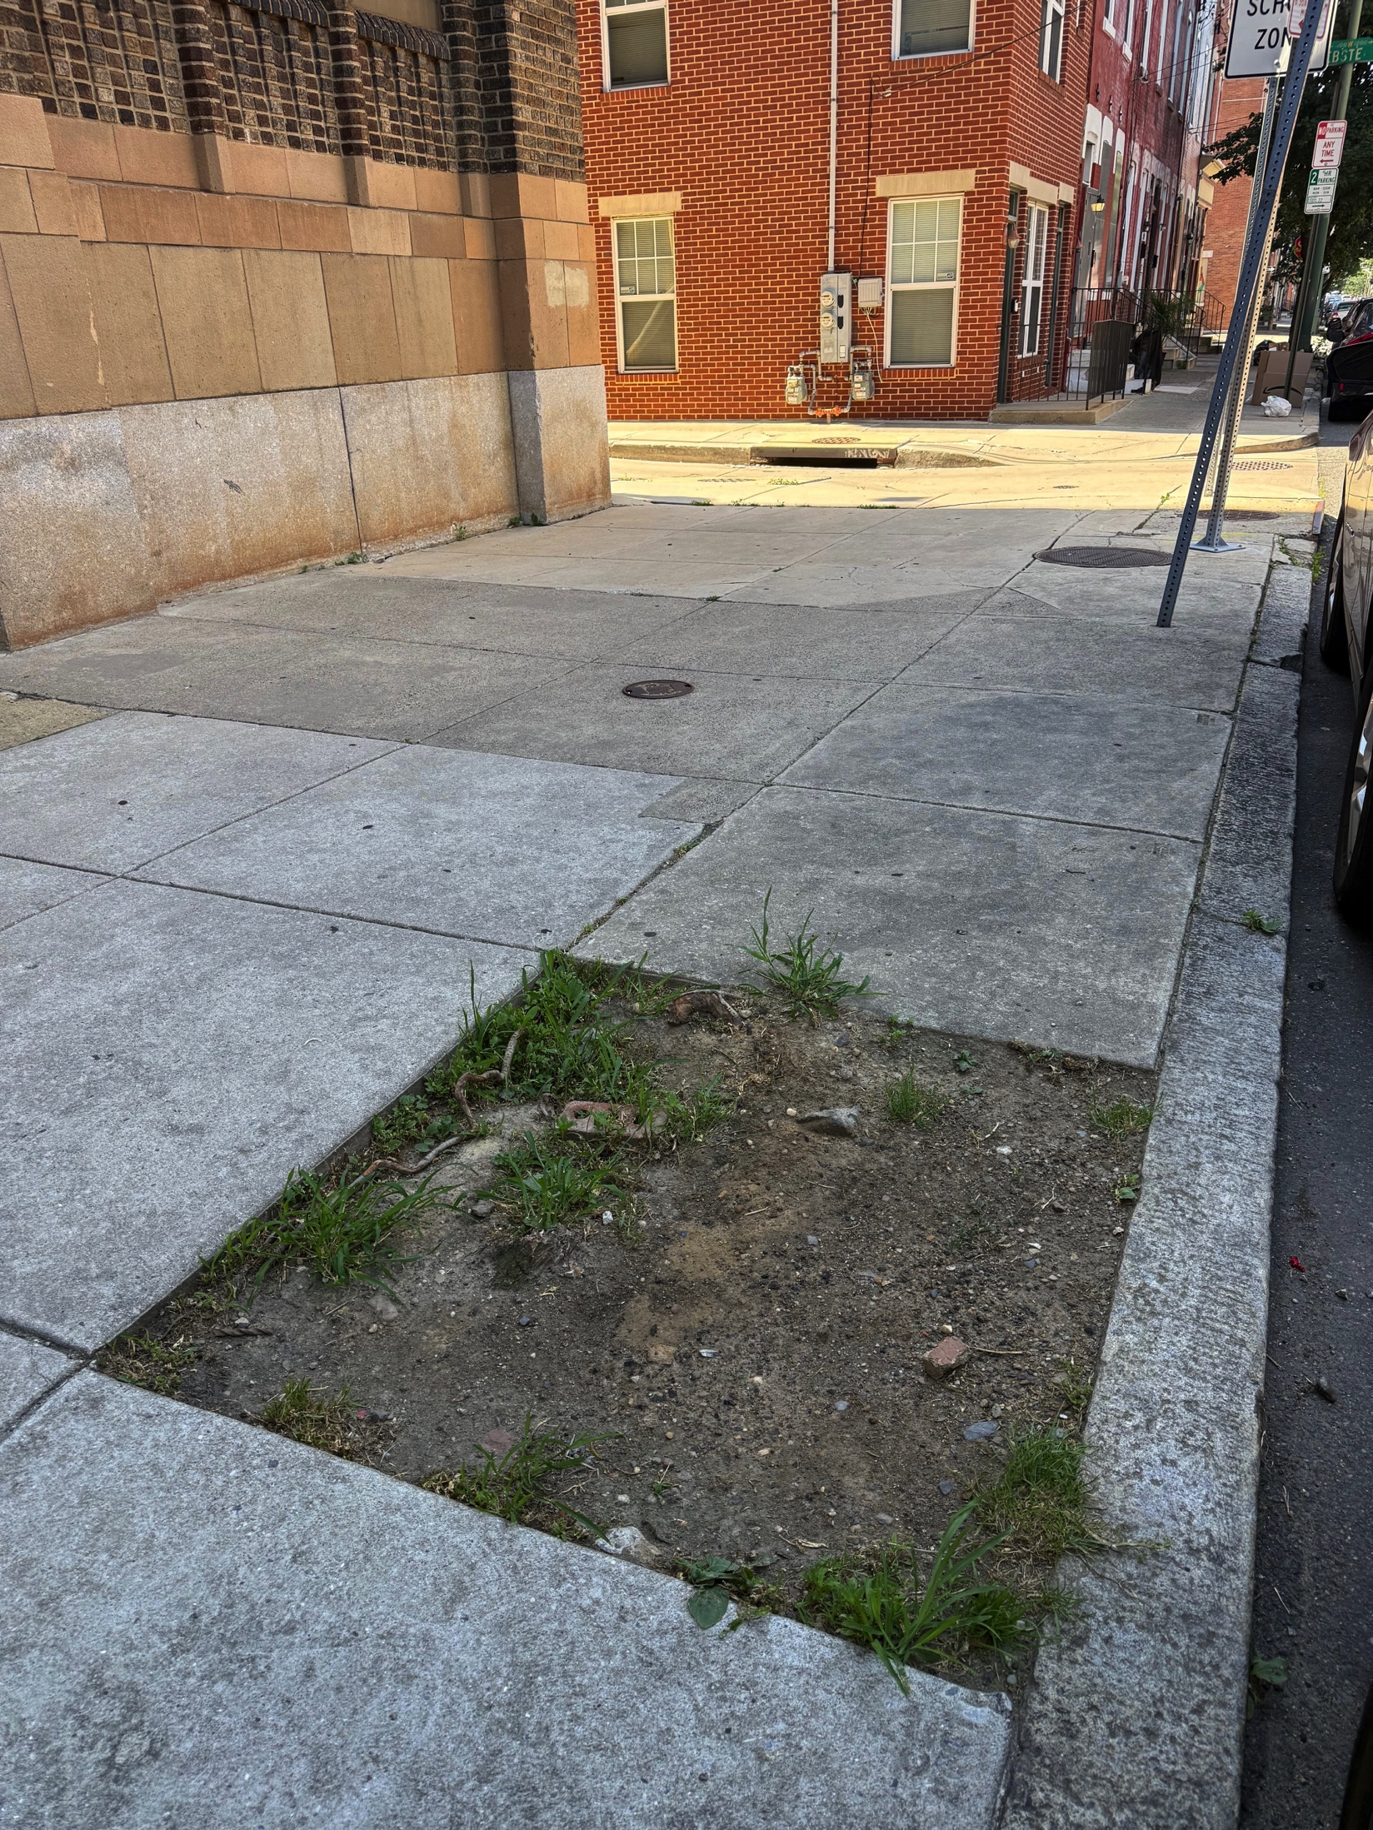
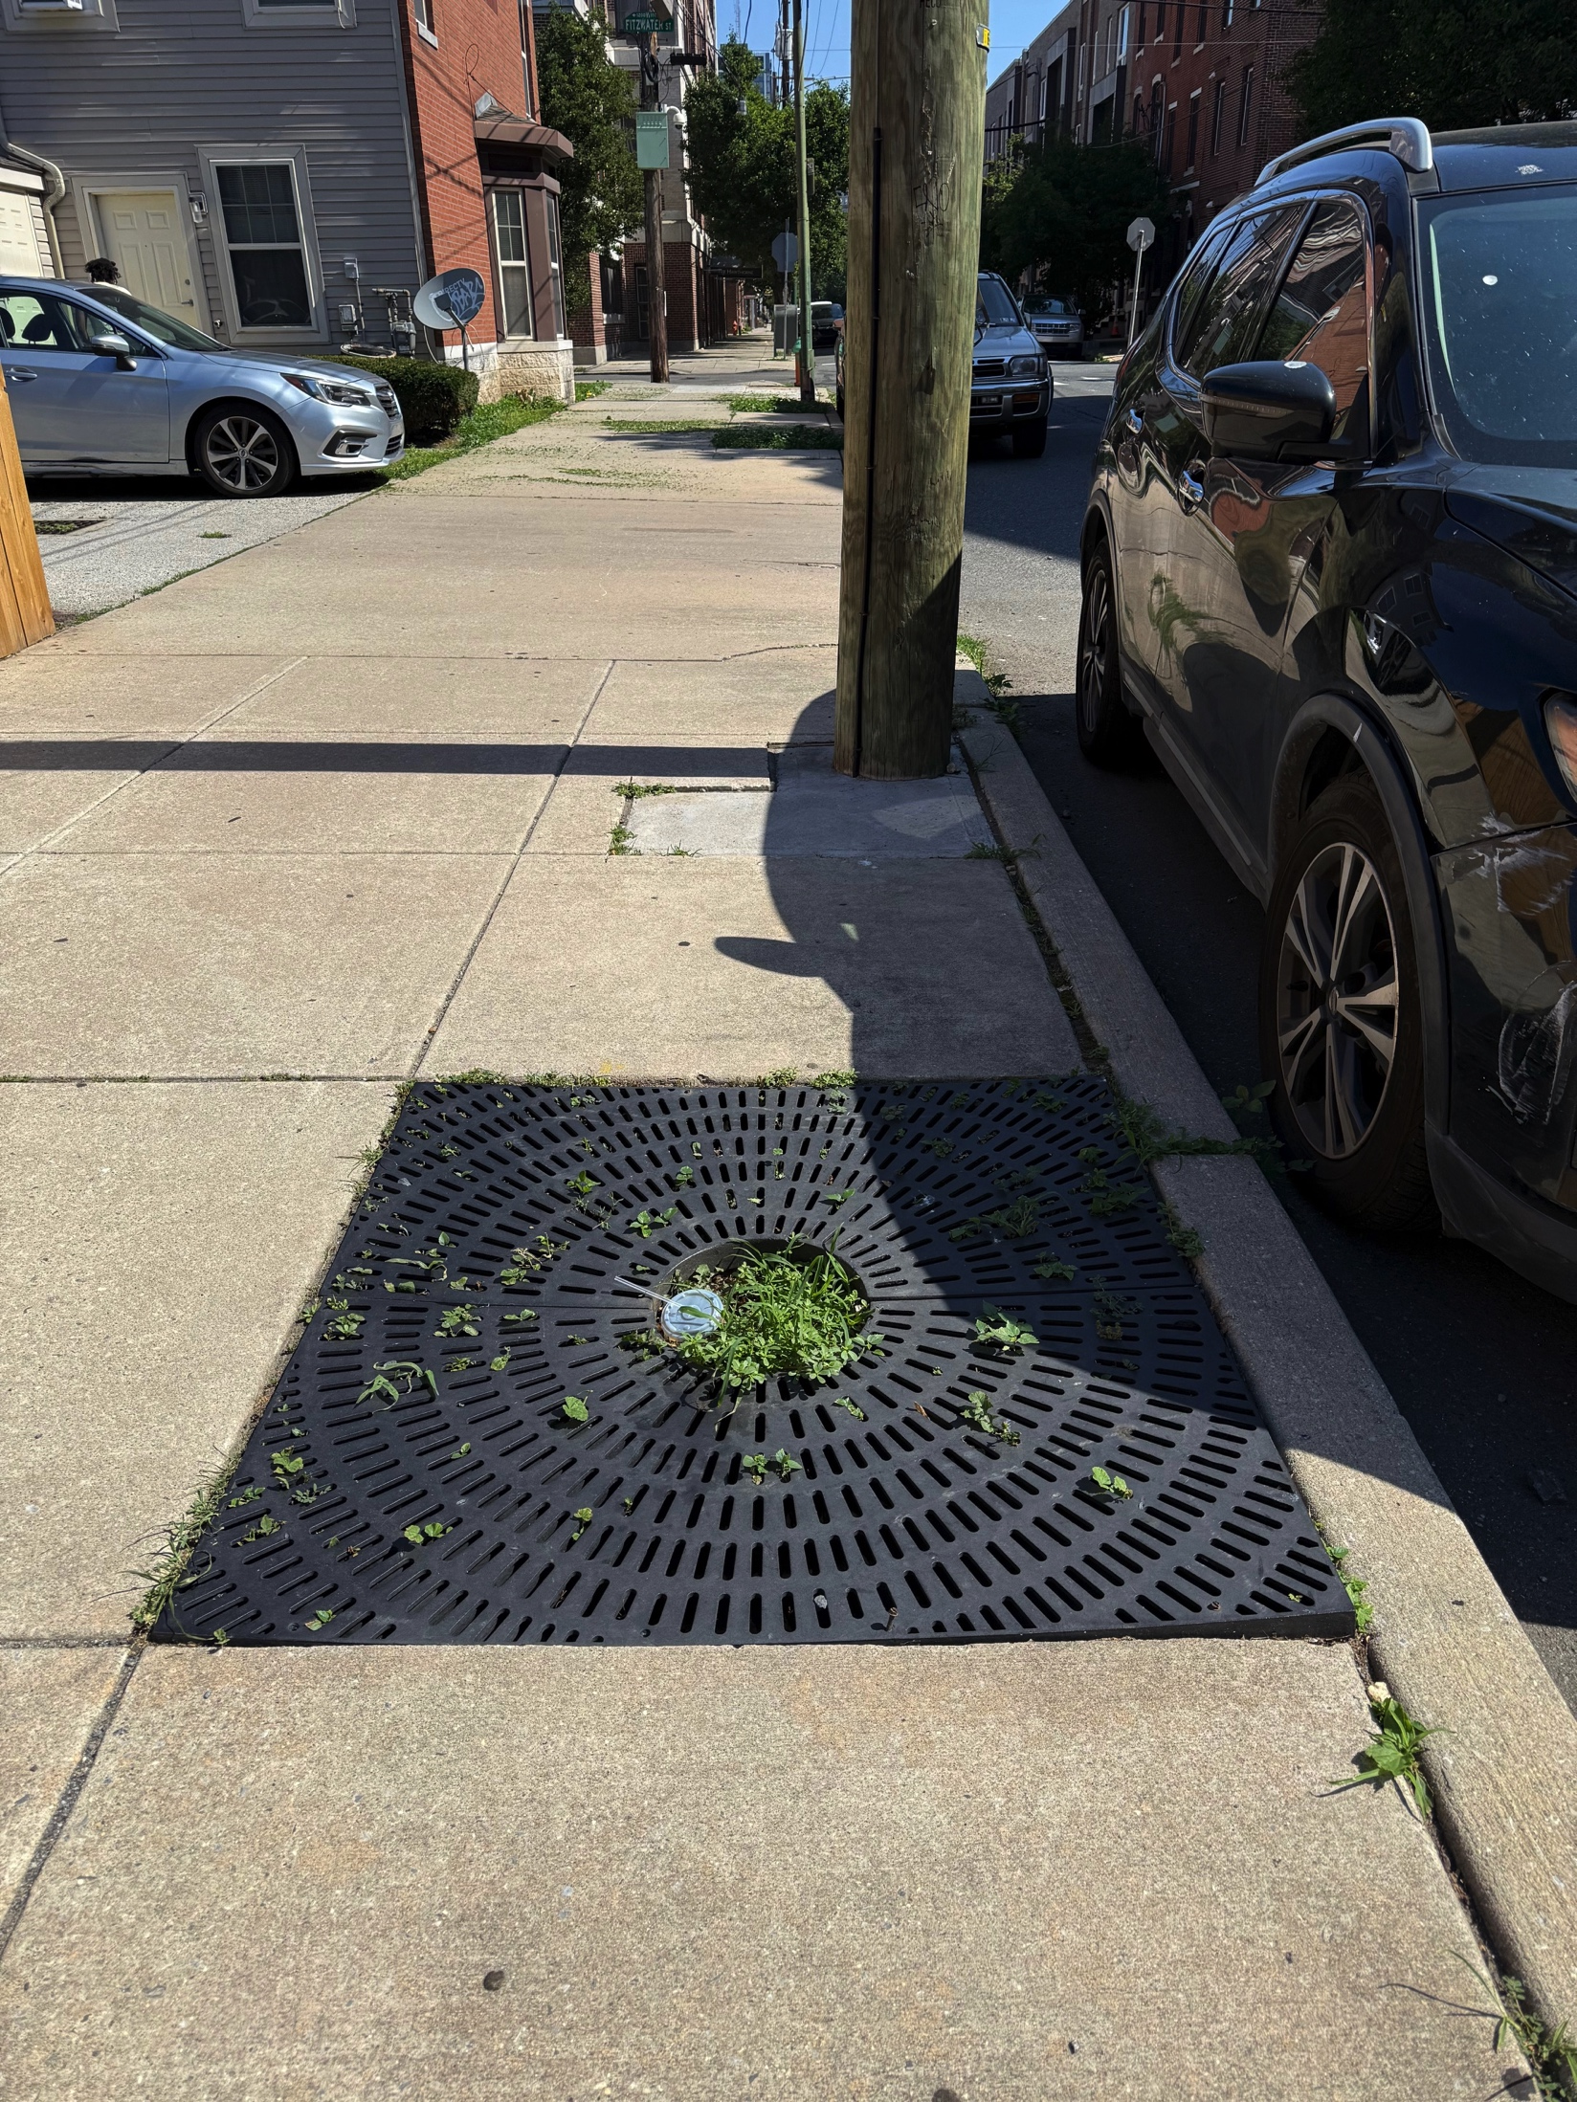
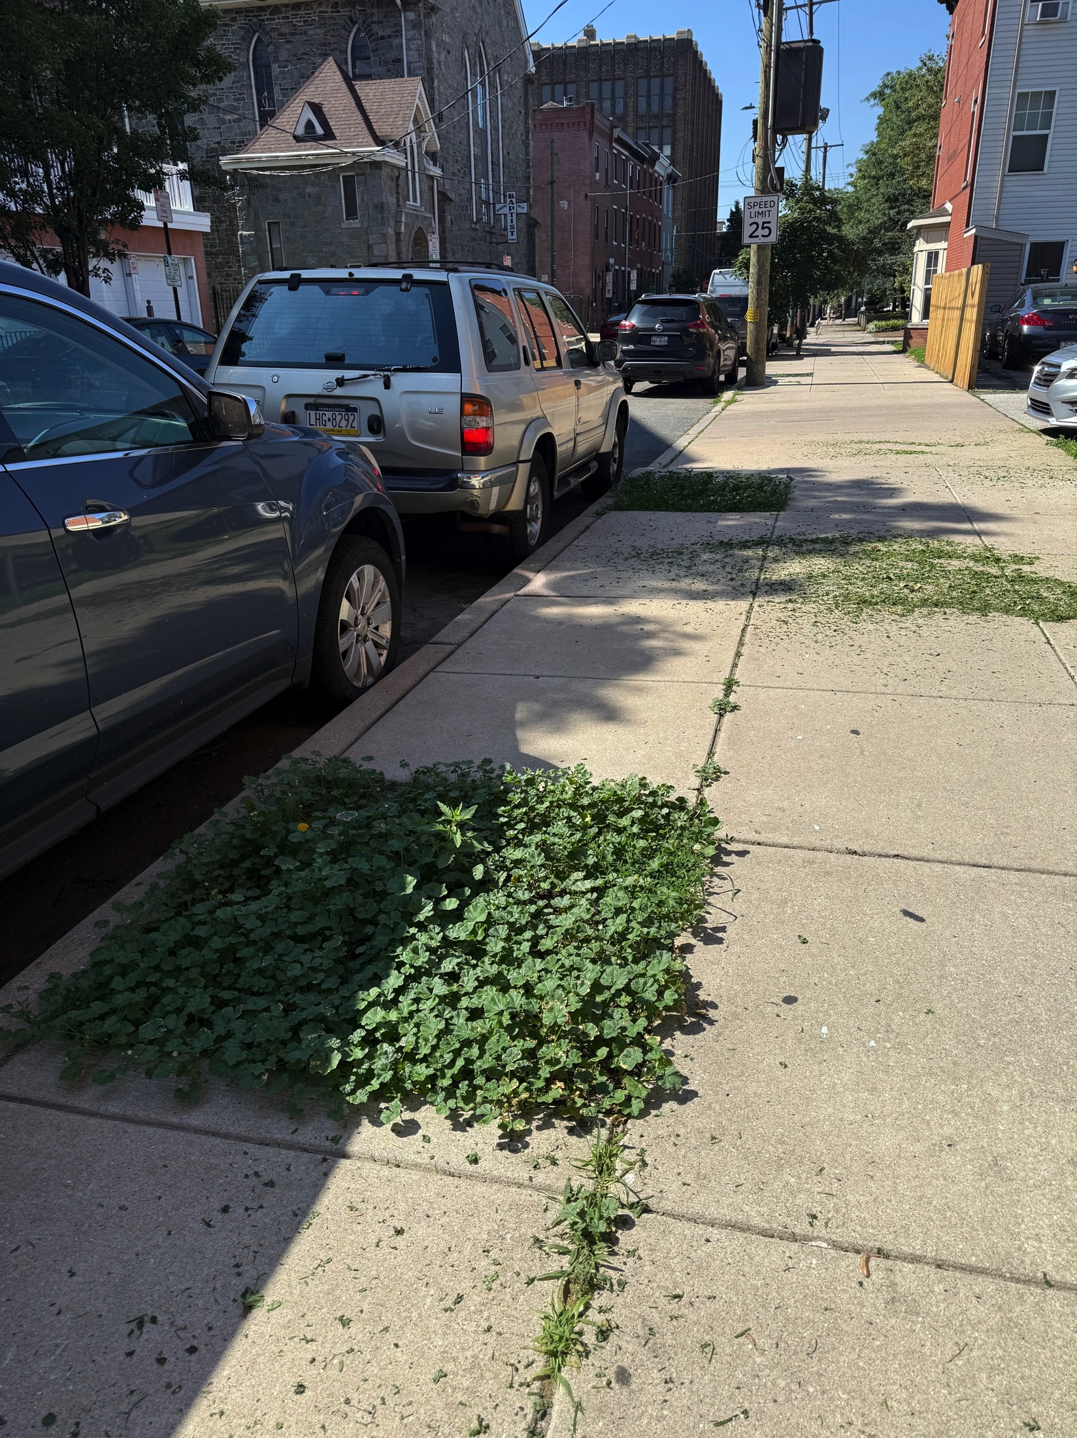
Hawthorne Tree cover Initiative
First locations to target: Empty Tree Wells

Slide 13
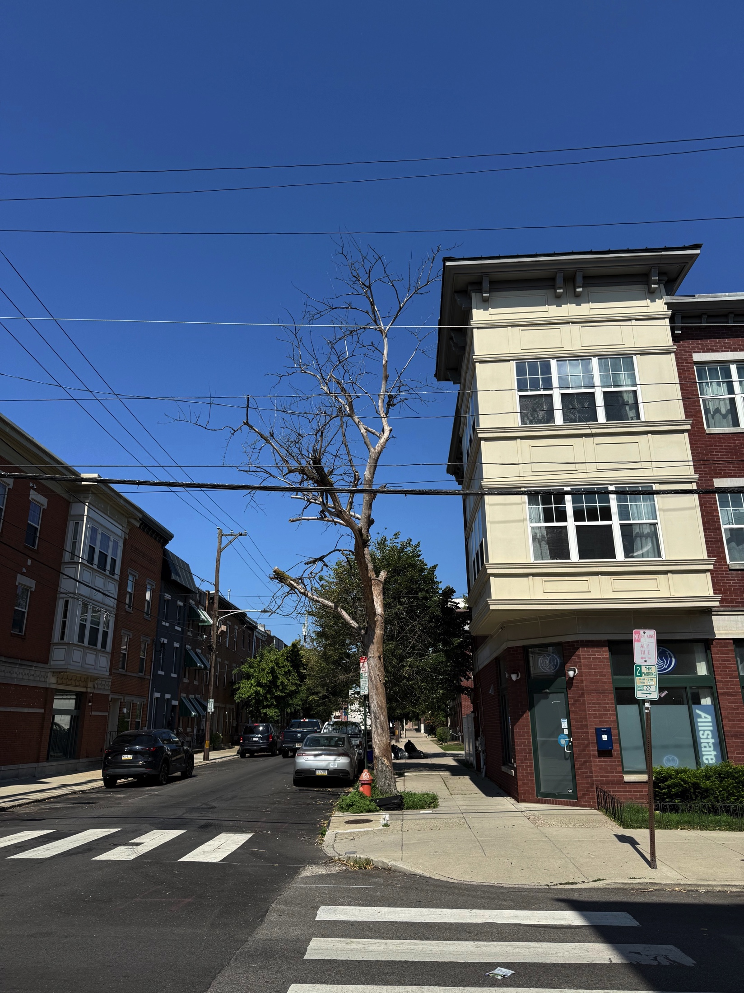
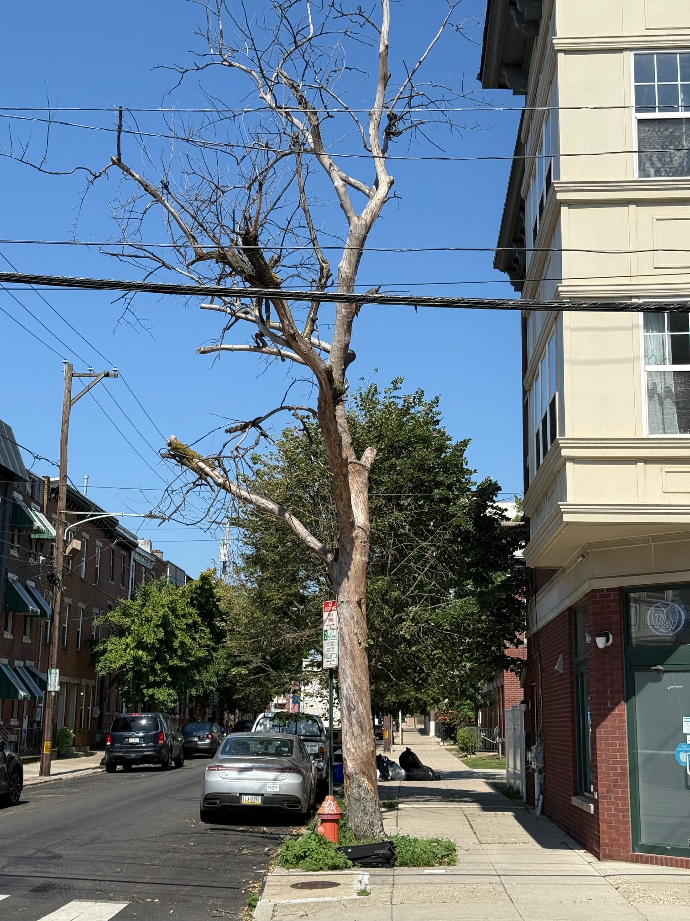
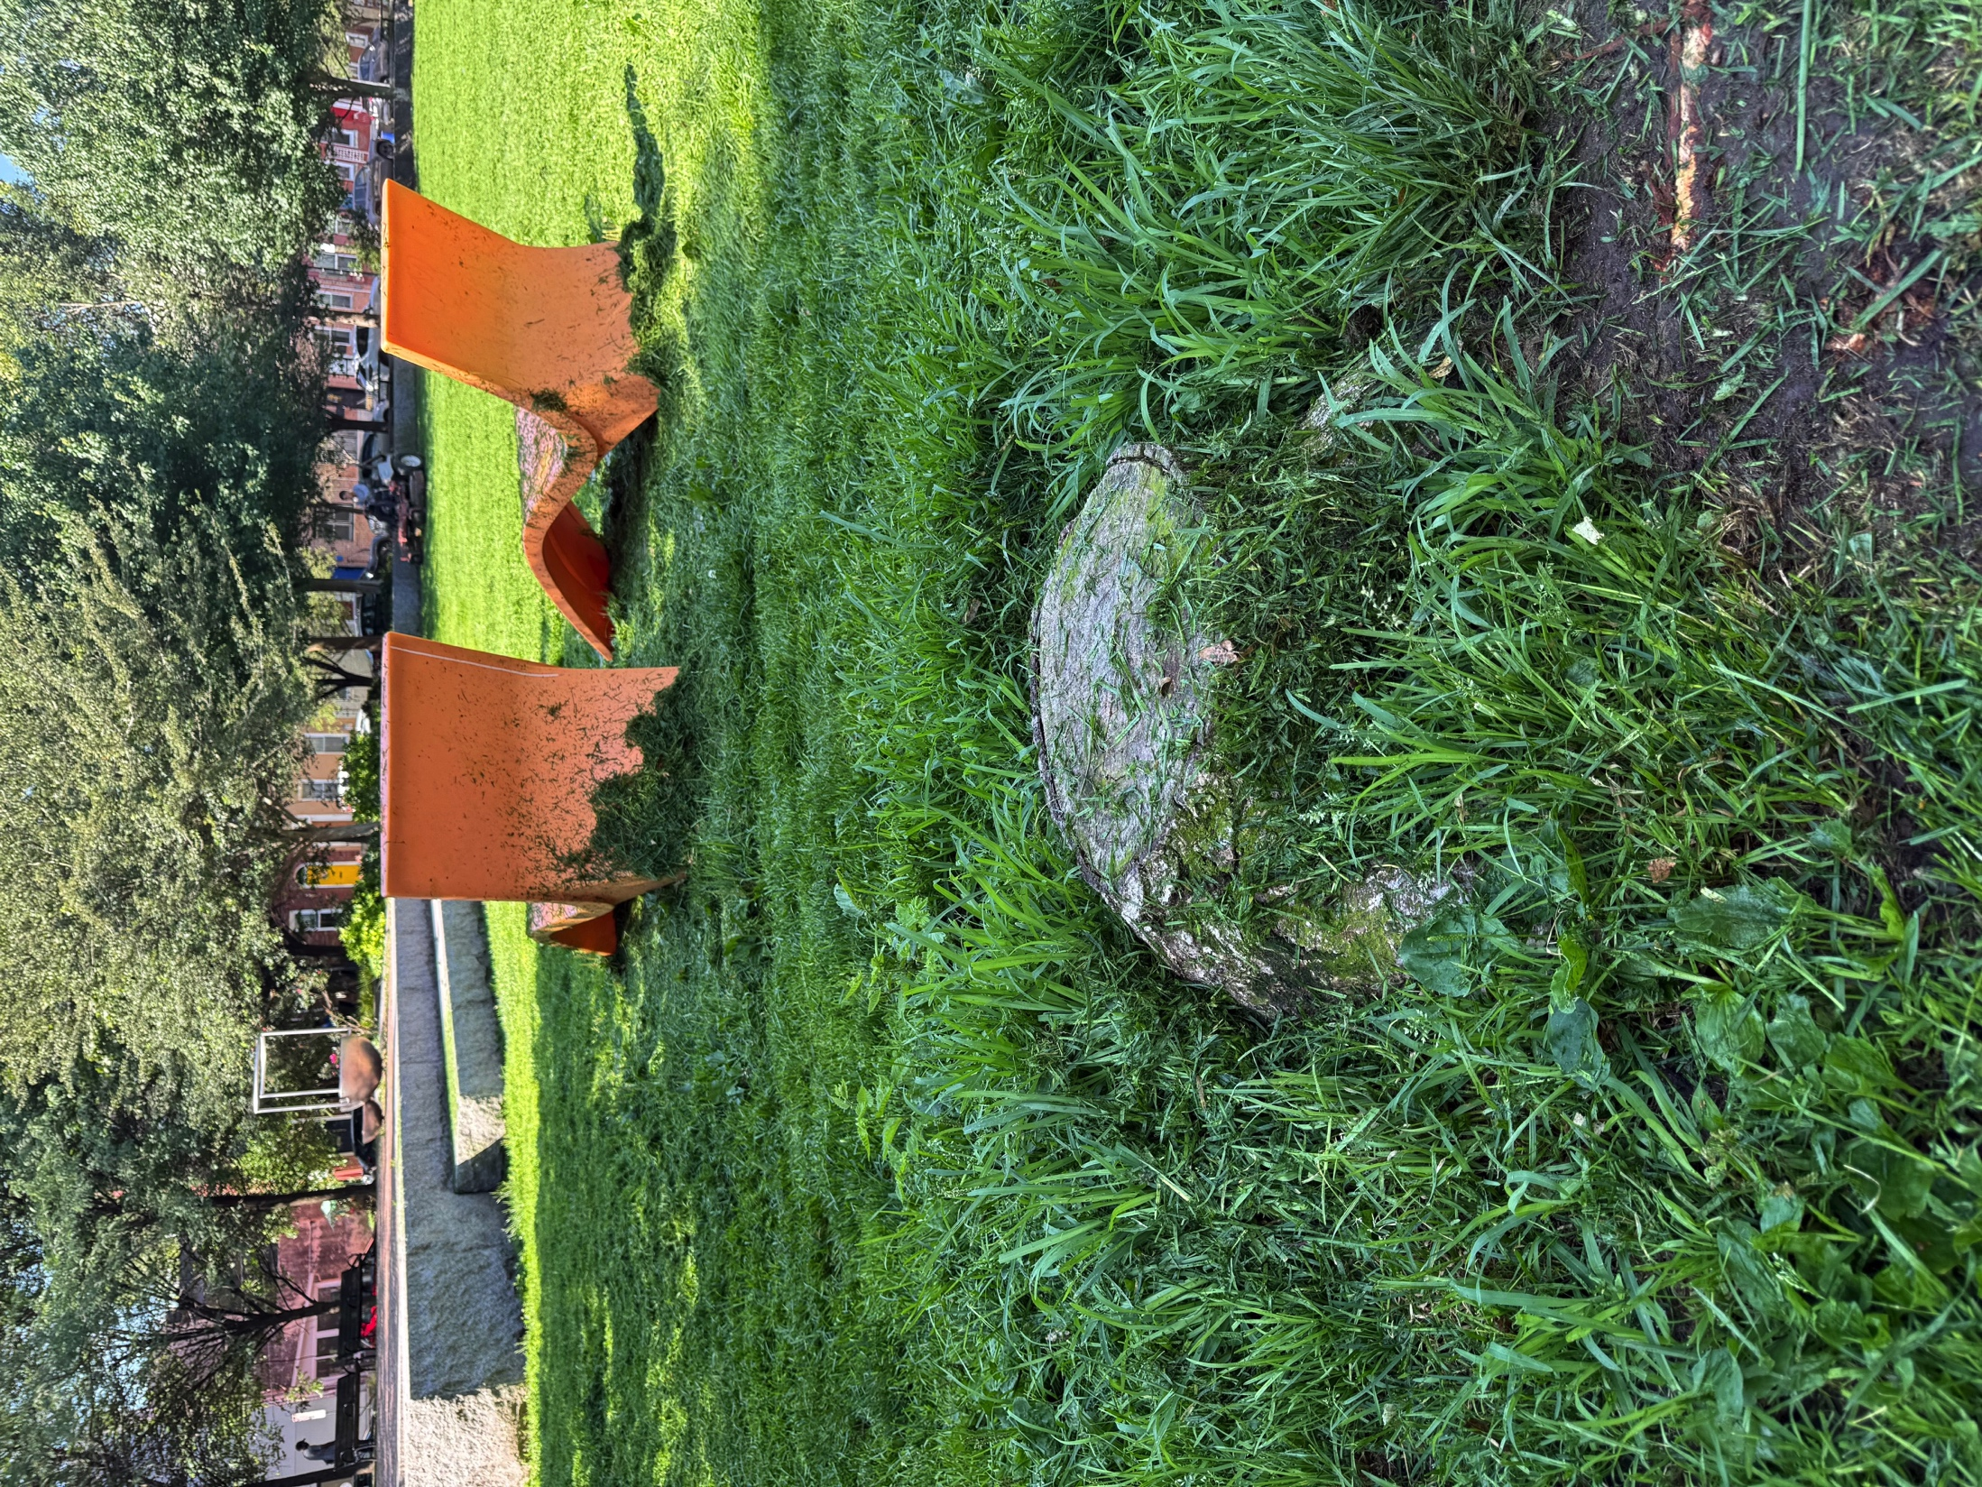
Hawthorne Tree Cover Initiative
Dead tree and stump removals. Need to contact city.

Slide 14
Committee Updates
Arts Committee: The 1001 S Broad St. Art Installation and Opening Event, featuring local artists from our community and schools, is unfortunately postponed due to a temporary budget issue with buildings developers. The Arts Committee chaired by Kelly Korzun has been working hard for this event, but unfortunately is still awaiting the sidewalk to be finished. We will have an update soon.
Zoning Committee: There are now HEC Zoning meetings for June or July. Meetings are being scheduled for August and September
Upcoming Developments: 1101 Catherine Street

Slide 15
Events
Jazz at Hawthorne Park -> Tonight! Featuring vocalist Kevin Velentine at 7PM
Movies in Hawthorne Park
Friday, August 22nd at 7:45PM. Moana 2.
Friday, July 18th at 8:30PM. Wicked.

Slide 16
Guest Speaker
Aaron Davis – SEPTA Update

