Slide 1

Sreyas Institute of Engineering and Technology
An Autonomous Institution
Approved by AICTE, Affiliated to JNTUH
Accredited by NAAC-A Grade, NBA (CSE, ECE & ME) & ISO 9001:2015 Certified
Department of Computer Science and Engineering
A REAL-TIME PROJECT REVIEW-3
On
Smart Queue and Appointment Management System
BACHELOR OF TECHNOLOGY
IN
COMPUTER SCIENCE AND ENGINEERING
BY
24VE1A05A9 SHREE PRANAV
24VE1A05A2 Kaveri Podisheti
24VE1A0569 B. Anjali Devi
24VE1A0575 CH. Chandu
Under the Guidance of -
Dr .G J BHARAT KUMAR

Slide 2
Testing: Definition & Types
Definition: Verifying that software meets requirements and performs expected behavior; identifying defects before production.
Why needed: Improves reliability, ensures requirements, prevents regression.
Major types:
Unit Test – single function/module
Integration Test – combined modules or services
System Test – full app behavior end-to-end
Acceptance Test – user/business acceptance
(Optional) Regression Test – verify unchanged functionality after modifications
(Optional) Performance/Security/Load Test – non-functional

Slide 3
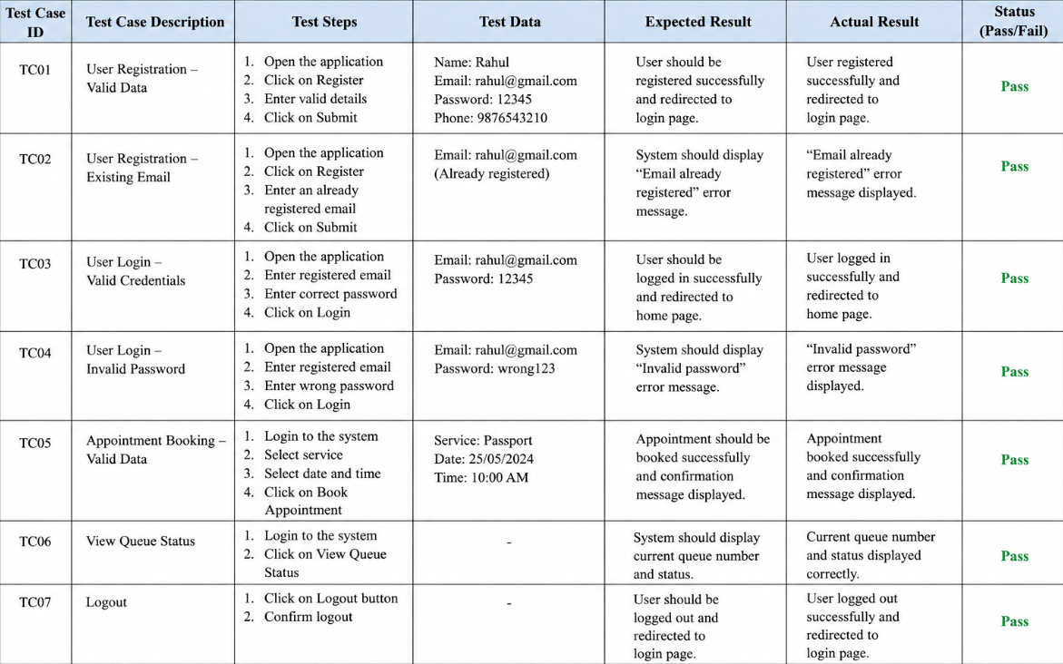
Test Cases (Backend Queue Appointment)

Slide 4
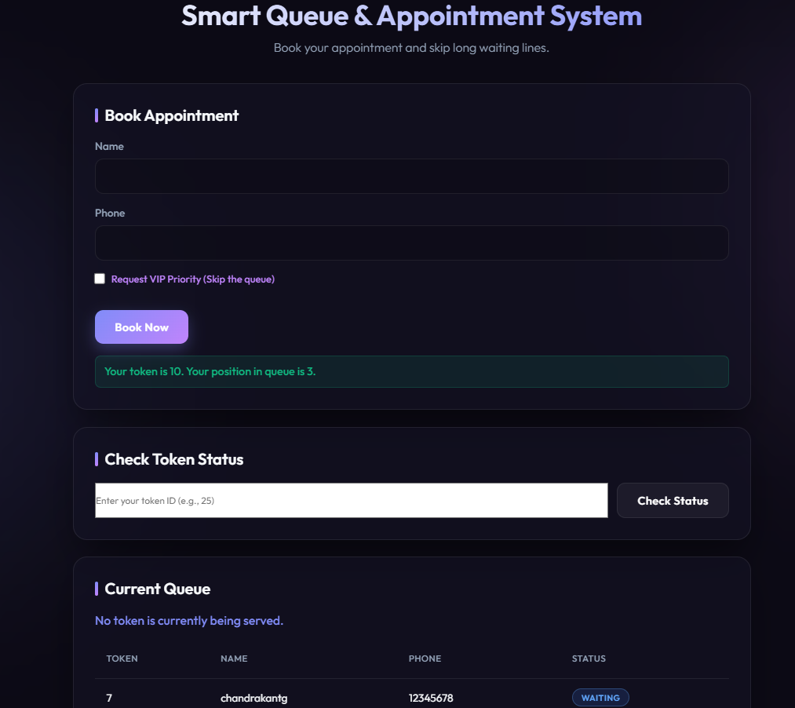
Output-1

Slide 5
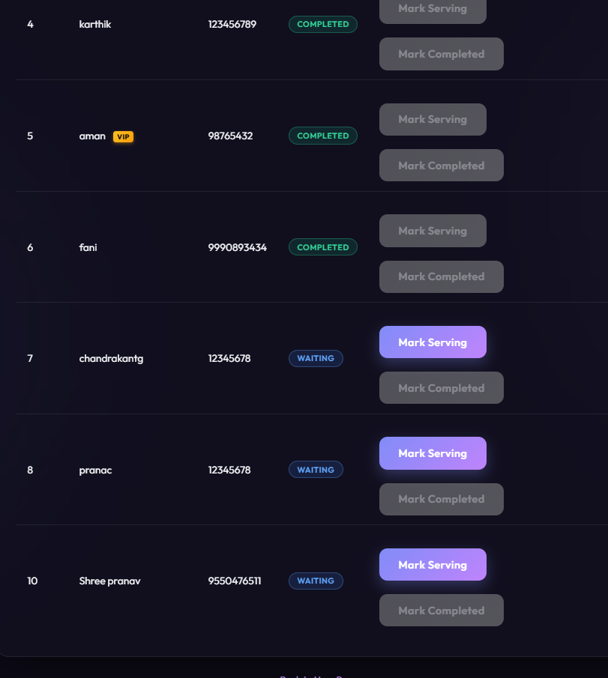
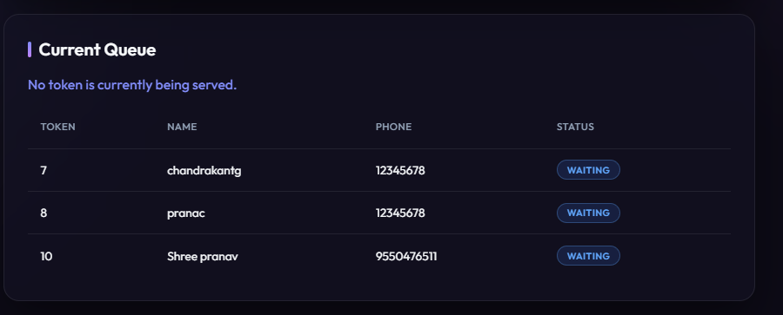
Output-2

Slide 6
Limitations
No user auth/role-based security (open endpoints)
Basic UI, not mobile responsive
No persistent DB (in-memory only or limited)
Concurrency/race conditions not fully hardened
No automated test integration pipeline in current version

Slide 7
Future scope
Add authentication + OAuth / JWT
Use real DB (MySQL/PostgreSQL/Mongo)
Implement async worker queue + retry logic
Expiry/cancelation/reschedule workflows
API docs (Swagger/OpenAPI) + CI/CD tests
UI redesign (React/Vue) + admin analytics dashboard
Multi-tenant support, load testing, security hardening

Slide 8
Conclusion
Project delivers core appointment queue workflow with booking + status query.
Demonstrated test coverage, error handling and validations.
Easy to extend and harden in future.
Value: quick patient flow management and fair token queuing.
Next step: production-grade persistence, secure API, full test pipeline.

