Slide 1
汤学明 xmtang126@126.com
信息安全实验室

Slide 2
3.有限域上的椭圆曲线
3.1什么是椭圆曲线
3.2椭圆曲线密码体制
3.3 安全椭圆曲线的构造
3.4椭圆曲线中的计算

Slide 3
3.1什么是椭圆曲线
- <number> -

Slide 4
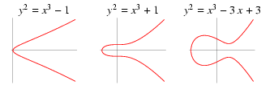
Elliptic curves over R
Elliptic curves over R of form y²=x³+ax+b

Slide 5
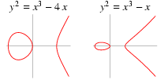
Elliptic curves over R

Slide 6
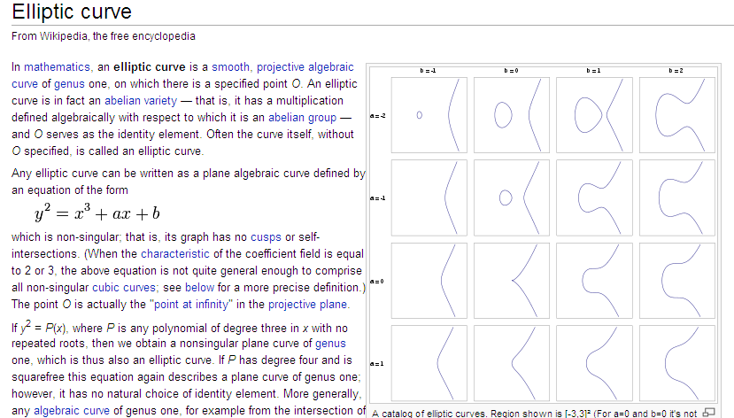
Elliptic curves over R

Slide 7
Theorem : A real smooth elliptic curve is (projectively) linearly equivalent to exactly one equation of the form
y²= x(x-1)(x-λ), 0< λ<1
(two components)
or
y²= x(x²-2λx+1), -1< λ<1
(one component)

Slide 8

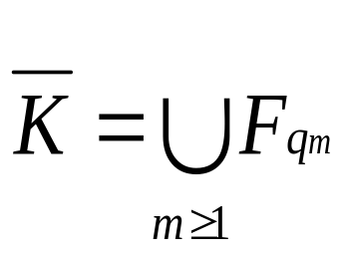

(1) Definitions
F_{q} : the finite field containing q elements
q is prime power
:the algebraic closure of a field K
i.e. if K = F_{q} then
The projective plane P²(K) over K is the set of equivalence classes of the relation ~ acting on K³\{(0 , 0, 0)}, where (x₁, y₁, z₁) ~ (x₂, y₂, z₂) iff there exists u K* such that x₁=ux₂, y₁=uy₂, z₁=uz₂. We denote the equivalence class containing (x, y, z) as (x : y : z).

Slide 9
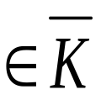
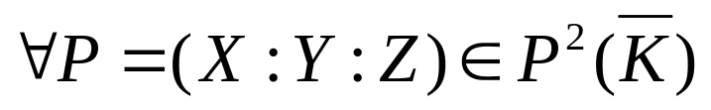
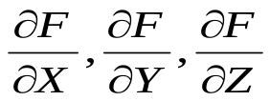
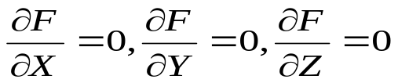
(1) Definitions: (Weierstrass equation)
where a₁, a₂, a₃, a₄, a₆
satisfying
Smooth (non-singular) :
at least one of is non-zero at P.
Singular: at P, then P is called a singular point.

Slide 10
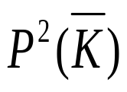
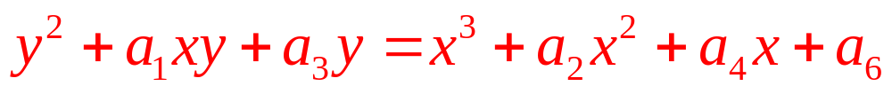

(1) Definitions: (Elliptic curve)
Elliptic curve E: the set of all solutions in of a smooth Weierstrass equation.
Point at infinity O : there is exactly one point in E with Z-coordinate equal to 0, namely (0:1:0).
For convenience, let x=X/Z, y=Y/Z
(2.1)
E/K : if a₁, a₂, a₃, a₄, a₆ K, then E is said to be defined over K.
E(K) :

Slide 11
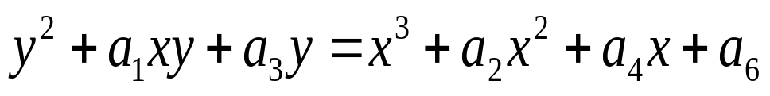
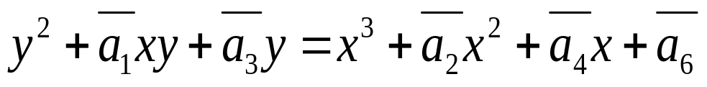
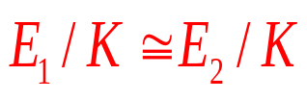


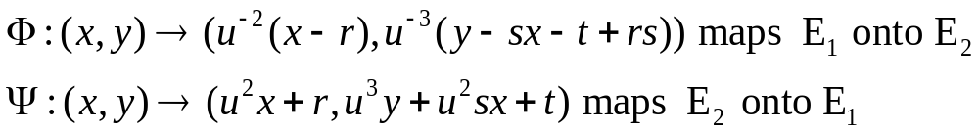
(1) Definitions: (Isomorphism)
Theorem:
Two elliptic curves E₁/K and E₂/K given by the equations
E₁:
E₂:
are isomorphic over K, denoted by , iff there exists u, r, s, t K, ,such that

Slide 12


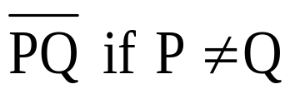
(2) Group Law
Theorem:
(E,+) is an abelian group with identity element O. If E is defined over K, then E(K) is a subgroup of E.
Addition rule:
For all P,Q E,
(i) O+P=P+O=P.
(ii)-O=O.
(iii) If P=(x1,y1) O, then -P=(x₁,-y₁-a₁x₁-a₃).
(iv) If Q=-P, then P+Q=O.
(v) If P,Q O, Q -P, then let R be the third point of intersection of either the line , or the tangent line to the curve at P if P=Q, with the curve. Then P+Q=-R.

Slide 13
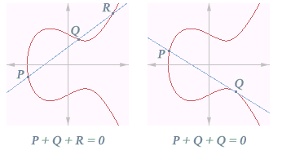
(2) Group Law

Slide 14
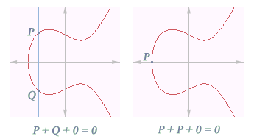
(2) Group Law

Slide 15
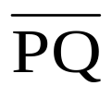
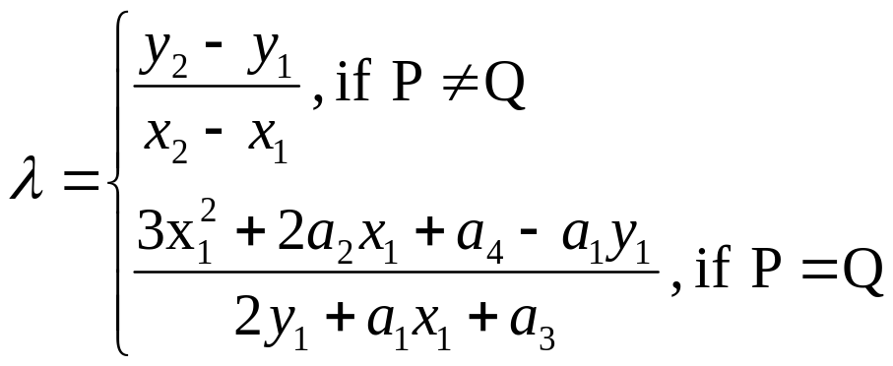
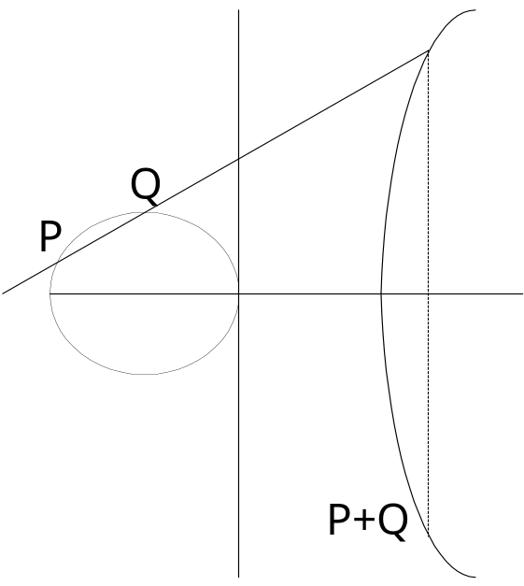
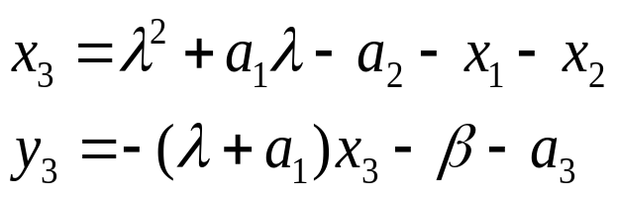
(2) Group Law
Formulas for case (v)
The slop λ of or tangent line is
β=y₁-λx₁
The line is y=λx+β.
Hence P+Q=(x₃,y₃) where

Slide 16
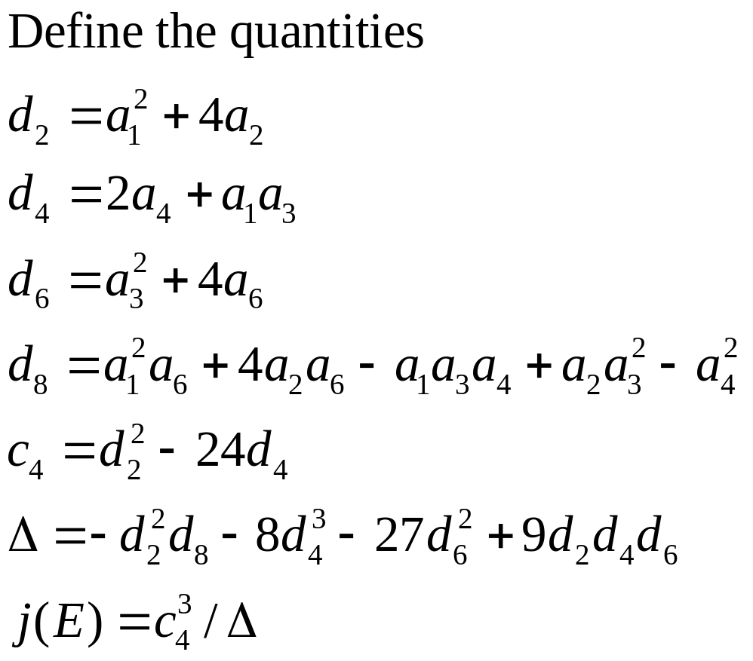
(3) The Discriminant and j-invariant
The quantity Δ is called the discriminant of the Weierstrass equation, while j(E) is called the j-invariant of E if Δ≠0.

Slide 17
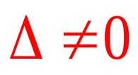
(3) The Discriminant and j-invariant
Theorem: E is an elliptic curve, i.e., the Weierstrass equation is non-singular, if and only if
Theorem: If two elliptic curve E₁/K and E₂/K are isomorphic over K, then j(E₁)=j(E₂). The converse is also true if K is an algebraically closed field.

Slide 18
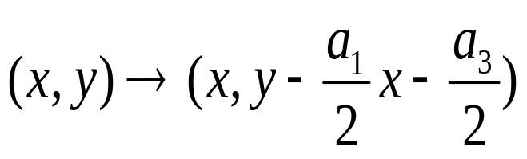
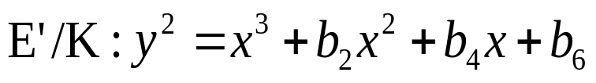

(4) Curves over K, char(K)≠2,3
E/K, if char(K) ≠2 then
transforms E/K to the curve
note that

Slide 19
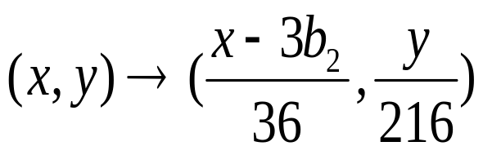
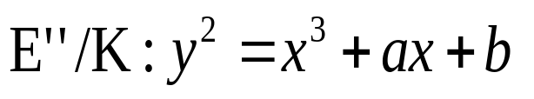

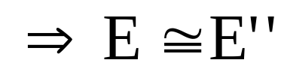
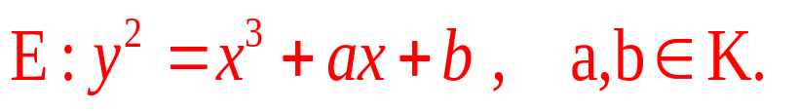
(4) Curves over K, char(K)≠2,3
E/K, if char(K) ≠2,3 then
transforms E’/K to the curve
note that
(2.11)

Slide 20
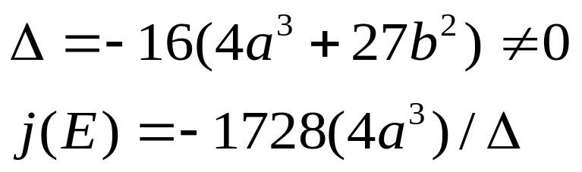
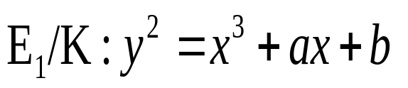
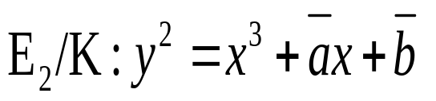
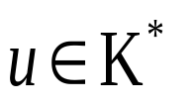
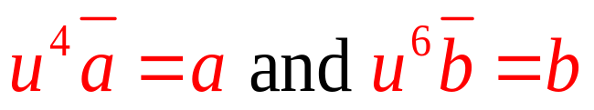
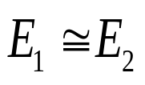
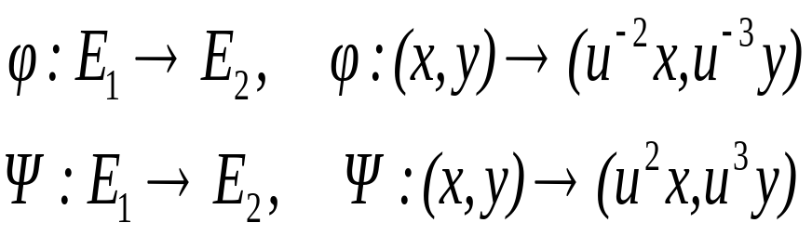
(4) Curves over K, char(K)≠2,3
With equation (2.11),
Theorem: The elliptic curves
and are isomorphic over K iff there exists such that
If over K, then the isomorphism is given by

Slide 21
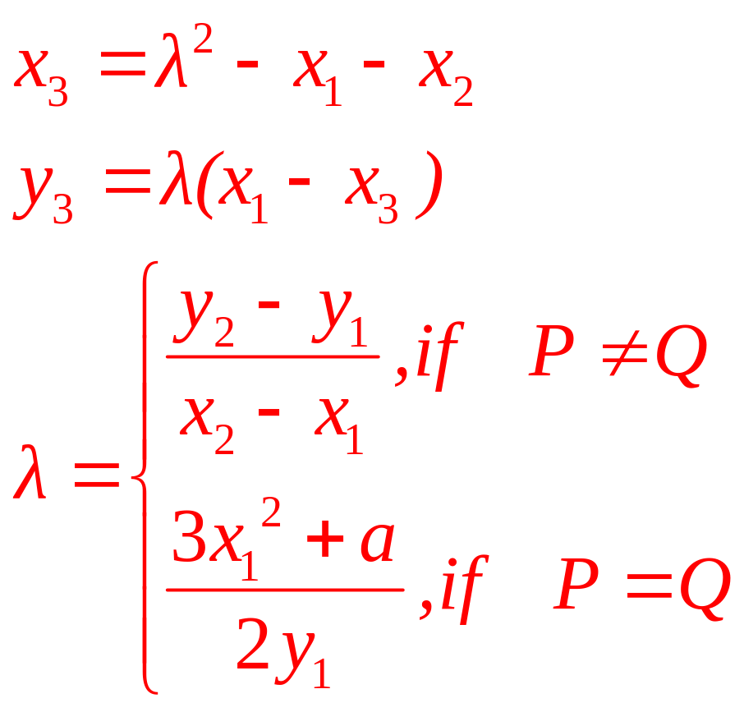
(4) Curves over K, char(K)≠2,3
Addition formulas
If P=(x₁,y₁) E, then -P=(x₁,-y₁). If Q=(x₂,y₂) E, Q≠-P, then P+Q=(x₃,y₃), where

Slide 22
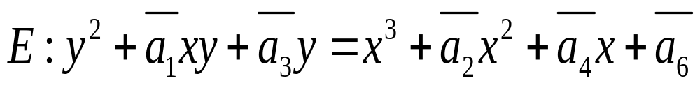
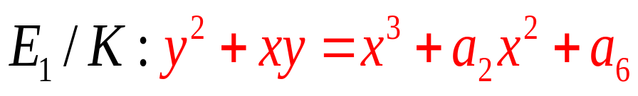
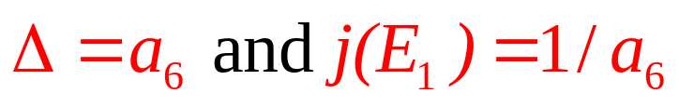
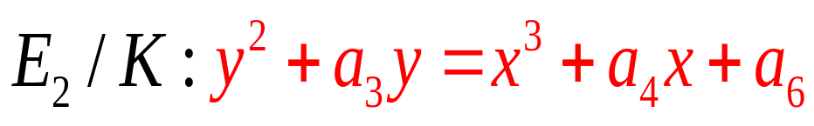
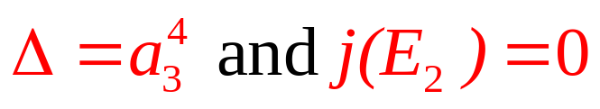
(5) Curves over K, char(K) =2
E/K, char(K)=2
If j(E) ≠0, then E is isomorphic to
for E₁,
If j(E) =0, then E is isomorphic to
for E₂,

Slide 23
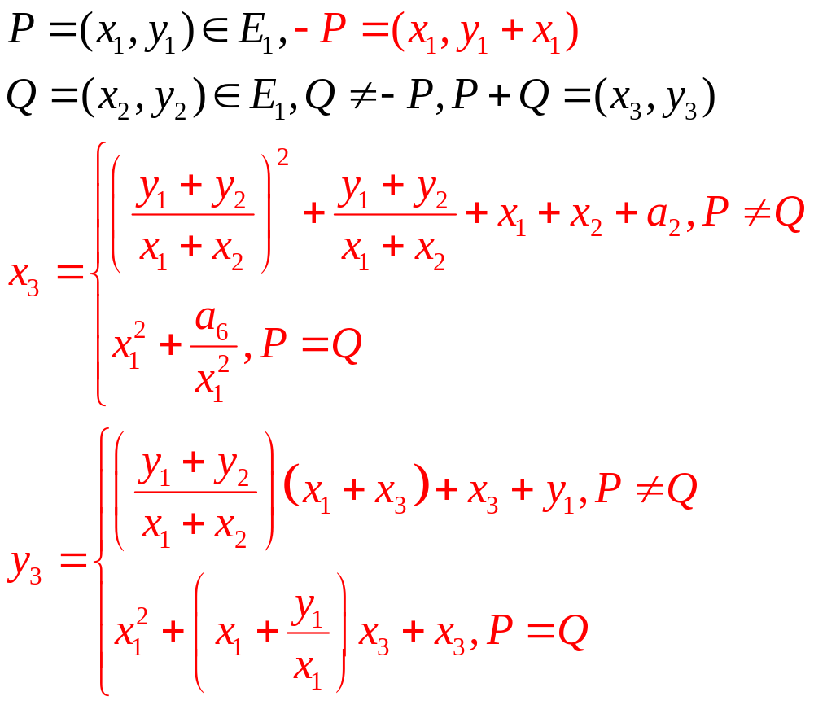
(5) Curves over K, char(K) =2
Addition formulas when j(E) ≠0

Slide 24
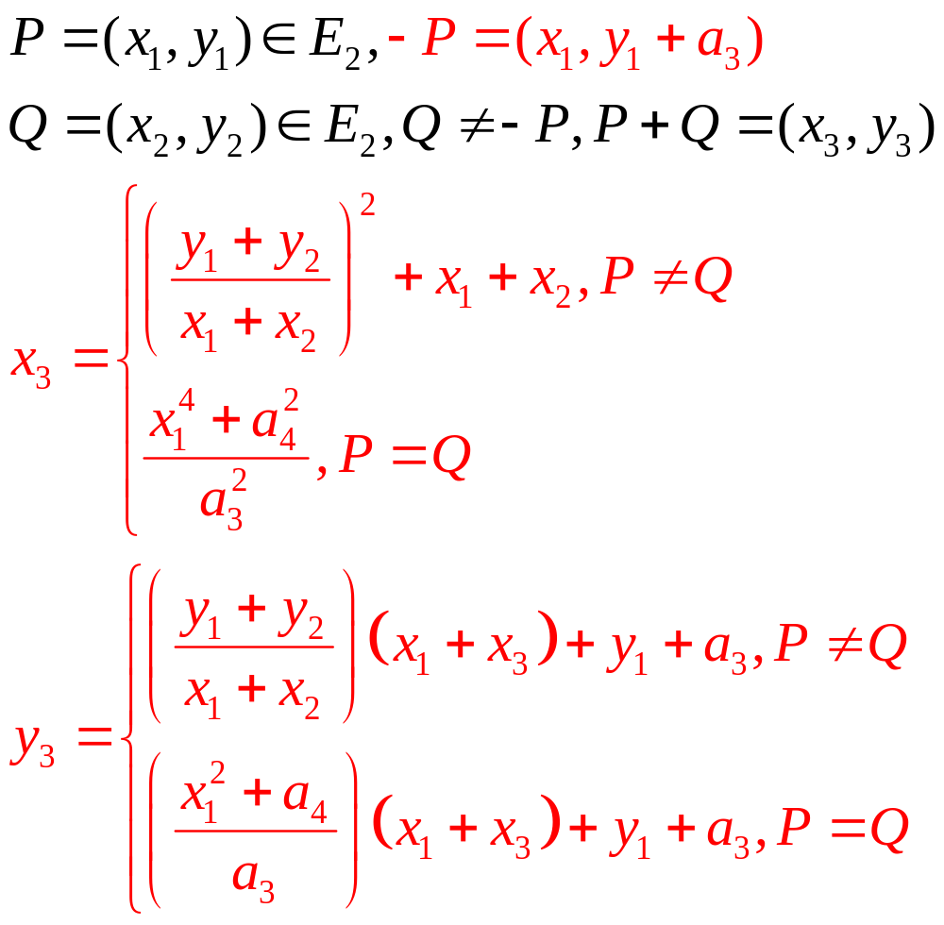
(5) Curves over K, char(K) =2
Addition formulas when j(E) = 0

Slide 25
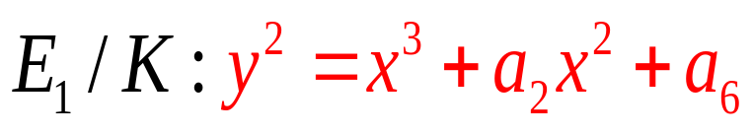
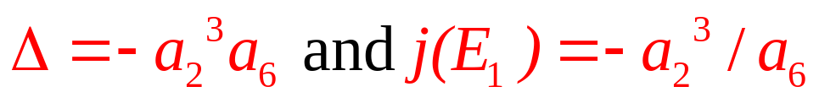
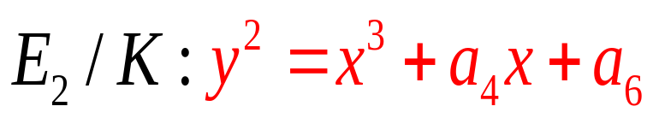
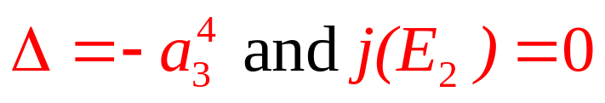
(6) Curves over K, char(K) =3
E/K, char(K)=3
If j(E) ≠0, then E is isomorphic to
for E₁,
If j(E) =0, then E is isomorphic to
for E₂,

Slide 26
3.2椭圆曲线密码体制
- <number> -

Slide 27


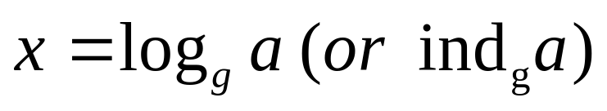
[1] Discrete Logarithm Problem
Let G is a finite cyclic group of size n generated by generator g, i.e.
G = <g> = {g ^{i} | i = 1, 2, …, n}
or {g ^{i} | i = 0, 1, …, n-1}
  Given g and i, it is easy to compute g^{i} by repeated squaring
  Discrete logarithm problem
  Given , find x such that
  We denote

Slide 28
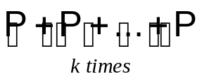
[2] Elliptic Curve DLP
Basic computation of ECC
  Q = kP =
  where P is a curve point, k is an integer
Strength of ECC
  Given curve, the point P, and kP
  It is hard to recover k
  - Elliptic Curve Discrete Logarithm Problem (ECDLP)

Slide 29


Slide 30
ECC Benefits
ECC is particularly beneficial for application where:
computational power is limited (ICCs, wireless devices, PC cards)
integrated circuit space is limited (ICCs, wireless devices, PC cards)
high speed is required.
intensive use of signing, verifying or authenticating is required.
signed messages are required to be stored or transmitted (especially for short messages).
bandwidth is limited (wireless communications and some computer networks).

Slide 31

有限域中判断是否平方元

Slide 32

有限域上的平方根算法

Slide 33

有限域上的平方根算法

Slide 34

有限域上的平方根算法

Slide 35

有限域上的平方根算法

Slide 36


编码（求点）1
设n=2n’,K= ,明文为整数m,0≦m<p^{n}
将m表示为m=m₀+m₁p+…+m_{n’-1}p^{n’-1},
0≦m_{i}<p.
适当选择 的一组基{b₀,b₁,…,b_{n’-1}},令
X(m)=m₀b₀+m₁b₁+…m_{n’-1}b_{n’-1},
Y(m)为K中的元素，且满足椭圆方程。
得到(X(m),Y(m))
注意：若p^{n}-1=2^{s}t,只需s步即可求得平方根。

Slide 37

编码（求点） 2（概率编码）
设K=
E的方程为：y²=x³+ax+b,
限定明文满足0≦m≦ p/1000－1
补足m的后三位，直到找到x满足：
1000m ≦x≦ 1000(m+1)<p,使得
f(x)=x³+ax+b是一个平方。
此时定义y=f(x)^{(p+1)/4}

Slide 38

编码（求点） 3（概率编码）
设K=
是K的一组基，E的方程为：y²+y=x³
限定明文满足0≦m<2^{n-10},
m=m₀+m₁2+…m_{n-11}2^{n-11},mi为0或者1
令y=m₀b₀+…+m_{n-1}b_{n-1}为K中元素，其中
m_{n-10}, m_{n-9}, m_{n-8},…, m_{n-1}可变，以保证y²+y
是立方元。
定义x=（y²+y）^{(2^n+2)/9}

Slide 39


编码（求点） 4
设K=
B是K的一组正规基{ }，E的方程为：y²+xy=x³+a₄x²+a₆ （1）
平方和平方根分别是循环右移和循环左移
所以方程Y²+Y=a是容易求解的
将方程（1）两边同时乘以x⁻²(x<>0)有
（x⁻¹y)²+x⁻¹y=x⁻²(x³+a₂x²+a₆)
令Y=x⁻¹y,将m编码成x，求出Y，再求出y。

Slide 40

ECES算法

Slide 41

ECES算法

Slide 42

X－ElGamal算法

Slide 43

X－ElGamal算法

Slide 44

SM2算法就是ECC椭圆曲线密码机制，但在签名、密钥交换方面不同于ECDSA、ECDH等国际标准，而是采取了更为安全的机制。另外，SM2推荐了一条256位的曲线作为标准曲线。
SM2标准包括总则，数字签名算法，密钥交换协议，公钥加密算法四个部分，并在每个部分的附录详细说明了实现的相关细节及示例。

Slide 45


Slide 46


3.椭圆曲线的构造
#E（GF（q））椭圆曲线的阶
Frobenius自同态的迹t=q+1-#E,
为了抵抗椭圆曲线密码攻击，椭圆曲线必须满足条件：
1.t不能为0,1,2,且p不能整除t;
2.#E必须包含一个大素数因子。

Slide 47
3.椭圆曲线的构造
特征为p
（1）*GF(P):y²=x³+ax+b
（2）GF(P^{n}): y²=x³+ax+b,p为较小的素数（5，7，11），通常选取p接近机器字长的素数。

Slide 48
3.椭圆曲线的构造
特征为2
（1） *GF(2^{n}):y²+xy=x³+a₂x²+a₆
n选择素数，并且足够大
（2）GF(2^{r}):y²+xy=x³+a₂x²+a₆
例如r=1或者32，曲线确定后，在其扩域中寻找合适的椭圆曲线。

Slide 49




3.椭圆曲线的构造
椭圆曲线的阶
Schoof算法（1985）
1.#E=q+1-t,只需计算t，可选择小的素数l=2,3,5,7,….分别计算t（mod l），然后根据中国剩余定理求t.
2.Frobenius映射：
满足（Hasse定理）
即：
对任意
3.穷举

