Slide 1
26 pin IDC connector
10 pin
IDC connector
1
26-wire ribbon cable
reduced to 11-wires
1
1 wire cut
USBDM-CF-JMxx to reduced Coldfire connector
Top
BDM
Target Board

Slide 2
10 pin
IDC connector
26 pin IDC connector
1
26-wire ribbon cable
reduced to 11-wires
1
1 wire cut
USBDM-CF-JS16 to full Coldfire connector
10 pin
IDC connector
10 pin
IDC connector
1
1
10-pin ribbon cable
USBDM-CF-JS16 to reduced Coldfire connector

Slide 3
The link should be removed when using JTAG.
(MC56F800x or unsecuring Coldfire devices.)
10 pin
IDC connector
1
Top
BDM
Target Board
The link on JP1 should be removed for JTAG/ONCE use

Slide 4
14 pin
IDC connector
14 pin
IDC connector
Pin 8 hole should be filled to ‘key’ the connector.
The corresponding pin should be absent from the PCB header
1
14-pin ribbon cable
(viewed from above)
1
1
USBDM-CF-JS16 to DSC (M56F80xx) connector
14 pin
IDC connector
1

Slide 5
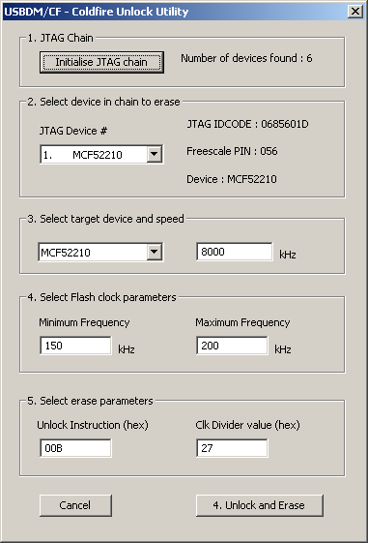

Slide 6
BDM
Top
Target Board
Top
BDM
Target Board

Slide 7
Res
Bkgd
Gnd
Bkgd
N/C
Res
V+
N/C
V+
Gnd
Top view

Slide 8
BDM Connector
N/C
N/C
N/C
N/C
Vdd
RST*
Gnd
Gnd
N/C
1
N/C
N/C
N/C
N/C
TDO
TDI
TCLK
N/C
TMS
ONCE/JTAG Connector
DE*
Vdd
RST*
N/C
TCLK
TDO
TDI
1
TRST
N/C
TMS
Gnd
Gnd
Gnd
Viewed from above

Slide 9
Eclipse Codewarrior
Codewarrior V10 (Eclipse), Linux & MSWin
For HCS08, RS08, CFV1, CFVx
USBDM GDI Layer provided by:
HCS08_GDI_V4
RS08_GDI_V4
CFV1_GDI_V4
CFVx_GDI_V4
USBDM library*
USBDM.4
USBDM library*
USBDM.4
Libusb0 library
(in system area)
Libusb1 library
libusb.1
* Swappable versions according to desired USB drivers under Win32
Win64 & Linux always uses Libusb.1

Slide 10
Legacy Codewarrior
Codewarrior
For DSC
MC56F80xx
Codewarrior
For Coldfire
CFV2, 3, 4
Codewarrior
For Microcontrollers
HCS08, RS08, CFV1
Codewarrior
For S12(X)
HCS12 etc
GDI Layer
DSC_GDI_Legacy_V4
GDI Layer
CFVx_GDI_Legacy_V4
GDI layer (uses existing)
OpensourceBDM
TBDML
USBDM library*
USBDM.4
USBDM library*
USBDM.4
Libusb0 library
(in system area)
Libusb1 library
libusb.1
* Swappable versions according to desired USB drivers

Slide 11
Programmers & Utilities
All programmers and utilities directly use the USBDM library
USBDM library*
USBDM.4
USBDM library*
USBDM.4
Libusb0 library
(in system area)
Libusb1 library
libusb.1
* Swappable versions according to desired USB drivers under Win32
Win64 & Linux always uses Libusb.1

Slide 12
10/26-pin 0.1” ribbon
20-pin 0.05” ribbon
Top
CF BDM
Adapter Board
Kinetis Target
USBDM-CF-JMxx to Kinetis adapter

Slide 13
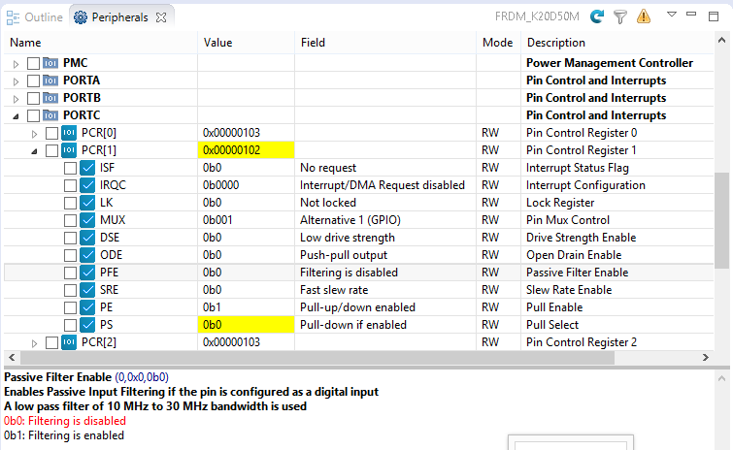
Yellow indicates items that have changed relative to a snapshot taken before the last execution
Apply filter to display only checked items
Refresh
visible registers
Current
device
Display Exception information
Description of current field
value
Description of register or field
Mode of access
RW = read-write
RO = read-only
WO = write only
Detailed description of current item
(Selected field value in red)

Slide 14
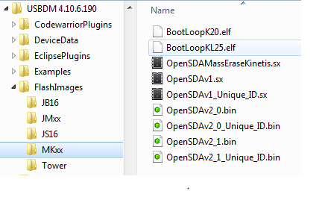
Open-SDAv1
Open-SDAv2.0
Open-SDAv2.1

