Slide 1
Spotify Data Story
Design Decisions
Why Do Some Songs Blow Up on Spotify While Most Are Never Heard?
How and why we built what we built
Cécile Sulzer, Charlotte Windlin, Angelina Zambroni
Project Oriented Digital Storytelling
01.06.2026

Slide 2
01
What we built
A scrollable, interactive data story
Not a dashboard. Not a report. A narrative experience — published on GitHub Pages, open to anyone.
01
02
03
Popularity
distribution
Feature
correlations
Genre
profiles
04
05
06
Hits vs
non-hits
Mood
map
"Your
track"

Slide 3

02
Target audience & personas
Who are we designing for?
L
Lena Bachmann
Communication design student
· Casual daily Spotify listener
· No coding or data background
· Wants to understand why songs blow up
→ Plain language, no jargon, narrative framing over raw stats
[1] https://www.magnific.com/premium-photo/young-girl-student-smiling-against-university_5670223.html

Slide 4

02
Target audience & personas
Who are we designing for?
J
Jonas Müller
Bedroom music producer
· Releases on SoundCloud & Spotify
· Curious about what makes songs popular
· No data science background
→ Interactive slider: "what would your song score?"
[2] https://www.digitalmusicnews.com/2021/10/29/how-to-record-music-at-home/

Slide 5
03
Format choice
Why a data story and not a dashboard?
Exploratory
Explanatory
Exhibitory
✓
Highlights key
insights for reader
Storytelling = Data + Visuals + Narrative

Slide 6
04
Narrative structure
Martini glass structure
Theory
Our application
Author-driven
Sections 1–5
The author tells the story
Fixed scroll order
Reader-driven
Section 6
The reader explores freely
"Your track" slider
Martini glass
Genre filter
Starts author-driven (the stem), then opens up to reader exploration (the bowl)
Checkboxes for filtering

Slide 7
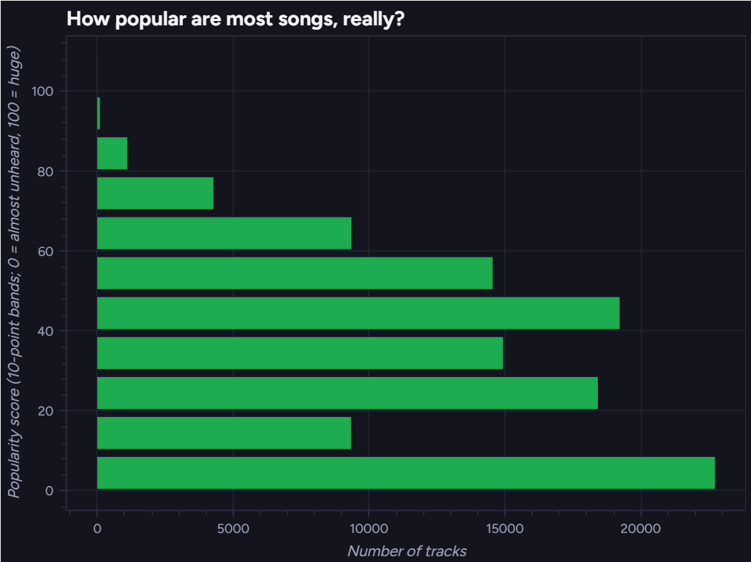
05
Visualization choices
Why each chart type?
§1 Popularity
Histogram
1 continuous variable

Slide 8
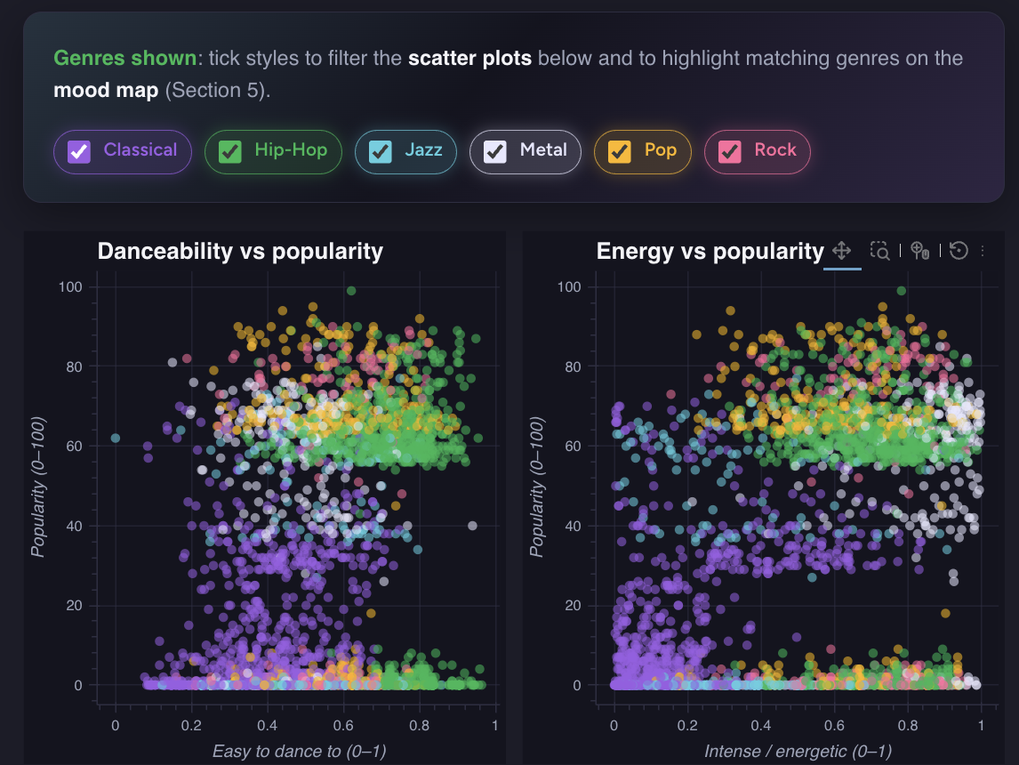
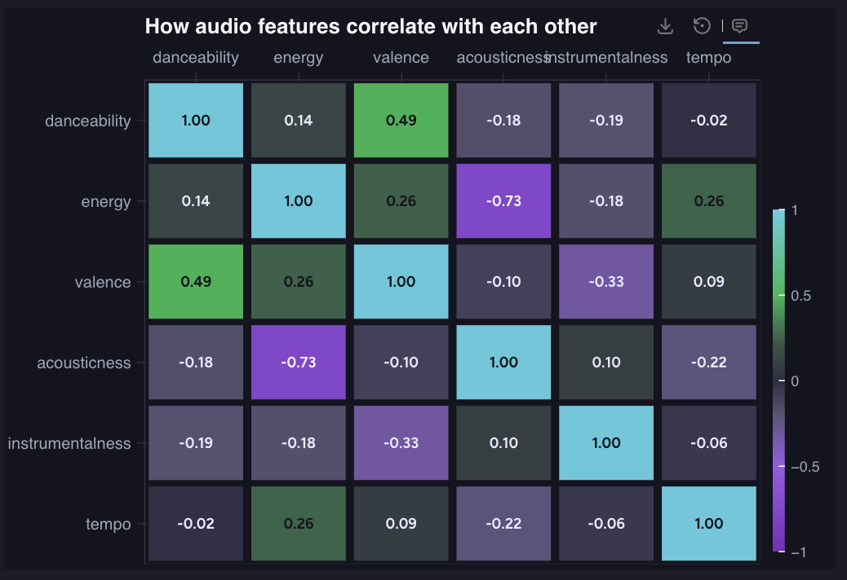
05
Visualization choices
§2 Features
Why each chart type?
Scatterplot & Heatmap
2 continuous variables

Slide 9
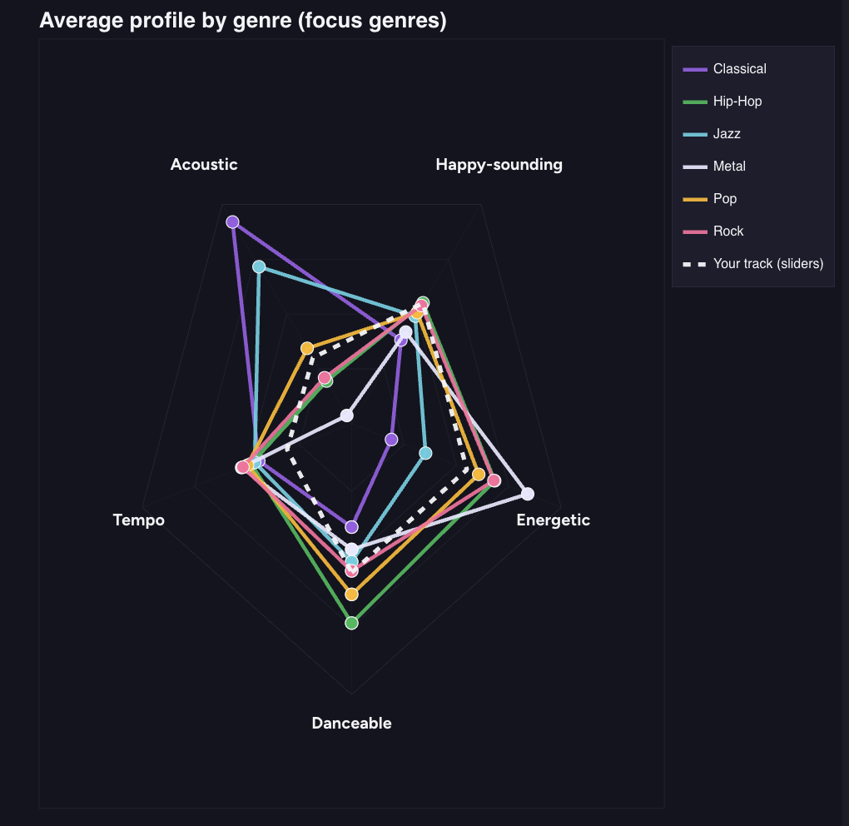
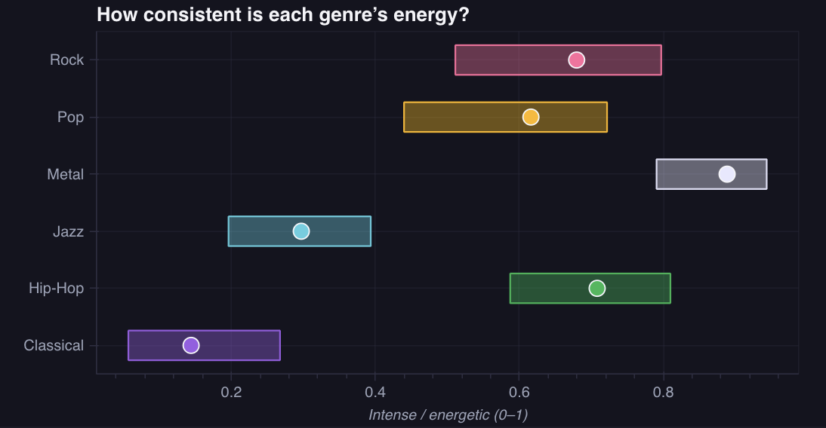
05
Visualization choices
§3 Genres
Why each chart type?
Radarchart
Range plot
Multiple continuous variables for comparison
One variable to shows how consistent each genre is

Slide 10
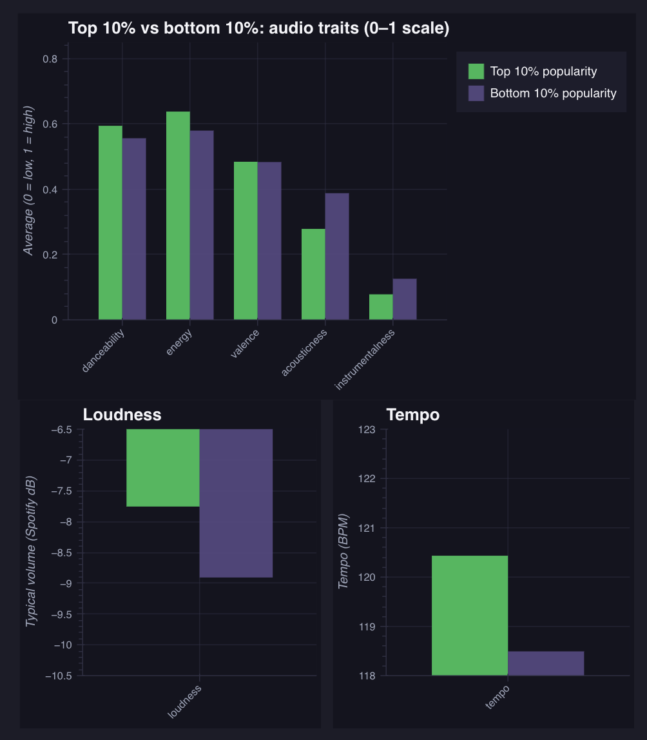
05
Visualization choices
Why each chart type?
§4 Hits
Grouped bar chart
Categorical x continuous comparison

Slide 11
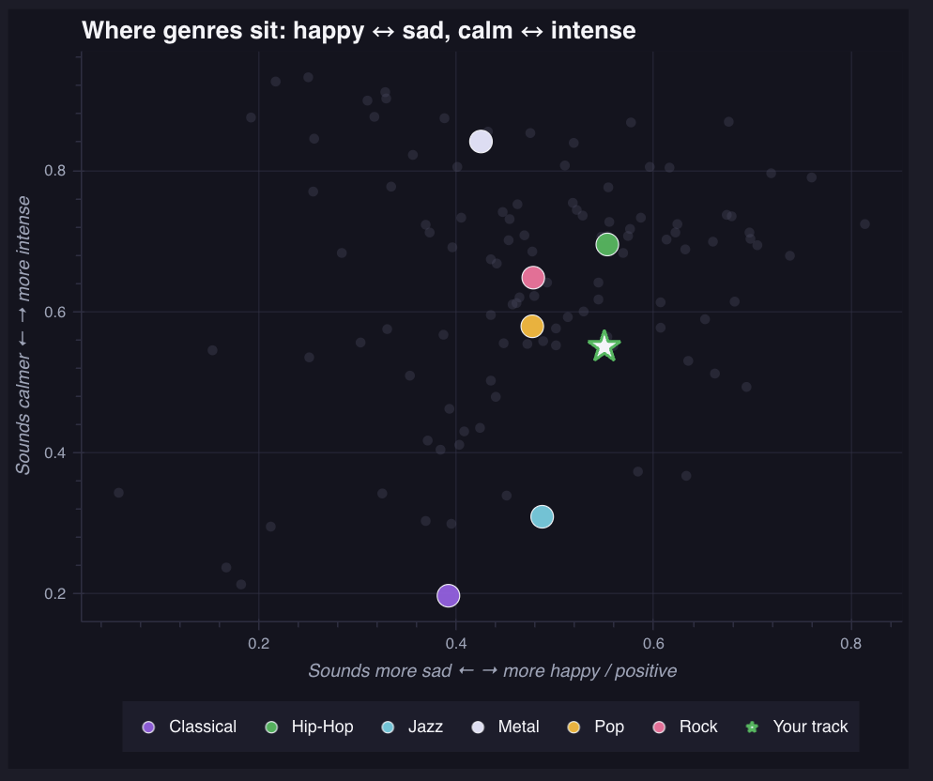
05
Visualization choices
Why each chart type?
§5 Moodmap
Scatterplot
2 continuous axes

Slide 12
06
Interactivity
Three types of interactivity
Filtering
User picks which data to include
Participating
User contributes their own data
Highlighting
Emphasises items without hiding others

Slide 13
07
Reflection
What worked and what we'd revisit
What worked
Would revisit
✓ Martini glass
△ Mobile layout
✓ Persona-driven language
△ Radar chart legend
✓ "Your track" slider
△ Section 2 heatmap

Slide 14
Are you curious about a song?
Let’s find your score!
podsv-fs26-ad24.github.io/ad24-1-fancyproject/story.html

Slide 15
THANK YOU
The design tells a consistent story.
Theory made every choice defensible.
Open the data story →
podsv-fs26-ad24.github.io/ad24-1-fancyproject/story.html

Slide 16
References
[1] https://www.magnific.com/premium-photo/young-girl-student-smiling-against-university_5670223.html
[2] https://www.digitalmusicnews.com/2021/10/29/how-to-record-music-at-home/
Based on: podsv-fs26-ad24.github.io/ad24-1-fancyproject/story.html
And if you want to have a listen: https://soundcloud.com/user-855433362

