Slide 1

DROP Inc · Applied Data Visualisation 2026
Geopolitical Conflict
& Trade Explorer
How war, trade and military spending are connected — and what the data reveals
conflict-and-trade-explorer.streamlit.app

Slide 2



TOPIC & GOAL
What we built and why
The Data
The Question
The Product
COW Bilateral Trade · COW War Data · SIPRI Military Expenditure
Three major datasets historically unconnected for analysts
How do military spending, bilateral trade and conflict involvement interact across time for any given country or war?
A single interactive dashboard: search by State or Conflict, filter by time, explore network and trend views

Slide 3


TARGET GROUP
One tool - two very different users
Sarah, 38
Marco, 31
Senior Policy Analyst
Investigative Data Journalist
VS
Needs: instant overview of a conflict for a ministerial briefing Pain: manually merging COW + SIPRI + Comtrade CSVs Gain: a ready-made conflict narrative in minutes
Needs: spot trade anomalies and back stories with hard data Pain: official portals are impossible to navigate without coding Gain: from hypothesis to citable finding — no IT support needed

Slide 4
NARRATIVE & FEEDBACK
How we tell this story today
Narrative Approach
We want your feedback on…
🎭 Persona Dramatisation
① Visual Encoding
We follow Marco live through the dashboard — his hypothesis drives every click
Does the trade/military dual-axis chart communicate the correlation clearly, or does it confuse?
📖 Two-Act Structure
② Navigation Flow
Act 1: Iraq War trade collapse (conflict view)
Act 2: India–Pakistan arms & trade paradox (state view)
Is the State vs. Conflict toggle intuitive for a first-time user?
🔍 Overview → Zoom → Detail
③ Missing Data UX
Each act mirrors the Shneiderman mantra built into the dashboard itself
Are gaps in the data handled transparently enough for academic use?

Slide 5
THE PROBLEM
The data exists.
The insight doesn't.
What analysts do today
1. Download 3 separate CSVs
2. Manually match country codes (COW ≠ ISO)
Three major academic datasets - all public, all separate, none designed to talk to each other.
3. Build custom scripts just to join tables
4. Repeat for every new question
COW Bilateral Trade
Trade flows since 1870
5. No time left for actual analysis
COW War Data
Every interstate war since 1816
SIPRI Military Exp.
Defence budgets post-WWII

Slide 6
MEET MARCO
Marco has a hypothesis.
ACT 1 · IRAQ
“The Gulf War (1990–91) shattered Iraq’s trade network overnight.
But which countries actually stayed? And who left first?”
ACT 2 · INDIA – PAKISTAN
“Two nuclear rivals. Three wars. A shared border.
Both are ramping up military spending in the 1990s — but is trade dying too, or doing something unexpected?”

Slide 7
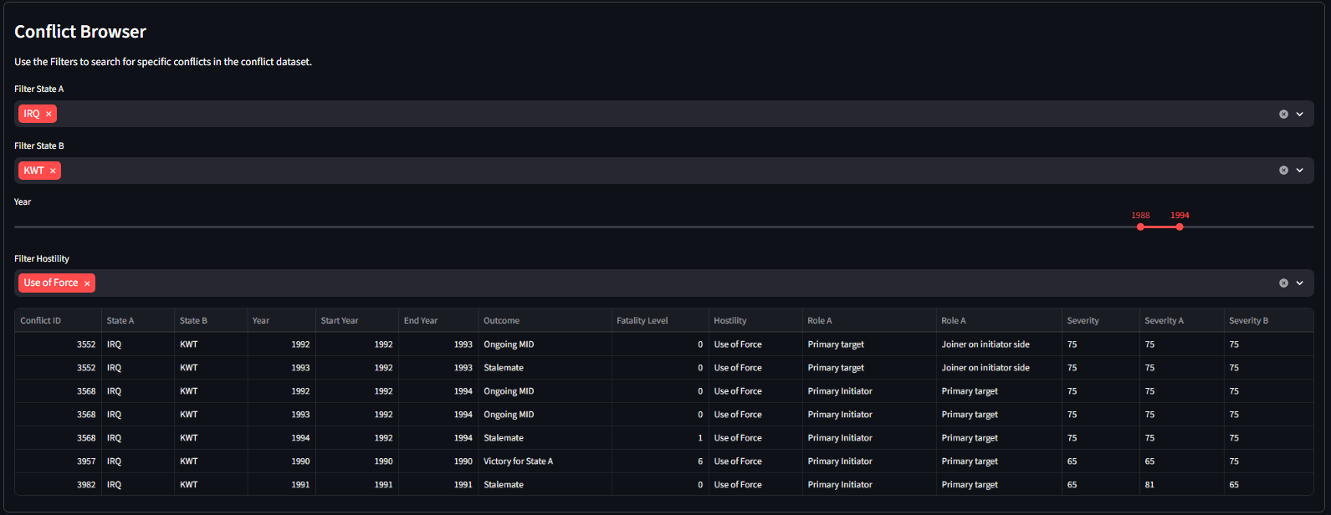
ACT 1 · IRAQ — STEP 1
Step 1: Find the conflict
● ● ● conflict-and-trade-explorer.streamlit.app · Conflict Browser
How Marco uses it
①
Set State A = IRQ
Filter the conflict list to only show Iraq's disputes
②
Set State B = KWT
Narrow down to direct confrontations between the two
③
Adjust year range
1988–1994 isolates the Gulf War period
Filter by state pair
④
Pick Conflict #3982
The table shows IDs
Marco picks the 1991 entry

Slide 8
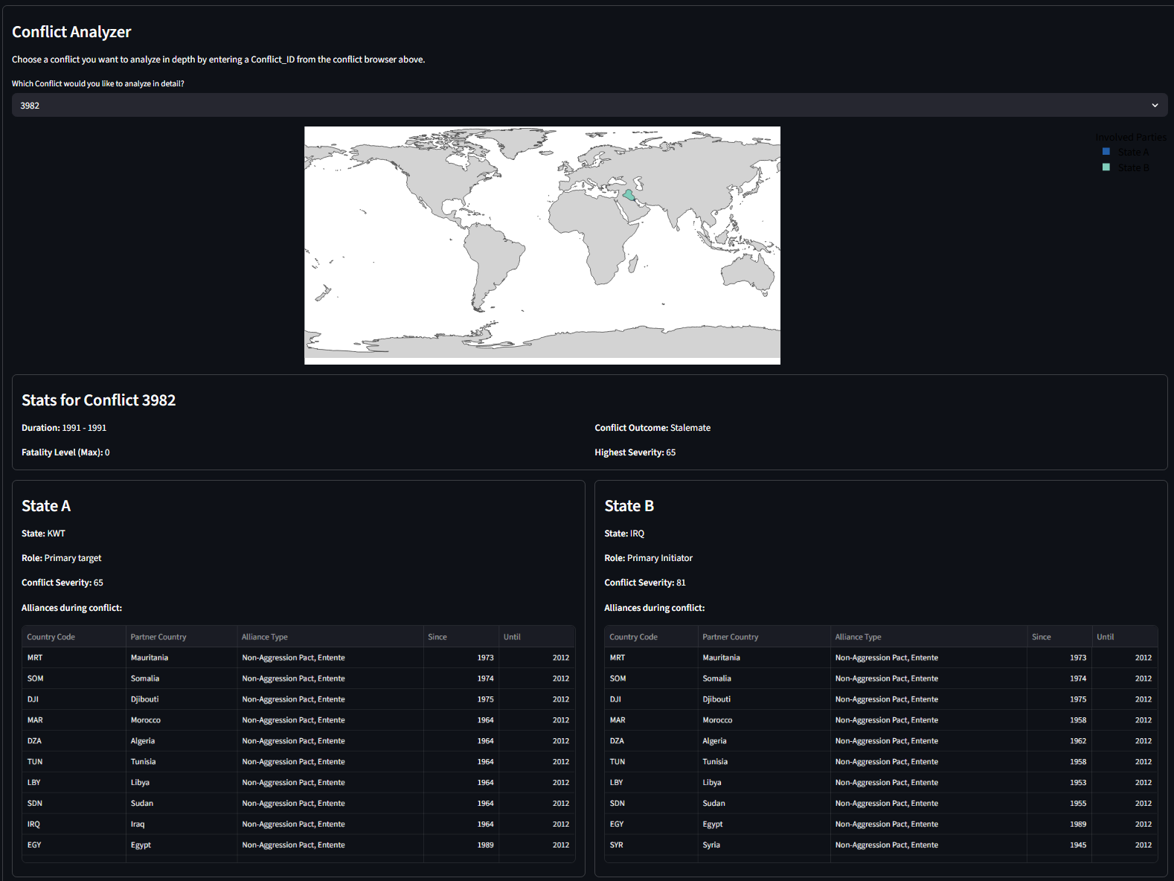
ACT 1 · IRAQ — STEP 2
Step 2: Enter Conflict ID 3982
What appears
▸ Map highlights KWT & IRQ
The two belligerents shown geographically instant orientation
▸ Duration: 1 Year in 1991
Operation Desert storm liberation of Kuwait through US led coalition
▸ Outcome: Stalemate
No decisive resolution, conflict severity 65/100
▸ Alliance tables
Full list of each state's treaty partners during the conflict

Slide 9
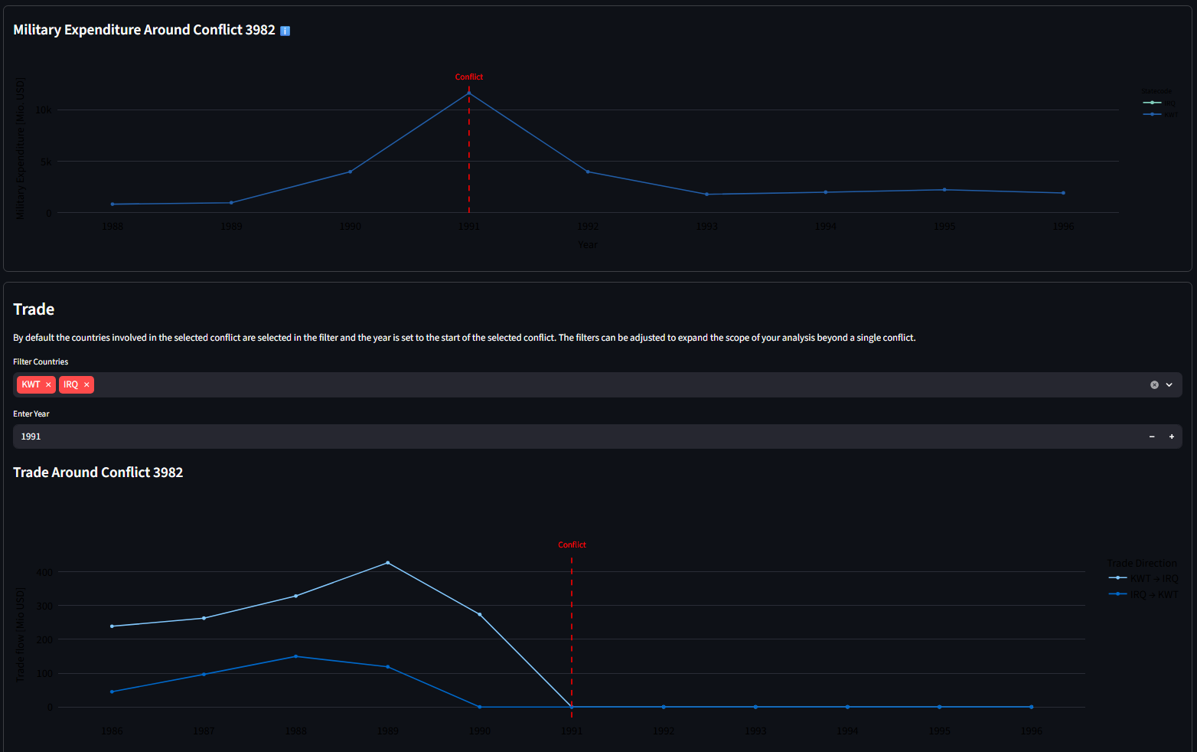
ACT 1 · IRAQ — FINDING
The trade drops to zero and never recovers
Marco's finding
Kuwaits military expenditure peaks during the conflict
Kuwait-Iraq trade hits zero in 1991 and flatlines permanently
not a dip, a permanent break.
The red line makes the conflict period unmissable.
This took Marco 3 clicks. Previously: days of CSV work.
Trade = 0 from 1991 onward
3 clicks → story found

Slide 10
ACT 2 · INDIA–PAKISTAN
Same tool.
New hypothesis.
ACT 2 · IND vs. PAK
“India and Pakistan have fought three wars. Both are ramping up military spending in the 1990s.
Does trade between them die too or does something unexpected happen?”
3
~70%
?
Wars fought
1947 · 1965 · 1971
India mil. spend
rise 1988–2000
Bilateral trade
during this period

Slide 11
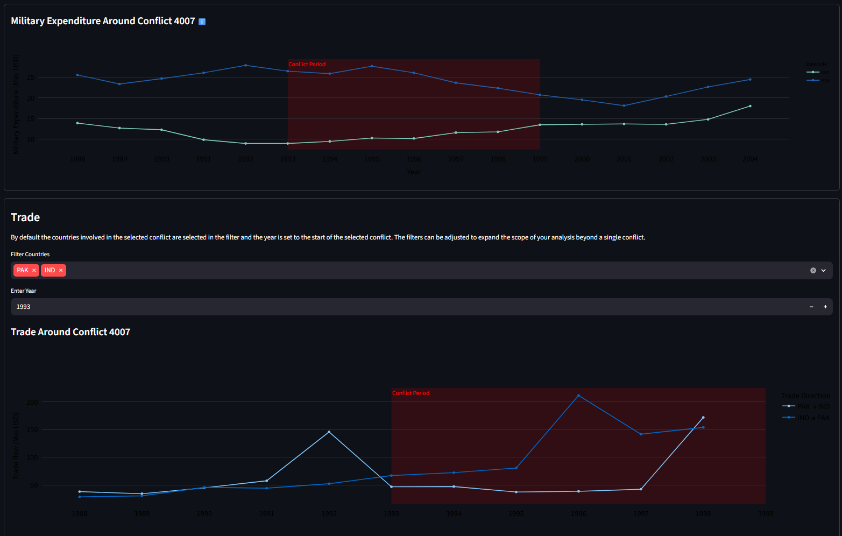
ACT 2 · INDIA–PAKISTAN — FINDING
Guns AND butter: the paradox
Marco's finding
▸ Both spend more on arms
India's military budget doubles from 1993-2004.
▸ Trade was flat - then it wasn't
Bilateral trade was near zero until 1995, then starts climbing consistently.
▸ Kargil barely dents it
Even the 1999 war barely interrupts the trade upturn. Commerce proves resilient.
▸ The paradox
Same tool. Opposite story to Iraq.
Guns AND butter. Rivals arm up and trade up simultaneously.

Slide 12
UNDER THE HOOD
How the dashboard is built
COW Trade
CSV
→
COW Wars
CSV
→
SIPRI Mil.
Expenditure
Key Engineering Challenges
▸ Entity Matching
↓
COW State Codes → ISO country codes, required custom mapping table
Data Cleaning
& Entity Matching
▸ Temporal Mismatch
SIPRI starts post-WWII; COW trade goes from 1816 to 2014 triad only possible for overlapping years
↓
▸ Performance
Streamlit
Dashboard
Large bilateral CSVs cached as Parquet; reactive filters avoid full reloads
Parquet / Cache
→
▸ Missing Data
Gaps clearly flagged in UI academic honesty over false completeness

Slide 13
Try it yourself.
🔗 conflict-and-trade-explorer.streamlit.app
COW Bilateral Trade · COW War Data · SIPRI Military Expenditure
We'd love your feedback on:
Visual encoding clarity · Navigation intuitiveness · Missing data transparency
DROP Inc · Applied Data Visualisation 2026

