Slide 1

Institute of Aeronautical Engineering
(Autonomous)
Department of Electronics and Communication Engineering
TOPIC:- NOISE REDUCTION USING SIGNAL TO NOISE RATIO(SNR) REDUCTION
Supervisor
Dr. Surekha Reddy Bandela
Electronics and Communication Engineering
Team Members
19951A04D6 – P.saikiran
19951A04H6 – E. srikar

Slide 2
OUTLINE
Abstract.
Introduction.
Prerequisites.
Existing method.
Drawbacks .
Proposed method .

Slide 3
Abstract :
In this project we are going to use signal to noise ratio to reduce the unwanted noise.
Signal-to-noise ratio (SNR) is the measurement used to describe how much desired sound is present in an audio recording, as opposed to unwanted sound (noise).

Slide 4
What is Max SNR?
The maximum SNR value is 30dB, which indicates the best link quality. Anything that is above 18-20dB means that the link is working properly. Anything below those values may indicate that there is interference or that the selected settings are not suited for the current radio environment.

Slide 5
What is the minimum SNR dB?
10 dB to 15 dB: is the accepted minimum to establish an unreliable connection. 15 dB to 25 dB: is typically considered the minimally acceptable level to establish poor connectivity.
25 dB to 40 dB: is deemed to be good.
41 dB or higher: is considered to be excellent.

Slide 6
Introduction:
Best setting for noise reduction?
Noise Reduction controls the amount of volume reduction to be applied to the noise.
For light noise, adjust this parameter between 12 and 15dB to reduce the noise but maintain the integrity of the interview audio.
Sensitivity controls how much of the audio will be considered as noise on a scale of 0 to 24.

Slide 7
Objectives
How can the signal-to-noise ratio improved?
When the signal is constant or periodic and the noise is random, it is possible to enhance the SNR by averaging the measurements. In this case the noise goes down as the square root of the number of averaged samples.

Slide 8
Prerequisites
SOFTWARE REQUIRED
Python programming

Slide 9
Existing Method:
NOISE REDUCTION USING SIMULTANEOUS MASKING PROPERTY AND SNR VARIATION FOR VARIOUS NOISE CORRUPTIONS
A speech enhancement algorithm adapted by both intraframe masking properties of the human auditory system and inter-frame SNR variation is proposed to enhance a speech signal corrupted by colored noise. Herein, we employ a gain factor adapted by the SNR variation to reduce the spectral variation over successive frames, so the effect of musical residual noise can be mitigated.

Slide 10
Existing Method:
In addition, the masking property of the human ears is also employed to adapt the gain factor, enabling the imperceptive residual noise with energy below the noise masking threshold to be retained. The speech distortion is therefore reduced by preserving more noisy speech signals. Experimental results show that the proposed scheme can efficiently reduce the effect of musical residual noise by rendering residual noise perceptually white.

Slide 11
Drawbacks
If the original audio signal is higher than the noise signal range then the noise signal can’t be cleared
This electrical noise can inject itself onto analog or digital signals and fool control equipment into thinking the process variable is different from what it actually is.

Slide 12
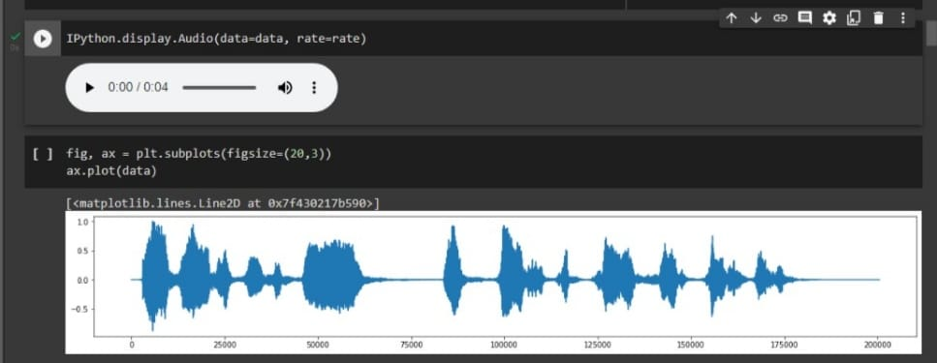
SAMPLE INPUT SIGNAL
AUDIO SIGNAL WITHOUT ANY NOISE

Slide 13
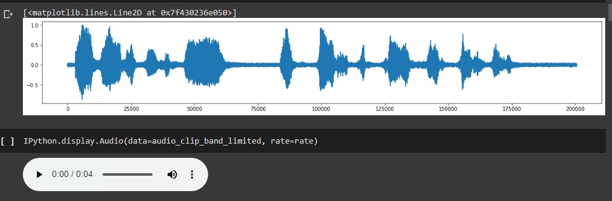
SAMPLE INPUT SIGNAL
AUDIO SIGNAL AFTER ADDING NOISE

Slide 14
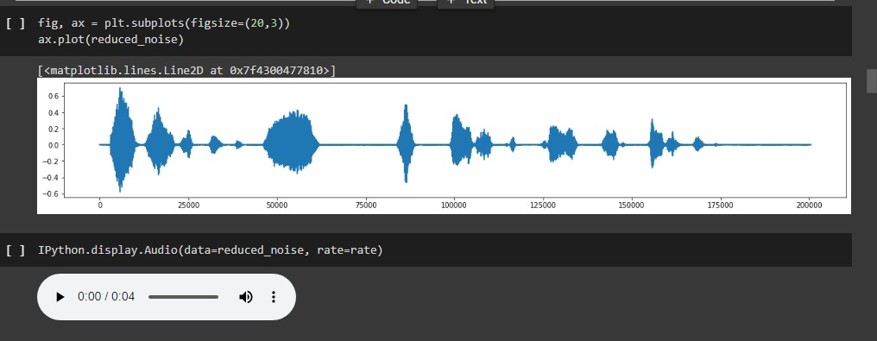
SAMPLE INPUT SIGNAL
AUDIO SIGNAL AFTER REMOVING THE NOISE

Slide 15
Proposed Method
In this method the noise can be reduced very easily without losing the original audio frequency and by just reducing the multiple background noiseswith the use of SNR filter by removing the stationary and non stationary noises from the audio sampling without causing any disortion in the original signal.

Slide 16
Proposed Method
The proposed method deals with Internal electronic noise of measurement systems can be reduced through the use of SNR
When the characteristics of the noise are known and are different from the signal it is possible to use a filter to reduce the noise

Slide 17
Proposed Method
SNR measurements are already in decibel form, then you can subtract the noise quantity from the desired signal: SNR = S - N.
This is because when you subtract logarithms, it is the equivalent of dividing normal numbers. Also, the difference in the numbers equals the SNR

Slide 18
Proposed Method
A low pass filter (LPF) is an audio signal processor that removes unwanted noise frequencies from a signal above a determined cut off frequency.
Noise can be reduced very easily without losing the original audio frequency and also by just reducing the multiple background noises with the use of SNR filter
by removing the stationary and non stationary noises from the audio sample without causing any distortion to the original signal.

Slide 19
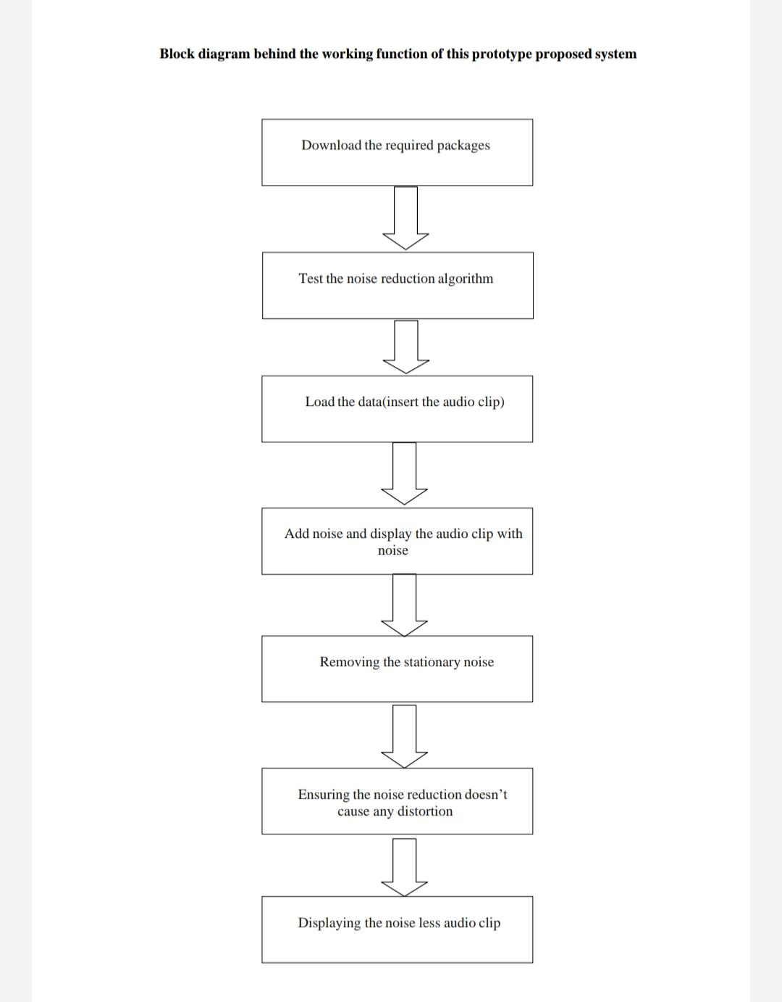
Flow Chart

Slide 20


