Slide 1
Seasonally Adaptive Data Compression in LoRaWAN Using Huffman Coding
Doshisha University
Department of Information Systems Design
Airi Kokuryo Kohei Inoda Akihito Kohiga Takahiro Koita

Slide 2
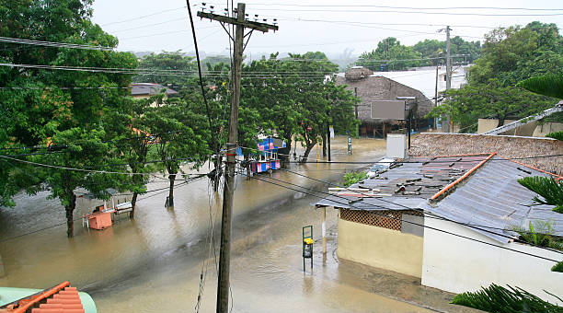
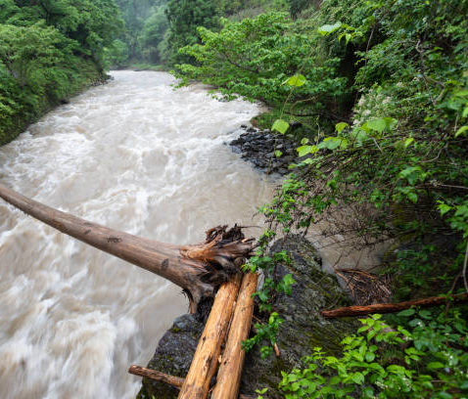
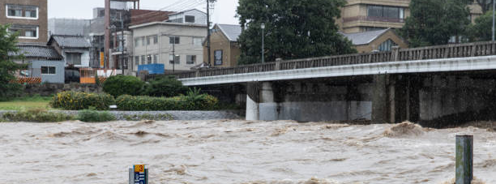
Motivation
Notes:
Global warming has led to an increase in the frequency and intensity of heavy rainfall, heightening the risk of flooding at various scales.
In fact, Japan’s annual average rainfall is on the rise, and Tokyo recorded its highest-ever average temperature in 2023.
Early flood detection is a crucial problem in timely evacuation, particularly in forested areas since they are often affected first.
In response to the growing threat of natural disasters, we are developing an early flood detection system for use in forests and mountainous regions, with LoRaWAN and IoT-based sensors.
0:55

Slide 3
LoRaWAN
(Long Range Wide Area Network)
LPWAN (Low-power wide area network) protocol
⊕ Low power
⊕ Long-term operation
⊖ Small payload (11 bytes maximum)
Efficient compression method must be needed for early flood alerts
Notes:
LoRaWAN is a LPWAN protocol designed for enabling long-range communication between battery-powered IoT devices.
It operates on unlicensed radio frequencies and is optimized for low power consumption, making it ideal for applications where devices must operate autonomously over long periods without frequent battery replacements.
Because we want to build an IoT system inside forests, which lacks power and requires wireless connections, we will be using LoRaWAN.
Despite its long communication range and low power usage, LoRaWAN has a payload limitation of a maximum of 11 bytes, which poses challenges for transmitting large or frequent sensor readings
To address this challenge, we propose a Huffman coding-based data compression method specifically optimized for flood detection scenarios.

Slide 4
Project Goal
To propose a data compression method for a flood detection sensor system
  Increase data compression rate
  Decrease sensor data send counts
Fundamental compression method:
Huffman Coding
Notes:
Our project goal is ~~
In particular, to find a better compression method for flood sensing IoT system and decrease the sensor data send counts for less energy consumption.
We will be using Huffman coding as our fundamental compression method.
2:35

Slide 5
Huffman Coding
Lossless data compression algorithm
Assign codes with length based on frequencies of the input characters
Efficient for biased distributions
Notes:
Zip: not tailored for specific use such as flood detection
Such as
Environmental sensor data
Text data
2:57

Slide 6

Huffman Coding
100
1
0
49
0
1
51
25
0
“D” is 110
1
0
1
26
25
24
13
12
“A”
“B”
“C”
“D”
“E”
Notes:
Here we see a Huffman tree constructed based on character frequencies.
Each node represents the combined frequency of its child nodes, and each edge is labeled with either a 0 or a 1, which we follow to generate the binary code for each character.
For example, let’s trace how the character 'D' is encoded.
Starting from the root node at the top with frequency 100, we follow the path:
Right → gives us 1
Right again → another 1
Then left → gives us 0
So, the code for 'D' is ‘110’.
This method allows us to assign shorter codes to more frequent characters and longer codes to less frequent ones, optimizing the overall compression.
4:15

Slide 7


Prior Work: Seasonal Huffman Coding
Sensor Data
Temperature
Humidity
Compress & Send
(Seasonal Huffman Coding)
Create Huffman trees based on seasonal temperature and humidity data (Summer, Fall, Winter, Spring)
Notes:
今prior workがあって、Huffman codingを季節ごとに変える,こうしましたという説明
Next, I would like to introduce our prior work: Seasonal Huffman Coding.
In this approach, we divided the sensor data by season — spring, summer, fall, and winter — and built a separate Huffman tree for each.
When encoding, we selected the appropriate tree based on the timestamp of each sensor reading, to capture seasonal patterns in the data distribution.
4:55

Slide 8
Prior Work: Seasonal Huffman Coding
Result:
Compression performance (reduction rate):
-> Seasonal Huffman coding outperforms raw or standard ZIP compression.
Huffman Coding | Huffman Coding + Run-length Compression | ZIP Compression
88.8% | 94.8% | 87.5%
Notes:
To evaluate the proposed method, we compared compression ratios between standard and compressed data transmission using the sensor data from Japan Meteorological Agency.
The result is as shown in this graph.
Huffman coding performed 88.8% reduction rate to where ZIP compression performed 87.5%.
This shows how seasonal Huffman coding outperformed raw or standard ZIP compressions.
(I did not include run-length encoding in the extended abstract because it required creating an additional Huffman tree for the repetition counts. This made the method more complex and less practical for real-world deployment.)
5:30

Slide 9
Research Question
Is seasonal Huffman coding more effective than all-season Huffman coding?
  Compare both seasonal and all-season Huffman
The current method doesn’t consider a threshold for sending data
  Introduce Flood Probability(FP) as a threshold, and assign higher weights to data with higher FP values
Notes:
This came to us with these questions:
Is seasonal Huffman coding more effective than all-season Huffman coding?
In order to answer this question, we decided to compare both seasonal and all-season Huffman coding.

Slide 10





Compression Methods
Seasonal Huffman
All-Season Huffman
Capture seasonal bias
Simpler deployment
Notes:
Now I would like to explain what Seasonal and All-Season Huffman coding is.
Seasonal Huffman coding divides the dataset into four temporal segments corresponding to the four seasons: Spring(March-May), Summer(June-August), Fall(September-November), and Winter(December-February).
For each segment, a separate Huffman tree is constructed based on the symbol frequencies observed during that specific season.
This was what we used in our prior experiment.
II. All-Season Huffman Coding:
All-season Huffman coding, by contrast, constructs a single Huffman tree combining all samples from each season.
This approach attempts to generalize across seasonal fluctuations, producing a tree that reflects the average symbol distribution across the entire year.
This would be simpler to deploy in the real world compared to the seasonal huffman.
7:20

Slide 11
Research Question
Is seasonal Huffman coding more effective than all-season Huffman coding?
  Compare both seasonal and all-season Huffman
The current method doesn’t consider a threshold for sending data
  Introduce Flood Probability(FP) as a threshold, and assign higher weights to data with higher FP values
Notes:
Coming back to the research question…
The current compression method does not take into account any threshold for transmitting data.
However, when designing a flood-aware IoT sensor system, this kind of threshold is essential.
To address this, we introduce Flood Probability, or FP for short.
FP represents the likelihood of a flood occurring, and it can be calculated from sensor data such as temperature, humidity, and rainfall.
In addition, we apply weights based on FP — assigning higher weights to data with higher flood probability.
This allows the system to prioritize transmitting more critical data, while ignoring low-risk information.
8:16

Slide 12

Symbol Weighting Strategy
Unweighted
Flood-Risk Weighted
Raw data
Raw data
Weight with FP
Weighted data
Don’t consider flood risk
Consider flood risk
Notes:
This is how the weights work.
When constructing the Huffman tree, we consider two weighting strategies.
The unweighted method uses raw symbol frequency, treating all data equally, regardless of flood risk.
In contrast, the flood-risk weighted method gives more importance to symbols that frequently appear when the Flood Probability is high.
This means sensor patterns strongly correlated with flood conditions are more efficiently encoded.

Slide 13
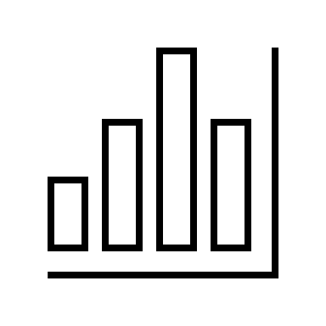

Approach
Sensor Data
Temperature
Humidity
FP Calculation
Is FP ≥ 90%
Compress & Send
(Seasonal Huffman /
All-season Huffman)
Develop a better way to generate a Huffman tree for data sent under high Flood Probability (FP) conditions
Notes:
In our proposed approach, we first do a FP calculation, to check whether the given sensor data indicates high flood risks.
If the FP exceeds 90%, we compress the data using the Huffman trees and send it to the cloud via LoRaWAN.
Here, we mainly focused on how to generate better Huffman trees that reflect the characteristics of data under high-risk conditions.
9:28

Slide 14
Approach: Flood Probability(FP)
Method: Logistic regression
Trained on:
  Inputs: temperature, humidity, precipitation
  Precipitation ≥ 10mm (2023-2024)
  8 regions across 4 seasons in Japan
Notes:
Now, FP is a probability that the precipitation is likely to go over 10mm(which we decided as a threshold for the term “flood”, only because it was hard to find data that went over 30mm which is considered the amount flood could occur)
(We calculate the FP using logistic regression.
The model was trained on meteorological data from 2023 to 2024, collected across 8 regions in Japan and spanning all four seasons.
Each data point includes temperature, humidity, and precipitation
To focus on flood-relevant scenarios, we filtered the dataset to only include actual flood cases.)
10:25

Slide 15
Approach: Compression Strategy
Huffman Tree
Seasonal
Compression methods
All-season
Symbol Weighting Strategy
unweighted
weighted
unweighted
weighted
Compared between 4 strategies
Notes:
Our compression strategy consists of two main parts.
The compression methods of either seasonal Huffman or all-season Huffman coding, and symbol weighting strategy, of either unweighted or weighted.
Therefore, there will be four strategies of creating a Huffman tree.
10:50

Slide 16
Experimental Methodology
FP Model:
Input: flood data csv
Output: coefficient, intercept
Huffman Tree Construction:
Input: 4 season data csv, FP model(coef & intercept)
Output: Huffman tree
Source: Japan Meteorological Agency(JMA)
Notes:
All parts of the experiment were implemented in Python.
We used meteorological CSV data from the Japan Meteorological Agency.
First, we trained the FP model using temperature, humidity, and precipitation.
This model outputs coefficients and intercepts, which we later use to compute FP values for each sensor reading.
Next, we used this FP information along with the seasonal data to construct Huffman trees — either unweighted or flood-risk weighted — depending on the strategy
11:30

Slide 17
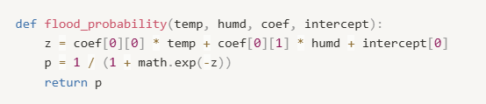
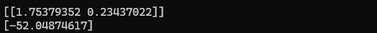
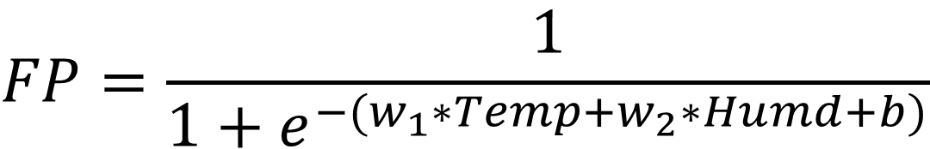
Experimental Methodology: FP
$$FP=\frac{1}{1+e^{−(w_{1}∗Temp+w_{2}∗Humd+b)}}$$
-> coefficient (coef)
-> intercept
Notes:
To calculate Flood Probability, we used a logistic regression model trained in Python.
The model takes temperature and humidity as input and outputs the probability of flooding.
The coefficient and intercept values shown here were obtained by training the model using historical data of actual flood cases with precipitation over 10 mm.

Slide 18
Experimental Methodology: Metrics
Compression Ratio
  Compressed size vs raw data size
Transmission Count
  How often data had to be sent
Notes:
The metrics are as shown here.

Slide 19
Results –File Size
Fall and Winter data can become a noise
  Flood risk weighting outperformed seasonal distribution
Notes:
Here, we can observe the file sizes.
First, seasonal Huffman coding performs better than the standard all-season model.
This confirms that the seasonal distribution was effective improving the compression rate.
On the other hand, the unweighted all-season Huffman coding shows the lowest compression efficiency.
This is because it focuses on encoding the most frequent data across all seasons — such as temperature — which may not have direct correlations with the rainfall.
As a result, data from fall and winter, which have low flood relevance, become a noise in the Huffman tree."
Q&A:
I think the seasonal Huffman didn’t have much effect with weighted or unweighted, because it had less datasets than the all season Huffman.
So, we’ll have to try with a larger dataset to
13:18

Slide 20
Results –File Size
Weights on FP rather than temperature itself
  Flood risk weighting outperformed seasonal distribution
Notes:
Second, the flood-risk-weighted all-season model outperforms all others, achieving the smallest file size.
Although it is trained on data from all four seasons, applying FP-based weighting enables the model to focus on flood-relevant data.
This results in a more effective Huffman tree for compressing flood-related sensor readings.
While seasonal segmentation helps to capture temporal patterns, the all-season model benefits from a larger dataset and the ability to selectively emphasize high-risk data via FP, leading to the best overall compression performance.
Q&A:
I think the seasonal Huffman didn’t have much effect with weighted or unweighted, because it had less datasets than the all season Huffman.
So, we’ll have to try with a larger dataset to
14:18

Slide 21
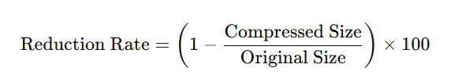
Results
Prior Work:
Huffman Coding | Huffman Coding + Run-length Compression | Zip Compression
88.8% | 94.8% | 87.5%
4 Huffman Coding Strategies:
Seasonal | Seasonal weighted | All-season | All-season weighted | ZIP
92.06% | 92.06% | 87.56% | 93.08% | 88.58%
Notes:
This slide compares the results from our initial experiment to the final version using the Flood Probability model.
We found that integrating FP into the compression pipeline significantly improved overall performance.
In both experiments, every method except the unweighted all-season Huffman outperformed ZIP compression.
As for run-length encoding, we decided not to include it in the second experiment, because it required building a second Huffman tree just for encoding repetition counts, which added complexity and made it less suitable for real-world applications.
15:10

Slide 22
Results –Times Sent
  Reduced transmission counts by more than 1/10
Notes:
This slide shows the number of transmissions needed after applying Huffman compression.
For reference, the uncompressed send counts were: Spring – 649, Summer – 840, Fall – 67, and Winter – 0.
Now look at the bar chart: both Seasonal and All-Season Huffman methods reduce transmission counts drastically, with fewer than 70 sends even in high-data seasons like Spring and Summer.
This highlights the system's adaptive nature, sending data only when necessary, based on flood probability.
This doesn’t just save bandwidth — it also preserves energy, which is critical for remote sensors operating in forests or mountains over long periods.
Q: これは、どうやって送信した回数を数えた？
Answer:
From the csv sensor data, we compressed only the data that had the FP of over 90% and encoded the Huffman code by writing into a text file.
In the text file, a newline was inserted whenever the FP dropped below 90% or when the length of a line exceeded 11 bytes, indicating a transmission event.
The total number of new lines was then counted to estimate the number of transmissions.
Q: What does it mean seasonal and all-season here about the send counts?
16:10

Slide 23
Results
Best performance:
All-season Huffman (Weighted)
Flood-risk weighting improved the compression efficiency of all-season Huffman trees
Notes:
As for result, All-season Huffman coding with flood-risk weighted showed the best performance.
The weighting by flood-risk helped prioritize symbols that are important during emergencies. And instead of managing four seasonal trees, a single weighted tree gave us better results and simplified implementation
Compared to the seasonal Huffman coding, all-season Huffman is
✔ Simpler to deploy and
✔ More stable across seasons
16:36

Slide 24
Future Work
Real-world deployment:
✔ Arduino + LoRaWAN sensor testing
Hardware optimization:
✔ Investigate ASIC-based Huffman Deep Compression (HDC)
Energy analysis:
✔ Measure power savings per transmission
Notes:
Our next step is to implement this in hardware and test in real environmental conditions.
We also want to explore custom ASICs for further power and performance optimization.

Slide 25
Conclusion
Seasonal Huffman showed better compression than All-season Huffman
With FP implementation, All-season Huffman with flood-risk weighting had the best compression rate
Achieved:
✔ Higher compression ratio
✔ Lower transmission frequency
Notes:
We found that combining Huffman compression with flood-awareness significantly improves performance, making the system both efficient and practical for real-world deployment.
We achieved ~ than our prior work.
17:47

Slide 26
Thank you for listening
Airi Kokuryo
cguh1034@mail4.doshisha.ac.jp

