Slide 1
Change Attribute of Face Image with
Generative Adversarial Networks
Team Member:
Zhen Mao, N10975345, zm720@nyu.edu
Kaixiang Ye, N17641793, ky934@nyu.edu
Long Wan, N10288570, lw2284@nyu.edu

Slide 2
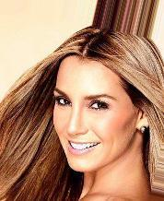
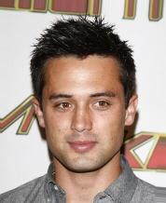
Task
Change attribute of face images
For simplicity, we just use gender as our target binary attribute, male or female. And generate new gender inversed images with other feature remain the same
Female
Male
Male
Female
?
?

Slide 3
Data set: CelebA
CelebFaces Attributes Dataset(CelebA) is a large-scale face attributes dataset, includes:
10,177 number of identities
202,599 number of face images
5 landmark locations, 40 binary attributes annotations per image
For our Face Image Gender Transfer task:
Use 40000 Align&Cropped face images for training
Use Gender as binary target attribute, which is either male or female
Inverse gender of random face images for test
Dataset can be found at: http://mmlab.ie.cuhk.edu.hk/projects/CelebA.html

Slide 4
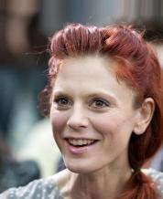
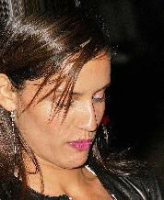
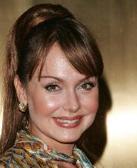
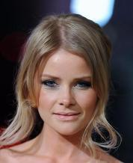
Data set: CelebA
Female Sample Images

Slide 5
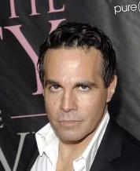
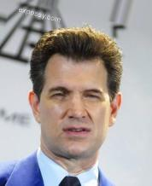
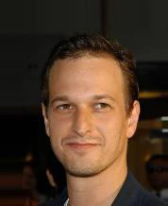
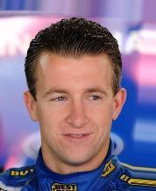
Data set: CelebA
Male Sample Images

Slide 6
Generative Adversarial Networks
Discriminator
Is Input real?
Real Image
Generator
Make Discriminator distinguish real image from fake image more accurate
Training
Fake Image
Latent space
Random noise
Make generator generate more “Real” image to cheat generator

Slide 7
Generative Adversarial Networks
Optimization Goal:
Generative Network (G)
Capture sample data distribution
Input a random noise, and output target image
Optimize G: generate more real images to cheat D, make D difficult to distinguish fake image from real image
Discriminative Network (D)
Classify real image and fake image
Input both real image and fake image, and output its decision
Optimize D: make more accurate decision to tell fake image from real
When D think real image is similar with fake image, G can produce realistic target images

Slide 8
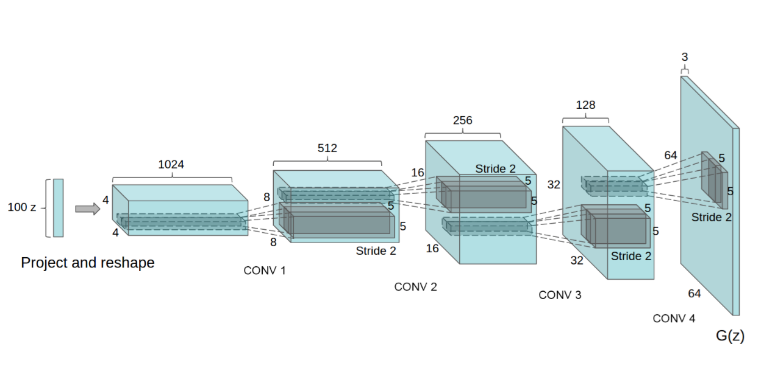
Deep Convolutional GAN
DCGAN is an advanced stable GAN architecture
DCGAN architecture
Image from paper “Unsupervised Representation Learning with Deep Convolutional Generative Adversarial Networks”

Slide 9
Deep Convolutional GAN
DCGAN is an advanced stable GAN architecture
Features of DCGAN architecture
Replace pooling with convolutions, use strides convolutions in discriminator, factional-stride convolution in generator
Use batch norm in both generator and discriminator
Apply BN to all layers will cause model unstable and sample vibrate, to avoid this, output layer in generator and input layer in discriminator will not use BN
Remove full connection layer, full connection layer increase model stability but hurt model converge speed
Except output layer, generator use ReLU as activation function, output layer use Tanh
Discriminator use LeakyReLU as activation function

Slide 10
Conditional GAN
Problem: we can only produce realistic fake images with GAN, but can’t control images’ attribute
For example, if we use face image for training, G will just generate face images, can’t control its gender
Conditional GAN: attach a attribute vector as input for both G and D to control attribute
But we still need modify architecture to take image as input of G, generate new images based on old images
Attribute Vector
Discriminator
Is Input real?
Real Image
Generator
Fake Image
Attribute Vector

Slide 11
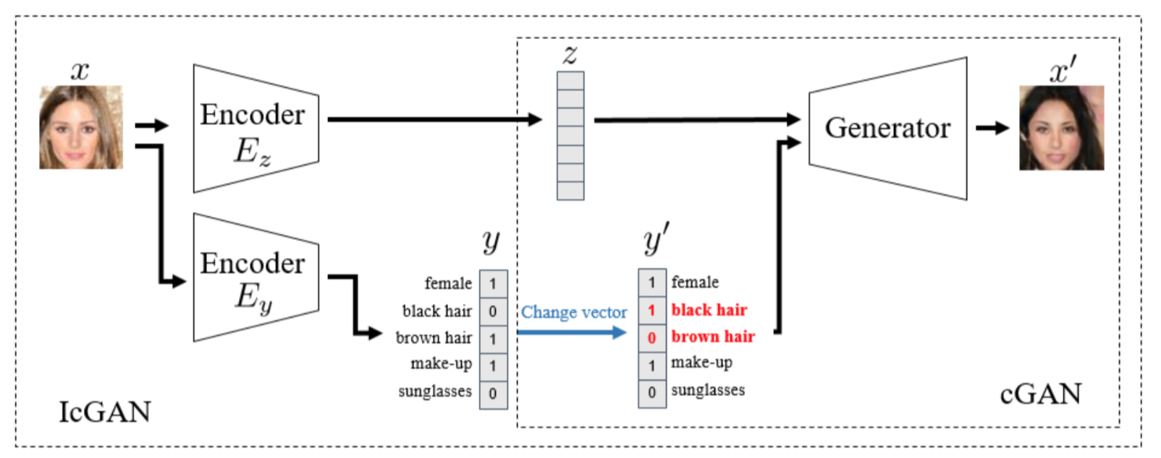
Invertible Conditional GAN
ICGAN: introduce an encoder to determine specfic representation of generated images, which inverse the mapping of cGAN, given an input image x, to obtain its representation as a latent variable z instead of random noise and a attribute vector y, and we can modify z and y to re-generate the original image with complex variations.
We use ICGAN for our task
Image from paper “Conditional Generative Adversarial Nets”

Slide 12
Invertible Conditional GAN
Generative Network G
Generate new images based on latent variable z and modified attribute vector y’
Loss Function: G_loss = -log(D(G(z,y’),y’))
Discrimitive Network D
Distinguish input image is real or not, combined with attribute vector
Loss Function: D_loss = -(log(D(x,y)) + log(1-D(G(z,y'),y')))
Encoder Ez
Map image to a feature vector which can best present the image and restored to original image
Loss Function: z_loss = l2_loss(z-enz(G(z,y')))
Encoder Ey
Get the attribute vector of original image
Loss Function: y_loss = l2_loss(y-eny(x))

Slide 13
Training Detail
Encoder z Architecture
Convolution layer 1
Convolution layer 2
Convolution layer 3
Convolution layer 4
FC
FC
Kernel
5*5*3*32
Kernel
5*5*32*64
Kernel
5*5*64*128
Kernel
5*5*128*256
BN
BN
BN
BN
BN
Stride
2*2
ReLU
Stride
2*2
ReLU
Stride
2*2
ReLU
Stride
2*2
ReLU
ReLU
512
Input image
64*64*3
4096

Slide 14
Training Detail
Encoder y Architecture
Convolution layer 1
Convolution layer 2
Convolution layer 3
Convolution layer 4
FC
FC
Kernel
5*5*3*32
Kernel
5*5*32*64
Kernel
5*5*64*128
Kernel
5*5*128*256
BN
BN
BN
BN
BN
Stride
2*2
ReLU
Stride
2*2
ReLU
Stride
2*2
ReLU
Stride
2*2
ReLU
ReLU
2
Input image
64*64*3
100

Slide 15
Training Detail
Generator G Architecture
Deconvolution layer 1
Deconvolution layer 2
Deconvolution layer 3
Deconvolution layer 4
Deconvolution layer 5
Kernel
4*4*512*514
Kernel
4*4*256*512
Kernel
4*4*128*256
Kernel
4*4*64*128
Kernel
4*4*3*64
z
512
BN
BN
BN
BN
Stride
2*2
ReLU
Stride
2*2
ReLU
Stride
2*2
ReLU
Stride
2*2
ReLU
Stride
2*2
Tanh
y
2
Image size
4*4*512
Image size
8*8*256
Image size
16*16*128
Image size
32*32*64
Image size
64*64*3

Slide 16
Training Detail
Discriminator D Architecture
Convolution layer 1
Convolution layer 2
Convolution layer 3
Convolution layer 4
Convolution layer 5
Kernel
4*4*3*64
Kernel
4*4*66*128
Kernel
4*4*128*256
Kernel
4*4*256*512
Kernel
4*4*256*512
BN
BN
BN
BN
sigmoid
Stride
2*2
Stride
2*2
LReLU
Stride
2*2
LReLU
Stride
2*2
LReLU
Stride
2*2
LReLU
y
2
Input image
64*64*3

Slide 17
Training Detail
Training Process
Training Encoder y with original image and its gender attribute one-hot vector
Training Encoder z with generated image and its latent space vector
Training GAN with latent space from Encoder z and inverse attribute vector from Encoder y
Hypermeters
Encoder
Batch size = 64
Learning rate = 0.001
Epoch = 10
Optimizer = Adam
GAN
Batch size = 64
Learning rate = 0.0002
Epoch = 15
Optimizer = Adam
We also attach our trained checkpoint file on github in directory “model_z”, “model_z”, “model_gan”

Slide 18
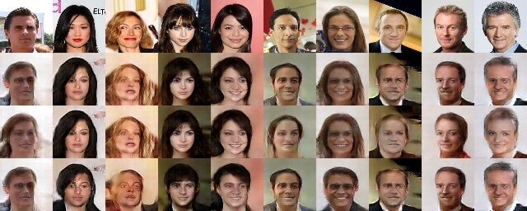
Test Result
GAN training iteration
Original image
5000
10000
15000

Slide 19
Result Analysis
From perceptual intuition, some face images can perfectly inverse gender, and produce new images
Most generated images suffer from blurry problem (blurry seems like a common problem for all GAN, but we notice some GAN architecture aims to solve it)
The training of GAN is very unstable, some generated images make no sense, like No.3 in our test.

Slide 20
THANKS!

