Slide 1
ENGI 301 Mini Rube Goldberg + Game Proposal
Monday, September 25th, 2023
Paula Ortega Giménez

Slide 2
Background Information
Story: I have always liked games like Rube Goldberg machines and those involving puzzles or surprising elements. I decided to make a device that started through the input of a mini version of the Rube Goldberg machines – a marble track. The second part was basically due to wanting to make something artsy or visual while still adding a fun component to it.

Slide 3
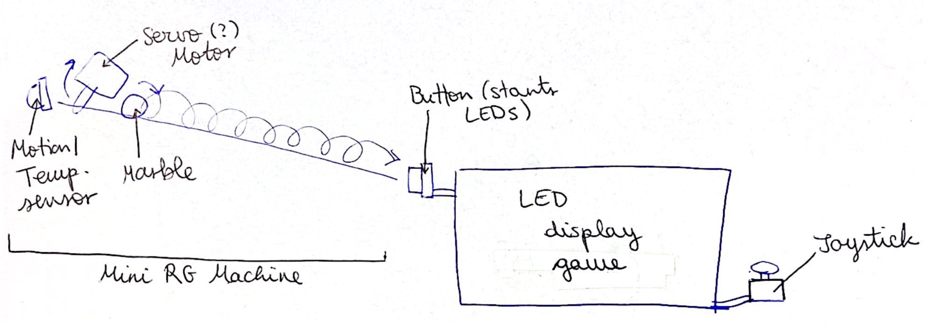
Background Information
I am proposing a mini Rube Goldberg Machine with an LED display at the end. This display will potentially have a game on it (like the snake game in [4]), but this might be out of scope for the class, so otherwise, it will just be a display. Also, the complexity of the RG machine might vary, so some of these components are also tentative depending on the difficulty of the tasks as well as where I decide to focus (i.e., more on the display or more on the RG machine?).
Picture of ideal plan:

Slide 4
Background Information
Some existing projects that gave me ideas / might be useful:
Uses motion sensor:
https://www.hackster.io/FutureSharks/raspberry-pi-security-system-with-motion-detection-camera-bed172 [1]
LED game:
LEDs and Buzzer Controlled by Joystick: https://www.hackster.io/arnaum/leds-and-buzzer-controlled-by-joystick-336696 [2]
Programming 8x8 LED Matrix: https://www.hackster.io/SAnwandter1/programming-8x8-led-matrix-23475a [3]
Snake LED 16x16 matrix game https://www.hackster.io/vasiljevalentin/snake-led-16x16-matrix-game-27ba6d [4]
Game of Lights (uses LED strip): https://www.hackster.io/josh-holder/game-of-lights-1d74af [5]
Could also use an LED strip and something like this: Android Things Word Clock https://www.hackster.io/daniele-bonaldo/android-things-word-clock-46cc14 [6]
Servo:
Servo Motor + Ultrasonic Sensor: https://www.hackster.io/anjalishaw1125/servo-motor-ultrasonic-sensor-e69be3 [7]
A Totally Useless IoT Machine: https://www.hackster.io/macsboost/a-totally-useless-iot-machine-eee434 [8]
Marble path:
Could 3D print (Thingiverse): https://www.thingiverse.com/search?theme=store&utm_medium=cpc&utm_source=google&utm_campaign=Search_US_PRO_DSA_Quote&utm_adgroup=PRO&utm_content=&gad=1&gclid=CjwKCAjw38SoBhB6EiwA8EQVLrS9Ds5gu_eQL7mR9CashCs2ye7Fa9uiAJuqYGOISkla5nITyfE9iBoCzCoQAvD_BwE&q=marble+path&page=1&type=things&sort=relevant
There are several options as well as a potential energy path that might allow me to have the ball return to the initial position (might be out of scope)
Countdown example: New Year’s Countdown https://www.hackster.io/milesnash_/new-year-s-countdown-aeefff [9]
Since I am putting a lot of ideas together, I feel like this might be enough complication to existing projects, but I will develop this depending on the professor’s feedback. I am basically putting a lot of components together as well as some parts from other projects, mainly the LED display portion. As for the software, I will be checking what could be useful from these projects, and while a base for many of these components probably exists, I will have to put everything together so that it works for my specific application. I will probably also change some component of the LED display so that I can display what I want.
Note: The citation numbers given here are such that these projects can be referenced in the Diagrams below if necessary

Slide 5
System Block Diagram
Internet
Host Computer
GPIO
Button
7 Segment Display
PRU
USB
Pocket Beagle
LED Display
Servo Motor
PRU
P1_8 [5]
PRU
Motion/Temp. Sensor
[2]
GPIO
[2]
Joystick
PRU

Slide 6
Power Block Diagram
Pocket Beagle
[2]
Joystick
5V
LED
[4,5,6]
P1_24, P2_13
Servo
[7]
Sensor?
[7]
Host Computer Connection
5V
V_in micro-USB
3.3V
1.8V

Slide 7
Components / Budget
Component | Need to Buy | Cost ($)
x1 Servo Motor (? Not sure which motor is better) | No
x1 Button | No
LED matrix 8x8, 16x16 or 32x32 (or rectangular if just as easy to work with) (size depends on what I end up doing – scope of project, but I would study prices before making a decision) Some options: https://www.adafruit.com/product/607 (parts list) https://www.adafruit.com/search?q=LED+Matrix+Panel&p=2 https://www.adafruit.com/product/454 (taken from https://www.hackster.io/SAnwandter1/programming-8x8-led-matrix-23475a) | Yes (potentially parts list) | Will try for it to be < 30 (cost of 32x32 given on Sheet)
Marbles Theres many options in Amazon: https://www.amazon.com/s?k=marbles&rh=p_36%3A-500&qid=1695690773&rnid=386491011 | Yes | < 5
Motion sensor or temperature sensor | Yes (parts list) | 1.98 or 1.70
Potentially Joystick https://www.amazon.com/DEVMO-Joystick-Breakout-Controller-Arduino/dp/B07RB493PT/ | Yes? | 12.99 for x5
Potentially 7 segment display | No
Might have to buy path for RG machine, but I can probably make this or print it with the 3D printers if allowed | ?

