Slide 1
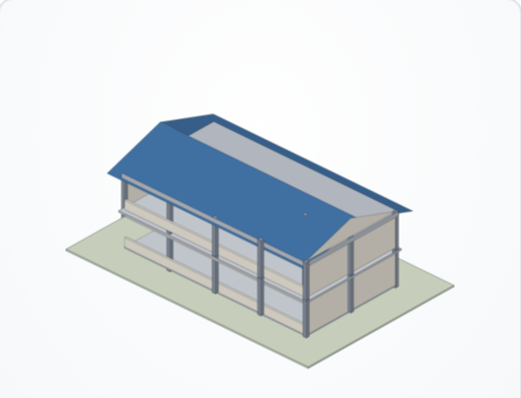
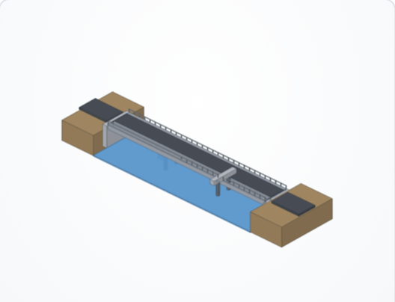
BUHAY-AH
PRACTICAL RESEARCH 2 · INTRODUCTION AND METHODOLOGY
A Budget-to-Blueprint Design Generator, Standards-Based Quantity Take-Off, and Hybrid Machine Learning System for Start Quotations and Over-Budget Detection in Public Buildings and Bridges
Enrique Miguel C. Buban
Lead Researcher
Mathematical and Computational Sciences · 2026
Notes:
Good day. I am Enrique Miguel C. Buban, and this is BUHAY-AH. Buhay means life, because public infrastructure carries lives. This study builds a system that designs public buildings and bridges from a budget, prices them from engineering standards, and flags contracts that are over budget.

Slide 2



Presentation Outline
OVERVIEW
I
F
M
Introduction
Framework
Methodology
Background, research gap and rationale, objectives, significance, scope and delimitation, definition of terms
Review of related literature, theoretical framework, conceptual framework
Research design, locale and data, instruments, procedure, models, validation, ethics
Notes:
This presentation follows the IMRaD structure of Practical Research 2. This deck covers the Introduction and the Methodology.

Slide 3
Introduction
01
Background of the study, research gap and rationale, objective, significance, scope and delimitation, definition of terms
Notes:
We begin with why this study was needed.

Slide 4

Corruption Hides in the Price
BACKGROUND OF THE STUDY
10–30%
32 / 100
₱545.64B
₱62.64M
of public infrastructure investment lost to corruption, mismanagement and inefficiency
Philippine score in the 2025 Corruption Perceptions Index; 120th of 182
flood-control projects, July 2022 – May 2025; about 20% went to 15 contractors
overstatement found by COA in the Cebu City Medical Center building
CoST, n.d.
Transparency International, 2026
DZRH News, 2025; PCIJ, 2025
Cebu Daily News, 2023
In 2025 a newly opened ₱1.2-billion bridge in Isabela collapsed less than a month after completion (Philstar, 2025). In Bicol, COA findings on DPWH projects worth ₱13 billion showed that cost checks against an independent estimate happen late, if at all.
Notes:
Construction is one of the sectors most exposed to corruption. CoST estimates 10 to 30 percent of investment in public infrastructure is lost to corruption, mismanagement and inefficiency. The Philippines scored 32 of 100 in the 2025 Corruption Perceptions Index, ranking 120th of 182. About 20 percent of 545.64 billion pesos in flood-control projects went to 15 contractors. COA found the Cebu City Medical Center building overstated by about 62.64 million pesos, partly because VAT was computed at 12 percent instead of 5 percent.

Slide 5


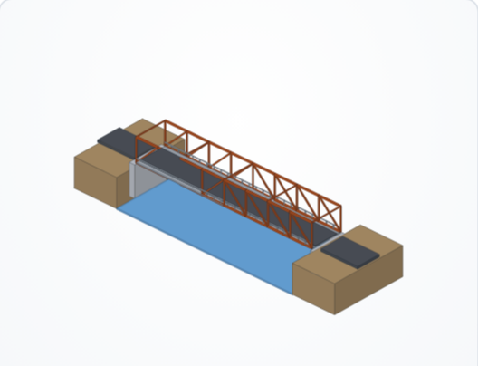


Why Buildings and Bridges
BACKGROUND OF THE STUDY
Every padded peso is a missing classroom
School buildings, health stations and evacuation centers are what communities rely on during typhoons.
Bridges keep communities reachable
Bicol is in NSCP Seismic Zone 4 and in the path of frequent typhoons; thin bridges fail first.
The ABC is set by the same office
Each project gets a Program of Works and an ABC; outsiders have no independent estimate to compare.
Machine learning screens many contracts
Regression and XGBoost predict cost; CORA screened 11,646 Bicol road contracts (Buban, 2026).
Notes:
Buildings and bridges carry a particular weight. School buildings, health stations and evacuation centers are the facilities communities rely on during typhoons; bridges are the links that keep them reachable. Each is priced through a Program of Works and Detailed Unit Price Analysis leading to the ABC. Machine learning can screen many contracts, but it learns from past prices.

Slide 6





Five Gaps This Study Closes
RESEARCH GAP AND RATIONALE
Scope gap
Reference gap
Validation gap
Design gap
Access gap
Cost screening research has focused on roads; buildings and bridges have frames, footings, girders and piles.
Data-driven models learn what projects have cost; if past prices were padded, so is the model.
Anomaly detectors are tested where true overpricing is unknown, so recall cannot be measured.
Many communities have a need and a budget but no plan, and so no independent price at all.
Models stay in notebooks; barangays, school heads, auditors and reporters need a tool on their phones.
Rationale: a fair price can be computed from the plan and the standards, then compared with the contract.
Notes:
Five gaps motivate this study. Scope: screening has focused on roads. Reference: data-driven models learn what similar projects have cost, not what they should cost. Validation: detectors are tested where nobody knows the true overpriced cases. Design: communities know only their need and budget. Access: models stay in notebooks.

Slide 7
Research Questions
OBJECTIVE OF THE STUDY
This study aimed to develop BUHAY-AH, a budget-to-blueprint design generator, standards-based quantity take-off and hybrid machine-learning system that produces start quotations and detects over-budgeted public buildings and bridges in Bicol Region V. Specifically, it sought to answer the following research questions:
RQ1
What plan variables and derived indicators can be extracted from building and bridge plans and engineering standards to estimate construction cost, in terms of physical properties; structural system and foundation; and location and price year?
RQ2
How can schematic designs be generated from a requirement or a budget, in terms of a modular design library; budget-to-design optimization; and compliance with design and space standards?
RQ3
How accurately does the standards-based quantity take-off engine estimate construction cost, in terms of the lean start quotation, standard fair estimate and ceiling; and MAPE against fair awarded costs?
Notes:
This study aimed to develop BUHAY-AH, a budget-to-blueprint design generator, standards-based quantity take-off and hybrid machine-learning system that produces start quotations and detects over-budgeted public buildings and bridges in Bicol Region V. Specifically, it sought to answer six research questions.

Slide 8
Research Questions (continued)
OBJECTIVE OF THE STUDY
RQ4
How do Multiple Linear Regression and Extreme Gradient Boosting (XGBoost) perform in predicting construction cost, in terms of R², RMSE and MAPE under leave-one-out cross-validation?
RQ5
How effectively do the over-budget ratio, the XGBoost residual, the Isolation Forest and the hybrid BUHAY-AH Risk Index detect over-budgeted contracts, in terms of precision, recall, F1-score and ROC AUC?
RQ6
How can the system be deployed as a mobile application with a design studio, a download website, and an explainable interface with floor plans, 3D models and SHAP explanations?
Notes:
Questions four to six cover the models, detection and deployment.

Slide 9





Who Benefits
SIGNIFICANCE OF THE STUDY
DPWH and Implementing Offices
COA, Ombudsman and ICI
LGUs, DepEd and DOH Offices
Cross-check programs of works and ABCs with an independent take-off before bidding; catch errors such as wrong VAT rates.
Rank contracts by risk and focus field inspections on projects that need them most.
Get a design and a starting quotation from just a requirement or a budget.
Contractors
Taxpayers, Civil Society, Media
Academe and Future Researchers
A public reference that rewards fair bids and helps honest bidders defend their price.
Check a project on a phone and see the bill of quantities behind a price.
A reproducible pipeline, a benchmark with known overpricing and an open price book.
Notes:
BUHAY-AH gives anyone with a need, a budget or a plan an itemized, standards-based design and price, and a fast way to see whether a contract amount is defensible.

Slide 10
Alignment with the SDGs
SIGNIFICANCE OF THE STUDY
SDG 16
SDG 9
SDG 11
SDG 12
SDG 4
Peace, Justice and Strong Institutions
Industry, Innovation and Infrastructure
Sustainable Cities and Communities
Responsible Consumption and Production
Quality Education
16.5 reduce corruption and bribery; 16.6 accountable institutions; 16.10 public access to information
9.1 quality, reliable and resilient infrastructure
11.5 reduce losses from disasters
12.7 sustainable public procurement (RA 12009)
4.a build and upgrade education facilities
Notes:
SDG 16.5, 16.6 and 16.10: reduce corruption, build accountable institutions and widen public access to information. SDG 9.1 and 11.5: fair pricing protects the quality of resilient infrastructure. SDG 12.7: sustainable public procurement under RA 12009. SDG 4.a: lean quotations stretch school-building funds to more classrooms.

Slide 11


What the Study Covers
SCOPE AND DELIMITATION
Covers
Delimitations
Public buildings: schools, government offices, health facilities, multi-purpose halls and evacuation centers, covered courts, dormitories, public markets
Bridges: RC box culverts, RC deck girders (RCDG), prestressed concrete girders (PSCG), steel trusses; spread footings, driven piles, bored piles
Six Bicol provinces: Albay, Camarines Norte, Camarines Sur, Catanduanes, Masbate, Sorsogon; price years 2022–2026
Plan input by dimensions, reference plans, DXF outlines and generated designs
Roads, flood control, water supply, ports, land acquisition, right-of-way, design and supervision fees, furniture and equipment are excluded
Unit costs are indicative 2025 Albay prices with location factors and a yearly index
Generated designs are schematic, for estimating only; licensed architects and engineers must develop them
Models are trained and validated on a 300-project simulated benchmark (SBD-300); a flag is not evidence of wrongdoing
Notes:
The study covers public buildings and bridges in the six provinces of Bicol Region V, priced from 2022 to 2026. Roads and flood-control structures are excluded. Unit costs are indicative 2025 Albay prices. Generated designs are schematic. The benchmark is simulated because itemized bills of quantities are not publicly available in machine-readable form.

Slide 12
Key Terms
DEFINITION OF TERMS
Term | Operational definition
Approved Budget for the Contract (ABC) | The ceiling price a procuring entity sets; computed as EDC plus OCM, profit and 5% VAT under DPWH D.O. 197 s. 2016 and D.O. 30 s. 2025.
Lean Start Quotation | The lowest code-compliant price of a plan: minimum NSCP reinforcement and basic finishes; the recommended starting price.
Standard Fair Estimate | The ABC at typical DPWH design intensities; the reference for the over-budget ratio.
Ceiling Estimate | The highest price that can still be defended for a plan; contracts above it are flagged.
Over-Budget Ratio (OBR) | Contract amount divided by the standard fair estimate.
BUHAY-AH Risk Index (BRI) | A 0–100 score combining the OBR, XGBoost residual and anomaly score; 30 or more is flagged.
Budget-to-Design Optimization | The search for the largest facility whose quotation fits a budget, keeping Pareto-efficient designs.
Quantity Take-Off (QTO) | Measuring the work quantities of a plan, such as cubic metres of concrete and kilograms of steel.
SHAP | Shapley additive explanations; splits a prediction into each feature’s contribution.
Notes:
These terms are defined conceptually and operationally to ensure a common understanding of the key concepts.

Slide 13
Framework
02
Review of related literature, theoretical framework, conceptual framework
Notes:
Next, the literature and the frameworks that guided the study.

Slide 14
What Earlier Studies Found
REVIEW OF RELATED LITERATURE
Study | Method | Finding | Gap for this study
Mahamid (2011) | Multiple regression, road projects | Early cost estimates from a few variables | Roads only
Elmousalami (2020) | Review of AI and parametric cost models | Tree ensembles lead in accuracy | Learns from past prices
Coffie & Cudjoe (2024) | XGBoost + SHAP | Predicts cost overruns with explanations | No reference price
Larocque et al. (2025) | Explainable ML, 11,646 road contracts | Accurate, explainable road cost estimates | Roads only
Liu et al. (2008) | Isolation Forest | Unsupervised anomaly detection by short paths | Misses ordinary-looking padding
Buban (2026), CORA | MLR, XGBoost, Isolation Forest, Bicol roads | R² 0.8723, MAPE 29.20%; three flags | Recall unknown, roads only
GAO (2020); Flyvbjerg et al. (2002) | Should-cost estimating; cost underestimation | Bottom-up estimates expose misrepresentation | No open tool
Notes:
Regression has long been used for early cost estimates. Tree ensembles and parametric models are now the standard tools. Isolation Forest detects anomalies without labels. CORA combined MLR, XGBoost and Isolation Forest on Bicol road contracts. None of these says what a project should cost, and none was validated where overpricing is known.

Slide 15
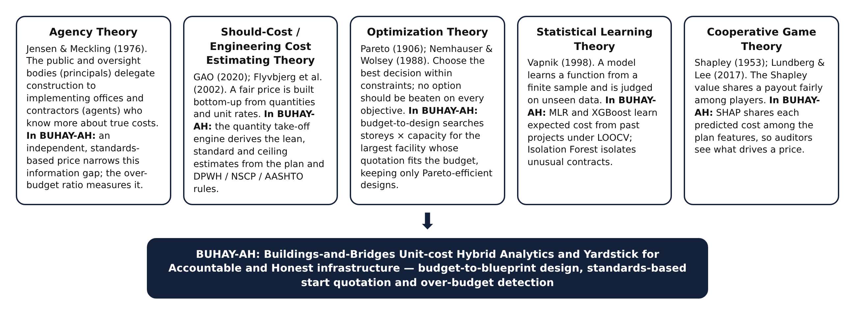
Five Theories Behind BUHAY-AH
THEORETICAL FRAMEWORK
Agency (Jensen & Meckling, 1976) · Should-Cost (GAO, 2020) · Optimization (Pareto, 1906; Nemhauser & Wolsey, 1988) · Statistical Learning (Vapnik, 1998) · Cooperative Games (Shapley, 1953)
Notes:
Agency Theory explains why padding happens: information asymmetry between the public and implementers. Should-Cost Theory says a fair price can be built bottom-up. Optimization Theory chooses the best design under a budget. Statistical Learning Theory guides the models. Cooperative Game Theory gives the Shapley value behind SHAP.

Slide 16
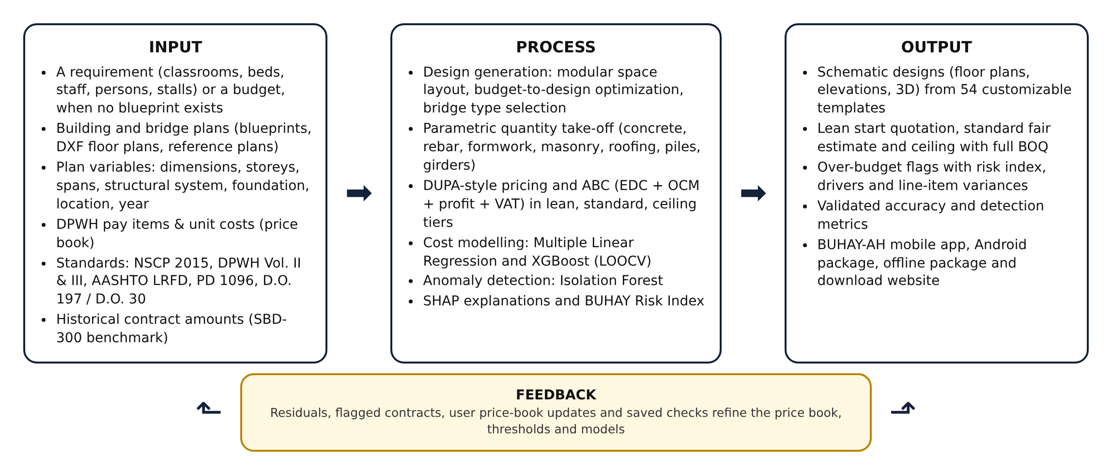
Input–Process–Output–Feedback
CONCEPTUAL FRAMEWORK
Notes:
Inputs are a requirement, a budget, or a plan, plus the standards, the price book and past projects. The process generates designs, performs the take-off, prices the quotation tiers, trains the models and scores the risk. Outputs are designs, quotations, flags and the app. Feedback updates the price book and thresholds.

Slide 17
Methodology
03
Research design, locale and data, instruments, procedure, models, validation and ethical considerations
Notes:
Now the methodology, which is where Mathematical and Computational Sciences does the work.

Slide 18




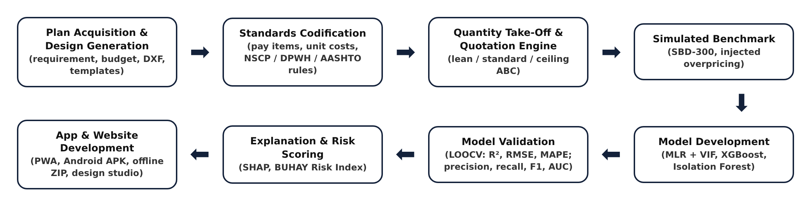
Quantitative Developmental Design
RESEARCH DESIGN
A quantitative developmental design with a simulation-based computational experiment: the problem is expressed as mathematical models, solved as algorithms and validated with statistics.
Deterministic modeling
Combinatorial optimization
Statistical and machine learning
Monte Carlo simulation
Quantity take-off and ABC from NSCP, DPWH and AASHTO
Budget-to-design integer program and Pareto filter
MLR, XGBoost, Isolation Forest, SHAP
SBD-300 benchmark with known overpricing
Notes:
This is a quantitative developmental research design with a simulation-based computational experiment, following the approach of the Mathematical and Computational Sciences. Four kinds of mathematics work together: deterministic modeling, combinatorial optimization, statistical and machine learning, and Monte Carlo simulation.

Slide 19

Bicol Region V, Standards and Prices
RESEARCH LOCALE AND DATA SOURCES
Province | Location factor | Cost index
Albay | 1.00 | 0.90 (2022)
Camarines Sur | 1.00 | 0.94 (2023)
Camarines Norte | 1.03 | 0.97 (2024)
Sorsogon | 1.03 | 1.00 (2025)
Masbate | 1.10 | 1.03 (2026)
Catanduanes | 1.12 | —
Standards codified
NSCP 2015 Vol. I (buildings); AASHTO LRFD 9th ed. (bridges)
DPWH Standard Specifications Vol. II (2013) and Vol. III (2019)
DPWH D.O. 197 s. 2016 and D.O. 30 s. 2025 (indirect costs)
PD 1096, BP 344 accessibility, RA 9514 fire code
DepEd Educational Facilities Manual; DOH AO 2016-0042; Sphere
BUHAY-AH price book: DPWH pay items and 2025 unit costs
Location factors and yearly cost index bring each price to 2025 Albay levels.
Notes:
The locale is Bicol Region V: six provinces with location factors. The data sources are engineering standards, DPWH pay items and unit costs for 2025, reference plans and the simulated benchmark.

Slide 20

Plan Variables Extracted
RESEARCH INSTRUMENTS
Building variables (9) | Unit
Gross floor area, footprint | m²
Number of storeys | —
Structural span (bay) | m
Floor-to-floor height | m
Facility type, roof system | category
Location factor, cost index | factor
Bridge variables (11) | Unit
Total length, span length | m
Deck width, deck area | m, m²
Pier and abutment heights | m
Superstructure type | category
Foundation type, pile length | category, m
Location factor, cost index | factor
Plan sources: dimensions typed in, 19 reference plans, generated designs, or a DXF file. The largest closed polyline is the outline; area and perimeter come from the shoelace formula; walls on WALL or PARTITION layers are measured, and $INSUNITS sets the scale.
Notes:
The instruments are the BUHAY-AH plan reader, cost engine and models. Nine variables describe a building and eleven a bridge. A DXF outline is read with the shoelace formula for area and perimeter; walls drawn on WALL or PARTITION layers are measured.

Slide 21
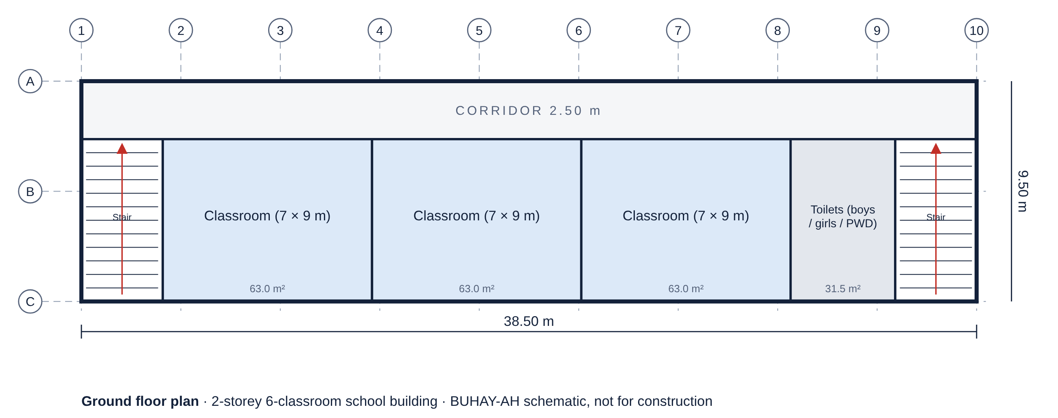
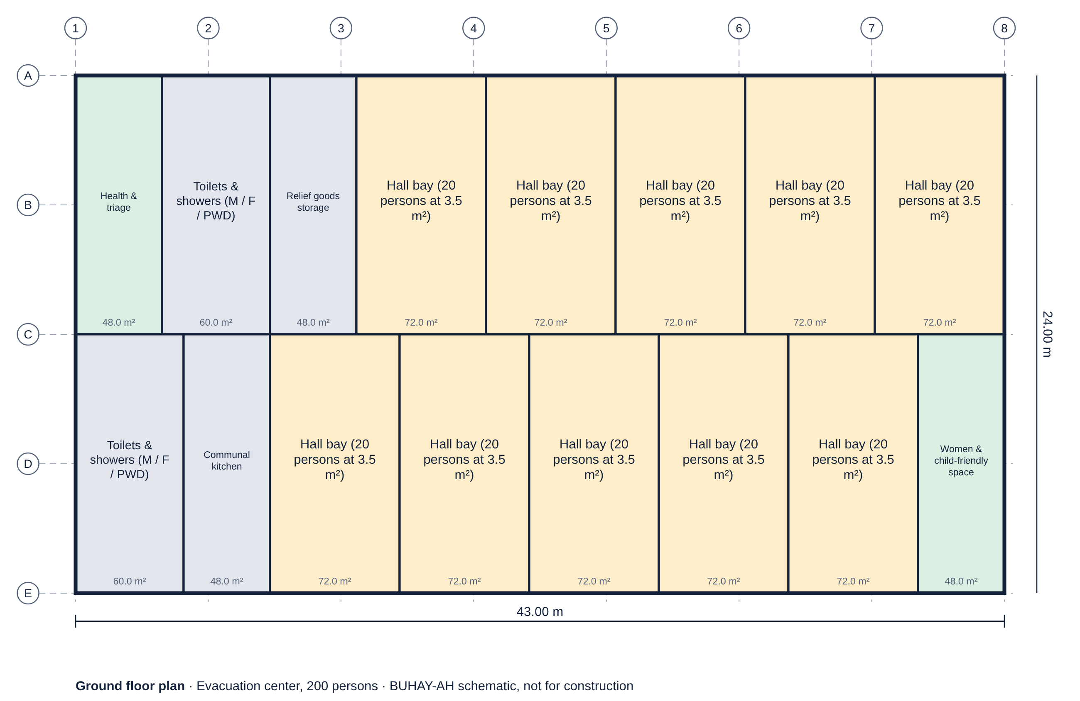
Design Generation from a Budget
DATA GATHERING PROCEDURE
55 space modules (7 × 9 m DepEd classroom, 6-bed ward, 20-person evacuation bay…) laid out in rows and floors
41 building + 13 bridge templates, customizable and combinable as wings
Budget-to-design: maximize capacity κ subject to ABC ≤ budget, length ≤ lot, storeys ≤ limit
Exhaustive enumeration + Pareto filter, because cost jumps with new stairs, floors and footings
Notes:
When there is no plan, BUHAY-AH builds one from 55 space modules sized to DepEd, DOH, National Building Code and DSWD norms. Modules are laid out in rows along corridors and across floors. For a budget, the best design maximizes capacity subject to the ABC fitting the budget, the length fitting the lot and the storeys within the limit. Because cost is not monotonic in capacity, the solver enumerates every combination and keeps the Pareto-efficient designs.

Slide 22
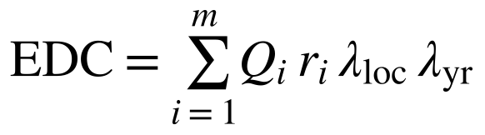

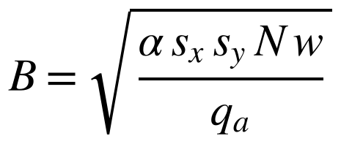
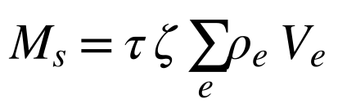
Quantity Take-Off and Quotation
DATA GATHERING PROCEDURE
Estimated direct cost and ABC
Setting | Lean (start) | Standard | Ceiling
Reinforcement factor τ | 0.80 | 1.00 | 1.25
Structural steel factor | 0.92 | 1.00 | 1.15
Floor finish | Cement topping | Ceramic tiles | Porcelain / granite
MEPF allowance factor | 0.85 | 1.00 | 1.25
Mobilization / OSH | 1.0% / 1.0% | 1.2% / 1.5% | 1.5% / 2.0%
Scope contingency | — | — | 8% of works
Structural quantities from engineering formulas
EDC bracket | OCM | Profit
Up to ₱5 million | 15% | 10%
₱5M – ₱50M | 12% | 8%
₱50M – ₱150M | 10% | 8%
Above ₱150M | 8% | 8%
Footing width from load and soil bearing; steel from volume × intensity.
Notes:
The engine lays out the column grid, sizes footings from the service load and allowable soil bearing, computes concrete, reinforcement, formwork, masonry, roofing, finishes and MEPF, multiplies each quantity by its DPWH unit cost, and applies OCM, profit and 5% VAT by bracket. It runs three times: lean, standard and ceiling.

Slide 23
Simulated Benchmark SBD-300
DATA GATHERING PROCEDURE
300
160
140
36
simulated projects
buildings
bridges
injected overpricing
Awarded cost
Hidden variation the plan cannot see
Unit prices ±7% per project
Reinforcement ±10%, concrete ±6%
MEPF ±8%, earthworks +5–15%
Pile lengths 0.95–1.35 × planned
Provinces weighted by size; award years 2022–2025
η: lognormal bid competition (fair bids slightly below standard)
μ = 1 for fair projects; 1.20–1.40 moderate, 1.40–2.10 severe padding
Notes:
To measure recall, the truly overpriced contracts must be known. SBD-300 has 160 buildings and 140 bridges, each priced by the engine plus hidden variation the plan does not show, then bid competition, and in 36 projects deliberate overpricing of 20 to 110 percent.

Slide 24
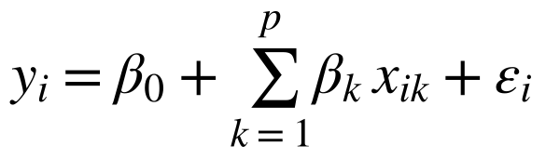
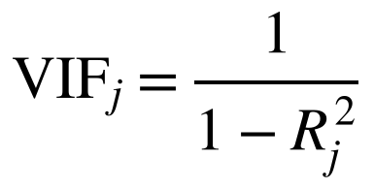
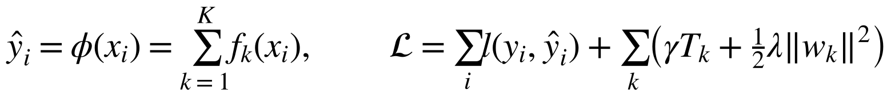
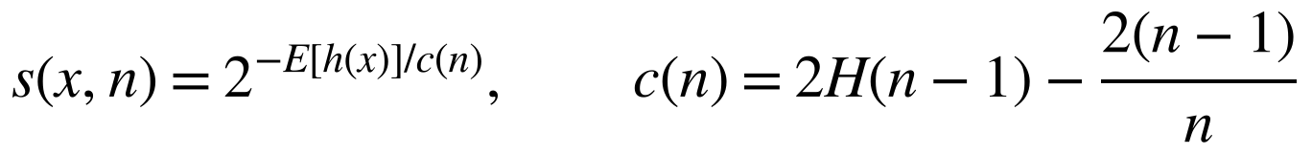
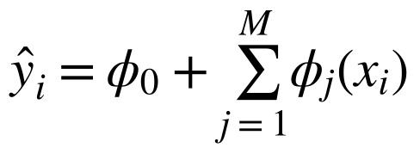
Model Development
DATA ANALYSIS
Multiple Linear Regression
XGBoost
Interpretable baseline; VIF > 10 removed
Regularized trees on log cost; randomized search, 5-fold CV
Isolation Forest
SHAP (Shapley values)
Short average path → unusual contract
Exact TreeSHAP, also run on the phone
Notes:
Multiple Linear Regression is the interpretable baseline, with VIF used to remove multicollinear predictors above 10. XGBoost is trained on the logarithm of cost with randomized hyperparameter search. Isolation Forest scores how unusual a contract is from its plan features, log cost and residual. SHAP explains every prediction.

Slide 25
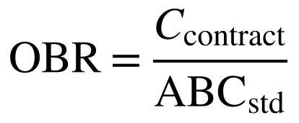
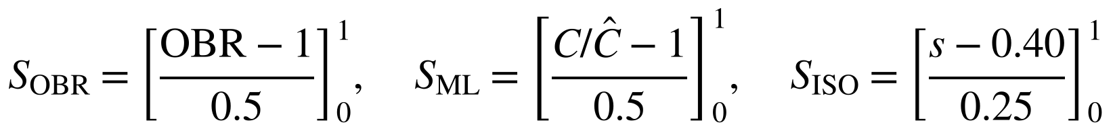
The BUHAY-AH Risk Index
DATA ANALYSIS
Over-budget ratio
BRI 0 – 20
Fair
Risk index and signal scaling
BRI 20 – 30
Review
BRI 30 – 100
Each signal is clipped to [0, 1]; the over-budget signal does not inherit padding from past prices.
Flag for review by COA, Ombudsman, ICI
Notes:
Three signals are combined: the over-budget ratio weighted 0.5 because it does not depend on past prices, the XGBoost residual weighted 0.3, and the Isolation Forest score weighted 0.2. A BRI of 30 or more is a flag; 20 to 30 is for review.

Slide 26

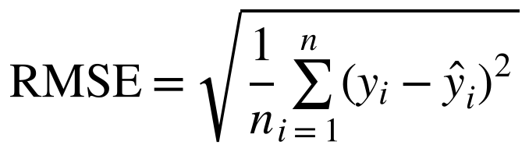
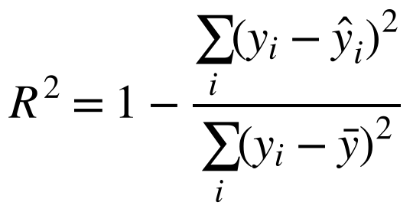
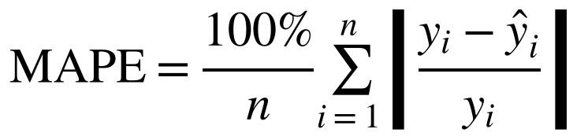
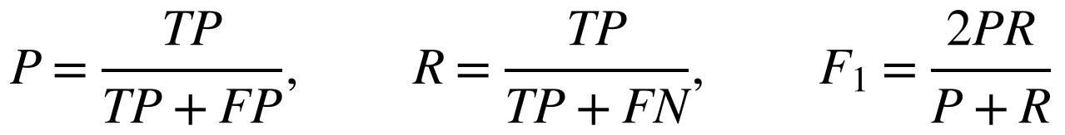
Validation and Metrics
DATA ANALYSIS AND STATISTICAL TREATMENT
Leave-one-out cross-validation: Each of the 300 projects is predicted by a model that never saw it; honest error on a small sample.
Cost prediction: Typical error in pesos, share of variance explained, and error as a percentage of each project’s cost.
Detection: Against the 36 injected cases; threshold-free ROC AUC.
Design generation: Space-standard checks passed; budget used; search time in milliseconds.
Notes:
Models were validated by leave-one-out cross-validation: each project is predicted by a model trained without it. Cost prediction is measured by RMSE, R² and MAPE. Detection is measured against the injected labels with precision, recall, F1-score and ROC AUC. Generated designs are checked against space standards; search time is recorded.

Slide 27
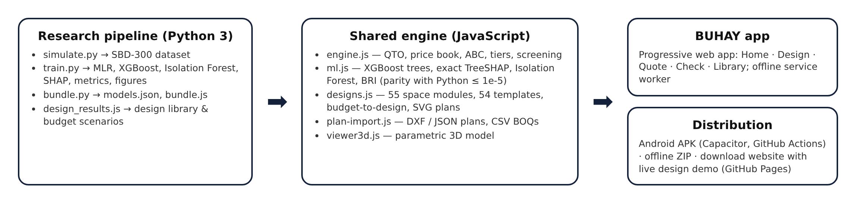




App and Website Development
DATA GATHERING PROCEDURE
Python research pipeline
One JavaScript engine
Android + offline
Float32 parity
NumPy, scikit-learn, statsmodels, XGBoost, SHAP
Same take-off and models in app, site and paper
PWA, Capacitor APK, offline ZIP
Math.fround thresholds; SHAP within 1e-5
Notes:
A single JavaScript cost engine is shared by the app, the website and the research pipeline. The trained XGBoost trees and Isolation Forest are exported to JSON and evaluated in the browser with exact TreeSHAP; parity with Python is within 1e-5 in log cost. The app is a progressive web app, packaged for Android with Capacitor through GitHub Actions, and offered as an offline ZIP and a download website.

Slide 28



Risk, Safety and Responsible Use
ETHICAL CONSIDERATIONS
No human participants
Public and simulated data
No surveys, interviews or personal data; a purely computational study.
Standards, price items and news reports are public; the benchmark is simulated.
Flags are not verdicts
Schematic designs
A high BRI calls for review by the implementing office, COA, Ombudsman or ICI.
Designs are for estimating; licensed architects and engineers must develop them.
Notes:
The study involves no human participants, animals, hazardous materials or devices. All data are simulated or drawn from public documents. Results are screening signals, not findings of wrongdoing; generated designs are schematic. Personal information is not collected.

Slide 29
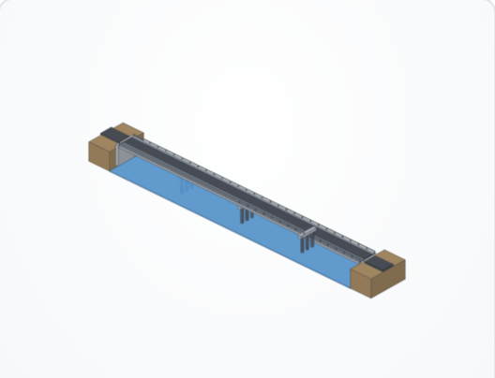
Thank You
BUHAY-AH
Design it. Price it. Keep it honest. A building should be priced by what it needs, not by who builds it.
Enrique Miguel C. Buban
Lead Researcher
Results are from the simulated benchmark SBD-300; a flag calls for review, not proof of wrongdoing.
Notes:
Thank you. BUHAY-AH shows that mathematics can stand between a budget and a padded price. I welcome your questions.

