Slide 1



BUHAY-AH
A Budget-to-Blueprint Design Generator, Standards-Based Quantity Take-Off, and Hybrid Machine Learning System for Start Quotations and Over-Budget Detection in Public Buildings, Bridges, Airports and Seaports
Dave Justin Ll. De Asis · Lead Researcher
Researchers: Peter John A. Brimbuela, Yeaseong Shin · Support group: Uriel Sizouzemihr D. Guianan

Slide 2
INTRODUCTION
10–30% of public infrastructure investment is lost to corruption, mismanagement and inefficiency (CoST).
32 / 100: Philippine score in the 2025 Corruption Perceptions Index, 120th of 182.
₱545.64 billion in flood-control projects (2022–2025); about 20% went to 15 contractors.
₱62.64 million overstatement in the Cebu City Medical Center: VAT at 12% instead of 5%.
₱1.225 billion Cabagan–Santa Maria Bridge collapsed less than a month after completion (2025).
Outside reviewers cannot rebuild an estimate from the plans; padding hides in the price.

Slide 3
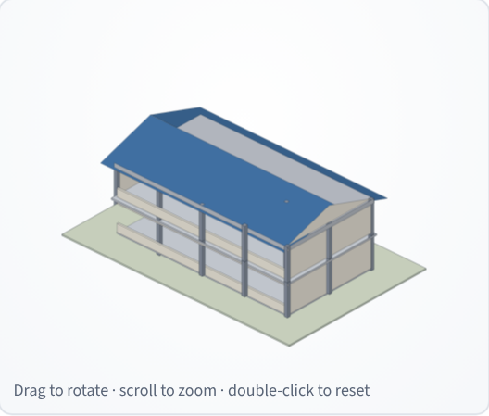
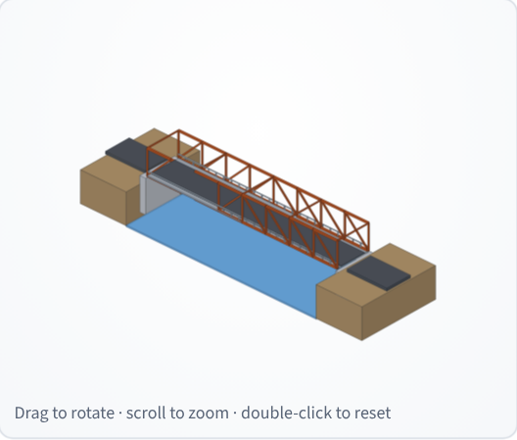
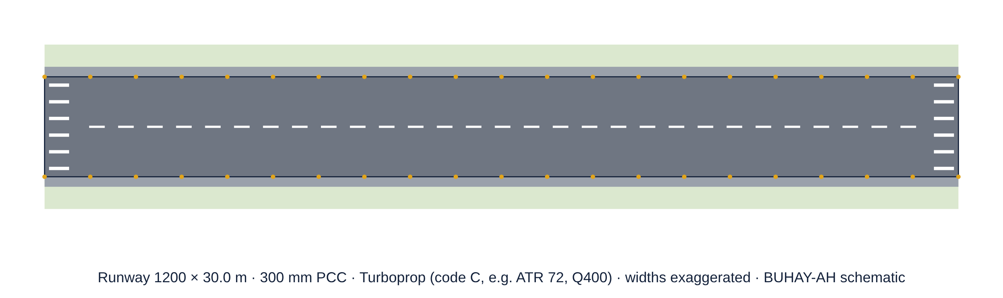
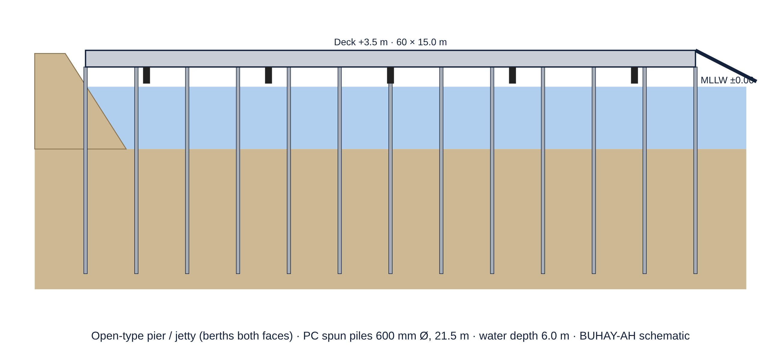
INTRODUCTION
Schools, hospitals and evacuation centers protect communities in typhoon- and earthquake-prone Bicol.
Airports, seaports, RoRo piers and jeepney, UV Express and bus terminals are the largest facilities a region builds.
Machine learning learns what projects HAVE cost, not what they SHOULD cost.
Communities often have only a need and a budget, not a plan.

Slide 4
RESEARCH GAP AND RATIONALE
Scope gap: cost screening has focused on roads, not buildings, bridges, airports and ports.
Reference gap: data-driven models copy past padding; no open standards-based yardstick.
Validation gap: detectors are never tested where the truly padded contracts are known.
Design gap: no independent design and price for a community with only a need and a budget.
Access gap: models stay in notebooks, not on the phones of auditors, officials and citizens.
Rationale: a fair price can be computed from the plan and the standards, then compared with the contract.

Slide 5
RRL/RRS
Study | Method | Finding | Gap for this study
Mahamid (2011) | Multiple regression | Early cost estimates | Roads only
Elmousalami (2020) | AI cost-model review | Tree ensembles lead | Learns past prices
Coffie & Cudjoe (2024) | XGBoost + SHAP | Explains cost overruns | No reference price
Larocque et al. (2025) | Explainable ML | 11,646 road contracts | Roads only
Liu et al. (2008) | Isolation Forest | Label-free anomalies | Misses ordinary padding
GAO (2020) | Should-cost estimating | Bottom-up fair price | No open tool
ICAO (2022); OCDI (2009) | Aerodrome / port standards | Runway, pier rules | Not priced

Slide 6
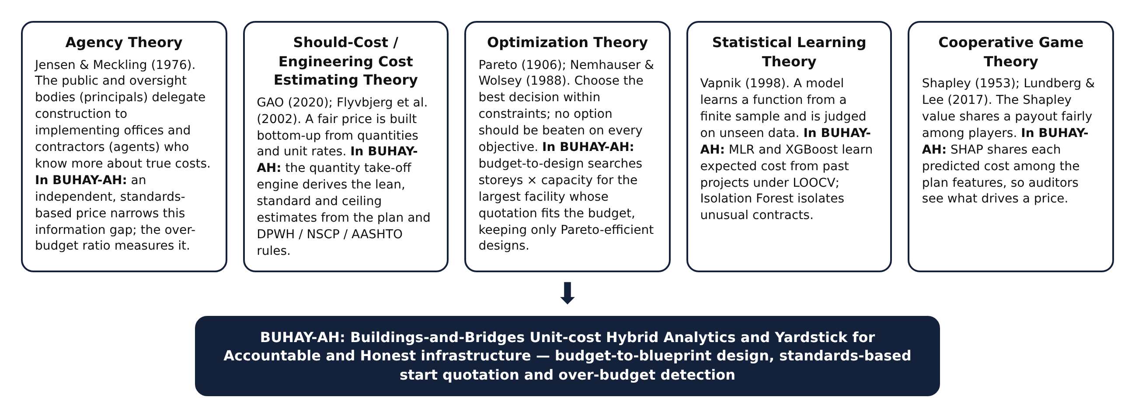
THEORETICAL FRAMEWORK
Agency · Should-Cost · Optimization · Statistical Learning · Cooperative Game Theory

Slide 7
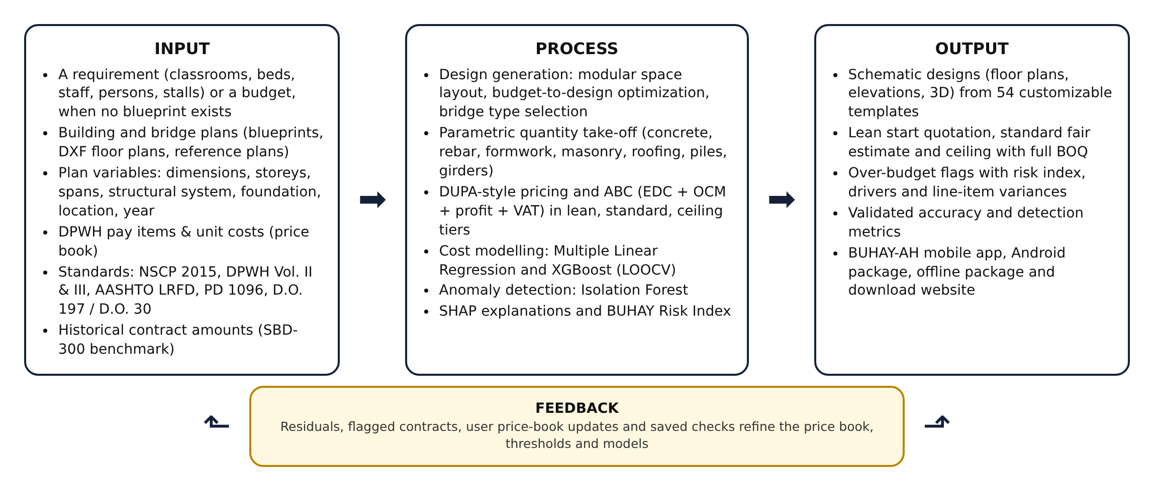
CONCEPTUAL FRAMEWORK PARADIGM

Slide 8
SIGNIFICANCE OF THE STUDY
DPWH, DOH, DOTr, CAAP, PPA: cross-check programs of works and ABCs before bidding.
COA, Ombudsman, ICI: rank contracts by risk; focus inspections.
LGUs, schools, hospitals, cooperatives: a design and price from a need or a budget.
Contractors: a public reference that rewards fair bids.
Citizens and media: check any project on a phone.
Academe: open pipeline, price book and benchmarks with known overpricing.
SDGs: 16.5, 16.6, 16.10 (anti-corruption) · 9.1, 11.5 (resilient infrastructure) · 12.7 (procurement) · 4.a (schools).

Slide 9
OBJECTIVES OF THE STUDY / SOP
This study aimed to develop BUHAY-AH, a budget-to-blueprint design generator, standards-based quantity take-off and hybrid machine-learning system that produces start quotations and detects over-budgeted public buildings, bridges, airports and seaports in Bicol Region V. Specifically:
1. What plan variables can be extracted from plans and standards (physical, structural, location and year)?
2. How can designs be generated from a requirement or a budget (module library, optimization, standards)?
3. How accurate are the lean, standard and ceiling quotations against fair awarded costs (MAPE, R²)?
4. How do MLR and XGBoost predict cost under LOOCV (R², RMSE, MAPE)?

Slide 10
OBJECTIVES OF THE STUDY / SOP
5. How well do the over-budget ratio, XGBoost residual, Isolation Forest and BUHAY-AH Risk Index detect over-budgeted contracts (precision, recall, F1, AUC)?
6. How can the generator and engine extend to hospitals, airport, seaport and jeepney, UV Express and bus terminals, airfield pavements and port structures (templates, accuracy, detection)?
7. How can the system be deployed as a mobile app, a download website and an explainable interface?

Slide 11
HYPOTHESIS (IF ANY)
Developmental study: expected outcomes instead of statistical hypotheses (DM 058 s. 2026 Research Plan).
The standards-based estimate will be closer to fair awarded costs than the data-driven models.
A hybrid risk index will catch more padded contracts than an Isolation Forest alone.
An exact budget-to-design search will run fast enough for a phone.
The same take-off will extend to hospitals, terminals, runways and piers.

Slide 12
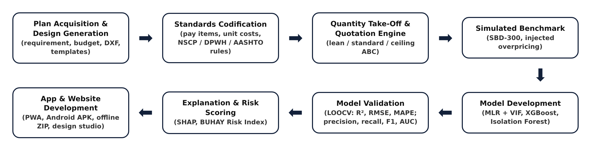
METHODOLOGY
Quantitative developmental design with a simulation-based computational experiment (Mathematics and Computational Science): deterministic modeling, combinatorial optimization, statistical and machine learning, and Monte Carlo simulation.

Slide 13
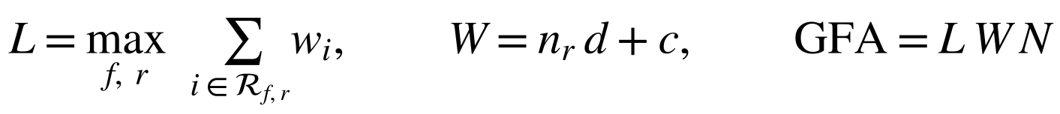
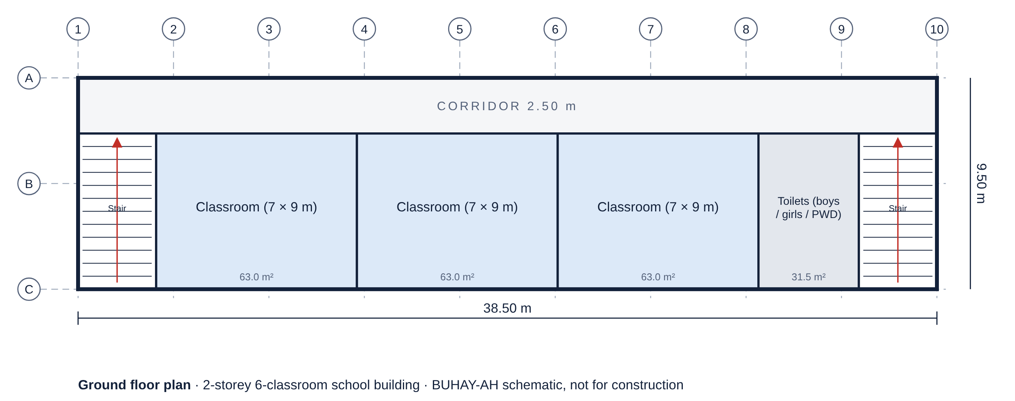
METHODOLOGY: DESIGN GENERATION
106 space modules on DepEd, DOH, NBC, DSWD, IATA and AASHTO norms.
Rows and floors by a greedy longest-first rule; stairs and exits per RA 9514.
Budget-to-design: largest capacity whose quotation fits the budget.
Exact enumeration + Pareto filter (cost is not monotonic).

Slide 14
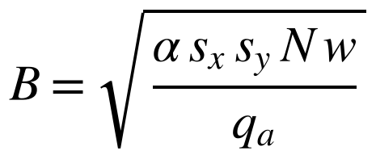
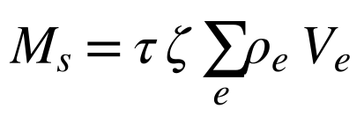
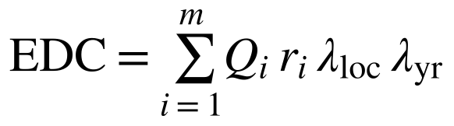

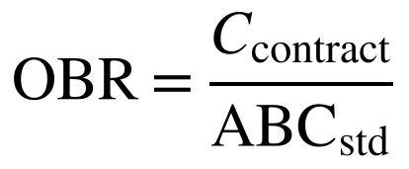
METHODOLOGY: QUANTITY TAKE-OFF
NSCP 2015, DPWH Vol. II/III, AASHTO LRFD, PD 1096, BP 344, RA 9514.
DPWH pay items and 2025 Bicol unit costs (editable price book).
OCM, profit and 5% VAT per D.O. 197 s. 2016 / D.O. 30 s. 2025.
Three tiers: lean start quotation, standard fair estimate, ceiling.

Slide 15
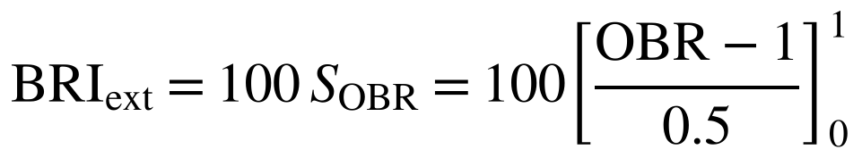
METHODOLOGY: EXTENSION
Hospitals (DOH Level 1–3): medical gases, standby power, bed elevators.
Airport and seaport terminals: curtain walls, baggage, curbside.
Jeepney, UV Express and bus terminals: bays, PCCP, canopies.
Runways, taxiways, aprons (ICAO, FAA); piers and wharves on piles (OCDI, PIANC).

Slide 16
METHODOLOGY: BENCHMARKS
SBD-300: 160 buildings + 140 bridges, 36 injected overpricing cases.
SBD-EXT: 180 hospitals, terminals, airfields and ports, 22 injected cases.
Hidden variation: unit prices ±7%, rebar ±10%, concrete ±6%, MEPF ±10%, piles ×0.95–1.35.
Overpricing μ = 1.20–1.40 (moderate) and 1.40–2.10 (severe).

Slide 17
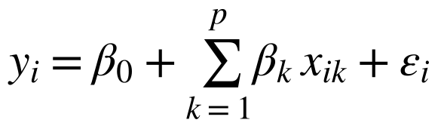
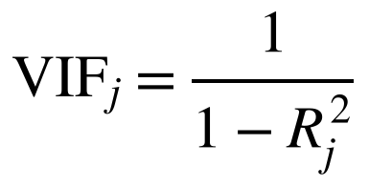
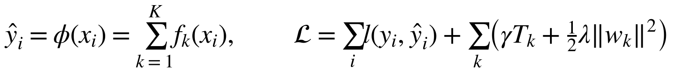
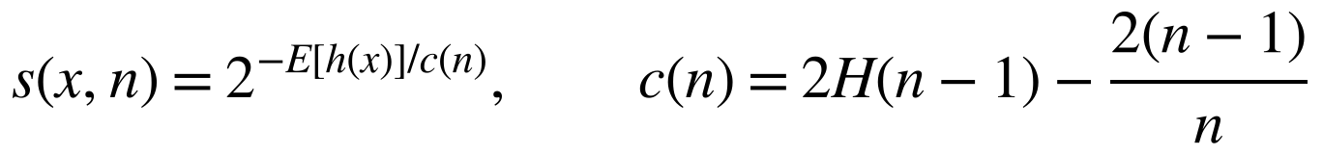
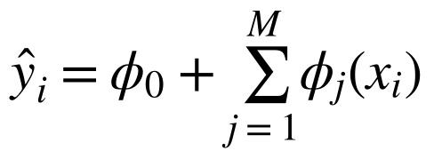
METHODOLOGY: MODELS
MLR with VIF screening (interpretable baseline).
XGBoost on log cost, randomized search, 5-fold CV.
Isolation Forest on features, residual and OBR.
Exact TreeSHAP explanations, also on the phone.

Slide 18
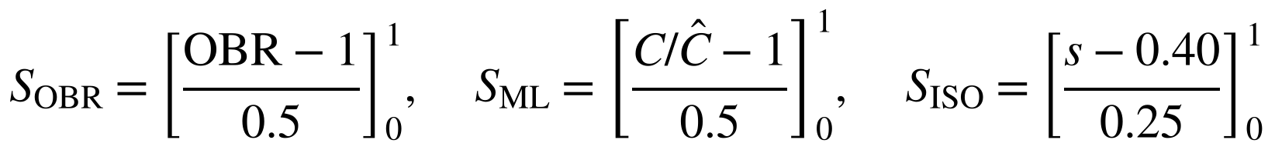
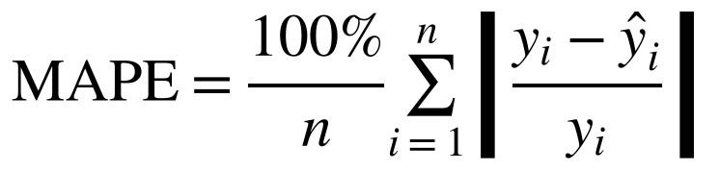
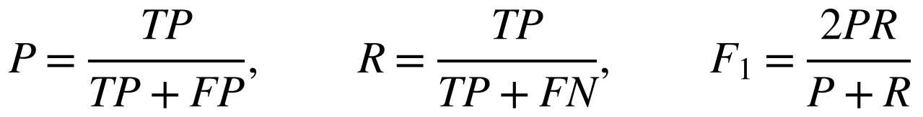
METHODOLOGY: VALIDATION
Leave-one-out cross-validation for cost models.
RMSE, R² and MAPE for cost prediction.
Precision, recall, F1 and ROC AUC for detection.
BRI ≥ 30 flags; 20–30 review.

Slide 19
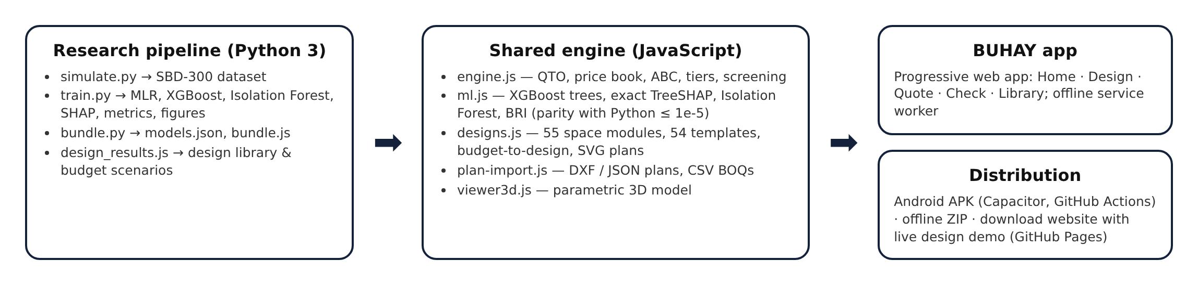
METHODOLOGY: APP & ETHICS
One JavaScript engine for app, website and paper; offline PWA, Android APK, ZIP.
No human participants, animals or hazardous materials; public and simulated data only.
A flag calls for review by COA, the Ombudsman or the ICI; it is not proof of wrongdoing.

Slide 20
Q & A

Slide 21

THANK YOU

