Slide 1



BUHAY-AH
A Budget-to-Blueprint Design Generator, Standards-Based Quantity Take-Off, and Hybrid Machine Learning System for Start Quotations and Over-Budget Detection in Public Buildings, Bridges, Airports and Seaports
Enrique Miguel C. Buban (Lead) · Peter John A. Brimbuela · Dave Justin Ll. De Asis · Yeaseong Shin

Slide 2
INTRODUCTION
10–30% of public infrastructure investment is lost to corruption, mismanagement and inefficiency (CoST).
32 / 100: Philippine score in the 2025 Corruption Perceptions Index, 120th of 182.
₱545.64 billion in flood-control projects (2022–2025); about 20% went to 15 contractors.
₱62.64 million overstatement in the Cebu City Medical Center: VAT at 12% instead of 5%.
₱1.225 billion Cabagan–Santa Maria Bridge collapsed less than a month after completion (2025).
Outside reviewers cannot rebuild an estimate from the plans; padding hides in the price.

Slide 3
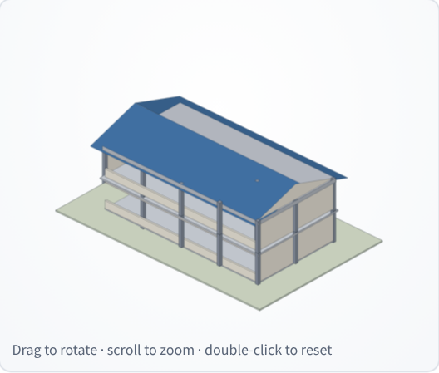
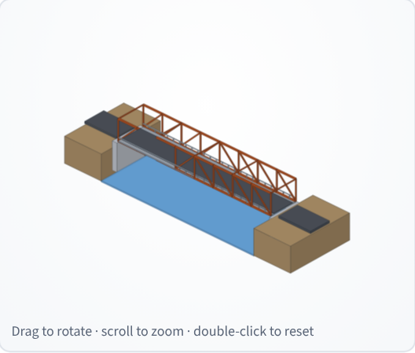
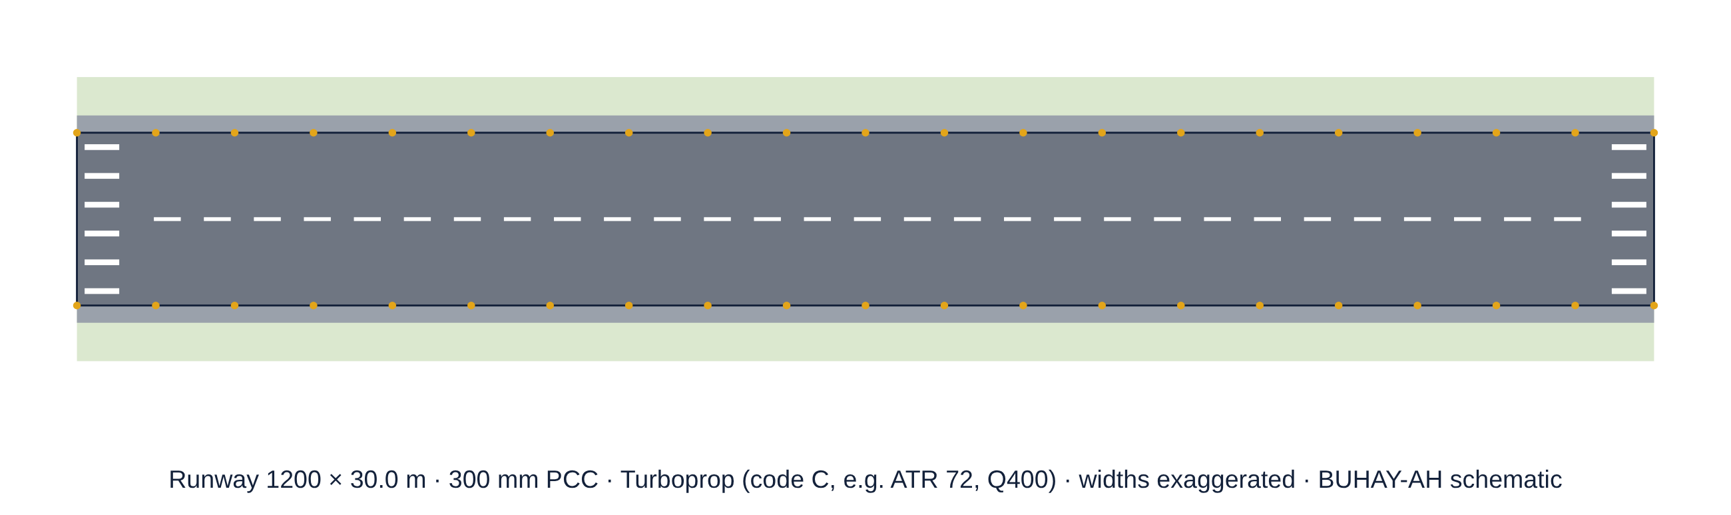
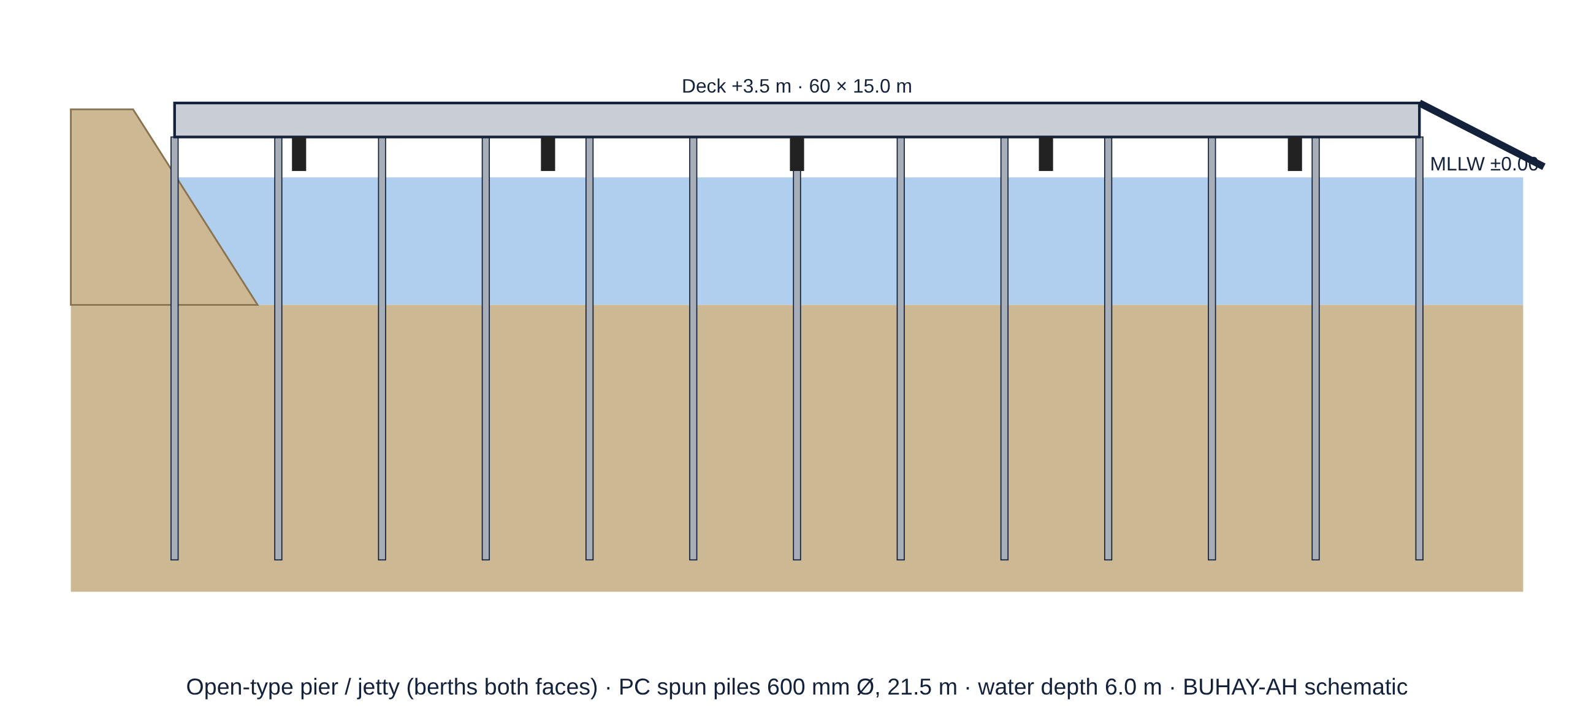
INTRODUCTION
Schools, hospitals and evacuation centers protect communities in typhoon- and earthquake-prone Bicol.
Airports, seaports, RoRo piers and jeepney, UV Express and bus terminals are the largest facilities a region builds.
Machine learning learns what projects HAVE cost, not what they SHOULD cost.
Communities often have only a need and a budget, not a plan.

Slide 4
RESEARCH GAP AND RATIONALE
Scope gap: cost screening has focused on roads, not buildings, bridges, airports and ports.
Reference gap: data-driven models copy past padding; no open standards-based yardstick.
Validation gap: detectors are never tested where the truly padded contracts are known.
Design gap: no independent design and price for a community with only a need and a budget.
Access gap: models stay in notebooks, not on the phones of auditors, officials and citizens.
Rationale: a fair price can be computed from the plan and the standards, then compared with the contract.

Slide 5
RRL/RRS
Study | Method | Finding | Gap for this study
Mahamid (2011) | Multiple regression | Early cost estimates | Roads only
Elmousalami (2020) | AI cost-model review | Tree ensembles lead | Learns past prices
Coffie & Cudjoe (2024) | XGBoost + SHAP | Explains cost overruns | No reference price
Larocque et al. (2025) | Explainable ML | 11,646 road contracts | Roads only
Liu et al. (2008) | Isolation Forest | Label-free anomalies | Misses ordinary padding
Buban (2026), CORA | MLR + XGBoost + IF | R² 0.8723, MAPE 29.20% | Recall unknown
GAO (2020) | Should-cost estimating | Bottom-up fair price | No open tool
ICAO (2022); OCDI (2009) | Aerodrome / port standards | Runway, pier rules | Not priced

Slide 6
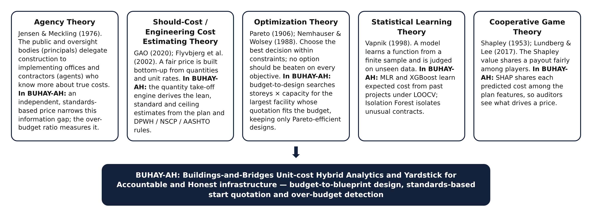
THEORETICAL FRAMEWORK
Agency · Should-Cost · Optimization · Statistical Learning · Cooperative Game Theory

Slide 7
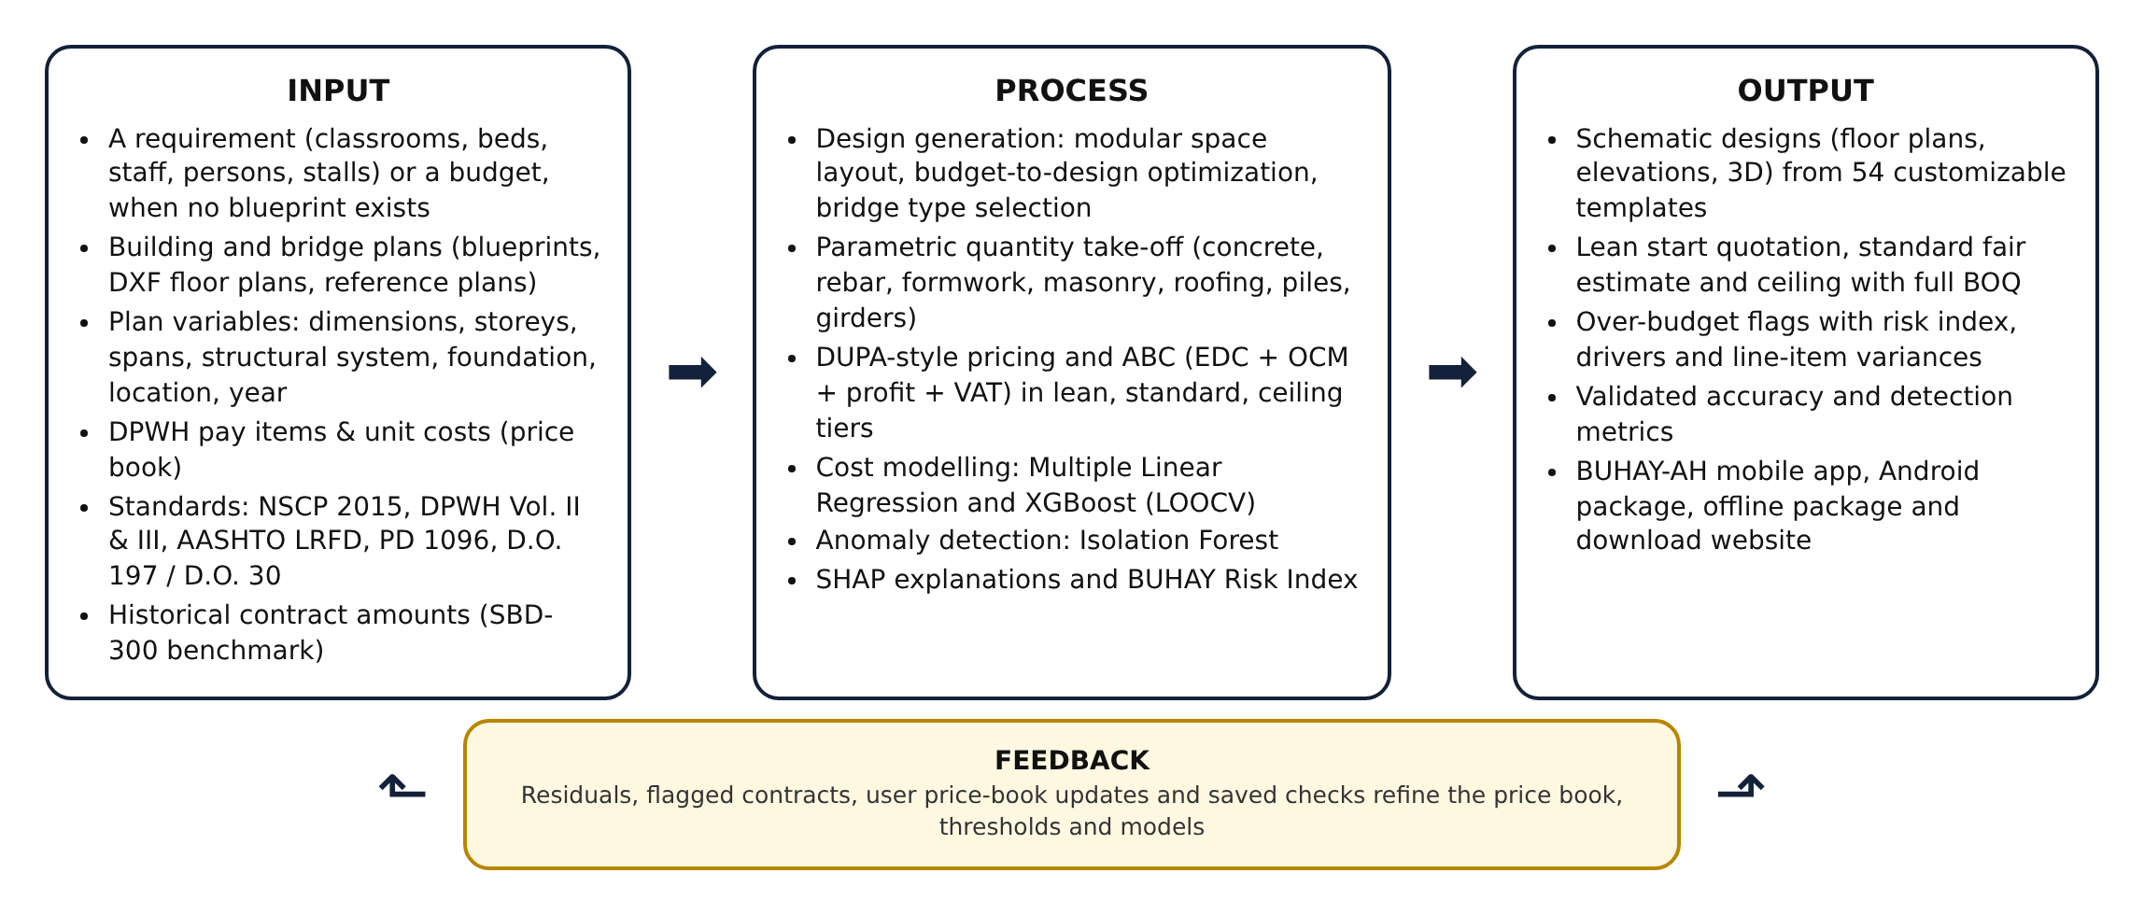
CONCEPTUAL FRAMEWORK PARADIGM

Slide 8
SIGNIFICANCE OF THE STUDY
DPWH, DOH, DOTr, CAAP, PPA: cross-check programs of works and ABCs before bidding.
COA, Ombudsman, ICI: rank contracts by risk; focus inspections.
LGUs, schools, hospitals, cooperatives: a design and price from a need or a budget.
Contractors: a public reference that rewards fair bids.
Citizens and media: check any project on a phone.
Academe: open pipeline, price book and benchmarks with known overpricing.
SDGs: 16.5, 16.6, 16.10 (anti-corruption) · 9.1, 11.5 (resilient infrastructure) · 12.7 (procurement) · 4.a (schools).

Slide 9
OBJECTIVES OF THE STUDY / SOP
This study aimed to develop BUHAY-AH, a budget-to-blueprint design generator, standards-based quantity take-off and hybrid machine-learning system that produces start quotations and detects over-budgeted public buildings, bridges, airports and seaports in Bicol Region V. Specifically:
1. What plan variables can be extracted from plans and standards (physical, structural, location and year)?
2. How can designs be generated from a requirement or a budget (module library, optimization, standards)?
3. How accurate are the lean, standard and ceiling quotations against fair awarded costs (MAPE, R²)?
4. How do MLR and XGBoost predict cost under LOOCV (R², RMSE, MAPE)?

Slide 10
OBJECTIVES OF THE STUDY / SOP
5. How well do the over-budget ratio, XGBoost residual, Isolation Forest and BUHAY-AH Risk Index detect over-budgeted contracts (precision, recall, F1, AUC)?
6. How can the generator and engine extend to hospitals, airport, seaport and jeepney, UV Express and bus terminals, airfield pavements and port structures (templates, accuracy, detection)?
7. How can the system be deployed as a mobile app, a download website and an explainable interface?

Slide 11
HYPOTHESIS (IF ANY)
Developmental study: expected outcomes instead of statistical hypotheses (DM 058 s. 2026 Research Plan).
The standards-based estimate will be closer to fair awarded costs than the data-driven models.
A hybrid risk index will catch more padded contracts than an Isolation Forest alone.
An exact budget-to-design search will run fast enough for a phone.
The same take-off will extend to hospitals, terminals, runways and piers.

Slide 12
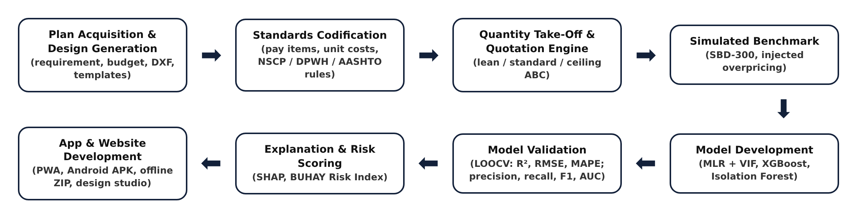
METHODOLOGY
Quantitative developmental design with a simulation-based computational experiment (Mathematics and Computational Science): deterministic modeling, combinatorial optimization, statistical and machine learning, and Monte Carlo simulation.

Slide 13
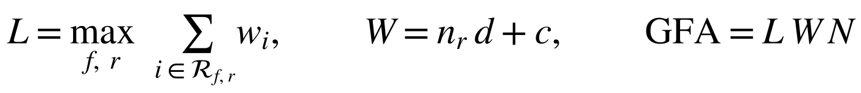
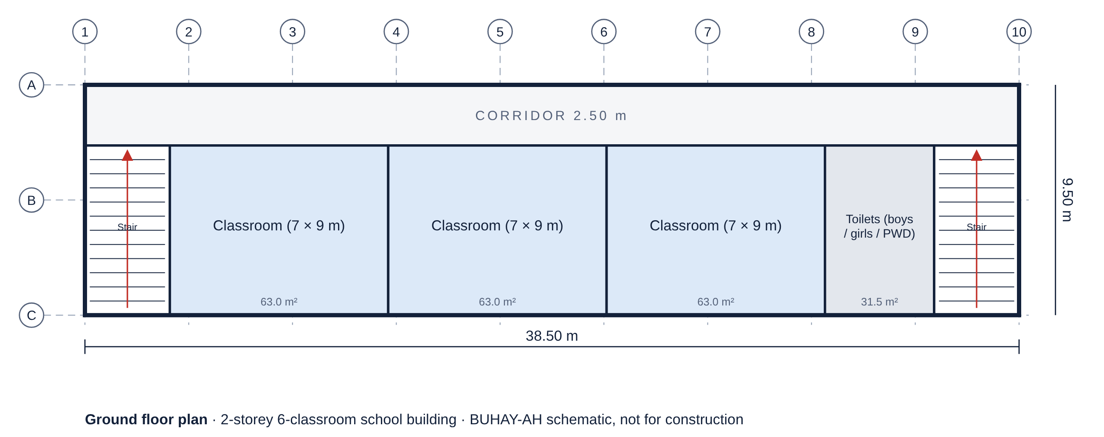
METHODOLOGY: DESIGN GENERATION
106 space modules on DepEd, DOH, NBC, DSWD, IATA and AASHTO norms.
Rows and floors by a greedy longest-first rule; stairs and exits per RA 9514.
Budget-to-design: largest capacity whose quotation fits the budget.
Exact enumeration + Pareto filter (cost is not monotonic).

Slide 14
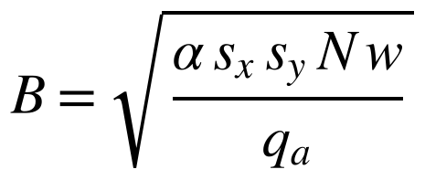
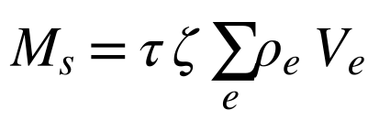
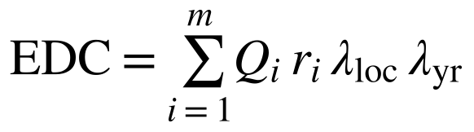

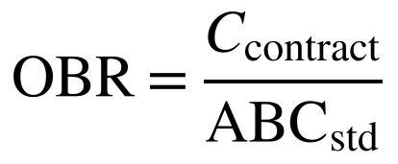
METHODOLOGY: QUANTITY TAKE-OFF
NSCP 2015, DPWH Vol. II/III, AASHTO LRFD, PD 1096, BP 344, RA 9514.
DPWH pay items and 2025 Bicol unit costs (editable price book).
OCM, profit and 5% VAT per D.O. 197 s. 2016 / D.O. 30 s. 2025.
Three tiers: lean start quotation, standard fair estimate, ceiling.

Slide 15
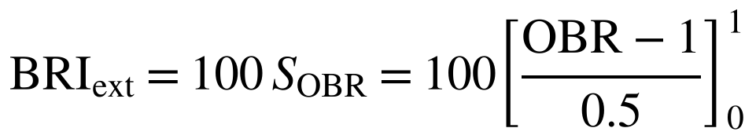
METHODOLOGY: EXTENSION
Hospitals (DOH Level 1–3): medical gases, standby power, bed elevators.
Airport and seaport terminals: curtain walls, baggage, curbside.
Jeepney, UV Express and bus terminals: bays, PCCP, canopies.
Runways, taxiways, aprons (ICAO, FAA); piers and wharves on piles (OCDI, PIANC).

Slide 16
METHODOLOGY: BENCHMARKS
SBD-300: 160 buildings + 140 bridges, 36 injected overpricing cases.
SBD-EXT: 180 hospitals, terminals, airfields and ports, 22 injected cases.
Hidden variation: unit prices ±7%, rebar ±10%, concrete ±6%, MEPF ±10%, piles ×0.95–1.35.
Overpricing μ = 1.20–1.40 (moderate) and 1.40–2.10 (severe).

Slide 17
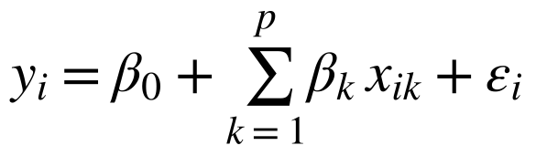
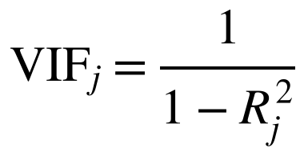
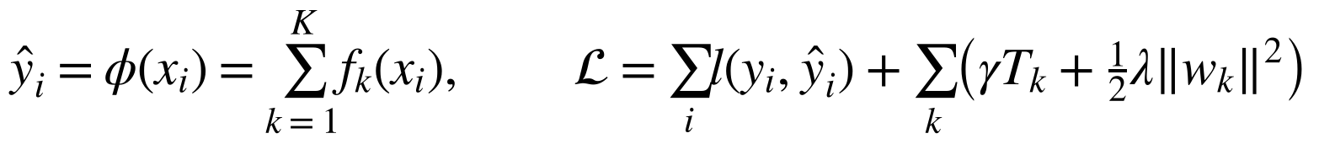
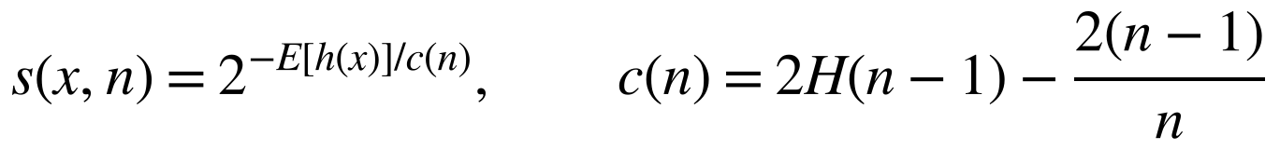
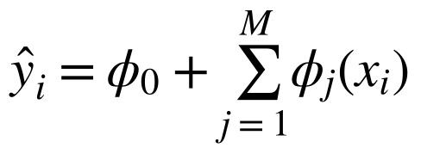
METHODOLOGY: MODELS
MLR with VIF screening (interpretable baseline).
XGBoost on log cost, randomized search, 5-fold CV.
Isolation Forest on features, residual and OBR.
Exact TreeSHAP explanations, also on the phone.

Slide 18
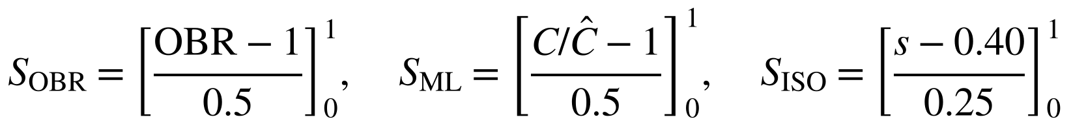
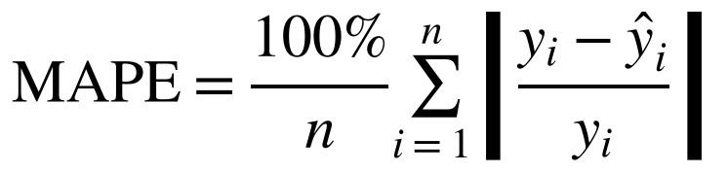
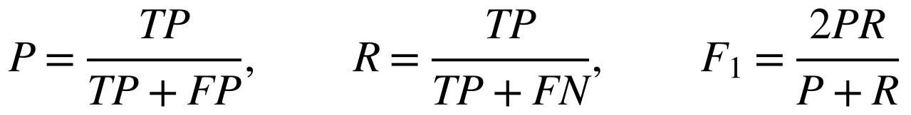
METHODOLOGY: VALIDATION
Leave-one-out cross-validation for cost models.
RMSE, R² and MAPE for cost prediction.
Precision, recall, F1 and ROC AUC for detection.
BRI ≥ 30 flags; 20–30 review.

Slide 19
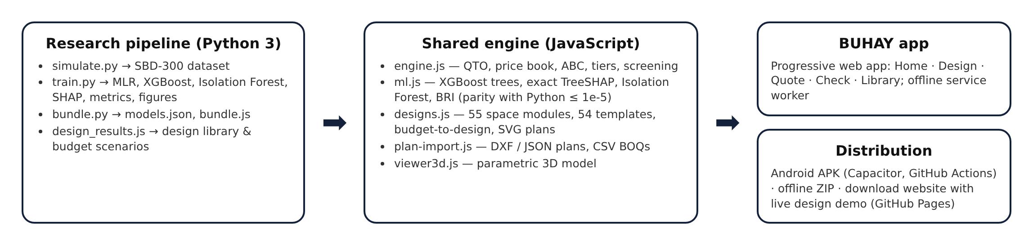
METHODOLOGY: APP & ETHICS
One JavaScript engine for app, website and paper; offline PWA, Android APK, ZIP.
No human participants, animals or hazardous materials; public and simulated data only.
A flag calls for review by COA, the Ombudsman or the ICI; it is not proof of wrongdoing.

Slide 20
RESULTS: PLAN VARIABLES
9 building variables: GFA, footprint, storeys, span, floor height, type, roof, location, year.
11 bridge variables: length, deck width and area, span, pier and abutment heights, superstructure, foundation, pile length, location, year.
Extension: beds, peak-hour passengers, loading bays, runway and deck dimensions, water depth.
Bridges varied far more than buildings in size and cost.

Slide 21
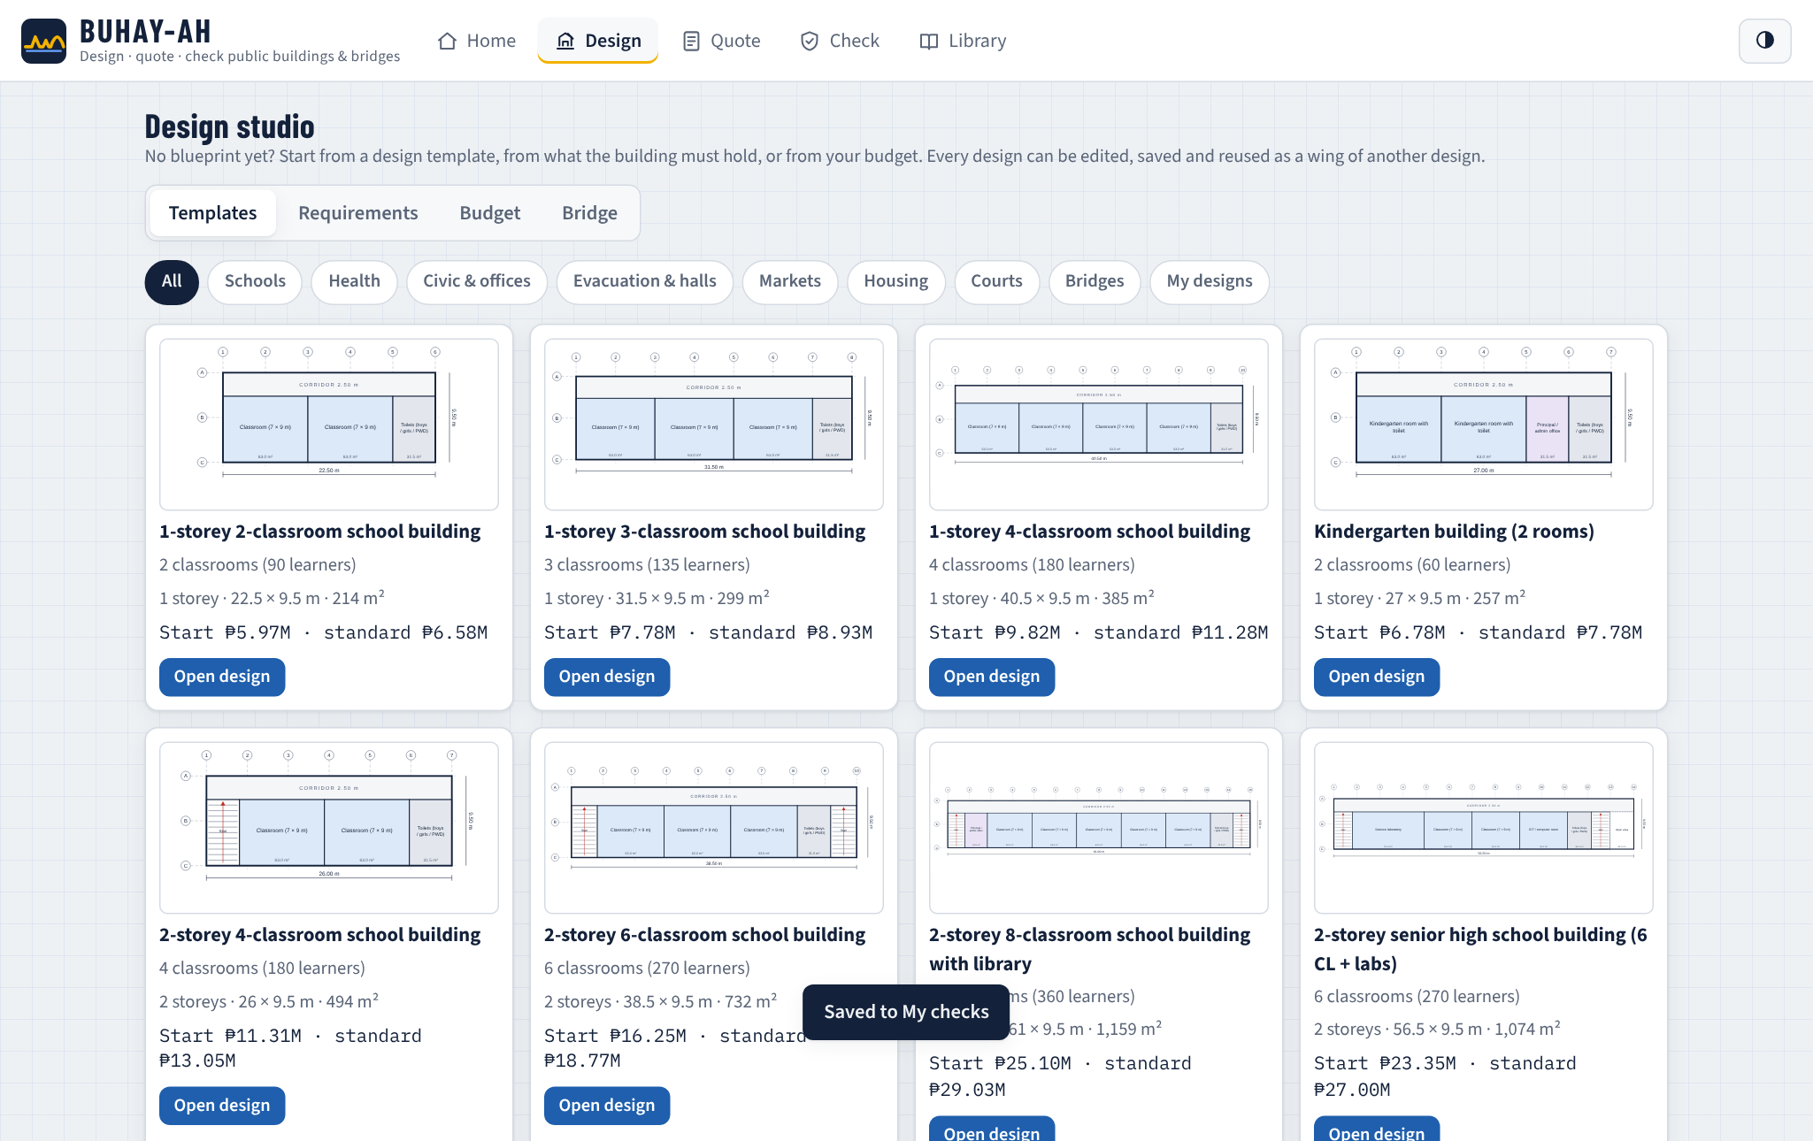
RESULTS: DESIGN GENERATION
55 building, 13 bridge, 7 airfield, 5 port designs.
210/210 space-standard checks passed.
Median search 3.6 ms.
Multi-storey adds up to 10 classrooms per budget.

Slide 22
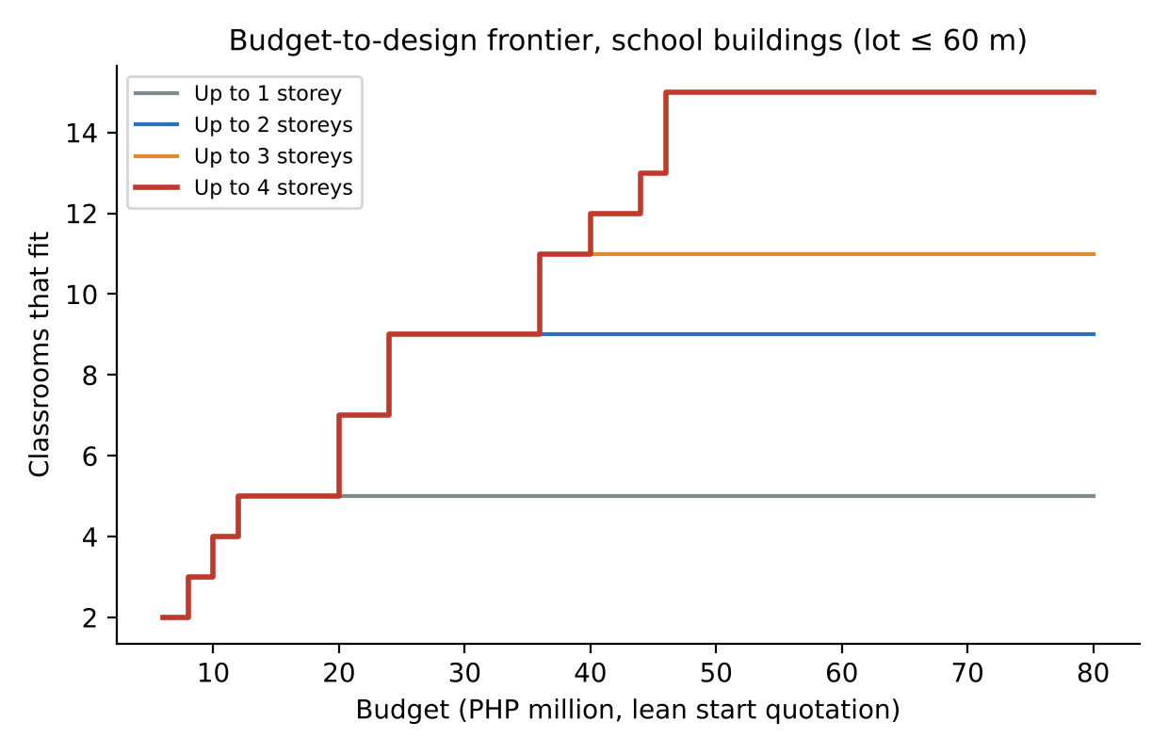
RESULTS: BUDGET-TO-DESIGN
₱10M → 4 classrooms (1 storey).
₱25M → 9 classrooms (2 storeys).
₱50M → 15 classrooms (4 storeys).
₱150M → 185-bed hospital (4 storeys).
₱40M → 12-bay bus terminal.

Slide 23
RESULTS: QUANTITY TAKE-OFF
MAPE 5.21% buildings, 7.67% bridges; R² about 0.98.
Less than half the error of the best data-driven model.
Lean start quotation about 14.4% (buildings) and 5.9% (bridges) below standard, keeping code minimums.
Extension (SBD-EXT): MAPE 6.40%, R² 0.9863; ceiling covers 95.6% of fair awards.

Slide 24
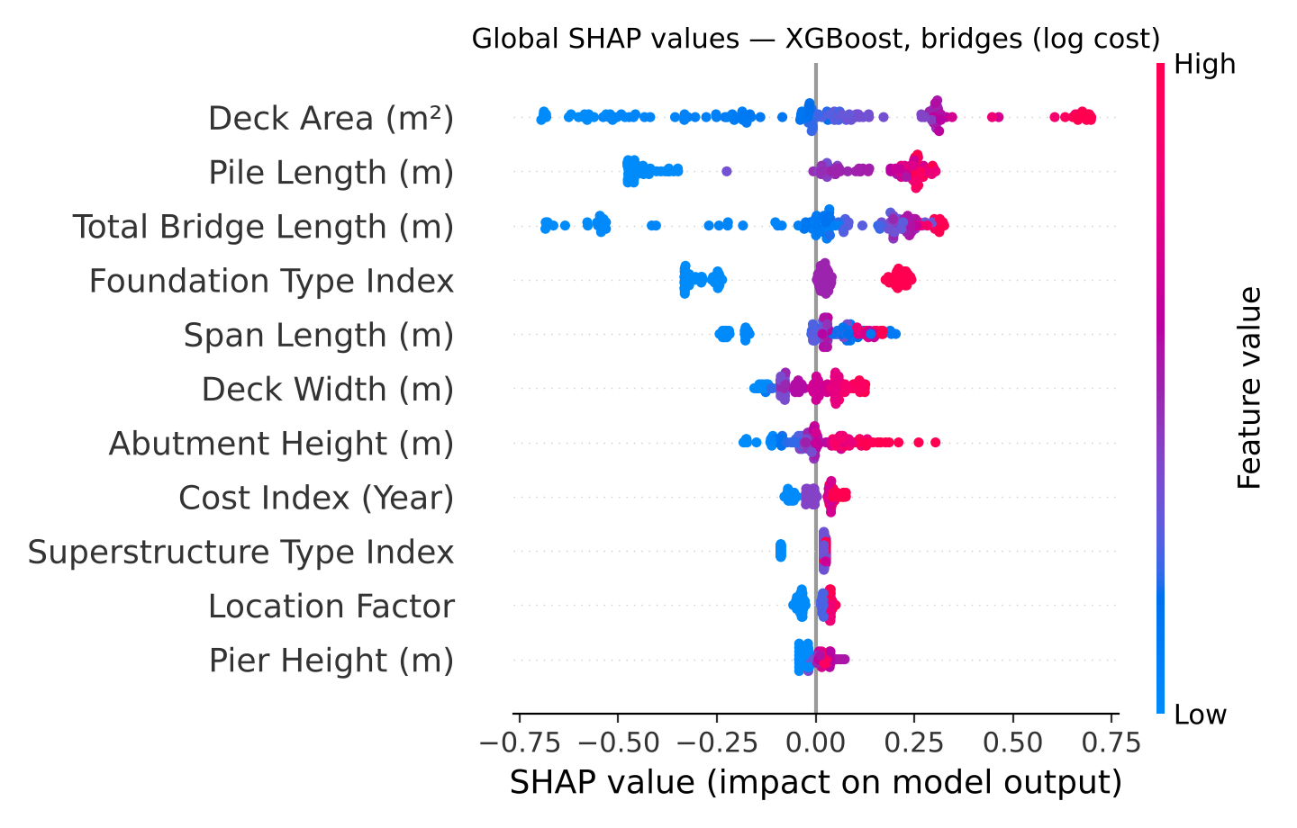
RESULTS: COST MODELS
LOOCV | Buildings | Bridges
MLR R² | 0.8112 | 0.8640
MLR MAPE | 13.43% | 65.65%
XGBoost R² | 0.7874 | 0.8630
XGBoost MAPE | 13.94% | 19.18%

Slide 25
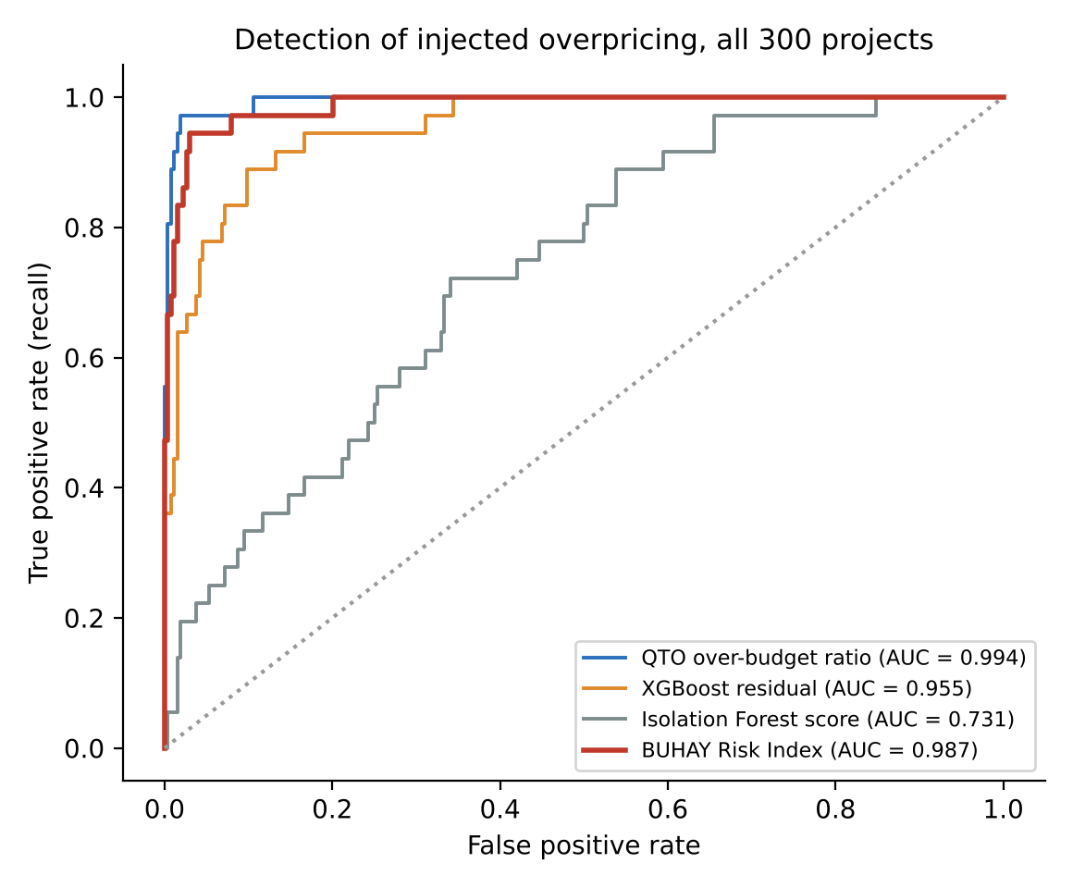
RESULTS: DETECTION
Risk Index: recall 94.4%, F1 0.764, AUC 0.987.
Isolation Forest alone: recall 27.8%.
Extension rule: recall 95.5%, precision 0.750.
Most false alarms: unseen pile lengths (bridges, ports).

Slide 26
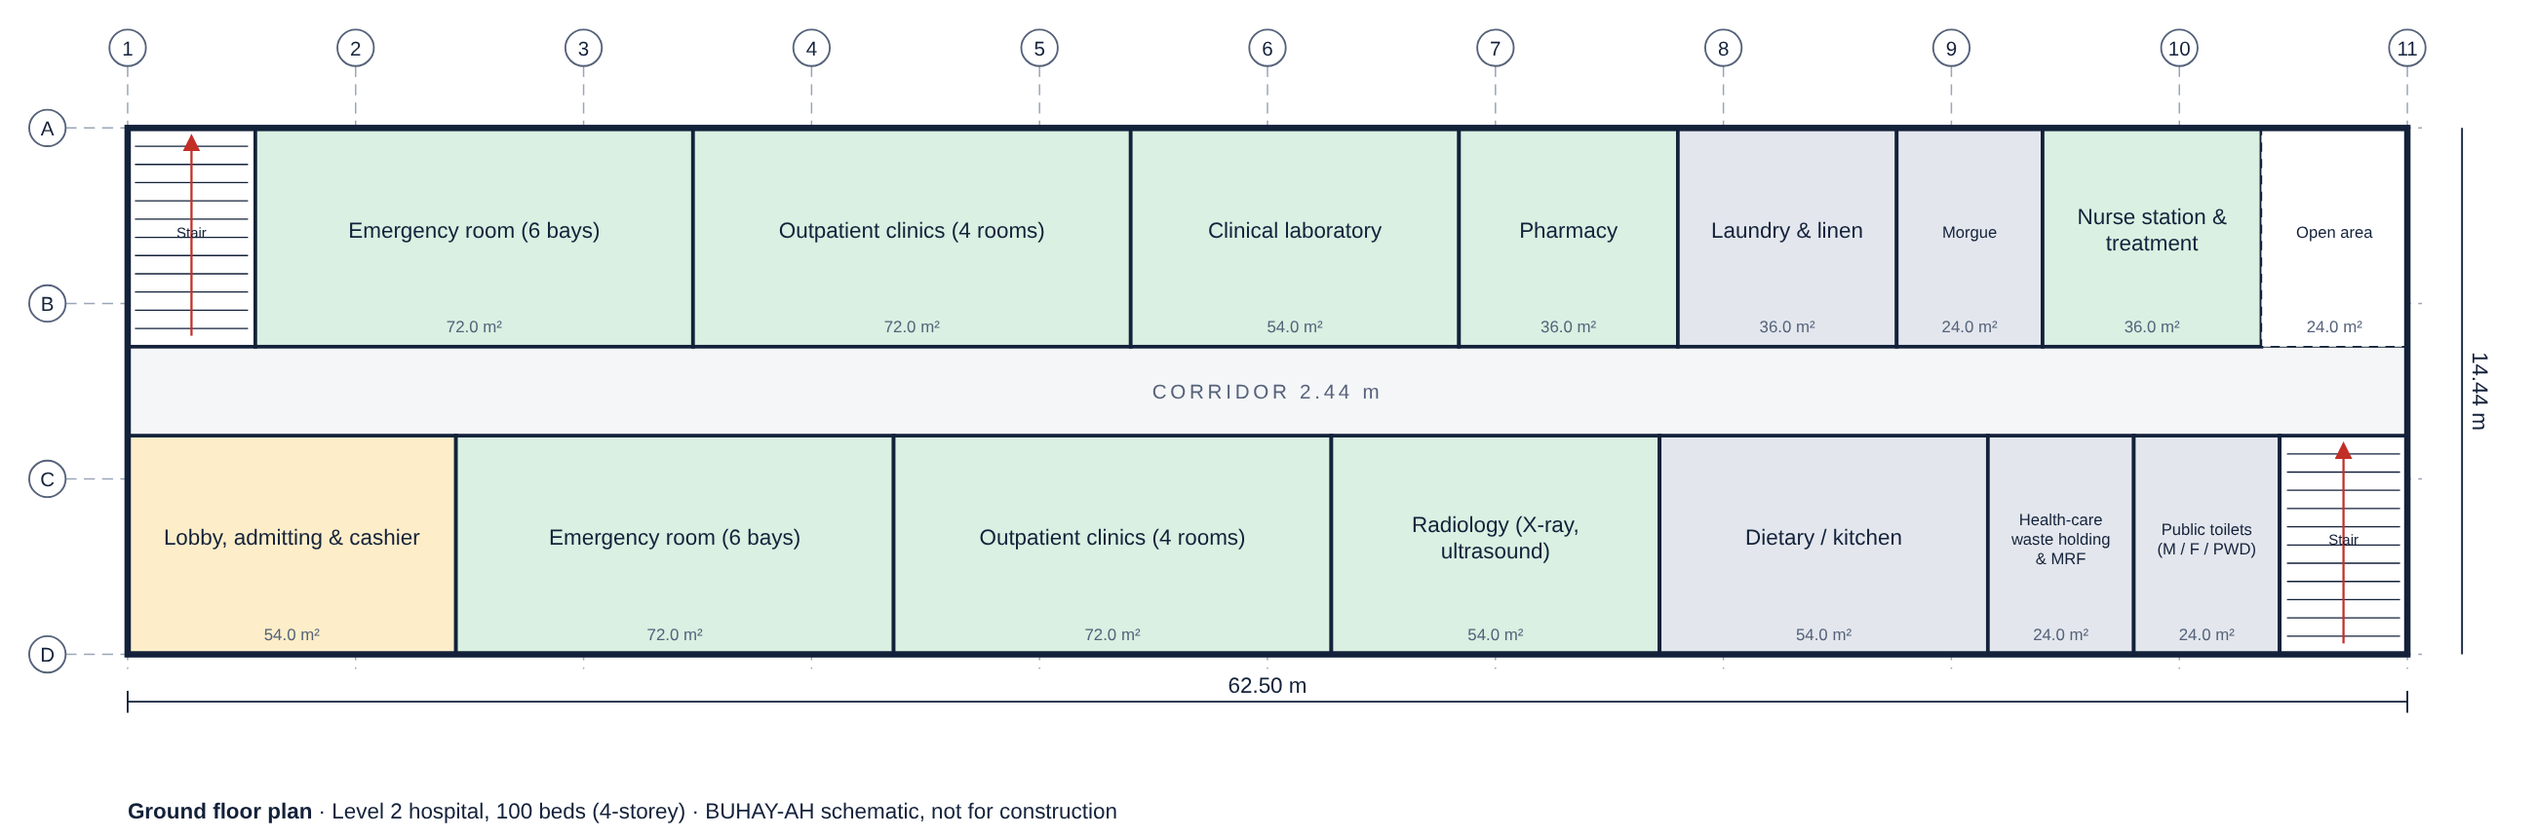
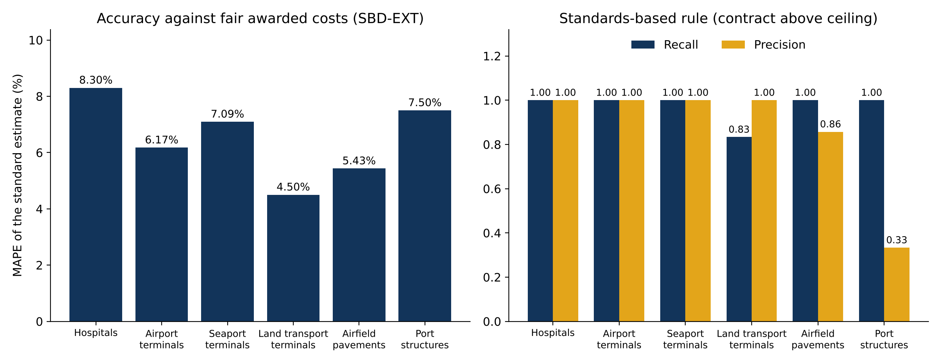
RESULTS: EXTENSION

Slide 27
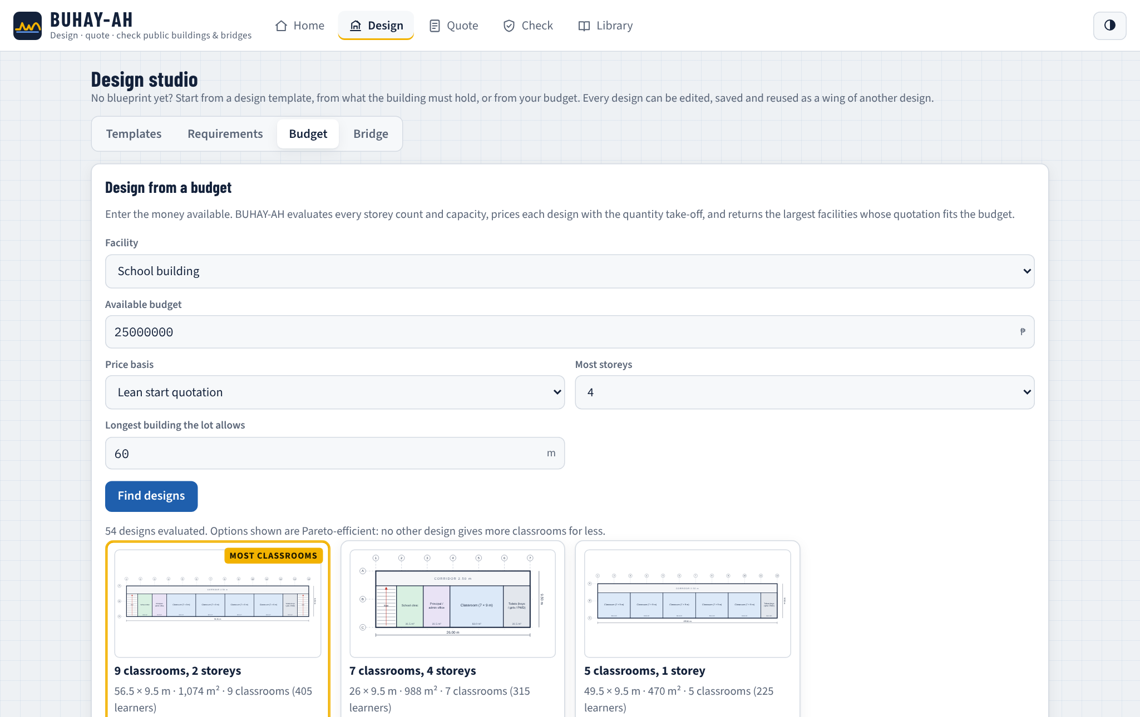
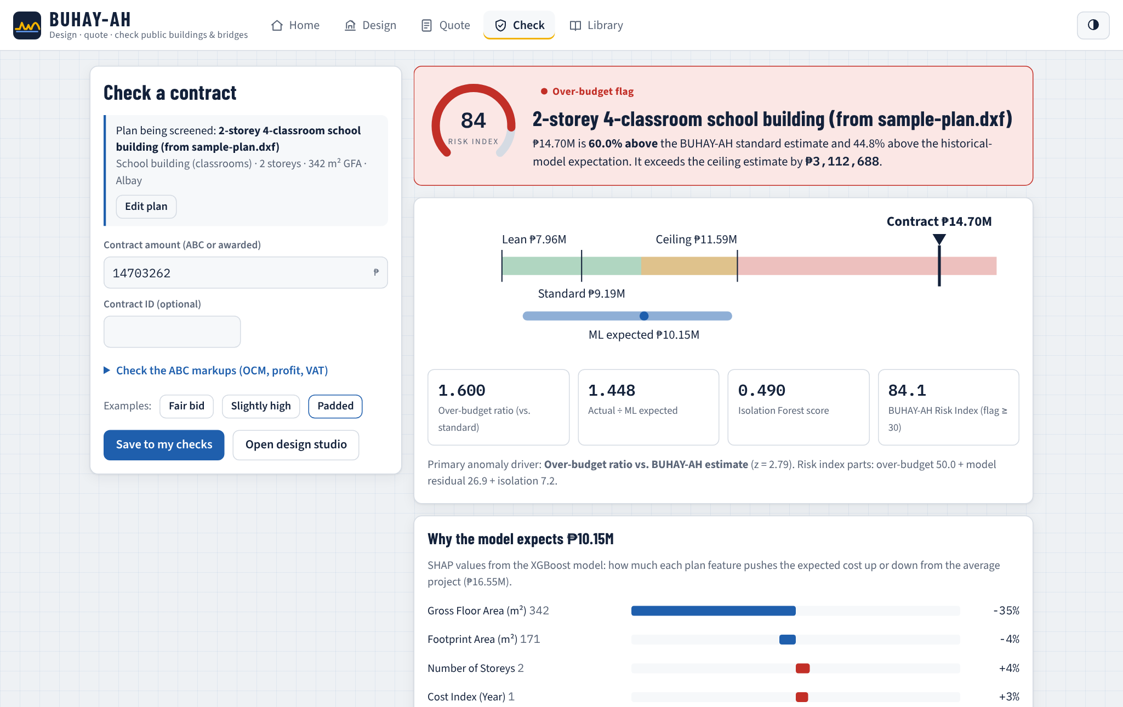
RESULTS: DEPLOYMENT

Slide 28
CONCLUSION
Plan variables from plans and standards are enough to price a project.
Designs can be generated from a need or a budget, exactly and fast, and pass the standards.
The standards-based estimate beats the data-driven models on accuracy.
XGBoost is needed for bridges; regression suffices for buildings.
The Risk Index caught 94.4% of padded contracts vs. 27.8% for Isolation Forest alone.
The engine extends to hospitals, terminals, runways and piers.
BUHAY-AH runs offline as an app, an Android package and a website.

Slide 29
RECOMMENDATIONS
Validate on actual DPWH, DOH, CAAP and PPA contracts.
Review the design library with licensed architects and engineers.
Add geotechnical data for bridge and port piles.
Connect current DPWH and PSA price data.
Retrain the models for the extension types; calibrate thresholds by class.
Extend to flood control, water systems and roads with CORA.
Pilot with oversight bodies; publish open contracting data.

Slide 30
REFERENCES
Buban, E. M. C. (2026). CORA: Computational outlier recognition and analytics for road construction cost prediction.
Chen, T., & Guestrin, C. (2016). XGBoost: A scalable tree boosting system. KDD, 785–794.
Department of Public Works and Highways. (2016). D.O. No. 197, s. 2016: Approved budget for the contract.
Federal Aviation Administration. (2021). Airport pavement design and evaluation (AC 150/5320-6G).
International Civil Aviation Organization. (2022). Annex 14, Vol. I: Aerodrome design and operations (9th ed.).
Liu, F. T., Ting, K. M., & Zhou, Z.-H. (2008). Isolation forest. IEEE ICDM, 413–422.
Lundberg, S. M., & Lee, S.-I. (2017). A unified approach to interpreting model predictions. NeurIPS 30.
OCDI. (2009). Technical standards and commentaries for port and harbour facilities in Japan.
Shapley, L. S. (1953). A value for n-person games. Contributions to the Theory of Games II, 307–317.
U.S. Government Accountability Office. (2020). Cost estimating and assessment guide (GAO-20-195G).

Slide 31
QUESTIONS & ANSWER

Slide 32

THANK YOU

