Slide 1


LIGTA-S
Say it like ligtas (LIG-tas), the Filipino word for safe
Safe Shelter, Open Schools: A Verified Network-Flow Model for Planning Evacuations in Albay by Hazard Zone, Shelter Capacity, and Vulnerability While Keeping Classrooms Open
De Asis, Dave Justin Ll.
◆ LEAD RESEARCHER · FOUNDER OF THE LIGTA-S RESEARCH & APPLICATION ◆
Brimbuela, Peter John A. • Shin, Yeaseong
Research Adviser: Calleja, Dick Anthony M.
Legazpi City Science High School • Legazpi City, Albay • Mathematics and Computational Sciences, Team (MCS-T)
Notes:
Good day, honorable judges. We are the LIGTA-S team from Legazpi City Science High School. I am Dave Justin De Asis, the lead researcher, with Peter John Brimbuela and Yeaseong Shin, under our research adviser, Dick Anthony M. Calleja. LIGTA-S is said like the Filipino word ligtas, which means safe.
Our study is titled Safe Shelter, Open Schools: A Verified Network-Flow Model for Planning Evacuations in Albay by Hazard Zone, Shelter Capacity, and Vulnerability While Keeping Classrooms Open.
In one sentence: we built a planning model that gives every evacuee a shelter with room, protects vulnerable residents first, and uses classrooms only when nothing else is left, and we proved and then tested that it behaves the way the law intends.

Slide 2

Notes:
Blank slide. Keep it up until it is your turn, then click to the rationale video.

Slide 3
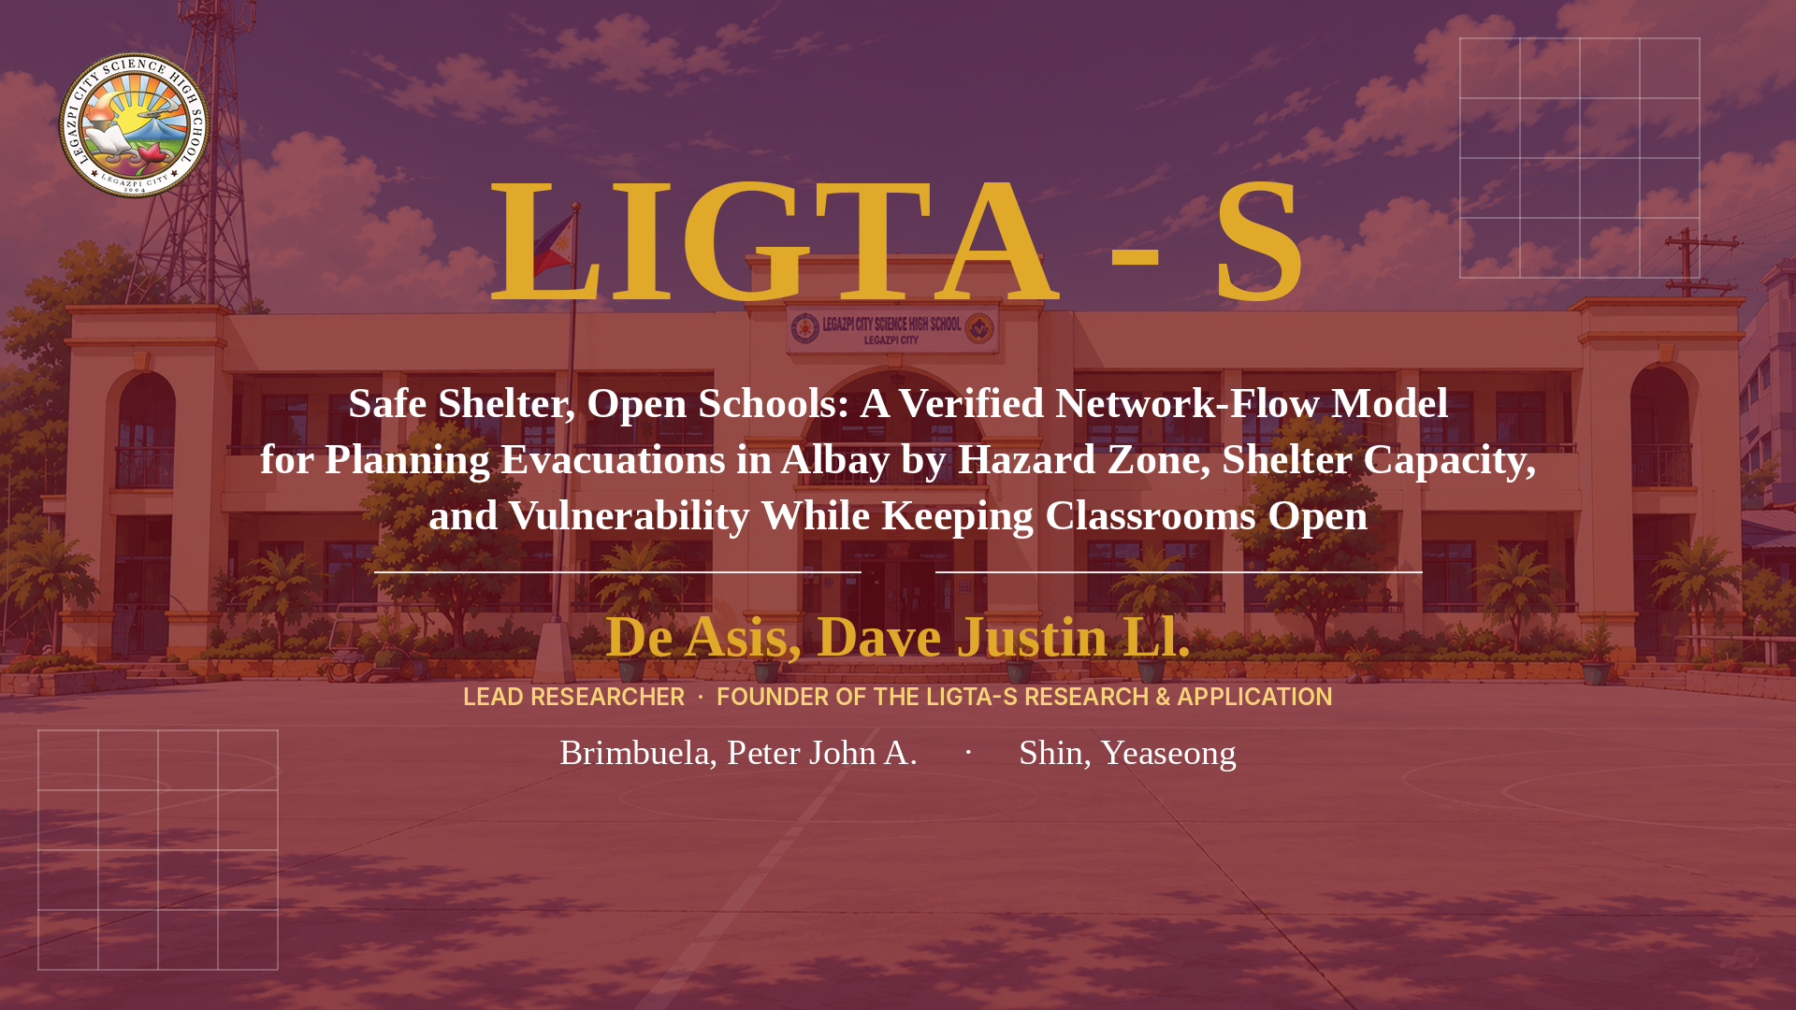

Notes:
Click once to play the rationale video. It runs 2 min 35 s. Stay silent and let it play to the title card.

Slide 4
A MAP SHOWS WHERE THE SHELTER IS,
OUR MODEL SHOWS IF THERE IS ROOM.
EVERYONE SHELTERED, CLASSROOMS LAST
LEGAZPI CITY SCIENCE HIGH SCHOOL
MCS-T: DE ASIS
Notes:
Read the two lines on the screen slowly, then introduce the study.

Slide 5
LIGTA-S
Say it like ligtas (LIG-tas), the Filipino word for safe
Safe Shelter, Open Schools: A Verified Network-Flow Model for Planning Evacuations in Albay by Hazard Zone, Shelter Capacity, and Vulnerability While Keeping Classrooms Open
De Asis, Dave Justin Ll.
◆ LEAD RESEARCHER · FOUNDER OF THE LIGTA-S RESEARCH & APPLICATION ◆
Brimbuela, Peter John A. • Shin, Yeaseong
Research Adviser: Calleja, Dick Anthony M.
Legazpi City Science High School • Legazpi City, Albay • Mathematics and Computational Sciences, Team (MCS-T)
Notes:
Introduce the study title and the researchers, then go to the Introduction.

Slide 6







INTRODUCTION
Background of the Study
Mayon's 2026 alerts turned schools into shelters, and learners paid in lost class days
Jan 6
608
34
132
Alert Level 3
learners displaced
classrooms used
schools hit by ashfall
PHIVOLCS raised Mayon to Alert Level 3; Albay ordered the preemptive evacuation of the Permanent Danger Zone (6 km).
from the danger zone in January 2026; 3,424 more were affected as four schools became evacuation centers.
in three Camalig schools sheltered 488 families, about 1,315 people, in May 2026.
Ashfall from Mayon reached up to 132 schools in May 2026.
Interaksyon/Philstar, 2026
Philippine Daily Inquirer, 2026
Daily Tribune, May 4, 2026
Philippine Star, May 6, 2026
June 2023 unrest
Typhoon Durian (Reming), 2006
The setting: Albay
More than 19,000 people from 26 barangays stayed in 26 evacuation centers.
Mayon lahars left about 1,200 dead and missing in Albay.
18 cities and municipalities, 720 barangays, 1,374,768 residents.
ReliefWeb, 2023
Philippine Daily Inquirer, 2016
PSA 2020 census
Notes:
This year showed the problem clearly. On January 6, 2026, PHIVOLCS raised Mayon Volcano to Alert Level 3, and Albay ordered the preemptive evacuation of the six-kilometer Permanent Danger Zone. In January, 608 learners were displaced from the danger zone and 3,424 more were affected because four schools became evacuation centers; some schools moved to modular and blended learning. By May, 34 classrooms in three Camalig schools were sheltering 488 families, about 1,315 people, and ashfall reached up to 132 schools.
This is not new. In the June 2023 unrest, more than 19,000 people from 26 barangays stayed in 26 evacuation centers. In 2006, Typhoon Reming brought Mayon lahars that left about 1,200 dead and missing in Albay. Albay has 18 cities and municipalities, 720 barangays, and about 1.37 million residents.
Evacuation saves lives. Our question is how to evacuate while losing as few class days as possible.

Slide 7





INTRODUCTION
What the Law Asks
The law sets the order; no tool yet says how many classrooms an evacuation truly needs
RA 10821 (2016)
Children's Emergency Relief and Protection Act
RA 12076 (2024)
Ligtas Pinoy Centers Act
Sphere Handbook (2018)
3.5 m² of covered space per person
Schools may be evacuation centers only when no other suitable space exists
DepEd guidance: gyms and open spaces before classrooms; classrooms are the last resort
School use limited to 15 days for longer displacement unless the LGU documents the need
Signed December 6, 2024
An evacuation center in every city and municipality
Open question: where would each new center free the most classrooms?
9 m
7 m
63 m² ÷ 3.5 m² = 18 evacuees per standard DepEd classroom
The missing number
How many classrooms does an evacuation truly need, who should go where so that the fewest close, and where would a new Ligtas Pinoy Center free the most?
Notes:
The law already sets the order. Republic Act 10821, the Children's Emergency Relief and Protection Act, allows schools to be used as evacuation centers only when no other suitable space exists. DepEd guidance asks that gyms and open spaces be used before classrooms, which are the last resort, and limits school use to fifteen days for medium- and long-term displacement unless the local government documents the need.
Republic Act 12076, the Ligtas Pinoy Centers Act signed on December 6, 2024, requires an evacuation center in every city and municipality.
For space we use the Sphere Handbook indicator of 3.5 square meters of covered living space per person. A standard DepEd classroom is 7 by 9 meters, or 63 square meters, so it holds 18 evacuees.
What no one can compute yet is the missing number at the bottom: how many classrooms an evacuation truly needs, who should go where so the fewest close, and where a new center would free the most.

Slide 8
INTRODUCTION
Statement of the Problem
Eight problems in an Albay evacuation, each answered by one part of the model
No. | Problem | What happens | Model component that responds
P1 | The nearest evacuation center is already full | Families are turned away and travel again | Shelter capacity from floor area (Sphere)
P2 | Classrooms are opened before gyms and halls | Learners lose class days a better plan would keep | Shelter tiers and the lexicographic plan
P3 | Evacuees are spread thinly over many classrooms | More rooms close than the evacuees require | Classroom packing and its proven bound
P4 | Vulnerable residents reach a shelter they cannot use | They wait or are moved twice | Vulnerable-first level; accessible shelters only
P5 | No one knows how long the evacuation will take | The order to leave comes too late | Time-expanded network and clearance time
P6 | A lahar takes out a bridge | Residents are cut off or must detour | Closure scenarios for whole lahar channels
P7 | A higher alert level brings more evacuees | A plan for one level fails at the next | Nested scenarios; alert-level monotonicity
P8 | LGUs must build Ligtas Pinoy Centers but do not know where | Money goes where it frees few classrooms | Coverage function and greedy siting
Notes:
We framed the situation as eight concrete problems, seen from the evacuee and from the school.
Families arrive at a full center and must travel again. Classrooms are opened before gyms and halls. Evacuees are spread over more rooms than needed. Vulnerable residents reach shelters they cannot use. No one knows how long the evacuation will take, so the order may come too late. A lahar takes out bridges. A higher alert level brings more evacuees than the plan expected. And local governments must build Ligtas Pinoy Centers without knowing where.
The last column names the part of our model that answers each problem. The rest of the presentation follows these components.

Slide 9
RRL/RRS
Related Literature and Studies
Evacuation models exist, but none treats a classroom as a resource with a cost to learners
Area | Key sources | Use in this study
Evacuation as a network | Hamacher & Tjandra (2002) | Barangays, roads, and shelters form one flow network
Flows over time | Ford & Fulkerson (1958, 1962); Hoppe & Tardos (2000); Skutella (2009) | Time-expanded network gives the exact clearance time
Shelter location and allocation | Sherali et al. (1991); Kongsomsaksakul et al. (2005); Bayram et al. (2015) | Assign evacuees to shelters; none splits off classrooms
Coverage and submodularity | Church & ReVelle (1974); Gale (1957); Edmonds (1970); Nemhauser et al. (1978) | Ligtas Pinoy Center siting with a 63.2% guarantee
Space standards | Sphere Association (2018); DepEd (2010) | 3.5 m² per person; 18 per 7 m × 9 m classroom
Schools as evacuation centers | RA 10121 (2010); RA 10821 (2016); RA 12076 (2024); SDO Muntinlupa (2026) | The legal order of priorities the plan follows
Lexicographic and integral flows | Ahuja et al. (1993); Schrijver (2003) | Whole-person plans; priorities imposed by penalties
Albay setting (RRS) | PSA (2021); Inquirer (2016, 2026); ReliefWeb (2023); Brimbuela et al. (2026) | Population, Mayon history, and the companion road layer
Notes:
Our review covered eight areas. Evacuation is classically modeled as a network flow, as surveyed by Hamacher and Tjandra. Ford and Fulkerson showed that flows over time can be computed on a time-expanded network, which we use for the clearance time. Shelter location models, such as those of Sherali and colleagues, Kongsomsaksakul and colleagues, and Bayram and colleagues, assign evacuees to shelters but treat each shelter as one block of capacity.
Church and ReVelle's maximal covering problem, Gale's flow theorem, Edmonds' polymatroids, and the result of Nemhauser and colleagues on submodular functions give our siting guarantee. Sphere and DepEd give the space standard; Philippine laws and DepEd guidance give the order of priorities; and the theory of network flows guarantees plans in whole persons.
For the local setting we use the PSA census, news and ReliefWeb reports on Mayon, and the road layer of our companion study.

Slide 10



RRL/RRS
Research Gap
Six gaps remain after the review, and each one is answered by a contribution of this study
G1 No model counts classrooms
G2 No plan follows the legal order
G3 No clearance time for Albay
Shelters are one block of capacity; none separates a gym from a classroom.
Vulnerable first, non-school before school, open space before classrooms: never written as checkable math.
No open model says how long moving everyone takes, with or without lahar-damaged bridges.
Answered by: Shelter tiers (C1)
Answered by: Lexicographic flow (C2)
Answered by: Time-expanded network (C4)
G4 No siting method for RA 12076
G5 No proof that plans behave sensibly
G6 No open inventory
New centers are required, but nothing says where they would free the most classrooms.
A higher alert should never look better; a closed road should never shorten the evacuation.
Floor areas, classroom counts, and accessibility are scattered across agencies.
Answered by: Greedy siting with a guarantee (C6)
Answered by: Propositions 5 and 9 (C3, C5)
Answered by: Open register and schema (C7)
Notes:
Six gaps remain. First, no model counts classrooms. Second, no plan turns the legal order of priorities into mathematics that can be checked. Third, there is no open clearance-time model for Albay that accounts for lahar-damaged bridges. Fourth, RA 12076 requires new evacuation centers but gives no method for placing them. Fifth, planners have no proof that a plan behaves sensibly, for example that a higher alert never makes the plan look better and a closed road never shortens the evacuation. Sixth, shelter data are scattered across agencies.
The bottom line of each card names the contribution of our study that closes that gap.

Slide 11
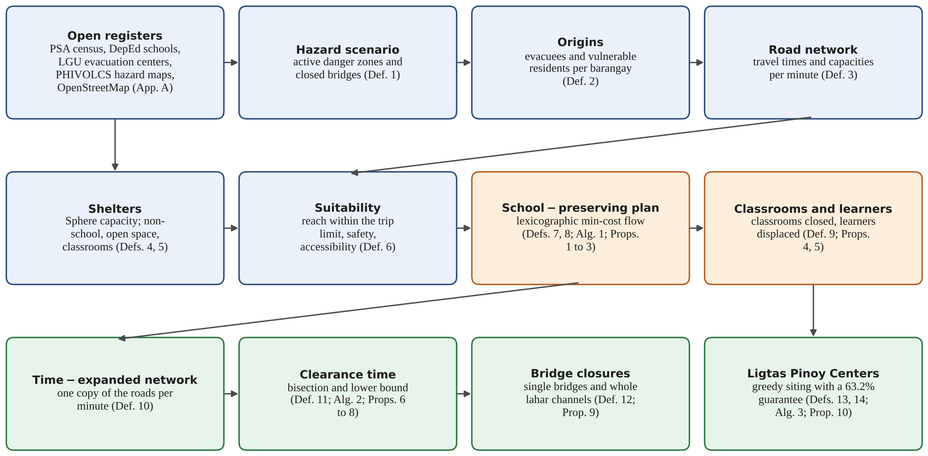
THEORETICAL/CONCEPTUAL
FRAMEWORK PARADIGM
Conceptual Framework
Three layers turn open data into an evacuation plan that keeps classrooms open
Data layer
Hazard scenarios, origins, roads, shelters, suitability
Definitions 1 to 6
Planning layer
School-preserving plan; classrooms closed and learners displaced
Definitions 7 to 9; Propositions 1 to 5
Time and siting layer
Clearance time, bridge closures, Ligtas Pinoy Centers
Definitions 10 to 14; Propositions 6 to 10
Theories used: network flows over time (Ford & Fulkerson) • total unimodularity (Ahuja et al.) • max-flow min-cut (Gale) • submodular maximization (Nemhauser et al.)
Notes:
Our conceptual framework has three layers. The blue data layer builds the hazard scenarios, the origins with their vulnerable residents, the road network with travel times and capacities, and the shelters sized by the Sphere standard; together they decide which shelters each person may use.
The orange planning layer computes the school-preserving plan and counts the classrooms closed and the learners displaced.
The green layer adds time and siting: the time-expanded network gives the clearance time, closure scenarios test the lahar bridges, and greedy siting proposes Ligtas Pinoy Centers.
Four established theories hold it up: network flows over time, total unimodularity, the max-flow min-cut theorem, and submodular maximization.

Slide 12




THEORETICAL/CONCEPTUAL
FRAMEWORK PARADIGM
Research Paradigm
Input, process, output: public registers in, a verified evacuation plan out
INPUT
PROCESS
OUTPUT
Hazard zones and lahar channels (PHIVOLCS)
Barangay populations and vulnerable residents (PSA 2020)
Roads: travel time and capacity (OpenStreetMap)
Shelters: floor areas, classrooms, accessibility (DepEd, LGUs)
Space standard: 3.5 m² per person (Sphere)
Algorithm 1: lexicographic minimum-cost flow
Packing evacuees into full classrooms
Algorithm 2: time-expanded network and bisection
Closure of whole lahar channels
Algorithm 3: greedy siting of Ligtas Pinoy Centers
Ten propositions, checked against independent code
Who goes where, vulnerable residents first
Classrooms closed and learners displaced
Clearance time and the bridges that matter
Ranked sites for new evacuation centers
Advice for PDRRMO, APSEMO, and DepEd
Feedback: verified shelter inventories and drill data replace the synthetic inputs, with no change to the mathematics.
Notes:
As a research paradigm: the inputs are public registers, namely PHIVOLCS hazard zones, the PSA census, OpenStreetMap roads, DepEd and LGU shelter lists, and the Sphere standard.
The process is our three algorithms plus verification: the lexicographic minimum-cost flow, packing into full classrooms, the time-expanded network with bisection, closure of whole lahar channels, and greedy siting. Each proven property is checked against independently written code.
The outputs are a plan of who goes where, the classrooms closed and learners displaced, the clearance time and the bridges that matter, and ranked sites for new centers, offered as advice to PDRRMO, APSEMO, and DepEd.
The feedback loop matters: once verified inventories exist, they replace our synthetic inputs without any change to the mathematics.

Slide 13
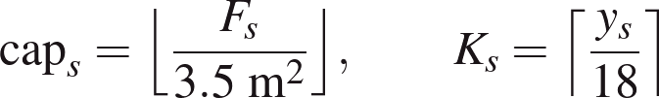



HOW MCS COMES INTO PLAY
HOW MCS COMES INTO PLAY
The Essence of MCS
Mathematics states the problem exactly, computation solves it at scale, and science grounds it in open data.
Open data
Graph
Algorithm
Numbers
Optimisation
Proof
M
C
S
Mathematical
Computational
Sciences
Roads become a graph G = (N, E) with travel times and capacities; shelters become three tiers; the law's order of priorities becomes a lexicographic minimum-cost flow. Ten propositions are proven.
An exact flow solver returns the plan in seconds; a time-expanded network with bisection gives the clearance time; a greedy rule sites Ligtas Pinoy Centers with a 63.2% guarantee.
Inputs come from PSA, DepEd, PHIVOLCS and the Sphere standard of 3.5 m² per person. Every number is reproduced by one seeded script, and test-network results are labelled synthetic.
10 results, proven, then verified: 300/300 plans · 660/660 networks · 4,796 checks · 0 violations
Notes:
This is where MCS comes into play. Mathematics turns the evacuation into a graph and a lexicographic flow; computation solves it exactly and fast; science keeps it grounded in public data and independent checks.

Slide 14
SIGNIFICANCE OF THE STUDY
Who Benefits
Every classroom the plan keeps open is a class that keeps meeting
Families
Learners and teachers
School heads and barangay captains
Know before an alert which shelter their barangay goes to, how long the trip takes, and whether it is accessible.
Fewer classrooms closed means fewer class days moved to modular or blended learning.
See in advance whether, and how many, classrooms may be needed at each alert level.
PDRRMO, APSEMO, and DepEd
LGU planners
Future researchers
Recompute the plan in seconds when a shelter fills or a bridge fails; know how early to order the evacuation.
Rank sites for Ligtas Pinoy Centers under RA 12076 by the classrooms they would free.
Reuse an open, verified pipeline in any province that shelters evacuees in schools.
SDG 4.a
safe learning environments
SDG 10.2
inclusion of the vulnerable
SDG 11.5
fewer people hurt by disasters
SDG 13.1
resilience to hazards
Notes:
The study is meant to help six groups. Families can know before an alert where their barangay goes, how long the trip is, and whether the shelter is accessible for an older or disabled member. Learners and teachers lose fewer class days. School heads and barangay captains can see in advance how many classrooms may be needed. The disaster offices can recompute the plan in seconds when a shelter fills or a bridge fails, and know how early the order must be given. LGU planners can rank sites for Ligtas Pinoy Centers. Future researchers get an open, verified pipeline.
The work relates to SDG targets 4.a, 10.2, 11.5, and 13.1. These are likely uses of the work, not outcomes we have demonstrated.

Slide 15





SUSTAINABLE DEVELOPMENT GOALS
SUSTAINABLE DEVELOPMENT GOALS
Goals Served
Five goals, one plan: shelter everyone, the vulnerable first, and keep classrooms open.
SDG 11.5
SDG 13.1
SDG 4.a
SDG 10.2
SDG 1.5
Fewer people affected by disasters: every evacuee gets a shelter, in time.
Resilience to climate hazards: clearance time and lahar bridges planned before the rain.
Safe learning environments: the fewest classrooms closed, so classes keep meeting.
Inclusion: vulnerable residents placed first, in accessible shelters.
Resilience of the poor: new Ligtas Pinoy Centers sited where they shelter the most.
SDG icons: United Nations. These are intended uses of the model; none has been measured in practice yet.
Notes:
These are the Sustainable Development Goals the study serves. They are intended uses; none has been measured yet.

Slide 16

OBJECTIVES OF THE STUDY / SOP
Objectives
GENERAL OBJECTIVE
Construct, prove correct, and verify by computation a network model that sends every evacuee in an Albay hazard zone to a reachable shelter with room, serves vulnerable residents first, closes as few classrooms as possible, and measures clearance time and the value of new evacuation centers.
Build, from open data, hazard scenarios, evacuee origins, roads with travel times and capacities, and shelters sized by a published standard.
Quantify, with proven monotonicity, how closing lahar bridges and adding shelters change the plan and the clearance time.
1
5
Write the shelter plan as a minimum-cost flow ordered by RA 10821; prove it integral, lexicographically optimal, and vulnerable-first at no cost.
Choose sites for Ligtas Pinoy Centers with a proven guarantee on the added coverage.
2
6
Bound how far the classrooms closed can exceed the true minimum; prove a higher alert level never frees classrooms.
Test every proven property on synthetic instances against independently written reference code.
3
7
Find the exact clearance time on a time-expanded network, and prove a lower bound that needs no such network.
Run the whole pipeline on a synthetic volcano test network; fix the hypotheses for Albay in advance.
4
8
Notes:
Our general objective was to construct a network model, prove it correct, and verify it by computation: a model that sends every evacuee to a reachable shelter with room, serves vulnerable residents first, closes as few classrooms as possible, and measures the clearance time and the value of new evacuation centers.
Specifically, we set out to: one, build the inputs from open data; two, write the shelter plan as a minimum-cost flow that follows RA 10821 and prove its key properties; three, bound the classrooms closed and prove that higher alerts never free classrooms; four, compute the exact clearance time with a quick lower bound; five, measure the effect of bridge closures and new shelters; six, site Ligtas Pinoy Centers with a guarantee; seven, check every property against independent code; and eight, run the whole pipeline on a synthetic test network and fix our hypotheses for Albay in advance.

Slide 17
OBJECTIVES OF THE STUDY / SOP
Statement of the Problem
PRIMARY QUESTION
For a given alert level, how can every evacuee in Albay be assigned to a shelter so that vulnerable residents are protected first, everyone is sheltered, and the fewest classrooms close, and how long does such an evacuation take?
Can shelter capacity, hazard zones, and travel times be built from open registers in a form a laptop can compute with?
Can the clearance time be computed exactly, and how close is a bound that needs only one static flow?
Q1
Q5
Can the priorities of RA 10821 be written as one minimum-cost flow, and is its solution integral and lexicographically optimal?
Which bridges and closures matter for the clearance time, and do closures ever shorten it?
Q2
Q6
Does placing vulnerable residents first ever reduce the number of people who can be sheltered?
Where would a new Ligtas Pinoy Center shelter the most evacuees outside classrooms, and how close to the best is a greedy rule?
Q3
Q7
How far can the classrooms closed be from the true minimum, and does a higher alert level ever free classrooms?
Do the proven properties hold against independent code, and what does the pipeline show on a small test network?
Q4
Q8
Notes:
Our primary question asks how every evacuee can be assigned to a shelter so that vulnerable residents come first, everyone is sheltered, and the fewest classrooms close, and how long such an evacuation takes.
Eight sub-questions follow the objectives one by one, from whether open data are enough, Q1, to whether the proven properties survive independent testing, Q8.
Q3 deserves a note: we asked whether protecting vulnerable residents first could ever cost someone else a place. Proposition 2 shows that it never does.

Slide 18
HYPOTHESES
Fixed in Advance
Eight model hypotheses for the Albay open-data instance, each stated with its decision rule before any run
At Alert Level 3, the school-preserving plan closes fewer than half the classrooms of the time-only plan.
Rule: Supported if the bootstrap interval of the ratio lies wholly below 0.5.
In the compound scenario, at least one barangay cluster is cut off from every shelter outside its pocket.
Rule: Supported if the list of trapped origins is not empty.
M1
M5
Keeping schools open adds less than ten minutes of mean travel per evacuee.
Rule: Supported if the whole bootstrap interval falls under 10 minutes.
Two greedy Ligtas Pinoy Centers cut persons in classrooms at Alert Level 4 by at least 30%.
Rule: Supported if the recomputed plan shows a cut of 30% or more.
M2
M6
The nearest-site rule overfills at least one shelter in every scenario.
Rule: Supported if the overflow is positive in all scenarios.
Every vulnerable resident can be placed in an accessible shelter at Alert Level 3.
Rule: Supported if all are placed; otherwise the deficit is reported by municipality.
M3
M7
Higher alerts never free classrooms; closures never shorten the evacuation.
Rule: Guaranteed by Propositions 5 and 9; a violation flags a data error.
The ranking of municipalities by classrooms closed is stable under the space standard.
Rule: Supported if Spearman's ρ > 0.8 between 3.5 and 4.5 m².
M4
M8
Notes:
The results on the Albay open-data instance will be reported separately, so we fixed eight model hypotheses and their decision rules before running anything on it; that way the results cannot shape the questions.
M1 and M2 measure the trade-off: fewer than half the classrooms, for less than ten extra minutes of travel. M3 tests whether the habit of going to the nearest shelter overfills shelters. M4 is guaranteed by our proofs, so a violation would flag a data error. M5 looks for barangays trapped by lahar closures. M6 tests whether two new centers cut classroom use by 30 percent. M7 checks that every vulnerable resident fits in an accessible shelter, and M8 checks that the ranking of municipalities survives a stricter space standard.
The statistics are fixed too: percentile bootstrap intervals, the Wilcoxon signed-rank test, the Mann-Whitney U test, and Spearman's rank correlation.

Slide 19




METHODOLOGY
Research Design
Fully computational: every number comes from a proof, a synthetic test network, or a public register
1
2
3
4
Hazard scenarios
Origins
Road network
Shelter inventory
Danger zones and lahar channels as scenarios: AL3, AL4, AL4 + lahar
Barangay assembly points with population and vulnerable residents
OpenStreetMap roads with travel time (min) and capacity (persons/min)
Floor areas, classrooms, and accessibility give tier capacities
5
6
7
8
Shelter plan
Evacuation over time
Siting
Verification
Algorithm 1: lexicographic min-cost flow, then packing into rooms
Algorithm 2: time-expanded network, bisection, lower bound
Algorithm 3: greedy Ligtas Pinoy Center sites; plan recomputed
Each proposition checked against independent code; time measured
Tools: Python with NetworkX (network simplex, maximum flow) and SciPy HiGHS for the reference programs; one fixed random seed (20261017); runs on an everyday laptop
Notes:
Our design is fully computational. No evacuation center was visited and no one was interviewed; every number comes from a proof, a synthetic test network, or a public register.
The work ran in eight stages. Stages one to four build the data: hazard scenarios, origins, the road network, and the shelter inventory. Stage five computes the shelter plan, stage six the evacuation over time, stage seven the siting of new centers, and stage eight verifies everything against independently written code.
We used Python with NetworkX, and SciPy's HiGHS solver for the reference linear and integer programs, with one fixed random seed so that every number can be reproduced.

Slide 20
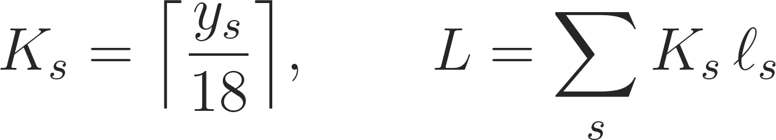
METHODOLOGY
The Shelter Plan
The legal order of priorities becomes one minimum-cost flow
Tier 0
Non-school space
Evacuation center, Ligtas Pinoy Center, church hall
Rule: Use first
Lexicographic order (Definition 8)
1 Most vulnerable placed
2 Most people placed
3 Fewest in classrooms
4 Fewest in school open space
5 Least travel
Tier 1
School open space
Gymnasium, covered court, multipurpose hall
Rule: When tier 0 is full
Penalties make one person out of a classroom outweigh any travel (Prop. 3)
Packing fills one classroom before opening the next (Def. 9, Prop. 4)
Tier 2
Classrooms
18 persons per room (63 m² ÷ 3.5 m²)
Rule: Last resort: each room closes a class
Whole persons, by total unimodularity: no evacuee is split (Prop. 1)
Vulnerable first never costs anyone a place (Prop. 2)
At most one extra classroom per school in use (Prop. 4)
Vulnerable evacuees go only to accessible shelters; trips longer than 120 minutes and shelters inside active zones are excluded.
Notes:
This is the heart of the model. Every shelter is split into three tiers: tier zero is non-school space, tier one is school open space such as gyms and covered courts, and tier two is classrooms, at 18 persons per room.
The plan follows a strict order: first place as many vulnerable residents as possible, then as many people as possible, then put the fewest persons in classrooms, then the fewest in school open spaces, and only then minimize travel. We impose this order with two large penalties, M sub O and M sub Y, chosen so that moving one person out of a classroom always outweighs any amount of travel or open-space use. Proposition 3 proves that the order is met exactly.
Because the problem is a network flow, the solution is in whole persons, Proposition 1, and placing the vulnerable first never costs anyone a place, Proposition 2. Finally, evacuees in a school are packed room by room, and Proposition 4 proves this closes at most one extra classroom per school in use.

Slide 21
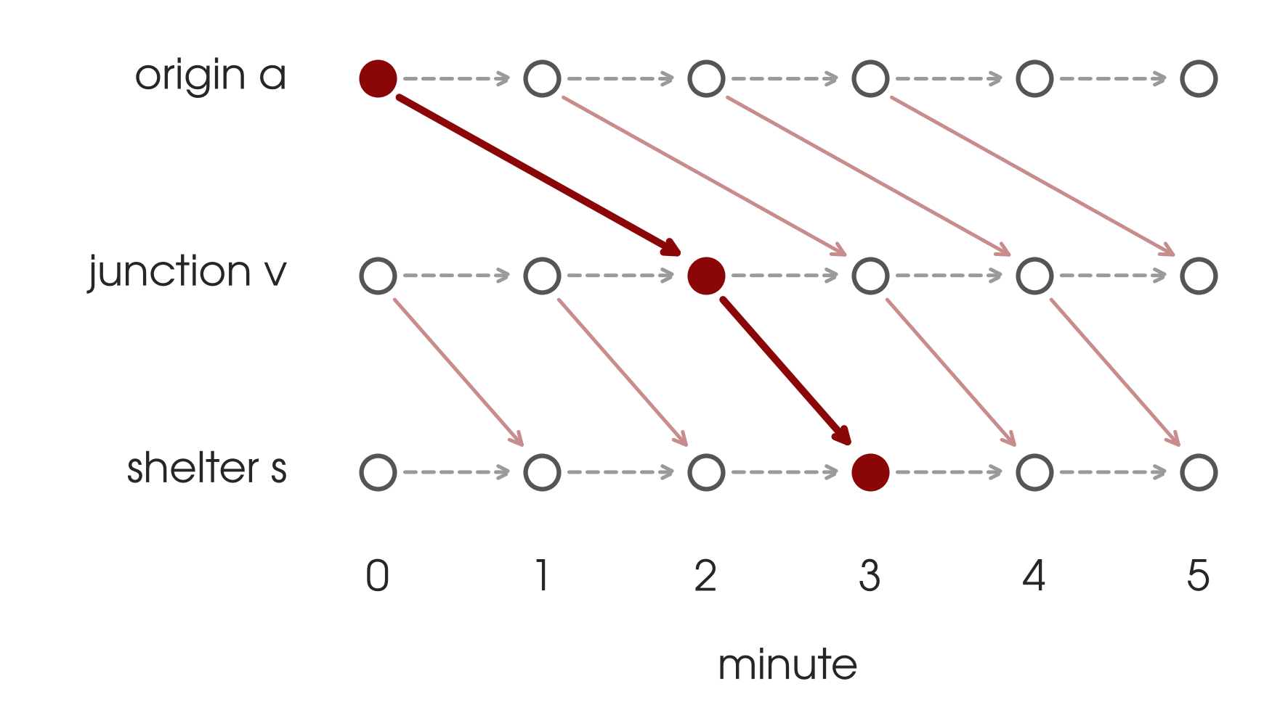
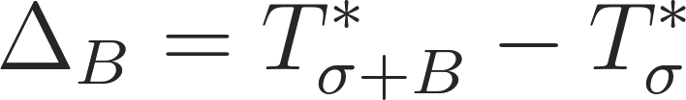
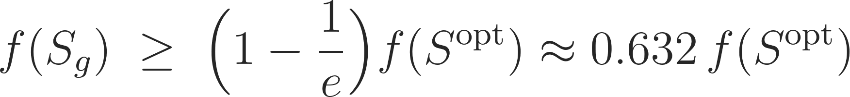
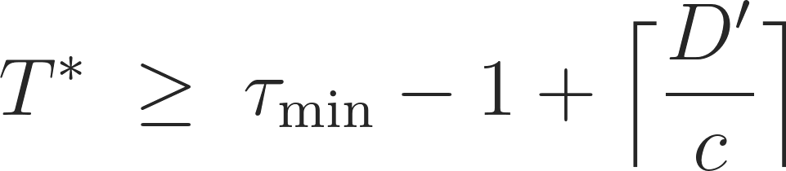
METHODOLOGY
Time, Bridges, and Siting
One copy of the road network per minute gives the exact clearance time
Clearance time
Bridge closures
Ligtas Pinoy Centers
Closure effect (Def. 12)
Siting gain of new sites S (Def. 14)
A lahar closes every bridge over its channel at once, so whole channels are tested, not only single bridges
Prop. 9: closing roads never shortens the evacuation; adding shelters never adds classroom use
An infinite effect means residents are trapped: evacuate them before the rain, or build a shelter there
Greedy guarantee (Prop. 10)
Coverage: evacuees sheltered outside classrooms within θ = 30 minutes
f is monotone and submodular: each new site adds less than the one before
Greedy: add the site with the largest gain, k times
Earliest minute everyone is sheltered (Def. 11)
Lower bound from one static flow (Prop. 8)
Bisection finds T* with about 2 log₂ T* max flows (Props. 6, 7)
Notes:
To know how long an evacuation takes, we copy the road network once per minute, as Ford and Fulkerson did. A person moving along a road jumps forward by its travel time; a person waiting moves to the next minute. The clearance time T star is the first minute by which everyone can be inside a shelter, and bisection finds it with only a few maximum-flow computations. We also prove a lower bound that needs only one static flow.
For bridges, we measure how much the clearance time grows when a whole lahar channel closes. Proposition 9 proves that closures never shorten the evacuation.
For Ligtas Pinoy Centers, the gain of a set of new sites is monotone and submodular, so the simple greedy rule is guaranteed to reach at least 63.2 percent of the best possible gain.

Slide 22
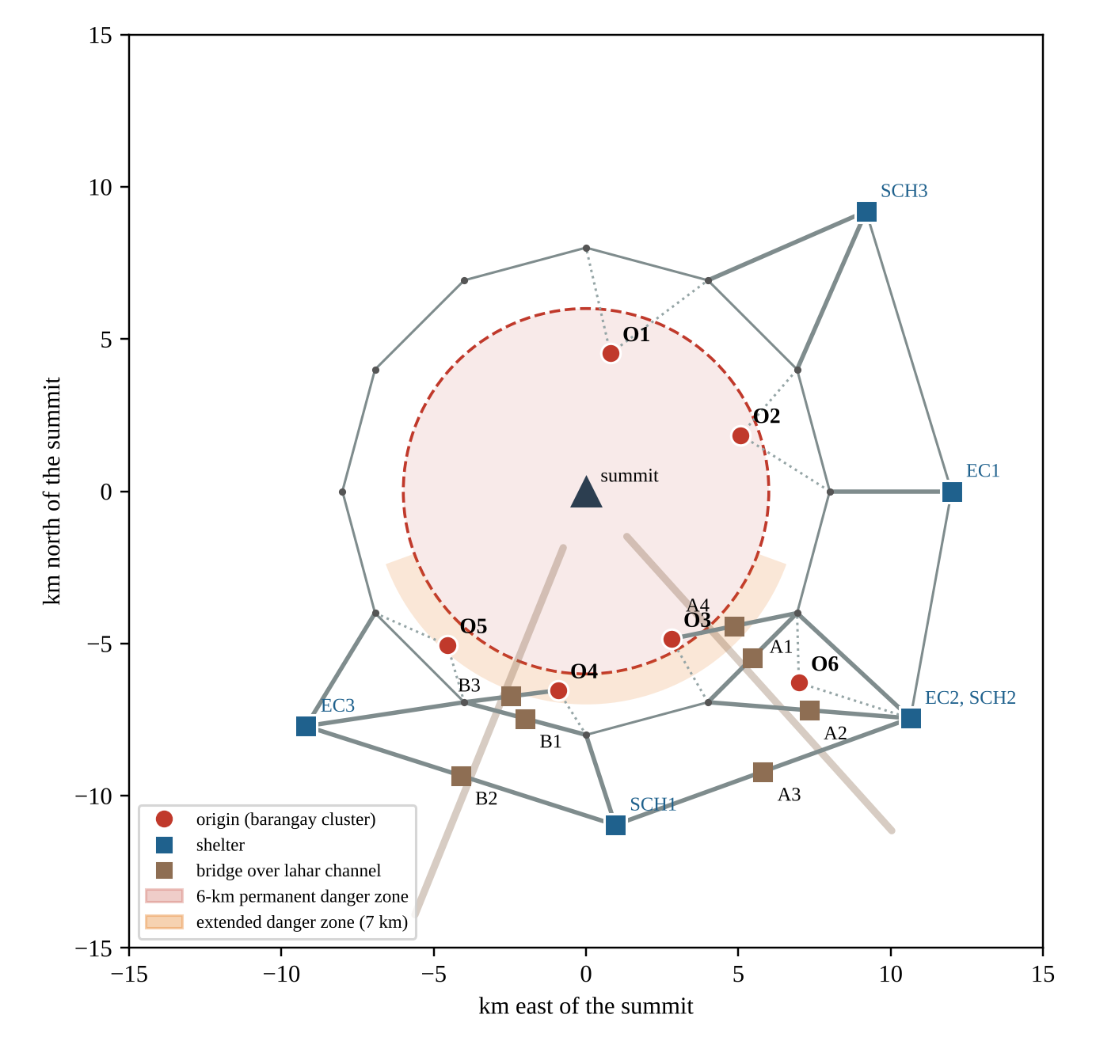

METHODOLOGY
Test Network and Checks
Test network E1: a small synthetic volcano that exercises every stage (not real Albay data)
Test network E1 (synthetic)
6 barangay clusters (O1 to O6) with 2,690 residents
6 shelters: 900 places in non-school space, 420 in school open space, 64 classrooms (1,152 places)
2 lahar channels crossed by 7 bridges (A1 to A4, B1 to B3)
Scenario | Active zones and closures | Evacuees
AL3 | 6-km Permanent Danger Zone | 1,560
AL4 | Adds the 7-km Extended Danger Zone (south) | 2,390
AL4 + lahar | Adds the lahar area; channel bridges closed | 2,690
Verification design
Random synthetic instances, each checked against code written separately: five sequential LPs and an exact MIP (HiGHS), the Ford-Fulkerson formula, a minute-by-minute scan, and exhaustive search.
Notes:
To exercise every part of the pipeline, we built a small synthetic volcano we call test network E1. It is not Albay data; the towns are only positions on the compass. It has six barangay clusters with 2,690 residents, six shelters with 900 places in non-school space, 420 in school open space, and 64 classrooms, and two lahar channels crossed by seven bridges.
The three scenarios are Alert Level 3 with 1,560 evacuees, Alert Level 4 with 2,390, and Alert Level 4 with a lahar, with 2,690.
Separately, the verification ran on random synthetic instances, where each answer was compared with reference code written independently: linear and integer programs solved with HiGHS, the Ford-Fulkerson formula, a minute-by-minute scan, and exhaustive search.

Slide 23

RESULTS AND DISCUSSION
Shelter Plans
Test network E1, Alert Level 3: both plans shelter all 1,560 evacuees and all 342 vulnerable residents
Where the 1,560 evacuees stay (persons, test network)
40 → 14
1,702 → 532
classrooms closed
learners displaced
time-only → school-preserving
1,170 learners spared
+1.70 min
298
mean trip
evacuees reach full shelters
29.48 → 31.18 minutes
if all go to the nearest site
Over a 15-day stay: 17,550 learner-days of face-to-face classes kept, or 390 classroom-days.
Alert Level 4: 2,390 evacuees fill shelters to 97%; both plans close 60 classrooms. Only new shelters help.
Notes:
Here is the main result on the test network at Alert Level 3. Both plans shelter all 1,560 evacuees, including all 342 vulnerable residents.
The time-only plan fills the nearby classrooms and closes 40 rooms, displacing 1,702 learners. The school-preserving plan fills every non-school space and school open space first and closes only 14 classrooms, displacing 532 learners, at a cost of 1.70 minutes of extra average travel. Over a fifteen-day stay, that is 17,550 learner-days of face-to-face classes kept.
For comparison, if every barangay simply went to its nearest site, 298 people would arrive at full shelters.
At Alert Level 4 the shelters are 97 percent full and both plans close 60 classrooms: when space itself is short, only new shelters help. These are test-network numbers, not estimates for Albay.

Slide 24
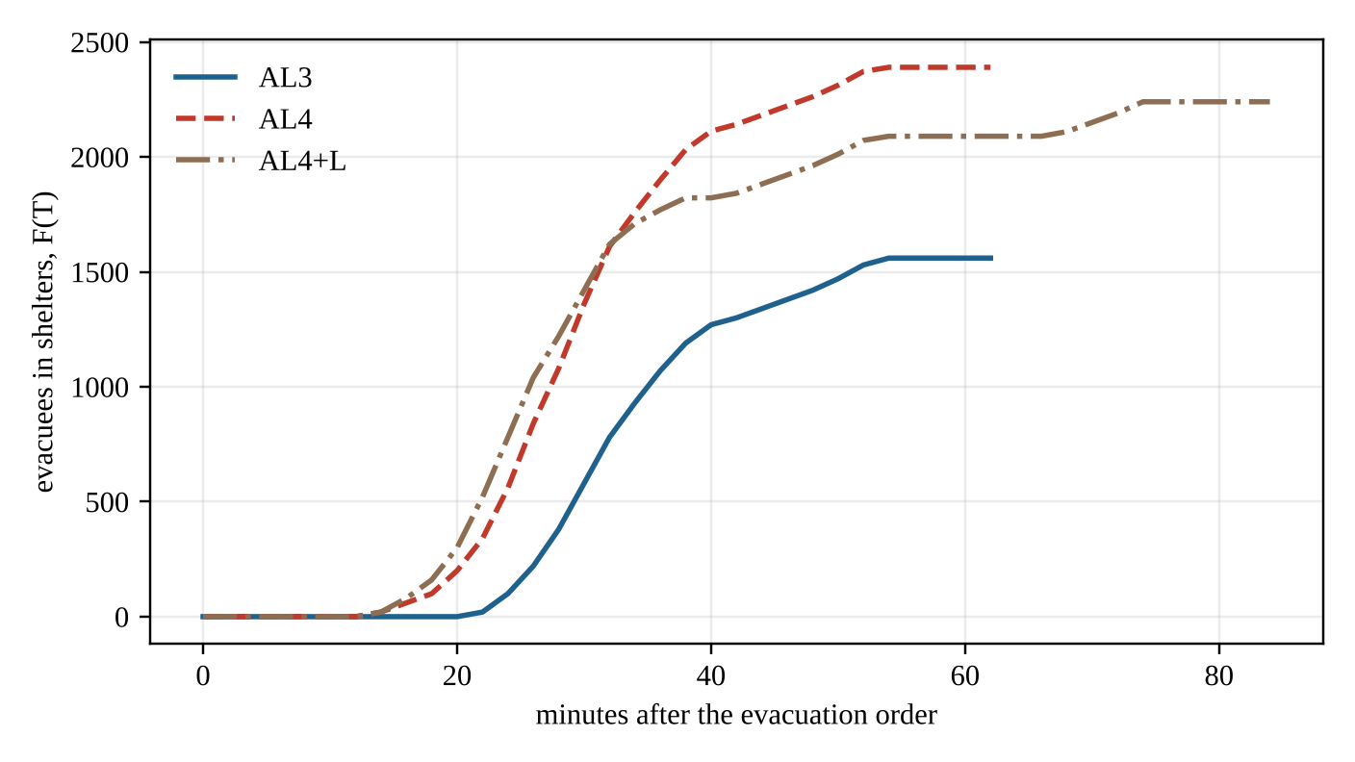
RESULTS AND DISCUSSION
Clearance Time and Bridges
Single bridges barely matter; a lahar that closes a whole channel does
53 min
34 min
clearance time, Alert Level 3
lower bound, no time-expanded network
Lahar channels closed at Alert Level 4 (plan held fixed)
Bridges closed | Clearance | Change
None | 53 min | –
Channel A (A1 to A4) | 95 min | +42 min
Channel B (B1 to B3) | 74 min | +21 min
Both channels | never ends | 450 trapped
Evacuees inside shelters by minute, F(T), test network E1 (synthetic)
Warning no single-bridge study gives: losing both channels cuts off a southern pocket (O3, O4, school SCH1). Evacuate it before lahar-producing rain, or give it a shelter of its own.
Notes:
At Alert Level 3 the last evacuee on the test network is sheltered after 53 minutes. Our lower bound gives 34 minutes without building the time-expanded network at all. The curves show the pattern: nobody arrives until the shortest trips end, then arrivals climb as fast as the busiest roads allow, and flatten as the longest trips finish.
For bridges: closed one at a time, the seven bridges barely matter, because the network has alternatives; six leave the clearance time at 53 minutes and one adds a minute. But a lahar closes every bridge over its channel at once. Losing channel A adds 42 minutes, channel B adds 21, and losing both cuts off a southern pocket where 450 residents can no longer be sheltered at all.
So the model gives a concrete warning: that pocket must be evacuated before lahar-producing rain, or it needs a shelter of its own. Again, these are test-network results.

Slide 25
RESULTS AND DISCUSSION
Ligtas Pinoy Center Siting
Compound scenario (Alert Level 4 + lahar), 30-minute standard: the first site goes inside the trapped pocket
Sites (k) | Greedy choice | Gain | Not sheltered | In classrooms | Rooms closed
0 | – | 0 | 450 | 920 | 52
1 | South town | 400 | 50 | 920 | 52
2 | + Northeast town | 750 | 50 | 570 | 32
3 | + Southwest town | 900 | 50 | 360 | 20
Persons in classrooms as sites are added
Gain of one new center alone (evacuees, test network)
400 of 450
k = 1 to 3
trapped residents sheltered by the first site
greedy equals the exhaustive best
Notes:
In the hardest scenario, Alert Level 4 with a lahar, 450 residents have nowhere to go. We offered five candidate sites, one per town, and measured how many more evacuees each set of sites could shelter outside classrooms within 30 minutes. Alone, the sites would add 400, 350, 150, 30, and 0.
The greedy rule picks the south town first, which lies inside the trapped pocket and shelters 400 of the 450. The second site cuts the persons in classrooms from 920 to 570, from 52 classrooms to 32, and the third cuts it to 360 persons in 20 classrooms.
For one to three sites, the greedy choice matched the best set found by exhaustive search. The southeast city gains nothing because its existing shelters already cover everyone who can reach it in half an hour.

Slide 26
RESULTS AND DISCUSSION
Verification
Ten propositions, each proven and then checked against independently written code: no check failed
No. | What is proven | Independent check | Result
1 | Plans are in whole persons; no evacuee is split | 300 random instances vs five sequential linear programs (HiGHS) | 300/300 matched at all five levels (1,500 values); no fractional flow
2 | Placing the vulnerable first costs no one a place
3 | The penalties give the legal order exactly
4 | Packing closes at most one extra classroom per school in use | 150 instances vs an exact mixed-integer program | Bound held 150/150; packing exact in 144
5 | A higher alert level never frees classrooms | 52 nested alert-level checks | 0 violations
6 | The time-expanded network is exact (Ford & Fulkerson) | 660 horizon tests vs the static-flow formula | 660/660 agree
7 | Bisection finds the clearance time exactly | 79 instances vs a minute-by-minute scan | 79/79 same; 5.2 vs 26.9 max flows
8 | Lower bound on the clearance time from one static flow | The same 79 instances | Never violated; bound/T* averaged 0.585
9 | Closures never shorten the evacuation; new shelters never add classroom use | 120 instances, 411 checks | 0 violations
10 | Siting gain is monotone and submodular; greedy reaches at least 63.2% | 80 instances: 4,796 checks; 320 exhaustive comparisons | 0 violations; greedy worst 0.890, mean 0.997, optimal in 94.7%
Notes:
Every result was first proven and then checked numerically against code written separately, so that a coding mistake could not slip into our results.
The plan matched five sequential linear programs at all five levels in 300 of 300 instances, or 1,500 values. The classroom bound held in all 150 exact comparisons, and packing was exactly optimal in 144. The time-expanded network agreed with the Ford-Fulkerson formula in 660 of 660 tests, and bisection matched a minute-by-minute scan in all 79 instances with about five times fewer maximum-flow computations. The lower bound was never violated. There were no monotonicity violations, and none in 4,796 submodularity checks.
Greedy siting never fell below 89 percent of the optimum, averaged 99.7 percent, and was exactly optimal in 94.7 percent of 320 cases, far above the guaranteed 63.2 percent.

Slide 27
CONCLUSIONS
What the Study Shows
Public data suffice to plan evacuations that keep schools open
The law becomes one computable plan
The legal order of priorities is a single minimum-cost flow, solved exactly in seconds on a laptop; vulnerable first costs no one a place.
On test network E1 (synthetic)
14 vs 40
classrooms closed
Classrooms are counted and bounded
Packing is within one room per school in use of the true minimum; a higher alert never frees classrooms, so plan once for the highest level.
532 vs 1,702
learners displaced
+1.70 min
mean travel
Clearance time is exact
Whole lahar channels, not single bridges, decide how long an evacuation takes.
Limitations
Worked results come from a synthetic test network
Road capacities are declared; everyone leaves at once
Families may be split; accessibility is one flag
Floor areas not yet surveyed; ashfall not modeled
Siting has a guarantee
Greedy Ligtas Pinoy Center siting reaches at least 63.2% of the best; in tests, at least 89.0% and optimal in 94.7%.
Every result was proven, then checked
No check failed against independently written code.
Notes:
We conclude five things. First, the legal order of priorities can be written as one minimum-cost flow and solved exactly in seconds on a laptop. Second, classrooms can be counted and bounded, and since a higher alert never frees classrooms, local governments can sign school agreements once, for the highest alert they plan for. Third, clearance time can be computed exactly, and whole lahar channels, not single bridges, decide it. Fourth, Ligtas Pinoy Center siting has a proven guarantee. Fifth, every result passed independent checks.
On the test network, that meant 14 classrooms instead of 40 and 532 learners displaced instead of 1,702, for 1.70 more minutes of average travel.
Our limits are clear: the worked results come from a synthetic test network and say nothing yet about real schools; road capacities are declared; everyone is assumed to leave at once; floor areas are not yet surveyed; and ashfall on shelters is not modeled.

Slide 28


RECOMMENDATIONS
Next Steps
From a verified model to a pilot with the Provincial Government and DepEd Albay
1
2
3
4
Shelter inventory
Field validation
Pilot as advice
Ligtas Pinoy Centers
Floor areas of gyms, halls, and classrooms, accessibility, and contacts for every evacuation center and school in the danger-zone municipalities.
Calibrate road capacities from drills (trucks, loads, trip times); replay the January and May 2026 evacuations from DSWD records.
PDRRMO, APSEMO, and the Schools Division Offices test the plan as advice to the officer who signs the order, never as an automatic order.
LGUs rank candidate lots under RA 12076 by the classrooms they would free, then weigh land, cost, and hazard.
For future researchers
Add departure waves, keep families together (whole-family flows), and route vehicles for vulnerable residents who cannot walk to a pick-up point.
Beyond Albay
The inputs are public registers, OpenStreetMap, and the Sphere indicator, so any province that shelters evacuees in schools can adopt the model.
Notes:
We recommend four steps toward use. First, an inventory of every evacuation center and school in the danger-zone municipalities, with floor areas, accessibility, and contact persons. Second, field validation: calibrate road capacities from evacuation drills, and replay the January and May 2026 evacuations using DSWD records to ask how many classrooms the plan would have kept open. Third, a pilot by the Provincial Government and DepEd Albay, with PDRRMO, APSEMO, and the Schools Division Offices, where the plan is advice to the officer who signs the evacuation order, never an automatic order. Fourth, local governments can rank candidate lots for Ligtas Pinoy Centers by the classrooms they would free, then weigh land, cost, and hazard.
Future researchers can add departure waves, keep families together, and route vehicles for vulnerable residents. Because the inputs are public, other provinces that shelter evacuees in schools can adopt the model.

Slide 29

REFERENCES
Key Sources
Key sources cited in this presentation; the full list is in the paper
Ahuja, R. K., Magnanti, T. L., & Orlin, J. B. (1993). Network flows: Theory, algorithms, and applications. Prentice Hall.
Church, R., & ReVelle, C. (1974). The maximal covering location problem. Papers of the Regional Science Association, 32(1), 101–118.
Daily Tribune. (2026, May 4). DepEd urges Albay schools to prioritize safety as Mayon Volcano unrest intensifies, evacuation centers activated.
Department of Education. (2010). Educational facilities manual (Rev. ed.).
Ford, L. R., Jr., & Fulkerson, D. R. (1958). Constructing maximal dynamic flows from static flows. Operations Research, 6(3), 419–433.
Ford, L. R., Jr., & Fulkerson, D. R. (1962). Flows in networks. Princeton University Press.
Gale, D. (1957). A theorem on flows in networks. Pacific Journal of Mathematics, 7(2), 1073–1082.
Hamacher, H. W., & Tjandra, S. A. (2002). Mathematical modelling of evacuation problems: A state of the art. In Pedestrian and evacuation dynamics (pp. 227–266). Springer.
Interaksyon. (2026, January 6). Philippines raises alert level at restive Mayon volcano. Philstar.com.
Nemhauser, G. L., Wolsey, L. A., & Fisher, M. L. (1978). An analysis of approximations for maximizing submodular set functions, I. Mathematical Programming, 14(1), 265–294.
Philippine Daily Inquirer. (2016). Albay survivors remember 'Reming' a decade after.
Philippine Daily Inquirer. (2026a). 4,000 students shift to modular, blended learning amid Mayon unrest.
Philippine Star. (2026, May 6). Mayon ashfall affects 132 schools.
Philippine Statistics Authority. (2021). 2020 Census of Population and Housing population counts [Press release].
ReliefWeb. (2023). Philippines: Mayon Volcano – Jun 2023.
Republic Act No. 10821. (2016). Children's Emergency Relief and Protection Act.
Republic Act No. 12076. (2024). Ligtas Pinoy Centers Act.
Schools Division Office of Muntinlupa City. (2026). Unnumbered memorandum No. 174, s. 2026 [Use of schools as evacuation centers].
Sphere Association. (2018). The Sphere handbook (4th ed.).
Notes:
These are the key sources behind the facts and methods we presented. The full list, including every law, guideline, and news report we cited, is in the reference section of our paper.

Slide 30
LIGTA-S
Say it like ligtas (LIG-tas), the Filipino word for safe
Safe Shelter, Open Schools: A Verified Network-Flow Model for Planning Evacuations in Albay by Hazard Zone, Shelter Capacity, and Vulnerability While Keeping Classrooms Open
De Asis, Dave Justin Ll.
◆ LEAD RESEARCHER · FOUNDER OF THE LIGTA-S RESEARCH & APPLICATION ◆
Brimbuela, Peter John A. • Shin, Yeaseong
Research Adviser: Calleja, Dick Anthony M.
Legazpi City Science High School • Legazpi City, Albay • Mathematics and Computational Sciences, Team (MCS-T)
Notes:
Return to the title before questions.

Slide 31
QUESTIONS
& ANSWER
Notes:
Thank you for listening. We are happy to answer your questions.
Points to keep ready:
- Why a synthetic test network? The worked instance shows that the pipeline obeys its own rules; it is not an estimate for Albay. Verified inventories will replace it without any change to the mathematics.
- Why penalties instead of five separate programs? One minimum-cost flow with the penalties gives exactly the same plan (Proposition 3), and it matched five sequential linear programs in all 300 tests.
- Is 18 per classroom realistic? It follows the Sphere indicator of 3.5 square meters on a 63-square-meter DepEd classroom; the planned sweeps repeat everything at 4.5 square meters.
- Why not minimize classrooms exactly? That is an integer program; packing is provably within one room per school in use, and it was exact in 144 of 150 tests.
- Does the model order evacuations? No. It plans; the decision stays with the PDRRMO, APSEMO, DepEd, and the Provincial Government.

Slide 32
THANK YOU
Notes:
On behalf of the LIGTA-S team, thank you. Safe shelter for every family, and open schools for every learner.

