Slide 1


BANTA-Y
Say it like bantay (BAN-tai), the Filipino word for watch or guard
Where People Go, Dengue Goes: A Verified Mobility-Coupled Network Model for Ranking Dengue Hotspots, Issuing Early Warnings, and Allocating Vector Control at Least Cost in Albay
De Asis, Dave Justin Ll.
◆ LEAD RESEARCHER · FOUNDER OF THE BANTA-Y RESEARCH & APPLICATION ◆
Brimbuela, Peter John A. • Shin, Yeaseong
Research Adviser: Calleja, Dick Anthony M.
Legazpi City Science High School • Legazpi City, Albay • Mathematics and Computational Sciences, Team (MCS-T)
Notes:
Good day, honorable judges. We are the LIGTA-S team from Legazpi City Science High School. I am Dave Justin De Asis, the lead researcher, with Peter John Brimbuela and Yeaseong Shin, under our research adviser, Dick Anthony M. Calleja. LIGTA-S is said like the Filipino word ligtas, which means safe.
Our study is titled Safe Shelter, Open Schools: A Verified Network-Flow Model for Planning Evacuations in Albay by Hazard Zone, Shelter Capacity, and Vulnerability While Keeping Classrooms Open.
In one sentence: we built a planning model that gives every evacuee a shelter with room, protects vulnerable residents first, and uses classrooms only when nothing else is left, and we proved and then tested that it behaves the way the law intends.

Slide 2

Notes:
Blank slide. Keep it up until it is your turn, then click to the rationale video.

Slide 3
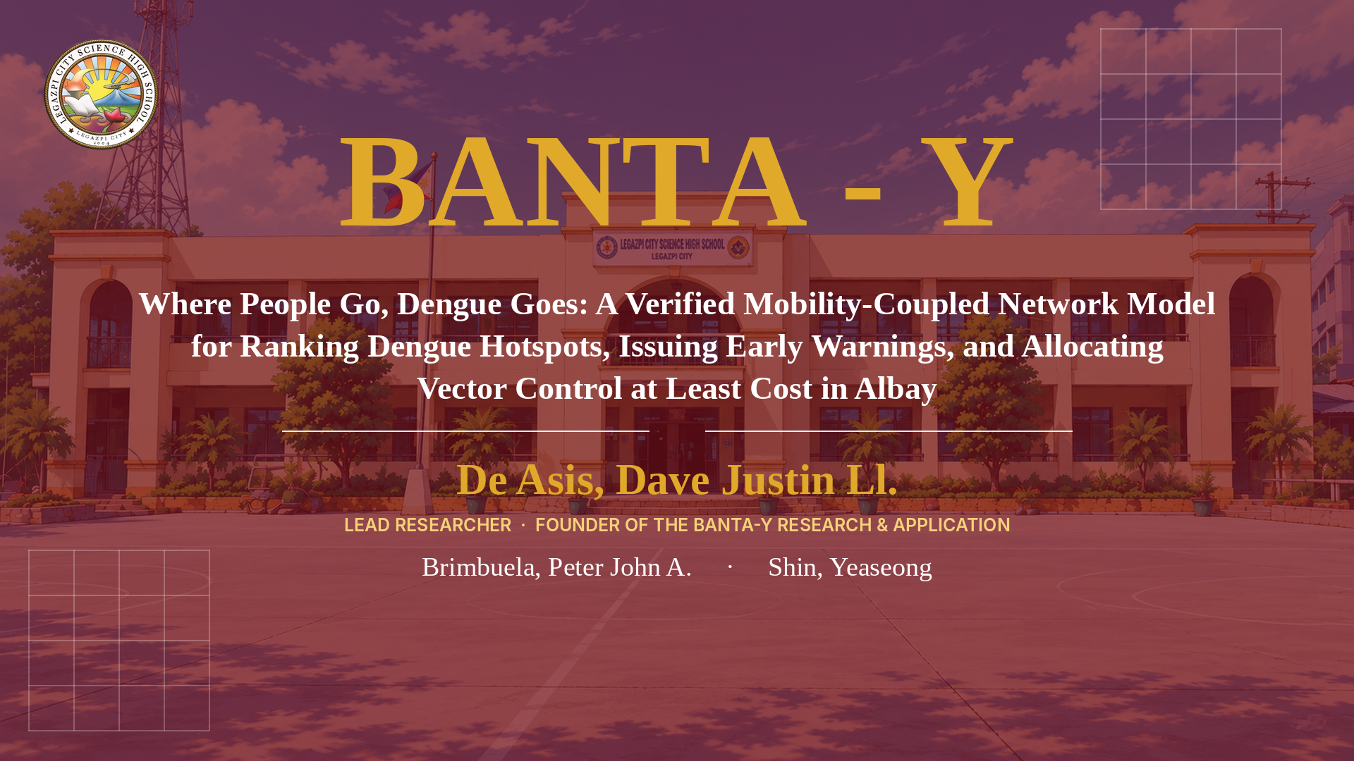

Notes:
Click once to play the rationale video. It runs 2 min 38 s. Stay silent and let it play to the title card.

Slide 4
HOMES SHOW WHERE DENGUE IS REPORTED,
OUR MODEL SHOWS WHERE IT SPREADS.
TARGETING DENGUE BY PLACE ACROSS ALBAY
LEGAZPI CITY SCIENCE HIGH SCHOOL
MCS-T: DE ASIS
Notes:
Read the two lines on the screen slowly, then introduce the study.

Slide 5
BANTA-Y
Say it like bantay (BAN-tai), the Filipino word for watch or guard
Where People Go, Dengue Goes: A Verified Mobility-Coupled Network Model for Ranking Dengue Hotspots, Issuing Early Warnings, and Allocating Vector Control at Least Cost in Albay
De Asis, Dave Justin Ll.
◆ LEAD RESEARCHER · FOUNDER OF THE BANTA-Y RESEARCH & APPLICATION ◆
Brimbuela, Peter John A. • Shin, Yeaseong
Research Adviser: Calleja, Dick Anthony M.
Legazpi City Science High School • Legazpi City, Albay • Mathematics and Computational Sciences, Team (MCS-T)
Notes:
Introduce the study title and the researchers, then go to the Introduction.

Slide 6






INTRODUCTION
INTRODUCTION
Background of the Study
Albay's 2026 dengue surge: cases are filed at home, but infections happen where people spend the day.
2,179 cases · 14 deaths
+84%
2,888 cases
State of calamity
Albay, January 1 to September 12, 2026
over the 1,183 cases of the same months of 2025
by September 21, 2026
declared Sept 10; public schools closed Sept 14 to 18 for cleanup and fogging
Most cases by municipality (by home address)
Why place matters
Legazpi City 486
Bacacay 296
Daraga 220
Tabaco 181
Malilipot 171
Aedes aegypti bites by day and stays close to where it breeds.
People carry the virus between homes, schools, markets and workplaces (Stoddard et al., 2013).
DOH 4S: search and destroy, self-protection, seek early consultation, support fogging only in hotspots.
Sources: Daily Tribune, 2026; Philippine Information Agency (DOH 4S strategy).
Notes:
Open with the 2026 numbers, then the key idea: the mosquito bites by day where people gather, but cases are filed by home address.

Slide 7
INTRODUCTION
INTRODUCTION
Statement of the Problem
Nine problems in dengue control, each answered by one part of the model.
No. | Problem | What goes wrong | Model component
P1 | Cases are recorded where patients live | Cleanup goes to homes while the source persists elsewhere | Residence-to-place inversion
P2 | Province-wide figures look moderate | Pockets of intense transmission stay hidden | Local exposure numbers and bounds
P3 | Brigades have fixed team-days | Effort is spread evenly or by guesswork | Least-cost control (convex program)
P4 | Outbreaks are seen only after wards fill | Response begins weeks late | Poisson CUSUM alarm with proven delay
P5 | No ranking of places to treat first | The barangay with most cases goes first by default | Place shares and hotspot score
P6 | Schools and markets draw people from many barangays | One busy place seeds cases across town | Residence-time matrix
P7 | The effect of a plan is unknown in advance | Success is judged after the season | Network reproduction number
P8 | The rainy season multiplies mosquitoes | A plan that works in March fails in August | Season factor
P9 | Officials need assurance a plan is enough | Plans are approved without a guarantee | Certificate and certified interval
Notes:
Walk through the problems row by row; each row ends with the part of the model that answers it.

Slide 8
RRL/RRS
RRL/RRS
Related Literature and Studies
Models of movement and dengue exist; none gives an Albay health office a verified, least-cost plan by place.
Area | Key sources | Use in the present study
Dengue and its vector | Bhatt et al. (2013); WHO (2012) | Burden and the case for vector control
Dengue in the Philippines | OCHA (2019); Edillo et al. (2015); RA 11332 | Reporting by address; national context
Reproduction numbers | Diekmann et al. (1990); van den Driessche & Watmough (2002); Smith et al. (2012) | Next-generation matrix of the model
Human movement | Stoddard et al. (2009, 2013); Cosner et al. (2009) | Residence-time (Lagrangian) coupling
Uneven exposure | Dye & Hasibeder (1986) | Averages understate the risk
Weather | Mordecai et al. (2017); Su (2008); Sumi et al. (2017) | Parameter ranges and the season factor
Vector control | Esu et al. (2010); Bowman et al. (2016) | Control acts on mosquito numbers
Outbreak detection | Page (1954); Lucas (1985); Brook & Evans (1972); Hussain-Alkhateeb et al. (2018) | CUSUM alarm and exact run length
Matrix tools | Horn & Johnson (2013); Overton (1988); Varah (1975) | Bounds, convexity and the inversion error
Notes:
Each row is one strand of literature and how this study uses it.

Slide 9
RRL/RRS
RRL/RRS
Research Gap
Six gaps remain after the review, and each one is closed by a part of the model.
G1 Cases by home, infections by place
G2 No provincial R0 with movement
G3 No least-cost allocation
No tool turns cases by residence into infections by place.
No residence-time model of a Philippine province from open data, with bounds a barangay can compute.
No method gives the cheapest plan that provably brings transmission below its threshold.
G4 No ranking of places
G5 Alarms without guarantees
G6 No verification
Hotspots are named by case counts, not by how much transmission each place carries.
Delays and false-alarm rates of thresholds are rarely computed.
Planning tools seldom show their formulas were checked against independent code.
Notes:
Read each gap and the part of the model that closes it.

Slide 10
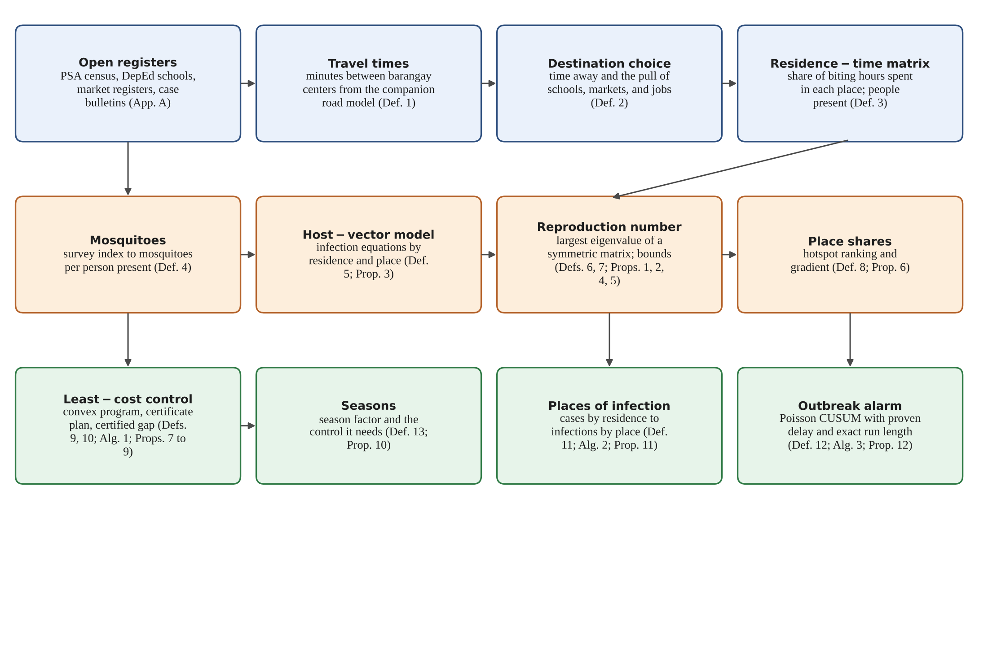
THEORETICAL/CONCEPTUAL FRAMEWORK PARADIGM
THEORETICAL/CONCEPTUAL FRAMEWORK PARADIGM
Conceptual Framework
Three layers turn open data into dengue decisions: movement, transmission, and decision.
Notes:
Explain the three layers from top to bottom: where people spend the day, how dengue spreads, and what to do.

Slide 11
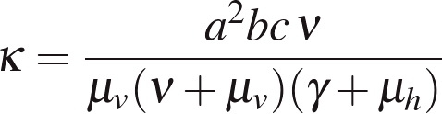

HOW MCS COMES INTO PLAY
HOW MCS COMES INTO PLAY
The Essence of MCS
Mathematics states the problem exactly, computation solves it at scale, and science grounds it in open data.
Open data
Graph
Algorithm
Numbers
Optimisation
Proof
M
C
S
Mathematical
Computational
Sciences
Daily movement becomes a residence-time matrix; transmission becomes a symmetric matrix whose largest eigenvalue is the reproduction number; the cheapest control becomes a convex program. Twelve propositions are proven.
An eigen-solver ranks places in under a second for 720 barangays; an interior-point method finds the least-cost plan with a certified gap; a Markov chain gives the alarm's exact run length.
Inputs come from the PSA census, DepEd schools, case bulletins and published Aedes aegypti parameters. Every number is reproduced by one seeded script; test-network results are labelled synthetic.
12 results, proven, then verified: 300/300 R0 values · 120/120 control plans · 10,000 alarm checks · 0 violations
Notes:
This is where MCS comes into play: the matrix and eigenvalue give the reproduction number, optimisation gives the cheapest plan with a certificate, and every result was proven and checked against independent code.

Slide 12
SIGNIFICANCE OF THE STUDY
SIGNIFICANCE OF THE STUDY
Who Benefits
Every team-day sent to the right place lowers transmission the most.
Households and schools
Barangay health workers and brigades
Provincial and municipal health offices
See whether the places they visit by day carry the most transmission, and when cleanup days matter.
A ranking per team-day and a schedule of team-days per barangay.
A monthly reproduction number, infections by place, and an alarm with a known false-alarm rate.
Budget and disaster planners
DOH 4S campaign
Future researchers
How many team-days a stronger rainy season will need, before the rains.
Search-and-destroy and hotspot fogging aimed at the places that carry transmission.
An open, verified pipeline for any province and any Aedes-borne disease.
Notes:
Name each group and what the model gives them.

Slide 13



SUSTAINABLE DEVELOPMENT GOALS
SUSTAINABLE DEVELOPMENT GOALS
Goals Served
Three goals, one model: target dengue where it spreads and warn before wards fill.
SDG 3.3 and 3.d
SDG 4.a
SDG 17.18
End the epidemics of neglected tropical diseases, dengue among them, and strengthen early warning.
Safe learning environments: schools are often the places that carry the most transmission.
Open, reusable data: an Albay data set any health office can rebuild and check.
SDG icons: United Nations. These are intended uses of the model; none has been measured in practice yet.
Notes:
These are the Sustainable Development Goals the study serves. They are intended uses; none has been measured yet.

Slide 14
OBJECTIVES OF THE STUDY / SOP
OBJECTIVES OF THE STUDY / SOP
Objectives
Build, prove, and verify a network model of dengue in Albay that follows residents through their day.
Specific objectives 1 to 4
Specific objectives 5 to 8
1. Represent barangays, residents, mosquitoes and time away as a residence-time network from open data.
2. Derive the reproduction number and prove its threshold, symmetric form and computable bounds.
3. Rank places by their share of transmission and prove what the ranking measures.
4. Formulate least-cost control as a convex program, with a certificate plan and a certified gap.
5. Recover the places of infection from cases by residence, with a proven error bound.
6. Design an outbreak alarm with a proven delay and an exact false-alarm rate.
7. Test each proven property against separately written reference code.
8. Run the pipeline on a test network and state the Albay hypotheses in advance.
Notes:
Read the general objective, then the eight specific objectives.

Slide 15
OBJECTIVES OF THE STUDY / SOP
OBJECTIVES OF THE STUDY / SOP
Statement of the Problem
Can open data tell where dengue spreads, how much control is enough and where, and when an outbreak begins?
Questions Q1 to Q4
Questions Q5 to Q8
Q1. Can daily movement between barangays be written as a matrix from travel times and attraction?
Q2. What is the reproduction number on such a network, and can each barangay bound it?
Q3. Does treating a province as well mixed ever overstate its safety?
Q4. Which places carry the most transmission, and does that predict where control works fastest?
Q5. Can least-cost vector control be solved exactly, and how much does it save?
Q6. Can cases counted at home be traced to places of infection, and how large is the error?
Q7. How quickly does a CUSUM alarm detect a rise, and how often does it sound falsely?
Q8. Do the proofs hold against separate code, and what does the pipeline show on a test network?
Notes:
Read the primary question, then Q1 to Q8.

Slide 16
HYPOTHESES
HYPOTHESES
Fixed in Advance
Eight model hypotheses for the Albay open-data instance, each with its decision rule.
Code | Hypothesis and decision rule
H1 | Network R0 exceeds the provincial-average value by at least 10% (bootstrap interval above 1.10).
H2 | In most municipalities with 10+ barangays, the top transmission share sits at a central school or market.
H3 | In at least half the municipalities, the top barangay by cases is not the top by inferred infections.
H4 | The least-cost plan costs at least 25% less than uniform control in most municipalities.
H5 | The certificate plan costs at most 30% more than the least-cost plan.
H6 | On 2026 data, the CUSUM alarm sounds before the single-week rule in at least 12 of 18 municipalities.
H7 | The ranking of places is stable across sensitivity sweeps (Spearman's rho above 0.8).
H8 | Monotonicity is exact by Propositions 7 and 10; any violation is treated as a data error.
Notes:
These are tested on the Albay instance, not on the test network.

Slide 17
METHODOLOGY
METHODOLOGY
Research Design
Fully computational: every number comes from a proof, a declared parameter, a public report, or a test network.
1 Barangays
2 Travel and attraction
3 Residence-time matrix
4 Mosquitoes
Census populations and barangay centers.
Travel times from the companion model; schools, markets, jobs.
Share of biting hours in each place.
Survey indices to adults per resident.
5 Transmission
6 Control
7 Places and alarms
8 Verification
R0, local exposure numbers, place shares.
Five strategies to the same target; season factor.
Inversion of cases; CUSUM on weekly counts.
Every proposition checked against independent code.
Notes:
Go through the eight steps left to right.

Slide 18
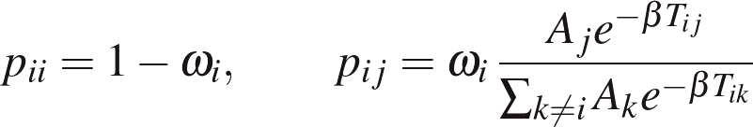
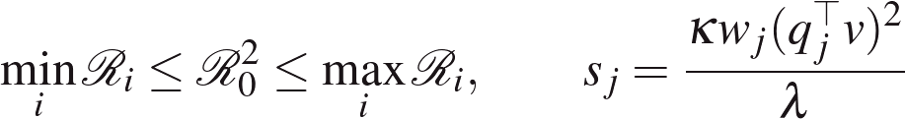
METHODOLOGY
METHODOLOGY
The Model
From where people spend the day to the reproduction number and the places that carry it.
Where residents spend the day
People present and mosquito density
Reproduction number
Bounds and place shares
Notes:
Explain each equation in one sentence: time away, people present, the two-generation matrix, the bounds, the shares.

Slide 19
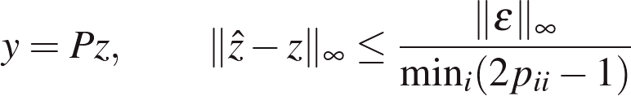

METHODOLOGY
METHODOLOGY
Control, Infection Places, Alarm
Three decision tools, each with a guarantee.
Least-cost vector control (convex)
Infections by place from cases by residence
Poisson CUSUM alarm
Season factor
Notes:
Explain the control program, the inversion with its error bound, the alarm, and the season factor.

Slide 20
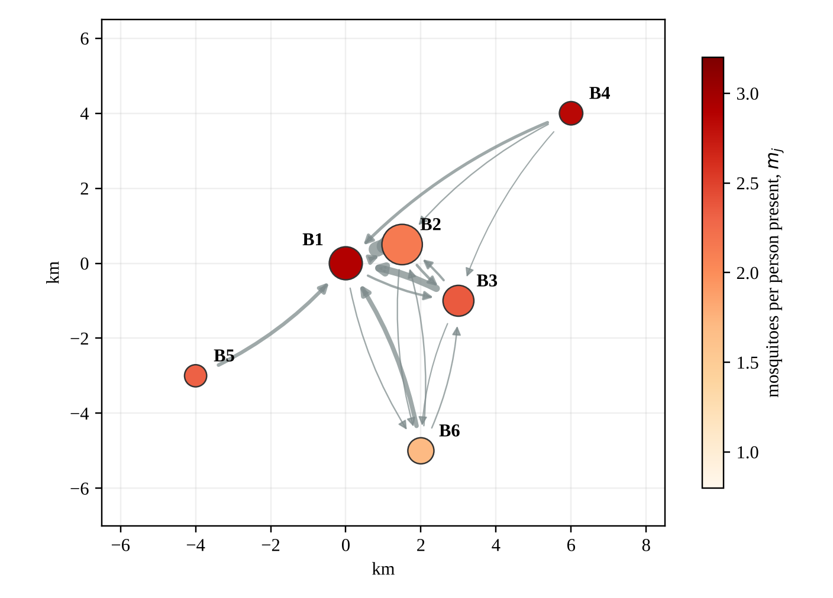
METHODOLOGY
METHODOLOGY
Test Network D1
Test network D1: a synthetic town of six barangays used to check every step (not Albay data).
Brgy | Description | Residents | Mosquitoes per resident | Share of day away | Team-days for full control
B1 | Poblacion: central school and public market | 4,000 | 5.3 | 0.20 | 19.52
B2 | Urban residential | 6,000 | 1.6 | 0.40 | 29.26
B3 | Peri-urban | 3,500 | 2.0 | 0.35 | 17.08
B4 | Rural upland | 2,000 | 2.3 | 0.25 | 9.76
B5 | Rural lowland (rice fields) | 1,800 | 1.8 | 0.30 | 8.78
B6 | Coastal | 2,500 | 1.4 | 0.30 | 12.20
Notes:
Introduce the six barangays; B1 has the central school and the public market.

Slide 21
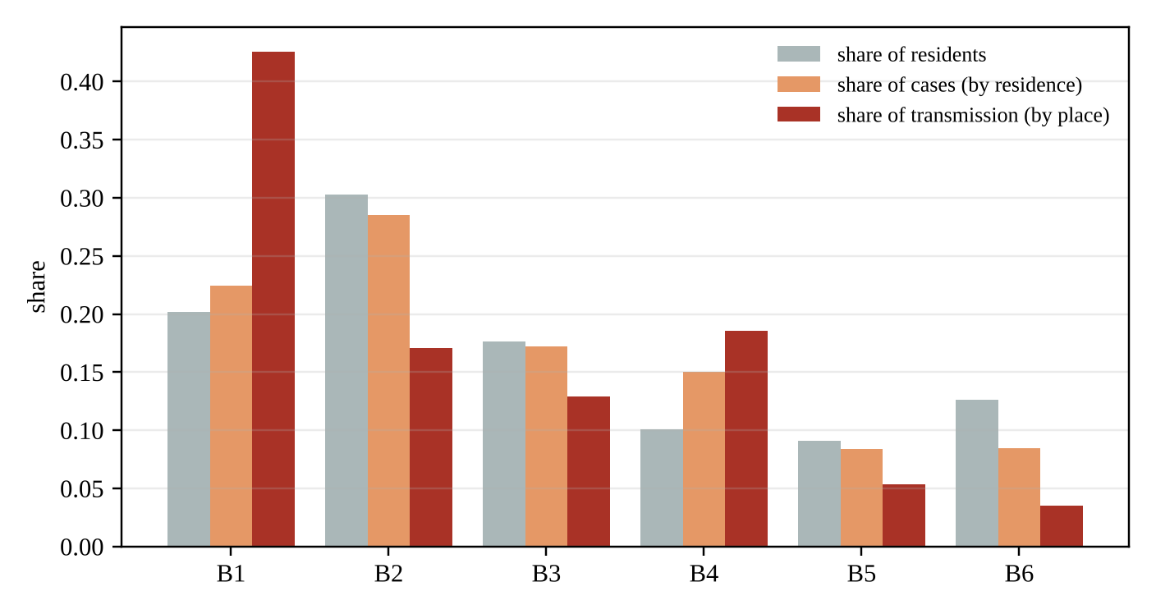
RESULTS AND DISCUSSION
RESULTS AND DISCUSSION
Where Transmission Happens
Homes point to B2, but 42.6% of transmission happens at B1, the school and the market (test network D1).
R0 = 1.214
network reproduction number
42.6%
of transmission at B1 (school + market)
28.5%
of cases filed at B2 (residential)
1.759
R0 of B1 if nobody moved
Notes:
Contrast the two percentage columns: cases by home versus transmission by place.

Slide 22
RESULTS AND DISCUSSION
RESULTS AND DISCUSSION
Least-Cost Vector Control
The certified least-cost plan needs 40% fewer team-days than spraying everywhere (test network D1).
Strategy | B1 | B2 | B3 | B4 | B5 | B6 | Team-days | R0 reached
Spray everywhere equally | 39% | 39% | 39% | 39% | 39% | 39% | 37.47 | 0.950
Spray where cases live | 46% | 59% | 35% | 31% | 17% | 17% | 38.88 | 0.950
Place-share heuristic | 69% | 28% | 21% | 30% | 9% | 6% | 29.54 | 0.950
Quick certificate (LP) | 80% | 5% | 21% | 40% | 22% | 0% | 26.49 | 0.924
Least cost (certified) | 80% | 0% | 11% | 39% | 16% | 0% | 22.60 | 0.950
Season factor and the team-days needed
factor 0.6: 0.0 · factor 0.8: 11.9 · factor 1.0: 22.6 · factor 1.2: 34.9 · factor 1.4: 44.3
Below a season factor of 0.68, dengue cannot take hold in D1; each rise of 0.2 adds about 10 to 12 team-days.
Notes:
Read the five strategies; the least-cost plan is cheapest and certified.

Slide 23
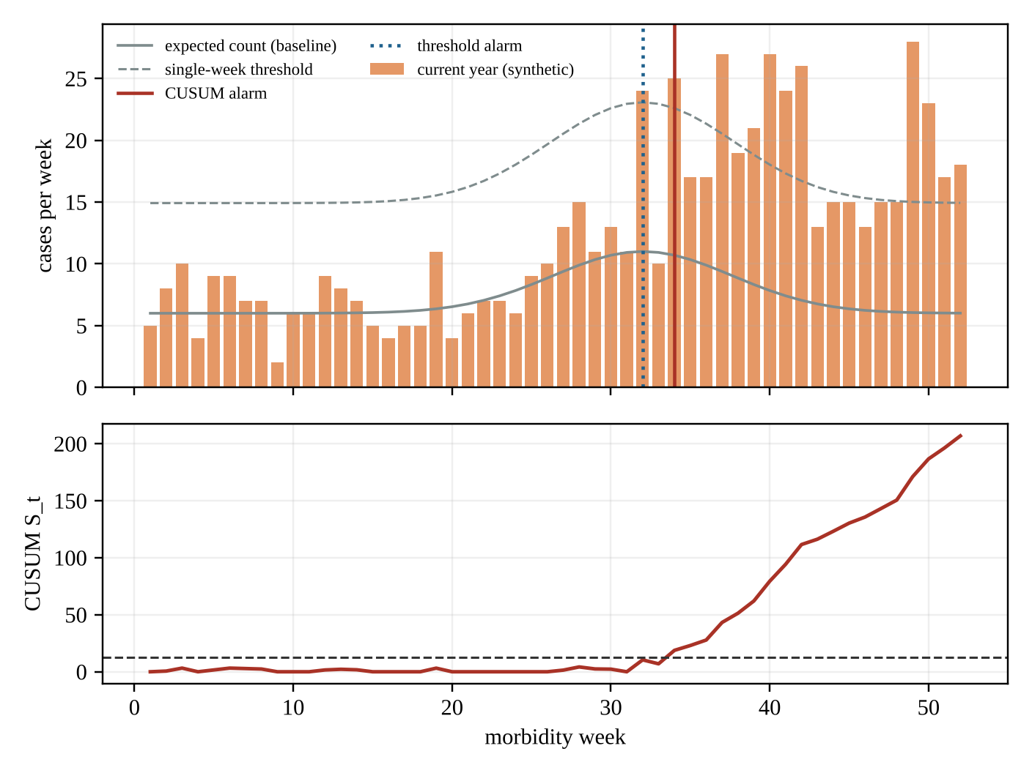
RESULTS AND DISCUSSION
RESULTS AND DISCUSSION
Infection Places and Early Warning
Cases by residence point to B2; the inversion points to B1. The CUSUM alarm warns 1.7 weeks sooner (test network D1).
Brgy | Cases by residence | Infections by place (truth) | Infections by place (inferred)
B1 | 76 | 138.8 | 151.0
B2 | 91 | 59.1 | 55.8
B3 | 53 | 43.9 | 40.0
B4 | 39 | 42.7 | 32.5
B5 | 24 | 19.3 | 15.5
B6 | 25 | 16.2 | 13.2
Mean weeks from outbreak start to alarm (5,000 simulated years, same 5% false-alarm rate)
CUSUM: 4.84 weeks (median 5) · single-week threshold: 6.52 weeks (median 7) · neither missed an outbreak
Notes:
Read the inversion table, then the alarm delays at the same 5% false-alarm rate.

Slide 24
RESULTS AND DISCUSSION
RESULTS AND DISCUSSION
Verification
Twelve propositions, each proven and then checked against independent code: no failures.
Property | Independent check | Result
Reproduction number (Prop. 1) | 300 networks vs numerical next-generation matrix | max difference 5.3e-15
Threshold (Prop. 2) | 300 Jacobians; 40 simulations | 300/300 and 40/40 agree
Bounds (Props. 4, 5) | 500 networks | 0 violations
Shares and gradient (Prop. 6) | 300 networks vs finite differences | gradient error 1.8e-09
Convexity (Prop. 7) | 6,000 pairs of plans | 0 violations
Least-cost control (Props. 8, 9) | 40 grid + 80 SLSQP cases | all consistent; gap ≤ 9.9e-08
Inversion (Prop. 11) | 300 exact + 400 noisy cases | closer to truth in 373 of 400
Alarm (Prop. 12) | 6 designs vs 20,000 runs; 10,000 sequences | all within 95%; 0 violations
Model solutions (Prop. 3) | 30 one-year simulations, RK4 | states ≥ 0; order 3.97
Notes:
Point to the result column: every check agreed.

Slide 25
CONCLUSIONS
CONCLUSIONS
What the Study Shows
Open data and routine case reports suffice to target dengue control by place, with guarantees.
Where it spreads
How much is enough
The reproduction number is a symmetric eigenvalue; place shares rank the true hotspots (B1 42.6% vs B2 by cases).
Least-cost control is a convex program; the certified plan used 22.60 team-days, 40% below uniform spraying.
Where people got infected
When to warn
Cases by residence can be traced to places with a proven error bound when residents stay home over half the day.
The CUSUM alarm warned 1.7 weeks sooner than a single-week rule at the same false-alarm rate.
Notes:
Summarize the four main findings.

Slide 26
RECOMMENDATIONS
RECOMMENDATIONS
Next Steps
From a verified model to a pilot with the Provincial Health Office.
Build the Albay instance
Ask about daily movement
Record where cases were by day
All 720 barangays with census, travel times, schools, markets and mosquito surveys.
A short school questionnaire to estimate where families spend the day.
One more line on the case form: where the patient spent most daytime hours.
Let parameters follow the weather
Pilot the brigade allocation
Release BANTA-Y
Temperature-dependent biting and survival; season factor from rainfall.
One municipality follows the least-cost plan for a season; compare with a neighbor.
The offline app for health offices and brigades, with the 4S checklist.
Notes:
Present the five next steps in order.

Slide 27
REFERENCES
REFERENCES
Key Sources
Key sources cited in this presentation; the full list is in the paper.
Bhatt, S., et al. (2013). The global distribution and burden of dengue. Nature, 496, 504-507.
Brook, D., & Evans, D. A. (1972). An approach to the probability distribution of CUSUM run length. Biometrika, 59, 539-549.
Cosner, C., et al. (2009). The effects of human movement on the persistence of vector-borne diseases. J. Theor. Biol., 258, 550-560.
Daily Tribune. (2026a-d). Albay dengue reports, September-October 2026.
Diekmann, O., Heesterbeek, J. A. P., & Metz, J. A. J. (1990). J. Math. Biol., 28, 365-382.
Horn, R. A., & Johnson, C. R. (2013). Matrix analysis (2nd ed.). Cambridge University Press.
Mordecai, E. A., et al. (2017). PLOS Neglected Tropical Diseases, 11(4), e0005568.
Page, E. S. (1954). Continuous inspection schemes. Biometrika, 41, 100-115.
Philippine Statistics Authority. (2021). 2020 Census of Population and Housing.
Smith, D. L., et al. (2012). Ross, Macdonald, and a theory for mosquito-transmitted pathogens. PLOS Pathogens, 8, e1002588.
Stoddard, S. T., et al. (2013). House-to-house human movement drives dengue virus transmission. PNAS, 110, 994-999.
United Nations General Assembly. (2015). Transforming our world: The 2030 Agenda (A/RES/70/1).
van den Driessche, P., & Watmough, J. (2002). Mathematical Biosciences, 180, 29-48.
Varah, J. M. (1975). Linear Algebra and Its Applications, 11, 3-5.
World Health Organization. (2012). Global strategy for dengue prevention and control 2012-2020.
Notes:
No need to read; show for completeness.

Slide 28
BANTA-Y
Say it like bantay (BAN-tai), the Filipino word for watch or guard
Where People Go, Dengue Goes: A Verified Mobility-Coupled Network Model for Ranking Dengue Hotspots, Issuing Early Warnings, and Allocating Vector Control at Least Cost in Albay
De Asis, Dave Justin Ll.
◆ LEAD RESEARCHER · FOUNDER OF THE BANTA-Y RESEARCH & APPLICATION ◆
Brimbuela, Peter John A. • Shin, Yeaseong
Research Adviser: Calleja, Dick Anthony M.
Legazpi City Science High School • Legazpi City, Albay • Mathematics and Computational Sciences, Team (MCS-T)
Notes:
Return to the title before questions.

Slide 29
QUESTIONS
& ANSWER
Notes:
Thank you for listening. We are happy to answer your questions.
Points to keep ready:
- Why a synthetic test network? The worked instance shows that the pipeline obeys its own rules; it is not an estimate for Albay. Verified inventories will replace it without any change to the mathematics.
- Why penalties instead of five separate programs? One minimum-cost flow with the penalties gives exactly the same plan (Proposition 3), and it matched five sequential linear programs in all 300 tests.
- Is 18 per classroom realistic? It follows the Sphere indicator of 3.5 square meters on a 63-square-meter DepEd classroom; the planned sweeps repeat everything at 4.5 square meters.
- Why not minimize classrooms exactly? That is an integer program; packing is provably within one room per school in use, and it was exact in 144 of 150 tests.
- Does the model order evacuations? No. It plans; the decision stays with the PDRRMO, APSEMO, DepEd, and the Provincial Government.

Slide 30
THANK YOU
Notes:
On behalf of the LIGTA-S team, thank you. Safe shelter for every family, and open schools for every learner.

