Slide 1



MAP - A
A Landmark-Anchored Timetable-Graph Model of Public Transport: Verified Computation of Accessibility, Its Inequality, and the Fare Matrix from Open Data, with Agent-Reported Hospital Bed Capacity for Ambulance and Patient Routing
De Asis, Dave Justin Ll.
Notes:
Cover. Keep it up while you are introduced.

Slide 2
Notes:
Blank slide. Keep it up until it is your turn.

Slide 3

NO SCHEDULES.
NO STOPS.
No way to know if the jeep can take you to the hospital in time.
This is public transportation in Albay today.
LEGAZPI CITY SCIENCE HIGH SCHOOL
MCS-T: DE ASIS
Notes:
Dave Justin Ll. De Asis | 0:00 to 0:39 (39 s)
(Cue: Walk to the center before speaking. Wait for full silence. Tell the story to the panel, not to the screen.)
Two in the morning, somewhere in Albay. A father carries his daughter, who can barely breathe, to the hospital his phone says is nearest. [pause] It has no free bed. [long pause] Worldwide, 4.6 billion people lack essential health services, and nearly four in ten city dwellers lack convenient public transport. In the Philippines, Metro Manila has had open route data since 2013. Albay never has. This August, a Legazpi councilor was still fielding questions on jeepney route structuring.

Slide 4
A MAP CAN SHOW YOU WHERE TO GO,
OUR MODEL SHOWS HOW TO GET THERE.
COVERING 18 LGUS ACROSS ALBAY
LEGAZPI CITY SCIENCE HIGH SCHOOL
MCS-T: DE ASIS
Notes:
Dave Justin Ll. De Asis | 0:39 to 1:00 (20 s)
(Cue: Read the line on the screen slowly, as if for the first time.)
Here, 1.37 million people ride routes no computer can read, at fares no one has mapped, toward hospitals whose free beds no one can see. [pause] A map can show you where to go. Our model shows how to get there.

Slide 5
MAP - A
A Landmark-Anchored Timetable-Graph Model of Public Transport: Verified Computation of Accessibility, Its Inequality, and the Fare Matrix from Open Data, with Agent-Reported Hospital Bed Capacity for Ambulance and Patient Routing
De Asis, Dave Justin Ll.
STEM 12 LAVOISIER
Mathematics and Computational Sciences (MCS)
Notes:
Dave Justin Ll. De Asis | 1:00 to 1:26 (26 s)
(Cue: Slow down for the title. Then greet the panel and introduce yourself.)
This is MAP - A: A Landmark-Anchored Timetable-Graph Model of Public Transport: Verified Computation of Accessibility, Its Inequality, and the Fare Matrix from Open Data, with Agent-Reported Hospital Bed Capacity for Ambulance and Patient Routing. [pause] Good morning, honorable panel. I am Dave Justin De Asis, a researcher from Legazpi City Science High School.

Slide 6
INTRODUCTION
Background of the Study
Table 1. The setting in figures
Most trips in Albay ride on jeepneys, tricycles, minibuses, and UV vans. None of them publishes its routes, schedules, or fares in a form a computer can read, so no one can forecast the time or the cost of a trip.
In an emergency, a map shows the nearest hospital. It does not show whether that hospital gives the level of care the patient needs or accepts what the family can pay.
Registers list licensed beds, not free ones. No one can see, in one place, which hospital in Albay can still admit a patient.
SDG targets 11.2 and 3.8 call for transport and health care that everyone can use (UNGA, 2015). Both are hard to track where routes seldom appear in official data (Klopp & Cavoli, 2019).
Indicator | Value | Source
Cities and municipalities in Albay | 18 | PSA (n.d.)
Barangays | 720 | PSA (n.d.)
Population, 2020 census | 1,374,768 | PSA (2021)
Land area | ≈ 2,575 km² | PhilAtlas (n.d.)
Urban residents with convenient access to public transport (412 cities, 2025) | 61.5% | UNSD (2026)
People without access to essential health services | 4.6 billion | WHO & World Bank (2025)
People facing financial hardship from health spending | 2.1 billion | WHO & World Bank (2025)
Purpose of the study. To find out whether open data and an ordinary laptop are enough to map Albay's public transport and forecast the fare of each trip, to route a patient by condition and ability to pay, and to track the bed capacity of every hospital in the province.
7
Notes:
Every figure here is public. No one has joined them into one network.

Slide 7
INTRODUCTION
The Three Main Points
MAP - A answers three questions with one model, built only from open data.
1
Transit Map and Fare Forecast
2
Patient Transport Map
3
Hospital Bed Capacity
Where can I go, how long will it take, and what will it cost?
Which hospital can take this patient, and how will the patient get there?
Does that hospital have a free bed right now?
Routes, stops, and headways of jeepneys, tricycles, minibuses, and UV vans as an open GTFS feed
Exact earliest arrival between landmarks
The fare of each trip at the LTFRB rates of September 28, 2026, with the 20% discount
A fare matrix between landmarks
Patient status (acuity 1 to 5) and payment class (0 to 3), entered by the crew or the user
Ambulance on the road network, or the patient on public transport and on foot
Nearest hospital with the right level of care, an emergency room when needed, and a bed
Cost never filters an emergency (RA 10932)
E-mail agents ask every hospital in Albay for its capacity and occupancy every 8 hours
Replies are checked against rules V1 to V5; forged replies are thrown away
Each hospital reads AVAILABLE, FULL, or UNKNOWN, always with the age of its report
A bed dashboard for the Provincial Health Office and the PDRRMO
Built on: OpenStreetMap, PSA census, LTFRB fare order
Built on: DOH hospital levels, Emergency Severity Index, PhilHealth and Malasakit lists
Built on: DOH facility registry, official hospital e-mail addresses, SMTP and IMAP
Supporting measure. On the transit map, the study also counts the essential landmarks each anchor reaches in 30 minutes and measures how unequal that access is (Gini, Theil, Lorenz, Palma).
8
Notes:
MAP - A stands on three points. [ pause ] A transit map that forecasts the time and the fare of every trip. A patient transport map that fits the hospital to the patient. And the bed capacity of every hospital in Albay.

Slide 8
RRL/RRS
Related Literature
Table 2. Related literature, grouped by the main point it supports
Point | Area | Key sources | Use in the present study
1 | Timetable routing | Dijkstra (1959); Pyrga et al. (2008); Delling et al. (2015); Dibbelt et al. (2018) | Earliest arrivals come from a label-setting search on a time-expanded graph.
1 | Regulated fares | Daguno-Bersamina (2026); Nieto (2026); RA 9994 (2010); RA 10754 (2016); RA 11314 (2019) | Fares follow the LTFRB rates of September 28, 2026, with the 20% discount for senior citizens, persons with disabilities, and students.
1 | Accessibility and its equity | Hansen (1959); Wachs & Kumagai (1973); Gini (1912); Theil (1967); Cobham & Sumner (2013); Lucas et al. (2016) | Landmarks reachable within 30 minutes are counted, then summarized with the weighted Gini, Theil, Lorenz, and Palma measures.
2 | Hospital care and payment | Gilboy et al. (2011); DOH (2012); RA 11223 (2019); RA 11463 (2019); RA 10932 (2017) | Hospitals are matched by acuity, level of care, free beds, and cost class. Cost is never a filter in an emergency.
3 | Software agents over e-mail | Wooldridge & Jennings (1995); Klensin (2008); Melnikov & Leiba (2021) | Agents ask each hospital for its bed count over SMTP and read the replies over IMAP.
Synthesis. The literature gives each point its method: exact routing and regulated fares for the transit map, DOH levels of care and RA 10932 for the patient, and software agents for the beds. It gives no data. Every measure assumes a transit feed, and none exists for Albay.
9
Notes:
The literature gives each point its method: exact routing and regulated fares, DOH care levels, and software agents.

Slide 9
RRL/RRS
Related Studies
Table 3. Related studies, the main point each informs, and their relation to the present study
Point | Study | What was done | Relation to the present study
1 | Williams et al. (2015) | Students logged Nairobi's matatu routes by phone and published the city's first GTFS feed. | Routes with no timetable can still become open data. Their work began in the field; this study begins with open registers.
1 | Saddier et al. (2016); Klopp & Cavoli (2019) | Mapped 315 trotro routes in Accra, and minibus routes in Maputo and Nairobi, using smartphones. | Same aim, same field-first method. That method needs time and people a student research team does not have.
1 | Narboneta & Teknomo (2015) | Built a multimodal route planner for Metro Manila on government GTFS data. | The closest Philippine example. Nothing like it exists for Albay.
1 | Delbosc & Currie (2011) | Measured how evenly transit supply is spread in Melbourne using Lorenz curves and the Gini coefficient. | Supports applying income-inequality measures to access.
1 | Owen & Levinson (2015); Stępniak et al. (2019) | Found that access figures shift with the departure time used. | Travel times here are averaged over 25 departures, 06:00 to 08:00.
2 | Brotcorne et al. (2003) | Reviewed models for locating and relocating ambulances. | Emergency research centers on the ambulance. This study looks at the hospital receiving the patient.
3 | Cabaro et al. (2023) | DOH DataCollect gathered bed counts from 1,906 facilities, 98% complete by December 2022. | Hospitals already report beds on a routine channel. The agent network relies on that habit.
Synthesis. Every transit dataset above started with fieldwork, and none tied a trip to a free hospital bed. This study tests how far open data can go before any fieldwork, and joins all three points in one model.
10
Notes:
Nairobi and Accra mapped their routes, but only after fieldwork, and none tied a trip to a free bed.

Slide 10
THEORETICAL/CONCEPTUAL FRAMEWORK PARADIGM
Theoretical Framework
Research gap, by main point
Theory or concept that addresses it
POINT 1
G1 No transit map and no fares
No machine-readable routes, stops, headways, or fares exist for any part of Albay. Access is judged by straight-line distance.
Time-expanded timetable graph and regulated fare model
Open registers become a GTFS feed. Dijkstra's (1959) search on the time-expanded graph (Pyrga et al., 2008) gives exact arrivals, and the LTFRB distance fare prices each leg. Access is then counted (Wachs & Kumagai, 1973) and tested for inequality (Gini, Theil).
POINT 2
G2 Routing that ignores the patient
A map sends every patient to the nearest hospital, whatever the patient's condition, the care offered, or what the family can pay. Some roads cannot take an ambulance.
Suitability rule and vehicle-class order
Acuity on the Emergency Severity Index (Gilboy et al., 2011) sets the minimum level of care (DOH, 2012), and cost filters only non-emergencies (RA 10932). Each vehicle class, the ambulance included, has its own road subgraph (Proposition 3).
POINT 3
G3 No live bed data
Registers list licensed beds, not free ones. The nearest hospital on a map may be unable to admit the patient.
Software agents over e-mail
Agents ask every hospital for its capacity and occupancy each 8-hour cycle (Wooldridge & Jennings, 1995). Validated replies give a bed status with its age, and a report lapses after 12 hours.
Figure 1. Research gaps under each main point (left) and the theories and concepts used to address them (right)
11
Notes:
Three gaps, one under each point, each met by a theory.

Slide 11
THEORETICAL/CONCEPTUAL FRAMEWORK PARADIGM
Conceptual Paradigm
INPUT
PROCESS
OUTPUT
OpenStreetMap roads and road limits
PSA 2020 census and PSGC codes
DOH facility registry and hospital levels
PhilHealth and Malasakit Center lists
DepEd school masterlist; PPA ports
LTFRB fares of September 28, 2026
Model parameters: 30-minute budget, 4.5 km/h walking, 10 vehicle classes
Build the road graph and the landmark set
Infer routes and headways; validate the GTFS feed
Compute earliest arrivals and fares between landmarks
Count landmarks within 30 minutes; measure inequality
Match hospitals to the patient: acuity, level of care, beds, payment
Collect bed reports through the e-mail agents
Prove the model's properties and verify the code
1 Transit map and fare forecast: open GTFS feed, travel times, and the fare matrix
2 Patient transport map: nearest suitable hospital by ambulance or public transport, and the payment gap
3 Hospital bed capacity: bed status of every hospital in Albay, with its report age
Also: accessibility atlas and inequality figures by anchor and municipality
Feedback: a field-verified feed can later replace the generated one
Figure 2. Conceptual paradigm of the study. The three outputs are the three main points.
12
Notes:
Public data go in, proven mathematics does the work, and the three points come out.

Slide 12
SIGNIFICANCE OF THE STUDY
Table 4. Beneficiaries of the study and the main point each one uses
Beneficiary | Point | What they gain
Commuters | 1 | Trip plans that give the arrival time and the fare, with the 20% discount for senior citizens, students, and persons with disabilities.
Local government units | 1 | Evidence for their Local Public Transport Route Plans. A proposed route can be tested on the model before a franchise is granted.
Ambulance crews and patients | 2 | The nearest hospital with the needed level of care and a free bed. In a critical case, an open emergency room on the way is not skipped.
Provincial Health Office and PDRRMO | 3 | A bed table by municipality during typhoons and Mayon alerts, and a map of where more public beds would cut travel time the most.
Hospitals | 3 | Reporting is a plain e-mail reply, at most two messages per cycle, and an opt-out is honored right away.
Future researchers | 1 to 3 | An open, tested dataset and code that a later field survey can plug into. The method can be repeated in other provinces.
The study supports SDG targets 11.2 (transport for all), 3.8 (health coverage), and 10.2 (reduced inequalities).
13
Notes:
Commuters gain the fare, ambulance crews the right hospital, and the health office a bed table in a typhoon.

Slide 13
OBJECTIVES OF THE STUDY / SOP
General objective. This study aims to find out whether a model of Albay's public transport, built only from open sources, can (1) map its routes and forecast the time and fare of each trip, measuring how many essential landmarks each anchor reaches within 30 minutes and how evenly that access is shared; (2) route a patient to the nearest hospital that suits the patient's condition and ability to pay; and (3) keep track of the bed capacity of every hospital in Albay.
Specifically, it seeks to answer the following questions, grouped here by main point:
1
Transit Map and Fare Forecast
2
Patient Transport Map
3
Hospital Bed Capacity
Can departure times be estimated from service headways, and can a time-expanded graph answer earliest-arrival queries exactly and quickly for all landmarks?
Is routing by arrival time, fare, and number of transfers still computationally feasible under the regulated fares?
Do the Gini, Theil, Lorenz, and Palma measures keep their expected properties on landmarks, and can the Theil index still separate inequality within and between municipalities?
How does the set of reachable places change when roads are filtered by width, clearance, gross mass, and axle load? Does routing stay consistent across vehicle classes, the ambulance included?
When patients are matched by acuity, level of care, bed status, and ability to pay, does the search find the nearest suitable hospital, and how does the choice change as urgency rises?
Can e-mail agents collect hospital bed status with few messages and fresh reports while discarding invalid replies?
Its limits are proved and simulated rather than tested as a hypothesis (Proposition 12).
14
Notes:
The objective joins the three points in one model; each of the six questions serves one of them.

Slide 14
HYPOTHESES
Model Hypotheses
These hypotheses are about the open-data model, not about field conditions. All of them were fixed before the Albay instance was run.
Code | Point | Hypothesis | Test or decision rule
M1 | 1 | Access to hospital beds is unequal, with a weighted Gini above 0.30 at the 30-minute baseline. | Supported if the 95% bootstrap interval lies wholly above 0.30
M2 | 1 | Anchors in urban centers have more access than rural anchors. | Mann–Whitney U test
M3 | 1 | Less than half of the Theil index comes from differences between municipalities. | Theil decomposition with a bootstrap interval
M4 | 2 | A larger vehicle class never reaches more of the road network than a smaller one. | Exact by Proposition 3; a violation means a road attribute is wrong
M5 | 1, 2 | M1 to M3, M6, and M7 hold for every anchor set and for budgets of 15, 30, and 45 minutes. | Robustness sweep
M6 | 2 | For a stable patient who needs free care (acuity 3, payment class 0), the payment gap is larger at rural anchors. | Mann–Whitney U test
M7 | 2 | For high-risk patients (acuity 2), more than half of the anchor weight has a nearest hospital that fails the capability test. | Supported if the 95% bootstrap interval lies wholly above 0.5
M8 | 2 | For emergency patients (acuity 1 and 2), the payment gap is zero at every anchor. | Exact by Corollary 11; a non-zero value means a coding error
All tests use alpha = 0.05 with Holm's correction. Point 3 has no statistical hypothesis: the agents' limits are proved (Proposition 12) and checked in a 30-day simulation.
15
Notes:
Eight hypotheses were fixed before the Albay instance ran. Two are exact by proof; if either fails, the error is in the code.

Slide 15
SCOPE AND DELIMITATION
Scope
Delimitation
All 18 LGUs in Albay's three legislative districts; landmarks as units of analysis
Point 1: jeepneys, tricycles, minibuses, UV vans, and walking; weekday and Saturday departures from 06:00 to 08:00; LTFRB fares; 30-minute baseline
Point 2: ten vehicle classes, including a van-type ambulance; five acuity levels and four payment classes
Point 3: capacity and occupancy of every hospital and infirmary in the registers, by e-mail
Computational only; no field survey and no human participants
No hospital is contacted; the agents run on a mock mail server
Barangays only weight the anchors and get no score of their own
Trips end at the provincial border
Typhoon and Mayon disruptions, traffic, and dispatch delays are not modeled
Hospital mode does not triage; the crew or user enters the acuity
Table 5. Study area by legislative district (PSA, 2021; PhilAtlas, n.d.)
District | Local government units | Population (2020) | Land area (km²)
First | Tabaco City, Bacacay, Malilipot, Malinao, Santo Domingo, Tiwi | 395,907 | 547.88
Second | Camalig, Daraga, Legazpi City, Manito, Rapu-Rapu | 477,781 | 673.85
Third | Guinobatan, Jovellar, Libon, Ligao City, Oas, Pio Duran, Polangui | 501,080 | 1,353.18
Total | 18 LGUs | 1,374,768 | 2,574.91
16
Notes:
All 18 LGUs. No field data, by design: a model must be built and verified before the field can test it.

Slide 16
METHODOLOGY
Research Design
This is a quantitative study built on computational modeling. No field data were collected. The model is formulated first, its properties are then proved, the software is checked against independent code, and the experiments are run last, on the open-data instance of Albay.
1. Formulate the model
2. Prove its properties
3. Verify the software
4. Run the experiments
Table 6. Variables of the study
Independent (varied) | Dependent (measured) | Controlled (held fixed)
Travel-time budget (15, 30, 45 min) Departure time (06:00 to 08:00) Headway changes (±25%, ±50%) Vehicle class (10 classes) Anchor set (3 versions) Acuity level and payment class | Earliest arrival and door-to-door time Fare and number of transfers Landmarks reachable in 30 minutes Gini, Theil, Lorenz, and Palma values Nearest suitable hospital and its travel time Payment gap and free-bed access | Walking speed of 4.5 km/h Walking leg of at most 15 minutes Minimum transfer time LTFRB fares and the 20% discount Report age limit of 12 hours Inquiry cycle of 8 hours
Where the numbers come from. Every value in the study is either taken from a public register, derived from one by a stated rule, declared as a model parameter, or generated synthetically for testing. Synthetic values are always labeled as such.
17
Notes:
Formulate, prove, verify, and only then experiment.

Slide 17
METHODOLOGY
Population and Sample
The study has no human respondents. Its population is every named public landmark in Albay that appears in at least one open register and meets the inclusion criteria. All qualifying landmarks are used, so there is no random sampling. Each anchor is weighted by the 2020 census population of the barangays nearest to it by road (PSA, 2021).
Table 7. Landmark classes, their role, and their source registers
Inclusion criteria
Landmark class | Role | Open register
Public transport terminal | Anchor | OpenStreetMap; LGU route plans
Municipal or city hall | Anchor | OpenStreetMap; PSGC
Town plaza, port, or pier | Anchor | OpenStreetMap; PPA port list
Major boarding junction | Anchor | OpenStreetMap junction nodes
Hospital, infirmary, or RHU | Destination | DOH registry; PhilHealth list; Malasakit directory
Public elementary or secondary school | Destination | DepEd Masterlist of Schools
Government service office | Destination | OpenStreetMap; agency directories
Public market | Both | OpenStreetMap; LGU lists
Designated evacuation center | Destination | LGU disaster risk reduction plans
Listed in an open register under a name residents know
Published location within 150 m of a road node
Currently operating, not closed or proposed
Has a size (beds, classrooms, windows) or counts as one
Exclusions
Private schools go to a separate layer. Records of one place within 50 m are merged and logged. A landmark more than 150 m from a road is dropped, never moved.
18
Notes:
The population is not people. It is every named public landmark in Albay.

Slide 18
METHODOLOGY
Data Gathering Tools
Data sources
Software and equipment
Validity and reliability
OpenStreetMap roads, road limits, and junctions
PSA 2020 census and PSGC
DOH National Health Facility Registry
DOH hospital licensing records
PhilHealth list of accredited hospitals
DOH Malasakit Center directory
DepEd Masterlist of Schools
Philippine Ports Authority port list
LTFRB fare order (September 28, 2026)
Routing engine in Python (label-setting search)
GTFS Schedule Validator by MobilityData
E-mail agents using SMTP and IMAP on a mock mail server
verify_hospital_mode.py, run with a fixed seed
MAP - A web application: transit map, hospital mode, and bed dashboard
One consumer laptop, single core, no server
Each result used in the analysis has a written proof, 12 in all (9 propositions, 3 corollaries).
The engine was checked against code that shares nothing with it: exhaustive enumeration, Floyd–Warshall, and a topological sweep.
1,018 of 1,018 random queries matched exhaustive enumeration.
5,200 of 5,200 hospital-mode queries matched the reference code.
The GTFS feed must pass the validator with no blocking errors.
A fixed seed and archived checksums let anyone reproduce every number.
19
Notes:
One laptop, no server, and every result checked against independent code.

Slide 19
METHODOLOGY
Data Gathering Procedure
Stage 1
Points 1, 2
Stage 2
Points 1, 2
Stage 3
Point 1
Stage 4
Point 1
Road network
Landmarks
GTFS feed
Graph and queries
OpenStreetMap roads are extracted with width, clearance, mass, and axle-load limits. Missing limits are set to +∞ and flagged.
Registers are combined and duplicates removed. Each landmark is snapped to a road node within 150 m; one that fails is dropped, not moved.
Stops, routes, trips, headways, fares, and shapes are generated. The feed must pass the GTFS validator.
The time-expanded graph is built with walking links. Earliest arrivals and fares are computed for every anchor, destination, and departure time.
Stage 5
Point 3
Point 1
Stage 6
Point 2
Stage 7
Stage 8
All points
Access and inequality
Hospital layer
Bed tracking
Prototype
Landmarks within 30 minutes are counted for each anchor. The Gini, Theil, Lorenz, and Palma values follow.
Each hospital gets its level, ER flag, ownership, PhilHealth and Malasakit status, and a cost class from 0 to 3.
The agents send inquiries, read replies, and check them against rules V1 to V5. This runs only on a simulated mail server.
Transit map and fares, hospital mode, and the bed dashboard are put together in one web application.
Figure 3. Data gathering procedure and the main point each stage serves. Stages 6 and 7 (dashed) belong to the hospital extension.
20
Notes:
Eight stages, each tagged with the point it serves.

Slide 20

METHODOLOGY
Model equations, by main point
Statistical treatment
 | Pt. | Question | Test or estimator
S1 | 1 | Is access more unequal than resampling noise? | Weighted Gini, 95% bootstrap interval (2,000 resamples)
S2 | 1 | Do urban and rural anchors differ in access? | Mann–Whitney U, rank-biserial correlation
S3 | 1 | Is the inequality local or structural? | Theil decomposition, bootstrap interval
S4 | 1 | Does access follow settlement density? | Spearman rank correlation
S5 | 1 | How much does the anchor set matter? | Discrete Fréchet distance between Lorenz curves
S6 | 1 | How much do the headway assumptions matter? | Headways changed by ±25% and ±50%
S7 | 2 | Do urban and rural anchors differ in payment gap? | Mann–Whitney U, rank-biserial correlation
S8 | 2 | How often is the plain-nearest hospital unsuitable? | Weighted share, 95% bootstrap interval
POINT 1 Fare of a journey
Each leg pays a base fare f0 for the first d0 km and r per km after. Traditional jeepney: PHP 14.00 for 4 km, then PHP 2.00 per km; discounted fare = 0.8 f(d).
POINT 1 Cumulative accessibility
Landmarks of type k that anchor a reaches within the budget, with travel time averaged over 25 departures from 06:00 to 08:00.
POINT 2 Suitable hospital
A hospital suits the patient only if it has the needed level of care, an emergency room when needed, is not reported FULL, and fits the payment class. Cost is waived in an emergency.
POINT 3 Free beds and report age
From the latest validated report. Status is UNKNOWN with no report or one older than 12 hours, FULL with no free bed or a full emergency room, and AVAILABLE otherwise.
All tests use alpha = 0.05 with Holm's correction, and effect sizes are reported. A result is called robust only if it holds in every sensitivity run.
21
Notes:
One equation per point: the fare of a journey, the fit of a hospital, and its free beds.

Slide 21
METHODOLOGY
Ethical Considerations
The study is computational. There are no human participants, no survey or interview, and no fieldwork.
No hospital was contacted. The e-mail agents were tested only on a mock mail server with made-up hospitals, and no message left the test computer.
Before any real use, the Scientific Review Committee must approve the protocol and the inquiry message. The Provincial Health Office will be informed, and hospitals must opt in.
Only total bed counts are asked for. No patient information is requested or stored, in line with the Data Privacy Act of 2012 (RA 10173).
All sources are used under their published terms. OpenStreetMap data are credited under the Open Database License.
No data were fabricated. Every synthetic result is labeled as a model output and kept apart from real data.
Hospital mode is a routing aid, not a medical device. It does not triage, it keeps a one-tap 911 button (EO 56, s. 2018), and it never filters by cost in an emergency (RA 10932).
22
Notes:
No person is studied, and no hospital is contacted until it opts in.

Slide 22
CONCLUSION
Without a field survey, open data are enough to define, prove, and compute all three points of MAP - A.
1
Transit Map and Fare Forecast
2
Patient Transport Map
3
Hospital Bed Capacity
1,018 of 1,018 test queries matched exhaustive enumeration. Arrival times are exact (Proposition 1).
All 1,000 fare splits were subadditive, so the router offers a set of best trips by time, fare, and transfers.
47.5% of reachable queries ran late, by 32.5 min on average, under a single-pass shortcut. Only verification catches it.
5,200 of 5,200 hospital queries matched the reference, settling about 1 in 20 vertices of a 16,000-vertex graph (Proposition 9).
Zero payment gap in every emergency, and never a negative one (Proposition 10, Corollary 11; RA 10932).
5 of 6 anchors in test network S1 had a full nearest hospital, where a distance-only router would have sent the patient.
At most 2 messages per cycle, an immediate stop on opt-out, and reports no older than 10 hours, held over a 30-day simulation (Proposition 12).
0 of 200 forged replies passed the validator.
Ready. The bed dashboard lists every licensed facility in Albay. Live reports begin after review-committee approval and hospital opt-in.
For Albay, open data now support SDG targets 11.2, 3.8, and 10.2. Field validation is the next step.
23
Notes:
Dave Justin Ll. De Asis | 3:42 to 4:08 (26 s)
(Cue: Five beats. Count One, Two, Three on your fingers, as on slide 8. Pause before the last line.)
ANSWER (3:42 to 3:46): Is open data enough? Yes, for all three points.
POINT 1, Transit map (3:46 to 3:50): One: the transit map is exact, 1,018 of 1,018.
POINT 2, Patient map (3:50 to 4:00): Two: the patient search is exact, 5,200 of 5,200. In the test network, five of six starting points had a full nearest hospital.
POINT 3, Hospital beds (4:00 to 4:05): Three: not one of 200 forged bed reports got through.
NEXT STEP, Field validation (4:05 to 4:08): [pause] Field validation comes next.

Slide 23
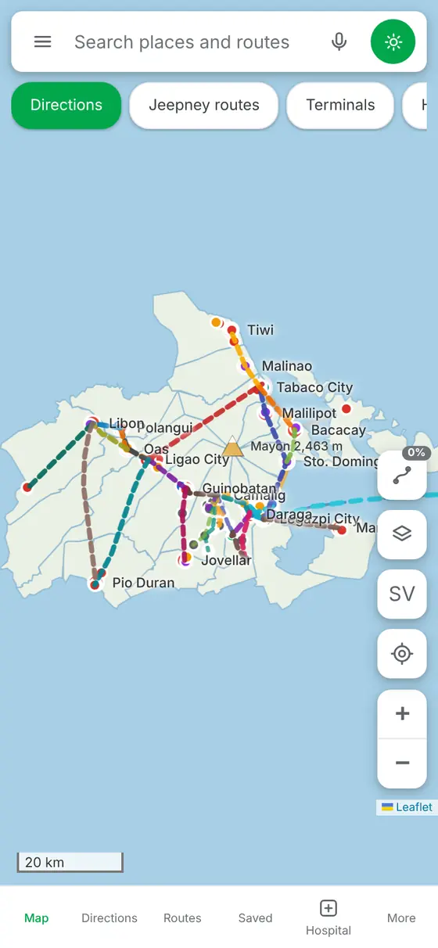
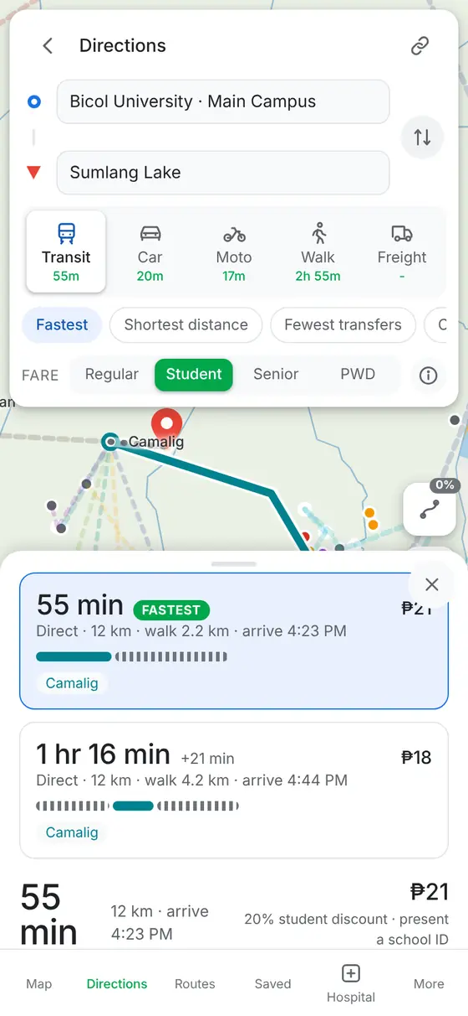
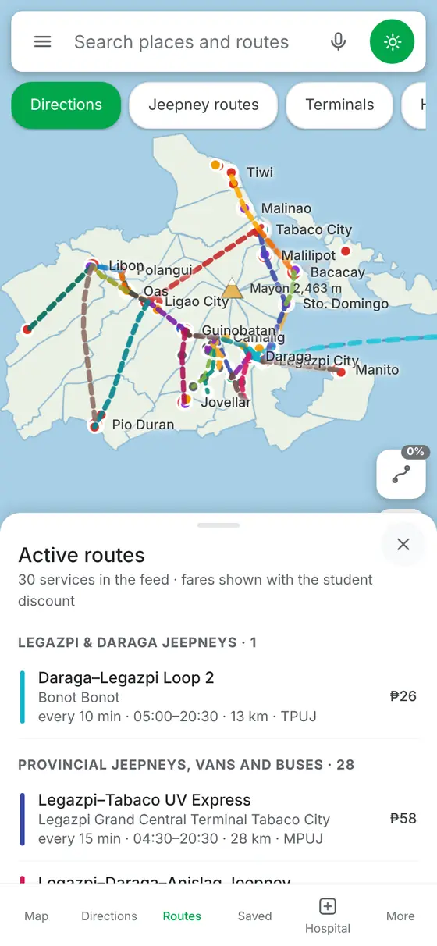
PROTOTYPE
Point 1: Transit Map and Fare Forecast
POINT 1
A trip and its fare
Bicol University to Sumlang Lake: travel time, walking, and the fare, here with the 20% student discount.
POINT 1
The network
The modelled jeepney, van, and bus lines of Albay on one map.
POINT 1
Every service
Each modelled service with its headway, hours, and fare.
Screens from the MAP - A prototype. Routes and headways are modelled from open data and await field verification.
24
Notes:
This is the prototype. Ask for a trip, and it returns the time and the fare.

Slide 24
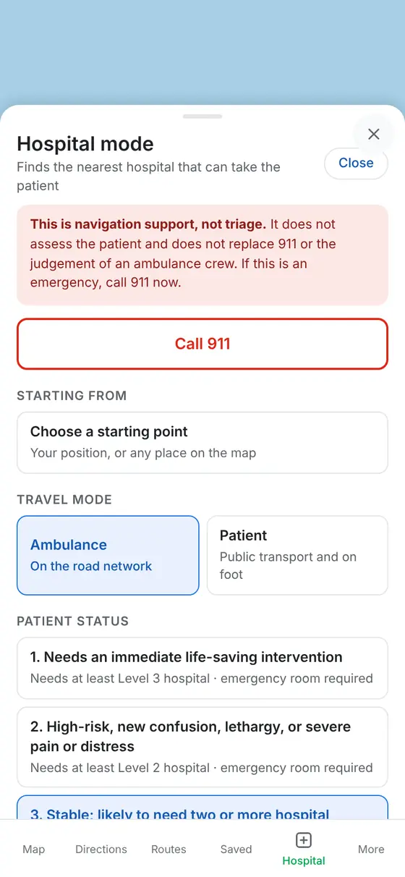
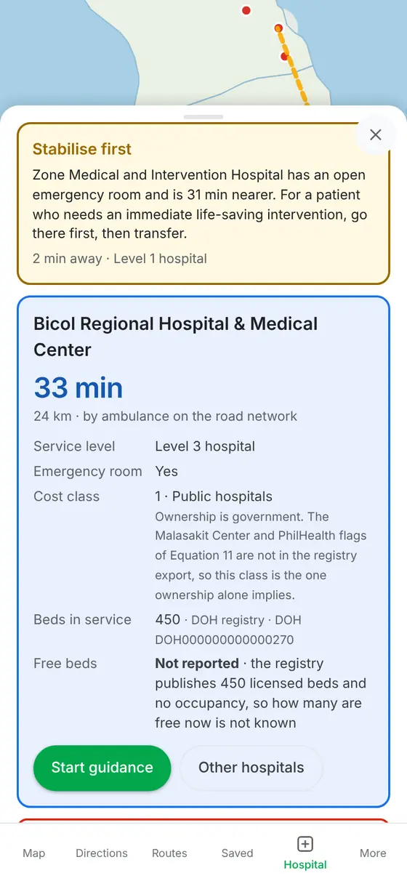
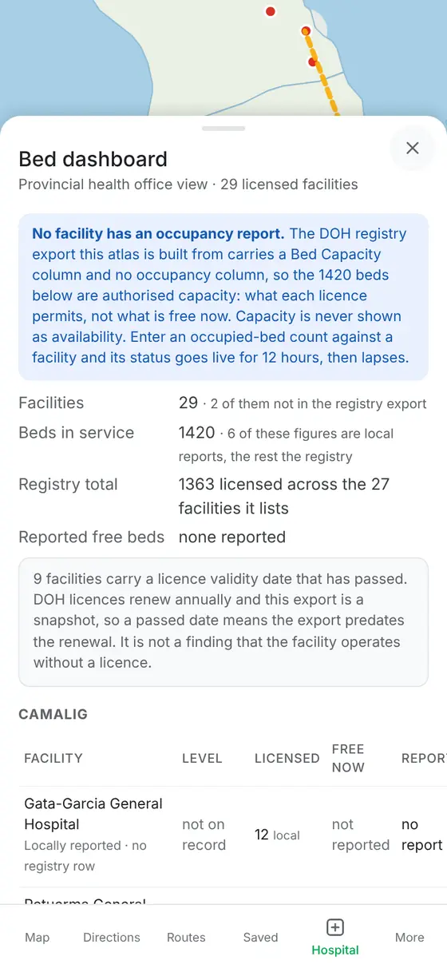
PROTOTYPE
Points 2 and 3: Patient Map and Beds
POINT 2
The hospital that can take the patient
A life-saving case is first sent to a nearer open emergency room, then to a Level 3 hospital, with its cost class and bed status.
POINT 3
Bed dashboard
Every licensed facility in Albay with its licensed beds. Free beds read “not reported” until hospitals answer the agents.
POINT 2
Hospital mode
The crew or user sets the patient's status and the travel mode. The app does not triage, and Call 911 stays on top.
Screens from the MAP - A prototype. No hospital has been contacted yet, so no free-bed figure is shown.
25
Notes:
Hospital mode reads the patient's condition and names the hospital that can take them. The bed dashboard lists every licensed facility in Albay.

Slide 25
MAP - A
A Landmark-Anchored Timetable-Graph Model of Public Transport: Verified Computation of Accessibility, Its Inequality, and the Fare Matrix from Open Data, with Agent-Reported Hospital Bed Capacity for Ambulance and Patient Routing
De Asis, Dave Justin Ll.
Notes:
Back to that father. [ pause ] MAP - A will not add one bed to Albay. But once hospitals report, it will tell him which one has a free bed and the right care. [ pause ] Distance tells you where the hospital is. Access tells you whether it can help in time. [ long pause ] Thank you. I welcome your questions.

Slide 26
QUESTIONS
& ANSWERS
Notes:
Dave Justin Ll. De Asis | 4:28 to 4:59 (31 s)
(Cue: Step forward. Slower. Hold eye contact through the last two lines.)
Back to that father. [pause] MAP - A will not add one bed to Albay. But once hospitals report, it will tell him which one has a free bed and the right care. [pause] Distance tells you where the hospital is. Access tells you whether it can help in time. [long pause] Thank you. I welcome your questions.

Slide 27

THANK YOU
Notes:
Advance here after the last question.

