Slide 1

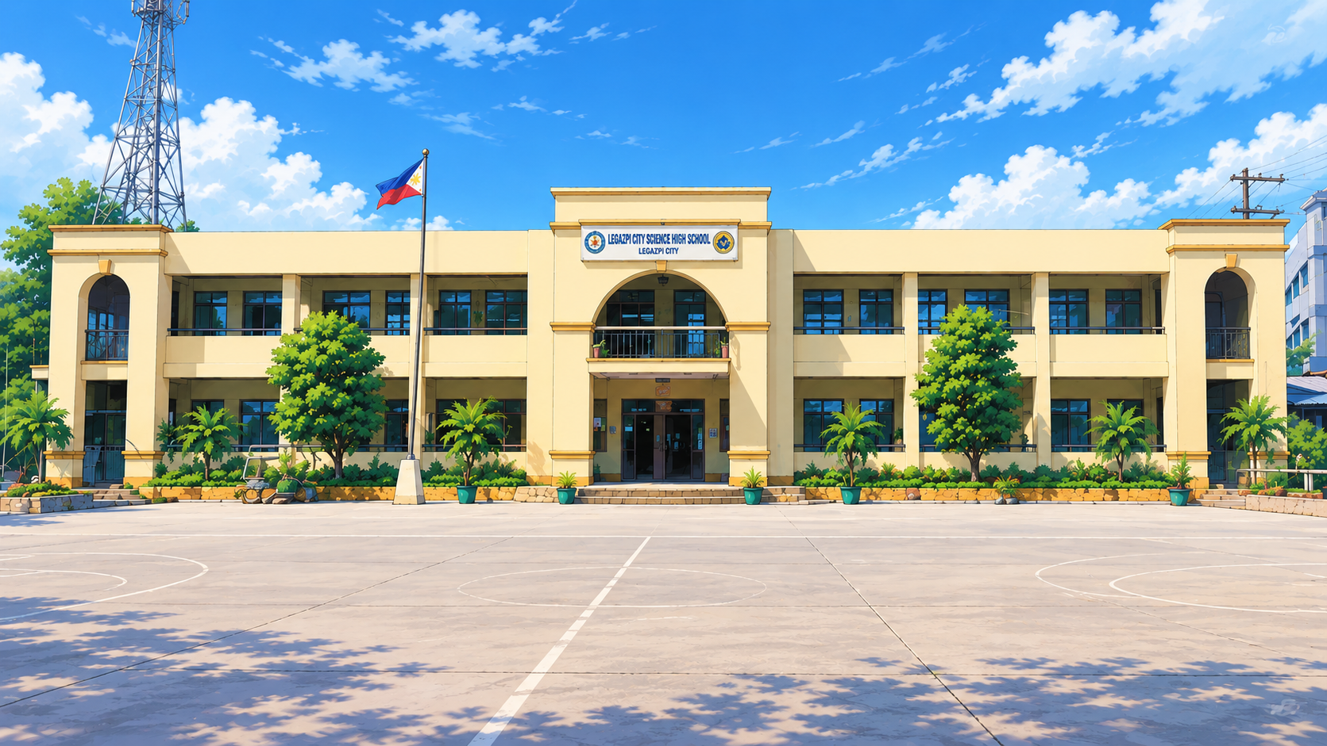

SENYAS: An Offline Intelligent System for Trilingual Sign Language and Braille Translation Using a Kinematic Hand Model, Landmark Geometry, and Braille Grid Fitting
[Surname, Firstname M.]
[Surname, Firstname M.]
[Surname, Firstname M.]

Slide 2
INTRODUCTION
Background of the Study
Table 1. The problem in figures
• RA 11106 (2018) made Filipino Sign Language the national sign language of the Filipino Deaf, but interpreters are rarely present.
• Most translation apps work in English, few in Filipino, almost none in Bikol, and they need the internet.
• Disasters in Albay (Mayon, typhoons, earthquakes) cut mobile data exactly when people must communicate.
• Deep sign recognisers need large video datasets that FSL does not have; braille readers assume scanners.
Indicator | Value | Source
People needing hearing care | > 430 million | WHO (2021)
People with vision impairment | ≥ 2.2 billion | WHO (2019)
National sign language | FSL | RA 11106 (2018)
Languages of Albay homes | Bikol, Filipino, English | —
Offline FSL + braille app in Bikol | none found | Review, Ch. 2
Purpose of the study. To build and test SENYAS, an offline intelligent system that translates between sign language, braille, text and speech in English, Filipino and Bikol.
2

Slide 3
RRL/RRS
Related Literature
Table 2. Related literature and how the study uses it
Area | Key sources | Use in the present study
Sign language structure | Stokoe (1960); RA 11106 (2018) | Handshape, location and movement guide the recogniser
Hand tracking | Lugaresi et al. (2019); Zhang et al. (2020) | 21 landmarks per hand, on the device
Robot kinematics | Craig (2005); Aristidou & Lasenby (2011) | Hand model and FABRIK thumb; avatar arms
Pattern recognition | Cover & Hart (1967); Sakoe & Chiba (1978); Schmitt (1938) | Nearest neighbour, DTW, hysteresis
Braille and images | ICEB (2013); Crow (1984); Viola & Jones (2001) | Grade 1 decoding; fast local contrast
Accessible software | W3C (2018); ISO/IEC 25010 (2011); CAST (2018) | Contrast, reflow, quality model, UDL lessons
Synthesis. Phones can track hands offline, and kinematics and geometry can describe hands and braille cells, so examples can be generated instead of collected.
3

Slide 4
RRL/RRS
Related Studies
Table 3. Related studies and their relation to the present study
Study | What was done | Relation to the present study
Cabalfin et al. (2012) | FSL recognition from video (manifold learning) | FSL can be recognised; SENYAS adds offline, Bikol, braille
Koller (2020); Rastgoo et al. (2021) | Surveys: deep, data-hungry methods | Motivates a geometric method without big data
Mitra & Acharya (2007) | Survey of gesture recognition | Separate handshape from movement
Antonacopoulos & Bridson (2004) | Braille from scanned pages | SENYAS reads phone photos and live video
Isayed & Tahboub (2015) | Review of optical braille recognition | Grid fitting and skew are the key steps
Synthesis. No free tool joins sign, braille, text and speech offline in English, Filipino and Bikol; the gap is an explainable, offline intelligent system.
4

Slide 5
THEORETICAL/CONCEPTUAL FRAMEWORK PARADIGM
Theoretical Framework
Research gap
Theory or method that addresses it
G1 No FSL dataset
Robot-hand kinematics generates labelled handshapes (FK, FABRIK).
G2 Hands vary in place, size, angle
Palm-frame coordinates are invariant to translation, scale, rotation.
G3 Signs move at different speeds
Hysteresis counting, winding number, dynamic time warping.
G4 Braille photos are skewed and noisy
Summed-area contrast, robust pitch and skew, grid fitting.
Figure 1. Research gaps (left) and the theories and methods used to address them (right)
5

Slide 6
THEORETICAL/CONCEPTUAL FRAMEWORK PARADIGM
Conceptual Paradigm
INPUT
PROCESS
OUTPUT
• Camera frames of hands
• Braille photos or frames
• Typed or spoken text (EN, FIL, BIK)
• Kinematic hand model
• Trilingual lexicon (93 words, 32 phrases)
1. MediaPipe 21-point landmarks
2. Palm-frame features + nearest template
3. Motion rules, two-hand rules, DTW
4. Braille dots → grid fit → Grade 1 decode
5. Longest-match phrase lookup
6. Nine computational experiments
• SENYAS app, website, Android app
• Text + Read aloud (on/off)
• Signing avatar + braille line
• Accuracy, CER, speed, layout results
Feedback: results guide a field validation with Deaf and blind learners
Figure 2. Conceptual paradigm of the study
6

Slide 7
SIGNIFICANCE OF THE STUDY
Deaf and hard-of-hearing learners. Their signing becomes spoken Filipino, English or Bikol, free and offline.
Blind and low-vision persons. Braille labels and notices are read aloud from a photo.
Teachers, SPED centres, families. Lessons, quizzes and camera practice in the home language.
Responders and health workers. An emergency phrasebook that works with no signal.
LGUs and DepEd. A free tool that supports RA 11106 and RA 7277.
Future researchers. An explainable method and open, repeatable benchmarks.
The study supports SDG 4 (inclusive education), SDG 10 (reduced inequalities) and SDG 11.5 (disaster resilience).
7

Slide 8
OBJECTIVES OF THE STUDY / SOP
General objective. To design, develop and evaluate SENYAS, an offline intelligent system for trilingual sign language and braille translation with a learning module.
Specifically, it seeks to answer the following questions:
1. How accurately are the 24 static letters classified as pose noise rises, and which design parts matter?
2. How reliably are 13 moving and 6 two-handed signs detected, with what false-alarm rate?
3. How accurately are fingerspelled words read across hold times and signer speeds?
4. How reliably are user-taught signs recognised, and how often are others falsely accepted?
5. How accurately are braille photos read across dot type, skew, blur and size?
6. How long does each component take per frame?
7. Does the interface fit all screens with readable contrast, and does the lexicon cover the phrasebook?
8

Slide 9
HYPOTHESES
Null Hypotheses
The hypotheses were stated before testing and are tested at the 0.05 level of significance.
Code | Hypothesis | Test or decision rule
H₀1 | Static-letter accuracy at expected noise is at most 90%. | One-sided exact binomial test
H₀2 | Detection of moving and two-handed signs is at most 90%. | One-sided exact binomial test
H₀3 | Fingerspelled-word accuracy at the default hold time is at most 80%. | One-sided exact binomial test
H₀4 | The braille character error rate is at least 20%. | Bound comparison; Wilson CI
H₀5 | Processing time per frame exceeds 100 ms. | Median latency
H₀6 | The interface has layout faults on at least one screen size. | Automated layout test
Reject H₀ when p < 0.05 (or when the measured value is beyond the bound).
9

Slide 10
SCOPE AND DELIMITATION
Scope
Delimitation
• Alphabet A–Z with Ñ, numbers 0–10, 21 live signs
• 93 words, 32 phrases in EN, FIL, BIK
• User-taught signs; Grade 1 braille with Ñ
• Web, installable and Android apps
• No full FSL sentences or facial grammar
• No Grade 2 braille
• No tests with human participants in this phase
• Results from generated data (repeatable)
Table 4. Validation experiments of SENYAS
Experiment | Data | Measure
E1–E2 Static letters | 24 letters × 40 hands × 4 noise levels; ablation | Accuracy
E3–E5 Moving, words, taught | 19 signs × 30; 40 words × 9 settings; 4 taught signs | Detection, word accuracy
E6–E9 Braille, camera, speed, screens | 300 photos; 288 renders; 11 screen sizes | CER, ms, layout faults
10

Slide 11
METHODOLOGY
Research Design
A developmental engineering-design study (Hevner et al., 2004). SENYAS is designed from kinematic and geometric models, built as working software, and evaluated with nine repeatable computational experiments.
1. Model
2. Build
3. Benchmark
4. Analyse
Table 5. Variables of the study
Independent (varied) | Dependent (measured) | Controlled (fixed)
Pose noise level; sign; hold time and signer speed | Accuracy; detection and false-alarm rates | Hand model and templates; random seed
Braille dot type, skew, blur, size | Word accuracy; character error rate | Frame rate 30 fps; image size
Screen size | Time per frame; layout faults; contrast | Same code as the shipped app
11

Slide 12

METHODOLOGY
Materials and Device
Table 6. Materials and components
System specification
Item | Specification | Purpose
Computer | x86-64, Linux, CPU only | Build and test
Chromium + Playwright | Headless browser | App, MediaPipe, braille, layout tests
Node.js 22 | JavaScript runtime | Recogniser tests
MediaPipe 0.10.14 | Float16 hand model | Landmarks
HTML/CSS/JS | No framework | App and website
Kotlin WebView | Android 7+ | Android app
Python 3 | Matplotlib, docx | Analysis, reports
• Input: phone or laptop camera, microphone, keyboard, photos
• Engine: MediaPipe Hand Landmarker (on device)
• Recogniser: 572 templates × 41 features
• Braille reader: grid fitting, Grade 1 + Ñ
• Output: text in EN/FIL/BIK, Read aloud, avatar, braille
• App: 190 KB page + 17 MB offline engine; Android app
12

Slide 13
METHODOLOGY
Data Gathering Procedure
Step 1
Step 2
Step 3
Step 4
Step 5
Define 37 handshapes with the hand model
Generate 572 templates
Build app, website, Android app
E1 static letters (3,840 hands)
E2 ablation (5 designs)
Step 6
Step 7
Step 8
Step 9
Step 10
E3 moving and two-handed signs
E4 fingerspelled words
E5 taught signs
E6 braille photos (300)
E7–E9 camera, speed, screens
Figure 3. Data gathering procedure (fixed random seeds, so every run can be repeated)
13

Slide 14
METHODOLOGY
Treatment of Data
Formulas
Statistical treatment
Accuracy = correct ÷ trials
Wilson CI: (p̂ + z²/2n ± z√(p̂(1−p̂)/n + z²/4n²)) ÷ (1 + z²/n)
Binomial test: p = P(X ≥ k | n, p₀)
CER = Σ Levenshtein(read, true) ÷ Σ length(true)
Palm frame: Y = (p₉−p₀)/s, Z = (p₅−p₁₇)×Y, X = Y×Z
Grid fit: min over P, x₀ of Σ min(|u−kP|, |u−δ−k′P|)
SOP | Question | Tool
1 | Static-letter accuracy; ablation | Accuracy, Wilson CI, binomial
2 | Moving and two-handed signs | Detection rate, binomial
3 | Fingerspelled words | Word accuracy, CER, binomial
4 | Taught signs | Detection, false accepts
5 | Braille photos | Exact rate, CER
6 | Speed | Median ms
7 | Screens, contrast, coverage | Faults, WCAG ratio
α = 0.05; software: Node.js, Chromium, Python
14

Slide 15
METHODOLOGY
Ethical Considerations and Safety
Ethics. No human participants in this phase; all data were generated.
Privacy. Video, photos and audio never leave the device; consent before storage (RA 10173).
Honesty. All sources cited in APA 7; every number comes from open scripts.
Accuracy notice. Signs shown are forms shared by FSL and ASL; local signs vary; not a certified interpreter.
Future tests. Ethics review, parental consent for minors, partnership with the Deaf community.
Licences. MediaPipe used under Apache-2.0.
15

Slide 16
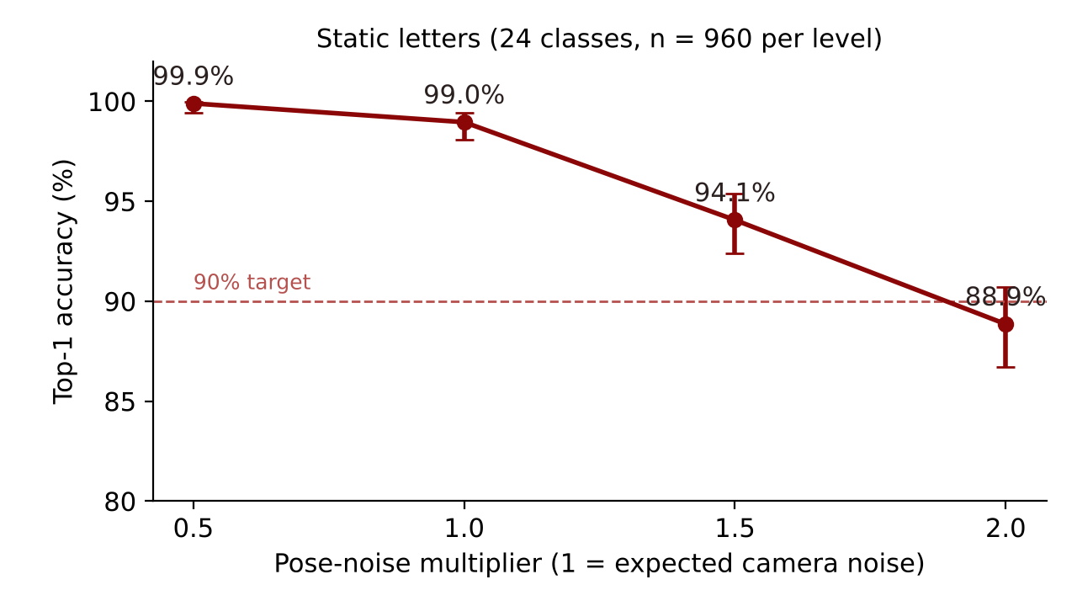
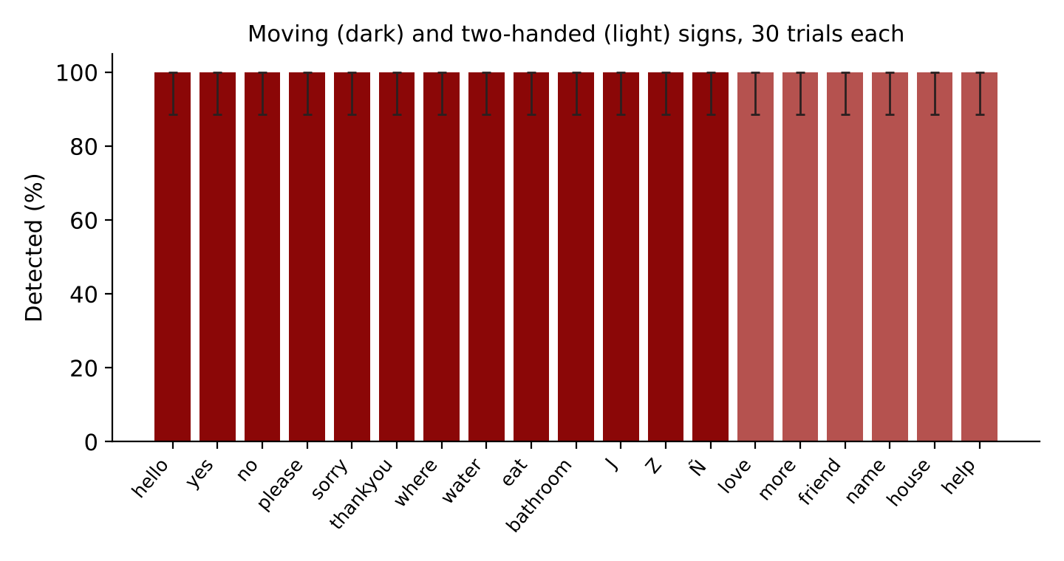
RESULTS AND DISCUSSION
Sign Recognition
Result | Value | 95% CI | Decision
Static letters at expected noise (E1) | 99.0% | 98.1%–99.4% | H₀1 rejected
Moving and two-handed signs (E3) | 570/570 | 99.3%–100.0% | H₀2 rejected; 0 false alarms
16

Slide 17
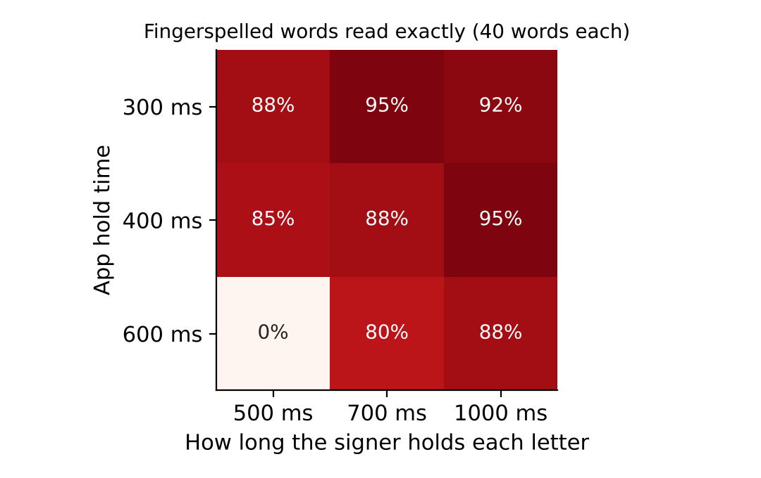
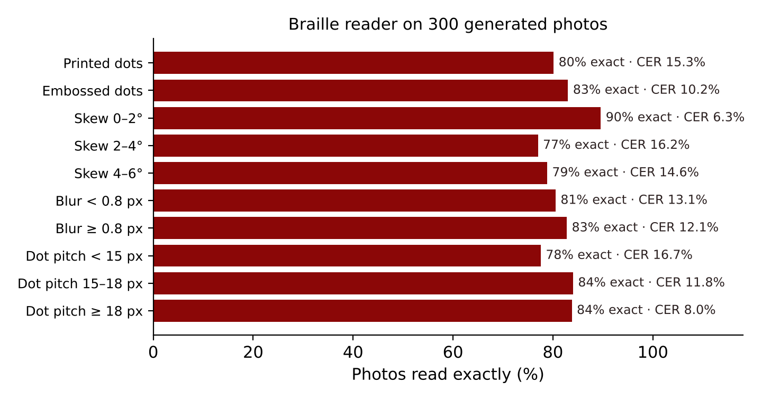
RESULTS AND DISCUSSION
Words, Taught Signs and Braille
Result | Value | Decision
Fingerspelled words at 400 ms (E4) | 89.2% | H₀3 rejected
Taught signs (E5) | 120/120, 0 false accepts | Reliable from 3 takes
Braille photos (E6) | 81.7% exact, CER 12.6% | H₀4 rejected
17

Slide 18
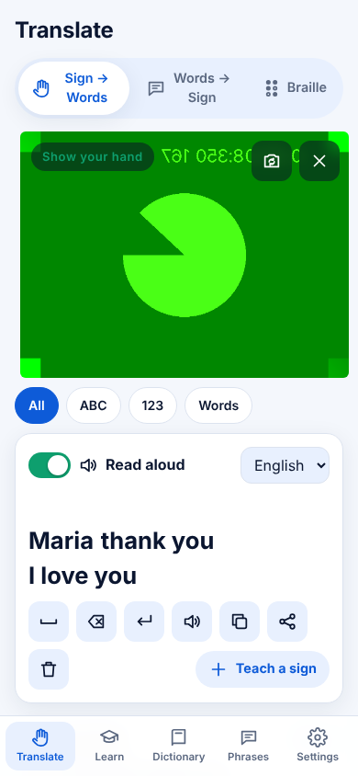
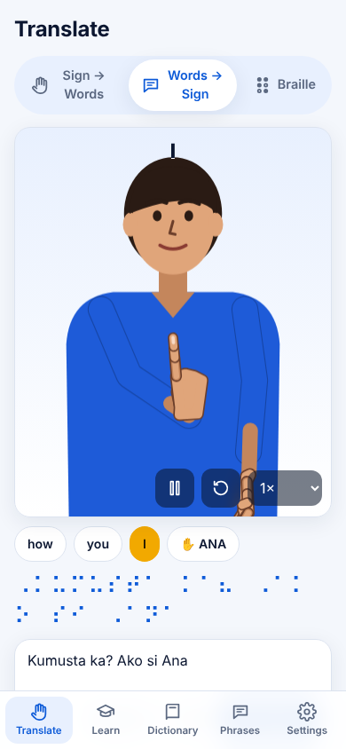
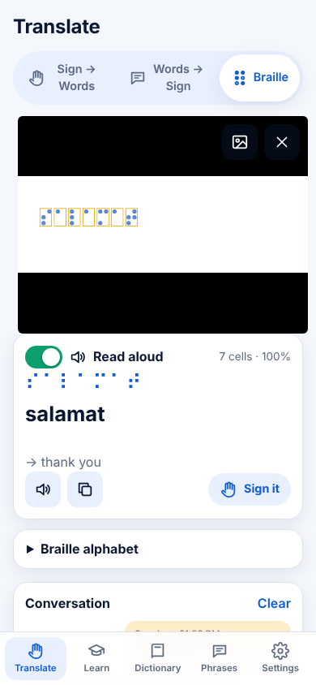
RESULTS AND DISCUSSION
Speed, Screens and the App
Hypothesis | Result | Decision
H₀1 accuracy ≤ 90% | 99.0% | Rejected
H₀2 detection ≤ 90% | 100.0% | Rejected
H₀3 words ≤ 80% | 89.2% | Rejected
H₀4 CER ≥ 20% | 12.6% | Rejected
H₀5 time > 100 ms | 71 + 0.09 ms | Rejected
H₀6 layout faults | 0 of 11 sizes | Rejected
All contrast pairs ≥ 4.5 : 1 (WCAG AA). All 32 phrases signed in 3 languages with no fingerspelling.
Figure 4. Live translation with Read aloud, the avatar, the braille reader
18

Slide 19
CONCLUSIONS AND RECOMMENDATIONS
Conclusions
Recommendations
• Geometry and kinematics classify static letters at 99.0% without a dataset.
• Moving and two-handed signs: 100.0%, no false alarms.
• Words 89.2%; taught signs 100.0%; braille 81.7% exact.
• Fast, offline, fits every screen; Read aloud on or off.
• Field-validate with Deaf and blind learners in Albay (ethics review, TAM).
• Calibrate templates with real landmark recordings.
• Review words and signs with Bikol speakers and Deaf FSL users.
• Add facial grammar, Grade 2 braille and a Bikol voice.
19

Slide 20
QUESTIONS
& ANSWERS

Slide 21

THANK YOU

