Slide 1
A Comparative Study of Housing Prices and Census Data in Minnesota in 2010
by Tokipona – Mike Pogatchnik, Carol Thompson, Evelyne Benie, Anna Rodell

Slide 2
Our Data Journey
Trials and Errors - challenges at the beginning to find the right dataset
Selection of five counties in Minnesota to tie together our comparative data points.
Hennepin
Itasca
Ramsey
Stearns
Steele

Slide 3
Data Gathering
Housing Data from Zillow: Value of housing per square foot – extracted and saved in CSV format
U.S. Census Bureau: Demographic data was pulled from Census Bureau API. Demographic variables included:
Educational Attainment
Race
Household Income
Poverty Rates
All data was pulled by the five counties in Minnesota

Slide 4
Data Analysis
Used Python in Jupyter Notebook to extract, combine, configure, analyze data, and create graphs.
Is there a correlation between the value of housing by county and level of education, race, household income, and poverty?

Slide 5
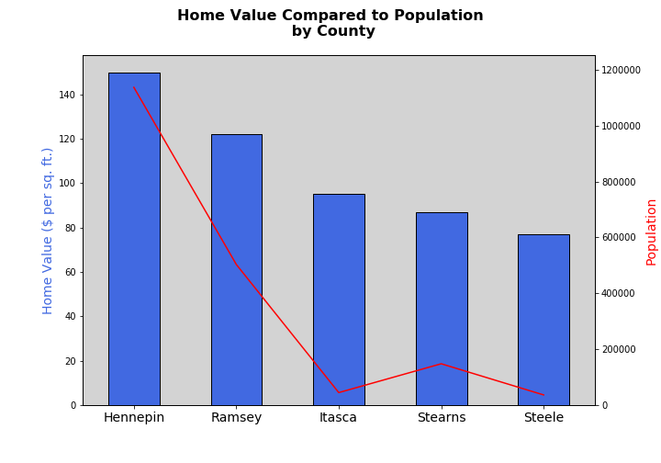
Housing Value and Population Size

Slide 6

Housing Value and Poverty Level

Slide 7
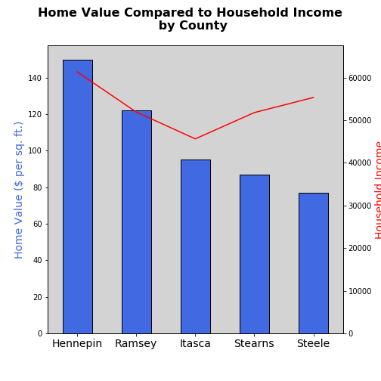
Housing Value and Household Income

Slide 8
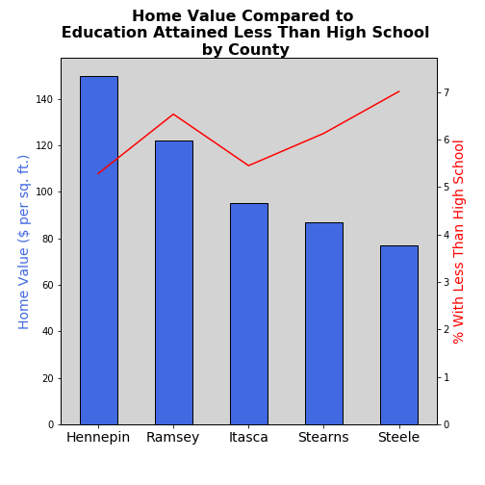
Housing Value and Educational Attainment

Slide 9
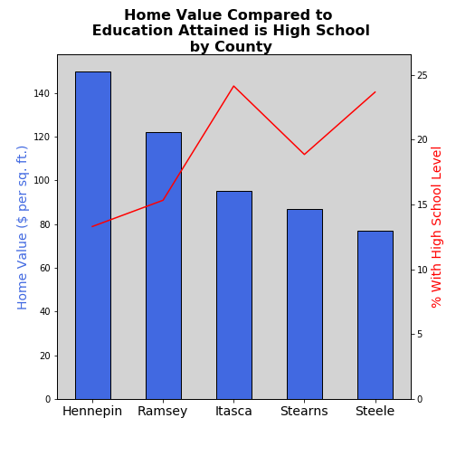
Housing Value and Educational Attainment

Slide 10
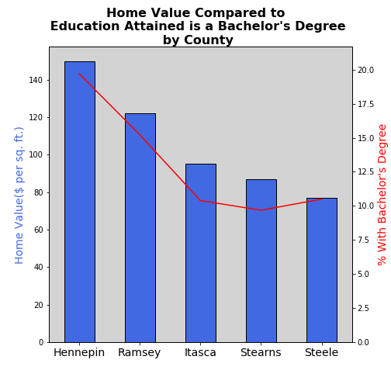
Housing Value and Educational Attainment

Slide 11
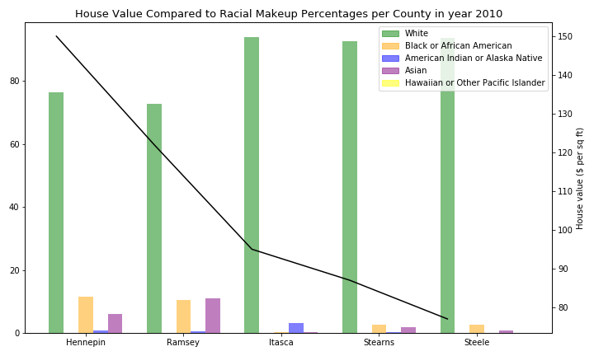
Housing Value and Race

Slide 12
Conclusion
The population size correlates the most to the value of housing
More variables than what was used in our study seem to be affecting the value of housing
If time allows, an in-depth data analysis could be conducted for a specific county to understand each variable more intimately.

