Slide 1
Portfolio
Young Hwa Park

Slide 2
Development skill
Language
C/C++, java, python, C#, JS, html, css
Web
Full stack
React, express.js, postgresql
AI
Tensorflow, keras
etc
linux
.NET(WPF)

Slide 3
Favorites
Language
C, JS
Field
Web backend, Server
AI
Subject
Network
Deep learning

Slide 4
github
https://github.com/poh12077?tab=repositories

Slide 5
Project
Web
Image processing
Histogram viewer
Edge detection viewer
Medical image viewer
AI
Chatting server
Android App
GUI

Slide 6
1. Web
URL
http://101.101.210.42/
What is this?
A web site for psychological test and showing what people think about relationships
Tech Stack
Frontend : React
Backend : Express.js
DB : Postgresql
Login ( test ID )
Id : test
Password : 1

Slide 7
2. Image processing
Histogram Viewer
Edge detection Viewer
Medical image Viewer

Slide 8
2-1. Histogram Viewer
What is this?
An application for displaying histogram of image
X-axis : pixel value
Y-axis : number of pixel
Tech Stack
C#
WPF

Slide 9
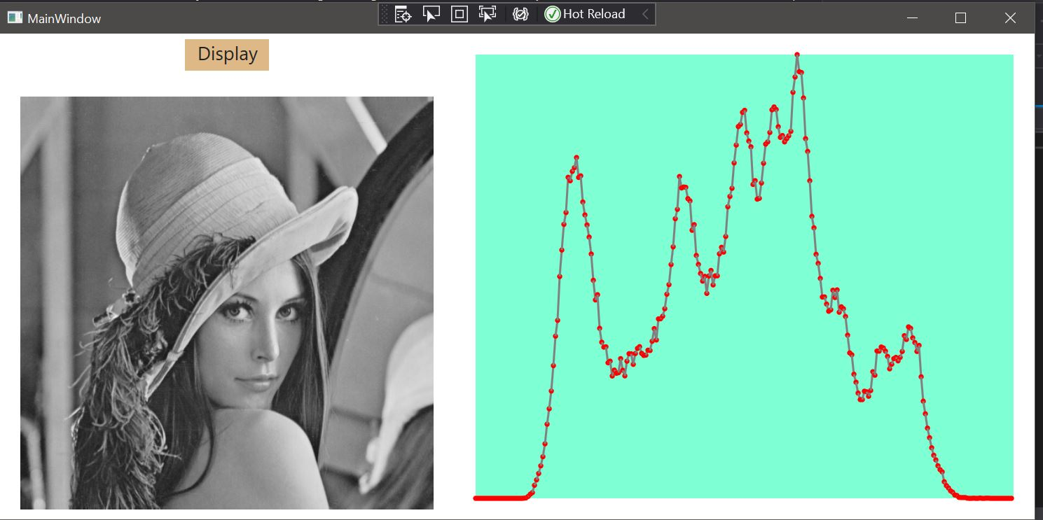
gray scale image

Slide 10
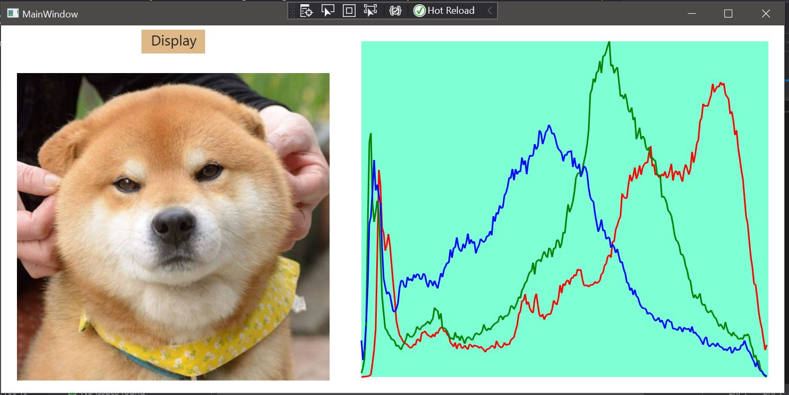
Jpg image (RGB)

Slide 11
2-2. Edge Detection Viewer
What is this?
An application for displaying edge detection, inversion, rotation, MRI
Tech stack
C#
WPF

Slide 12
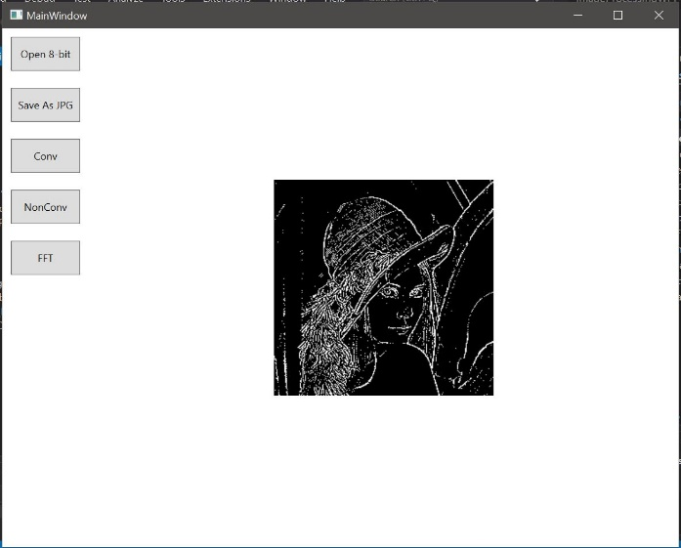
Edge detection ( Laplacian 1 )

Slide 13
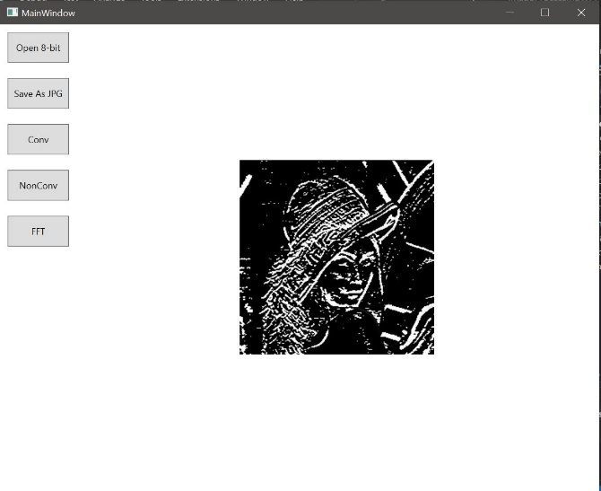
Edge detection ( Sobel Y )

Slide 14
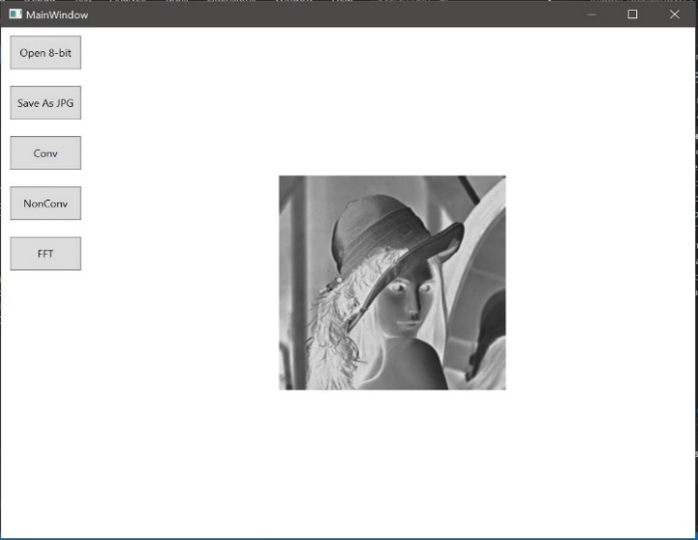
Inversion

Slide 15
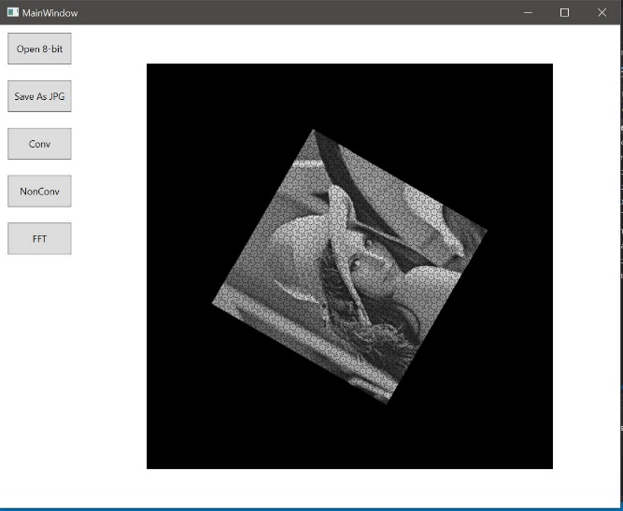
Rotation

Slide 16
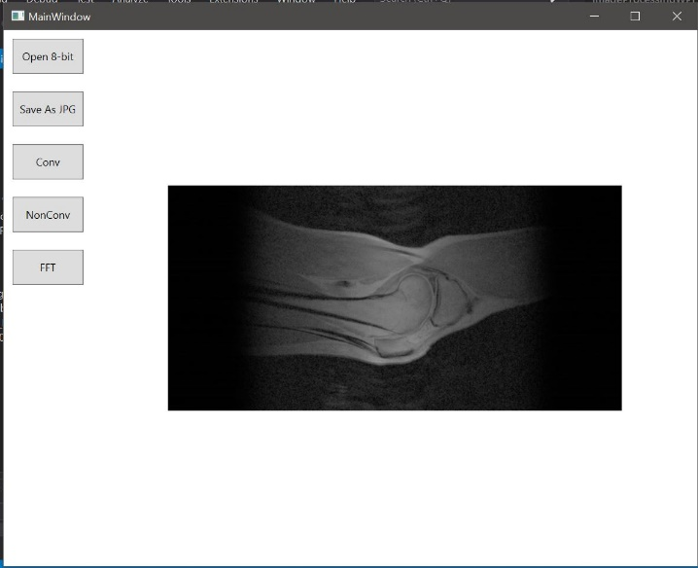
MRI viewing ( Reconstruction )

Slide 17
2-2. Medical Image Viewer
What is this?
An application for displaying medical image in DICOM format
Teck stack
C#
WPF
Fo-dicom API

Slide 18
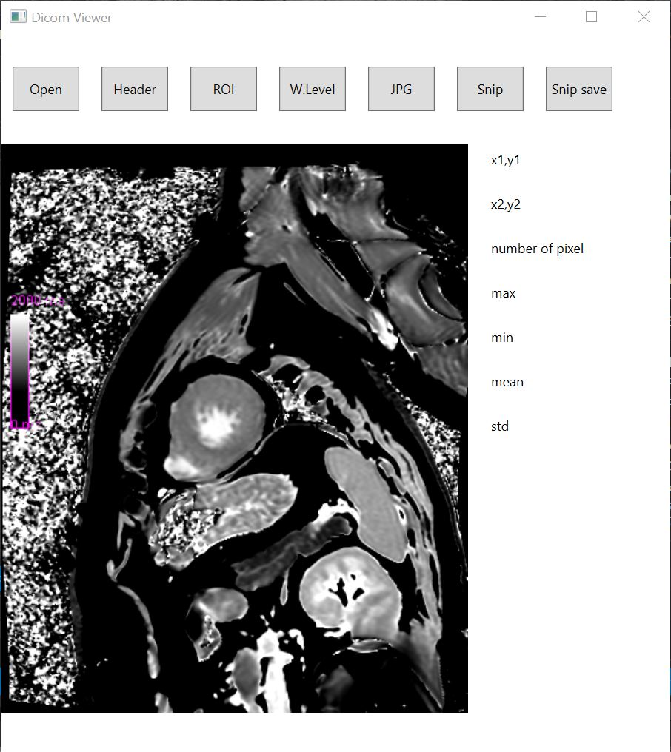
Medical image(dicom) viewing

Slide 19
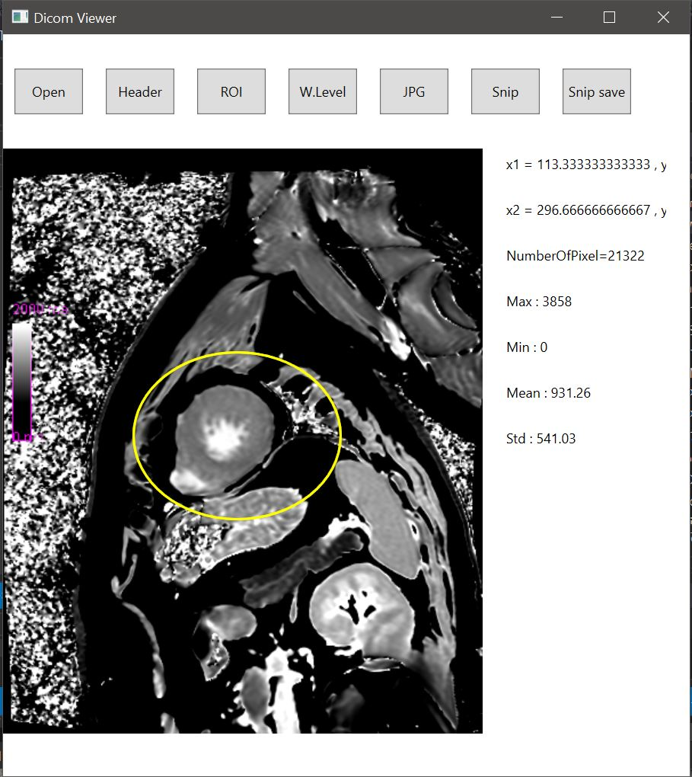
Draw an ellipse with the mouse and check max, min, mean, std, etc. inside the ellipse

Slide 20
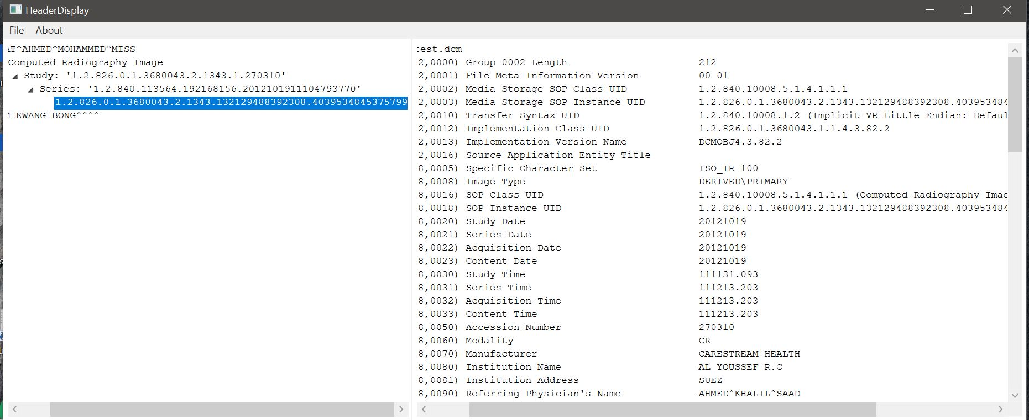
showing header of medical image

Slide 21
3. AI
Purpose
Predicting the Age of Abalone
Data
Feature
sex, length, diameter, height, weight, shell weight, intestine weight
Number of data
4177
age = number of stripe
sex
male=3, female=2, none=1

Slide 22
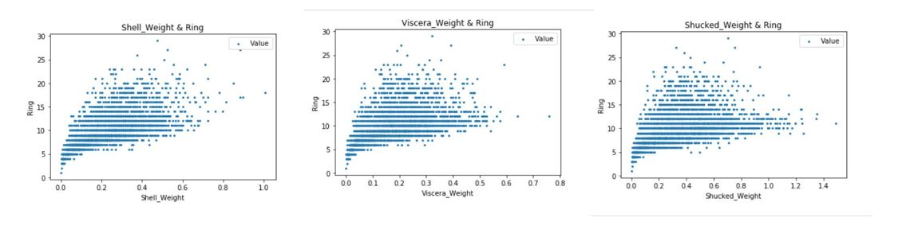
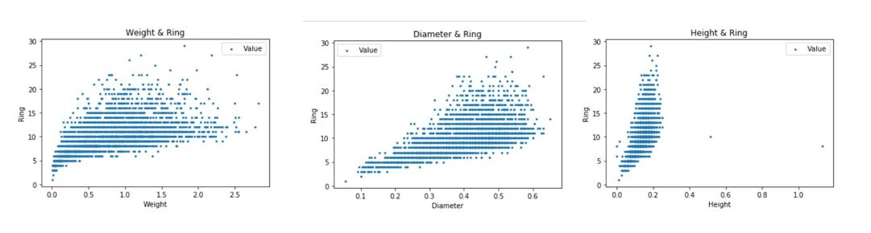
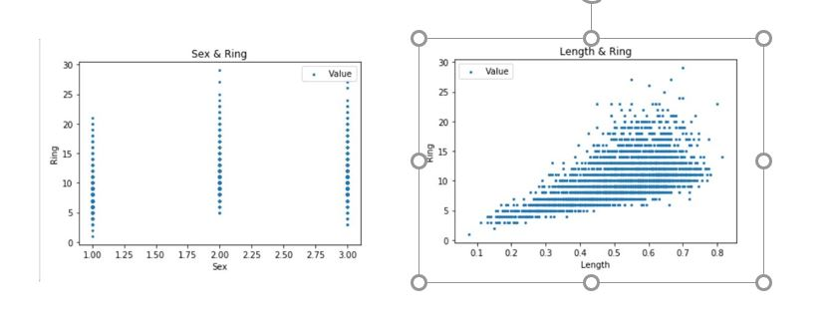
Correlation between each feature and stripe(ring)

Slide 23
Tech stack
Python
Keras
Regression
Data classification
Train data : 2506 ( 60%)
Test data : 836 (20%)
Validation data : 835 (20%)
Training
Optimizier : adam
Loss function : mean squared error
Epoch : 100
Batch size :1

Slide 24
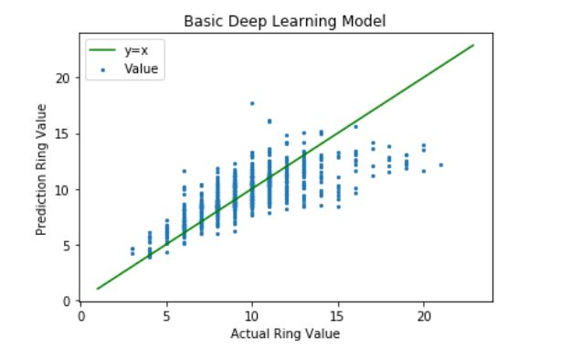
result
Graph explaination
X-axis : real value
Y-axis : prediction value
The closer to y = x, the better the performance.
accuracy
Rmse = 1.78
R2 = 0.56

Slide 25
Experiment
 | basic model | many layer model | many neuron model
Layer construction | (Input layer) Number of nodes = 64 activation fuction = relu (Hidden layer) Number of Layers = 4 Number of nodes = 32 activation fuction = relu (Output layer) Number of node =1 | (Input layer) Number of nodes = 64 activation fuction = relu (Hidden layer) Number of Layers = 20 Number of nodes = 32 activation fuction = relu (Output layer) Number of node =1 | (Input layer) Number of nodes = 128 activation fuction = relu (Hidden layer) Number of Layers = 4 Number of nodes = 64 activation fuction = relu (Output layer) Number of node = 1
performance | Rmse = 1.78 R2=0.56 | RMSE=2.00 R2=0.44 | RMSE = 2.16 R2 = 0.35
guess
Increasing the number of layers or increasing the number of neurons will improve the accuracy.
experimental process
Accuracy comparison by increasing the number of layers or increasing the number of neurons
Experiment result
Accuracy decreased when the number of layers or the number of neurons was increased.

Slide 26
4. Chatting server
Tech stack
C
I/O multiplexing
epoll
Asynchronous
Socket communication

Slide 27
5. Android App
What is this?
An application that draws a graph of the percentage of prime numbers in an interval
First input : interval length
Second input : number of points in the graph
X-axis : range of numbers
Y-axis : percentage of prime numbers
Tech stack
Java
Android studio

Slide 28
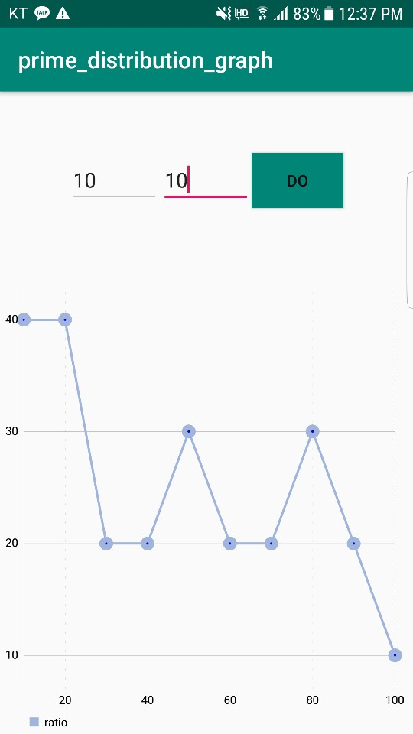
example
input
first : 10
second : 10
result
point (10,40) : there are 4 primes between 1 and 10
point (20,40) : there are 4 primes between 11 and 20

Slide 29

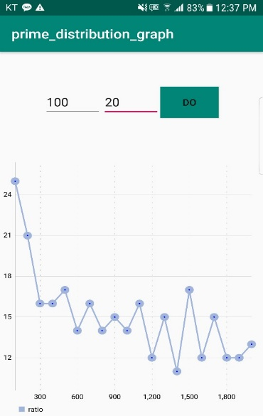
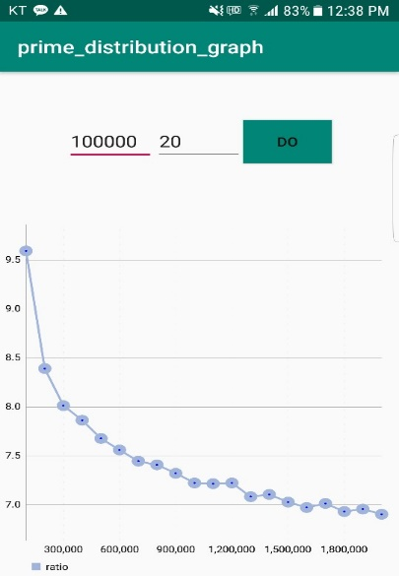

Slide 30
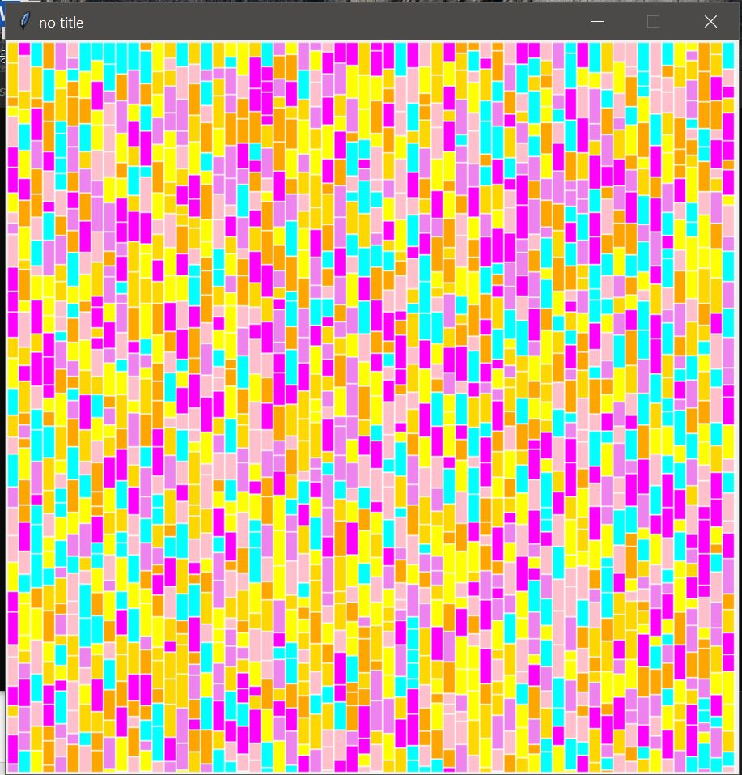
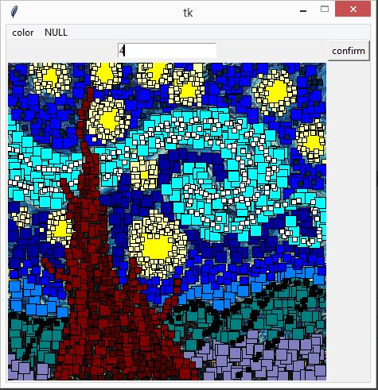
6. GUI ( python )

