Slide 1
數位訊號處理實驗
Digital Signal Processing Laboratory
Lab 3
Pre-Processing of ECG Signals

Slide 2
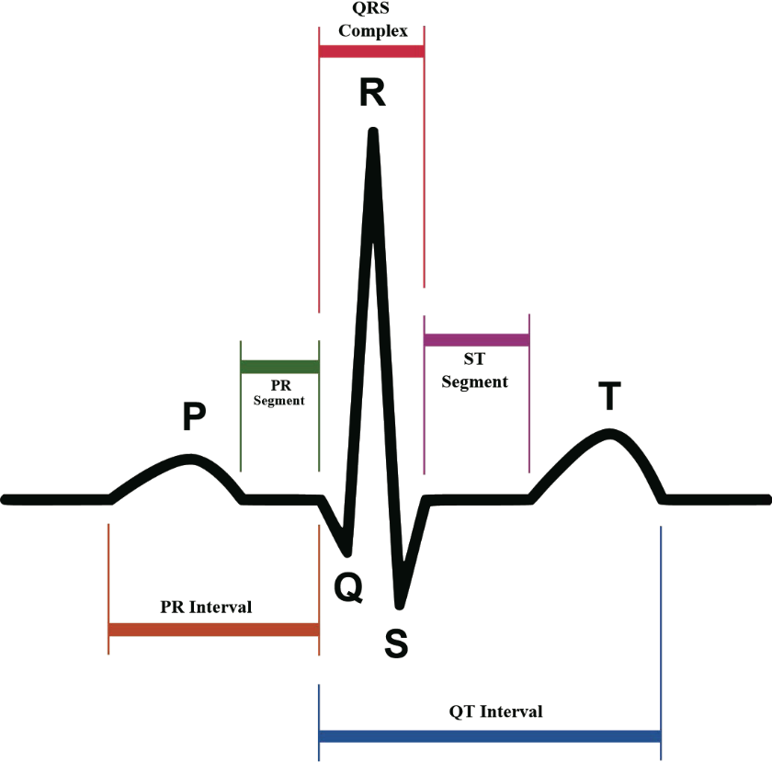
ECG Signal and Interferences (1/2)

Slide 3
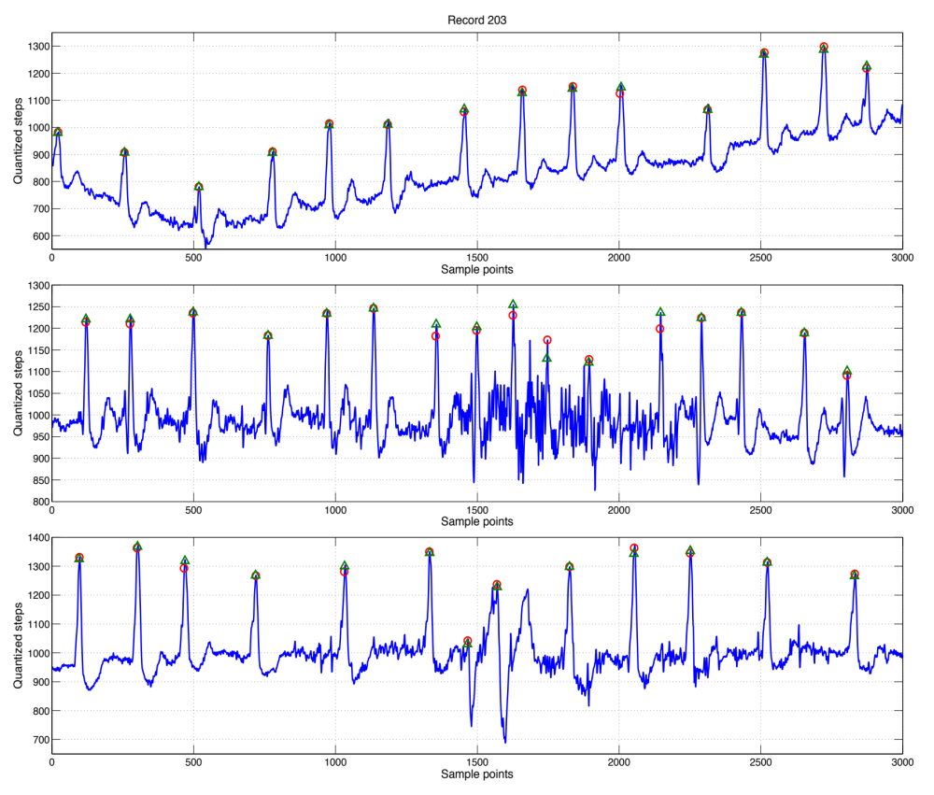
ECG Signal and Interferences (2/2)
Baseline Noise
Electromyography (EMG)
Noise
Motion Artifact

Slide 4
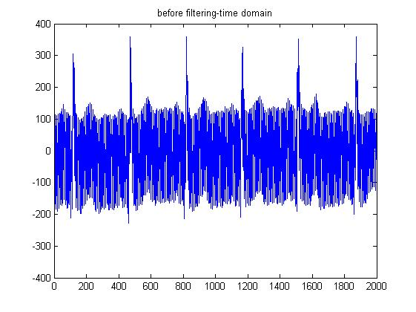
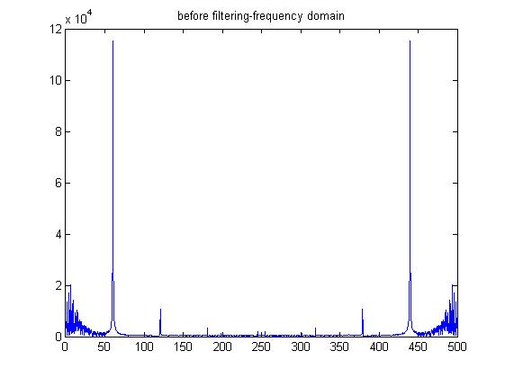
60-Hz Power-Line Interference
Samples
Hz

Slide 5
ECG Noise Reduction
Noise types:
  Baseline wander (BW) (below 1Hz)
  50 or 60 Hz power-line interference (PLI)
  Electromyogram (EMG)
  Motion artifact (MA)
Method | Noise Type
Adaptive Filter | BW, PLI, MA
Wavelet Transform | BW, EMG, MA
Empirical Mode Decomposition | BW, EMG, MA
Independent Component Analysis | MA
Moving Average | BW, (PLI), MA

Slide 6
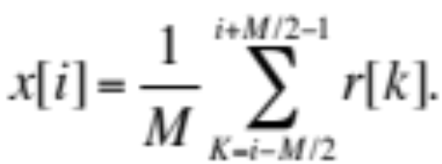
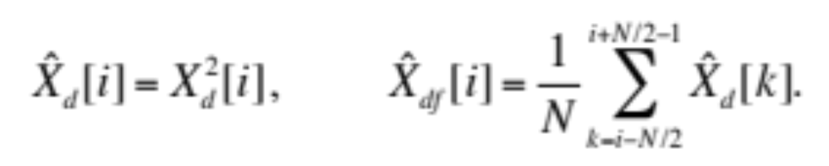
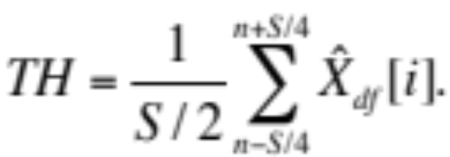
Pre-Processing of ECG Signals (1/3)
(1) 60 Hz filtering:
(2) Slope calculation:
(3) Squaring and flattening:
(4) Adaptive threshold calculation:
(Low pass filtering:
moving average filtering, FIR,
How about IIR?)
http://oregonstate.edu/instruct/ch490/lessons/lesson11.htm
(High pass filtering:
difference filtering, FIR,
How about IIR?)
(Low pass filtering:
moving average filtering, FIR,
How about IIR?)

Slide 7
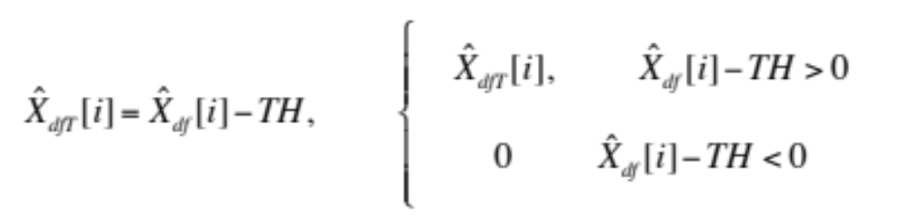
Pre-Processing of ECG Signals (2/3)
(4) Hard threshold:
(5) Slope local maximum detection
  Find the time index i of the local maximum of the slope.
(5) ECG local maximum detection:
  Use the sample index i to find the local maximum of original ECG signal by applying a short searching range.
  Searching region is set to be 0.1 second since normal QRS complex (5-40Hz) is about 80~100 ms duration.

Slide 8
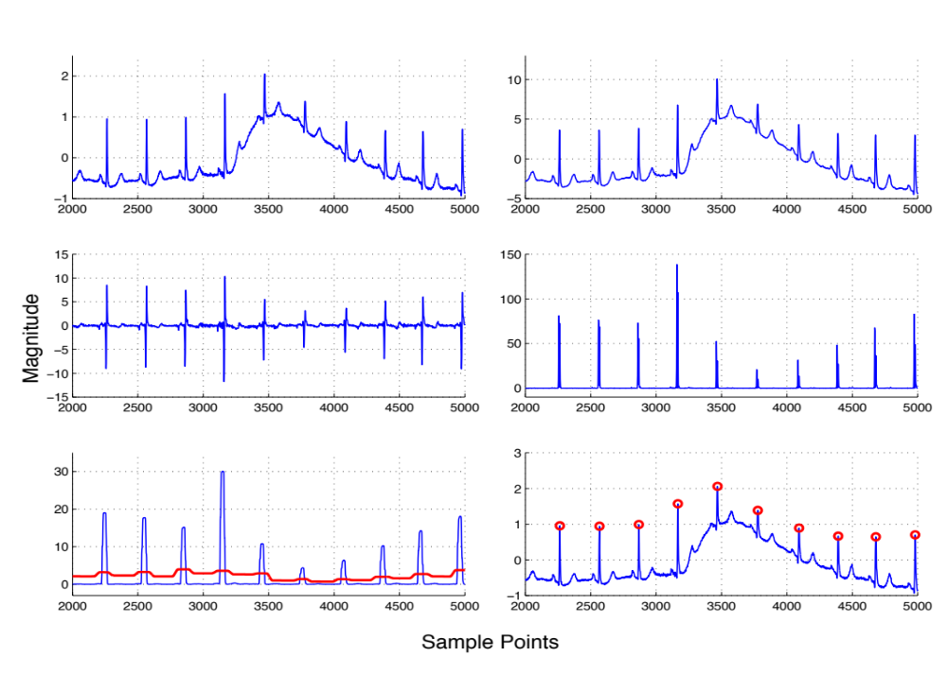
Pre-Processing of ECG Signals (3/3)
(1)
(2)
(3)
(4)
(5)

Slide 9
Task 3 (in the Handout) Today
Use 8 bits instead of 10 bits for the digitization of ECG signals. Design an algorithm and implement in Arduino to maintain the maximum dynamic range of the input ECG signal with 8-bit sampling.
  From 10 bit to 8 bit sampling while maintaining the maximum dynamic range of the ECG signals can (1) reduce the data rate and (2) for example, utilize the full swing (full range) of a following DAC (8 bit).

