Slide 1



Team Details
  Team name: Triple-8
  Product: RoomDrop
  Team leader name: Pete (team: Pete & AJ)
  Problem Statement: Travellers book hotels early but fear missing a cheaper rate later. RoomDrop lets them book early and still catch the drop. Peace of Mind Guaranteed!

Slide 2
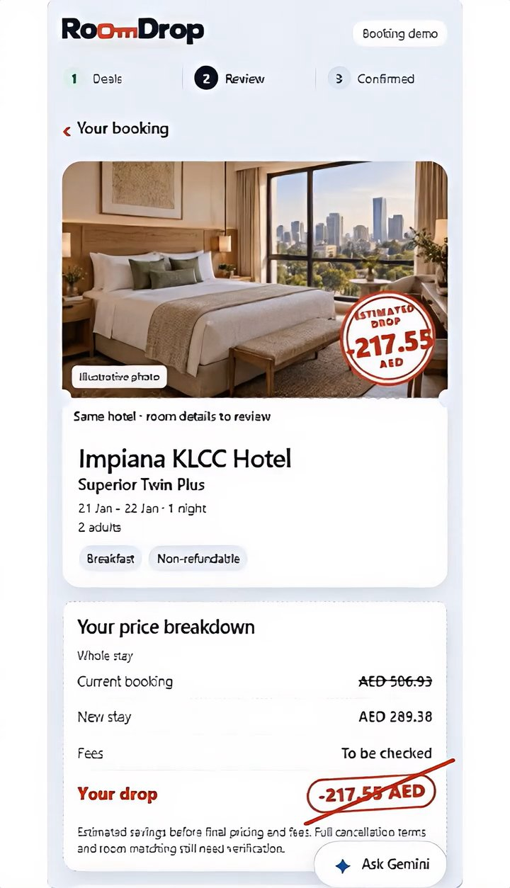
RoomDrop in 10 seconds
BEST DROP
-217.55
AED
Book early.
Still catch the drop.
A 10-second tour of the live prototype: find a drop, peek, ask Gemini, confirm.
Real Altovo quotation
Impiana KLCC Hotel, Kuala Lumpur
AED 506.93 to AED 289.38
Full 3-4 min demo: link on the final slide

Slide 3

Brief about the idea
Built on Google Cloud
Book early. Still catch the drop.
Cloud Run
Public app, private agency console and the price-watch job
Book your hotel early. RoomDrop keeps re-shopping the same stay for you.
Gemini on Vertex AI
Gemini 3.8 Flash drop adviser: structured JSON, validated by the server
A cheaper rate appears? See the drop, the saving and any flexibility you give up.
Ask Gemini, tick the trade-off, confirm in one tap.
Cloud Firestore
Bookings, drops, Drop Watch consent and sessions, with transactions and TTL

Slide 4
Opportunities
How different is it from any of the other existing ideas?
How will it be able to solve the problem?
USP of the proposed solution
Alerts only notify; RoomDrop shows a real drop with the saving and the flexibility you give up
Re-shops the exact stay you booked, no manual cancel-and-rebook
Runs on the agency's own quotation and supplier feed, not another meta-search
Starts from your current booking: same hotel, dates and guests
Ranks three drops by estimated saving and flags non-refundable risk
Gemini answers "should I switch?" using only the facts on screen
Book early, never overpay: every saving shown as a stamped drop
Trustworthy AI: Gemini cannot book, refund or invent prices
One engine, two markets: traveller savings and agency margin
Travellers lock in early and still catch the drop
Agencies re-shop held bookings to cut cost and raise margin
B2C
B2B

Slide 5
List of features offered by the solution
LIVE
LIVE
LIVE
LIVE
Booking + 3 drops
Saving stamps
Peek at a drop
Ask Gemini
Current booking ticket above three ranked drops
Estimated drop per stay, with cancellation and refund warnings
Price breakdown, room, board and cancellation flag
Compare all drops or ask about one, in plain language
LIVE
LIVE
SOON
NEXT
Grounded AI
Consent + receipt
Agency console
Drop Watch
Replies validated against the booking and the suggested drops
Explicit tick for lost flexibility, then a selection-only receipt
Private, read-only cases behind Google IAP
Consent, minimum saving and scheduled re-checks with alerts

Slide 6
Process flow diagram or Use-case diagram
Traveller journey B2C, live today
1
2
3
5
6
Your booking
Find drops
Peek at a drop
Ask Gemini
Review
Confirm
Hotel, dates, guests and price
3 ranked drops with saving stamps
Price breakdown and room facts
Grounded advice: price vs flexibility
Tick any lost flexibility
Receipt with the estimated drop
Agency use FUTURE B2B, same engine
Share booking
Re-shop the stay
Record drops
Review cases
Rebook cheaper
Agent sends an Altovo booking link
Supplier gateway, same hotel and dates
Booking and drops kept in Firestore
Private console behind Google IAP
Cut supplier cost, keep margin (next)

Slide 7
Architecture diagram of the proposed solution
Google Cloud asia-southeast1 unless noted
Traveller
Browser
HTML, CSS, JS
Cloud Run service
hotel-price-hunter, Node 24
public, CSRF + strict CSP
allowlisted facts + response schema
Gemini 3.8 Flash
Vertex AI, location global
JSON schema + grounding check
JSON IDs, validated by server
Agency operator
Google sign-in
Agency console
Cloud Run behind IAP
read-only cases
Cloud Firestore
Native mode, transactions
IAM identities
least privilege, no keys
roomdropBookingsV1/{code}
drops/{dropId} append-only
roomdropPublicSessionsV1 TTL
agency cases, watch state
External
Altovo share link
supplier rates
Cloud Run Job
roomdrop-price-watch
re-shops held stays
Artifact Registry
immutable images for
all Cloud Run workloads
No share-link tokens, contacts or guest names stored

Slide 8
Technologies to be used in the solution
Frontend
Backend
Vanilla HTML / CSS / JS
Node.js 24
node:24-bookworm-slim
ES modules, no build step
Strict CSP
built-in node:http
npm 11.6.2
AI
Data
Gemini 3.8 Flash
Vertex AI (global)
Cloud Firestore
Firestore SDK 9.3.1
@google/genai 2.28.0
JSON response schema
Firebase emulator for local Firestore tests
Cloud / DevOps
Testing
Cloud Run services + Job
Artifact Registry
node:test, 292 pass
Firestore emulator tests
IAM + Google IAP
Docker
Playwright, 320-1440 px

Slide 9
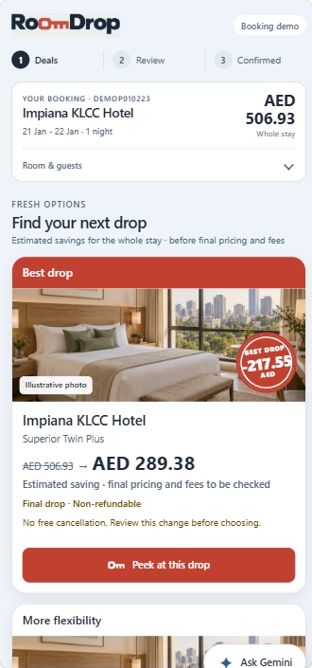
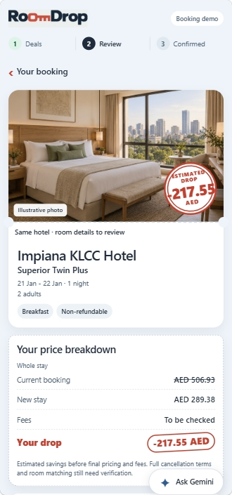
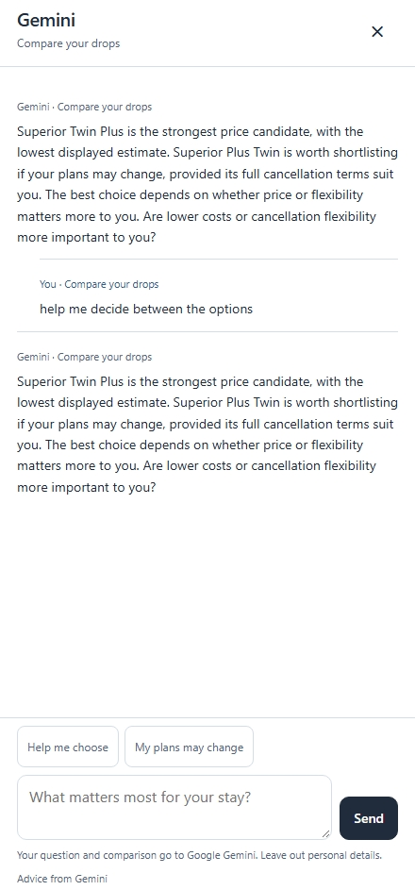
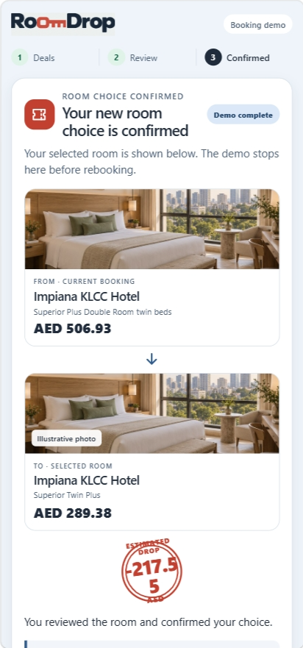
Snapshots of the prototype
1 Find your next drop
2 Peek at a drop
3 Ask Gemini
4 Confirmed

Slide 10
Prototype Performance report/Benchmarking
100/100
3.3 s
77 ms
292 pass
Accessibility and Best Practices, mobile and desktop
median Gemini reply; 7/7 passed grounding checks
warm page TTFB from Malaysia (server ~3 ms)
0 failures; 6 skips need the Firestore emulator
Lighthouse (median of 3) | Mobile | Desktop
Performance | 75 | 89
Accessibility / Best Practices | 100 / 100 | 100 / 100
SEO | 91 | 91
First Contentful Paint | 1.5 s | 0.43 s
Largest Contentful Paint | 12.2 s | 2.2 s
Total Blocking Time | 12 ms | 0 ms
Cumulative Layout Shift | 0 | 0.003
How we measured
18 Oct 2026, live Cloud Run URL (asia-southeast1, scales to zero). Lighthouse 12.8.2 x3 per preset; curl x10 sequential from Malaysia; 7 sequential Gemini chat calls.
Next: compress images
Mobile LCP is 12.2 s from 2.6 MB of PNG/JPG. WebP/AVIF and responsive sizes save ~1.2 MB.

Slide 11
Additional Details/Future Development (if any)
1
Share-link intake
2
Scheduled Drop Watch
Trust guardrails, live
Agent sends an Altovo link; booking and drops persist in Firestore
Cloud Scheduler runs the price-watch job daily on live supplier rates
Gemini replies are schema-bound IDs, re-validated by the server
Money is computed by code, never by the model
3
Drop alerts
4
Real rebooking
Notify when a drop beats the traveller's minimum saving
Turn a chosen drop into a new booking, cancel the old one, refund
Only allowlisted facts reach Vertex AI; no guest data
Selection only: no booking, payment or refund routes
5
Traveller sign-in
6
Agency actions
Non-refundable drops need an explicit tick
Invitations and identity so travellers can return to their drops
Act on cases from the IAP console; October UX review fixes
No service-account keys; agency behind IAP

Slide 12
Provide links to your:
GitHub Public Repository
https://github.com/pohlipit23/hotel-price-hunter
Demo Video Link (3-4 Minutes)
VIDEO_LINK_HERE
Final Product Link
https://hotel-price-hunter-2qbcpylngq-as.a.run.app/
Book early. Still catch the drop.

Slide 13


