Slide 1
Floor Surface detection
Ce9010 Group Assignment
Team 10
Lim Shu Fang [EDA, PCA, ML models]
Poh Yong Keat [Features extraction, NN models]

Slide 2

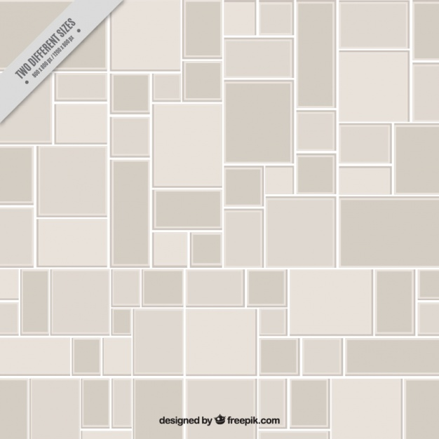



Where am I??

Slide 3
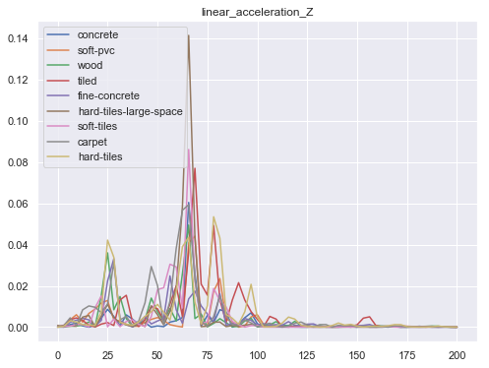
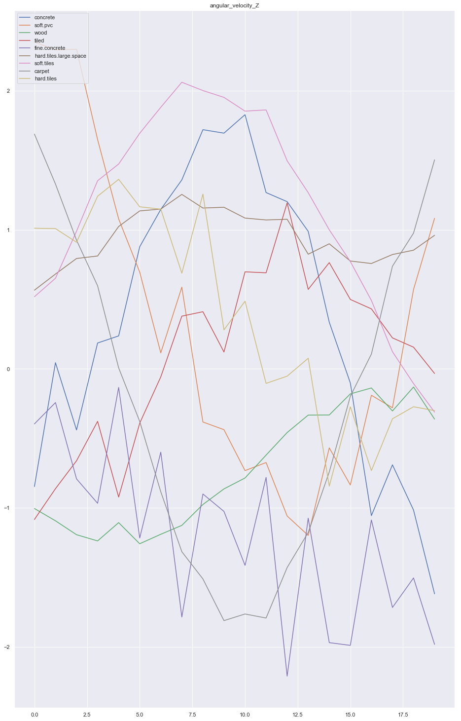
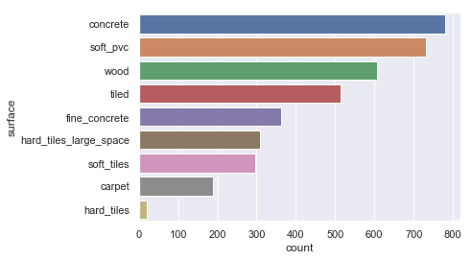
Step 3: Data Exploration
IMU Values: Orientation (convert from quaternion to cartesian form), angular velocity & linear acceleration
No missing/duplicate data
Frequency plot
Time-domain plot
Class distribution

Slide 4
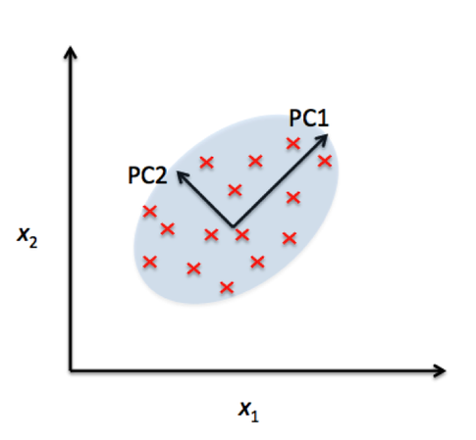
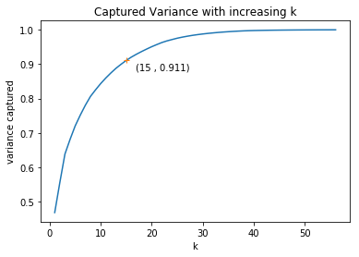
Step 4: Preprocessing & feature extraction
New Features
Mean
0-40Hz
40-80Hz
Std Dev
Skewness
Kurtosis
PSD
80-120Hz
120-160Hz
160-200Hz
9 new features per each old feature
81 → 15 features
>90% variance captured

Slide 5
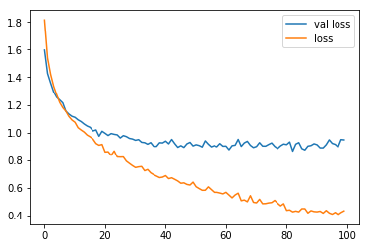
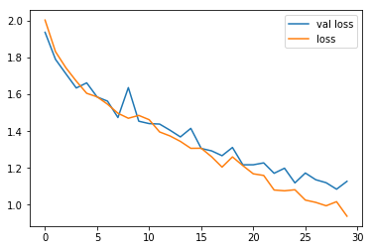
Step 5: Data Analysis
Traditional ML Classifiers
Neural Networks
Logistic Regression = 43%
Regularisation constant = 0.01
SVM (rbf & poly kernels) = 48%
Regularisation constant = 10, type of kernel = polynomial
Shallow MLP = 75%
Hidden Layer Neurons = 300, Dropout = 0.5, Epochs = 100
LSTM Model = 60%
# LSTM Layers = 1, Dropout = 0.1
Neural Networks perform better
SVM has higher accuracy than LR
LSTM limited by training epochs
epochs
epochs

Slide 6
Step 6: Summary of Results & Conclusion
Relationships between statistical features and type of surface are non-linear.
Neural Networks have high learning capacity, yielding good results.
Handcrafting important features may improve performance.
More potential for LSTM model.

Slide 7
References
External libraries used:
Tabulate [https://pypi.org/project/tabulate/]
Seaborn [https://pypi.org/project/seaborn/]
Scipy [https://pypi.org/project/scipy/]
Sklearn [https://pypi.org/project/scikit-learn/]
Keras [https://pypi.org/project/Keras/]
Plotly [https://pypi.org/project/plotly/

Slide 8
Thank you for your kind attention ☺
https://github.com/pohyk123/CE9010-SurfaceML

