Slide 1
Designed to Deceive: Do These People Look Real to You? (New York Times)
Scott Schwartz reporting on Kashmir Hill / Jeremy White article of November 21, 2020:
https://www.nytimes.com/interactive/2020/11/21/science/artificial-intelligence-fake-people-faces.html
Notes:
I show the article
I give first poll question: "what made it work"?
- simplicity is obviously good (ans 1)
- but the magic is that it emulates synchronous communication (ans 2)
- in order to engage you in asynchronous communication (ans 3)
- in fact the asynchronous parts of the article may have nothing at all to do with the synchronous parts!
I'll now go on to describe the text of the article

Slide 2
Article describes images of human faces made by GANs
GANs: Generative Adversarial Networks
The Generative part proposes an image (real or fake)
The Adversarial part decides if it's a real or a fake image
The Network part refers to Deep Learning Neural Networks
Notes:
The article gives this very simple and intuitive explanation of GANs

Slide 3
Article describes examples of related cautionary tales
Fake faces are being used
E.g., by "spies", "right-wing propagandists", and "online harassers"
Facial feature constructs have improved
"used by law enforcement"; and "activists to reveal the identities of police officers"
Arrests have been made based on "incorrect facial-recognition" matching
Notes:
Seems to be focussing on the negatives
Seems to be looking to empower people in these "dark arts"
- positives are:
+ Has worked
+ Interested people in AI/Deep Learning

Slide 4
Article describes examples of related cautionary tales
Tools are data dependent
Using "more photos of gorillas" caused Google to mis-label two Black people
Biased training causes voice systems "not to understand people with accents"
Traditional imaging "calibrated to best show the faces of light-skinned people" is "not as good at capturing people with dark skin"
Predictions on criminal behavior based on "past rulings made by human judges" automatically incorporates "judges’ biases"
Why have computers have learned to "associate glasses with “dweebs” or “nerds.”"?
Notes:
I describe the text of the article
These are very important points

Slide 5
Article describes examples of related cautionary tales
Humans are overly trusting of computer technology
"consistently made the wrong identification" on "fingerprints" and "human faces" with wrong computer assisted guidance
"drivers "followed devices’ directions to a fault", "into lakes, off cliffs and into trees"
Notes:
I describe the text of the article
This is a good point

Slide 6
Article describes examples of related cautionary tales
As seen from the articles title ("Designed to Deceive...")
The article takes a suspicious, pessimistic view of GANs
And is suspicious and pessimistic of technology, generally
It concludes that these tools retain inherent human biases
Notes:
I describe the text of the article
I would describe the article a having this bias
It points out that human corruption – as well unintentional bias -- will misuse technology

Slide 7
Article describes examples of related cautionary tales
"...we are putting our safety in the hands (and eyes) of software. We place a lot of trust in these systems, but they can be as fallible as us."
Notes:
I describe the text of the article
Which is perfectly wrapped up in this summary conclusion statement of the article
Last poll question:
Wing it to start some discussion

Slide 8
Communicating with Data Considerations on Communication
Presentation: Professor Scott Schwartz UVA School of Data Science
When you're in there
But need to get out here
Notes:
once again, the concept of barriers (good visual)
POLL QUESTIONS
0. most intersting from last time?
1. Retrieval Practice: find ways to test if they've understood
2. Spaced Repition: be patient and ready to re-explain, after breaks
3. knowledge graph: build on what people know; AND tell a memorable narrative that will connect it in more places!

Slide 9
Barriers
Personal Environmental
Economic
Emotional
Cultural
Experience
Perception
Time
Physical
Language
Preferences
Attitudes
Values ​
Bias
Notes:
This paper gives a characterization of the barriers to communication.
If you begin collecting the reasons your communications have failed you'll arrive at a list similar to this one

Slide 10
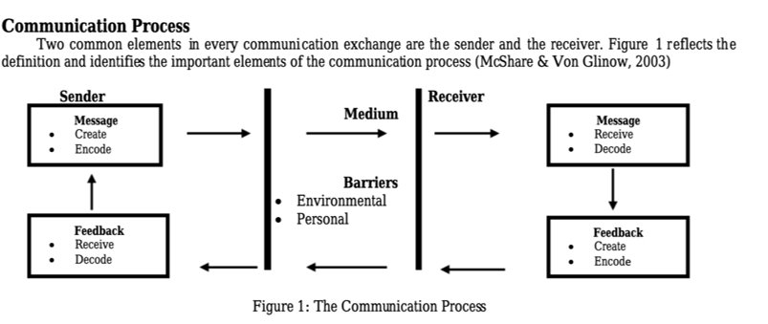
Barriers
Notes:
Would like to see this graphic improved a bit.
But it's good to keep this abstraction in mind.
once again, the concept of barriers.
Again, Communication needs to Emphasize Receiver and their capabilities and viewpoints.

Slide 11
Barriers
Notes:
Let's Focus on the Sender to start with

Slide 12



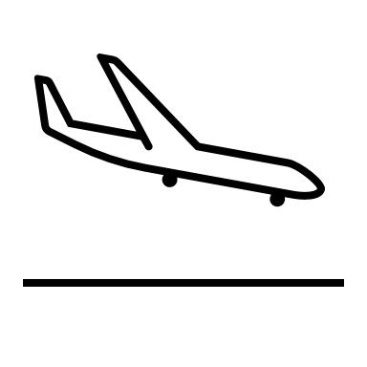
Barriers
Be clear with ideas goals
and objectives
(be intentional and purposeful)
Notes:
Maybe they're thinking about planes!
Because they're pilots!
Or because they saw the plane window and got to thinking about planes and they're not lifelong soccer players like me

Slide 13

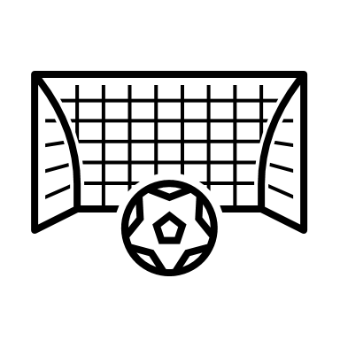

Barriers
Be clear with ideas goals
and objectives
(see and speak to their viewpoint)
Notes:
I think this highlights my main points

Slide 14

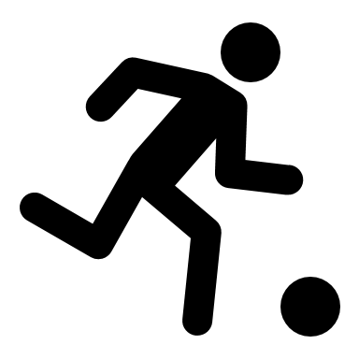


Barriers
Be clear with ideas goals
and objectives (mind overtone and feedback openness, responsiveness, receptiveness)
Notes:
Sender Role: how to get through the barriers!
I'm trying to be clear with my ideas, goals, and objectives
Be mindful as to your expressions and how your messaging is perceived!
ASK STUDENTS WHICH THEY PREFER

Slide 15
Barriers
Be clear with ideas goals
and objectives (take the environmental and human settings into account)*
Notes:
Sender Role: how to get through the barriers!
I'm trying to be clear with my ideas, goals, and objectives
We've already noted barriers
More of the physical side momentarily

Slide 16
Barriers
Personal Environmental
Economic
Emotional
Cultural
Experience
Perception
Time
Physical
Language
Preferences
Attitudes
Values ​
Bias
Notes:
This paper gives a characterization of the barriers to communication.
If you begin collecting the reasons your communications have failed you'll arrive at a list similar to this one

Slide 17
Barriers
Notes:
Would like to see this graphic improved a bit.
But it's good to keep this abstraction in mind.
once again, the concept of barriers.
Again, Communication needs to Emphasize Receiver and their capabilities and viewpoints.

Slide 18
Barriers
Notes:
Would like to see this graphic improved a bit.
But it's good to keep this abstraction in mind.
once again, the concept of barriers.
Again, Communication needs to Emphasize Receiver and their capabilities and viewpoints.

Slide 19
Barriers
Notes:
Receiver Responsibilities

Slide 20


Barriers
Be an Active Listener
(stop talking / pay attention)
Notes:
Receiver Responsibilities

Slide 21

Barriers
Be an Active Listener
(stop talking / pay attention) [Remove Distractions]
Notes:
Receiver Responsibilities

Slide 22

Barriers
Ask Questions
(then stop talking)
Notes:
Receiver Responsibilities

Slide 23
Barriers
Ask Questions
(then stop talking)
Notes:
Receiver Responsibilities

Slide 24

Barriers
Refrain from argument/criticism
in from argument/criticism​
Notes:
Receiver Responsibilities

Slide 25
Barriers
Refrain from argument/criticism
in from argument/criticism​
Notes:
Receiver Responsibilities

Slide 26

Barriers
Be patient and allow the speaker time to form ideas; don't interrupt
in from argument/criticism​
Notes:
Receiver Responsibilities

Slide 27
Barriers
Be patient and allow the speaker time to form ideas; don't interrupt
in from argument/criticism​
Notes:
Receiver Responsibilities

Slide 28

Barriers
Empathize: see another viewpoint
in from argument/criticism​
Notes:
Receiver Responsibilities

Slide 29
Barriers
Empathize: see another viewpoint
in from argument/criticism​
Notes:
Receiver Responsibilities

Slide 30
Barriers
Foster a permissive environment: put the speaker at ease
Notes:
Receiver Responsibilities

Slide 31
Barriers
Foster a permissive environment: put the speaker at ease
Notes:
The roles flip!

Slide 32
Barriers
(mind overtone and feedback openness, responsiveness, receptiveness)
Foster a permissive environment: put the speaker at ease
Notes:
Be mindful as to your expressions and how your messaging is perceived!
ASK STUDENTS WHICH THEY PREFER

Slide 33
What communication mediums do you have to share knowledge?
A
S
Visual
On the spot
Pen and Paper
Whiteboarding
Gestures
Prepared
Informal
Screen captures & demos
Formal
Reports & Presentations
Publications & Websites
Videos & Animations
Verbal
In Person
One on one
Dynamic small group
Presentation to audience
Video conferencing
Phone conversations
Witten
Email
Instant messaging, e.g., slack
Shared documents. E.g., google drive)
Report/Memo (external/internal)
Notes:
Let's distinguish betweeen the first two, mostly

Slide 34
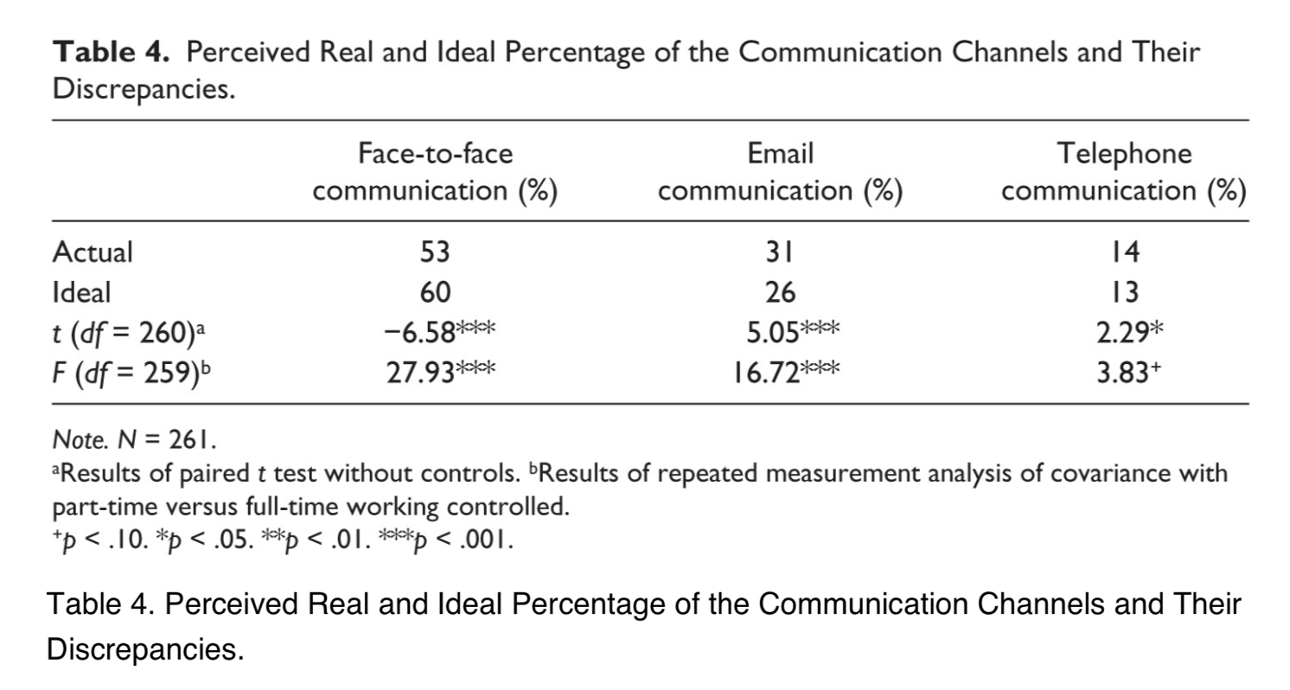
With sugar or cream? How do people like their coffee communication?
Preference for face to face with their leader
wished for 60% of communication to happen in this manner
26% by email and 13% by phone
Notes:
POLL:
1. How do you like communication?
2. What are the strengths and weakness of synchronous/asynchronous communication
Not personal, can't read tone, can't ask question, can be ignored (non-responses)
Emails lack a high fidelity emotion channel.
Communication means one person effecting another, but if it's not a "personal" exchange has this really happened?

Slide 35
More on Emails/IMs/Social Media...
Asynhronous Communication
<Emails/IMs/Social Media>?
Tone is not high fidelity (easily misunderstood)
Interaction and engagement with questions not supported
Feedback might never be given
Does not provide traditional communcation of personal human exchange and interaction
More Thoughtful?
More Accurate?
More Complete?
More Sincere?
More Demanding?
More Involved?
An Exploratory Study of the Application of Mindsight in Email Communication by S Ogwu, P. Sice, S. Keogh, C. Goodlet Heliyon 6(7) e04305 (2020)
Notes:
These are the answers to the last poll question

