Slide 1
Communicating with Data Studies on Learning
Content: Professor Michael Palmer UVA Center for Teaching Excellence
Presentation: Professor Scott Schwartz UVA School of Data Science
AKA How to get
stuff out here, in there
Notes:
Learning: getting information from the outside through the barrier

Slide 2
How to actually learn something
Practice Retrieving the Information
Engage in recall challenges; doesn't need to be high stakes
Provide Spacing between Practice [spaced repetition]
One or two days between sessions; minimize "cramming"
Interleave and (Re)Connect Concepts
Continuously build and reinforce your "knowledge graph"
Elaboration
A story, small detail, analogy, or visual metaphor can often be used to anchor a concept along many entry points in a knowledge graph
Notes:
We'll cover 1 and 2 at length – 3 and 4 are also very important huge

Slide 3
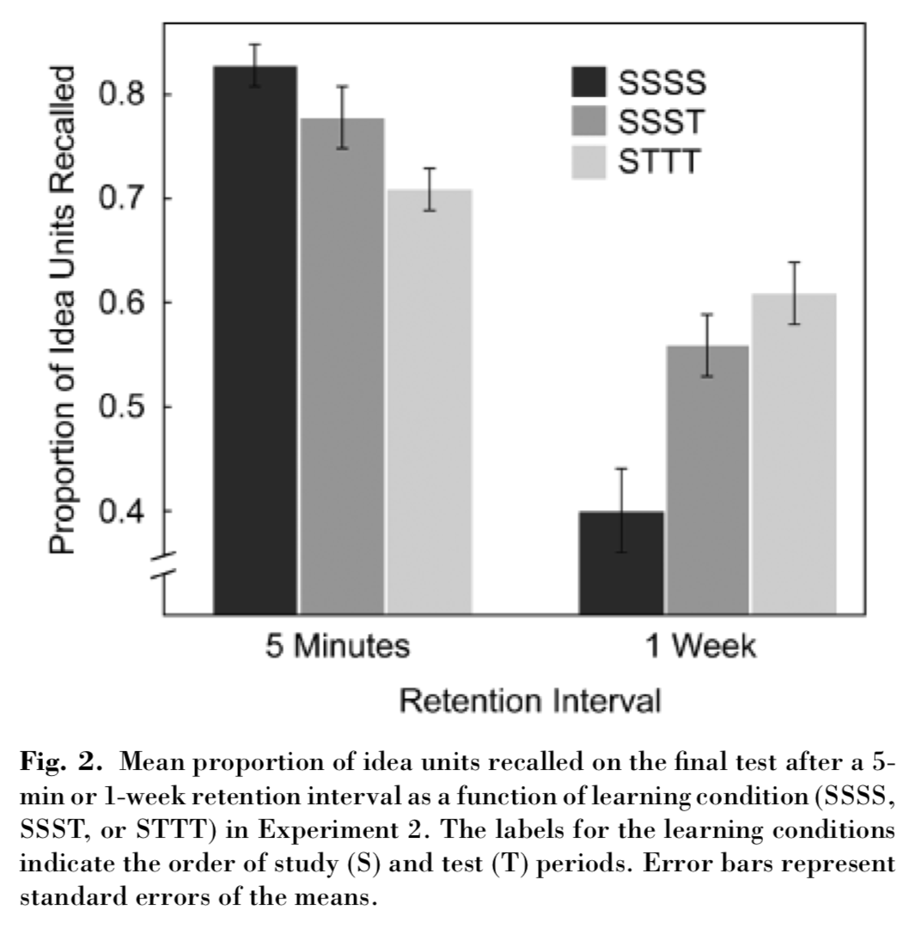
Testing is Good!
Notes:
Here's a study showing the effect of practice tests on retention a week later:
- Four study periods; or
- Three study periods and then a test; or
- One study period and then three tests
Proportion of "remembered stuff" ("or something"):
- At the end (after a 5-minute break), VS
- 1 week later
Pretty interesting, eh?
Oh!? Is *something* wrong or not to your liking?

Slide 4
Testing is Good!
Notes:
Is that better?
Cool: so testing has longer term effects compared to studying.
Recall practice, notecards, etc.
Really clear, big difference, right?
What about the "double-dash" down below 0.4?
How does the impression change if I extend down to zero?
Is that different or similar to what I did with my slides? <Flip Back>
DO FIRST SET OF (3) POLL QUESTIONS (3)

Slide 5
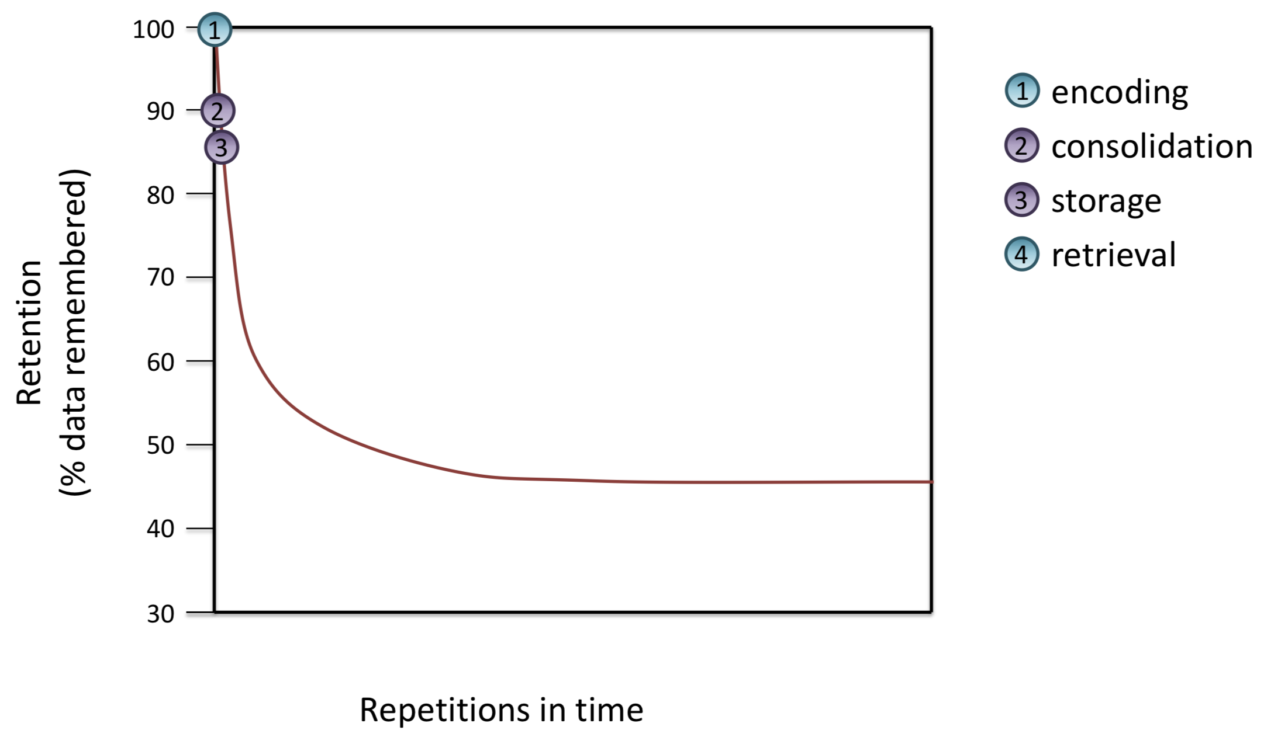
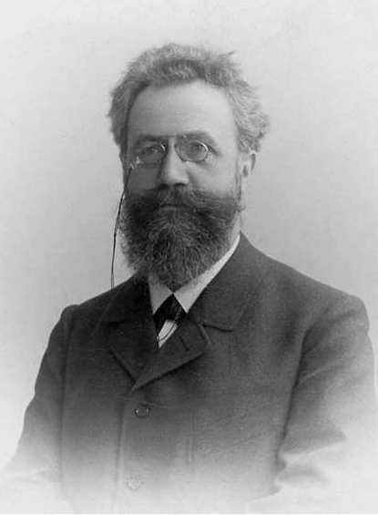
Memory: A contribution to experimental psychology by H Ebbinghaus
New York Dover
(1885/1974)
Notes:
When I joined the UVA faculty, we had an orientation on how to facilitate student learning, and this very interesting work was presented to us!
So this fellow, Ebbinghaus, worked on estimating how much you remember over time <Say-jall presented this to us last time and in her discussion board post.>
<point out the notations are about that not all information is necessary retained even right away—that's on the next page>
<describe 15 mono-syllabic experiment>
<next>

Slide 6
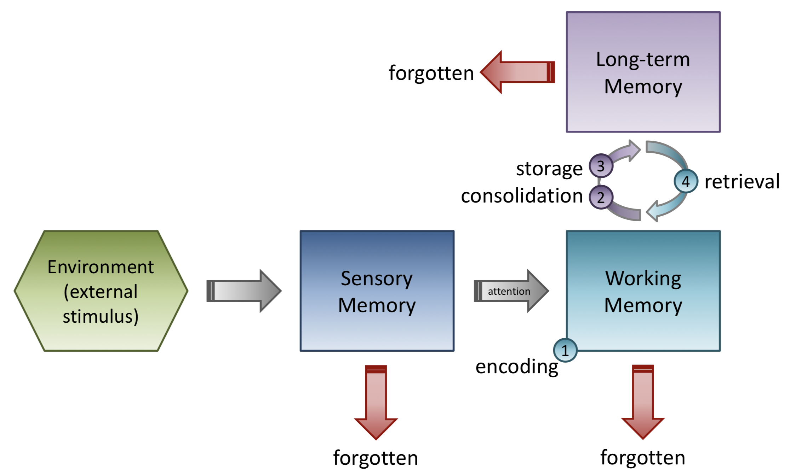
How Forgetting Happens
Memory: A contribution to experimental psychology by H Ebbinghaus
New York Dover
(1885/1974)
Notes:
Where the numers refer to this mechanism model – I won't go into this into detail here – but essentially it's just itemizing and describinig each step in the learning process
<next>

Slide 7
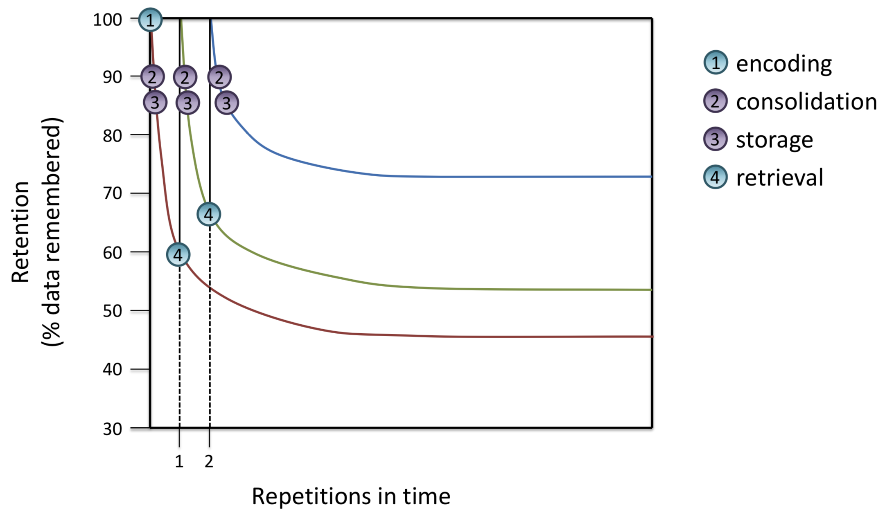
Memory: A contribution to experimental psychology by H Ebbinghaus
New York Dover
(1885/1974)
Notes:
Okay, so then we were showed that if you do a repeated studying session, you can increase the proportion of stuff you remember!
<next>

Slide 8
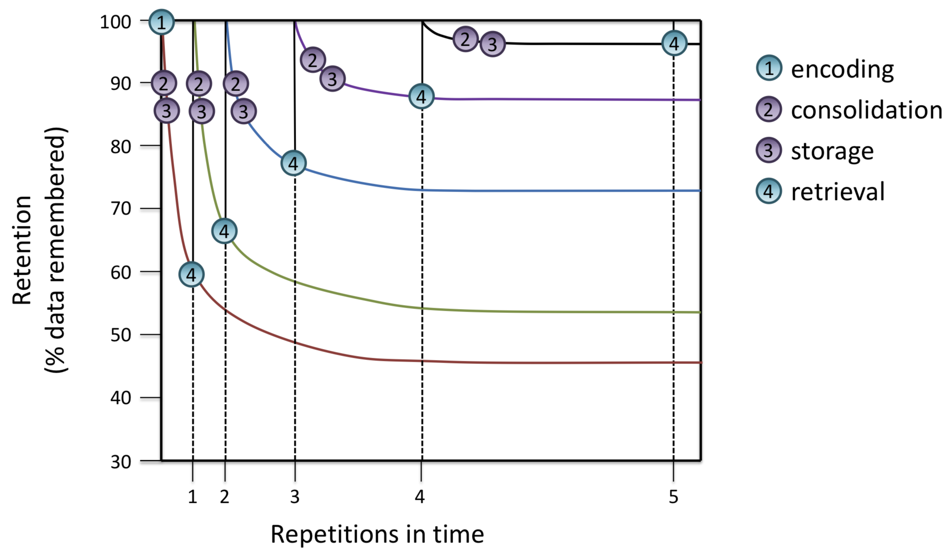
Memory: A contribution to experimental psychology by H Ebbinghaus
New York Dover
(1885/1974)
Notes:
And so on!
<next>

Slide 9
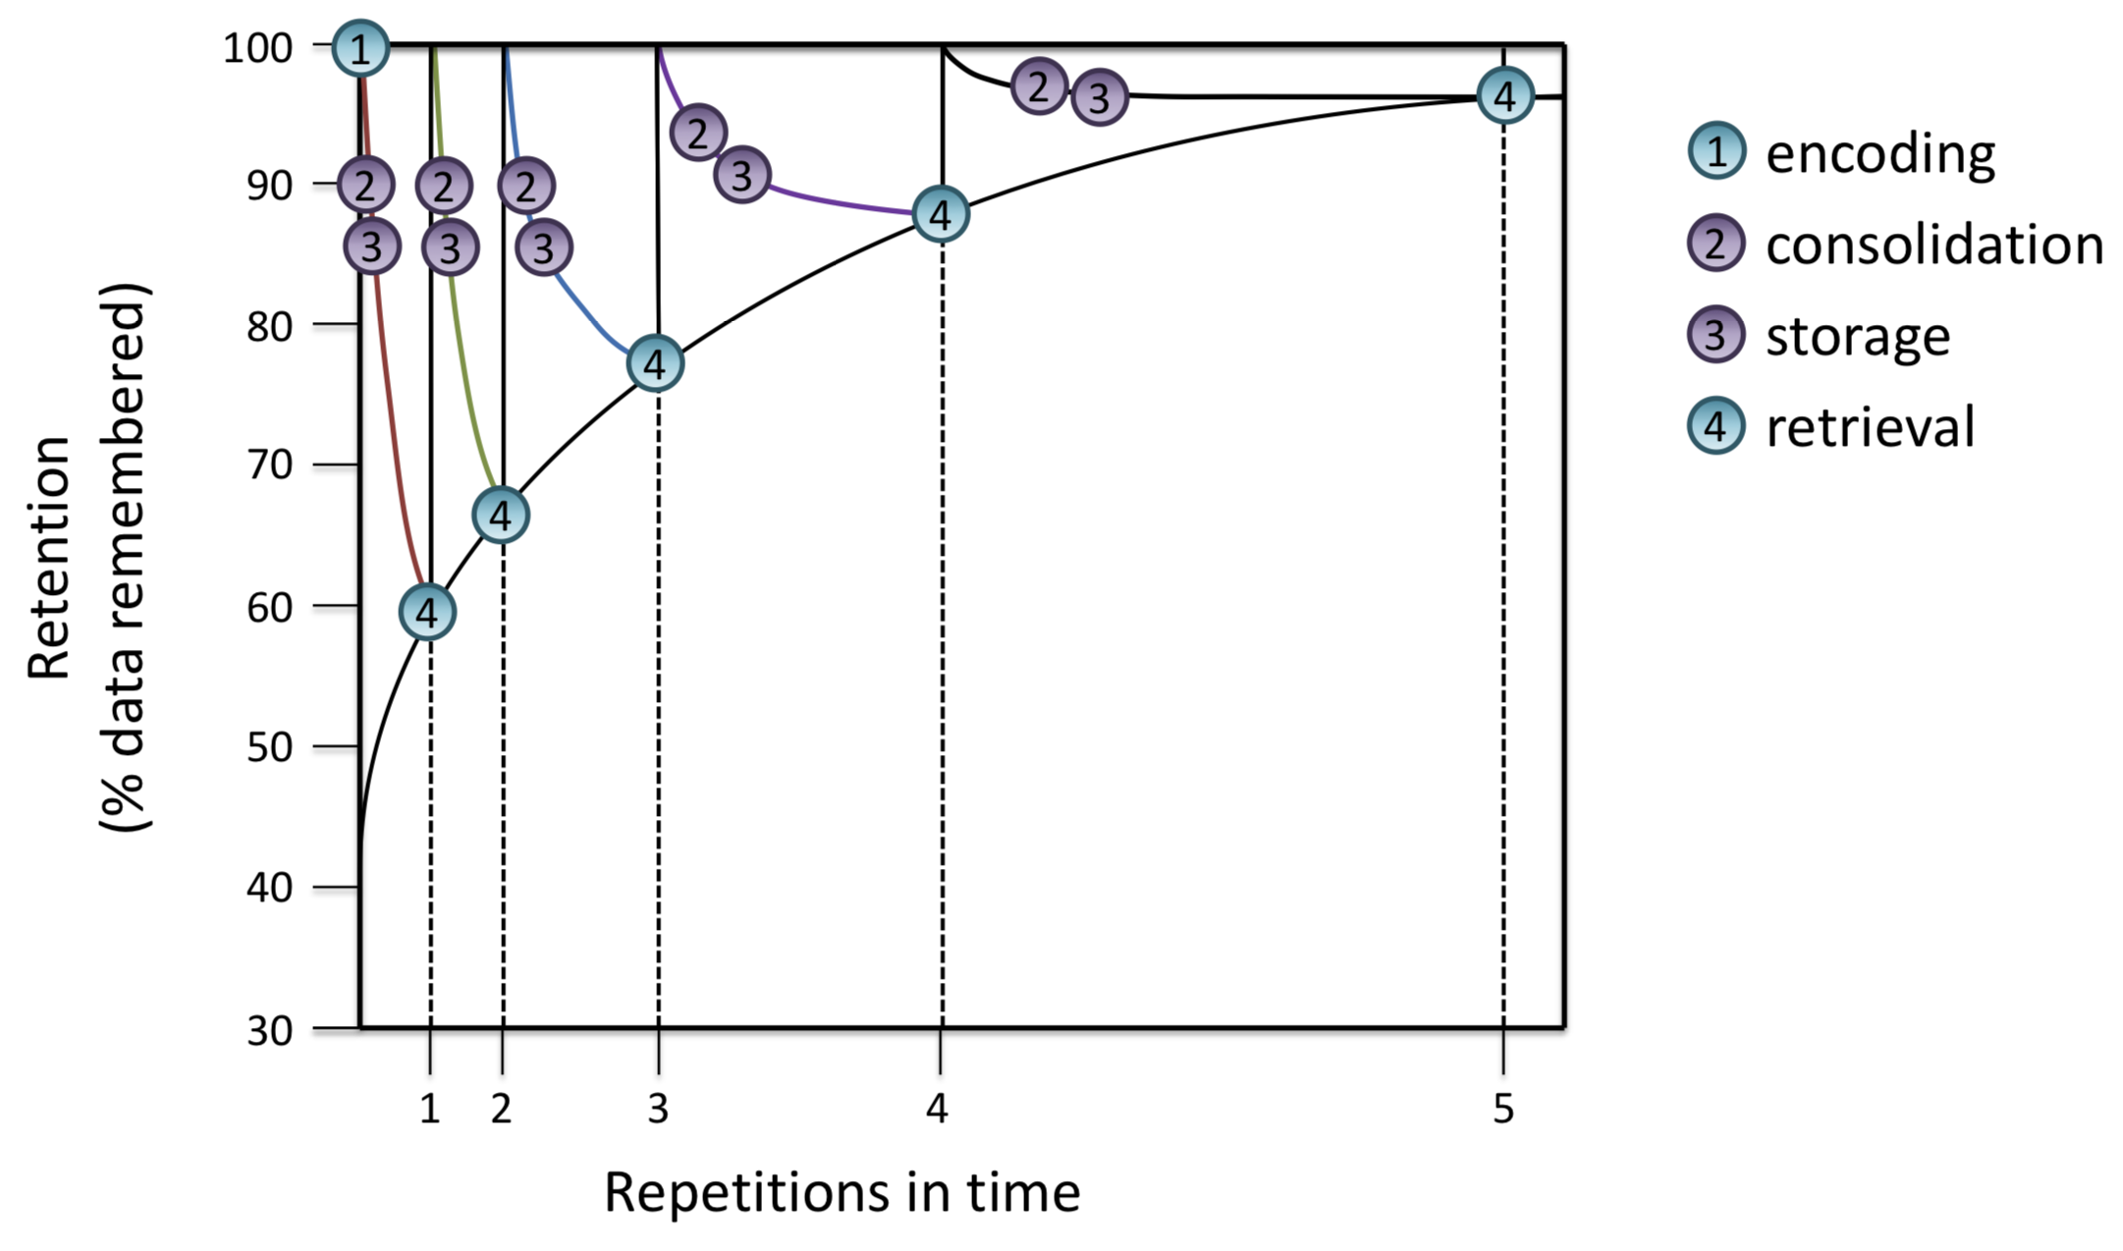
Memory: A contribution to experimental psychology by H Ebbinghaus
New York Dover
(1885/1974)
Notes:
So you can increase your long-term learning retention with SPACED REPETITION!
DO SECOND SET OF (3) POLL QUESTIONS (3)

Slide 10
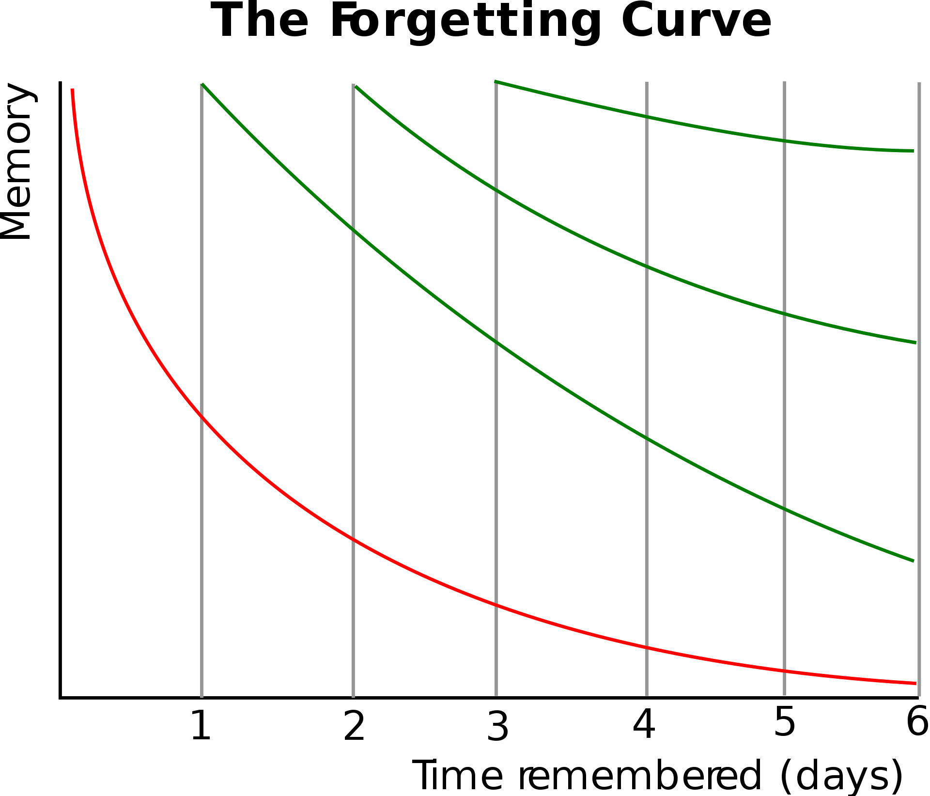
Memory: A contribution to experimental psychology by H Ebbinghaus
New York Dover
(1885/1974)
Notes:
If we go to the wikipedia page for Ebbinighaus, here's what we see.
There's his the forgetting curve on the bottom – the red line.
And then the green curves are what we've been talking about, based on spaced repetition.
<next>

Slide 11
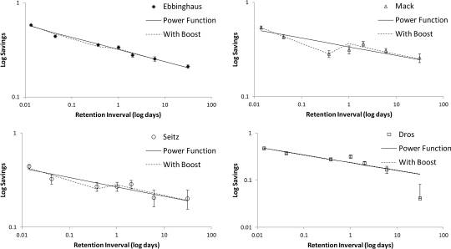
Replication and Analysis of Ebbinghaus’ Forgetting Curve JMJ Murre & J Dros (2015)
https://supermemo.guru/wiki/Hermann_Ebbinghaus_(1885)_and_spaced_repetition_(1985)
.
https://www.worldcat.org/title/memory-a-contribution-to-experimental-psychology/oclc/1175487
Notes:
Okay, the thing is, Ebbinghaus didn't study spaced repetition.
His work was seminal, fundamental, and laid the groundwork for spaced repetition.
But Ebbinghaus worked on the forgetting curve – NOT spaced repetition.
Here's what Ebbinghaus' actual data is;
ACTUALLY, his data plus a replication of his work.
<next>
[Possible Assignment: get this data and remake these plots – data does not appear very accessibly formatted...]

Slide 12
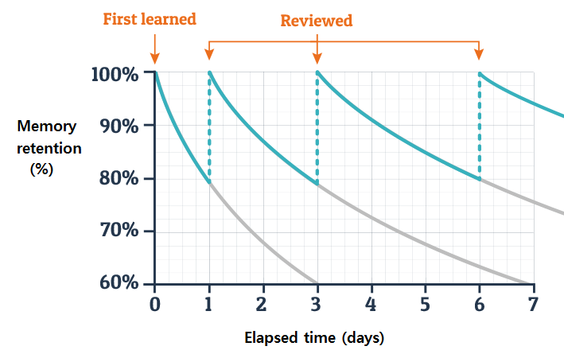
Memory: A contribution to experimental psychology by H Ebbinghaus
New York Dover
(1885/1974)
The effect of flipped learning on academic performance as an innovative method for
overcoming Ebbinghaus' forgetting curve by BA Chun & HJ Heo ICIET 56-60 (2018)
Notes:
If you want to reference the literature on Spaced Repetition, you require a different reference, like this one!
DO THRD SET OF (3) POLL QUESTIONS (3):
+ Do you prefer the emphasis on the line slope, or the spacing?
+ Does it matter what the Y-axis means? Do these plots disagree?
I'm glad you've said "no" -- because that's just a figure!
It looks extremely stylized. I'm not at all sure that there's data behind that.
It seems to me it might just be an idea exrpessed in a visual format.

Slide 13
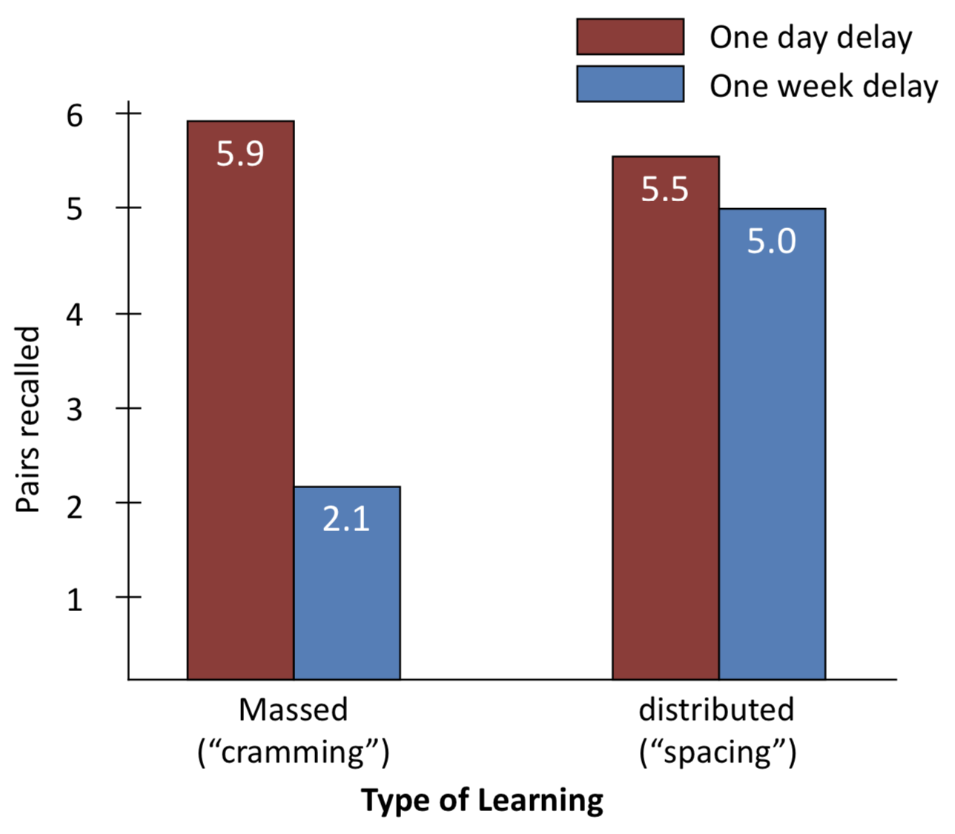
More Evidence
Borrowed from Professor Michael Palmer UVA Center for Teaching Excellence​
Notes:
Here are some study results suggesting:
+ cramming works in the short term, but not long-term
+ distributing your learning (spaced repetition) seems to work better in the long term
DO (3) THREEMORE POLL EVERYWHERE QUESTIONS (3)
1.
+ Uncertainty? n?
+ Try to figure out where this data actually came from in the referenced paper... (I'll give you extra credit if you can... don't advise it – I couldn't figure it out... but you can try if you have A LOT of free time)
+ "you can communicate a lot with data, but make sure you're communicating with data"
2.
At least what I'm showing you is "suggestive"? And so far seems to be "generally supported" in the scientific literature I've shown you thus far?
3.
Bias??

Slide 14
How to make learning easier
Lower the cost of mistakes
Negative repercussions of exhibiting learning behavior causes people not risk it and fear question asking, exposing weakness, ...
Make the lesson "Real"
Addressing concepts within their actual context "automatically" correctly locates them within the KG
Create Community
A shared mission, culture, support structure can synergize effort
Treat Identity as a fluid construct – not a fixed characteristic
Reduce "imposter syndrome": highlight similarity AND value uniqueness; Avoid Static Identity Labeling/Pigeonholing
The need
to belong is
a fundamental
human motivation
Baumeister & Leary, 1995
Notes:
1. seems REALLY important to me... I hope we're able to foster this in our class: being wrong is good—it's a great way to learn!
2. I think this just means make topics relatable and understandable so that people can actually get their hands and heads around the idea:
- it reminds me that puttting things in a "narrative" that can be worked through and followed is helpful
¾ were highly stressed at UVA – of all the learning facilitation techniques from the new faculty orientation I've been referencing emphasized these
-3 certainly belonging community is very powerful: I really like that quote on the bottom right
-4 For the last one, what they told us was: (a) help alleviate imposture syndrom, (b) point out similarities but value uniqueness.
These made sense to me; but, it became even clearer to me after a conversation with my Dad who does personell/job matching work for the Air Force:
- He told me about some interesting literature showing that when people percieve identity as fixed, learning becomes much more threatening, because if they perform poorly in a class, they percieve this to define something about who they are; whereas, if your identity is growing and fluid, then being wrong and learning from it need not be so threatening.

Slide 15
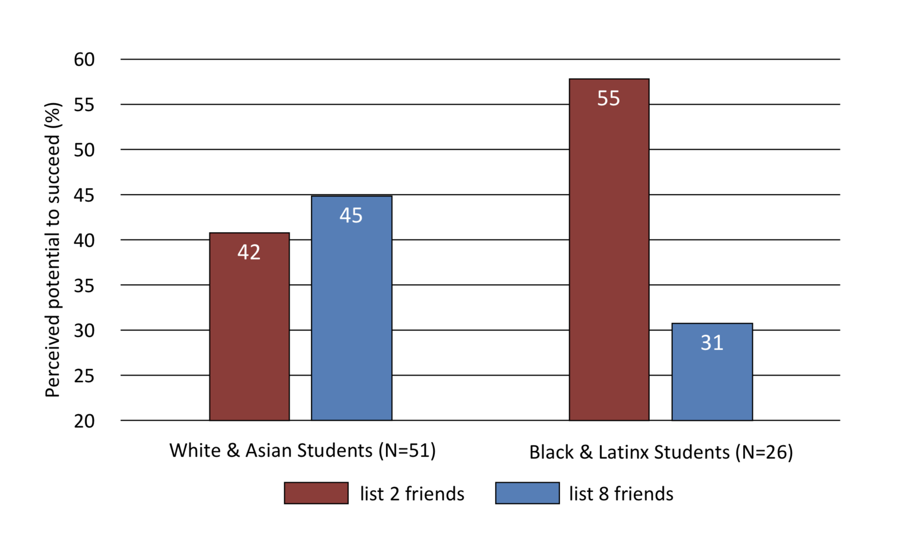
Presented to UVA Faculty
Notes:
Here's some really interesting data.
The study asks particpants:
(a) list 2/8 friends in your major; then
(b) tell us how you think you're going to do
Look how the effect is very different for non-traditional, less represented students...
So this is a question of feeling of belonging in the learnnig community.

Slide 16
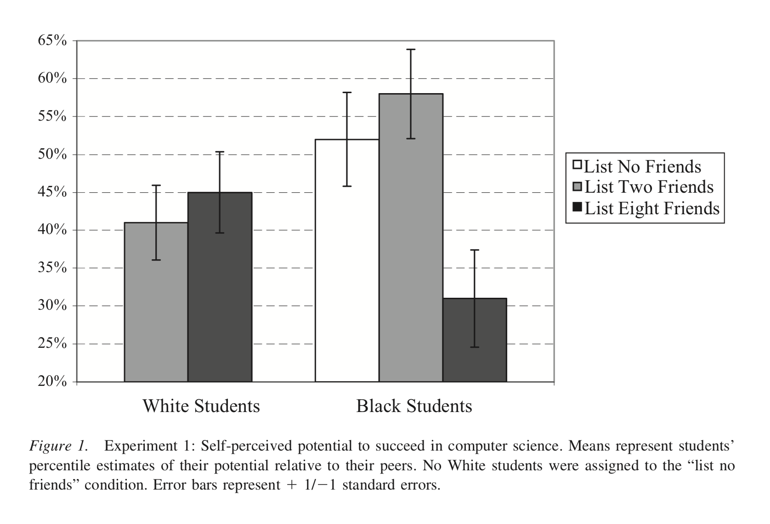
As Published in the Paper
Notes:
Pretty powerful, right?
Here's the actual figure from the paper. What do you notice here?
+ I'm not sure what the descrepancy is between "White" versus "White & Asian" -- perhaps the remade figure is being more explicity – I haven't checked
+ there's actually not a significant difference between "White" and "Black" students; but
+ I would say that there's a significant difference (i.e., data evidence) that within the "Black" students in the study, listing more friends hurts percieved success potential
LAST POLL EVERYWHERE QUESTION

Slide 17
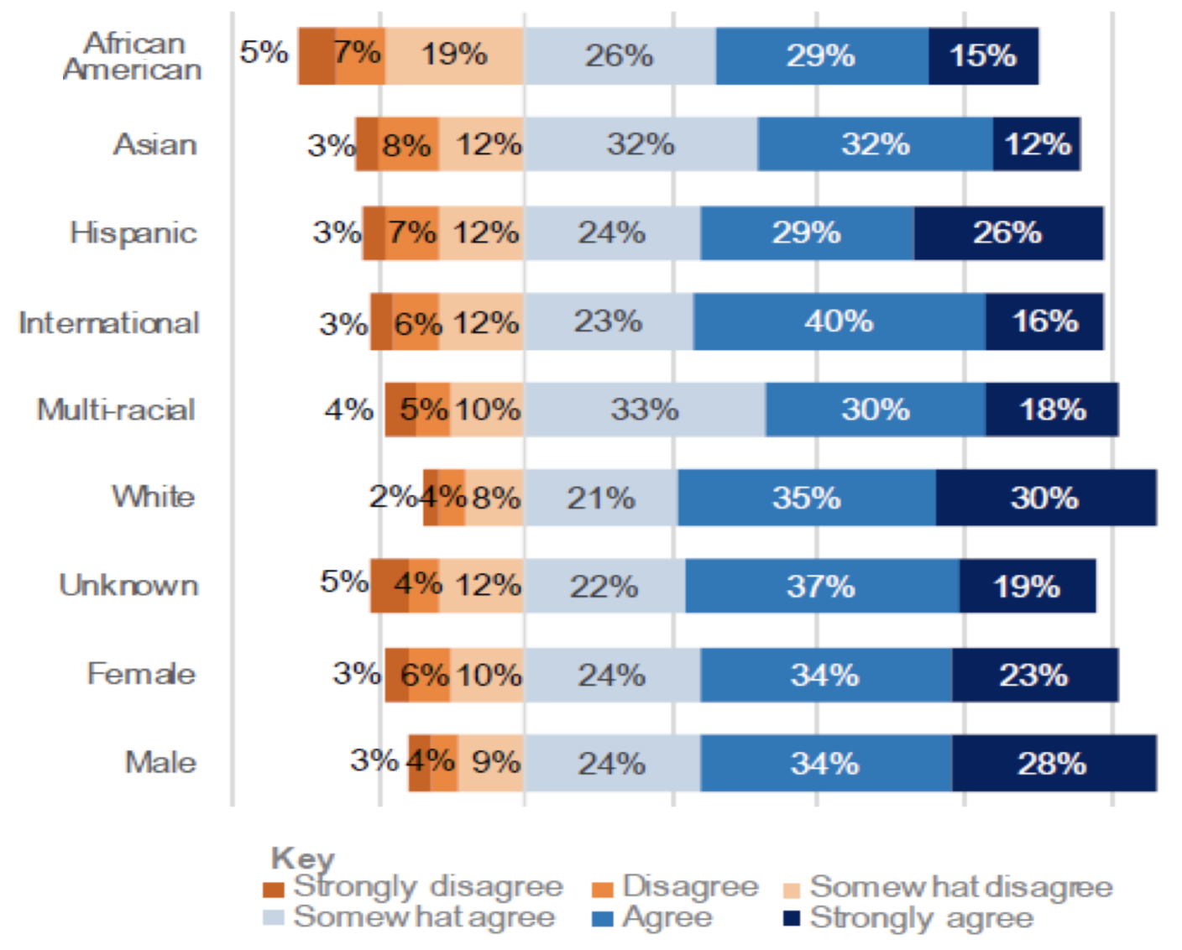
What's not to like about this ?
Notes:
Generality/Universality/Location? Hidden centering? Sample Size?
I think a very cool graphic could be made out of this... I don't think this is it...
[Possible Assignment – get this data – make a better graphic]

Slide 18
Assignment:
Find any article about "learning" that catches your interests (e.g., effective learning strategies, pyschosocial factors relevant/affecting learning, etc.)
Come to class prepared to summarize (in 15 seconds) one point of the article
If any graphic or data presentation is included in the article, and you have a positive or negative critique of the graphic that you can share: +1
Post your article on the discussion board along with your 1-3 sentence summary (and graphic with yourpositive or negative graphic critique if you have it)
Read and make a comment about one other article shared by your classmates that you find interesting:
[Possible Assignment: get the "Essinghaus" data and remake the reproducibility plots]
[Possible Assignment – get the "I feel I belong" data – make a better graphic]
(4) When is altering the impression a plot makes justfied/unjustified?
If the numerical impression is changed
If the adjustment is clear and clarifying
(11) Have you found the presentation on spaced repetitioncompelling?
(11) Did you find that the addition of citations strengthened the presentation? [in a second I'm going to show you they weren't even real]
(5-11) Have I sufficiently convinced you that repetition is the key to learning? [hope not... as thse are just drawings]
(16) Do you agree with dropping the error bars on plots?
(16) What do you think might translate from learning to communicating?
(20) Did you find the visual communications effective?
(20) Do you find pen and paper, whiteboard useful for visual communications?
(20) Do you find prepared visuals (like those from today's) can be effective?
(20) where is visual presentation useful?
(20) What is the difference between synchronous/asynchronous communication
(20) What are the stneghts and weakness of synchronous/asynchronous communication
Not personal, can't read tone, can't ask question, can be ignored (non-responses)
Communication means one person effecting another, but if it's not a "personal" exchange has this really happened?
Emails lack a high fidelity emotion channel.

Slide 19
Pre-assignment:
Find an article about communication that catches your interest.
Generally, the article should address a question of "what are some challenges in communication?" and discuss "techniques that can be used to address them".
There are many mediums of/for communication, so the article be focused on a specific kind of communication.
E.g.,"How to improve communication to others about your <code/analysis/project>"
E.g., "How to communicate in confrontational circumstances"
E.g., "How to communicate effectively in presentations"
E.g., "How to argue persuassively for something you're passionate about"
E.g., "How to communicate data science effectively to lay audiences"
And so on, these are just examples.
"Reserve" this article by creating a post with your article as the title on the discussion board – for the purposes of the placehold you can just put your name in the message.
If an article was already selected before you reserve it you will not get credit for the article.
Read the article and then edit you post to include a 1-3 sentence summary of the article.
Be able to communicate a key point communicated by the communication in about 30 seconds.
Describe the communication context, and a method recommended to improve communication in that context.
After class, read and make a comment about one other article shared by your classmates that you find interesting.

Slide 20
Summary of previous lecture points:
Theming, e.g., my "membrane in/out circle" and "theme cutoff analogy" can get the point across
Game time practice, Spaced repetition, KG, stories,
Artificial impression changes are very dangerous
Uncertainty is SO IMPORTANT for not over-interpreting evidence (point estimates suggest something that's not justified from the data)
Schematics can look like data – but they're just a means to convey an idea
Presentation Matters... Reproducibility matters... making data available matters
Just citing something is not evidence – it's an appeal to authority logical fallacy
Show me uncertainty! Show me what the experiment is! What is the context.

