Slide 1
Conflict
Schwartz
Notes:
Poll:
1: good about asynch
- more time to think
- more precision
2: bad about asynch
- can be demanding
- no quick questions clarification
- tone easily misunderstood
- missing much of traditional human communication
3:

Slide 2
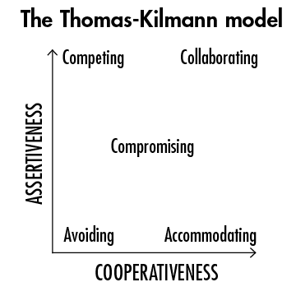
TKI
nstrament
ASSERTIVENESS
Illustrates the interaction between ASSERTIVENESS andCOOPERATIVENESS as a CARTESIAN (XY) COORDINATE SYSTEM
Allows us to draw on intuition from GEOMETRIC and NUMERIC concepts
Gives Us A Way To Characterize, Discuss, And Describe Conflict Experiences!
COOPERATIVENESS
https://www.zingtrain.com/blog/the-thomas-kilmann-model-a-helpful-tool-for-examining-how-you-respond-to-conflict/

Slide 3
TKI
I would have preferred if the
GEOMETRIC and NUMERIC intuition in the original figure was further emphasized, i.e., axes direction and magnitude
https://www.zingtrain.com/blog/the-thomas-kilmann-model-a-helpful-tool-for-examining-how-you-respond-to-conflict/

Slide 4
TKI
ASSERTIVENESS
I would have preferred if the
GEOMETRIC and NUMERIC intuition in the original figure was further emphasized, i.e., axes direction and magnitude
COOPERATIVENESS
https://www.zingtrain.com/blog/the-thomas-kilmann-model-a-helpful-tool-for-examining-how-you-respond-to-conflict/

Slide 5
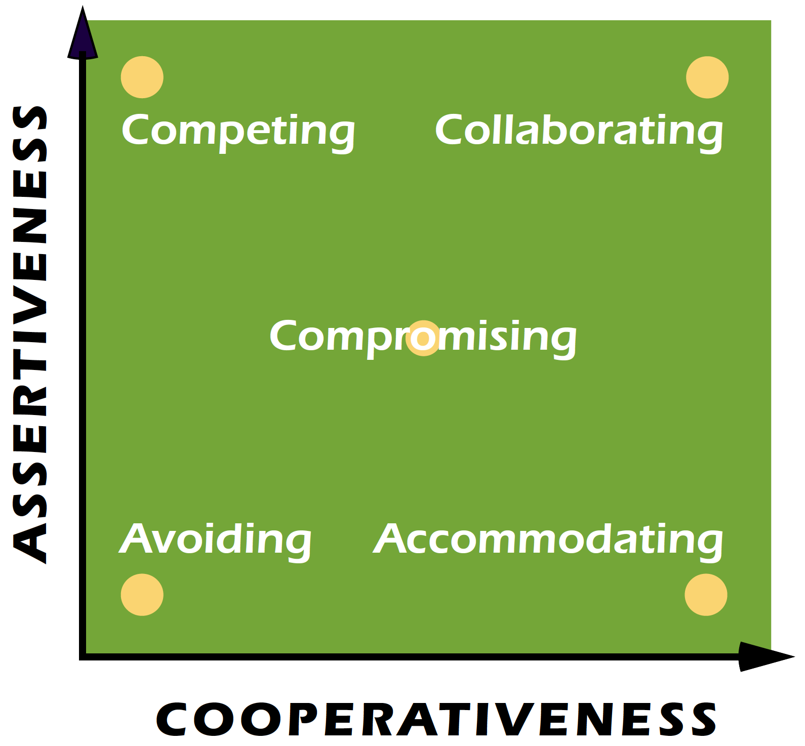
https://kilmanndiagnostics.com/overview-thomas-kilmann-conflict-mode-instrument-tki/

Slide 6
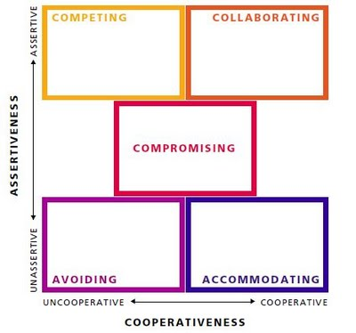
https://challengingcoaching.co.uk/conflict-and-challenge/

Slide 7
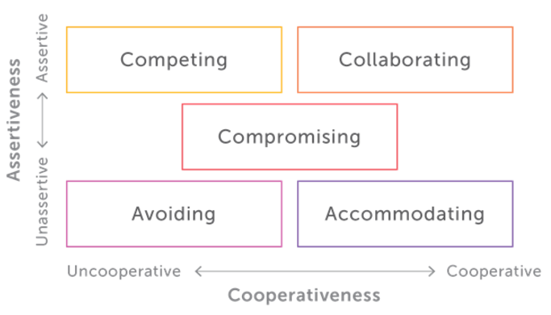
https://alainjeanbaptiste.com/business-mastery/ the-leadership-circle/the-leadership-culture-survey/ thomas-kilmann-conflict-mode-instrument-tki/

Slide 8
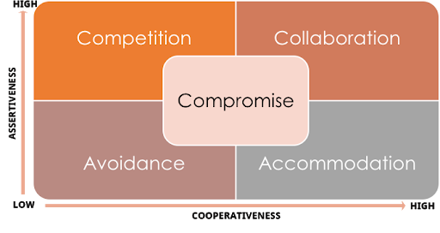
http://ascenditur.no/blog/2017/04/30/managing-workplace-conflicts/

Slide 9
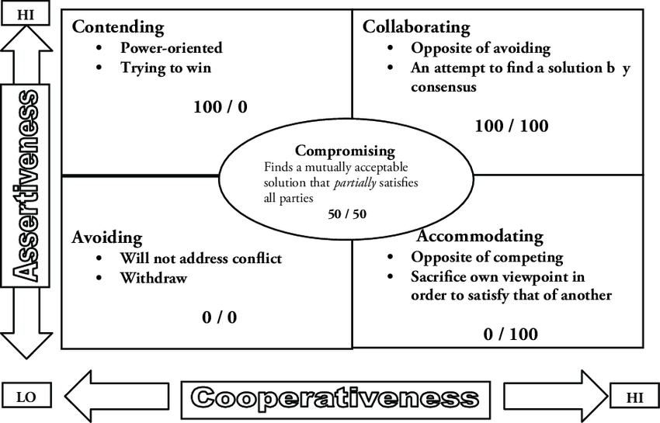
https://www.researchgate.net/figure/The-so-called-Thomas-Kilmann-Conflict-Mode-Instrument_fig1_233641635

Slide 10
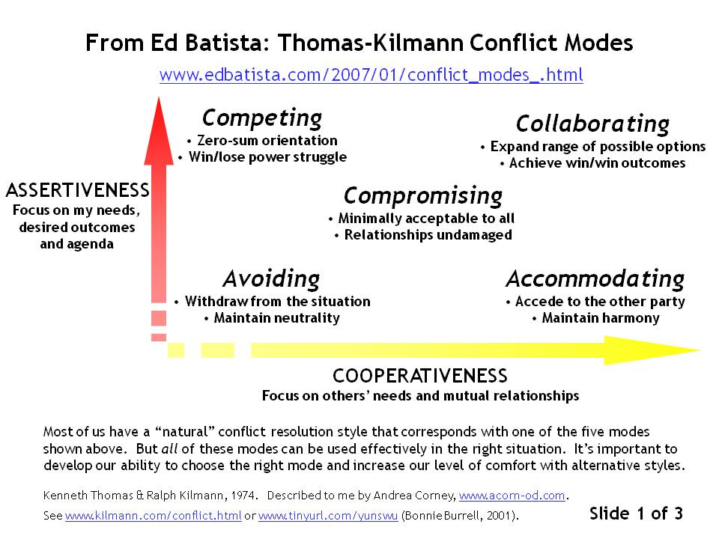
https://sararickover.wordpress.com/2012/09/24/how-do-you-deal-with-conflict-use-of-the-thomas-kilmann-conflict-mode-inventory-in-mediation/

Slide 11
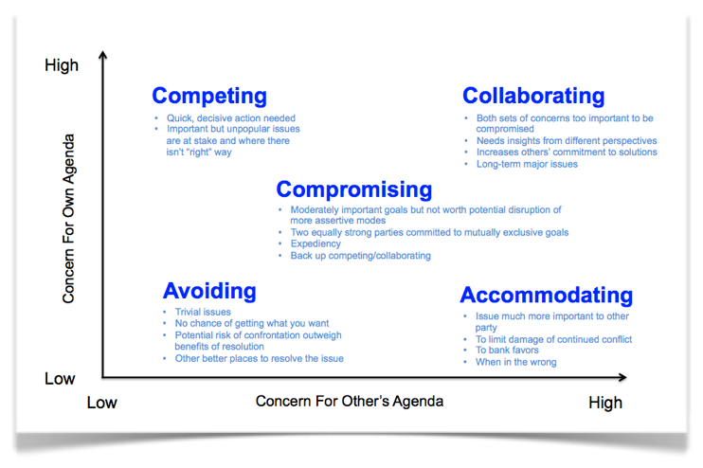
https://workshopbank.com/thomas-kilmann-conflict-mode-instrument

Slide 12
Avoiding
Is this ever good?
When is this good?
https://www.zingtrain.com/blog/the-thomas-kilmann-model-a-helpful-tool-for-examining-how-you-respond-to-conflict/

Slide 13
accommodating
Is this ever NOT good?
When isn't this good?
https://www.zingtrain.com/blog/the-thomas-kilmann-model-a-helpful-tool-for-examining-how-you-respond-to-conflict/

Slide 14
competing
Is this ever good?
When is this good?
https://www.zingtrain.com/blog/the-thomas-kilmann-model-a-helpful-tool-for-examining-how-you-respond-to-conflict/

Slide 15
compromising
Is this ever NOT good?
When isn't this good?
https://www.zingtrain.com/blog/the-thomas-kilmann-model-a-helpful-tool-for-examining-how-you-respond-to-conflict/

Slide 16
collaborating
Is this ever NOT good?
When isn't this good?
https://www.zingtrain.com/blog/the-thomas-kilmann-model-a-helpful-tool-for-examining-how-you-respond-to-conflict/

