Slide 1
Hi, my name is Deep learning
Could you please record the Q&A session? Due to visa restrictions, I am currently staying
in China,
which is
13 hours
ahead of the US eastern time zone. So I will not be able to attend it.
Scott Schwartz, PhD

Slide 2

A student

Slide 3

Solution
Problem solved

Slide 4

Solution
You're welcome
Problem solved

Slide 5
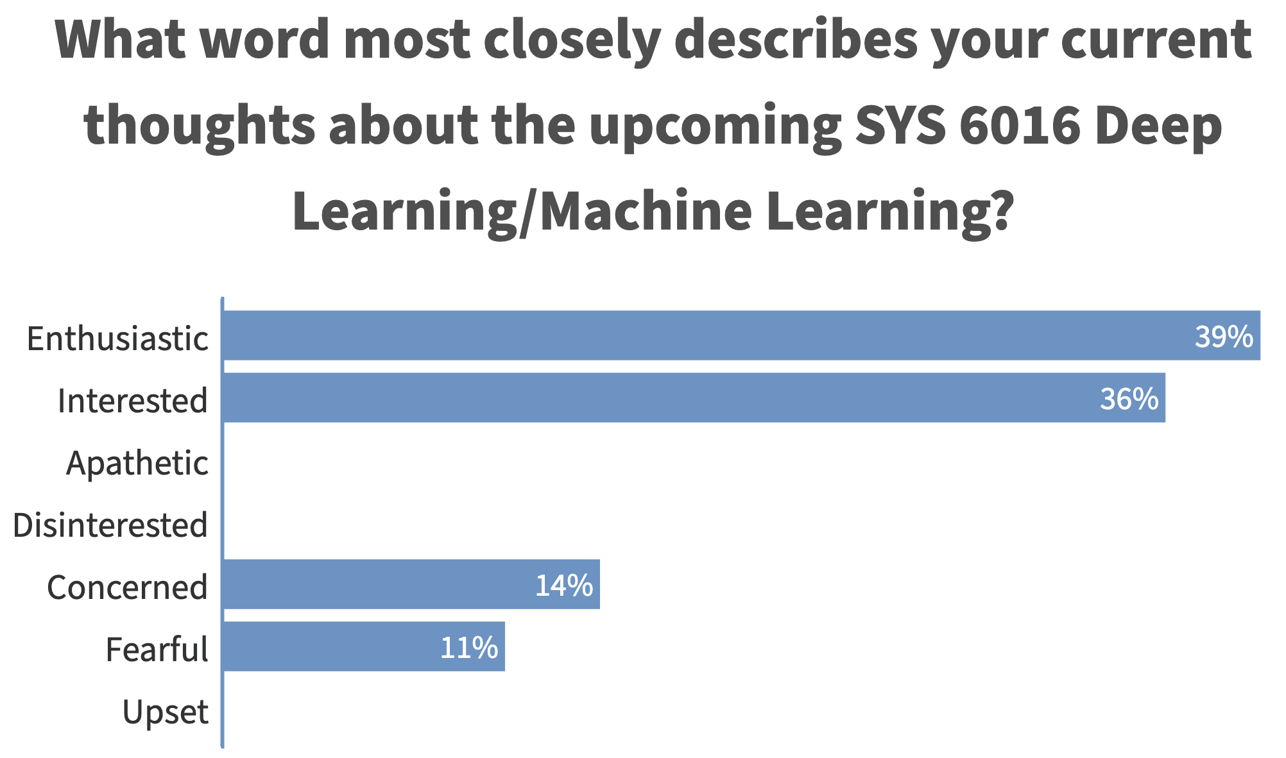
Survey Says

Slide 6
Survey Says
66%

Slide 7


What specific topics or tasks are we expected to be proficient in prior to week 1? What study / preparation materials should we use if we are not prepared for certain topics?

Slide 8
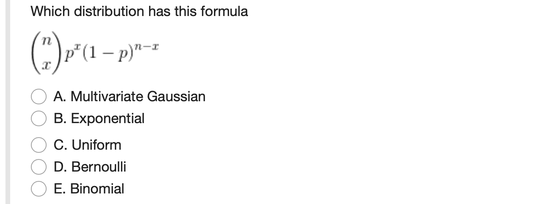

Slide 9
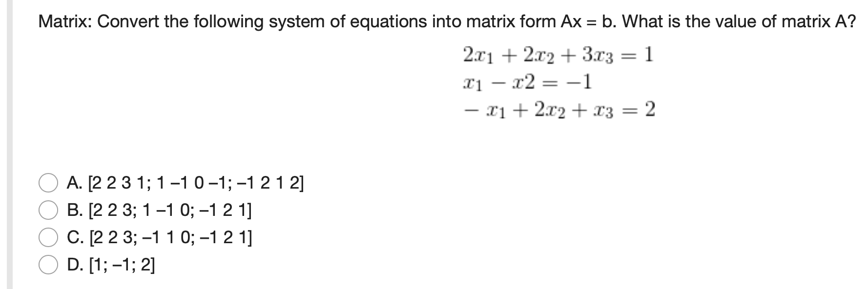

Slide 10
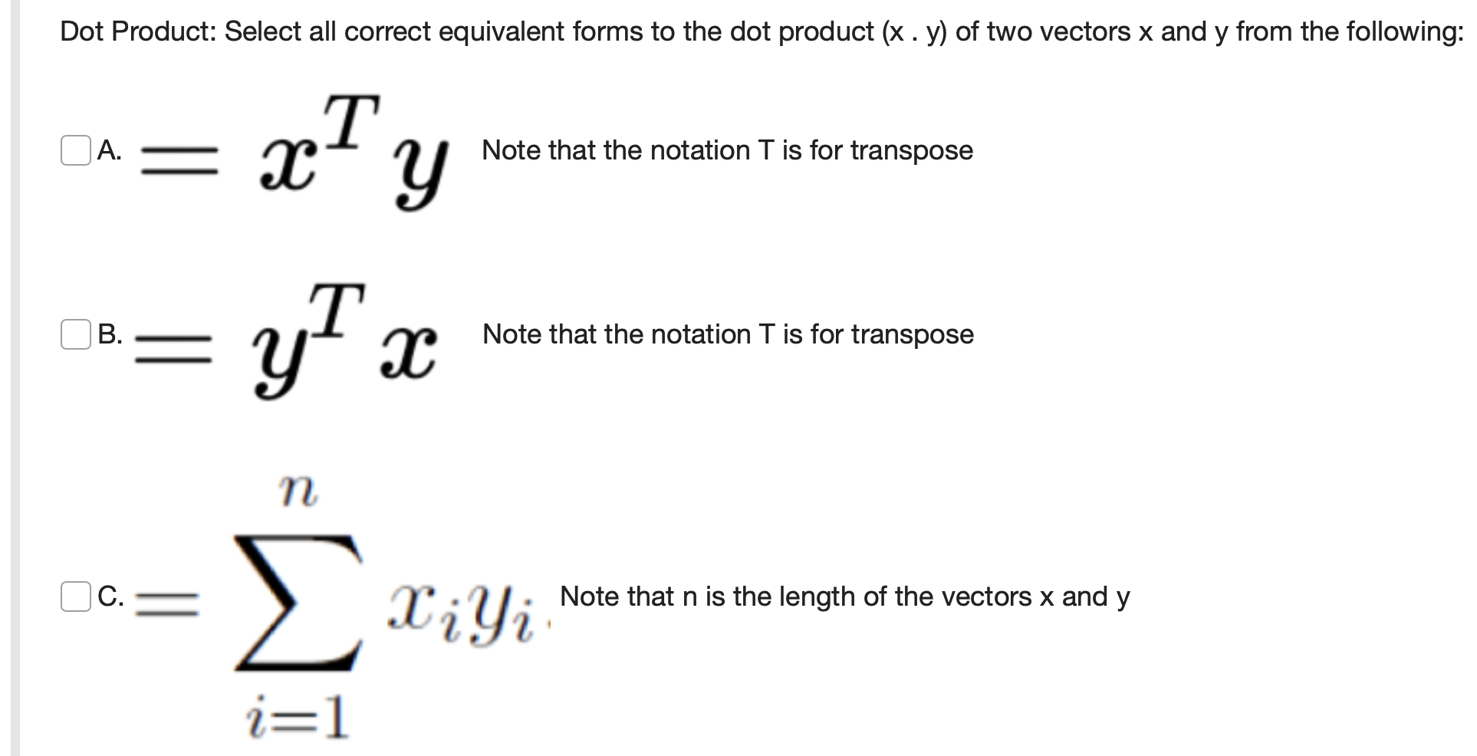

Slide 11
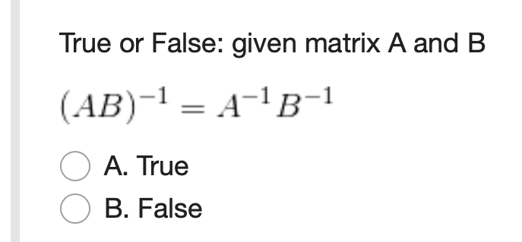

Slide 12
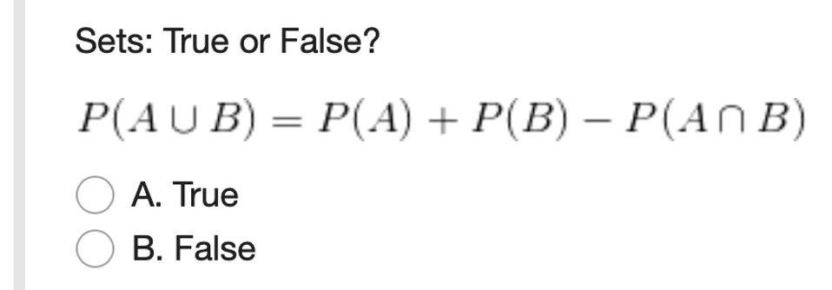

Slide 13
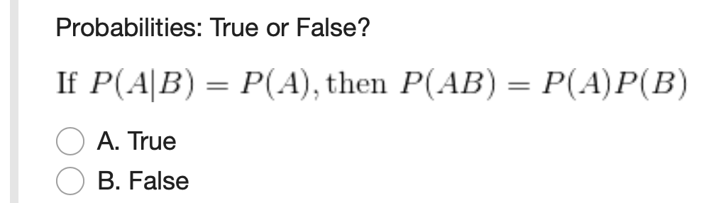

Slide 14
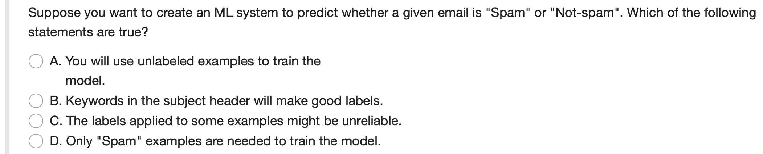
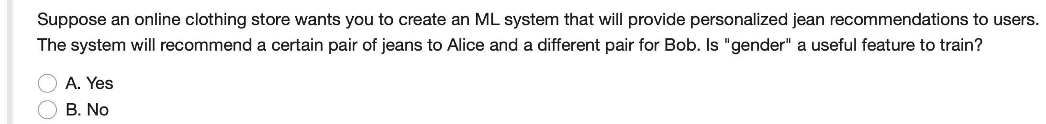
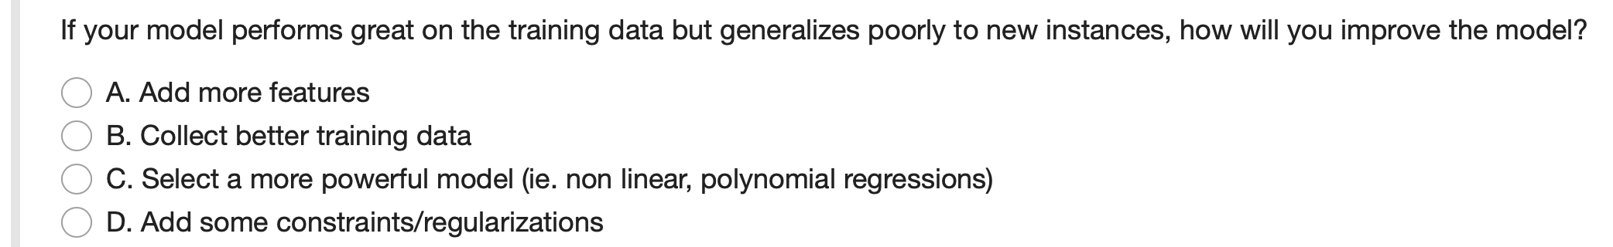

Slide 15
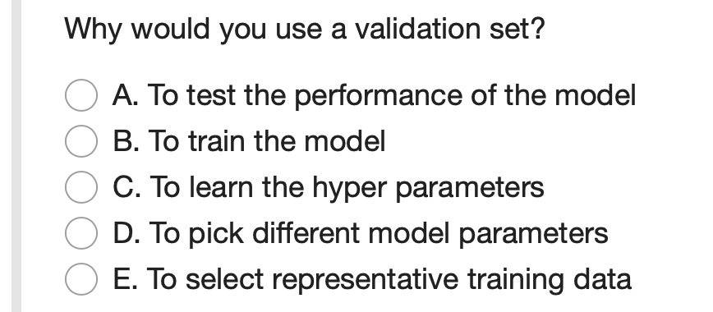

Slide 16
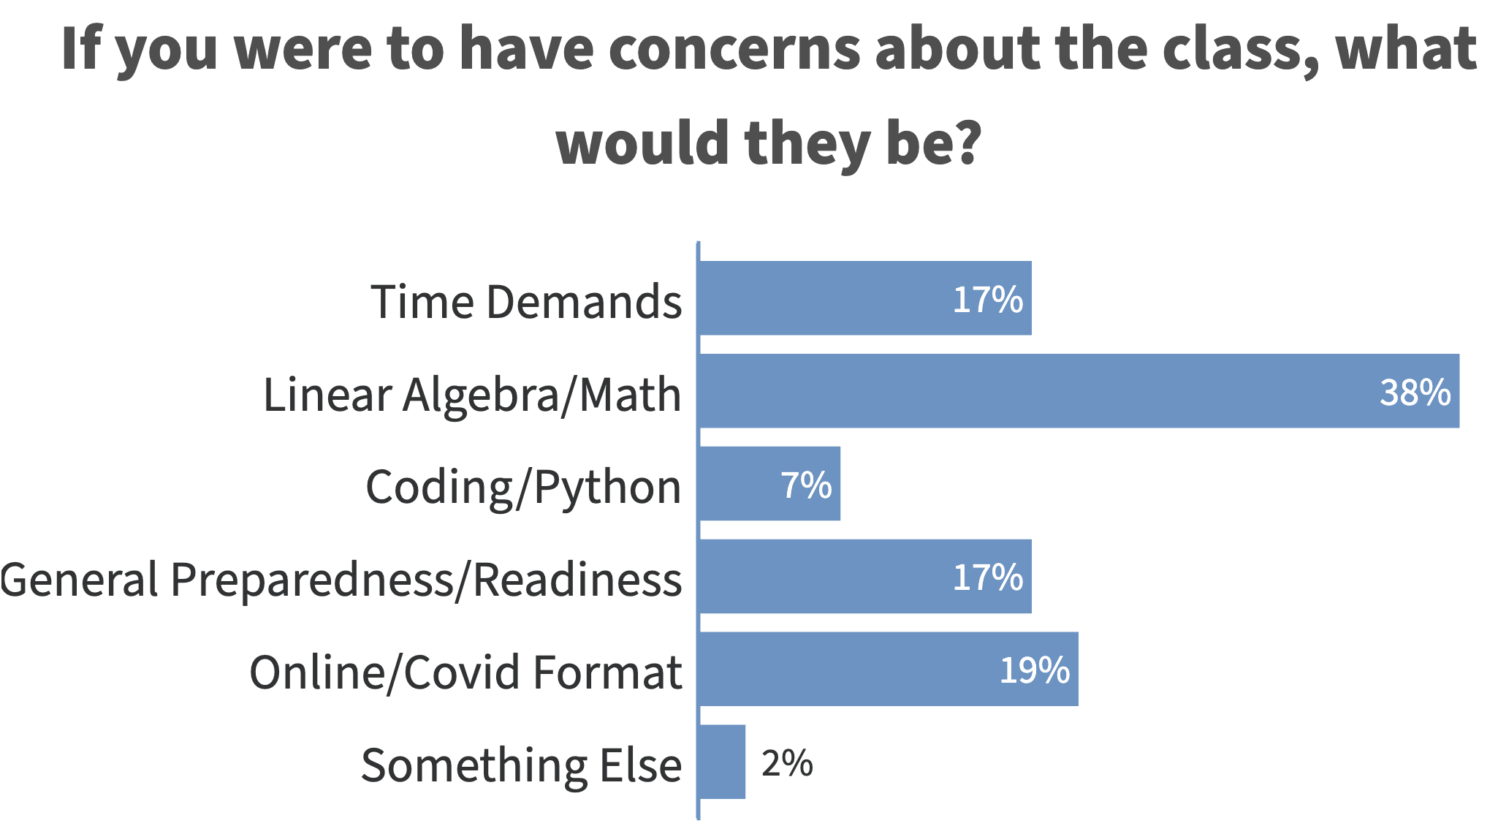
Survey Says

Slide 17
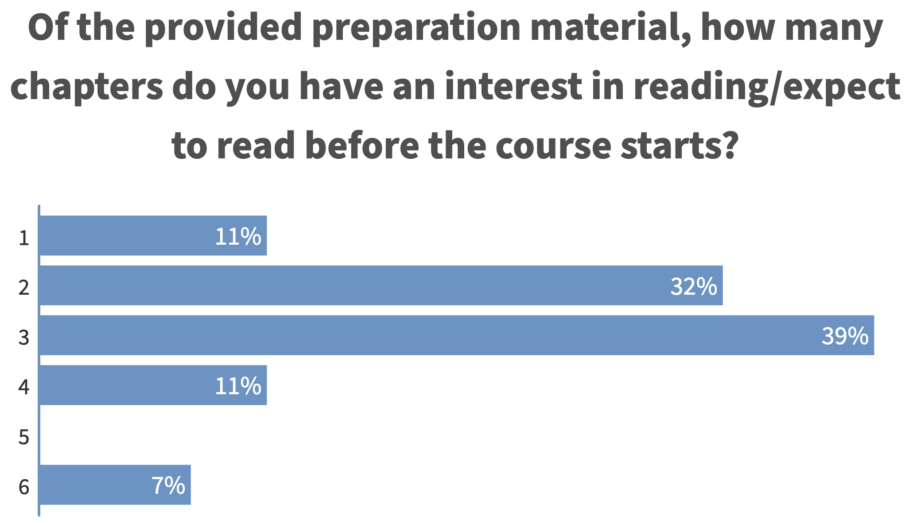
Survey Says

Slide 18
Survey Says

Slide 19
Survey Says
Which areas of math should study over break?
How to prepare for the course when you have limited coding background and a limited background in linear algebra
Will there be mathematical proofs or derivations required for this course?

Slide 20
Survey Says
I was great at math in undergrad, but have felt unprepared for the math-centric teaching in other MSDS courses like Bayes. I simply don't learn just by being shown equations. Please don't teach this way.

Slide 21

Math
Math is for fun
Because you like the way it helps you understand something in an exact way
Often along with a euphoric feeling of beauty and extreme elegance
If you never experience this beauty in your life, then I guess that makes you like basically every other human, historically speaking

Slide 22
Survey Says
Which areas of math should study over break?
How to prepare for the course when you have limited coding background and a limited background in linear algebra
YouTube math concepts that catch your eye from Ch 2

Slide 23
Survey Says
How to prepare for the course when you have limited coding background and a limited background in linear algebra
TensorFlow/Keras Tutorials
Simpler Python Tutorials

Slide 24

Survey Says
<Violins>...<silence> "runRead" <Rock metal>

Slide 25
Survey Says
<Violins>...<silence> "runRead" <Rock metal>

Slide 26
Survey Says
<Violins>...<silence> "runRead" <Rock metal>

Slide 27
Survey Says
Porting 10/12 modules (weeks) of a previously built online course into our "13" week format
Having more time/concept seems beneficial to me
Retaining old recorded lectures as extra material augmentation
Added code walk throughs and polling content reviews to course

Slide 28
Survey Says

Slide 29
Survey Says

Slide 30
Survey Says

Slide 31
Survey Says

Slide 32
What is this?
How do you envision organizing and running the course? Have any plans changed in response to the virtual format? In years past, what do you feel works well in this class? What do you think you could have improved on?

Slide 33
What is this?
How do you envision organizing and running the course? Have any plans changed in response to the virtual format? In years past, what do you feel works well in this class? What do you think you could have improved on?
Porting 10/12 modules (weeks) of a previously built online course into our "13" week format
Having more time/concept seems beneficial to me
Retaining old recorded lectures as extra material augmentation
Added code walk throughs and polling content reviews to course

Slide 34
What is this?
Why are we expected to do so much preparation for this course? It honestly doesn't seem reasonable and makes me concerned for the class. Also, I am concerned about the compressed semester. Will the course load be adjusted accordingly?
Porting 10/12 modules (weeks) of a previously built online course into our "13" week format
Having more time/concept seems beneficial to me
Retaining old recorded lectures as extra material augmentation
Added code walk throughs and polling content reviews to course

Slide 35
What is this?
Will the course be project based or exam based?
I found it is very easy to learn in this virtual environment if professor comes with prepared notes and goes over them during the zoom session. What will be your teaching format next semester?
How do you envision organizing and running the course? Have any plans changed in response to the virtual format? In years past, what do you feel works well in this class? What do you think you could have improved on?
I'm also interested in hearing about the online format, but would really, really like to know how to make the best use of the time available for this class.
Do you tend to show examples in class?
Or will I have to teach myself another course?
Will it be flipped classroom? If so, will we be given in class time to do homework?

Slide 36
grades
10%: reading quizzes
10%: video quizzes
80%: coding related [assignments, codeathons, project]
A
B
lectures
35% I code 35% I poll 30% I slides

Slide 37
grades
Fliipped classroom / active learning
10%: reading quizzes
10%: video quizzes
80%: coding related [assignments, codeathons, project]
A
B
lectures
35% I code 35% I poll 30% I slides
Fliipped classroom / active learning

Slide 38
Reading? The monopoly board space?
How to prepare for the course
Where are the preparation materials?
Why are we expected to do so much preparation for this course? It honestly doesn't seem reasonable and makes me concerned for the class. Also, I am concerned about the compressed semester. Will the course load be adjusted accordingly?
I'm also interested in hearing about the online format, but would really, really like to know how to make the best use of the time available for this class.

Slide 39
I was great at math in undergrad, but have felt unprepared for the math-centric teaching in other MSDS courses like Bayes. I simply don't learn just by being shown equations. Please don't teach this way.
I found it is very easy to learn in this virtual environment if professor comes with prepared notes and goes over them during the zoom session. What will be your teaching format next semester?
Do you tend to show examples in class?
Or will I have to teach myself another course?
What
Is learning?
I organize topical material of the course for your consideration
I give lectures
and talk to you in office hours
Hopefully my lectures are interesting & catalyzing

Slide 40
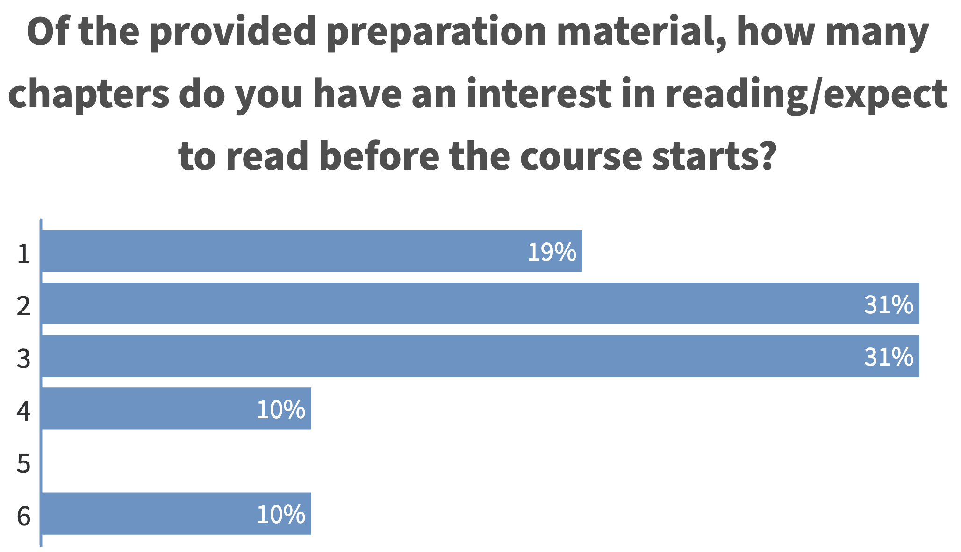
Survey Says

Slide 41
Survey Says
What specific topics or tasks are we expected to be proficient in prior to week 1? What study / preparation materials should we use if we are not prepared for certain topics?
YouTube math concepts that catch your eye from Ch 4
TensorFlow/Keras Tutorials
Simpler Python Tutorials

Slide 42
What's Deep Learning like?
What are the most difficult things for students to learn/understand in this course? in Deep Learning?
Different for different people
How to be effective in the face of computationally demanding and slow response time
All the things that we don't cover because either
We don't get to them
They don't yet exist
Whatever specific debugging or troubleshooting task you're currently working on

Slide 43
What's Deep Learning like?
Will the class work be exclusively be in Python, R, or other languages?
what packages will be use in this class?
What would you say are the 5 most basic fundamental building block concepts or ideas that when put together and manipulated make
up this course's content?
Goodfellow, Bengio, and Courville: Deep Learning
from tf import keras
Debug and Troubleshoot
Debug and Troubleshoot
Debug and Troubleshoot
Are there any good tutorials or books for Keras/PyTorch that you would recommend?

Slide 44
What's Deep Learning like?
.
.
.
.
.
Hella Lotta of Parameters
Hella Lotta Layers Laying
Hella Lotta SGD SGDing
Hella Lotta Compute Computing
And a partridge in a pear tree
What would you say are the 5 most basic fundamental building block concepts or ideas that when put together and manipulated make
up this course's content?

Slide 45
What's Deep Learning like?
.
.
.
.
.
Go read chapter 5: and get hyped!
Go read chapter 6: be like "oh my!"
What would you say are the 5 most basic fundamental building block concepts or ideas that when put together and manipulated make
up this course's content?

Slide 46

As much as possible, I should think
How many hours a week should we be expecting to spend on the course?
Depends

Slide 47
Not for us... not enough time...
Would this course build more material on the Bayesian Machine
Learning class? Would
you recommend reviewing the Bayes material prior to class? If so, which sections?
nope

Slide 48
no, neural networks and deep learning first principles
Does your course discuss explainable AI or neural net visualization?
No
Sounds like some great final project content tho

Slide 49
oh after each class
How much time can you commit for office hours?
2

Slide 50
agf
Why sort of commitment to quality are you willing to make up front? Quality control has been and issue with courses in the last. This topic seems like it will be difficult and we need
an instructor who can keep the course well taught and organized to get through it successfully.

