Slide 1


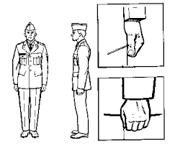
& Bert
All @attention
https://kazemnejad.com/blog/transformer_architecture_positional_encoding/
https://datascience.stackexchange.com/questions/51065/what-is-the-positional-encoding-in-the-transformer-model
http://jalammar.github.io/illustrated-transformer/

Slide 2
Outline
We'll explore the Transformer (seq2seq) model
Which uses Attention (and Positional Encoding)
Via a QUERY → (KEY, VALUE) "retrieval" scheme
To avoid relying upon recurrence like RNNs
Then we'll look at BERT

Slide 3
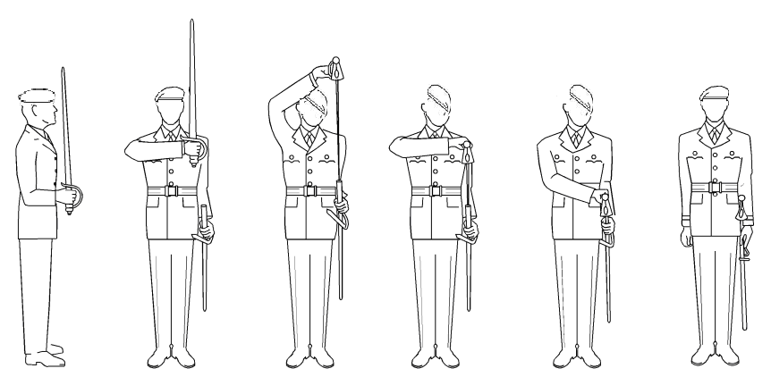
SEQUENTIAL DATA CONTEXT (E.G., SENTENCES)
[w₁, w₂]
1 2 3 4 5 6

Slide 4
SEQUENTIAL DATA CONTEXT (E.G., SENTENCES)
[w₁, w₂]
[w₁, w₂, w₃]
1 2 3 4 5 6

Slide 5
Sequential Data context (e.g., sentences)
[w₁, w₂]
[w₁, w₂, w₃] .
.
[w₁, w₂, w₃, …, w_{m-1}, w_{m}]
.
1 2 3 4 5 6

Slide 6
Seq2seq: translation
[w₁, w₂, w₃, …, w_{m-1}, w_{m}]
[w₁, w₂, w₃, …, w_{m-1}, w_{m}]
[w₁, w₂, w₃, …, w_{m-1}, w_{m}]
Train each sequential prediction to use the full
input and history so far
[o₀, o₁]
[o₀, o₁, o₂] .
.
[o₀, o₁, o₂, …, o_{m'-1}, o_{m'}]
.
1 2 3 4 5 6

Slide 7
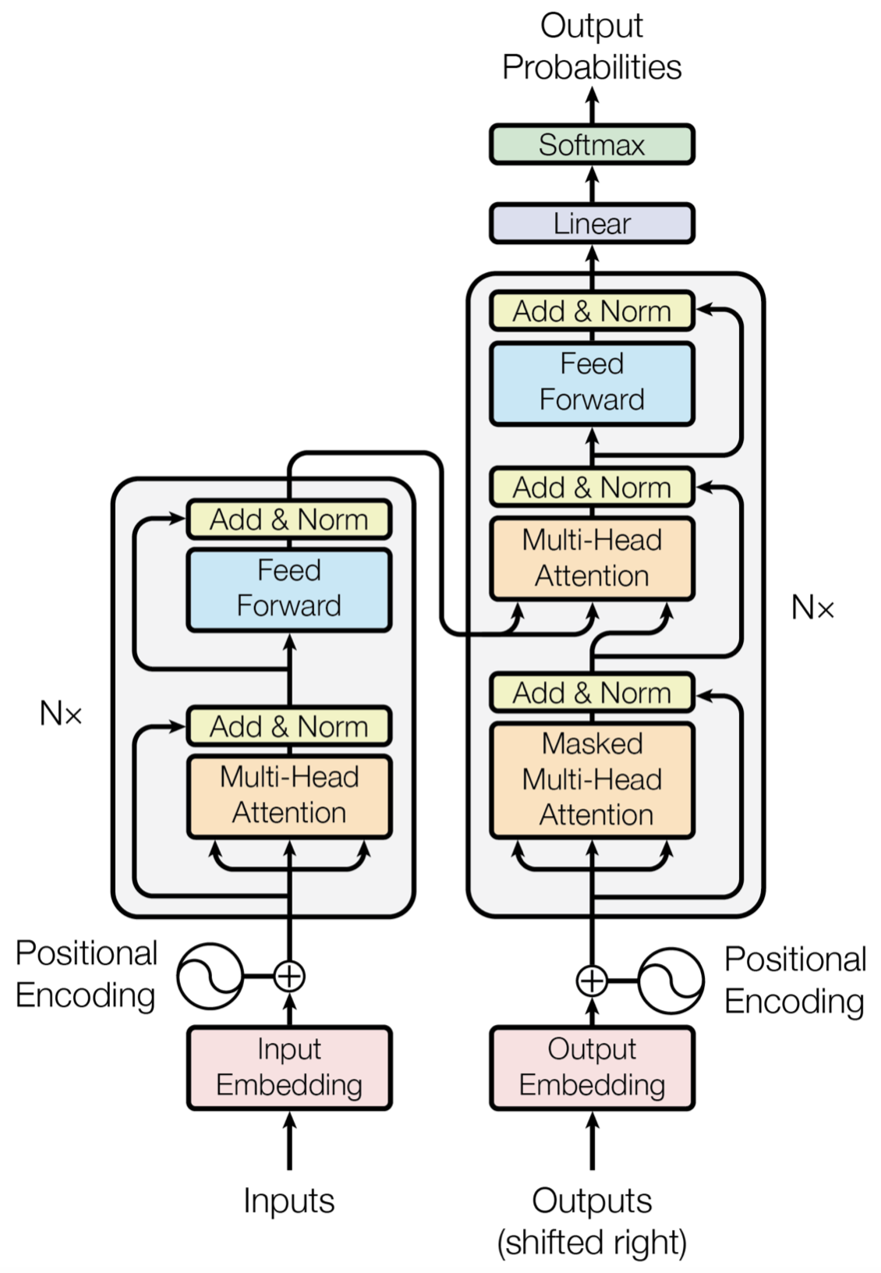
Words

Slide 8
Word Vectors

Slide 9
POSITIONAL ENCODINGS +
Word Vectors

Slide 10
context vectors+ POSITIONAL ENCODINGS +
Word Vectors

Slide 11
What each word means in the context of the sentence

Slide 12
Of Translation

Slide 13
Word Vectors of TRANSLATION

Slide 14
Position plus
One Encoding +
Word Vectors of TRANSLATION

Slide 15
Context so far +
Position plus
One Encoding +
Word Vectors of TRANSLATION

Slide 16
Attention +
Context so far +
Position plus
One Encoding +
Word Vectors of TRANSLATION

Slide 17
Attention +
Context so far +
Position plus
One Encoding +
Word Vectors of TRANSLATION
V K Q

Slide 18
Predict the
Next word in
the translation with FULL input and everything
Translated so far

Slide 19
Learn what words mean in context and What to focus on in the input sentence
to translate

Slide 20
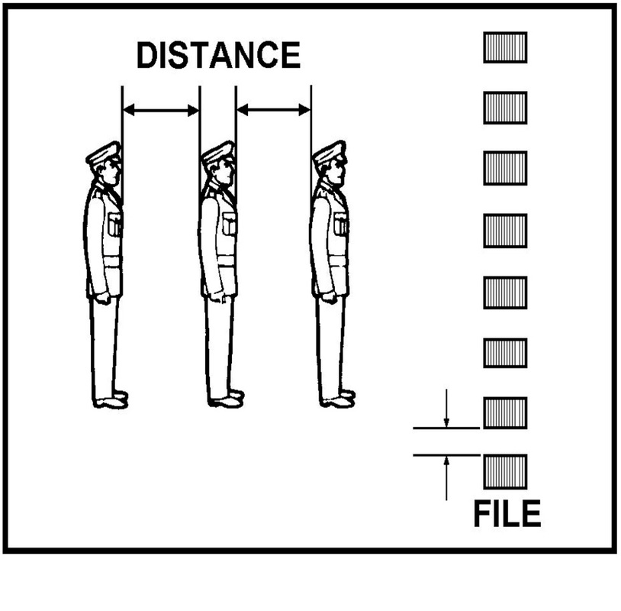
Positional encoding
Let s be a sentence
let w_{t} encode the t^{th} word in s
with encoding dimension d
Make the i^{th} value in length d Positional Encoding p_{t}
sin(t/10^{4*i/d}) if i is even
cos(t/10^{4*(i+1)/d}) if i is odd

Slide 21
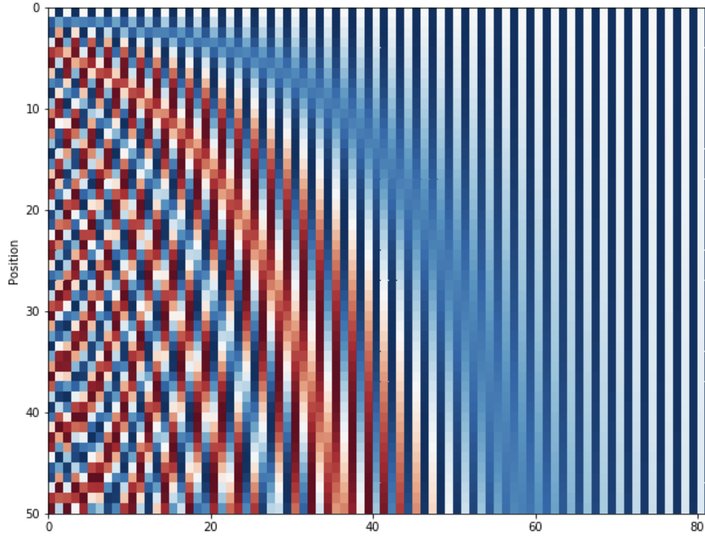
Positional encoding
dimension d

Slide 22
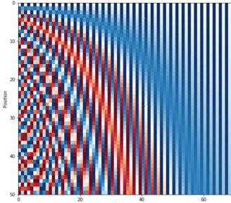
Positional encoding
w_{t}+p_{t} can encode location in the front, meaning in the back
p_{t} linearly transforms into p_{t+k} so distance behaves relatively
https://kazemnejad.com/blog/transformer_architecture_positional_encoding/
dimension d

Slide 23
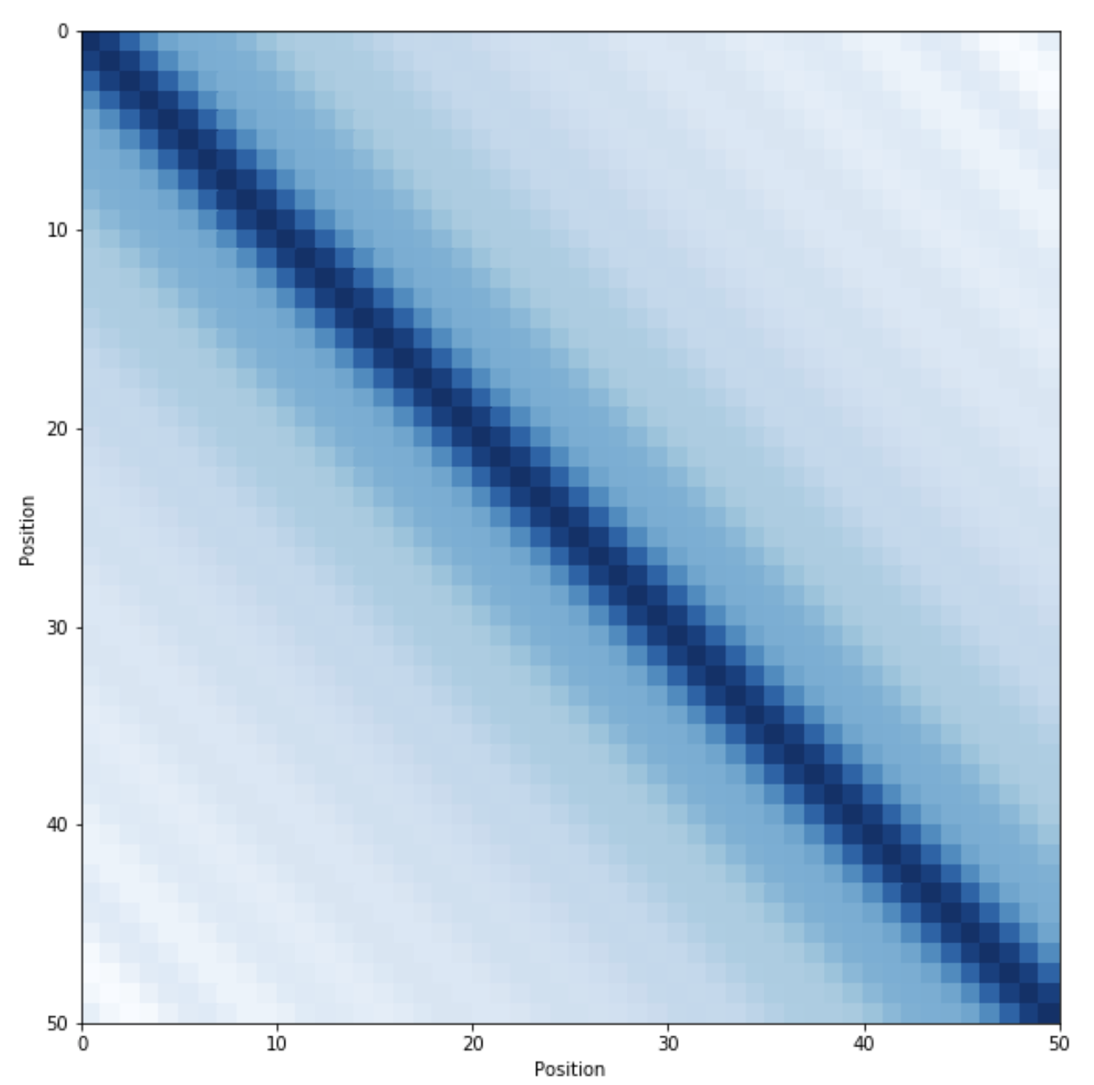
Positional encoding
w_{t}+p_{t} can encode location in the front, meaning in the back
p_{t} linearly transforms into p_{t+k} so distance behaves relatively
https://kazemnejad.com/blog/transformer_architecture_positional_encoding/

Slide 24
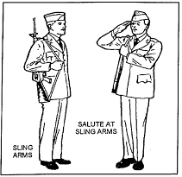
Query → (key, value)
Cosine similarity q^{T}k/(||q|| ||k||)
q^{T}k "dot product" is a similarity
orthogonal normal vectors q^{T}k=0
Identical normal vectors q^{T}k=1
Use value v "proportional" to q^{T}k
https://www.youtube.com/watch?v=iDulhoQ2pro&feature=youtu.be&t=1170

Slide 25
Attention: QUERY → (KEY, VALUE)
Query, Key, Value:
(w_{t}+p_{t})M^{Q} = q_{t}
(w_{t}+p_{t})M^{K} = k_{t}
(w_{t}+p_{t})M^{V} = v_{t}
(1 x d)(d x d') = (1 x d')
http://jalammar.github.io/illustrated-transformer/​

Slide 26
(self-)Attention: QUERY → (KEY, VALUE)
Query, Key, Value:
(w_{t}+p_{t})M^{Q} = q_{t}
(w_{t}+p_{t})M^{K} = k_{t}
(w_{t}+p_{t})M^{V} = v_{t}
(1 x d)(d x d') = (1 x d')
Word t ATTENSION on t' :
q_{t}^{T} k_{t'}
Word t ATTENTION vector a :
Σ_{t'} v_{t'} [exp(q_{t}^{T} k_{t'})/Σ_{j}exp(q_{t}^{T} k_{j})]
i.e., query-key weighted values
http://jalammar.github.io/illustrated-transformer/​

Slide 27
(self-)Attention
A Words' Encoding is now a Weighted Average
of all new Word Values
according to the
Attention given by a word
to each other word

Slide 28
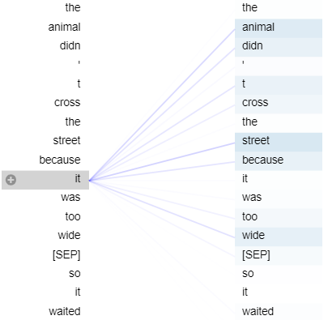
(self-)Attention
A Words' Encoding is now a Weighted Average
of all new Word Values
according to the
Attention given by a word
to each other word

Slide 29
Query → (key, value)
 | M
 | Q
w | + | p
=
q
Query, Key, Value:
(w_{t}+p_{t})M^{Q} = q_{t}
(w_{t}+p_{t})M^{K} = k_{t}
(w_{t}+p_{t})M^{V} = v_{t}
(1 x d)(d x d') = (1 x d')
 | M
 | K
w | + | p
=
k
 | M
 | V
w | + | p
=
v
http://jalammar.github.io/illustrated-transformer/​

Slide 30
(self-)Attention: QUERY → (KEY, VALUE)
Word t ATTENSION on t' :
q_{t}^{T} k_{t'}
Word t ATTENTION vector a :
Σ_{t'} v_{t'} [exp(q_{t}^{T} k_{t'})/Σ_{j}exp(q_{t}^{T} k_{j})]
i.e., query-key weighted values
Softmax( )
k
q
v
http://jalammar.github.io/illustrated-transformer/​

Slide 31
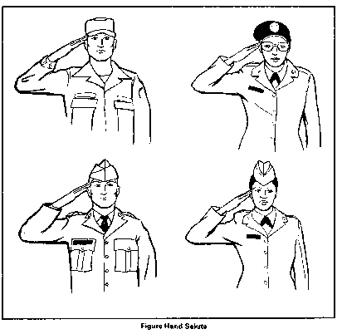
Multi-headed Attention
Softmax( )
k
 | 1
q
 | 1
v
 | 1
Softmax( )
k
 | 2
q
 | 2
v
 | 2
.
.
.
Softmax( )
k
 | 3
q
 | r
v
 | r
http://jalammar.github.io/illustrated-transformer/​

Slide 32
Multi-headed Attention
a
 | 1
a
 | 2
a
 | r
×
...
...
=
a | tt | e | n
t | i | o | n
http://jalammar.github.io/illustrated-transformer/​

Slide 33
Multi-headed Attention
Now combine with original encoding
Meaning, Location, and now Attention, as well!
+
a | tt | e | n
t | i | o | n
w | + | p
Context
vectors

Slide 34
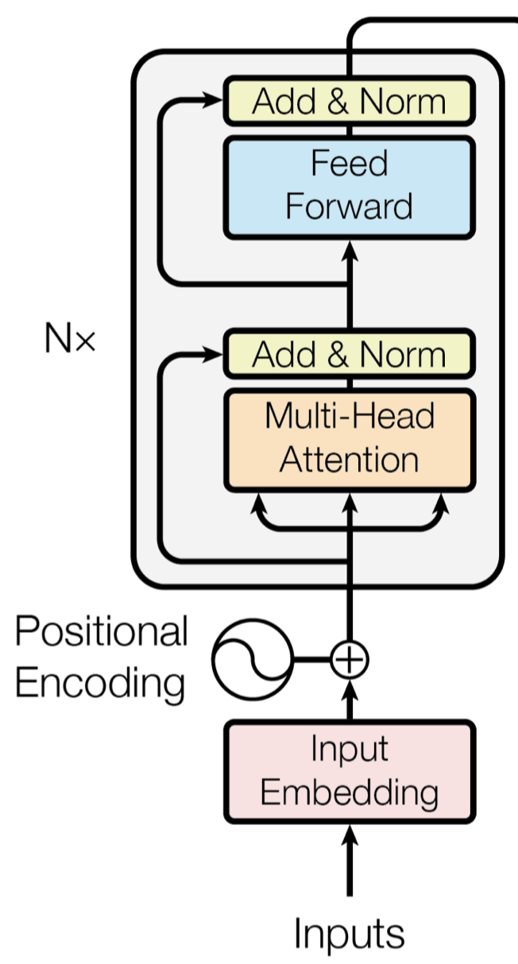
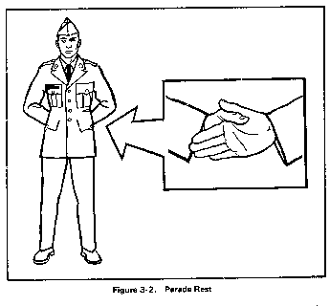
Recap
Encoder
ϵ connection
N×?
M-H Attention
VKQ
PE
Embedding
Attention Is All You Need

Slide 35
Recap
Encoder
ϵ connection
N×?
M-H Attention
VKQ
PE
Embedding
Attention Is All You Need

Slide 36
Recap
Encoder
ϵ connection
N×?
M-H Attention
VKQ
PE
Embedding
Attention Is All You Need

Slide 37
Recap
Encoder
ϵ connection
N×?
M-H Attention
VKQ
PE
Embedding
Attention Is All You Need

Slide 38
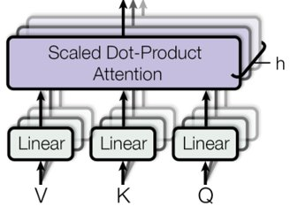
Recap
Encoder
ϵ connection
N×?
M-H Attention
VKQ
PE
Embedding
Attention Is All You Need

Slide 39
Recap
Encoder
ϵ connection
N×?
M-H Attention
VKQ
PE
Embedding
Attention Is All You Need

Slide 40
Recap
Encoder
ϵ connection
N×?
M-H Attention
VKQ
PE
Embedding
Attention Is All You Need

Slide 41
Recap
Attention Is All You Need
Well...
that, and
ALL of
the rest of
⟵ THIS
…
..
.
for seq2seq

Slide 42
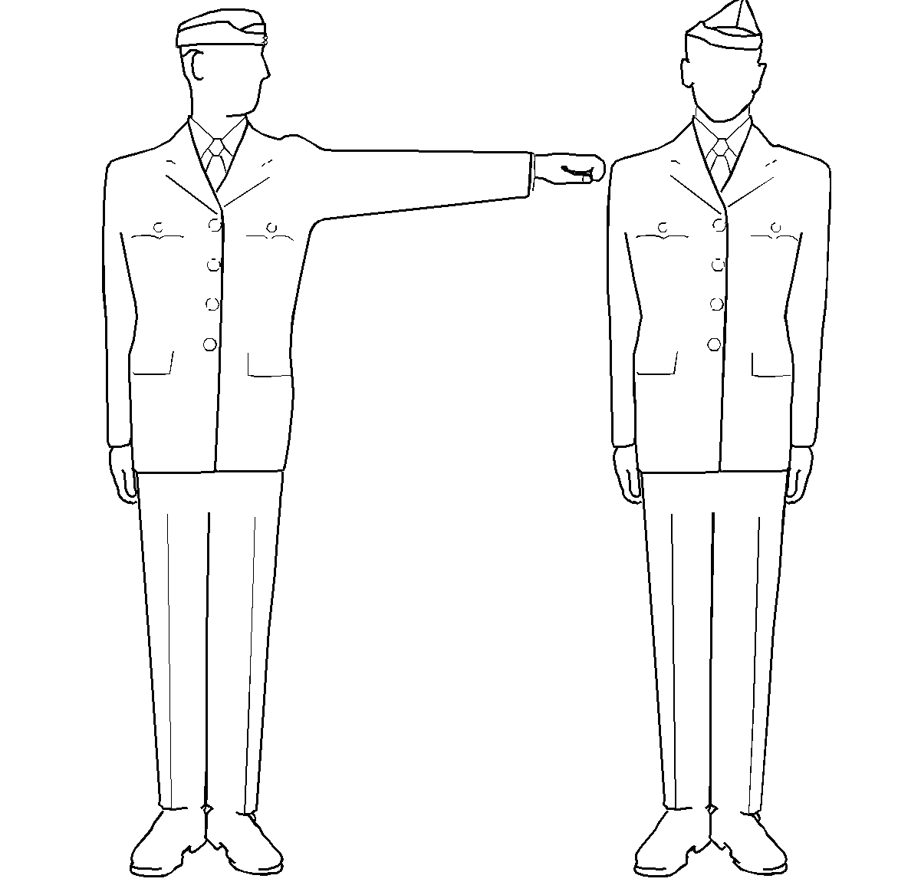
Attention Is All You Need

Slide 43
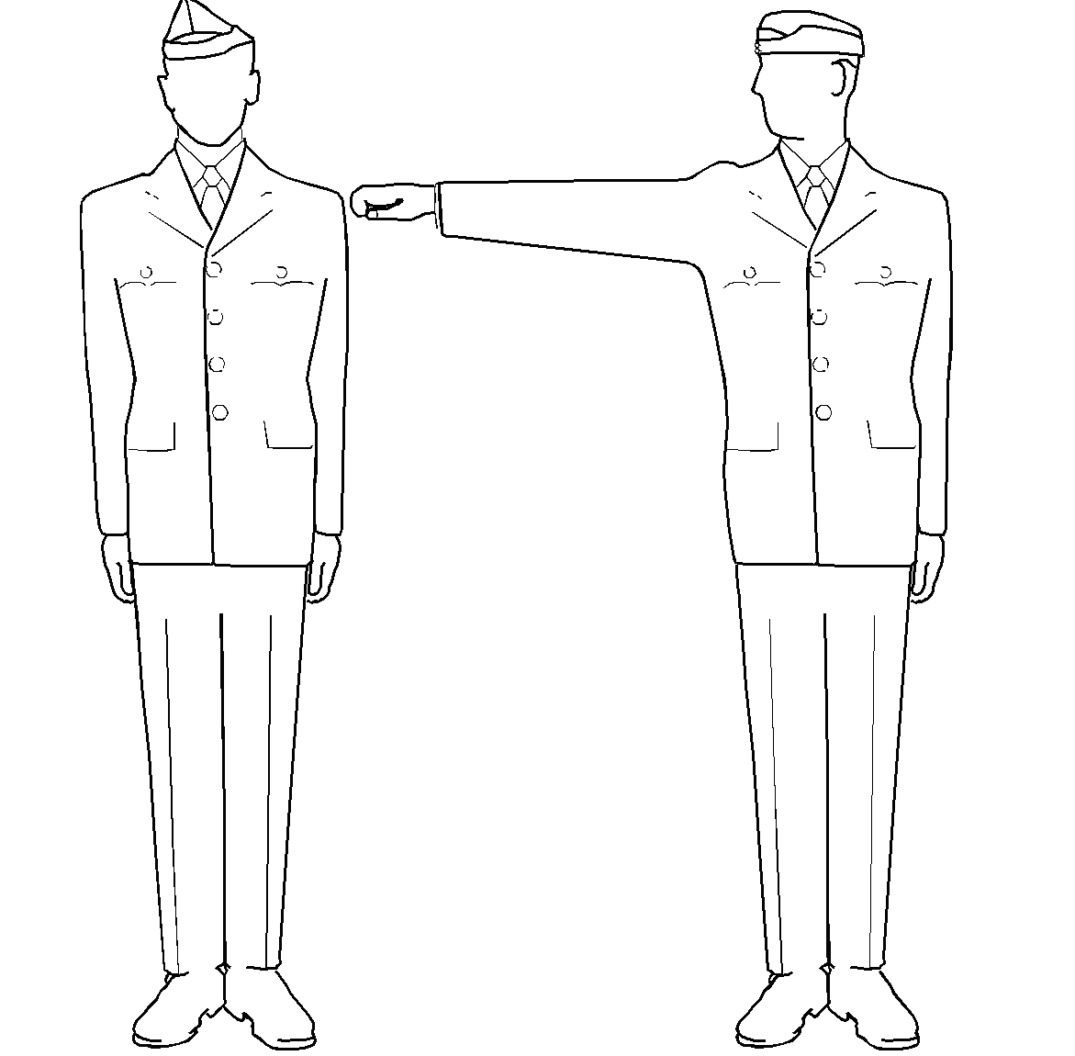
predict Next
Transform the current word to
Attention Is All You Need
[s₀, o₁, *, …, *, *, *]
[s₀, o₁, o₂, *, …, *, *]
[s₀, o₁, o₂,…, o_{m'-1}, o_{m'}]
"...so far" attention
m' is output length
​
…
https://www.youtube.com/watch?v=4Bdc55j80l8

Slide 44
predict Next
[V₁, V₂, …, V_{m-1}, V_{m}]
[K₁, K₂, …, K_{m-1}, K_{m}]
USING ALL INPUT + CONTEXT SO FAR
Attention Is All You Need
[s₀, o₁, *, …, *, *, *]
[s₀, o₁, o₂, *, …, *, *]
[s₀, o₁, o₂,…, o_{m'-1}, o_{m'}]
"...so far" attention
m' is output length
​
…
https://www.youtube.com/watch?v=4Bdc55j80l8

Slide 45

[V₁, V₂, …, V_{m-1}, V_{m}]
[K₁, K₂, …, K_{m-1}, K_{m}]
Using all input + context so far
Attention Is All You Need
Query: Context of Translation So Far
V&K: All of the Input

Slide 46
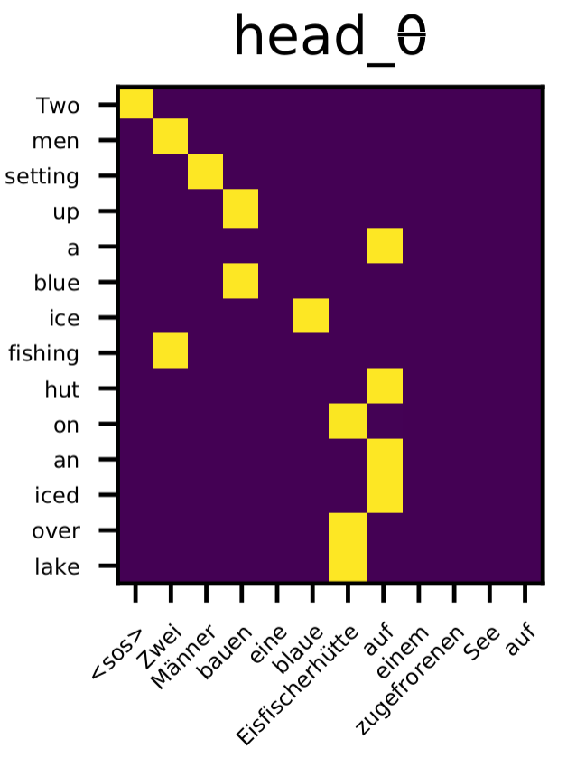
Query: needs pick out which of those is most helpful for prediction

Slide 47
Regularization
Dropout is used at a couple different layers
Label smoothing – the idea that the label might be wrong – is used to reduce confidence in each prediction by instead using a "nosified" version of the outcome Y
For Y a one-hot encoding of the vocabulary (of k words/tokens)
Y' = Yα + (1-Y)(1-α)/(k-1) = [(1-α)/(k-1), (1-α)/(k-1), …, α, …, (1-α)/(k-1), (1-α)/(k-1)]
So Y' has α in the 1 location where Y was 1, and (1-α)/(k-1) in the k-1 locations where Y was 0
https://towardsdatascience.com/what-is-label-smoothing-108debd7ef06

Slide 48
BERT
https://www.youtube.com/watch?v=-9evrZnBorM
It's just 28 transformer levels stacked on top of each other
With some very cleaver tricks by which pre-training is done
And which provides transfer learning that's amazing good
Because BERT actually aims to understand language itself

Slide 49
attention
context meaning encoding vectors
which words
does a word
care about
in context
?
combined into a representation of a
"contextual concept"
value vectors
key vectors
Multi-Head Attentaion
query vectors
M^{Q} M^{K} M^{V}
word/position encoding vectors
https://lilianweng.github.io/lil-log/2018/06/24/attention-attention.html

Slide 50
attention
context meaning encoding vectors
context vectors
...
value vectors
MHA
key vectors
Multi-Head Attentaion
context vectors
query vectors
MHA
context vectors
M^{Q} M^{K} M^{V}
MHA
word/position encoding vectors
context vectors

Slide 51
attention
The "contextual meanings"
of the "contextual concepts" of the "contextual concepts"
of the "contextual concepts"
of the "contextual concepts"
of the "contextual concepts" of the "contextual concepts" of the "contextual concepts"
of the "contextual concepts" of each of the words
context vectors
...
MHA
context vectors
...
MHA
context vectors
MHA
context vectors

Slide 52
Composition
The "contextual meanings"
of the "contextual meanings" of the "contextual meanings"
of the "contextual meanings"
of the "contextual meanings"
of the "contextual meanings" of the "contextual meanings" of the "contextual meanings"
of the "contextual meanings" of each of the words
context vectors
...
MHA
context vectors
...
MHA
context vectors
MHA
context vectors

Slide 53
Composition
The "contextual meanings"
of the "contextual meanings" of the "contextual meanings"
of the "contextual meanings"
of the "contextual meanings"
of the "contextual meanings" of the "contextual meanings" of the "contextual meanings"
of the "contextual meanings" of each of the words
context vectors
...
MHA
context vectors
...
MHA
context vectors
MHA
context vectors

Slide 54
Composition
The "contextual meanings"
of the "contextual meanings" of the "contextual meanings"
of the "contextual meanings"
of the "contextual meanings"
of the "contextual meanings" of the "contextual meanings" of the "contextual meanings"
of the "contextual meanings" of each of the words
context vectors
...
MHA
context vectors
...
MHA
context vectors
MHA
context vectors

Slide 55
Composition
The "contextual meanings"
of the "contextual meanings" of the "contextual meanings"
of the "contextual meanings"
of the "contextual meanings"
of the "contextual meanings" of the "contextual meanings" of the "contextual meanings"
of the "contextual meanings" of each of the words
context vectors
...
MHA
context vectors
...
MHA
context vectors
MHA
context vectors

Slide 56
Composition
The "contextual meanings"
of the "contextual meanings" of the "contextual meanings"
of the "contextual meanings"
of the "contextual meanings"
of the "contextual meanings" of the "contextual meanings" of the "contextual meanings"
of the "contextual meanings" of each of the words
context vectors
...
MHA
context vectors
...
MHA
context vectors
MHA
context vectors

Slide 57
Composition
How do the
words relate?
How do the sets of
related words relate?
How do the sets of
sets of related words relate?
How do the sets of
sets of
sets of related words relate?
How do the sets of
sets of sets of sets of sets of ...
sets of related words relate?
context vectors
...
MHA
context vectors
MHA
context vectors
MHA
context vectors

Slide 58
Composition
How do the
words relate?
How do the sets of
related words relate?
How do the sets of
sets of related words relate?
How do the sets of
sets of
sets of related words relate?
How do the sets of
sets of sets of sets of sets of ...
sets of related words relate?
context vectors
...
MHA
context vectors
MHA
context vectors
MHA
context vectors

Slide 59
Composition
How do the
words relate?
How do the sets of
related words relate?
How do the sets of
sets of related words relate?
How do the sets of
sets of
sets of related words relate?
How do the sets of
sets of sets of sets of sets of ...
sets of related words relate?
context vectors
...
MHA
context vectors
MHA
context vectors
MHA
context vectors

Slide 60
Composition
How do the
words relate?
How do the sets of
related words relate?
How do the sets of
sets of related words relate?
How do the sets of
sets of
sets of related words relate?
How do the sets of
sets of sets of sets of sets of ...
sets of related words relate?
context vectors
...
MHA
context vectors
MHA
context vectors
MHA
context vectors

Slide 61
Composition
How do the
words relate?
How do the sets of
related words relate?
How do the sets of
sets of related words relate?
How do the sets of
sets of
sets of related words relate?
How do the sets of
sets of sets of sets of sets of ...
sets of related words relate?
context vectors
...
MHA
context vectors
MHA
context vectors
MHA
context vectors

Slide 62
Composition
Increasing
Composition
of Increasingly
Composed
Concepts
by their
Relatedness
...
from Related
Sets of Words
up to Related
Sets of Ideas
How do the
words relate?
How do the sets of
related words relate?
How do the sets of
sets of related words relate?
How do the sets of
sets of
sets of related words relate?
How do the sets of
sets of sets of sets of sets of ...
sets of related words relate?
context vectors
...
MHA
context vectors
MHA
context vectors
MHA
context vectors

Slide 63
Composition
Increasing
Composition
of Increasingly
Composed
Concepts
by their
Relatedness
...
from Related
Sets of Words
up to Related
Sets of Ideas
How do the
words relate?
How do the sets of
related words relate?
How do the sets of
sets of related words relate?
How do the sets of
sets of
sets of related words relate?
How do the sets of
sets of sets of sets of sets of ...
sets of related words relate?
context vectors
...
MHA
context vectors
MHA
context vectors
MHA
context vectors

Slide 64
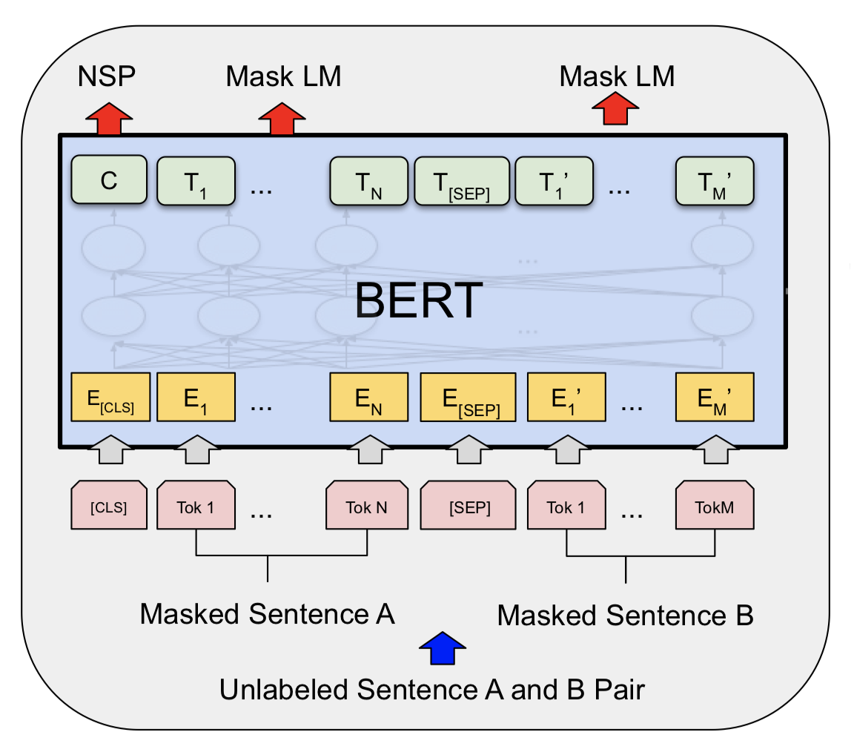
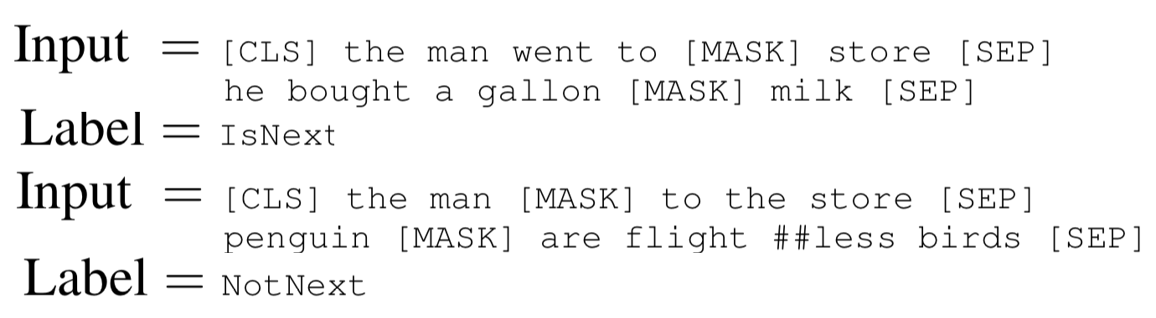
training
BERT (Bidirectional Encoder Representations from Transformers):
Pre-training of Deep Bidirectional Transformers for Language Understanding
https://arxiv.org/pdf/1810.04805.pdf
https://www.youtube.com/watch?v=-9evrZnBorM

Slide 65
training
BERT (Bidirectional Encoder Representations from Transformers):
Pre-training of Deep Bidirectional Transformers for Language Understanding
Learns to predict missing words in context;
and Learns if two sentences are sequential
https://arxiv.org/pdf/1810.04805.pdf
https://www.youtube.com/watch?v=-9evrZnBorM

Slide 66
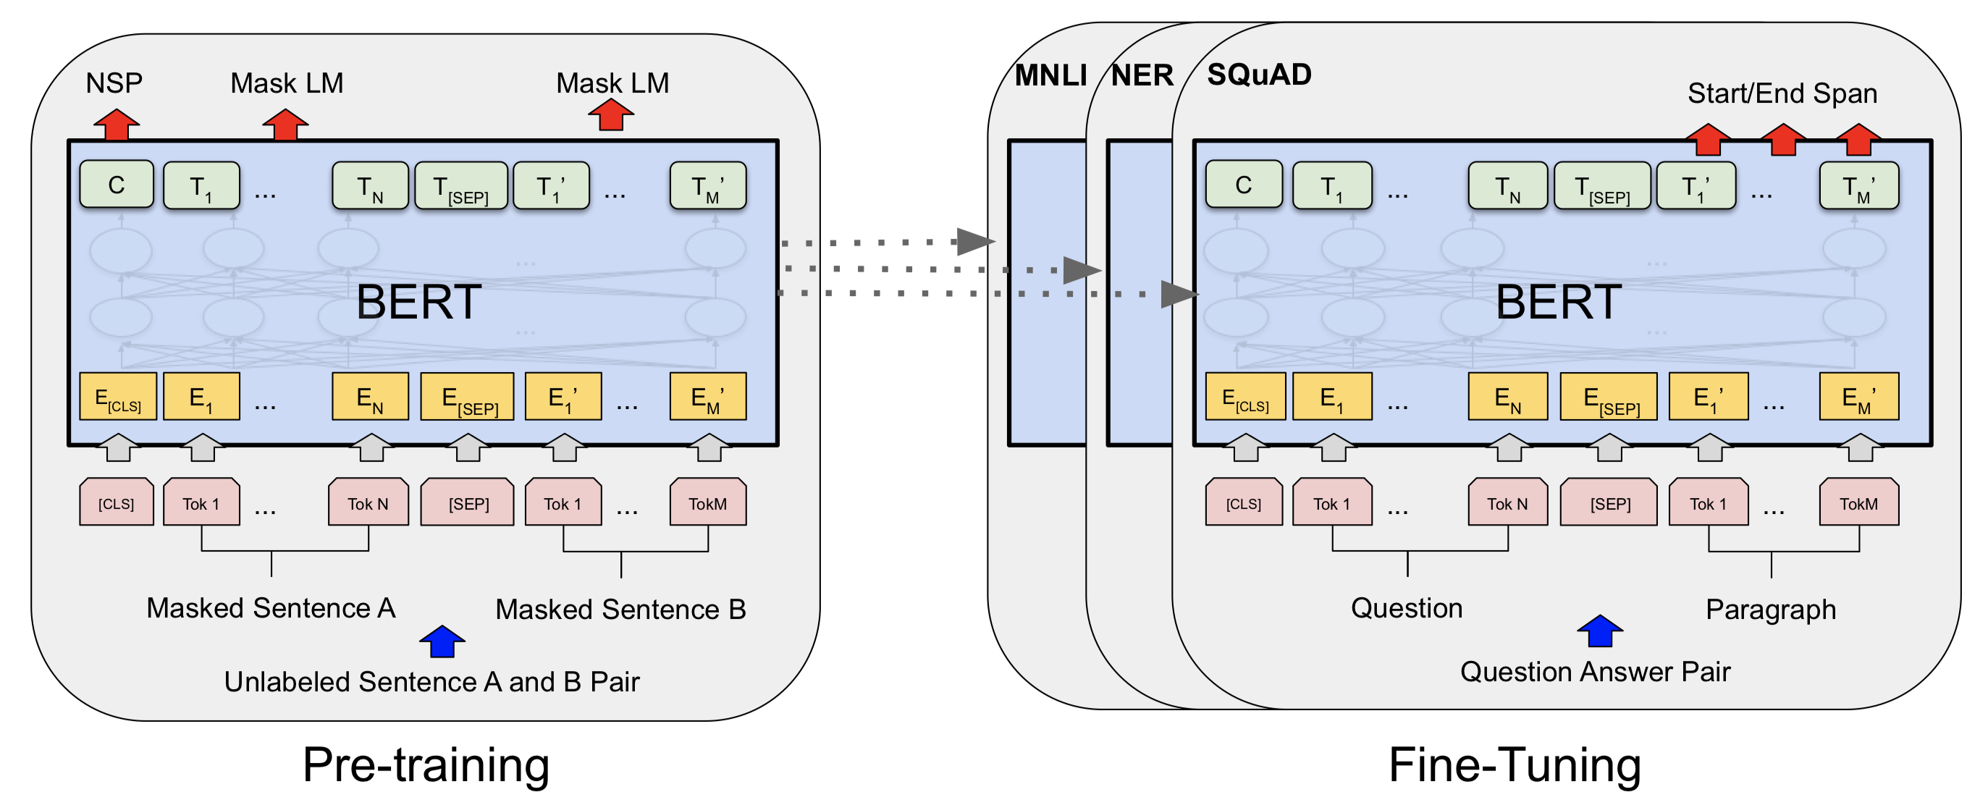
Training... a little more...
https://arxiv.org/pdf/1810.04805.pdf
https://www.youtube.com/watch?v=-9evrZnBorM

Slide 67
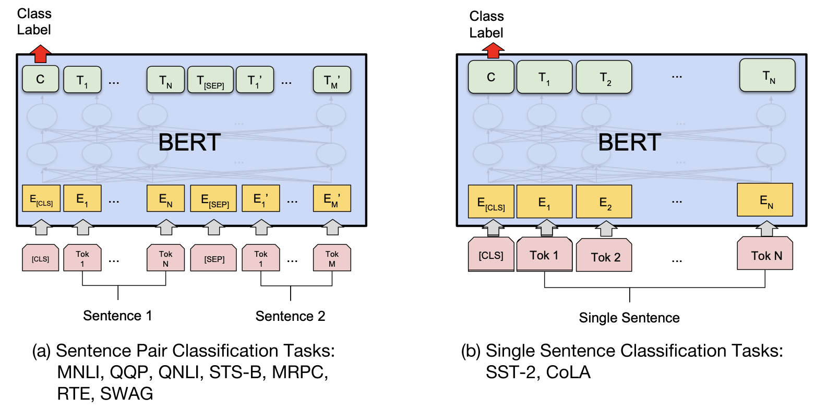
Training... a little more...
https://arxiv.org/pdf/1810.04805.pdf
https://www.youtube.com/watch?v=-9evrZnBorM

Slide 68
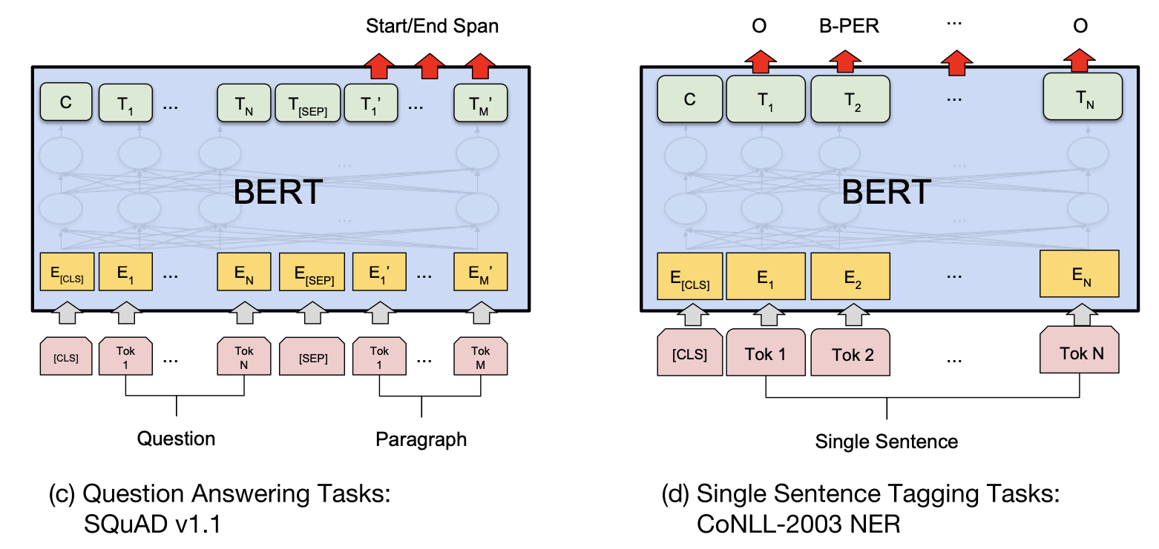
Training... a little more...
https://arxiv.org/pdf/1810.04805.pdf
https://www.youtube.com/watch?v=-9evrZnBorM

