Slide 1

Lecturer -6
Linear Algebra

Slide 2
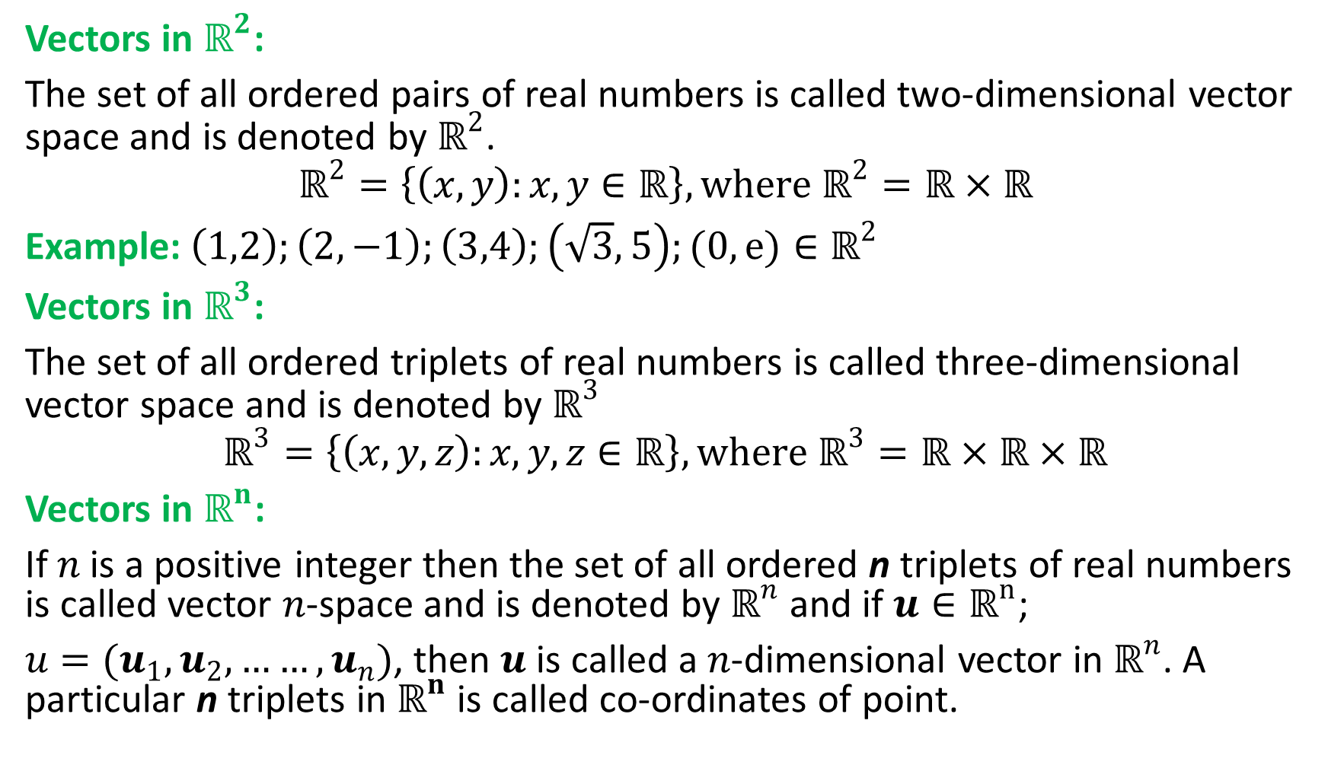
Vectors in $ℝ^{2}$:
The set of all ordered pairs of real numbers is called two-dimensional vector space and is denoted by $ℝ^{2}$.
$$ℝ^{2}=\left\{\left(x,y\right):x,y∈ℝ\right\}, where ℝ^{2}=ℝ×ℝ$$
Example:$\left(1,2\right);\left(2,−1\right);\left(3,4\right);\left(\sqrt{3},5\right);(0,e){∈ℝ}^{2}$
Vectors in $ℝ^{3}$:
The set of all ordered triplets of real numbers is called three-dimensional vector space and is denoted by $ℝ^{3}$
$$ℝ^{3}=\left\{\left(x,y,z\right):x,y,z∈ℝ\right\}, where ℝ^{3}=ℝ×ℝ×ℝ$$
Vectors in $ℝ^{n}$:
If$n$ is a positive integer then the set of all ordered n triplets of real numbers is called vector $n$-space and is denoted by $ℝ^{n}$ and if $u∈ℝ^{n}$;
$u=(u_{1},u_{2},……,u_{n})$, then $u$ is called a $n$-dimensional vector in $ℝ^{n}$. A particular n triplets in $ℝ^{n}$ is called co-ordinates of point.

Slide 3
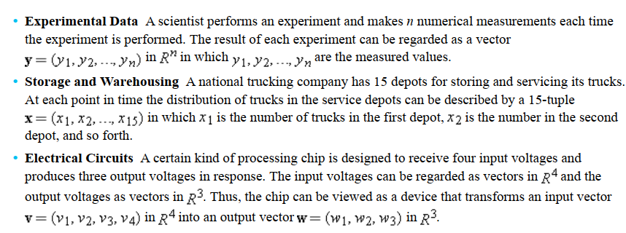
There are some typical applications that lead to n-tuples.

Slide 4
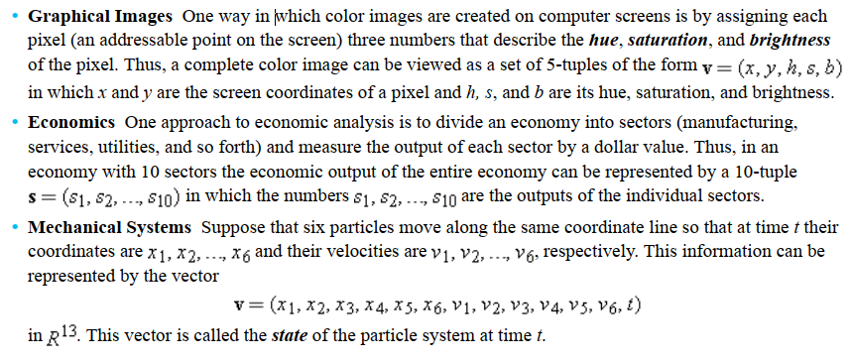

Slide 5
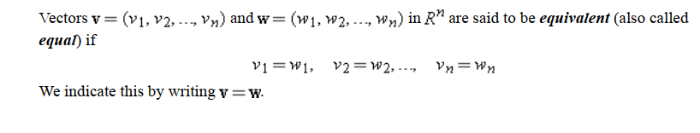
Definition:

Slide 6

Addition of two vectors in $ℝ^{2}$:
If a$=\left(a_{1},a_{2}\right)$and $b=\left(b_{1},b_{2}\right)$ be two vectors in $ℝ^{2}$ then $a+b=(a_{1}+b_{1}, a_{2}+b_{2})$

Slide 7
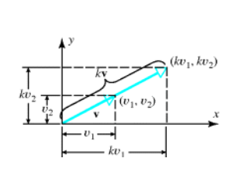
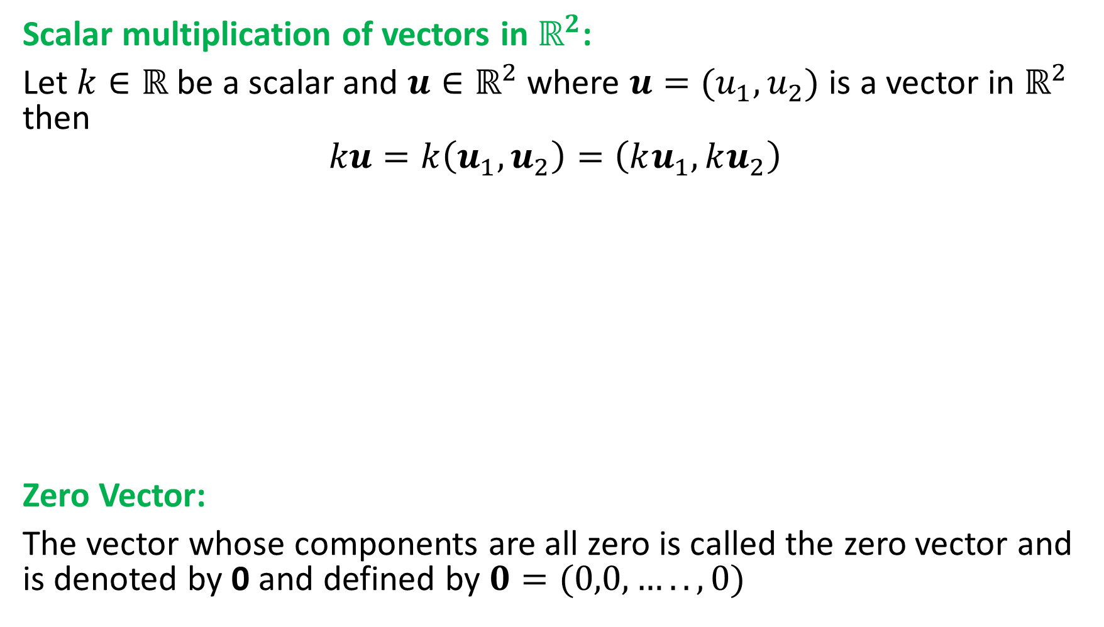
Scalar multiplication of vectors in $ℝ^{2}$:
Let $k∈ℝ$ be a scalar and $u∈ℝ^{2}$ where $u=(u_{1},u_{2})$ is a vector in $ℝ^{2}$ then
$$ku=k\left(u_{1},u_{2}\right)=\left(ku_{1},ku_{2}\right)$$
Zero Vector:
The vector whose components are all zero is called the zero vector and is denoted by 0 and defined by $0=(0,0,…..,0)$

Slide 8
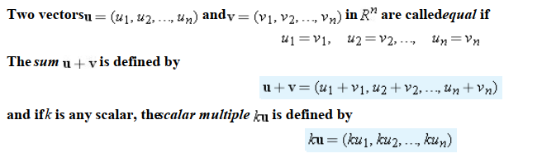

Addition of two vectors in $ℝ^{n}$:

Slide 9
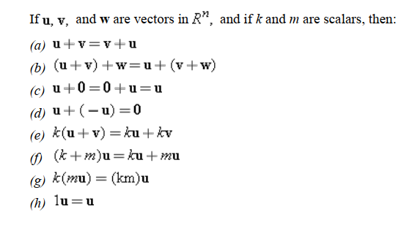
Some important properties of vector operations.

Slide 10
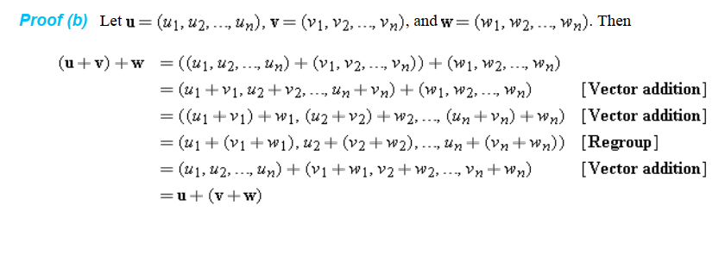

Slide 11
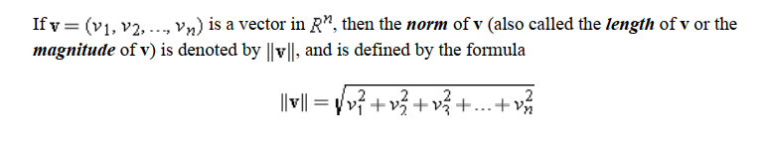
Norm of a Vector

Slide 12
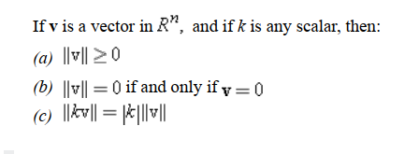
Properties of Norm:

Slide 13
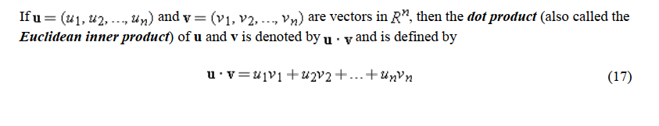
Inner product of non-zero vectors:

Slide 14
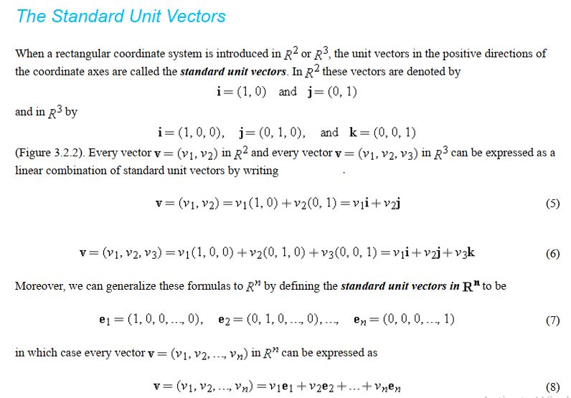

Slide 15


Orthogonal Vector

