Slide 1
Lecture 8
Diagonalization

Slide 2


Slide 3
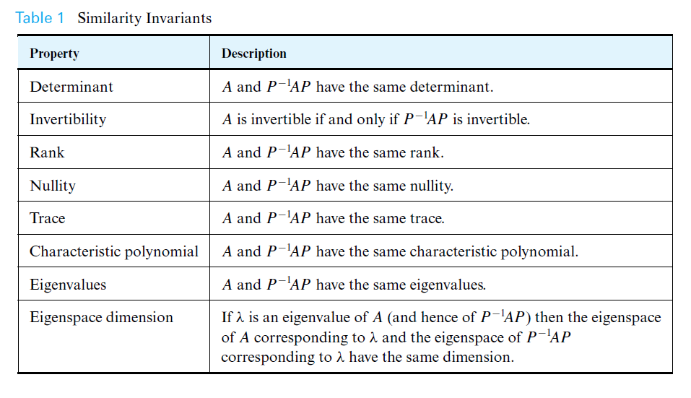

Slide 4



Slide 5
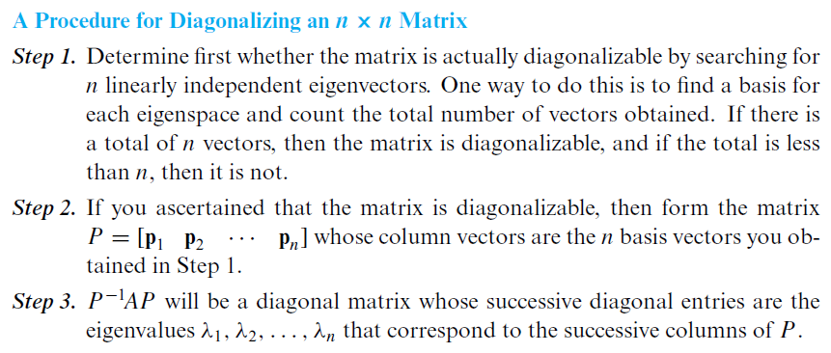

Slide 6


Slide 7
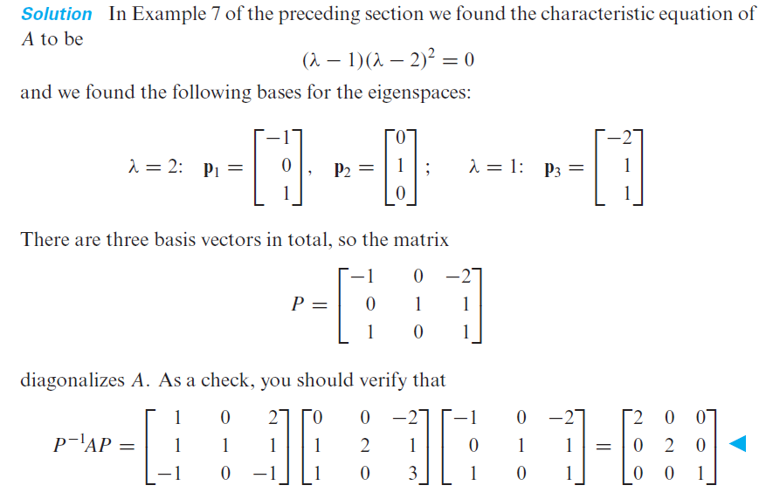

Slide 8
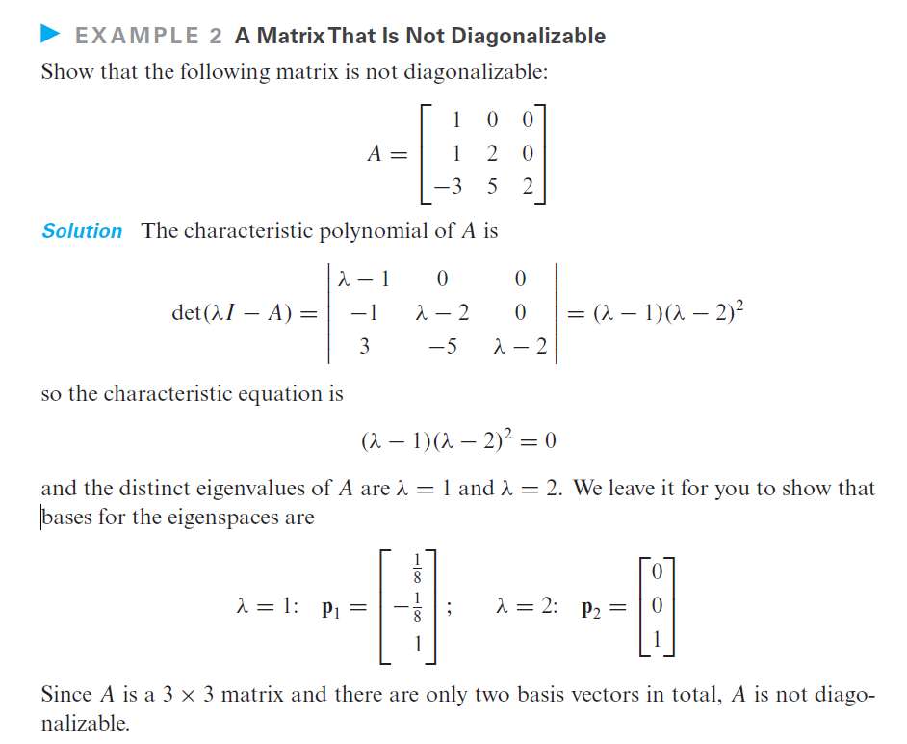

Slide 9
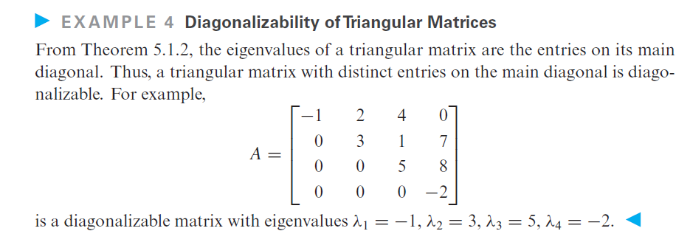

Slide 10

Eigenvalues of Powers of a Matrix

Slide 11
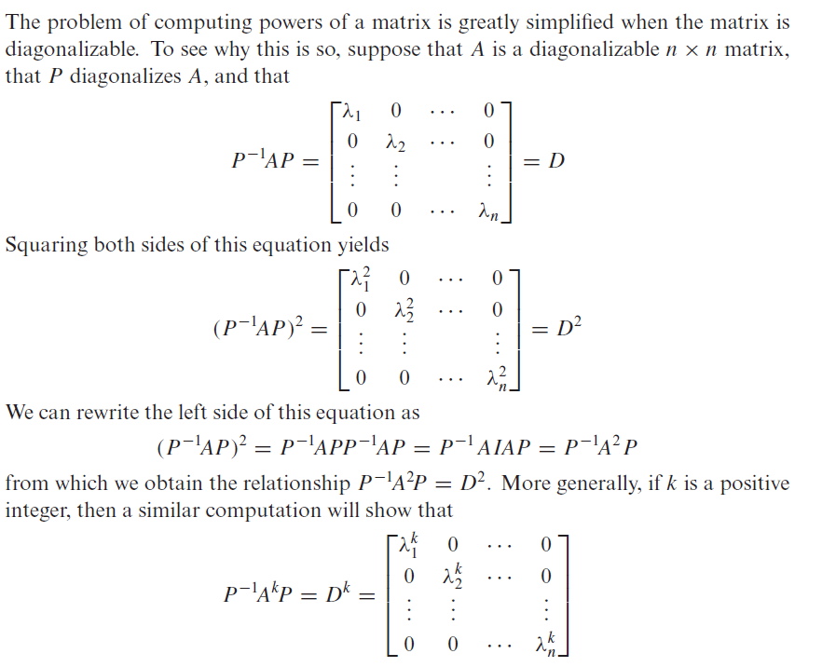
Computing Powers of a Matrix

Slide 12

Computing Powers of a Matrix

Slide 13

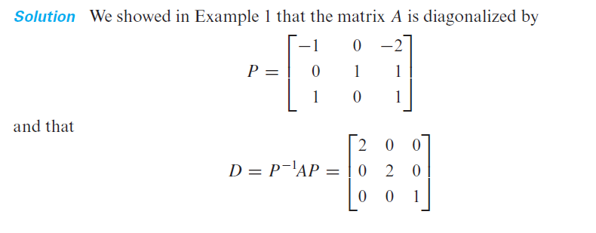

Slide 14
