Slide 1


Advanced FireDAC Technologies
Cary Jensen, Jensen Data Systems, Inc.

Slide 2
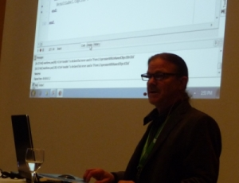
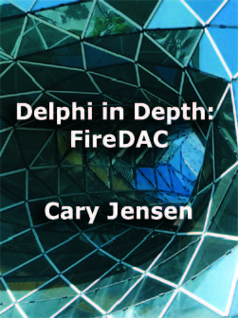
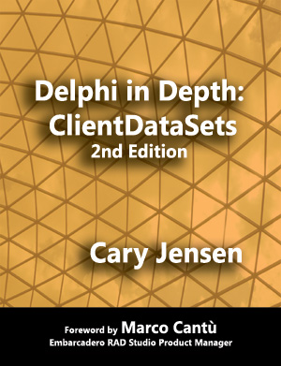

About Cary Jensen
Chief Technology Officer at Jensen Data Systems, with 30 years experience as a professional developer, consultant, mentor, and trainer
Best selling author of more than 25 books, including Delphi in Depth: FireDAC and Delphi in Depth: ClientDataSets
Author and trainer for the Delphi World Tour (1995 – 1999)
Founder of Delphi Developer Days (2001 – present)

Slide 3

Agenda
Brief overview of FireDAC
Configuration inheritance
SQL command preprocessor
FireDAC dataset persistence
Array DML
Cached updates

Slide 4
Overview of FireDAC
A comprehensive data access framework that ships with RAD Studio
Has become the preferred component library for data access in RAD Studio
Provides the most complete support for the TDataSet API, offering a smooth migration path for legacy applications
Supports a large collection of advanced capabilities. Today I will focus on five of these: Configuration inheritance Dataset persistence The SQL command preprocessor Array DML Cached updates

Slide 5
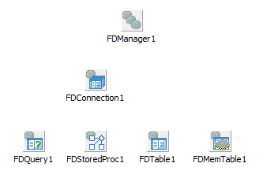
Configuration Inheritance
There are four inherited properties. These are FetchOptions, FormatOptions, ResourceOptions, and UpdateOptions,
FDConnection inherits properties from FDManager
FDQuery, FDStoredProc, and FDTable inherit properties from FDConnection
FDMemTable inherits properties from FDManager
Inherited property settings can be overridden

Slide 6
FireDAC Datasets Persistence
All datasets support persistence to files and streams
FireDAC supports three persistence formats: XML, JSON, and binary
ResourceOptions.StorePrettyPrint provides formatting of text-based formats
ResourceOptions properties support default folders and backups
FireDAC datasets can load data from a file or stream, even when active

Slide 7
SQL Command Preprocessor
The SQL command preprocessor can alter your SQL before sending it to the server when ResourceOptions.EscapeExpand and ResourceOptions.MacroExpand expand are true
FireDAC supports macro substitution and escape sequences
Macro substitution employs the ! and & characters to identify macros, which, like parameters, must be assigned a value before query execution. Beware of SQL Injection!
Escape sequences are enclosed in curly braces ( { } ). There are four types of escape sequences: Constant substitution Identifier substitution Conditional substitution FireDAC scalar functions

Slide 8
Array DML
Array DML provides blazing performance when used with databases that support batch command processing
Array DML employs a parameterized query along with an array of parameter values. The query and array are passed to the server, which in turn is responsible for parameter binding and query execution
Array DML is emulated on database servers that do not support batch command processing

Slide 9
Cached Updates
All FireDAC datasets support cached updates
FireDAC supports two cached updates modes: centralized cached updates and decentralized cached updates. Centralized cached updates can be used with one or more datasets, and applies those updates in the order in which they were posted. Decentralized cached updates is used on single datasets
Before applying cached updates, the cached updates can be reviewed and edited
Updates to two or more records, and two or more datasets, can be applied in an all-or-none fashion

Slide 10

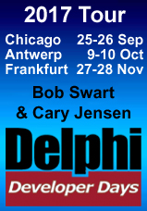
Questions and Answers
Code download: http://www.JensenDataSystems.com/FireDACcode.zip
Contacting Cary Jensen
mailto:cjensen@jensendatasystems.com
http://www.JensenDataSystems.com
http://caryjensen.blogspot.com
Twitter: @caryjensen
Learn more about Delphi Developer Days at www.DelphiDeveloperDays.com
Learn more about Delphi in Depth: FireDAC at www.JensenDataSystems.com/FireDACbook

