Slide 1
Power System Fault Detection and Classification
CAPSTONE PROJECT
Presented By:
1. Adarsh Prasad – IEM KOLKATA – CSE(AIML)

Slide 2
OUTLINE
Problem Statement (Should not include solution)
Proposed System/Solution
System Development Approach (Technology Used)
Algorithm & Deployment
Result (Output Image)
Conclusion
Future Scope
References

Slide 3
Problem Statement
Timely detection and classification of power system faults is critical to prevent outages, ensure reliability, and enable fast recovery. Manual monitoring is inefficient — hence, automated fault detection using machine learning enables faster and more accurate responses.

Slide 4
Proposed Solution
We built an automated ML pipeline to predict hourly demand using historical data and real-time features (like weather, holidays). After preprocessing and feature engineering, multiple models were evaluated. The system was deployed with real-time inference and evaluated using MAE and RMSE.
✅ Best performing model: Random Forest Classifier ✅ Deployment-ready with scalable architecture for real-time predictions.

Slide 5
System Approach
🔧 System Requirements
Jupyter Notebook (or IBM Watson Studio)
Python 3.x environment
Cloud storage access (IBM Cloud Object Storage)
📦 Required Libraries
pandas, numpy – Data handling
matplotlib, seaborn – Visualization
sklearn – Model building & evaluation
xgboost, lightgbm – Advanced ML models

Slide 6
Algorithm & Deployment
Algorithm We used Automated Machine Learning (AutoML) to evaluate multiple classifiers. The Random Forest Classifier delivered the best performance for detecting and classifying power system faults due to its accuracy and ability to handle complex feature interactions.
🔢 Data Input
Readings from dataset (Kaggle dataset link – https://www.kaggle.com/datasets/ziya07/power-systemfaults-dataset)
🧠 Training Process
Historical fault data was preprocessed and split into training and testing sets
AutoML handled feature selection and model tuning
Cross-validation ensured the model’s reliability
⚡ Prediction Process
Real-time sensor data is fed into the trained model
The system predicts the fault type or classifies the condition as normal, enabling timely response

Slide 7
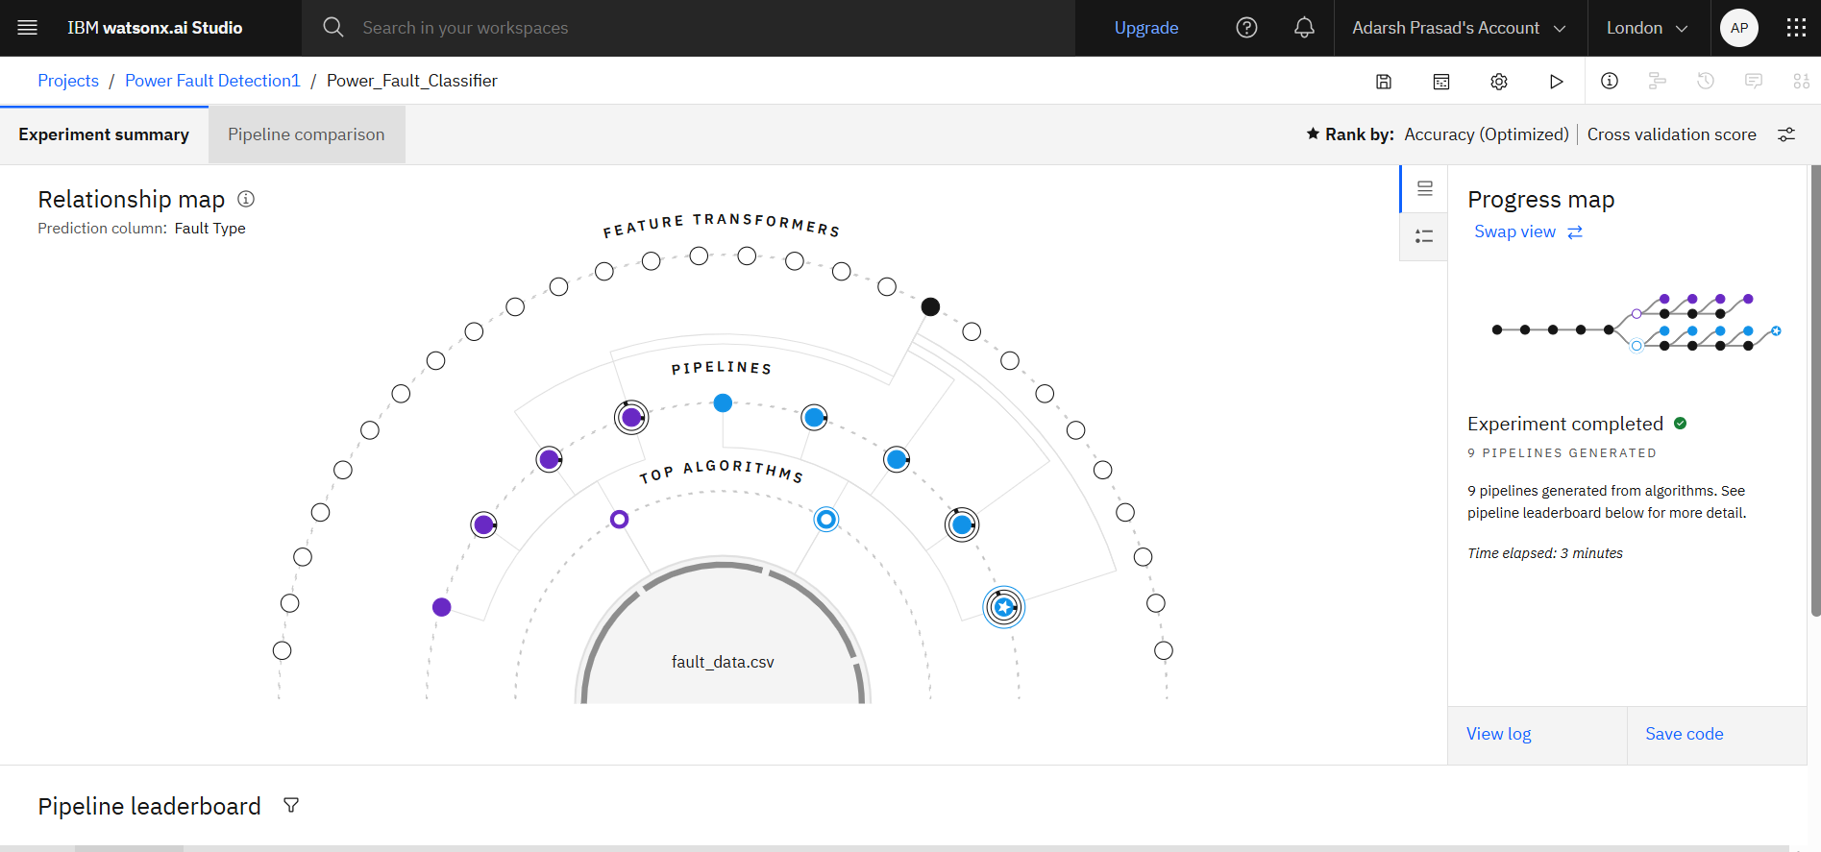
Result
Pipeline Leaderboard

Slide 8
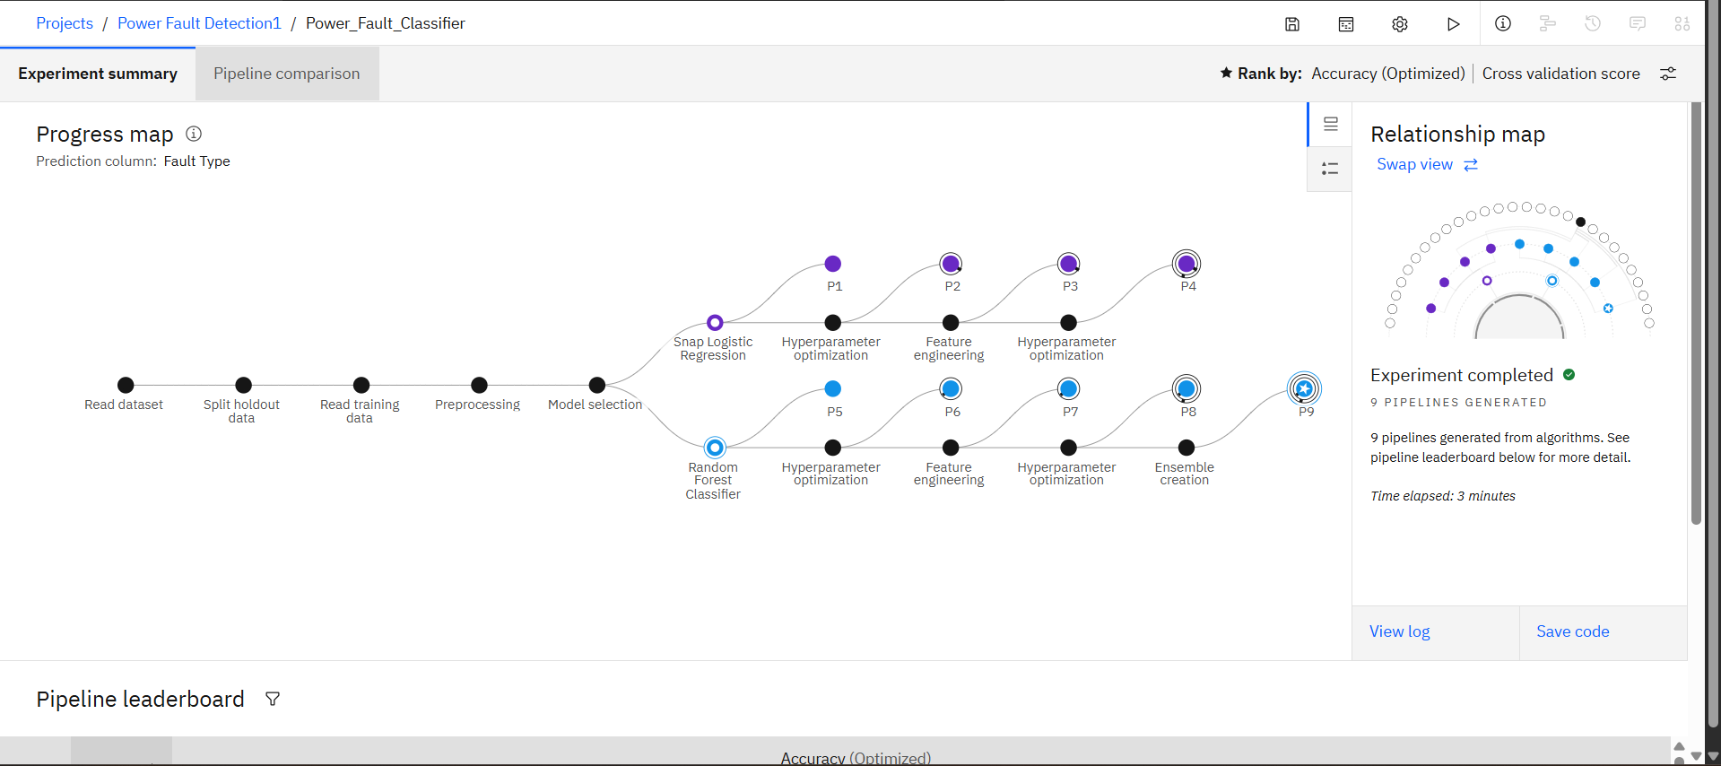
RESULT
Pipeline Leaderboard 2

Slide 9
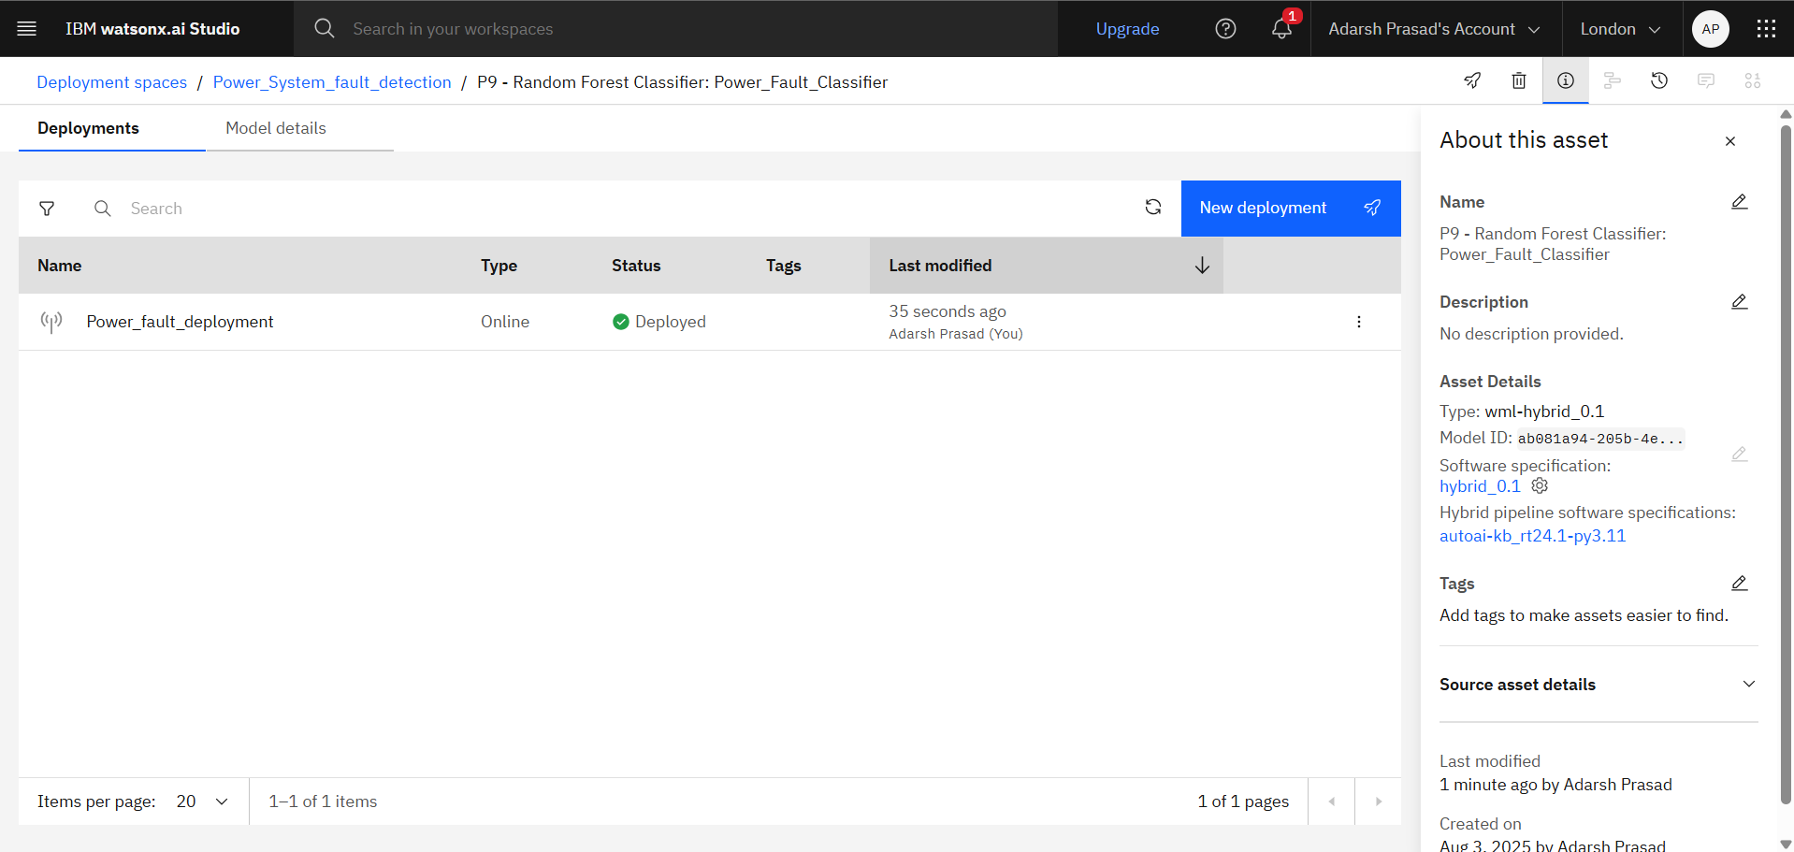
RESULT
Deploying of model

Slide 10
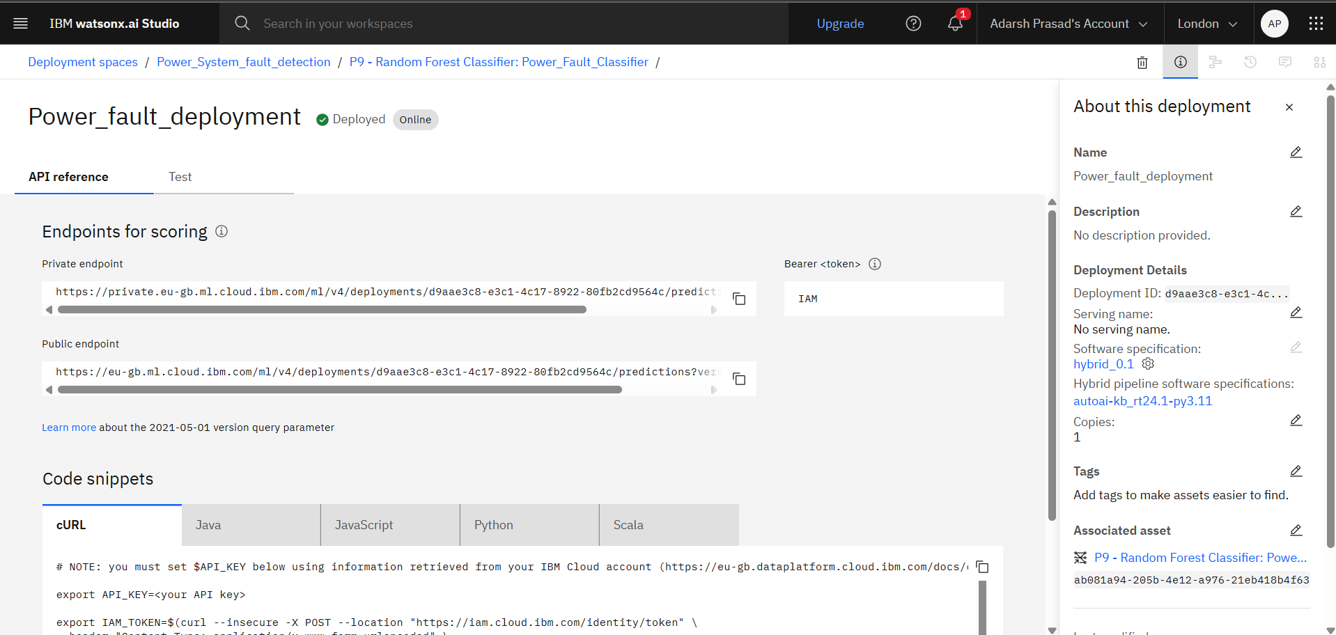
RESULT
Endpoints

Slide 11
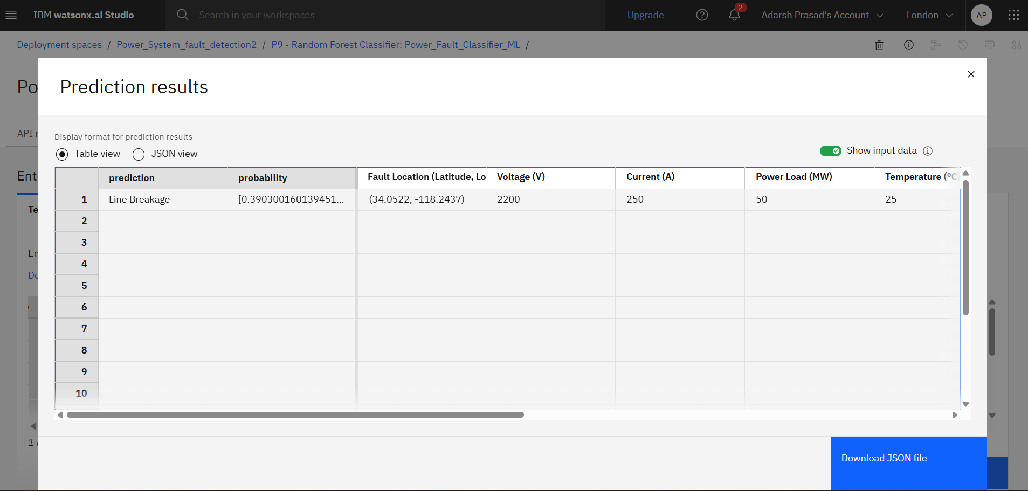
RESULT
PREDICTIONS

Slide 12
Conclusion
Developed an AutoML-based system for power fault detection.
Random Forest Classifier gave the best accuracy.
Helped classify faults like LG, LLG, LLLG effectively.
Faced data quality issues; real-time deployment needs improvement.
Ensures quick response and stable power supply.

Slide 13
Future scope
Integrate with real-time SCADA systems for live fault detection.
1
Expand to predictive maintenance using IoT sensor data.
2
Improve model accuracy with larger and more diverse datasets.
3
Deploy on cloud platforms like IBM Watsonx for scalability.
4
Add fault location detection for quicker field response.
5

Slide 14
References
IBM Cloud Docs – https://cloud.ibm.com/docs
Kaggle Dataset – Power System Fault Detection Dataset
Scikit-learn Documentation – https://scikit-learn.org
Pandas Documentation – https://pandas.pydata.org
Matplotlib & Seaborn – Python Visualization Libraries

Slide 15
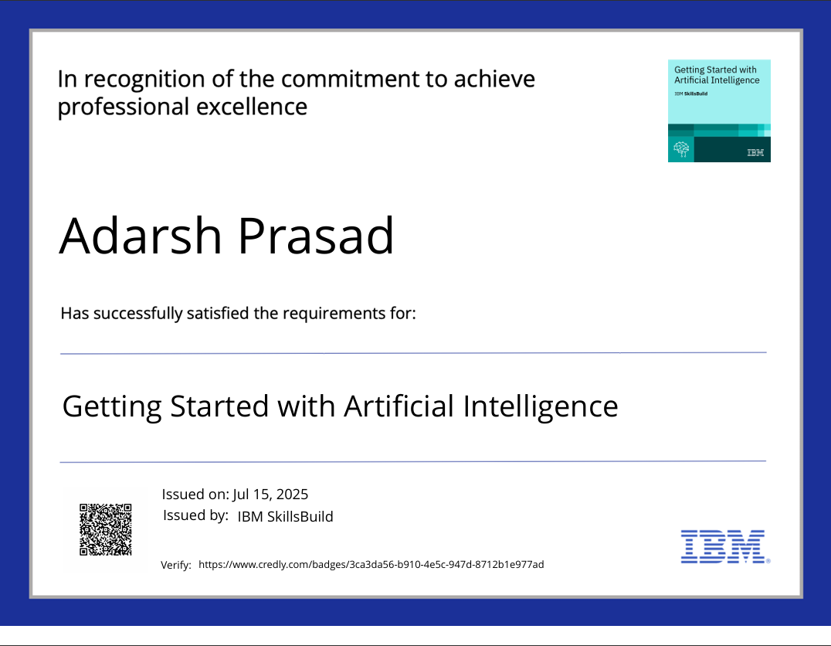
IBM Certifications
GETTING STARTED WITH AI

Slide 16
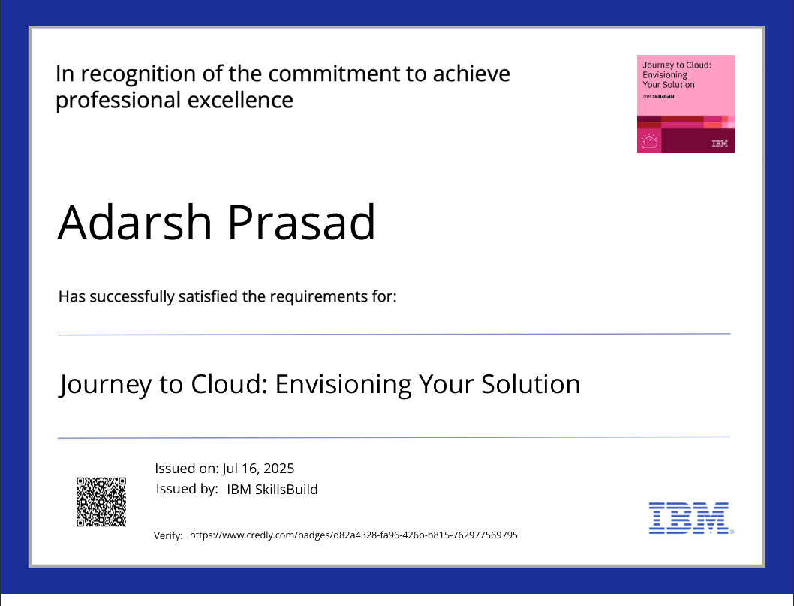
IBM Certifications
JOURNEY TO CLOUD

Slide 17
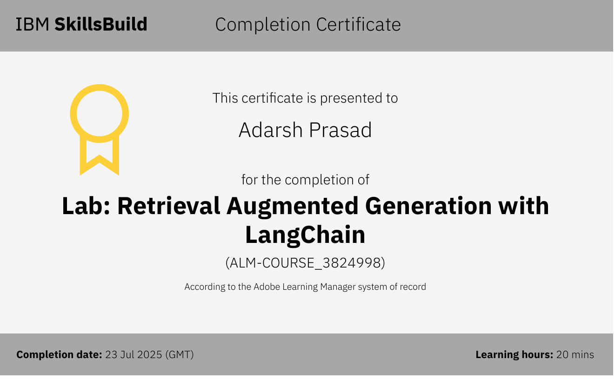
IBM Certifications
RAG LAB

Slide 18
THANK YOU

