Slide 1
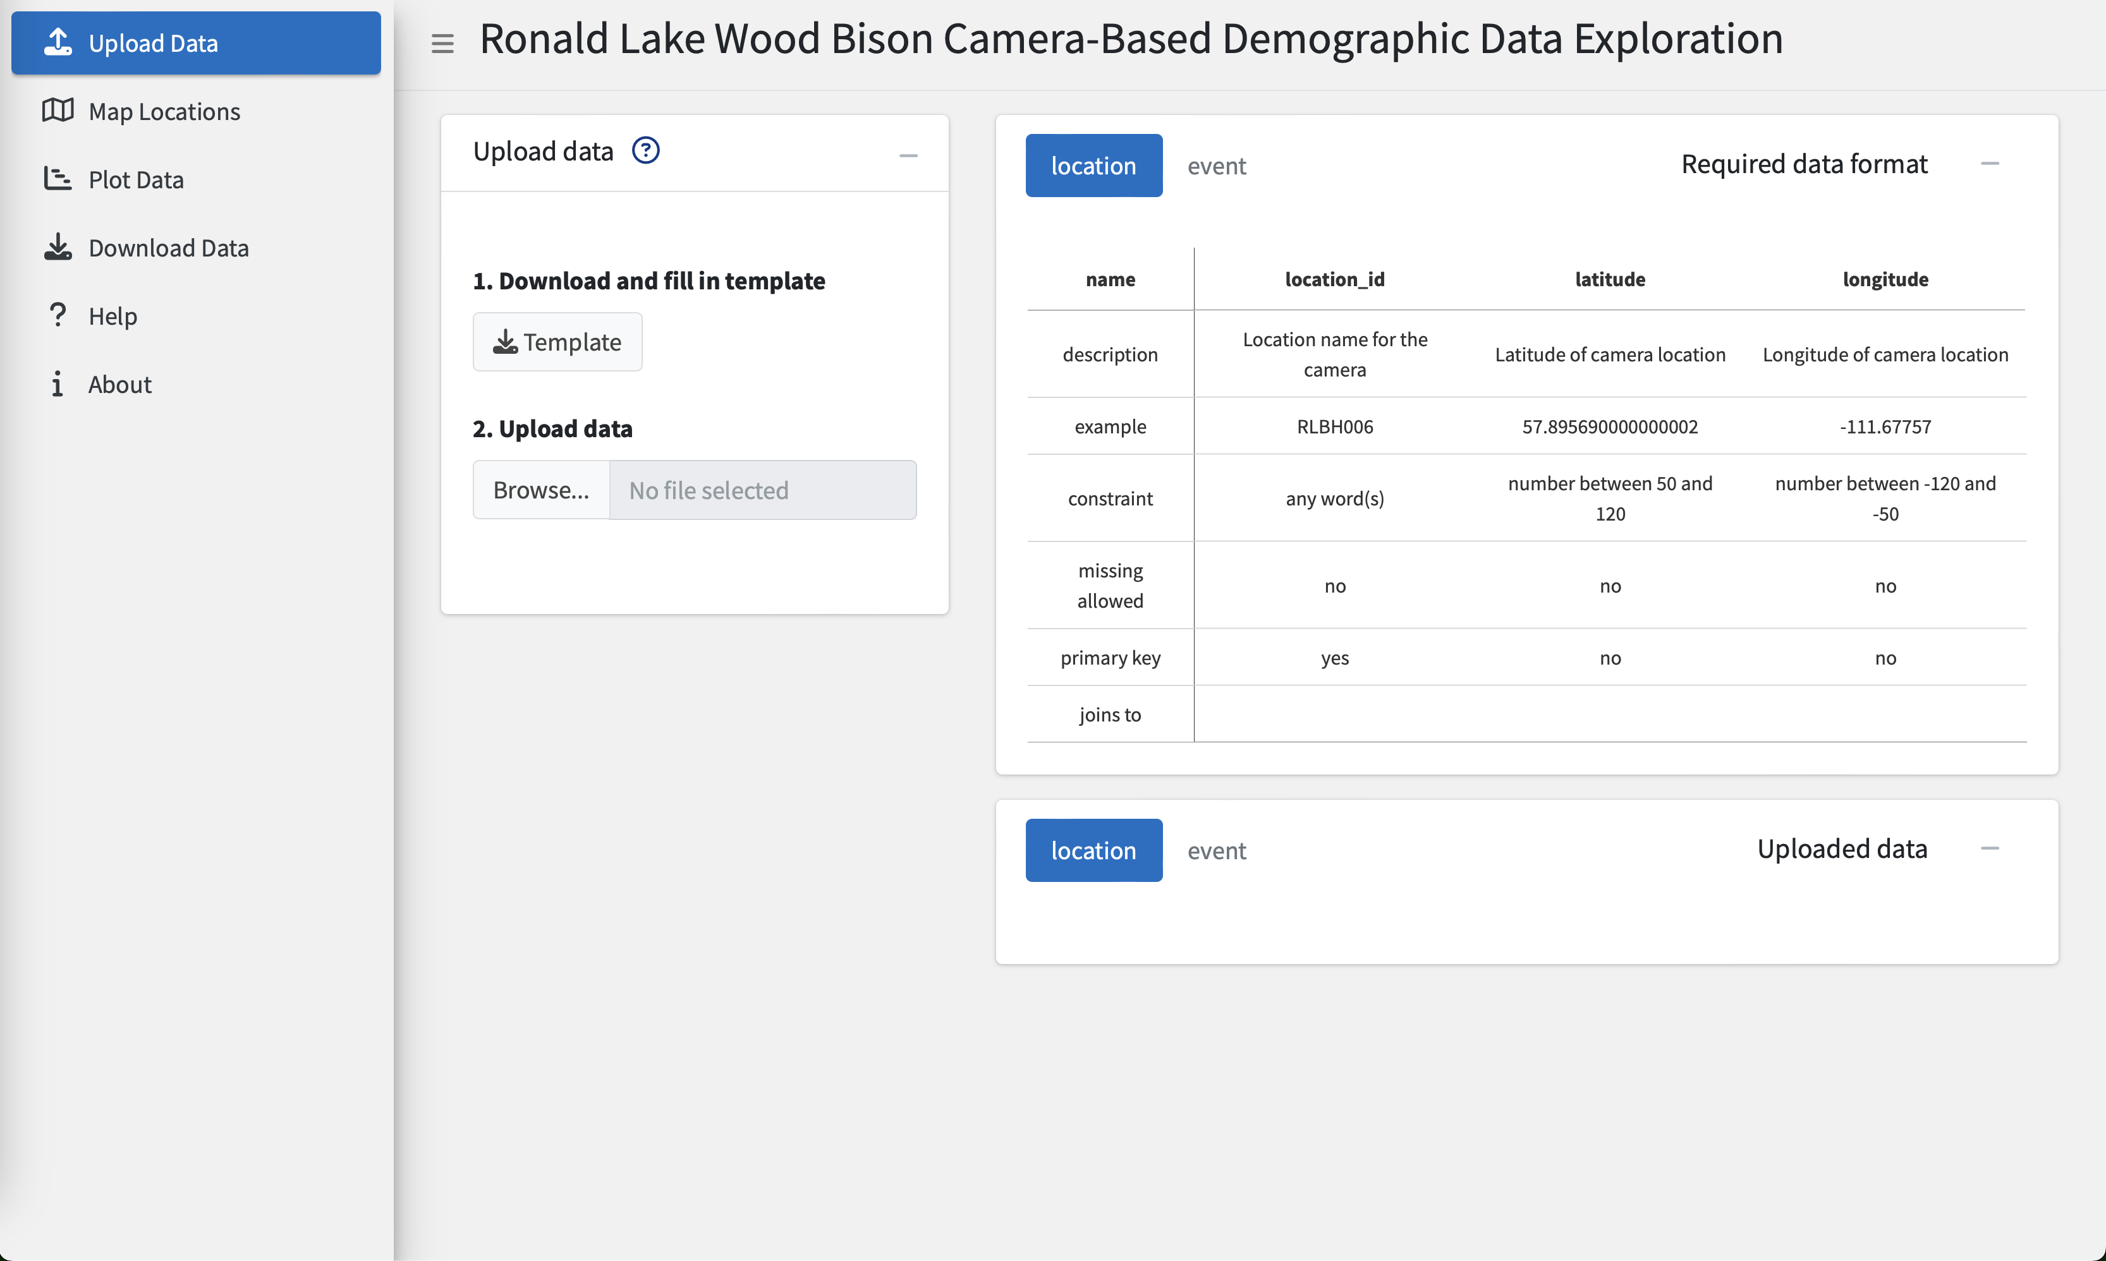
App tabs
Button to expand or collapse tabs
Button to access help information for the tab
Output of
the actions and options
Instruction box, perform actions and select options

