Slide 1
Empathy
By: Peter Opeyemi James

Slide 2
Definitions
Empathy is the ability to emotionally understand what other people feel, see things from their point of view, and imagine yourself in their place. Essentially, it is putting yourself in someone else's position and feeling what they are feeling. verywellmind.com
“It is the action of understanding, being aware of, being sensitive to, and vicariously experiencing the feelings, thoughts, and experience of another.“
Merriam-Webster

Slide 3
WHERE ARE WE TODAY?
A lack of consumer-centricity costs brands 69 points in NPS (experience rating). 75% of brands audited believed they were consumer-centric, but only 30% of their consumers agreed.
~ 2017 Global Survey by Capgemini
Empathy levels may be falling.
Our ability to empathise with others may be falling according to a meta-analysis of US citizen empathy test scores conducted over the past 30 years. The study found that average American today is less empathic than 75% of Americans 30 years ago.
~ Konrath et al (2011)
Women are (usually) more empathic. In a UK validation of the EQ with 1716 participants, women were found to have an average EQ of 48/80 (60%), and men 39/80 (49%), indicating that women are 11% more empathic than men.
~ Akio et al, Ciba University, Japan (2006)
For example, in one recent validation of this test, women could correctly read 76% of emotions expressed through eyes, men 71%.
Notes:
John’s feedback: + The challenge of detecting emotion over a phone call, Email and or Video Meeting
The Impact of Covid / Lockdown on Empathy?
If a client can get a comparable solution / resolution to a problem from an alternate provider, then factors like empathy have a bigger part to play with client satisfaction
Try get some UK stats rather than US ones

Slide 4
Empathy is Number ONE rule for “new product innovation success” The Nielsen Breakthrough Innovation Report
Of 61,000 SKUs representing more than 12,000 new launches since 2011. 3 in 4 FMCG launches fail within a year. Those that succeed focus on “walking in the shoes of the consumer to uncover key demand-driven insights”.
Notes:
John feedback: Walking in the slides of the consumer
Think about the last time you had a problem and needed to call someone to get it fixed
Phone tariff change
Takings some clothes back that didn’t fit
Car Tyres
What did it feel like?

Slide 5
Empathy improves satisfaction Sung, Stan and Mark. 2004
A Korean study in the healthcare sector found that empathy improves patient satisfaction and compliance (adhering to treatment schedule).
Five hundred and fifty outpatients participated in the study. Physician empathy levels were linked to better information exchange, perceived expertise, interpersonal trust, and partnership. This resulted in higher patient satisfaction and better compliance.
Notes:
John Feedback: Empathy leads to more buy in to the solution by a client. Better description of problem or goal

Slide 6
The empathy delusion in marketing Reach Solutions
199 marketing executives completed an empathy psychometric test (the IRI – Interpersonal Reactivity Index) measuring their empathy levels both cognitively and emotionally.
The study found no differences between marketers and the general population. Only 30% of marketers were proficient in experiencing the world from someone else’s (i.e., the consumer’s) perspective.
Notes:
John Feedback: Not sure when this is from but I’d be sceptical about this. It’s not really relevant to Nexus

Slide 7
The empathy deficit in business costs the average brand over $300m lost in revenue every year M&C Saatchi
By assessing whether people’s actual real-live experiences of brands matched marketing promises made by the brand.
They found that 18% of customers had stopped using a brand in the past 12 months because of the gap between marketing and experience. 32% believed the gap was overwhelming. The gap represents a fundamental empathy deficit among brands who are out of touch with what if feels like to use the brand.
Notes:
John Feedback: Expectations and reality
Aldi to Waitrose
Apple to Microsoft
Telsa to Ford

Slide 8
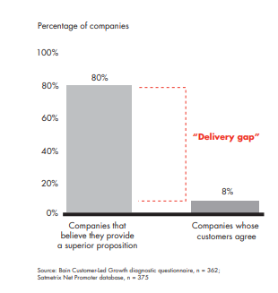
The empathy deficit and the 80:8 rule. Bain and Company

Slide 9
HOW EMPATHY CONTRIBUTES TO POSITIVE OUTCOMES (Forbes)
Of people who reported that their leaders were empathetic, 61% of employees reported that their leaders were most likely to be innovative.
Retention
57% of white women and 62% of women of color said they were unlikely to think of leaving their companies when they felt their life circumstances were respected and valued by their companies. However, when they didn’t feel that level of value or respect for their life circumstances, only 14% and 30% of white women and women of color respectively said they were unlikely to consider leaving.
Inclusivity
When people felt their leaders were more empathetic, 86% reported they are able to navigate the demands of their work and life—successfully juggling their personal, family and work obligations. This is compared with 60% of those who perceived less empathy.
Work-Life
50% of people with empathetic leaders reported their workplace was inclusive, compared with only 17% of those with less empathetic leadership.
Innovation
Notes:
John feedback: We could adapt this to how the people we work with affect our success. Rather than making is “Leaders” why don’t we try and make it about how the experience of someone in an office can feed up to a decision maker or influencer.

Slide 10

Empathy in Customer Service
In customer service, empathy is the ability to have a human interaction with a customer where you would intentionally put yourself in the customer’s shoes to understand their issue and find the best possible solution for your customers. Let’s look at an example of empathy in customer service for a better understanding.

Slide 11
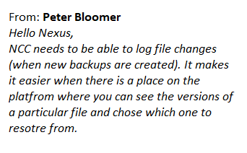
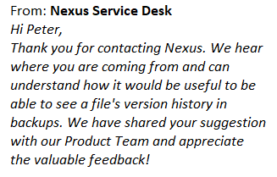
Example

Slide 12
Why is empathy important in customer service?
Noticing things that are unsaid
A better understanding of people
Dealing easily with conflicts
Building stronger customer relationships
Invoking empathy from customers
Predicting action and reaction
Notes:
John Notes – this slide and Next: Add some examples that have technical issues
How it goes wrong
How to turn it around

Slide 13
Identifying an empathy problem
Tone mismatch between the engineer and the client – One is too formal and the other is too informal.
Late responses are sent without apologies.
Clients are discouraged from contacting support, through words and behaviour.
Agents with the Somebody Else’s Ticket syndrome – That is, issues getting deflected to other departments without any explanations or follow-ups.
Lack of customer satisfaction – There is no bigger sign of lack of empathy than the customer being unhappy even after getting what they want.

Slide 14
How to build empathy?
Understand your biases
Reading fiction and other activities to put you in someone else’s shoes
Maintain positivity
Understand client business
Get feedback from your peers and customers
Teach
Notes:
John Notes: Help people understand their bias…Give them a way to reflect
Outside of work they could examine how an element of customer care made them feel – At what point did they decide what the experience was like? What was the trigger?
Listen to each others calls at work, when you hear it one way, you can decide how you feel about the call

Slide 15
Exercise
Active listening
Two sides to every story

Slide 16
Practical ways to empathize with a customer
Active listening
Avoid sympathy
Keep your attitude in check
Give people the benefit of doubt
Make customers a part of the solution
Be curious about your customer
Look for common interests
Always be respectful
Be extra careful when there is a language barrier
Respond to the customer’s tone
Do not assume, ask
Take their side when they are right

Slide 17
exercise
Laural, Yanny, and the dress

Slide 18
Some Powerful empathy statements
“Thank you for bringing this to our attention”
“I understand how you feel”
“Please let me know if my understanding of your problem is accurate - ”
“I’m sorry you’re facing this issue”
“I would do the same if I were in your position too”
“Your anger/frustration is completely justified”
“Here’s what you can do – ”

Slide 19
Be empathic!

Slide 20
NOTES

