Slide 1
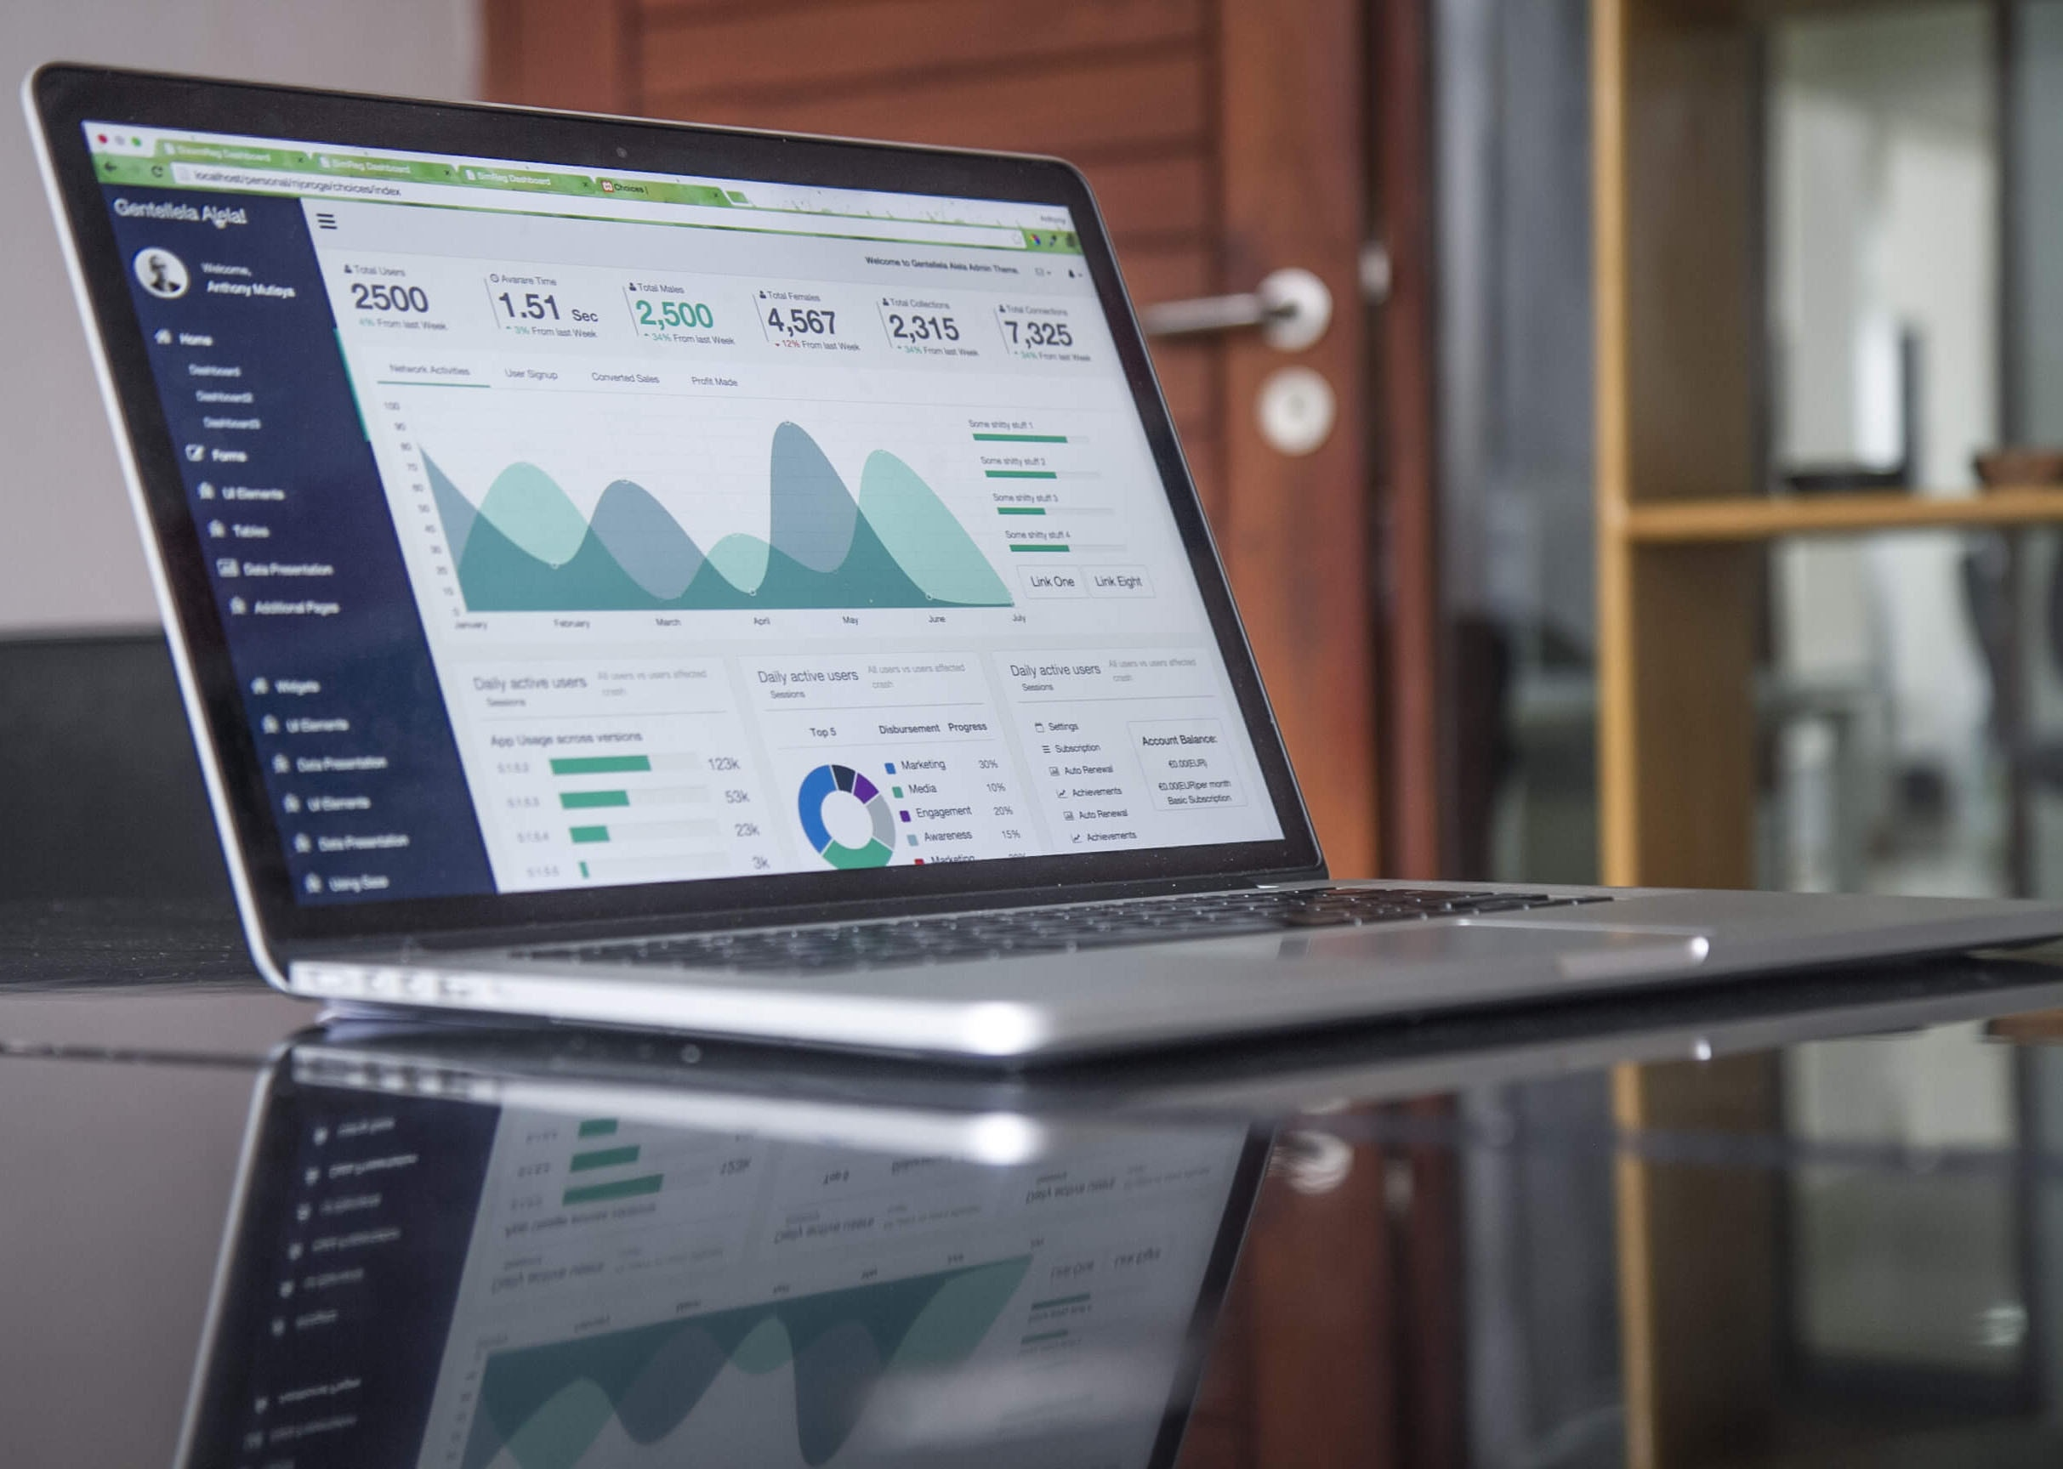
BIG DATA
ANALYSIS

Slide 2
Problem Definition:
The project involves delving into big data analysis using IBM Cloud Databases. The objective is to extract valuable insights from extensive datasets, ranging from climate trends to social patterns. The project includes designing the analysis process, setting up IBM Cloud Databases, performing data analysis, and visualizing the results for business intelligence.

Slide 3
Design Thinking
Data Selection: Identify the datasets to be analyzed, such as climate data or social media trends.
Database Setup: Set up IBM Cloud Databases for storing and managing large datasets.
Data Exploration: Develop queries and scripts to explore the datasets, extract relevant information, and identify patterns.
Analysis Techniques: Apply appropriate analysis techniques, such as statistical analysis or machine learning, to uncover insights
Visualization: Design visualizations to present the analysis results in an understandable and impactful manner.
Business Insights: Interpret the analysis findings to derive valuable business intelligence and actionable recommendations.

Slide 4
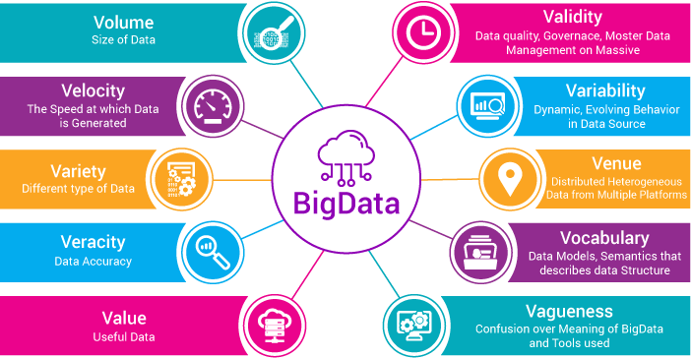

Slide 5

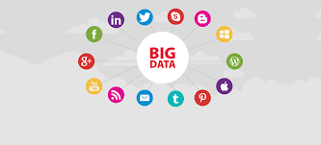
Data Selection:
The choice of datasets for analysis depends on your specific research or analysis goals. Here are some examples of different types of datasets that you might consider for analysis:
1.Climate Data:
Temperature Data: Historical temperature records from various locations.
Precipitation Data: Information about rainfall and snowfall patterns.
Climate Models: Data from climate models predicting future climate scenarios.
2.Social Media Trends:
Twitter Data: Tweets with hashtags related to a specific topic or event.
Instagram Data: Posts and comments related to a particular subject.
Facebook Data: Public posts and comments on Facebook pages.

Slide 6
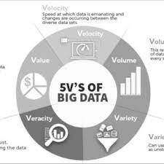
3.Economic Data:
Stock Market Data: Historical stock prices and trading volumes.
GDP and Economic Indicators: Gross Domestic Product, inflation rates, unemployment rates, etc.
Consumer Behavior: Data on consumer spending patterns and preferences.
4.Healthcare Data:
Electronic Health Records (EHR): Patient medical records for research or diagnosis.
Disease Outbreak Data: Information on the spread of diseases, such as COVID-19 data.
Drug Trial Data: Data from clinical trials for pharmaceutical research.
5.Demographic Data:
Census Data: Population, age, gender, and ethnicity statistics.
Education Data: Educational attainment, enrollment, and school performance data.
Migration Data: Information on immigration and emigration patterns.

Slide 7
Database Setup:
Setting up IBM Cloud Databases to store and manage large datasets involves several steps. IBM Cloud offers various database services, including Db2, Databases for PostgreSQL, Databases for MongoDB, and more. Here's a general guide on how to set up a database in IBM Cloud:
Sign In to IBM Cloud:
Go to the IBM Cloud website (https://cloud.ibm.com/).
Sign in or create an IBM Cloud account if you don't already have one.
Navigate to Databases:
Once logged in, click on the "Databases" option in the IBM Cloud dashboard or use the search bar to find the database service you want to use.
Create a Database Instance:
Click on the "Create" button or a similar option to create a new database instance.
Select Database Type:
Choose the type of database you want to create (e.g., Db2, PostgreSQL, MongoDB).

Slide 8
5.Configure Database Settings:
Configure the database settings, including the following:
Instance Name: Give your database instance a unique name.
Resource Group: Choose an existing resource group or create a new one.
3.Region: Select the geographic region where you want to deploy your database.
4.Plan: Choose the plan that best fits your needs, considering factors like storage, memory, and I/O performance.
5.Authentication: Set up authentication and access control, including usernames and passwords.
6.Additional Configuration:
Depending on the type of database you're setting up, you may need to configure additional settings such as networking, encryption, and scaling options. Follow the on-screen instructions and documentation specific to your chosen database service.
7.Review and Create:
Review your configuration settings to ensure they are accurate.
Click the "Create" or "Next" button to provision the database instance.

Slide 9
9.Backup and Disaster Recovery:
Set up regular backups and establish a disaster recovery plan to ensure data resilience.
10.Scaling:
As your dataset grows, you may need to scale your database resources. IBM Cloud provides options for vertical and horizontal scaling.
11.Maintenance and Updates:
Keep your database software up to date with the latest patches and updates.
12.Documentation and Support:
Refer to IBM Cloud's documentation and support resources for assistance in managing and optimizing your database.
Please note that the specific steps and options may vary depending on the type of database service you choose within IBM Cloud. Always refer to the official documentation and guides provided by IBM for detailed instructions on setting up and managing your chosen database service.

Slide 10
Data Exploration:
Data exploration involves using queries and scripts to interact with your datasets, extract meaningful information, and identify patterns or insights. The specific approach and tools you use can vary depending on the type of dataset and your analysis goals. Here's a general guide on how to explore datasets using queries and scripts:
Choose Your Tools:
Depending on the dataset and your preferences, you can use various tools and languages for data exploration, such as SQL, Python, R, or specialized data analysis tools like Jupyter notebooks or Tableau.
Load or Connect to the Dataset:
If your data is in a database, establish a connection using appropriate database libraries or tools.
If your data is in a file format (e.g., CSV, Excel), load it into your analysis environment using libraries or functions specific to your chosen language.
Perform Initial Data Inspection:
Start by examining basic statistics and properties of the dataset, such as the number of rows and columns, data types, and summary statistics (e.g., mean, median, standard deviation).

Slide 11
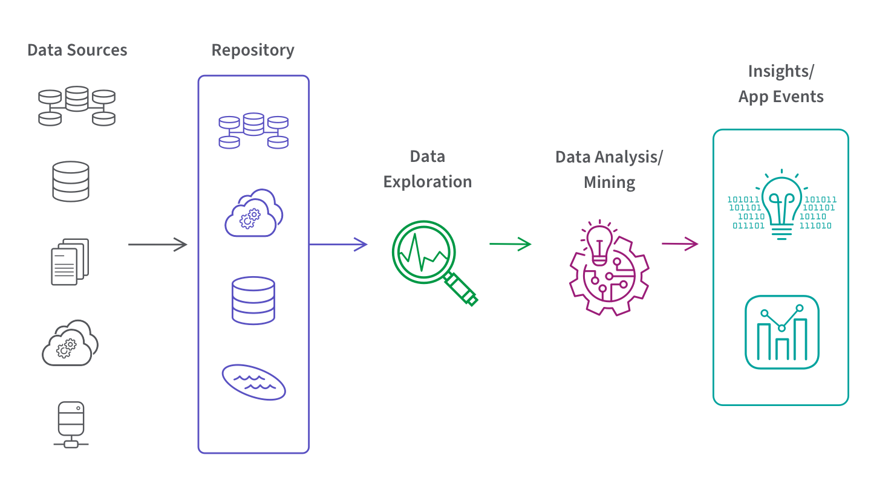
4.Data Filtering and Selection:
Write queries or scripts to filter and select relevant subsets of data based on your research objectives.
Use conditions, such as WHERE clauses in SQL or conditional statements in programming languages, to extract specific rows or observations.
5.Aggregate Data:
Aggregate data to gain a higher-level view. For example, calculate sums, averages, counts, or other aggregate functions on numerical columns.
Group data by categorical variables to observe trends within groups.

Slide 12
Analysis Techniques:
Applying appropriate analysis techniques, whether it's statistical analysis or machine learning, is a crucial step in uncovering insights from your data. The choice of technique depends on your research goals, the nature of your dataset, and the questions you want to answer. Here's how to apply these techniques effectively:
Statistical Analysis:
Descriptive Statistics:
Begin with descriptive statistics to summarize and understand the basic characteristics of your data. This includes measures like mean, median, variance, and standard deviation.
Hypothesis Testing:
Formulate hypotheses about relationships or differences in your data and conduct hypothesis tests. Common tests include t-tests, chi-squared tests, and ANOVA.
Correlation and Regression Analysis:
Use correlation analysis to identify relationships between variables. If you have a dependent and independent variable, consider linear or logistic regression to model these relationships.

Slide 13
Multivariate Analysis:
When dealing with multiple variables, consider techniques like principal component analysis (PCA) or factor analysis to reduce dimensionality and identify underlying patterns.
Time Series Analysis:
If your data is time-series data, employ time series analysis techniques such as autoregressive integrated moving average (ARIMA) or seasonal decomposition.
Non-parametric Methods:
When assumptions of normality or homoscedasticity are violated, use non-parametric tests like the Wilcoxon rank-sum test or Kruskal-Wallis test.
Data Preprocessing:
Clean and preprocess your data by handling missing values, outliers, and encoding categorical variables.
Split the data into training and testing sets for model evaluation.
Feature Engineering:
Create relevant features or transform existing ones to improve model performance.
Techniques may include feature scaling, one-hot encoding, or creating interaction terms.
Model Selection:
Choose the appropriate machine learning algorithm(s) based on your problem.
Machine Learning:

Slide 14
Visualization:
Designing effective visualizations is essential to present analysis results in an understandable and impactful manner. Well-crafted visualizations can help convey complex information, patterns, and insights to your audience. Here are steps and best practices for creating meaningful visualizations:
Understand Your Audience:
Consider who will be viewing your visualizations. Are they experts in the field or general stakeholders? Tailor your visualizations to their level of expertise and interests.
Choose the Right Visualization Type:
Select the appropriate chart or graph type that best represents your data and research findings. Common types include bar charts, line charts, scatter plots, pie charts, heatmaps, and more.
Simplify and Focus:
Keep your visualizations simple and focused. Avoid clutter, excessive decorations, or unnecessary elements that may distract from the main message.
Use Clear Titles and Labels:
Provide clear and concise titles and labels for your visualizations. Ensure that axes are labeled with units and are easily interpretable

Slide 15
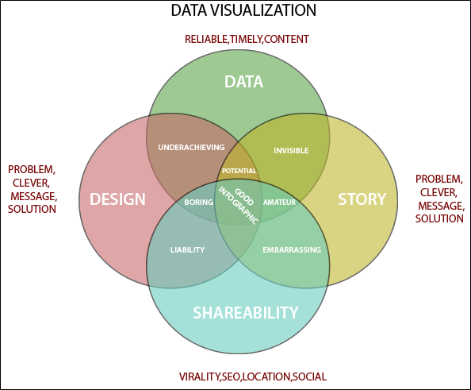
5.Color Palette:
Choose a color palette that is visually appealing and aids in understanding. Use color consistently to represent categories or variables, and be mindful of colorblindness.
6.Data Integrity and Accuracy:
Ensure that your visualizations accurately represent the underlying data. Avoid distorting scales or using misleading visual tricks.
7.Annotations and Text:
Use annotations, captions, and text to highlight key points or observations in your visualizations. Explain trends, outliers, or significant findings

Slide 16
Business Insights:
Interpreting analysis findings to derive valuable business insights and actionable recommendations is a critical step in the data analysis process. Here's a structured approach to help you extract meaningful insights and translate them into actionable business recommendations:
Understand the Context:
Begin by revisiting the business problem or objectives that initiated the analysis. Ensure a clear understanding of the context and goals.
Summarize Key Findings:
Start with a concise summary of the main findings and insights from your analysis. Highlight the most important takeaways.
Prioritize Insights:
Identify and prioritize insights based on their potential impact on the business. Not all insights are equally valuable or actionable.
Link Findings to Objectives:
Connect each finding to the specific business objectives or questions you aimed to address through the analysis. This helps establish relevance.

Slide 17
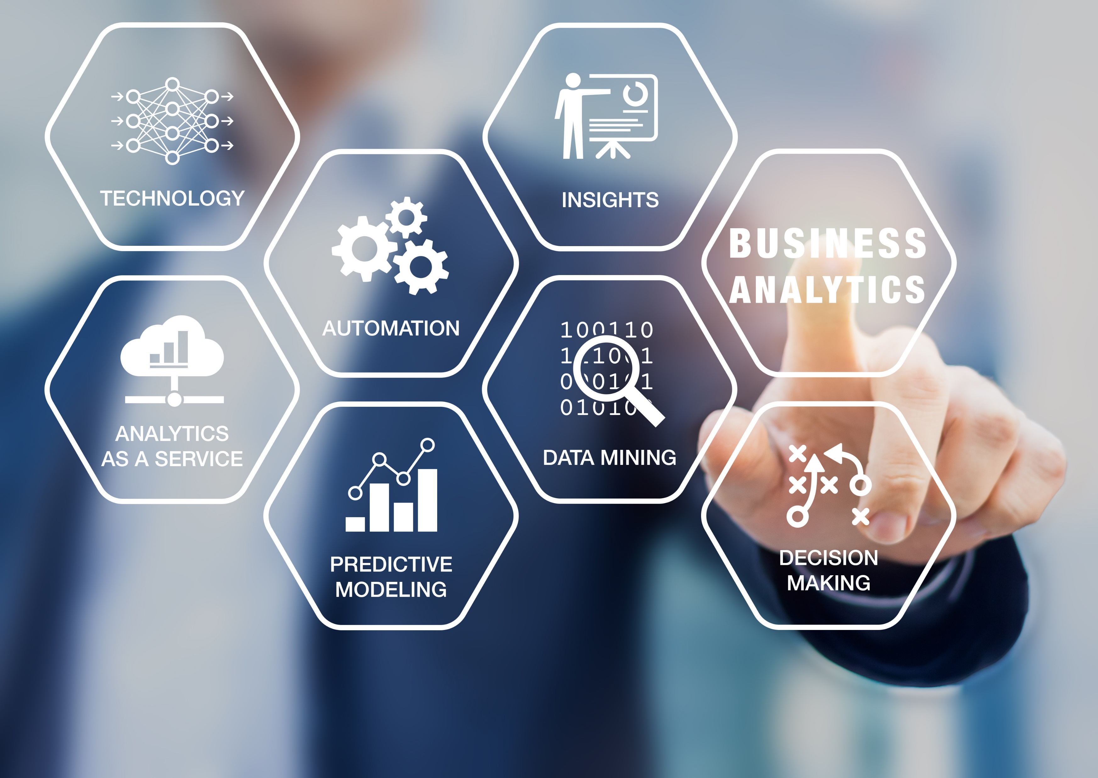
5.Quantify Impact:
Whenever possible, quantify the impact of your findings. Use metrics and data to illustrate the significance of the insights.
6.Provide Context:
Offer context around the insights. Explain why the findings are important and how they relate to broader business goals or industry trends.
7.Segmentation and Audience Analysis:
Consider segmenting your insights based on different audience groups (e.g., marketing, sales, product development). Tailor your recommendations to each audience's needs.

Slide 18


