Slide 1

Big data analysis with ibm cloud
POJAN KUMAR.R
912421104027

Slide 2
Phase-2:Innovation

Slide 3
Introduction to Big Data and IBM Cloud
Big data refers to the large and complex sets of data that are difficult to process and analyze using traditional data processing methods. With the advent of new technologies like IBM Cloud, big data analysis has become more accessible and efficient. IBM Cloud provides a scalable and secure platform for storing, processing, and analyzing big data. With IBM Cloud, organizations can leverage advanced machine learning algorithms for predictive analysis or anomaly detection in big data.

Slide 4
Data Collection and Storage:
Data is collected from various sources, such as social media platforms, IoT devices, and sensors. IBM Cloud offers various storage options for big data, including object storage, block storage, and file storage. Object storage is ideal for unstructured data, while block storage is suitable for structured data, and file storage is best for shared file systems.
IBM Cloud Storage Options:
Object Storage: Ideal for unstructured data such as audio, video, and images.
Block Storage: Suitable for structured data such as databases and applications.
File Storage: Best for shared file systems and home directories.

Slide 5
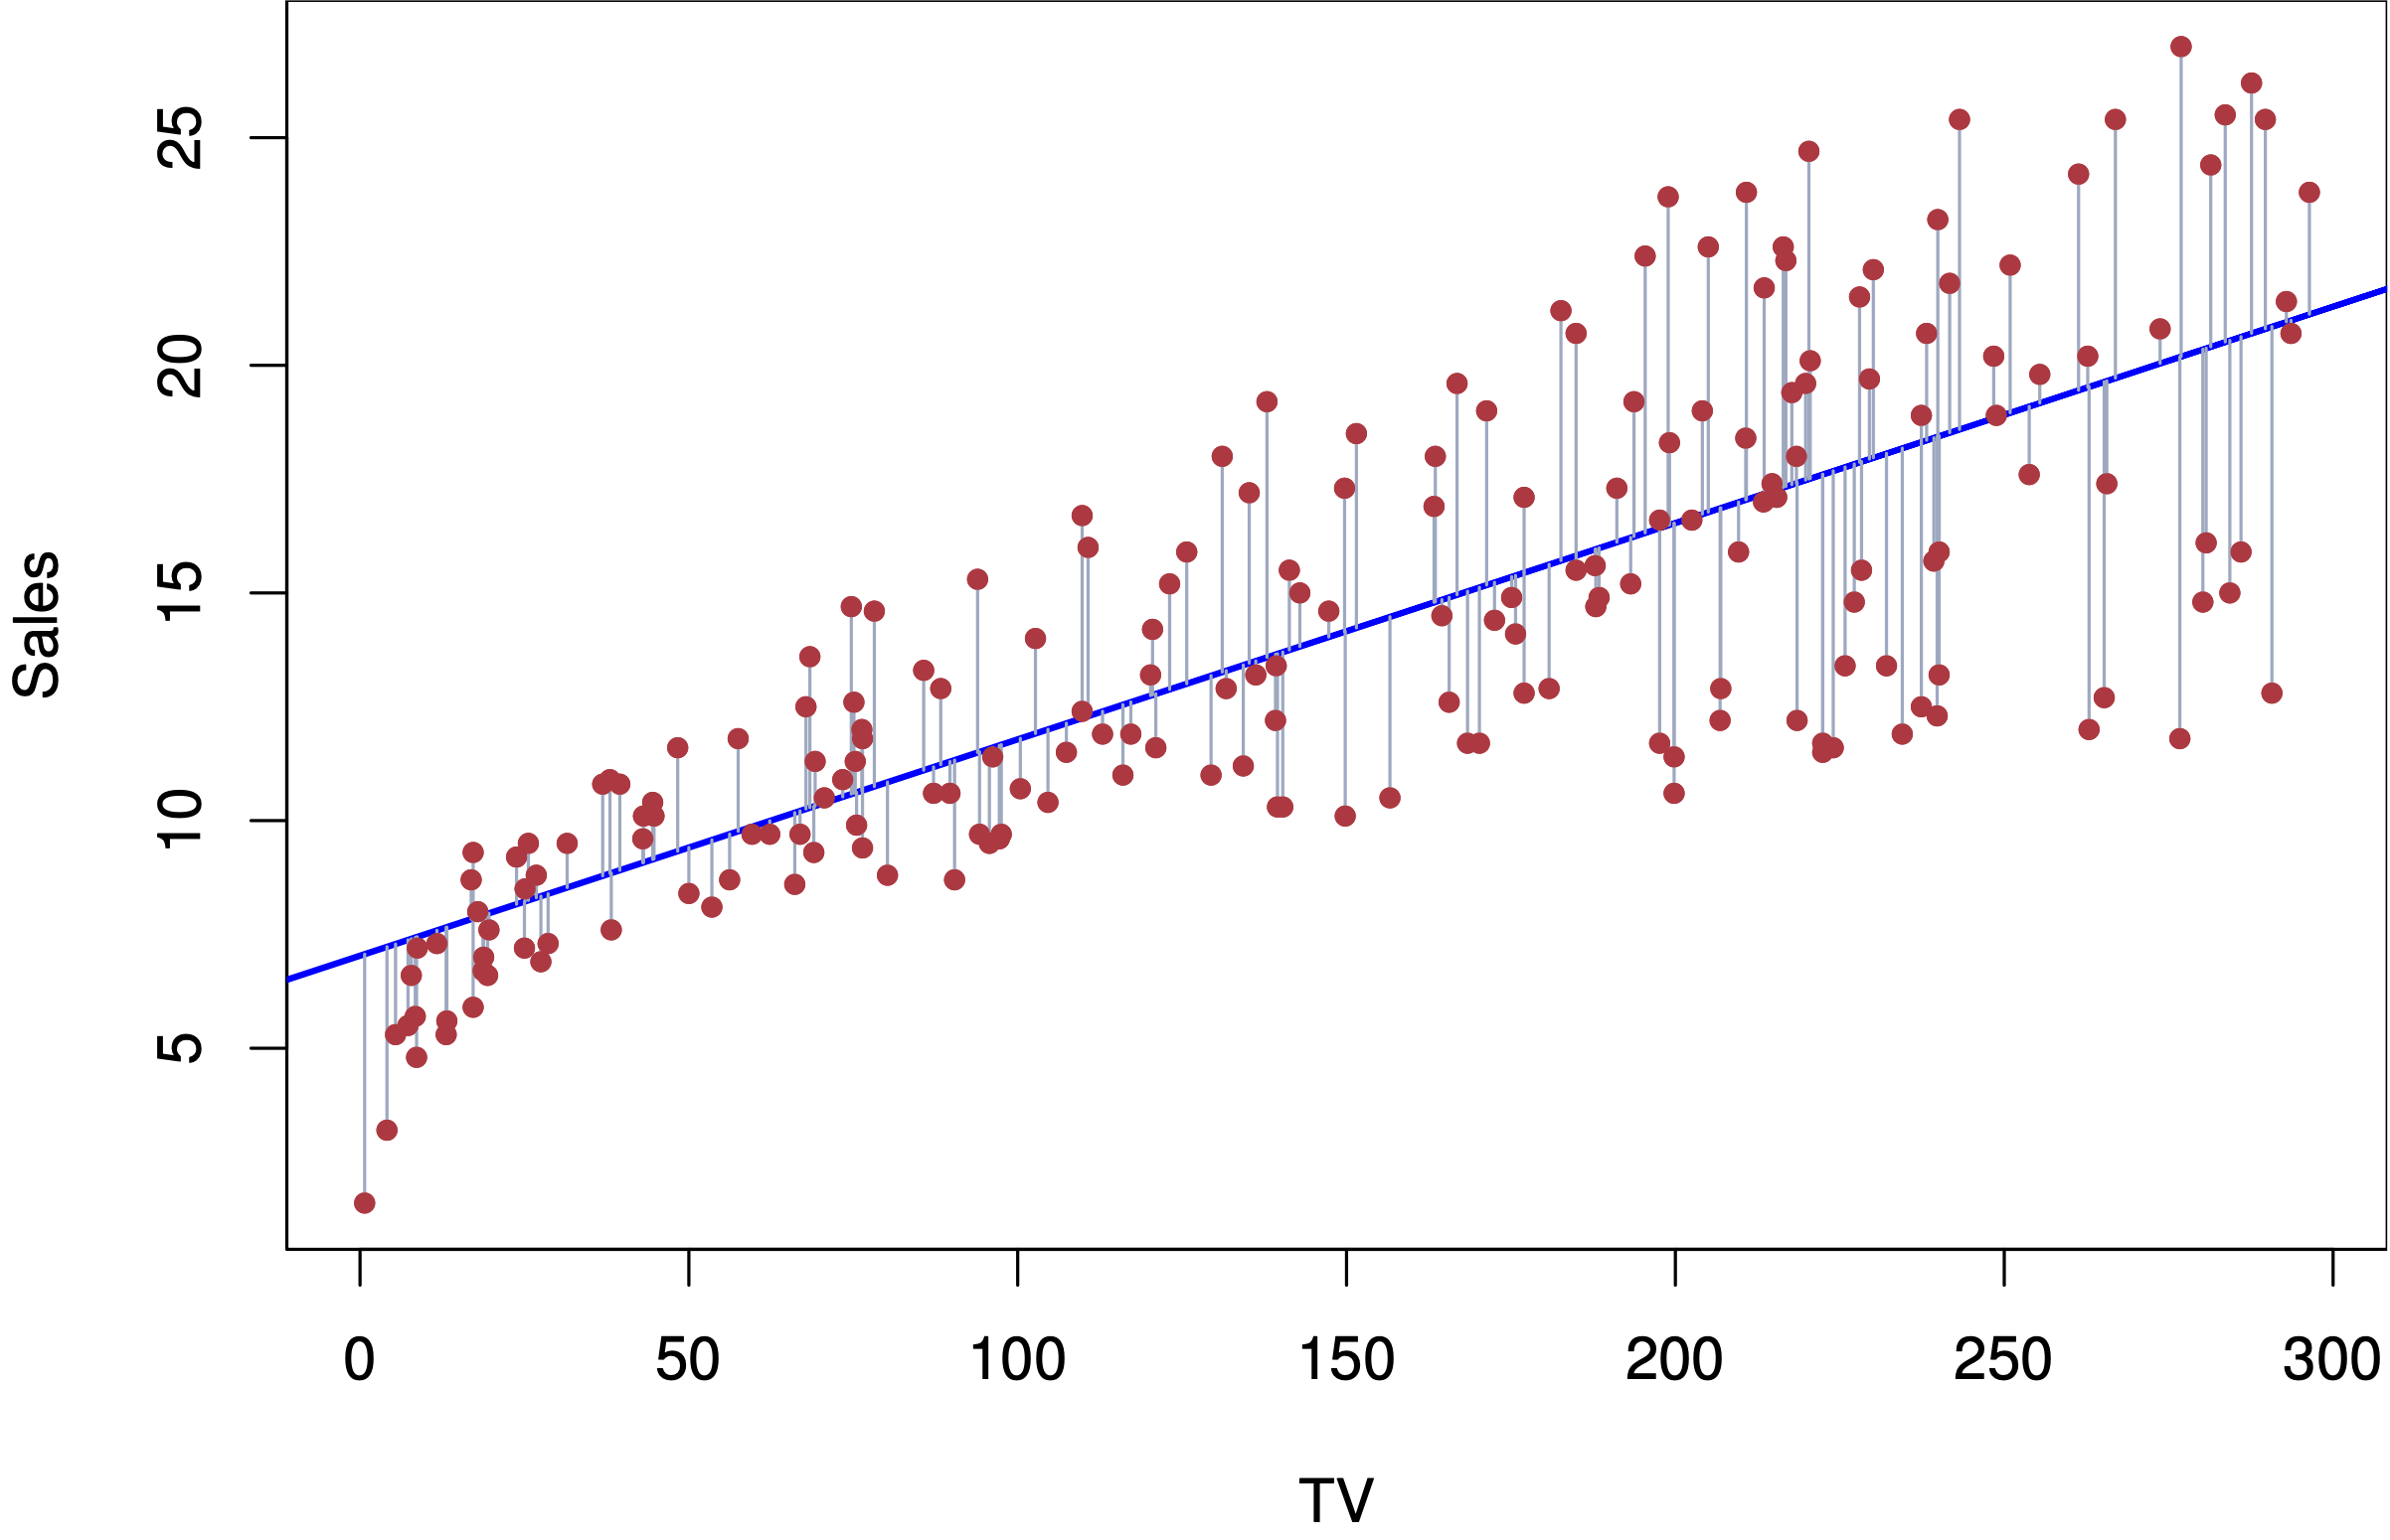
Machine Learning Algorithms for Predictive Analysis:
Linear Regression:
Linear regression is a simple machine learning algorithm that predicts a numeric value based on the relationship between one or more independent variables and a dependent variable.

Slide 6
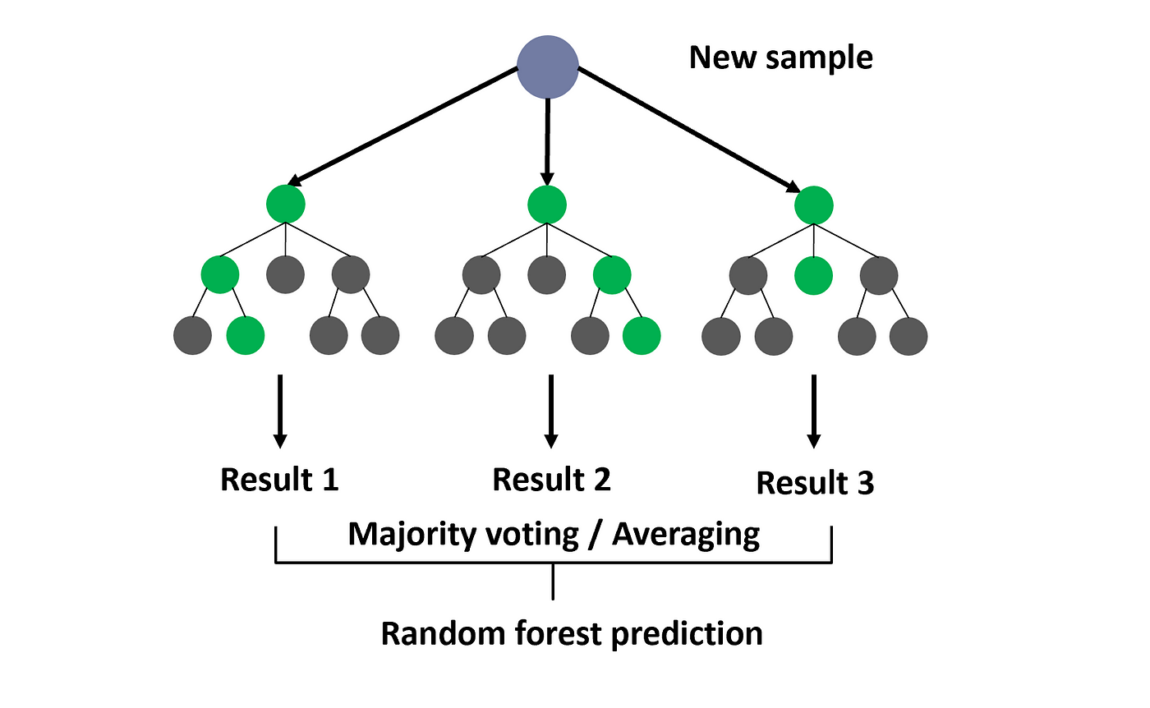
Random Forest:
Random forest is a popular machine learning algorithm used for predictive analysis. It creates multiple decision trees and combines their predictions to achieve higher accuracy.

Slide 7
Data Visualization:
Data visualization plays a crucial role in big data analysis as it allows for easy interpretation and understanding of complex data sets. IBM cloud offers a variety of tools and platforms for data visualization, including IBM cognos analytics and IBM watson studio.
Benefits of Data Visualization:
Simplifies complex data sets and makes trends and patterns more visible.
Facilitates communication and collaboration between different teams and departments.
Enables faster and more informed decision-making.

Slide 8
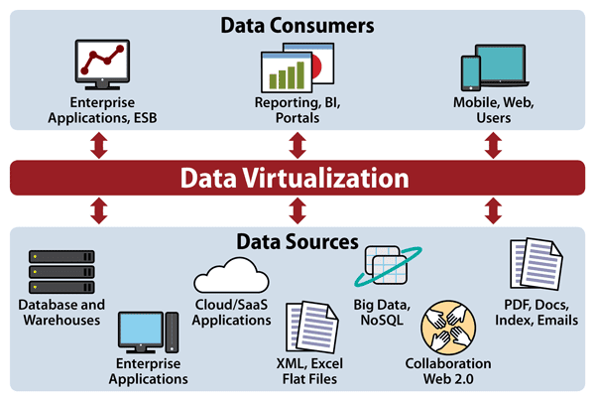
Data Visualization Techniques:
There are various techniques for data visualization, including:
Line charts and bar graphs for showing trends and comparisons.
Pie charts and donut charts for displaying proportions and percentages.
Heat maps and scatter plots for showing correlations and distributions.

Slide 9
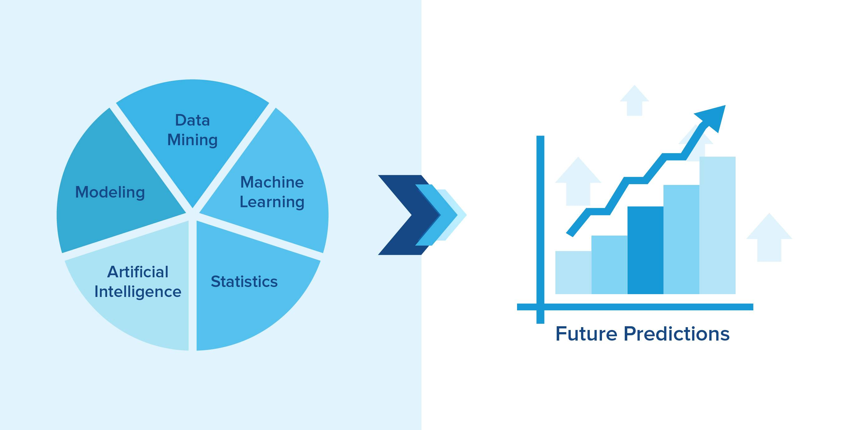
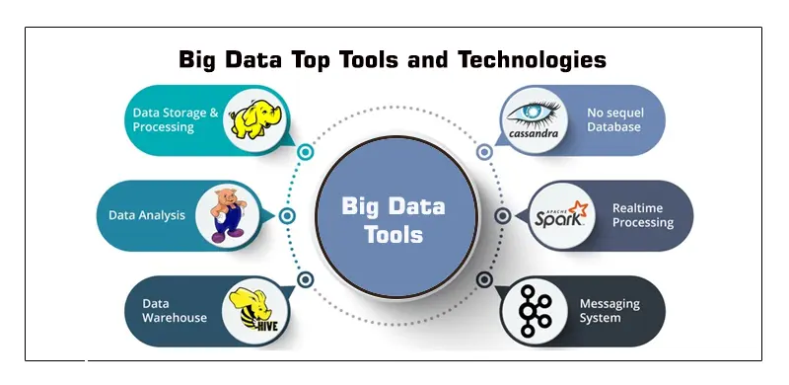
Predictive Analysis
Predictive analysis is a technique used to make predictions about future events based on historical data. Machine learning algorithms can be used to analyze large datasets and identify patterns that can be used to make predictions.
Predictive analysis can be used in a variety of industries, such as finance, healthcare, and marketing, to forecast trends and make informed decisions.

Slide 10
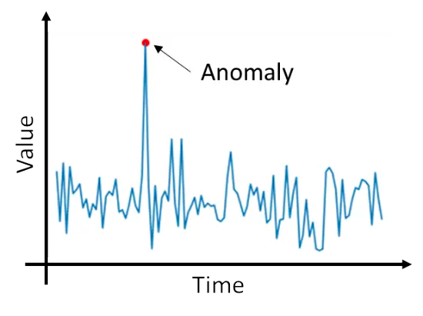
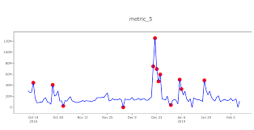
Anomaly Detection
Advanced machine learning algorithms can be used to detect anomalies in big data, allowing for quick identification and resolution of issues.
Machine learning algorithms can also be used to identify anomalies or outliers in big data. This.
can help companies detect fraud or other abnormal behavior

Slide 11
Data Security and Privacy:
Securing Big Data
IBM Cloud provides a secure environment for storing and processing big data. It offers features such as encryption, access controls, and auditing to ensure data security.
Protecting Data Privacy
IBM Cloud also provides tools for protecting data privacy. It includes features such as data masking, anonymization, and data classification to ensure that sensitive data is not exposed.
Compliance with Regulations
IBM Cloud is compliant with various regulations such as HIPAA, GDPR, and PCI-DSS. This ensures that data is processed and stored in accordance with legal requirements.

Slide 12
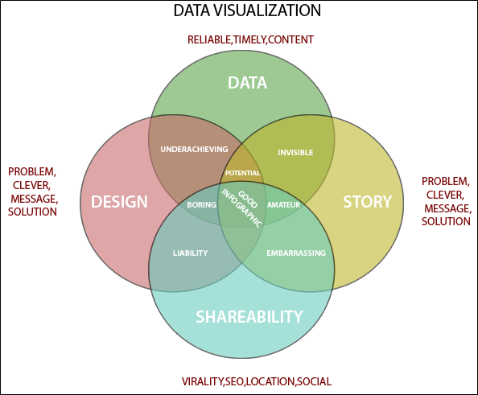
Scaling Big Data Applications:
The Challenge of Big Data Scale
As the volume, velocity, and variety of data continue to grow, scaling big data applications becomes increasingly challenging. Traditional approaches to scaling, such as vertical scaling, are often insufficient to handle the demands of big data. Horizontal scaling, or scaling out, is a more effective approach, but it requires careful consideration of the underlying architecture and infrastructure.

Slide 13
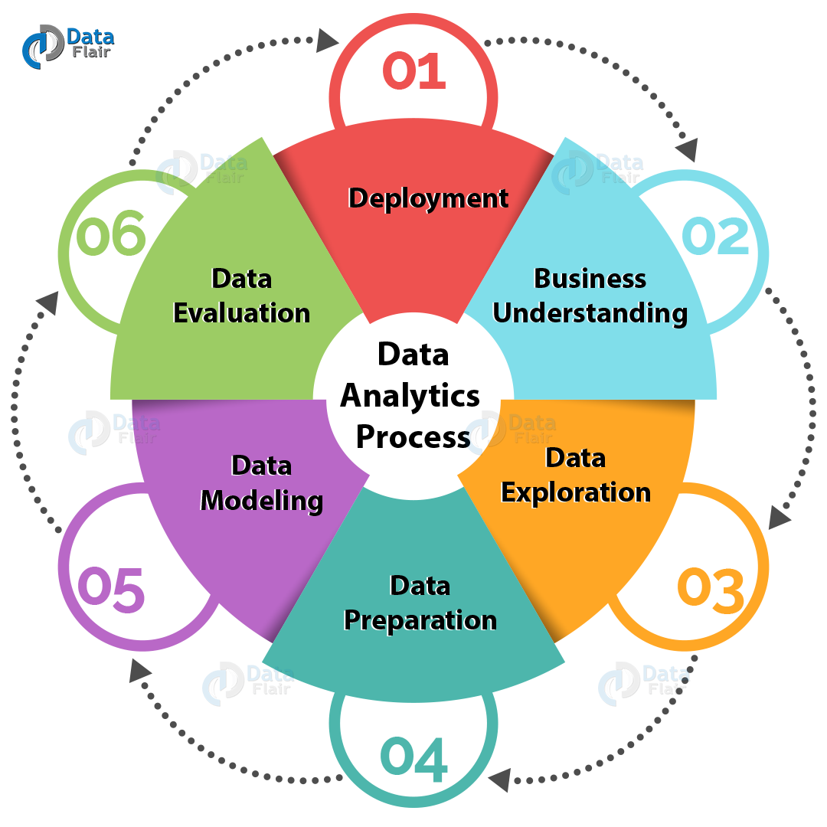
Cloud-based Scaling with IBM Cloud
IBM Cloud provides a scalable and flexible platform for big data applications. With its cloud-based infrastructure, IBM Cloud allows for easy horizontal scaling, enabling organizations to handle large volumes of data with ease. Additionally, IBM Cloud offers a range of tools and services for managing big data, including data warehousing, analytics, and machine learning.

Slide 14
Real-world Applications of Big Data:
Big data is being used in a variety of industries to gain insights and make better decisions. Some real-world applications of big data include:
Healthcare: Big data is being used to analyze patient data, identify patterns, and improve treatment outcomes.
Retail: Big data is being used to analyze customer behavior, improve supply chain management, and optimize pricing strategies.
Finance: Big data is being used to detect fraud, analyze market trends, and improve risk management.
Transportation: Big data is being used to optimize routes, reduce congestion, and improve safety.

Slide 15
The Future of Big Data Analysis
As big data continues to grow, the need for advanced data analysis techniques and tools will only increase. With the power of IBM Cloud and machine learning algorithms, the possibilities for predictive analysis and anomaly detection are endless.

Slide 16
Conclusion
Incorporating advanced machine learning algorithms for predictive analysis or anomaly detection in big data can provide valuable insights and improve decision-making processes. Machine learning techniques such as supervised, unsupervised, semi-supervised, and reinforcement learning can be applied to big data for various applications. However, there are also challenges and limitations that need to be addressed, such as data quality, bias, and scalability. The future of machine learning in big data is promising, with advancements in technology and increased availability of data. As the field continues to evolve, it will be important to stay up-to-date with the latest developments and best practices.

