Slide 1
Project 3 Report
EEE591: Python for Rapid Engineering Solutions
Po-Kan Shih
ASU ID: 1214361589

Slide 2
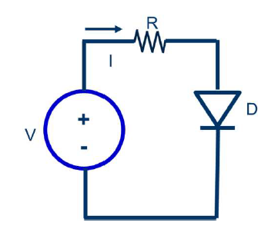
Circuit Model
resistor
diode current
diode
source voltage

Slide 3
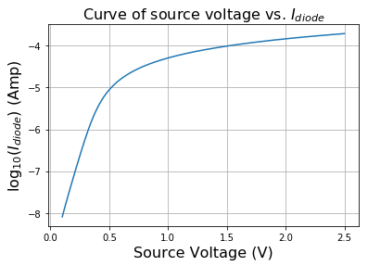
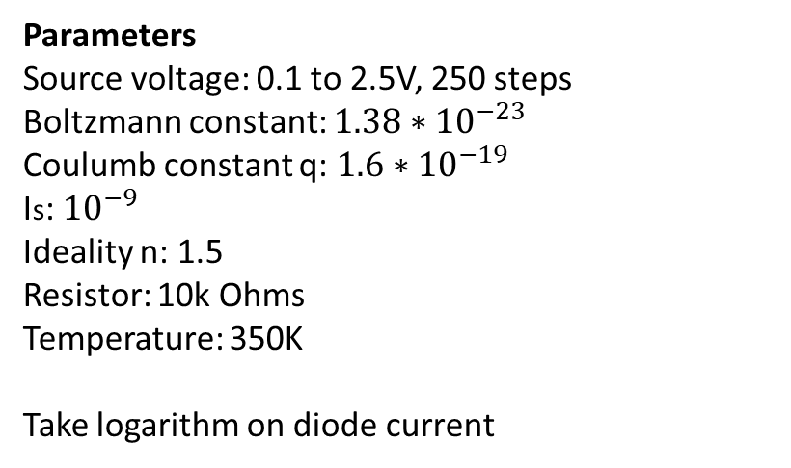
Problem 1
Parameters
Source voltage: 0.1 to 2.5V, 250 steps
Boltzmann constant: ${1.38∗10}^{−23}$
Coulumb constant q: ${1.6∗10}^{−19}$
Is: ${10}^{−9}$
Ideality n: 1.5
Resistor: 10k Ohms
Temperature: 350K
Take logarithm on diode current

Slide 4
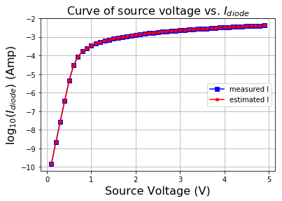
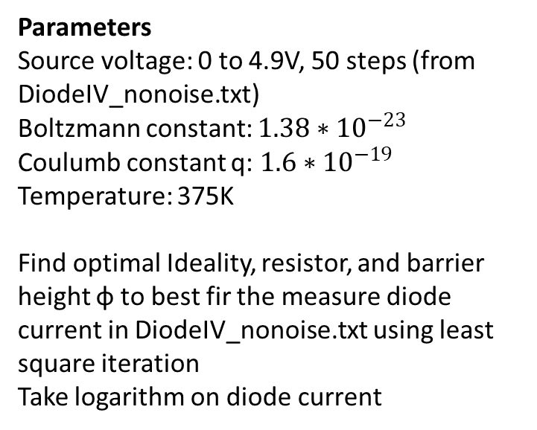
Problem 2
Parameters
Source voltage: 0 to 4.9V, 50 steps (from DiodeIV_nonoise.txt)
Boltzmann constant: ${1.38∗10}^{−23}$
Coulumb constant q: ${1.6∗10}^{−19}$
Temperature: 375K
Find optimal Ideality, resistor, and barrier height φ to best fir the measure diode current in DiodeIV_nonoise.txt using least square iteration
Take logarithm on diode current

Slide 5
Problem 2
Iteration R (ohm) Phi n error
1 710.30 0.5448 1.4588 7.41e+00
2 934.20 0.5486 1.4107 2.49e+00
3 952.39 0.5576 1.3710 1.98e+00
4 960.26 0.5652 1.3388 1.64e+00
5 966.80 0.5715 1.3127 1.36e+00
6 972.40 0.5767 1.2916 1.12e+00
7 977.13 0.5809 1.2745 9.28e-01
8 981.10 0.5844 1.2606 7.65e-01
9 984.42 0.5873 1.2493 6.30e-01
10 987.17 0.5897 1.2401 5.18e-01
11 989.44 0.5916 1.2326 4.25e-01
12 991.32 0.5932 1.2265 3.49e-01
13 992.87 0.5945 1.2214 2.87e-01
14 994.15 0.5956 1.2174 2.35e-01
15 995.20 0.5965 1.2140 1.93e-01
16 996.06 0.5972 1.2113 1.58e-01
17 996.77 0.5978 1.2090 1.30e-01
18 997.35 0.5983 1.2072 1.06e-01
19 997.83 0.5987 1.2057 8.71e-02
20 998.22 0.5990 1.2045 7.14e-02
Iteration R (ohm) Phi n error
21 998.54 0.5993 1.2035 5.85e-02
22 998.80 0.5995 1.2027 4.80e-02
23 999.02 0.5997 1.2020 3.93e-02
24 999.20 0.5999 1.2014 3.22e-02
25 999.34 0.6000 1.2010 2.64e-02
26 999.46 0.6001 1.2006 2.16e-02
27 999.56 0.6002 1.2003 1.77e-02
28 999.64 0.6002 1.2001 1.45e-02
29 999.70 0.6003 1.1999 1.19e-02
30 999.76 0.6003 1.1997 9.75e-03
31 999.80 0.6004 1.1996 7.99e-03
32 999.84 0.6004 1.1994 6.55e-03
33 999.87 0.6004 1.1993 5.36e-03
34 999.89 0.6004 1.1993 4.40e-03
35 999.91 0.6005 1.1992 3.60e-03
36 999.93 0.6005 1.1992 2.95e-03
37 999.94 0.6005 1.1991 2.42e-03
38 999.95 0.6005 1.1991 1.98e-03
39 999.96 0.6005 1.1991 1.62e-03
40 999.97 0.6005 1.1990 1.33e-03
41 999.97 0.6005 1.1990 1.09e-03
42 999.98 0.6005 1.1990 8.93e-04

