Slide 1
Bayesian Nonparametric Reinforcement Learning in LTE and Wi-Fi Coexistence
Po-Kan Shih
Electrical, Computer, and Energy Engineering
ASU

Slide 2
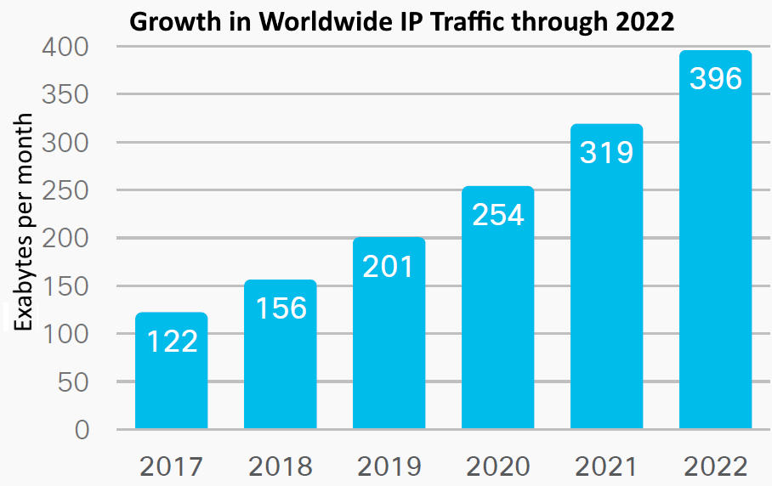
The Need For Coexistence
Growing demand
Number of connections grows fast Heterogeneous networks share the spectrum LTE off-loads its traffic to unlicensed spectrum Wi-Fi is the main usage of unlicensed spectrum
Current issues
LTE was not designed for coexistence Different networks require different QoS Heterogeneity prevents cooperation Spectrum is dynamic: Potentially infinite number of devices enter and leave the spectrum continually Resource requests are not constant

Slide 3
Related Work
Optimization Method
Pareto optimization for joint radar and communication systems [Kota, 2016] Only work on static environment Need access to all information
Q-Learning Method
Maintain pre-defined Q-table for all (state, action) pairs [Su, 2018][Maglogiannis, 2018] Need full observability of the global state Struggle in stochastic and non-stationary problem
Multi-Armed Bandit Method
Maintain a one-state Q-table for all actions [Han, 2020] Stateless, not suitable for complicated case Difficult to scale to larger problem
Deep Q-Learning Method
Use deep neural networks to approximate each Q(s, a) function [Li, 2020] Need extra regularization to avoid overfitting Need large data set to train neurons

Slide 4
Proposed Method In a Nutshell
Model coexistence between LTE and Wi-Fi nodes as dec-POMDP model
Bayesian reinforcement learning for policies for non-cooperative agents
Transform empirical value function into likelihood
Nonparametric model over policy priors to accommodate unbounded policy sizes
Coordinate ascend variational inference for posterior approximation
Fair coexistence between agents

Slide 5
Vignette of Contributions
Modeling
Formulated a coexistence problem as dec-POMDP model and use reinforcement learning to solve it Proposed cumulative reward function to reflect time dependency over history Bayesian nonparametric model to accommodate unbounded policy sizes First work on coexistence for LTE and Wi-Fi considering variable model sizes Introduced fairness indicator to balance spectrum access among agents Optimized policies over agents jointly for asynchronous actions
Inference
Turned distribution approximation into deterministic optimization using coordinate ascend variational inference Worked out the computational equations for variational distributions

Slide 6
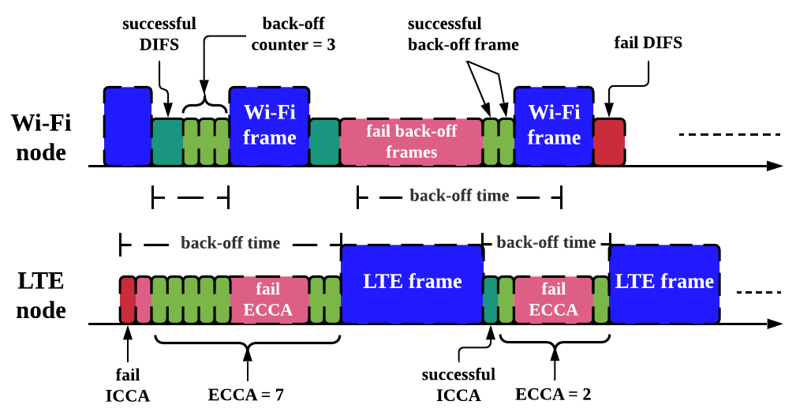
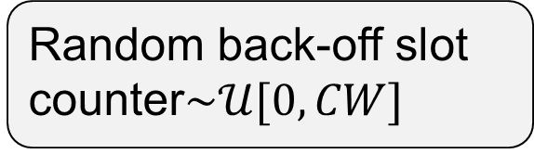
Coexistence Mechanism
Listen-Before-Talk
Initial DIFS sensing
Back-off sensing
Packet transmission
Wi-Fi AP
Random back-off slot counter$\sim 𝒰[0,CW]$
LTE eNB
ICCA sensing
ECCA sensing
Sub-frames transmission

Slide 7
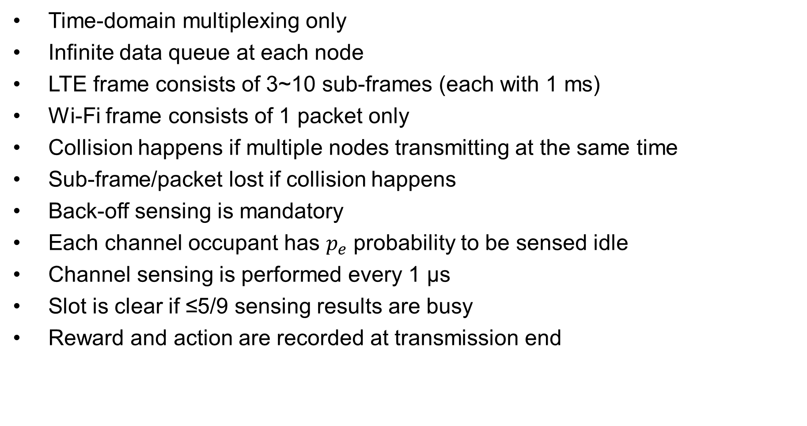
Coexistence Assumptions
Time-domain multiplexing only
Infinite data queue at each node
LTE frame consists of 3~10 sub-frames (each with 1 ms)
Wi-Fi frame consists of 1 packet only
Collision happens if multiple nodes transmitting at the same time
Sub-frame/packet lost if collision happens
Back-off sensing is mandatory
Each channel occupant has $p_{e}$ probability to be sensed idle
Channel sensing is performed every 1 μs
Slot is clear if ≤5/9 sensing results are busy
Reward and action are recorded at transmission end

Slide 8
Modeling: Decentralized POMDP
Components of Dec-POMDP Model
Agents: LTE eNB and Wi-Fi AP.
Actions: each element $a_{i}$ is a number representing the value of the contention window.
Actions: each element 𝑎_𝑖 is a number representing the value of the contention window.
States: each global state $s_{k}$ corresponds to one unique integer indicating the number of agents currently occupying the spectrum.
States: each global state 𝑠_𝑘 corresponds to one unique integer indicating the number of agents currently occupying the spectrum.
Observations: the actual time duration an agent spends in sensing the channel from the start of initial sensing to the end of back-off sensing.

Slide 9
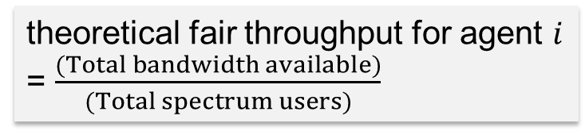
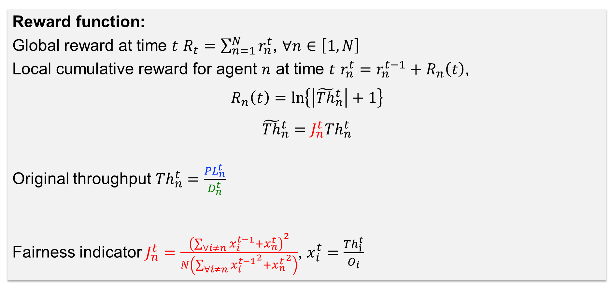
Reward function:
Global reward at time $t$ $R_{t}=\sum_{n=1}^{N}{r_{n}^{t}}$, $∀n∈\left[1,N\right]$
Local cumulative reward for agent $n$ at time $t$ $r_{n}^{t}=r_{n}^{t−1}+R_{n}\left(t\right)$,
$$R_{n}\left(t\right)=\ln\left\{\left|{\tilde{Th}}_{n}^{t}\right|+1\right\}$$
$${\tilde{Th}}_{n}^{t}=J_{n}^{t}{Th}_{n}^{t}$$
Original throughput ${Th}_{n}^{t}=\frac{PL_{n}^{t}}{D_{n}^{t}}$
Fairness indicator $J_{n}^{t}=\frac{{\left(\sum_{∀i≠n}{x_{i}^{t−1}}+x_{n}^{t}\right)}^{2}}{N\left(\sum_{∀i≠n}{{x_{i}^{t−1}}^{2}}+{x_{n}^{t}}^{2}\right)}$, $x_{i}^{t}=\frac{{Th}_{i}^{t}}{O_{i}}$
sub-frames/packets successfully transmitted without collision in an action
entire duration of an action (initial sensing starts to transmission ends)
theoretical fair throughput for agent $i$
= $\frac{(Total bandwidth available)}{(Total spectrum users)}$

Slide 10
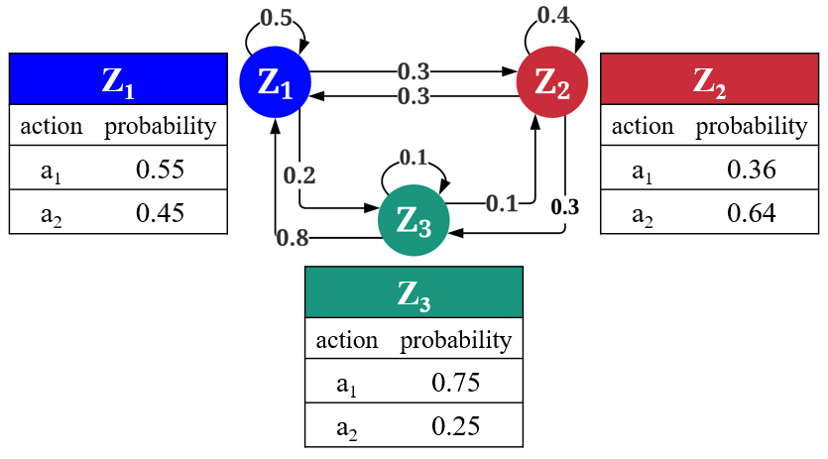
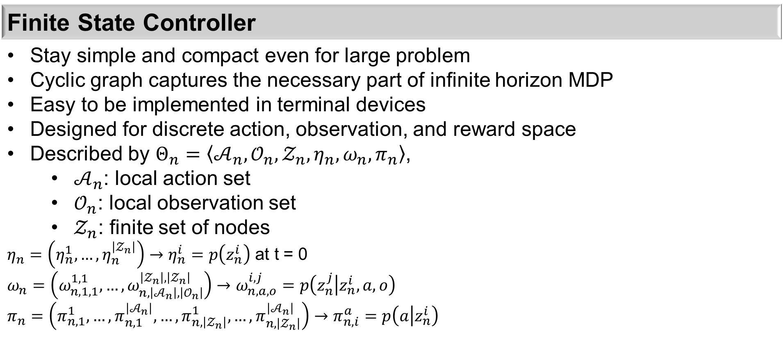
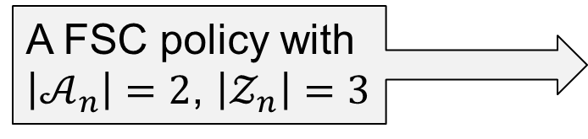
Policy Representation
Finite State Controller
Stay simple and compact even for large problem Cyclic graph captures the necessary part of infinite horizon MDP Easy to be implemented in terminal devices Designed for discrete action, observation, and reward space Described by $Θ_{n}=\left\langle 𝒜_{n},𝒪_{n},𝒵_{n},η_{n},ω_{n},π_{n}\right\rangle$, $𝒜_{n}$: local action set $𝒪_{n}$: local observation set $𝒵_{n}$: finite set of nodes $η_{n}=\left(η_{n}^{1},…,η_{n}^{\left|𝒵_{n}\right|}\right)→η_{n}^{i}=p\left(z_{n}^{i}\right)$ at t = 0 $$ω_{n}=\left(ω_{n,1,1}^{1,1},…,ω_{n,\left|𝒜_{n}\right|,\left|𝒪_{n}\right|}^{\left|𝒵_{n}\right|,\left|𝒵_{n}\right|}\right)→ω_{n,a,o}^{i,j}=p\left(z_{n}^{j} | z_{n}^{i},a,o\right)$$ $$π_{n}=\left(π_{n,1}^{1},…,π_{n,1}^{\left|𝒜_{n}\right|},…,π_{n,\left|𝒵_{n}\right|}^{1},…,π_{n,\left|𝒵_{n}\right|}^{\left|𝒜_{n}\right|}\right)→π_{n,i}^{a}=p\left(a | z_{n}^{i}\right)$$
A FSC policy with $\left|𝒜_{n}\right|=2$, $\left|𝒵_{n}\right|=3$

Slide 11
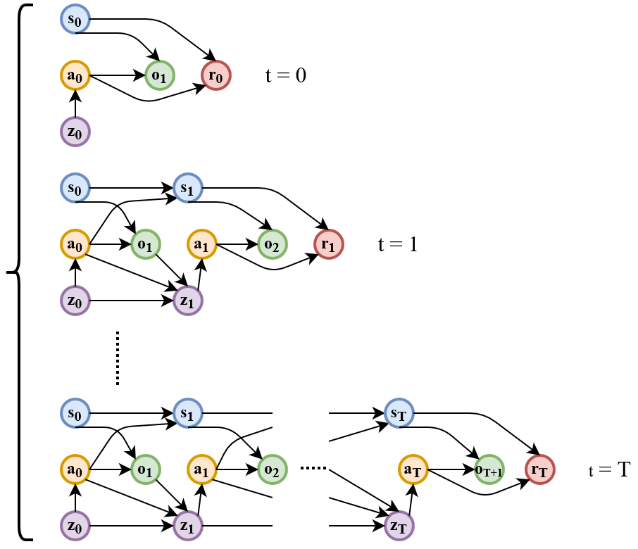
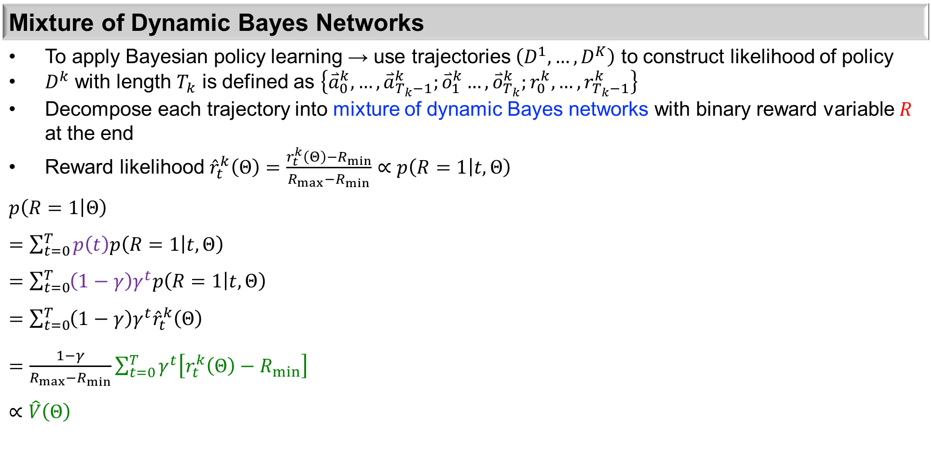
Likelihood
Mixture of Dynamic Bayes Networks
To apply Bayesian policy learning → use trajectories $\left(D^{1},…,D^{K}\right)$ to construct likelihood of policy $D^{k}$ with length $T_{k}$ is defined as $\left\{{\overset{⃑}{a}}_{0}^{k},…,{\overset{⃑}{a}}_{T_{k}−1}^{k};{\overset{⃑}{o}}_{1}^{k}…,{\overset{⃑}{o}}_{T_{k}}^{k};r_{0}^{k},…,r_{T_{k}−1}^{k}\right\}$ Decompose each trajectory into mixture of dynamic Bayes networks with binary reward variable $R$ at the end Reward likelihood ${\hat{r}}_{t}^{k}\left(Θ\right)=\frac{r_{t}^{k}\left(Θ\right)−R_{min}}{R_{max}−R_{min}}∝p\left(R=1 | t,Θ\right)$ $$p\left(R=1 | Θ\right)$$ $=\sum_{t=0}^{T}{p\left(t\right)p\left(R=1 | t,Θ\right)}$ $=\sum_{t=0}^{T}{\left(1−γ\right)γ^{t}p\left(R=1 | t,Θ\right)}$ $=\sum_{t=0}^{T}{\left(1−γ\right)γ^{t}{\hat{r}}_{t}^{k}\left(Θ\right)}$ $=\frac{1−γ}{R_{max}−R_{min}}\sum_{t=0}^{T}{γ^{t}\left[r_{t}^{k}\left(Θ\right)−R_{min}\right]}$ $∝\hat{V}\left(Θ\right)$
Geometric distribution over DBNs
Value function

Slide 12
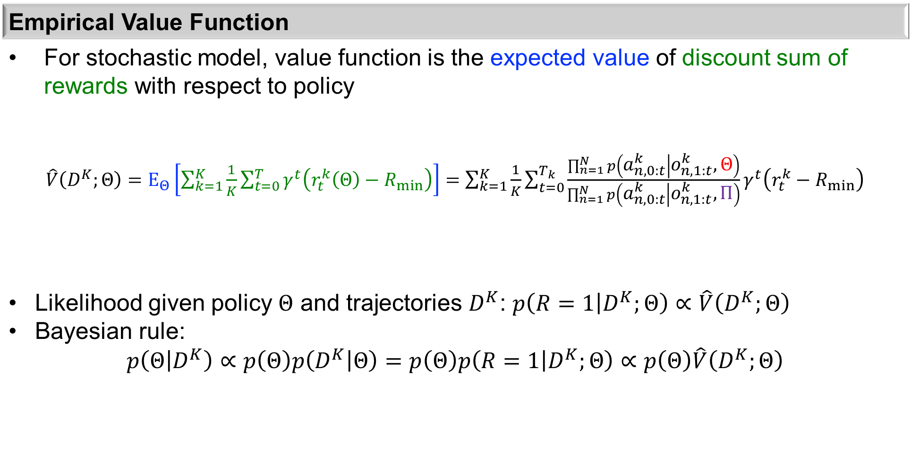
Likelihood
Empirical Value Function
For stochastic model, value function is the expected value of discount sum of rewards with respect to policy $\hat{V}\left(D^{K};Θ\right)=E_{Θ}\left[\sum_{k=1}^{K}{\frac{1}{K}\sum_{t=0}^{T}{γ^{t}\left(r_{t}^{k}\left(Θ\right)−R_{min}\right)}}\right]=\sum_{k=1}^{K}{\frac{1}{K}\sum_{t=0}^{T_{k}}{\frac{\prod_{n=1}^{N}{p\left(a_{n,0:t}^{k} | o_{n,1:t}^{k}, Θ\right)}}{\prod_{n=1}^{N}{p\left(a_{n,0:t}^{k} | o_{n,1:t}^{k}, Π\right)}}γ^{t}\left(r_{t}^{k}−R_{min}\right)}}$ Likelihood given policy $Θ$ and trajectories $D^{K}$: $p\left(R=1 | D^{K};Θ\right)∝\hat{V}\left(D^{K};Θ\right)$ Bayesian rule: $$p\left(Θ | D^{K}\right)∝p\left(Θ\right)p\left(D^{K} | Θ\right)=p\left(Θ\right)p\left(R=1 | D^{K};Θ\right)∝p\left(Θ\right)\hat{V}\left(D^{K};Θ\right)$$
Desired policy
Behavior policy
Policy prior

Slide 13
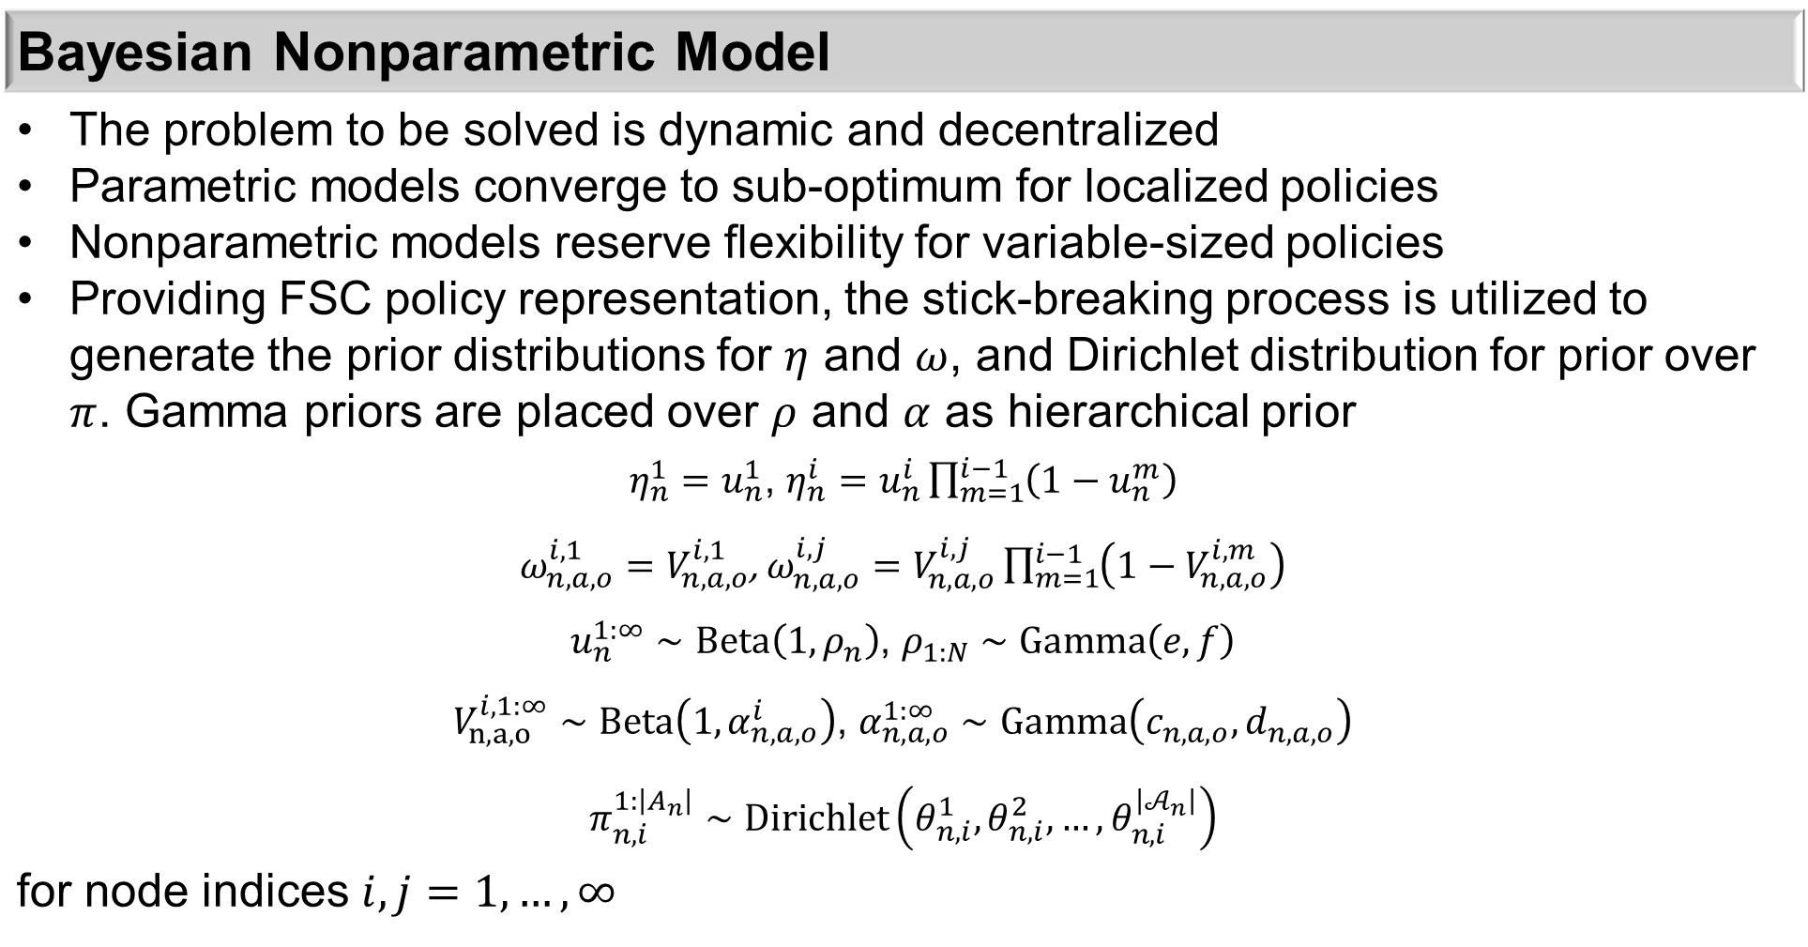
Policy Priors
Bayesian Nonparametric Model
The problem to be solved is dynamic and decentralized Parametric models converge to sub-optimum for localized policies Nonparametric models reserve flexibility for variable-sized policies Providing FSC policy representation, the stick-breaking process is utilized to generate the prior distributions for $η$ and $ω$, and Dirichlet distribution for prior over $π$. Gamma priors are placed over $ρ$ and $α$ as hierarchical prior $η_{n}^{1}=u_{n}^{1}$, $η_{n}^{i}=u_{n}^{i}\prod_{m=1}^{i−1}{\left(1−u_{n}^{m}\right)}$ $ω_{n,a,o}^{i,1}=V_{n,a,o}^{i,1}$, $ω_{n,a,o}^{i,j}=V_{n,a,o}^{i,j}\prod_{m=1}^{i−1}{\left(1−V_{n,a,o}^{i,m}\right)}$ $u_{n}^{1:∞}∼Beta\left(1,ρ_{n}\right)$, $ρ_{1:N}∼Gamma\left(e,f\right)$ $V_{n,a,o}^{i,1:∞}∼Beta\left(1,α_{n,a,o}^{i}\right)$, $α_{n,a,o}^{1:∞}∼Gamma\left(c_{n,a,o},d_{n,a,o}\right)$ $π_{n,i}^{1:\left|A_{n}\right|}∼Dirichlet\left(θ_{n,i}^{1},θ_{n,i}^{2},…,θ_{n,i}^{\left|𝒜_{n}\right|}\right)$ for node indices $i, j=1, …,∞$

Slide 14
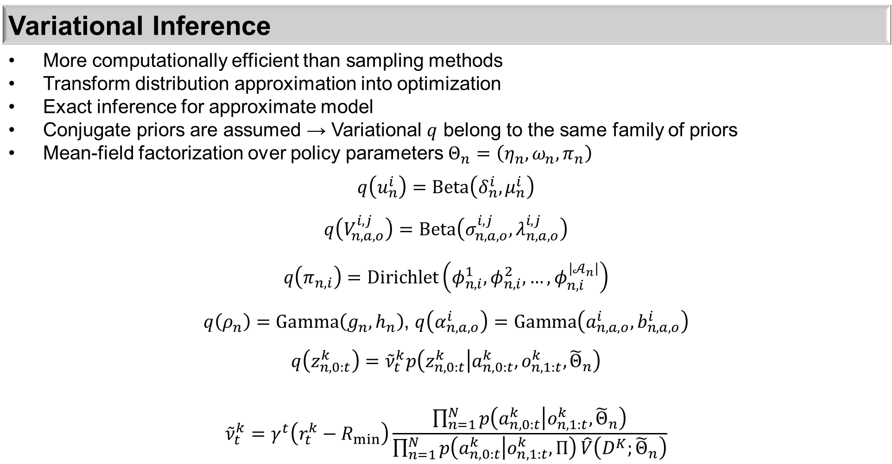
Posterior Inference
Variational Inference
More computationally efficient than sampling methods Transform distribution approximation into optimization Exact inference for approximate model Conjugate priors are assumed → Variational $q$ belong to the same family of priors Mean-field factorization over policy parameters $Θ_{n}=\left(η_{n},ω_{n},π_{n}\right)$ $q\left(u_{n}^{i}\right)=Beta\left(δ_{n}^{i},μ_{n}^{i}\right)$ $q\left(V_{n,a,o}^{i,j}\right)=Beta\left(σ_{n,a,o}^{i,j},λ_{n,a,o}^{i,j}\right)$ $$q\left(π_{n,i}\right)=Dirichlet\left(φ_{n,i}^{1},φ_{n,i}^{2},…,φ_{n,i}^{\left|𝒜_{n}\right|}\right)$$ $q\left(ρ_{n}\right)=Gamma\left(g_{n},h_{n}\right)$, $q\left(α_{n,a,o}^{i}\right)=Gamma\left(a_{n,a,o}^{i},b_{n,a,o}^{i}\right)$ $$q\left(z_{n,0:t}^{k}\right)={\tilde{ν}}_{t}^{k}p\left(z_{n,0:t}^{k} | a_{n,0:t}^{k},o_{n,1:t}^{k},{\tilde{Θ}}_{n}\right)$$ $${\tilde{ν}}_{t}^{k}=γ^{t}\left(r_{t}^{k}−R_{min}\right)\frac{\prod_{n=1}^{N}{p\left(a_{n,0:t}^{k} | o_{n,1:t}^{k},{\tilde{Θ}}_{n}\right)}}{\prod_{n=1}^{N}{p\left(a_{n,0:t}^{k} | o_{n,1:t}^{k},Π\right)}\hat{V}\left(D^{K};{\tilde{Θ}}_{n}\right)}$$

Slide 15
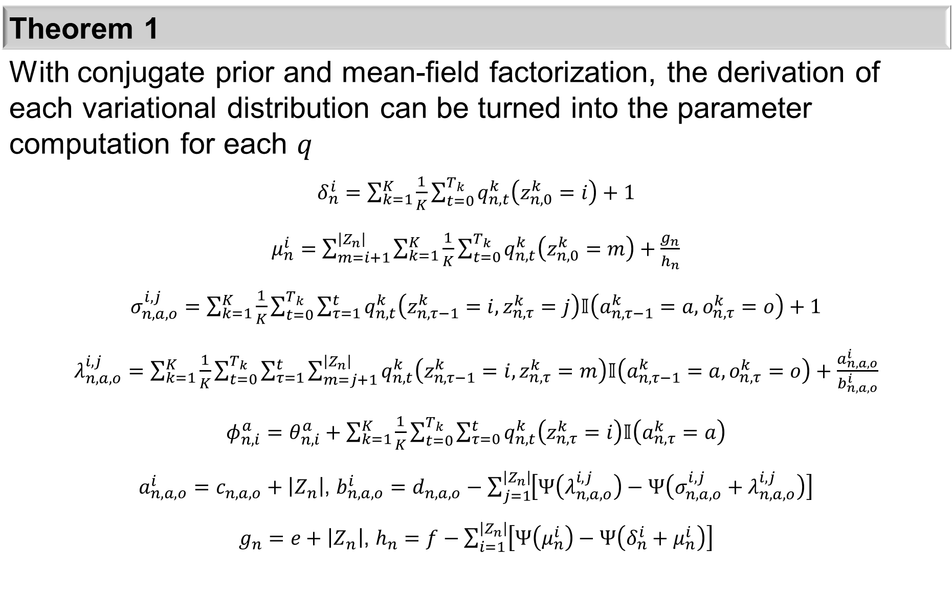
Theorem 1
With conjugate prior and mean-field factorization, the derivation of each variational distribution can be turned into the parameter computation for each $q$ $δ_{n}^{i}=\sum_{k=1}^{K}{\frac{1}{K}\sum_{t=0}^{T_{k}}{q_{n,t}^{k}\left(z_{n,0}^{k}=i\right)}}+1$ $μ_{n}^{i}=\sum_{m=i+1}^{\left|Z_{n}\right|}{\sum_{k=1}^{K}{\frac{1}{K}\sum_{t=0}^{T_{k}}{q_{n,t}^{k}\left(z_{n,0}^{k}=m\right)}}}+\frac{g_{n}}{h_{n}}$ $σ_{n,a,o}^{i,j}=\sum_{k=1}^{K}{\frac{1}{K}\sum_{t=0}^{T_{k}}{\sum_{τ=1}^{t}{q_{n,t}^{k}\left(z_{n,τ−1}^{k}=i,z_{n,τ}^{k}=j\right)𝕀\left(a_{n,τ−1}^{k}=a,o_{n,τ}^{k}=o\right)}}}+1$ $λ_{n,a,o}^{i,j}=\sum_{k=1}^{K}{\frac{1}{K}\sum_{t=0}^{T_{k}}{\sum_{τ=1}^{t}{\sum_{m=j+1}^{\left|Z_{n}\right|}{q_{n,t}^{k}\left(z_{n,τ−1}^{k}=i,z_{n,τ}^{k}=m\right)𝕀\left(a_{n,τ−1}^{k}=a,o_{n,τ}^{k}=o\right)}}}}+\frac{a_{n,a,o}^{i}}{b_{n,a,o}^{i}}$ $φ_{n,i}^{a}=θ_{n,i}^{a}+\sum_{k=1}^{K}{\frac{1}{K}\sum_{t=0}^{T_{k}}{\sum_{τ=0}^{t}{q_{n,t}^{k}\left(z_{n,τ}^{k}=i\right)𝕀\left(a_{n,τ}^{k}=a\right)}}}$ $a_{n,a,o}^{i}=c_{n,a,o}+\left|Z_{n}\right|$, $b_{n,a,o}^{i}=d_{n,a,o}−\sum_{j=1}^{\left|Z_{n}\right|}{\left[Ψ\left(λ_{n,a,o}^{i,j}\right)−Ψ\left(σ_{n,a,o}^{i,j}+λ_{n,a,o}^{i,j}\right)\right]}$ $g_{n}=e+\left|Z_{n}\right|$, $h_{n}=f−\sum_{i=1}^{\left|Z_{n}\right|}{\left[Ψ\left(μ_{n}^{i}\right)−Ψ\left(δ_{n}^{i}+μ_{n}^{i}\right)\right]}$

Slide 16
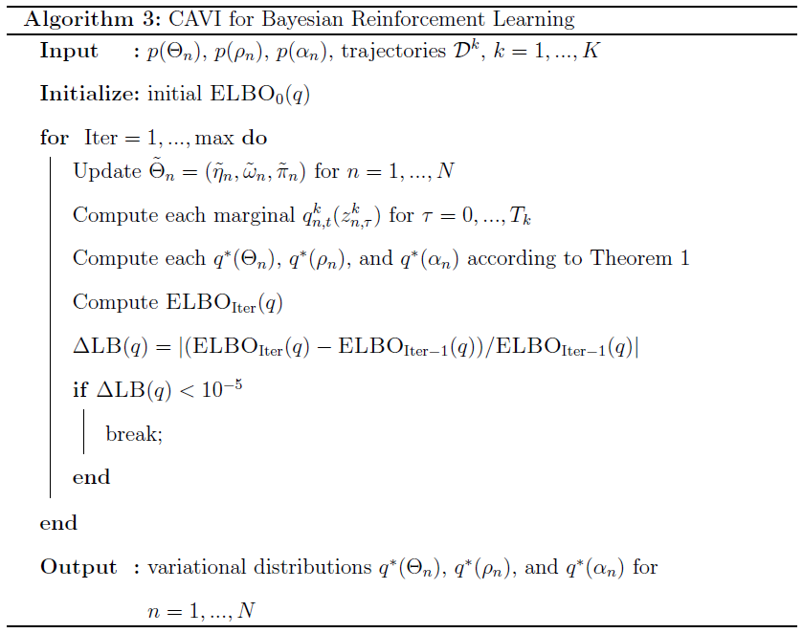
Algorithm

Slide 17
Experiment Parameters
Name | Value
Number of LTE eNB | 2
Number of Wi-Fi AP | 2
DIFS duration | 34 μs
ICCA duration | 43 μs
ECCA/back-off slot | 9 μs
Contention window | {15, 31, 63, 127, 255, 511, 1023}
LTE sub-frames per transmission | {3, 6, 8, 10}
Wi-Fi packets per transmission | 1
size of Wi-Fi packet | 15000 bytes
Transmission rate | 30 Mbps
Discount factor γ | 0.9

Slide 18
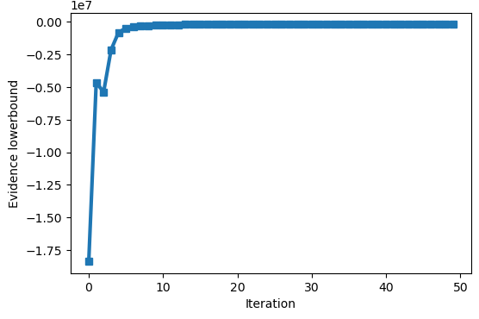
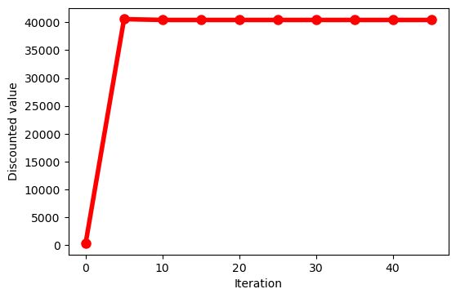
Experiment
Convergence of variational inference
ELBO value
Discounted value

Slide 19
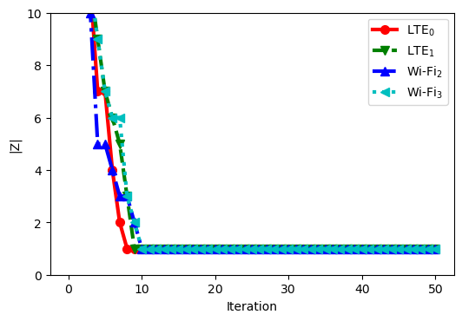
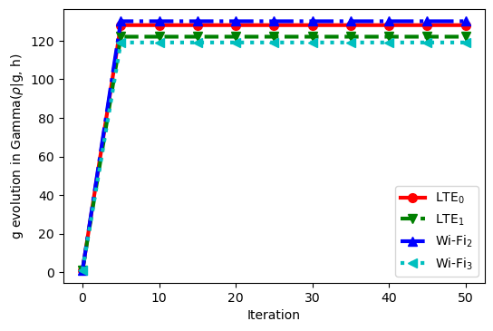
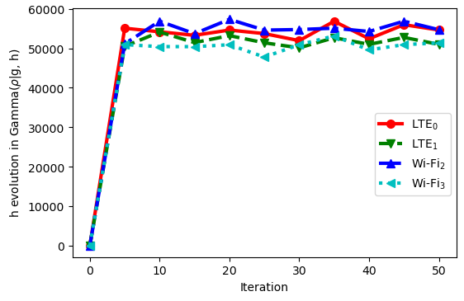
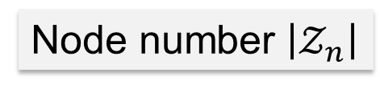
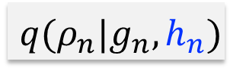
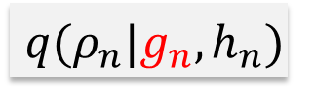
Experiment
Evolution of node number and parameters
for each agent
Node number $\left|𝒵_{n}\right|$
$$q(ρ_{n}|g_{n},h_{n})$$
$$q(ρ_{n}|g_{n},h_{n})$$

Slide 20
Future Experiment
To show the influence of exploration and exploitation trade-off
Use ε-greedy method to determine exploration or exploitation
Use 2 different ε convergence curves for learning process
Need large data set (currently accessible computing resource is not able to handle it)
Will run on research computing cluster

Slide 21
Future Work
Introducing dependent nonparametric model
Uneven priorities for different groups of agents
Joint optimization for global and local interests for decentralized agents
Different design of reward function
Simulation with large data set

Slide 22
Selected References
C. Amato, D. Bernstein, and S. Zilberstein. Optimizing fixed-size stochastic controllers for pomdps and decentralized pomdps. Autonomous Agents and Multi-Agent Systems, 21:293–320, 11 2010.
A. Kumar and S. Zilberstein. Anytime planning for decentralized pomdps using expectation maximization. arXiv preprint arXiv:1203.3490, 2012.
M. Liu, C. Amato, X. Liao, L. Carin, and J. P. How. Stick-breaking policy learning in dec-pomdps. In 24th International Joint Conference on Artificial Intelligence (IJCAI 2015), pages 2011–2018, 2015.
F. A. Oliehoek and C. Amato. A Concise Introduction to Decentralized POMDPs. Springer Publishing Company, Incorporated, 1st edition, 2016.
J. Kota, G. Jacyna, and A. Papandreou-Suppappola. Nonstationary signal design for coexisting radar and communications systems. In 50th Asilomar Conference on Signals, Systems and Computers, pages 549–553, 2016.
M. Han, S. Khairy, L. X. Cai, Y. Cheng, and R. Zhang. Reinforcement learning for efficient and fair coexistence between lte-laa and wi-fi. IEEE Transactions on Vehicular Technology, 69(8):8764–8776, 2020.
L. Li, L. Liu, J. Bai, H. H. Chang, H. Chen, J. D. Ashdown, J. Zhang, and Y. Yi. Accelerating model-free reinforcement learning with imperfect model knowledge in dynamic spectrum access. IEEE Internet of Things Journal, 7(8):7517–7528, 2020.
V. Maglogiannis, D. Naudts, A. Shahid, , and I. Moerman. A q-learning scheme for fair coexistence between lte and wi-fi in unlicensed spectrum. IEEE Access, 6:27278–27293, 2018.
Y. Su, X. Du, L. Huang, Z. Gao, and M. Guizani. Lte-u and wi-fi coexistence algorithm based on q-learning in multi-channel. IEEE Access, 6:13644–13652, 2018.
Po-Kan Shih and Bahman Moraffah. Bayesian Nonparametric Modelling for Model-Free Reinforcement Learning in LTE-LAA and Wi-Fi Coexistence. In preparation for submission, 2021

Slide 23

Acknowledgement
Thanks to…
My advisor: Dr. Bahman Moraffah, Dr. Antonia Papandreou-Suppappola
Committee members: Dr. Gautam Dasarathy, Dr. YiChang Shih
My family
And everyone who helped me in this journey

