Slide 1
CHAPTER 10
Electric Current
and its Effects
Symbols · Circuits · Heating Effect · Fuse & Safety
Class 7 · Science

Slide 2
01 · LEARNING GOALS
02 / 34
What will we learn?
1
Symbols of Components
Learn standard symbols for cell, bulb, switch, battery and wire
2
Battery
Understand how two or more cells are joined to make a battery
3
Circuit Diagrams
Draw and read simple electric circuit diagrams using symbols
4
Heating Effect
See how current produces heat and where this effect is used
5
Fuse & Safety
Learn about electric fuse, short circuit and overload
Electric Current and its Effects · Class 7 Science
02

Slide 3
02 · INTRODUCTION
03 / 34
How Steady is Your Hand?
Paheli and Boojho set up a fun game using an electric circuit (from Class 6).
They enjoyed it so much that they wanted to share it with their cousin in another town.
Paheli drew a neat picture of all the parts. But drawing every component was hard.
Boojho wondered: Is there an easier way to show these electric parts?
Yes! We use special symbols for each electric component.
These symbols make circuit diagrams simple, neat and easy to understand.
Cell
Bulb
Switch
Wire
Source of electricity
Gives light
Turns ON / OFF
Connects parts
Electric Current and its Effects · Class 7 Science
03

Slide 4
03 · SYMBOLS
04 / 34
1. Symbol of an Electric Cell
Symbol
Remember
An electric cell has two terminals:
• Positive terminal (+)
– longer line in the symbol
• Negative terminal (−)
– shorter, thicker line
Current flows from the positive
terminal to the negative terminal
in the external circuit.
+
−
Longer line → Positive terminal
Shorter thick line → Negative terminal
Electric Current and its Effects · Class 7 Science
04

Slide 5
03 · SYMBOLS
05 / 34
2. Symbol of an Electric Bulb
Symbol
Inside the Bulb
There is a thin wire called the filament.
When electric current passes through the filament, it becomes very hot and starts glowing.
If the filament breaks, the bulb is said to be fused and it will not glow.
Circle with a cross (or filament mark)
represents an electric bulb.
Electric Current and its Effects · Class 7 Science
05

Slide 6
03 · SYMBOLS
06 / 34
3. Symbols of a Switch
Switch in ON Position
Switch in OFF Position
The gap is closed.
Current can flow through the circuit.
The circuit is complete (closed).
There is a gap.
Current cannot flow.
The circuit is incomplete (open).
Electric Current and its Effects · Class 7 Science
06

Slide 7
03 · SYMBOLS
07 / 34
4. Battery and Wire Symbols
Battery
Wire
A simple straight line.
Wires are used to connect
the different components
in a circuit.
Two or more cells joined together.
Positive of one connected to
negative of the next.
Electric Current and its Effects · Class 7 Science
07

Slide 8
03 · SYMBOLS
08 / 34
Quick Reference – All Symbols
Component | Symbol Description
Electric Cell | Longer line (+) and shorter thick line (−)
Electric Bulb | Circle with a cross (filament) inside
Switch ON | Closed path – no gap
Switch OFF | Open path – with a gap
Battery | Two or more cell symbols joined
Wire | Straight line
Electric Current and its Effects · Class 7 Science
08

Slide 9
04 · BATTERY
09 / 34
What is a Battery?
A battery is made by connecting two or more electric cells together.
The positive terminal of one cell is connected to the negative terminal of the next cell.
Devices that use batteries:
1
2
3
4
Torch
TV Remote
Toys
Transistor / Radio
Usually 2–4 cells
Often 2 AA cells
Many use AA or AAA
Battery pack
Electric Current and its Effects · Class 7 Science
09

Slide 10
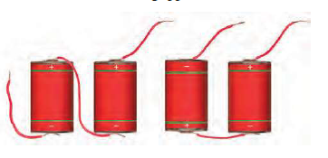
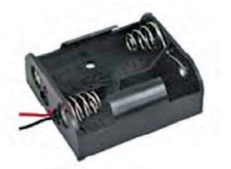
04 · BATTERY
10 / 34
How to Connect Cells Correctly
Correct Connection
Useful Tip
Positive (+) of one cell
must be connected to
Negative (−) of the next cell.
This is how a battery is formed.
Current can then flow properly.
Look inside any battery compartment of a torch or remote.
You will see a metal strip connecting the terminals.
+ and − signs are printed to help you place the cells the right way.
Electric Current and its Effects · Class 7 Science
10

Slide 11
05 · CIRCUIT DIAGRAM
11 / 34
What is a Circuit Diagram?
A circuit diagram is a simple drawing of an electric circuit using the standard symbols.
It is much easier and clearer than drawing the real components.
Important points:
Closed Circuit
Switch is ON. Path is complete. Current flows. Bulb glows.
Open Circuit
Switch is OFF. Path is broken. No current. Bulb does not glow.
Filament
Thin wire inside the bulb. It glows when current passes through it.
Electric Current and its Effects · Class 7 Science
11

Slide 12
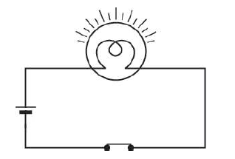
05 · CIRCUIT
12 / 34
Closed Circuit (Switch ON)
Current flows → Bulb glows
Electric Current and its Effects · Class 7 Science
12

Slide 13
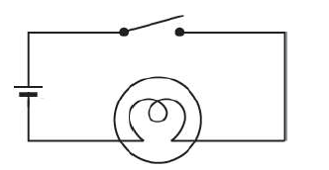
05 · CIRCUIT
13 / 34
Open Circuit (Switch OFF)
Electric Current and its Effects · Class 7 Science
13

Slide 14
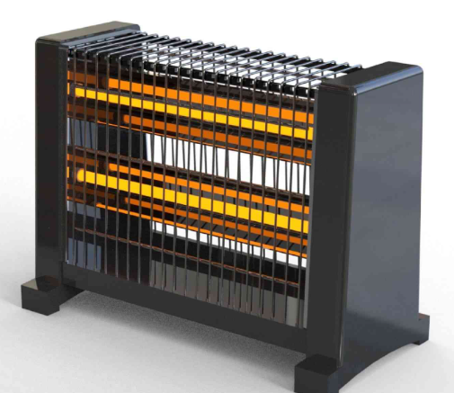
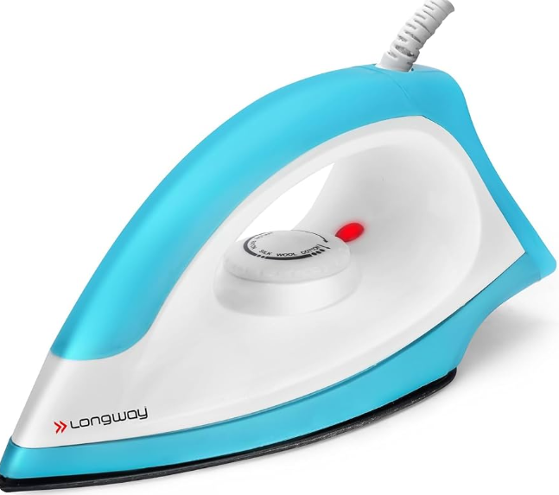
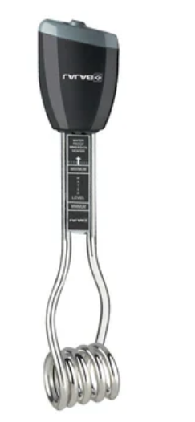
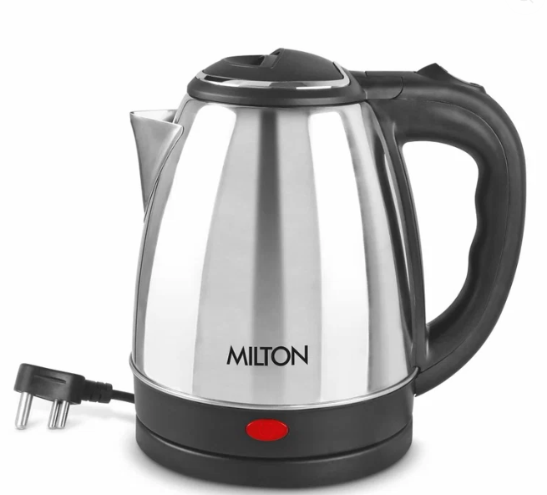
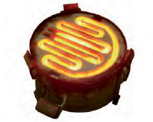
06 · HEATING EFFECT
14 /34
Heating Effect of Electric Current
When an electric current passes through a wire, the wire becomes hot.
This is known as the heating effect of electric current.
Everyday appliances that use this effect:
Electric Heater
Electric Iron
Immersion Rod
Electric Kettle
Electric Current and its Effects · Class 7 Science
14

Slide 15
06 · ACTIVITY
15 / 34
Activity: Feel the Heating Effect
From the textbook (Activity 10.2)
1
Make a circuit with one cell, a bulb, a switch and connecting wires.
2
Keep the switch in the OFF position. Touch the bulb – it is cool.
3
Move the switch to ON and let the bulb glow for about one minute.
4
Carefully touch the bulb again. It now feels warm.
5
This warmth is due to the heating effect of the electric current.
Electric Current and its Effects · Class 7 Science
15

Slide 16
06 · ELEMENT
16 / 34
What is an Element?
The coil of wire inside many electric appliances that becomes red hot and gives out heat is called an element.
Appliances that contain an element:
Electric Iron
Hot Plate
Immersion Heater
Geyser
Electric Kettle
Hair Dryer
Electric Current and its Effects · Class 7 Science
16

Slide 17
06 · HEATING EFFECT
17 / 34
What Affects the Heat Produced?
The amount of heat produced in a wire depends on three things:
1
Material of the wire
Some materials (like nichrome) heat up more easily than others.
2
Length of the wire
A longer wire produces more heat than a shorter wire of the same material.
3
Thickness of the wire
A thinner wire becomes hotter than a thicker wire of the same material and length.
Electric Current and its Effects · Class 7 Science
17

Slide 18
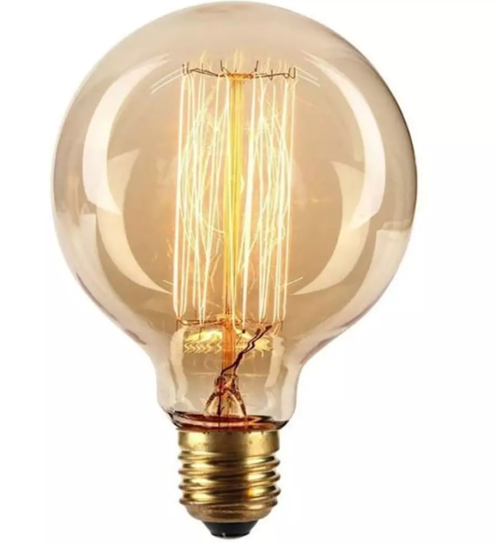
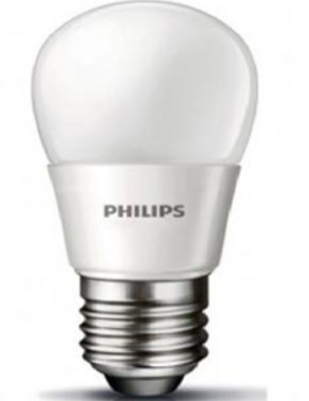
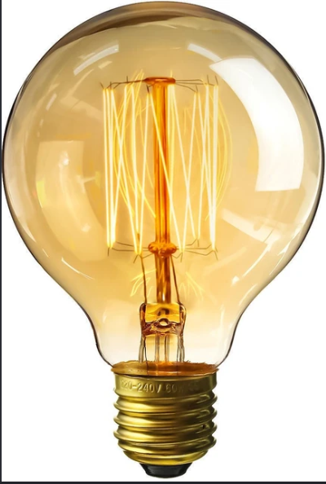
07 · LIGHTING
18 / 34
Better Lighting Options
Ordinary (Incandescent) Bulb
Better Choices
• Fluorescent tube-lights
• CFL (Compact Fluorescent Lamps)
• LED bulbs
LED bulbs use the least electricity for the same brightness.
Always look for the ISI mark on electrical products for safety and quality.
• Has a thin filament
• Filament becomes so hot that it glows
• A large part of electricity is wasted as heat
• Less electricity-efficient
These bulbs are slowly being replaced.
Electric Current and its Effects · Class 7 Science
18

Slide 19
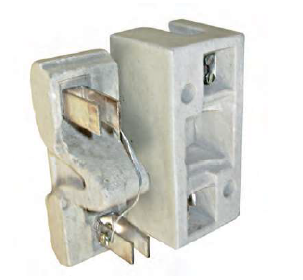
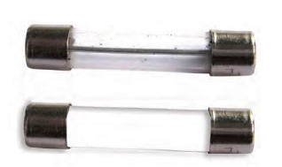
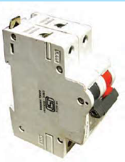
08 · FUSE
19 / 34
Electric Fuse – A Safety Device
A fuse contains a thin wire made of a special material that melts quickly when a large current flows through it.
This breaks the circuit and stops the current, protecting the wiring and appliances from damage or fire.
Protects appliances
Prevents fire
Keeps us safe
Stops excess current from damaging devices
Breaks the circuit before wires overheat
Reduces risk of electric shock and accidents
Electric Current and its Effects · Class 7 Science
19

Slide 20
08 · FUSE
20 / 34
How Does a Fuse Work?
1
Normal current flows
The fuse wire stays intact and current flows safely through the circuit.
2
Current becomes too large
Due to short circuit or overload, the current rises above the safe limit.
3
Fuse wire melts
The special thin wire heats up quickly and melts, creating a gap.
4
Circuit breaks
Current stops flowing. Appliances and the wiring of the house are protected.
Electric Current and its Effects · Class 7 Science
20

Slide 21
08 · SAFETY
21 / 34
Short Circuit
A short circuit happens when the insulation on the wires is damaged and the live and neutral wires touch each other directly.
This causes a very large current to flow suddenly through the circuit.
What can cause a short circuit?
Worn insulation
Damaged wires
Faulty appliances
Insulation comes off due to wear and tear
Wires get cut or frayed
Internal short inside a device
Electric Current and its Effects · Class 7 Science
21

Slide 22
08 · SAFETY
22 / 34
Overload
An overload happens when too many appliances are connected to a single socket.
The total current drawn becomes more than the safe limit of the circuit.
The wires heat up and can cause a fire.
How to avoid overload:
1. Do not plug too many devices into one socket
2. Use separate sockets for heavy appliances
3. Always have a proper fuse in the circuit
Electric Current and its Effects · Class 7 Science
22

Slide 23
08 · SAFETY DEVICE
23 / 34
MCB – Miniature Circuit Breaker
An MCB is a modern safety device that automatically switches off the electric circuit when the current becomes larger than the safe limit.
Unlike a fuse, it does not melt – it can be reset and used again.
How it works
Advantage over Fuse
• Detects excess current
• Switches the circuit OFF
• Protects wires & appliances
• Can be switched ON again
• No need to replace a wire
• Can be reset easily
• Works faster
• Safer and more convenient
Electric Current and its Effects · Class 7 Science

Slide 24
09 · SAFETY TIPS
24 / 34
Important Safety Tips
1
Never touch a lighted electric bulb connected to the mains – it can burn your hand.
2
Do not experiment with the electric supply from the mains, generator or inverter.
3
Use only electric cells for all classroom activities suggested in this chapter.
4
Never try to investigate an electric fuse connected to the mains on your own.
5
Look for the ISI mark when buying electrical products – it is a mark of quality and safety.
6
Dispose of damaged fluorescent tubes and CFLs safely – they contain mercury vapour.
Electric Current and its Effects · Class 7 Science

Slide 25
08 · ACTIVITY
25 / 34
Activity: Seeing a Wire Melt (Activity 10.4)
From the textbook – shows why fuse wires melt
1
Make the circuit used earlier, but use a battery of four cells.
2
Instead of nichrome wire, tie a thin strand of steel wool between the nails.
3
Switch off any fans in the room.
4
Pass the current for some time and carefully observe the steel wool.
5
The strand of steel wool melts and breaks – just like a fuse wire does.
Electric Current and its Effects · Class 7 Science

Slide 26
· MAGNETIC EFFECT
26 / 34
Magnetic Effect of Electric Current
When an electric current flows through a wire, it produces a magnetic field around the wire.
This is called the magnetic effect of electric current.
The wire behaves like a magnet as long as the current is flowing.
Simple Activity to Observe this Effect:
1. Take a straight copper wire and connect it to a battery through a switch.
2. Place a magnetic compass near the wire.
3. When the switch is OFF, the compass needle points in the north-south direction.
4. When the switch is ON, the needle deflects – showing a magnetic field is present.
Magnetic Effect of Electric Current · Class 7 Science

Slide 27
· MAGNETIC EFFECT
27 / 34
What Happens to the Compass?
Switch OFF
Switch ON
• No current in the wire
• No magnetic field around the wire
• Compass needle stays in
the north-south direction
• Wire does not behave
like a magnet
• Current flows in the wire
• Magnetic field is produced
• Compass needle deflects
• Wire behaves like a magnet
as long as current flows
Magnetic Effect of Electric Current · Class 7 Science

Slide 28
· MAGNETIC EFFECT
28 / 34
Important Points to Remember
1
Current produces magnetism
A wire carrying current acts like a magnet.
2
Temporary effect
The magnetic effect is present only while the current is flowing.
3
Direction matters
If the direction of current is reversed, the direction of the magnetic field also reverses.
4
Strength depends on current
Larger current → stronger magnetic field around the wire.
Magnetic Effect of Electric Current · Class 7 Science

Slide 29
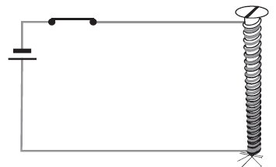
· ELECTROMAGNET
29 / 34
What is an Electromagnet?
An electromagnet is a temporary magnet made by winding a coil of insulated wire around a soft iron core and passing electric current through the coil.
It behaves as a magnet only when current is flowing. When the current is switched off, it loses its magnetism.
Main parts of an electromagnet:
Soft Iron Core
Insulated Wire Coil
Electric Current
A soft iron rod or bar that becomes magnetised
Many turns of copper wire wound around the core
Current must flow through the coil to produce magnetism
Magnetic Effect of Electric Current · Class 7 Science

Slide 30
· ELECTROMAGNET
30 / 34
How to Make a Simple Electromagnet
1
Take a soft iron nail or a soft iron rod.
2
Wind many turns of insulated copper wire tightly around it (this forms the coil).
3
Connect the two ends of the wire to a battery through a switch.
4
When the switch is turned ON, the iron nail becomes a magnet and can attract iron pins or paper clips.
5
When the switch is turned OFF, the nail loses its magnetism and the pins fall off.
Magnetic Effect of Electric Current · Class 7 Science

Slide 31
· ELECTROMAGNET
31 / 34
How to Make an Electromagnet Stronger?
1
Increase the number of turns
More turns of wire in the coil → stronger electromagnet.
2
Increase the current
Use a stronger battery or more cells → stronger magnetism.
3
Use a soft iron core
Soft iron gets magnetised easily and makes a strong electromagnet.
Magnetic Effect of Electric Current · Class 7 Science

Slide 32
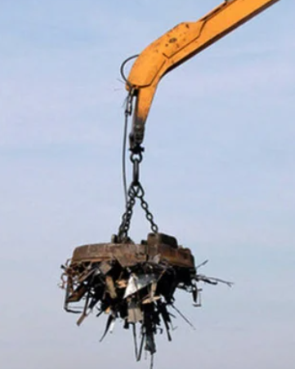
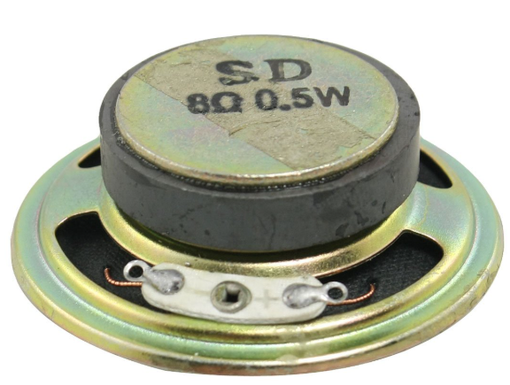
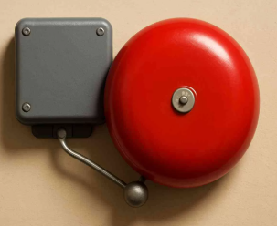
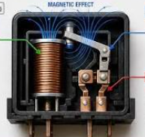

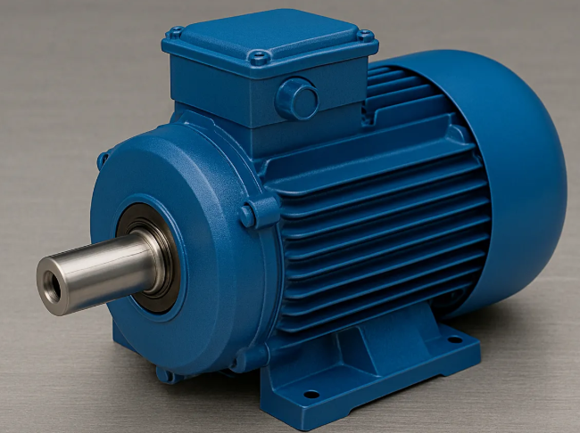
· ELECTROMAGNET
32 / 34
Uses of Electromagnets
Electric Bell
Cranes
Loudspeakers
Doorbells & Relays
MRI Machines
Electric Motors
Magnetic Effect of Electric Current · Class 7 Science

Slide 33
· ELECTRIC BELL
33 / 34
Electric Bell
An electric bell is a common device that uses an electromagnet to produce sound.
When we press the switch, the bell rings because of the continuous make-and-break of the circuit by the electromagnet.
Main parts of an electric bell:
Electromagnet
Armature
Hammer
Contact Screw
Soft iron core with coil
Soft iron strip that moves
Strikes the gong to produce sound
Makes and breaks the circuit
Magnetic Effect of Electric Current · Class 7 Science

Slide 34
· ELECTRIC BELL
34 / 34
How Does an Electric Bell Work?
1
When the switch is pressed, current flows through the coil of the electromagnet.
2
The electromagnet becomes magnetised and attracts the soft iron armature.
3
The armature moves and the hammer attached to it strikes the gong → bell rings.
4
At the same time, the contact is broken and current stops flowing.
5
The electromagnet loses magnetism. The armature springs back and contact is made again.
6
Current flows again and the process repeats rapidly → continuous ringing.
Magnetic Effect of Electric Current · Class 7 Science

